Slide 1
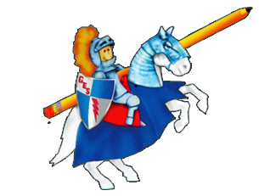
Daily Dose
Of
Second Grade
Week 9

Slide 2
What Can I do:
RI 2.8 Describe how reasons support specific points the author makes in a text.

Slide 3
READING
A key point is an important idea about a topic. Authors support their key points with reasons.

Slide 4
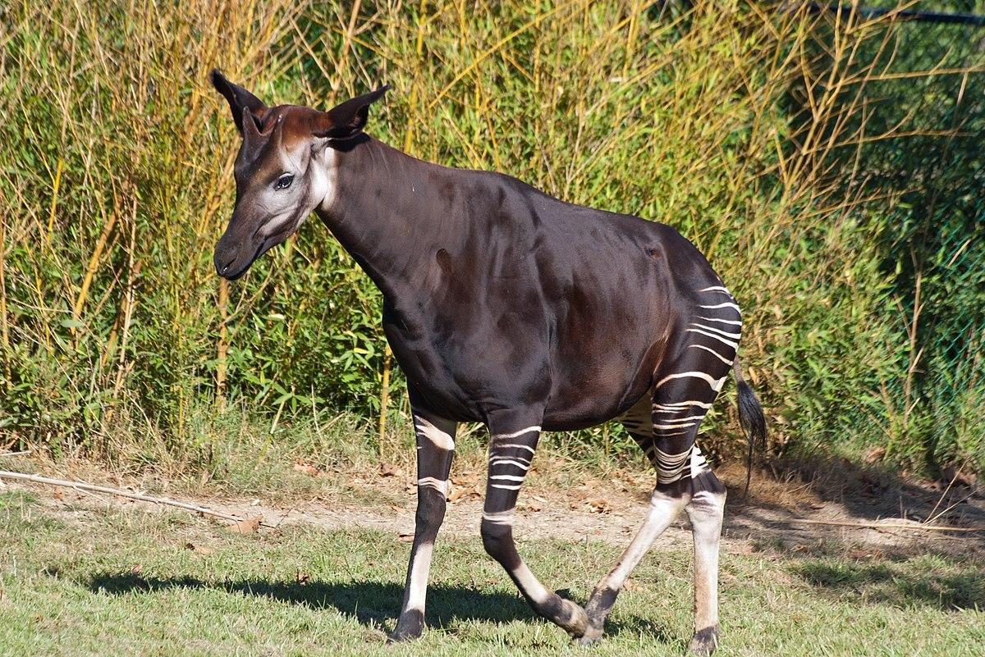
Read the following selection.
An okapi looks like a mix between many animals. These unique mammals live in Africa. Their bodies are shaped like horses or deer. They have a thick body and four long skinny legs. They have a long neck too. They look like horses and deer, but they aren’t! Okapi also look like a zebra on half of their body. The middle part of their body is covered in dark-brown fur. Their faces and legs are covered with fur that looks just like zebra stripes.

Slide 5
Answer the questions.
What is the author’s point?
What is one reason the author gives to support this?
What is another reason the author gives to support this?

Slide 6
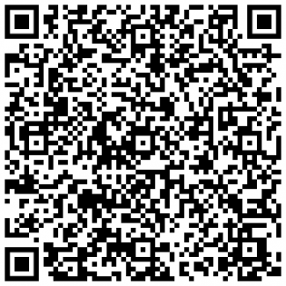
ANSWERS
Scan the QR code for the answers.

Slide 7
IDR TIME
Students read independently for 20 minutes on Raz-Kids, Epic, or book from home!
Ask yourself:
Who are the characters?
What is the setting?
What is the plot of the story? (beginning, middle and end)
What is the problem?
What is the solution?
How can you relate what you already know to the story?
How does the story you read compare to another story? Contrast?

Slide 8
Spelling
disinfect
dislocate
disarm
dislike
distrust
overstay
overlook
oversleep
unsafe
unlike

Slide 9
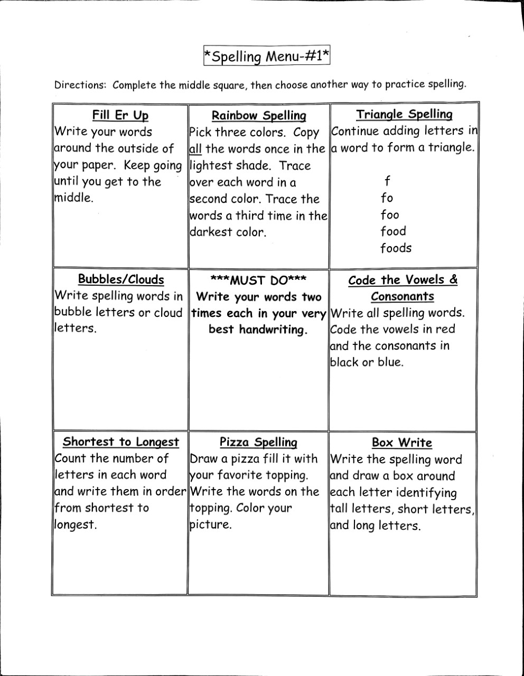
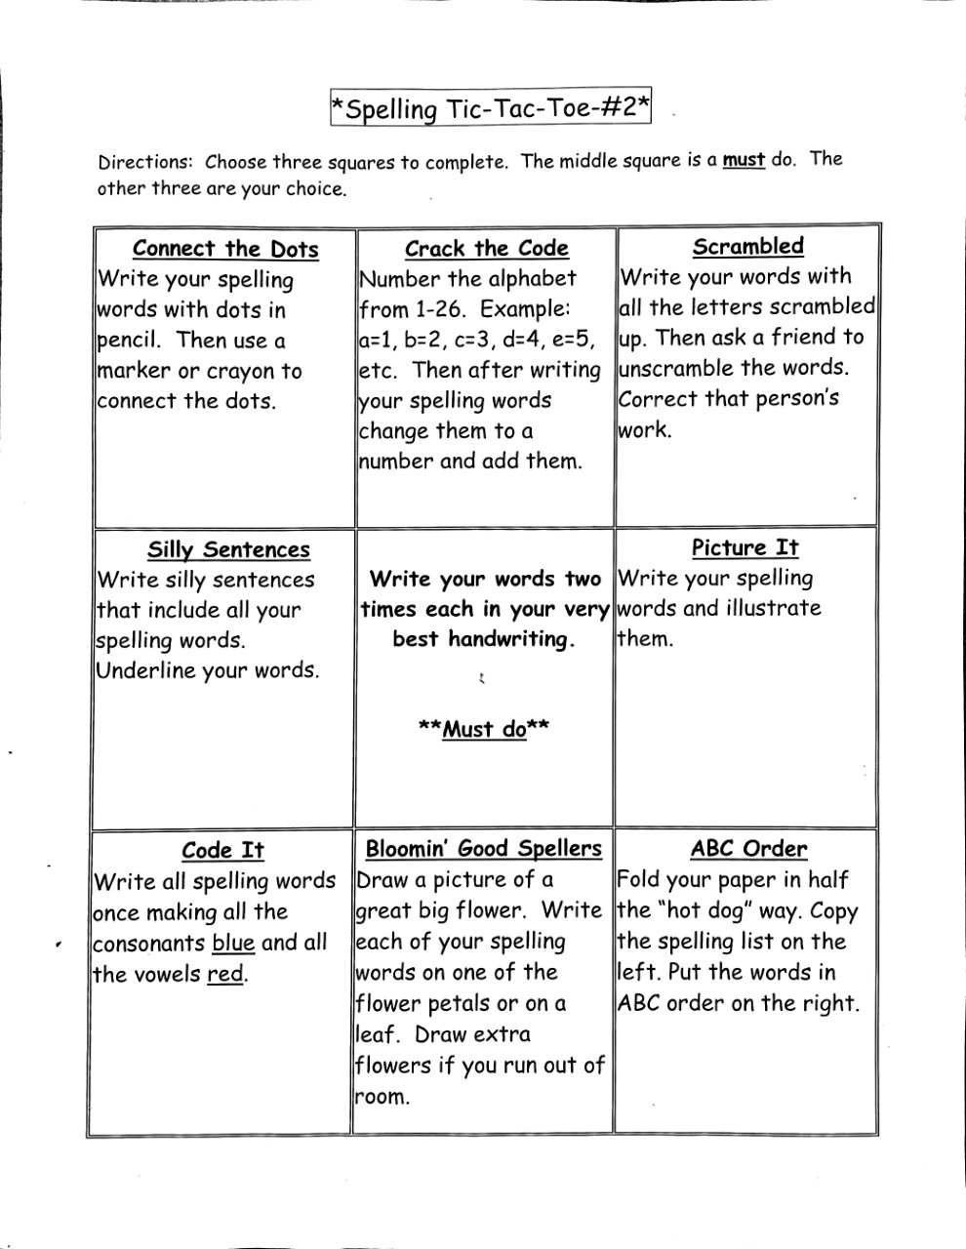
Spelling

Slide 10
Language Arts
L.2 Demonstrate command of the conventions of standard English grammar and usage when writing or speaking.

Slide 11
Parts of Speech, Capitalization & Punctuation
Read each sentence. Correct the mistakes and label the parts of speech.
samantha and rachel came with me to central park
john gave them to the mrs. simmons yesterday
would mom join us for a movie at malco tomorrow
susan bought beautiful roses for her
wow, he jumped from the airplane
my teacher read that funny book to us

Slide 12
Scholastic News
Go to this website: https://sn2.scholastic.com
Click log in as a student. The password is gb2019.
Go to the issue: Bounce Click explore. You need to be sure you are using the May issues.
Be sure to watch the videos and play the game!!!
ps://sn2.scholastic.com/etc/classroom-magazines/reader.html?id=12-030320

Slide 13
Questions from scholastic news
https://sn2.scholastic.com/content/dam/classroom-magazines/sn2/issues/2019-20/050320/SN2-050120-Trampoline-SKILL-ReadChkPnt.pdf
https://sn2.scholastic.com/content/dam/classroom-magazines/sn2/issues/2019-20/050320/SN2-050120-Trampoline-SKILL-Vocab.pdf
https://sn2.scholastic.com/content/dam/classroom-magazines/sn2/issues/2019-20/050320/SN2-050120-Trampoline-Activity-Printable.pdf

Slide 14
Scholastic News
Go to this website: https://sn2.scholastic.com
Click log in as a student. The password is gb2019.
Go to the issue: The Girl with Olympic Dreams Click explore. You need to be sure you are using the May issues.
Be sure to watch the videos and play the game!!!
ps://sn2.scholastic.com/etc/classroom-magazines/reader.html?id=12-030320

Slide 15
Questions from scholastic news
https://sn2.scholastic.com/content/dam/classroom-magazines/sn2/issues/2019-20/050420/SN2-050120-Olympics-SKILL-ReadChkPnt.pdf
https://sn2.scholastic.com/content/dam/classroom-magazines/sn2/issues/2019-20/050420/SN2-050120-Olympics-SKILL-Vocab.pdf
https://sn2.scholastic.com/content/dam/classroom-magazines/sn2/issues/2019-20/050420/SN2-050120-Olympics-SKILL-Read&Think.pdf
FUN ACTIVITY: https://sn2.scholastic.com/content/dam/classroom-magazines/sn2/issues/2019-20/050420/SN2-050120-Olympics-Activity-Printable.pdf

Slide 16
Writing
Wild and Wacky
Imagine your class is on a field trip to the zoo and one of the animals starts talking to you. What does he tell you?
Include the following:
Hook/topic sentence
3 to 5 details
Closing sentence

Slide 17
Math

Slide 25
2.NBT.7
I can use addition and subtraction within 1000.

Slide 26
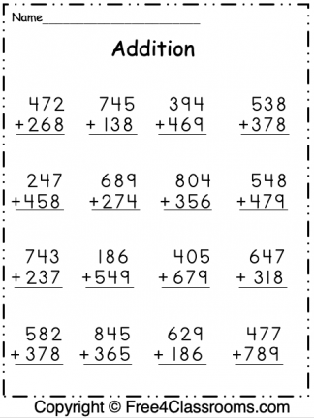
Add the following math problems

Slide 27
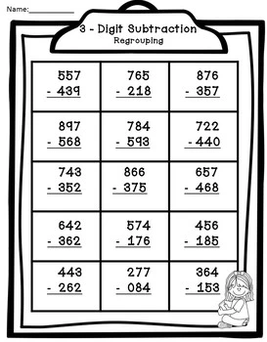
Subtract the following problems

Slide 28
Online Math Games
https://www.turtlediary.com/games/second-grade/addition.html
<a href="https://www.softschools.com/math/addition/3_digit_addition/3_digit_addition_with_regrouping/">3 Digit Addition with Regrouping</a>
https://www.turtlediary.com/games/second-grade/subtraction.html
<a href="https://www.softschools.com/math/subtraction/3_digit_subtraction/3_digit_subtraction_with_regrouping/">3 Digit Subtraction with Regrouping</a>

Slide 29
Answers
Scan QR code for answers to addition and subtraction problems.

