Slide 1

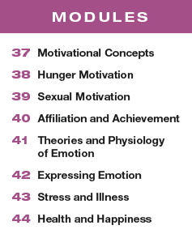

Unit 8
Motivation, Emotion, and Stress

Slide 2

Learning Targets
Module 41
41-1 Describe how arousal, expressive behavior, and cognition interact in emotion.
41-2 Explain whether we can experience emotions without consciously interpreting and labeling them.
41-3 Describe the basic emotions, and the link between emotional arousal and the autonomic nervous system.
Theories and Physiology of Emotion
41-4 Discuss whether different emotions activate different physiological and brain-pattern responses.
41-5 Discuss the effectiveness of polygraphs in using body states to detect lies.

Slide 3

What is emotion?
a response of the whole organism, involving physiological arousal,
expressive behaviors, and
conscious experience

Slide 4
Can you identify the three parts of emotion?
In the image above, what is the physiological arousal? The expressive behavior?
The conscious experience?

Slide 5

How do the three pieces fit together?
Emotion research considers two big questions:
Does your bodily arousal come before or after your emotional feelings?
How do thinking (cognition) and feeling interact? Does cognition always come before emotion?
Historical emotion theories, as well as current research, have sought to answer these questions.

Slide 6
What is the James-Lange theory of emotion?
the theory that our experience of emotion is
our awareness of our physiological
responses to an emotion-arousing stimulus:
stimulus leads to arousal which leads to emotion
“We feel sorry because we cry, angry because we strike, afraid because we tremble.”
(William James, 1890, p. 1066)

Slide 7
How did Walter Cannon disagree with the James-Lange theory of emotion?
Harvard physiologist Walter Cannon and his graduate student Philip Bard disagreed with the
James-Lange theory.
They asked:
“Does a racing heart signal fear or anger or love?”
The body’s responses—heart rate, perspiration,
and body temperature—are too similar, and they change too slowly, to cause the different emotions.

Slide 8
What is the Cannon-Bard thalamic theory of emotion?
the theory that an emotion-arousing
stimulus simultaneously triggers
(1) physiological responses and
(2) the subjective experience of
emotion

Slide 9
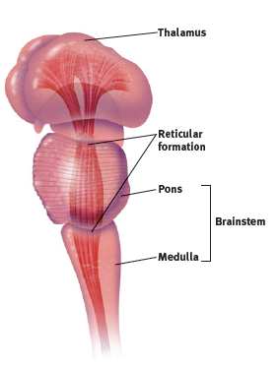
What is the thalamus?
Recall from Module 11 that the thalamus, at the top of the brain stem, is the brain’s sensory control center.

Slide 10
How does the Cannon-Bard thalamic theory explain emotion?
The Cannon-Bard theory suggests that stimulation/arousal and emotion are a combined response to a stimulus.
After exposure to a stimulus, sensory signals are transmitted to the thalamus.
Once the thalamus receives the signal, it relays the information to two structures: the amygdala and the brain cortex.

Slide 11
How are the amygdala and the sympathetic nervous system involved in emotion?
The amygdala is responsible for the instantaneous emotional response (fear, rage, etc.) and the cerebral cortex directs the response.
Simultaneously, the sympathetic nervous system sends signals to muscles and other parts of the body, causing them to tense or prepare for fight-flight or freeze.

Slide 12
How do the two theories differ?
James-Lange theory
Cannon-Bard theory
Physiological responses occur first and are the cause of emotions.
The emotional and the physical response occur simultaneously - one is not dependent upon the other.

Slide 13
1. What Would You Answer?
The Cannon-Bard theory of emotion states that
A. emotional response occurs before cognition.
B. physiological response occurs before emotional
response.
C. emotional response occurs before physiological
response.
D. cognition occurs before emotional response.
E. physiological response and emotion occur
independently and simultaneously.

Slide 14
Applying your knowledge.
Can you think of a recent time when you noticed your body’s reactions to an emotionally charged situation, such as a difficult social setting, or perhaps even a test or game you had been
worrying about in advance?
Can you apply the James-Lange and Cannon-Bard thalamic theories to your experience?

Slide 15
How do thinking and feeling interact?
The James-Lange theory and the Cannon-Bard theory both take into account physiological responses and the interplay with emotion.
But how does cognition factor in to the theory of emotion?
Stanley Schachter and Jerome Singer demonstrated that how we appraise (interpret) our experiences also matters.

Slide 16
What is the Schachter-Singer
Two-Factor theory of emotion?
Our physical reactions and our thoughts (perceptions, memories, and interpretations) together
create emotion.
In Schachter and Singer’s two-factor theory, emotions have two ingredients:
physical arousal and cognitive appraisal.
An emotional experience, they argued, requires a conscious interpretation of arousal.

Slide 17

What is the spillover effect?
Arousal spills over from one event to the next.
For instance, arousal from a soccer match can fuel anger, which can descend into rioting or other
violent confrontations.

Slide 18
How did Schachter and Singer research the spillover effect?
Schachter and Singer injected college men with the hormone epinephrine, which triggers feelings of arousal.
One group of men were told the injection would help test their eyesight.
A second group were told they might experience arousal because of the drug.
After receiving the injection, subjects went to a waiting room with another person (actually an accomplice of the experimenters) who was acting either euphoric or irritated.

Slide 19
What were the results?
Subjects began to feel their heart race, body flush, and breathing become more rapid
The subjects who attributed their arousal to the drug, felt little emotion.
The subjects who had been told the injection would produce no arousal, “caught” the apparent emotion of the other person in the waiting room.
They became happy if the accomplice was acting euphoric, and testy if the accomplice was acting irritated.

Slide 20
So, does cognition matter?
This discovery—that a stirred-up state can be experienced as one emotion or another, depending on how we interpret and label it—has been replicated in dozens of experiments and continues to influence modern emotion research.
(MacCormack & Lindquist, 2016; Reisenzein, 1983; Sinclair et al., 1994)

Slide 21

AP® Exam Tip
Be prepared for at least a multiple choice question that tests your ability to compare and contrast
the James-Lange, Cannon-Bard,
and Schachter-Singer Two-Factor
theories of emotion.

Slide 22
Does cognition have to precede emotion?
Must we always interpret our arousal before
we can experience an emotion?
Psychologist Robert Zajonc didn’t think so.
He contended that we actually have many emotional reactions apart from, or even before, our
conscious interpretation of a situation.

Slide 23
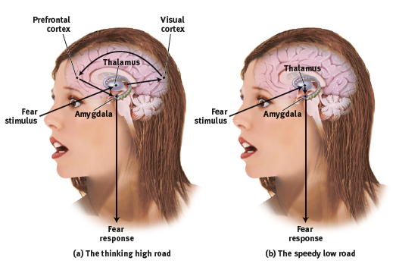
What are the brain’s pathways for emotion?
In the two-track brain, sensory input may be routed to the cortex, via the thalamus for analysis and then transmission to the amygdala, or directly to the amygdala, via the thalamus for an instant emotional reaction.

Slide 24
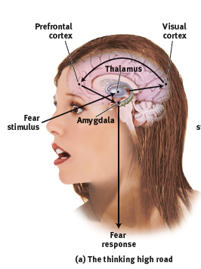
What is the “high road”?
Some complex emotions like hatred and love travel a
“high road.”
A stimulus following this path would travel via the thalamus to the brain’s cortex.
There, it would be analyzed and labeled before the response command is sent out, via the amygdala

Slide 25
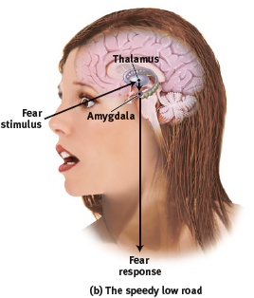
What is the “low road”?
Some simple emotions such as likes, dislikes, and fears take what Joseph LeDoux called the more direct “low road,” a neural shortcut that bypasses the cortex.
Following the low road, a fear-provoking stimulus would travel from the eye or ear, via the thalamus, directly to the amygdala

Slide 26
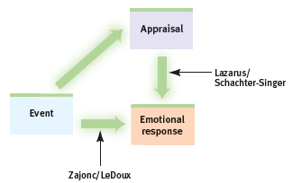
How do the Schachter-Singer and Zajonc-LeDoux theories of emotion compare?
Schachter-Singer
Zajonc-LeDoux
Our appraisal and labeling of events also determine our emotional responses.
Some emotional responses
are immediate, before any
conscious appraisal.

Slide 27
How did Richard Lazarus contribute to the discussion of emotion?
Emotion researcher Richard Lazarus conceded that our brain processes vast amounts of information without our conscious awareness, and that some
emotional responses do not require conscious thinking.
But he wondered:
How would we know what we are reacting to if we did not in some way appraise the situation?

Slide 28
What did Lazarus conclude?
The appraisal may be effortless and we may not be conscious of it, but it is still a mental function.
To know whether a stimulus is good or bad, the brain must have some idea of what it is.
(Storbeck et al., 2006)
Lazarus proposed that emotions arise when we appraise an event as harmless or dangerous.
For instance, we appraise the sound of the rustling bushes as the presence of a threat.
Later, we realize that it was “just the wind.”

Slide 29
2. What Would You Answer?
Which of the following is an example of cognitive appraisal?
A. Randall is happy all day because he is savoring the
wonderful events of yesterday.
B. Charles is frightened in a dark alley because he heard stories of others being attacked in dark alleys.
C. Sherika labels the arousal she is feeling as attraction
because she is in the presence of a good-looking man.
D. Dora is angry because she cannot figure out how to
convince her husband to take her to Hawaii.
E. Ann is frustrated because traffic has made her late for an important meeting.

Slide 30
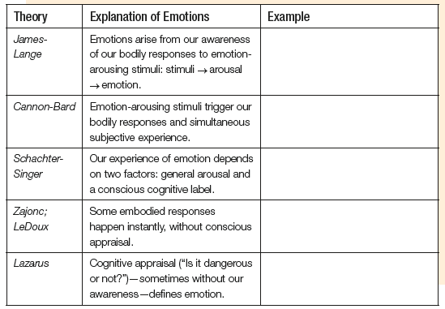
With a partner, create an example from your life that illustrates each of the five theories of emotion.

Slide 31
What are the basic emotions?
When surveyed, most emotion scientists agreed
that anger, fear, disgust, sadness, and happiness are basic human emotions. (Ekman, 2016)
Carroll Izard isolated 10 basic emotions (joy, interest-excitement, surprise, sadness, anger, disgust, contempt, fear, shame, and guilt), most present in infancy. (1977)
Others believe that pride and love are also
basic emotions.
(Shaver et al., 1996; Tracy & Robins, 2004)

Slide 32





Can you identify the basic infant emotions below?

Slide 33
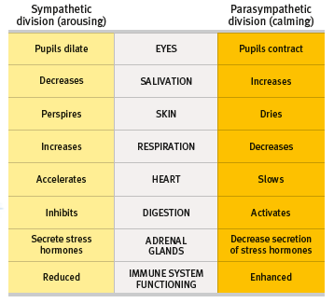
How are emotions and the autonomic nervous system (ANS) related?
Remember from Module 10 that the ANS controls the arousing and calming of the physiology of the body in times of crisis or stress by activating the sympathetic division and the parasympathetic division.

Slide 34

How does the sympathetic division of the ANS activate the body in a crisis?
The SNS directs your adrenal glands to release epinephrine (adrenaline) and norepinephrine (noradrenaline), the liver pours extra sugar into the bloodstream, respiration, heart rate and blood pressure increase,
digestion slows, pupils dilate, perspiration increases, and blood clots more quickly.

Slide 35

How does the parasympathetic division of the ANS calm the body in a crisis?
The PNS gradually calms your
body, as stress hormones slowly leave your bloodstream.
Respiration, heart rate and blood pressure decrease, pupils constrict, salivation and digestion activate.

Slide 36
Can one brain region be responsible for different emotions?
Yes.
Consider the insula, a neural center deep inside the brain.
The insula is activated when we experience various negative social emotions, such as disgust, lust and pride.
In brain scans, it becomes active when people bite into some disgusting food, smell disgusting food,
think about biting into a disgusting cockroach, or feel moral disgust over a sleazy business
exploiting a saintly widow. (Sapolsky, 2010)

Slide 37
Do different emotions trigger different brain circuits?
Observers watching fearful faces showed more amygdala activity than did other observers who watched
angry faces. (Whalen et al., 2001)
Depression-prone people, and those with generally negative perspectives, have shown more right frontal
lobe activity. (Harmon-Jones et al., 2002)
People with positive personalities have shown more activity in the left frontal lobe than in the right.
(Davidson, 2000; Urry et al., 2004)

Slide 38
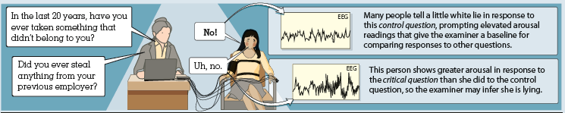
How effective are polygraphs in using body states to detect lies?
Polygraphs measure emotion-linked autonomic arousal, as reflected in changed breathing,
heart rate, and perspiration.
Can these results be used to detect lies?

Slide 39

Are polygraphs reliable?
If these polygraph experts had been the judges, more than one-third of the innocent would have been declared guilty, and nearly one-fourth of the guilty would have gone free.

Slide 40
What does the research show?
The CIA and other U.S. agencies have spent millions of dollars testing tens of thousands of employees.
Yet the U.S. National Academy of Sciences
has reported that “no spy has ever been caught [by] using the polygraph.”
(2002)

Slide 41
3. What Would You Answer?
Roger is about to ride a roller coaster. He is afraid of heights and is nervous about the ride.
How would each of the following theories explain Roger’s experience of fear on the roller coaster?
James-Lange Theory
Cannon-Bard Thalamic Theory
Schachter-Singer Two-Factor Theory

Slide 42
Learning Target 41-1 Review
Describe how arousal, expressive
behavior, and cognition interact in emotion.
Emotions are psychological responses of the whole organism involving an interplay among physiological arousal, expressive behaviors, and conscious experience.
Theories of emotion generally address two major questions: (1) Does physiological arousal come before or after emotional feelings, and (2) how do cognition and feeling interact?

Slide 43
Learning Target 41-1 Review cont.
Describe how arousal, expressive
behavior, and cognition interact in emotion.
The James-Lange theory maintains that emotional feelings follow our body’s response to emotion-inducing stimuli. (We observe our heart pounding and feel fear.)
The Cannon-Bard thalamic theory proposes that our body responds to emotion at the same time that we experience the emotion (one does not cause the other).

Slide 44
Learning Target 41-2 Review
Explain whether we can experience
emotions without consciously
interpreting and labeling them.
The Schachter-Singer Two-Factor theory holds that our emotions have two ingredients, physical arousal and a cognitive label, and the cognitive labels we put on our states of arousal are an essential ingredient of emotion.

Slide 45
Learning Target 41-2 Review cont.
Explain whether we can experience
emotions without consciously
interpreting and labeling them.
Lazarus agreed that many important emotions arise from our inferences. Zajonc and LeDoux, however, have contended that some simple emotional responses occur instantly, not only outside our conscious awareness but before any cognitive processing occurs. This interplay between emotion and cognition illustrates our two-track mind.

Slide 46
Learning Target 41-3 Review
Describe the basic emotions, and the link
between emotional arousal and
the autonomic nervous system.
Caroll Izard’s 10 basic emotions are joy, interest/excitement, surprise, sadness, anger, disgust, contempt, fear, shame, and guilt.
The arousal component of emotion is regulated by the autonomic nervous system’s sympathetic (arousing) and parasympathetic (calming) divisions.
In a crisis, the fight-or-flight response automatically mobilizes your body for action.

Slide 47
Learning Target 41-4 Review
Discuss whether different emotions
activate different physiological
and brain-pattern responses.
The large-scale body changes that accompany fear, and anger, and sexual arousal are very similar (increased perspiration, breathing, and heart rate), though they feel different. Emotions may be similarly arousing, but some subtle physiological responses, such as facial muscle movements, distinguish them.
More meaningful differences have been found in activity in some brain pathways and cortical areas.

Slide 48
Learning Target 41-5 Review
Discuss the effectiveness of polygraphs
in using body states to detect lies.
Polygraphs, which measure several physiological indicators of emotion, are not accurate enough to justify widespread use in business and law enforcement. The use of guilty knowledge questions and new forms of technology may produce better indications of lying.

