Slide 1

Teach Like a Pirate

Slide 2
Dave Burgess
Increase Student Engagement, Boost Creativity, Transform your life as an Educator

Slide 3

Why a pirate?
It’s the spirit of a pirate that is daring, adventurous, willing to set forth into uncharted territories with their crew.

Slide 4

How do you teach like a pirate?
Passion
Immersion
Rapport
Ask and Analyze
Transformation
Enthusiasm

Slide 5
Three Different Types of Passion Educators Have
Content- Within your subject matter, what are you passionate about?
Professional- Within your profession, what are you passionate about? What is it about being an educator that drives you?
Personal-Outside of your profession, what are you passionate about? Bringing those passions into a lesson plan personalizes you with students... Art, music, etc..

Slide 6
IMMERSION
Your students deserve your full attention. They know when you are not fully there in the classroom and engaged with them. If you are not engaged, why should they be?

Slide 7
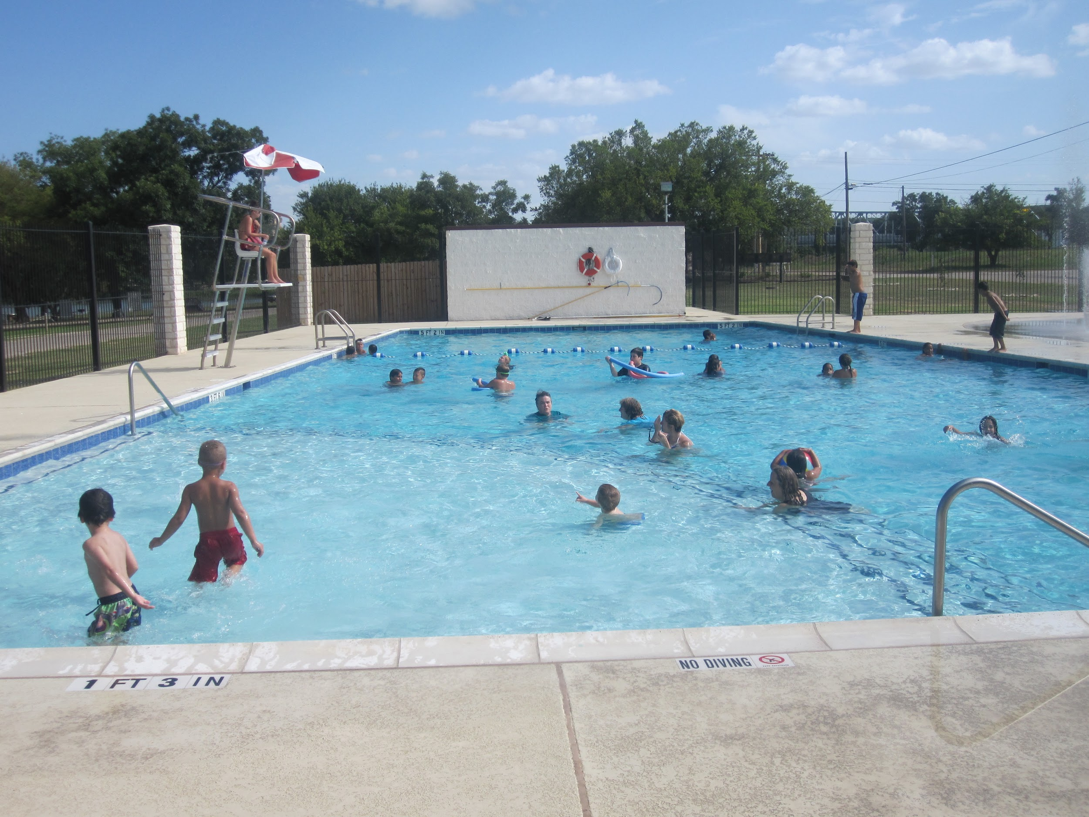
Example of Immersion
You are at the pool.
Someone tells you to immerse yourself in the swimming pool. Do you go to the edge of the pool, stand, and stare at it? Do you climb the lifeguard tower and observe the swimmers below? Are you in the pool? It’s the same in the classroom , are you lifeguard or are you the swimmer? Get in the pool. Get wet. Students know when you are participating or when your focus is off.

Slide 8

Rapport
You need to have good rapport with your students if you want them engaged in the learning process.
Most students misbehave out of boredom, being overwhelmed with work they are not capable of doing, or a lack of connection with the lesson.
Get to know your students, what interests them, and use those interests in your lesson.

Slide 9

ASK AND ANALYZE
A question you should ask yourself is, “How can I make this lesson outrageously entertaining, engaging, and powerful so that my students will never forget it and be desperate to come back for more?
How can I improve my lesson?
Would my lesson sell tickets?

Slide 10
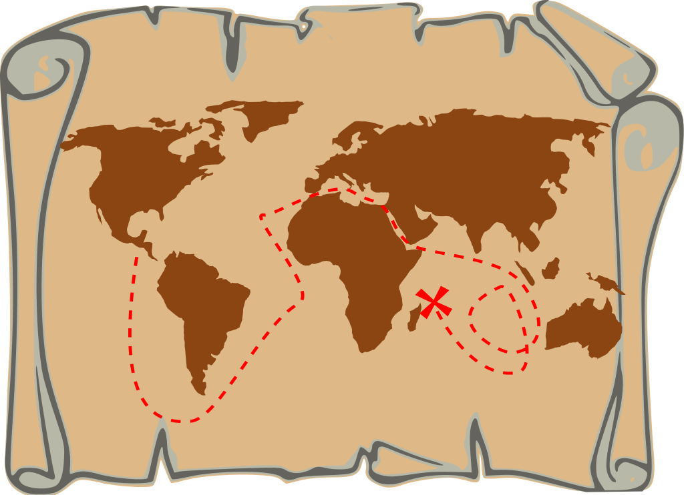
Transformation
You must be remarkable, so exceptional and different that people will talk about you in a good way.
The goal isn’t about ego, it’s about effectiveness.
It’s about wanting your students to feel like entering your room is like entering a new world.
Always have the destination in sight, set the goal, and map out a plan on how to get your students where they need to be.

Slide 11

Enthusiasm
If you apply nothing from this powerpoint but you consistently ramp up your enthusiasm level in the classroom, you will be far ahead of the game.
It’s a skill that separates good teachers from great ones.
How can you show enthusiasm for a subject matter you do not love? Fake the enthusiasm, your students will not know the difference.

Slide 12
Change What You Focus On
Focus on the positive.
Some teachers look out across their classrooms and feel successful when 99% of students are engaged. Others only focus on the 1% that’s not and feel like failures.
Choose to be positive and focus on what empowers you.

Slide 13
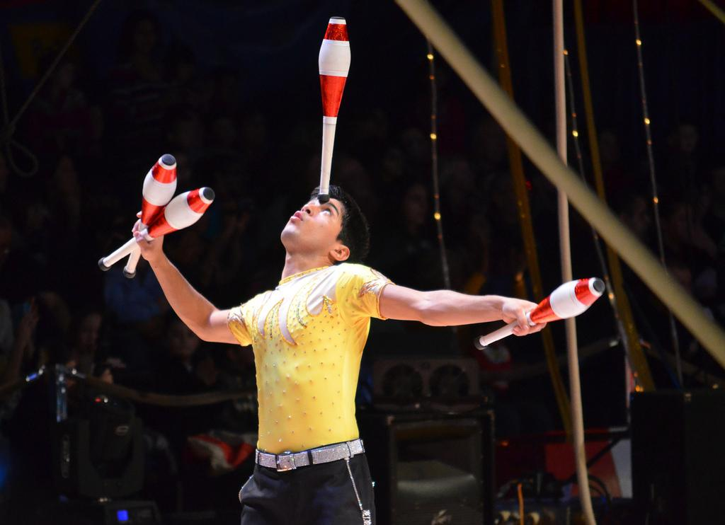
Crafting Engaging Lessons
A good teacher, like a good entertainer, first must hold his audience’s attention. Then , he can teach his lesson.

Slide 14
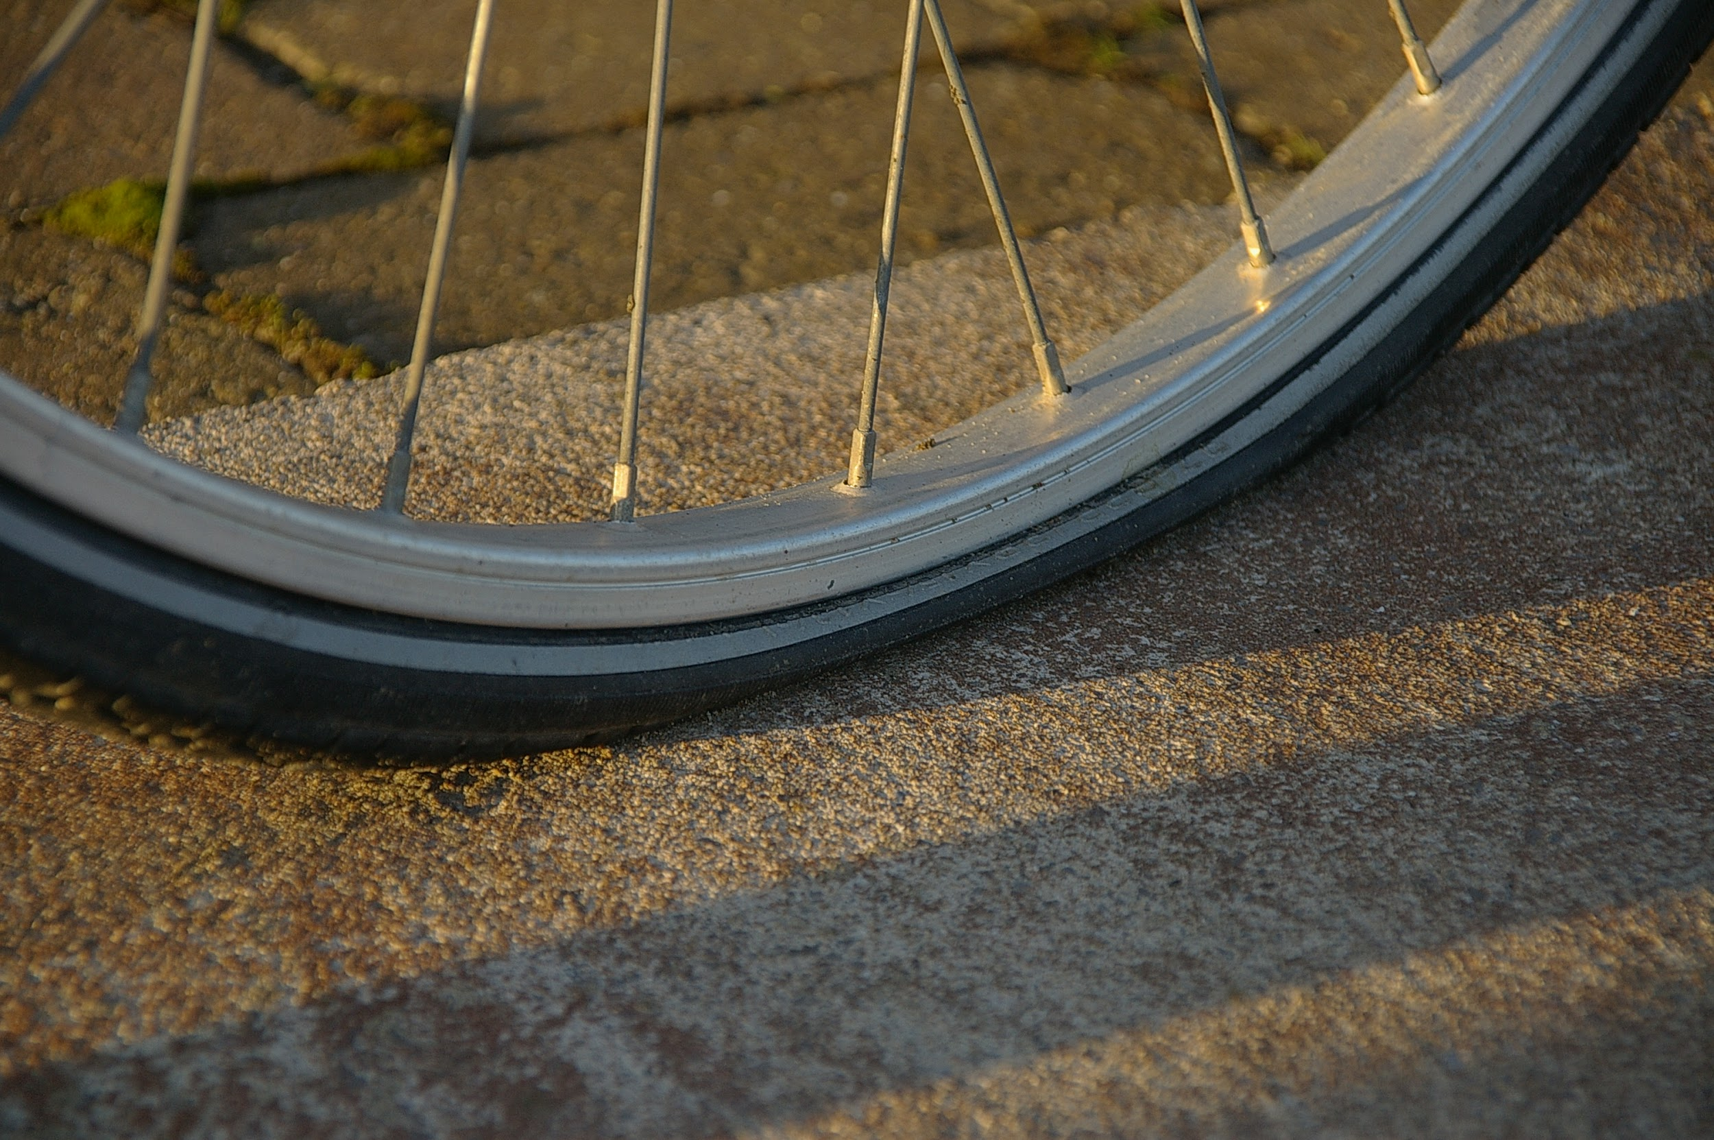
What’s a Lesson Look like without Engagement?
‘S
Notes:
It’s like riding a bike with flat tires. You may be doing everything right, but you’re working harder than necessary and getting
Sub-par results.

Slide 15
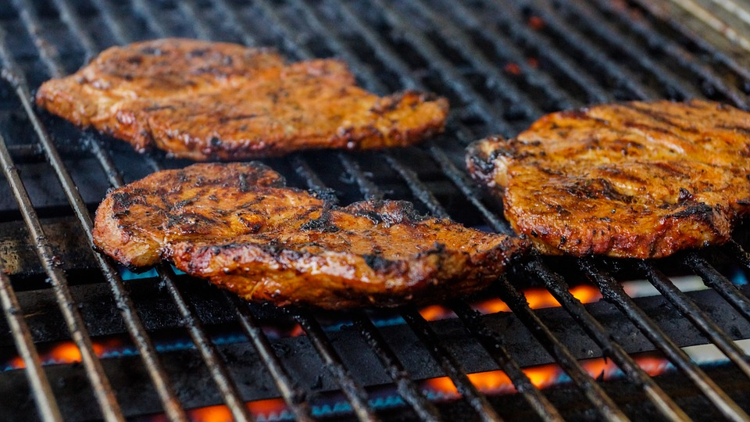
Welcome to the BBQ !!!!

Slide 16
Say you come to my house for a bbq, you are expecting a delicious meal, but I serve you a raw steak on a plate.
Did I even ask if you liked steak?
If I was going to serve you dinner, I would spend time marinate the steak, preheat the bbq by turning on propane. Baste and turn steaks over. Cook it to your specifications. Add side dishes and a desert. Serve drinks. That’s a meal!

Slide 17
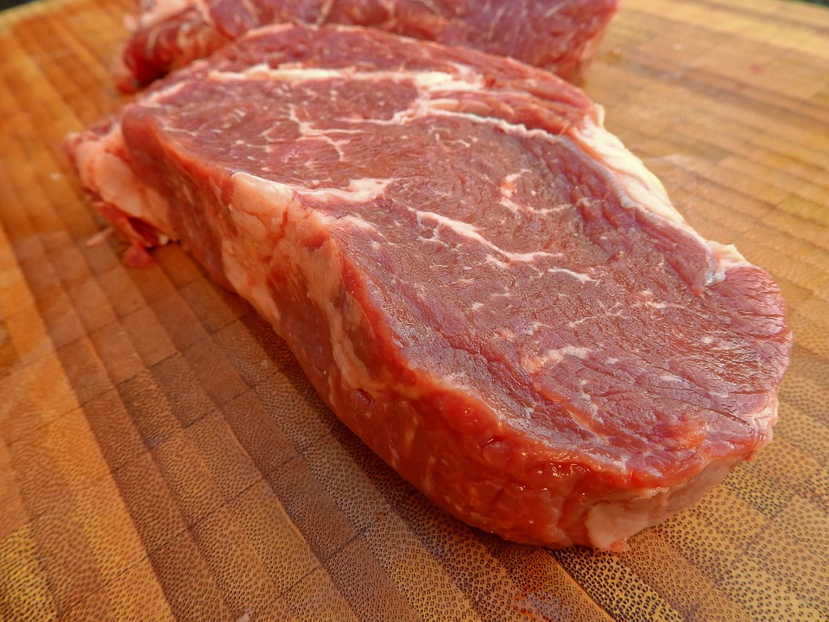
You can’t serve raw steak on a plate. However , that’s exactly what some educators serve their students every day. They walk into the classroom with their raw , unseasoned content, plop it down and say “Eat it”. No side dishes, and dessert is way too much trouble.

Slide 18
Not Losing The Engagement
Designing a lesson involves making many choices. Transitions will kill you. Magic is in the planning of small details.
Example: A teacher tells a powerful story where all of her students are engaged. At the end, she tells them to get a piece of paper out of their notebooks before tying up all of the important parts of her lesson. That two minutes of getting their paper together , and they have lost engagement.

Slide 19
How To Hook Your Students into Your Lesson
There are many different types of hooks an educator can use to grab student’s engagement.

Slide 20
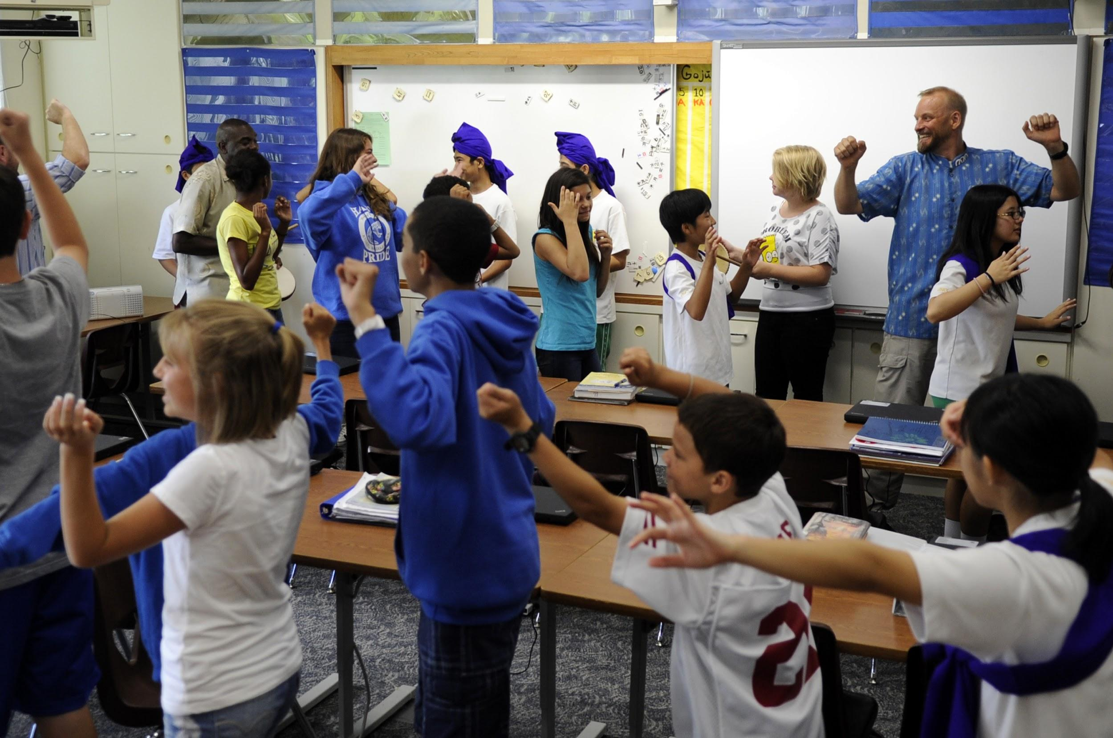

I like to MOVE IT, MOVE IT
The brain and body work best when there is a flow of oxygen and blood.
The Kinesthetic Hook
How can I incorporate movement into my lesson?
Can we act something out?
Can we learn gestures for learning of concepts?

Slide 21

The People Prop Hook
How can I make my lesson using students as props?
Can we create a human graph?

Slide 22
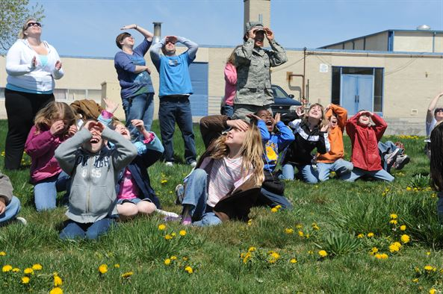
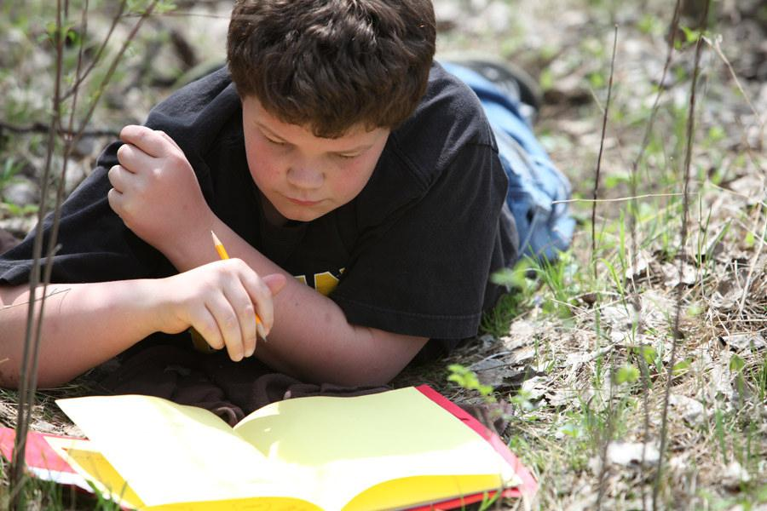
The Safari Hook
Can we teach this outside the four walls of the classroom?

Slide 23

LONG LIVE THE ARTS !
The PICASSO HOOK
How can I incorporate art into this lesson?
What can my students draw or make that would help them understand information?

Slide 24

MOZART HOOK
How can I use music to aid my presentation?
What songs have lyrics that relate to my lesson?
Can I use music as they enter or leave my room to help with more smoother transitions?

Slide 25
Drama Hook
Can I provide the opportunity for my students to do skits?

Slide 26
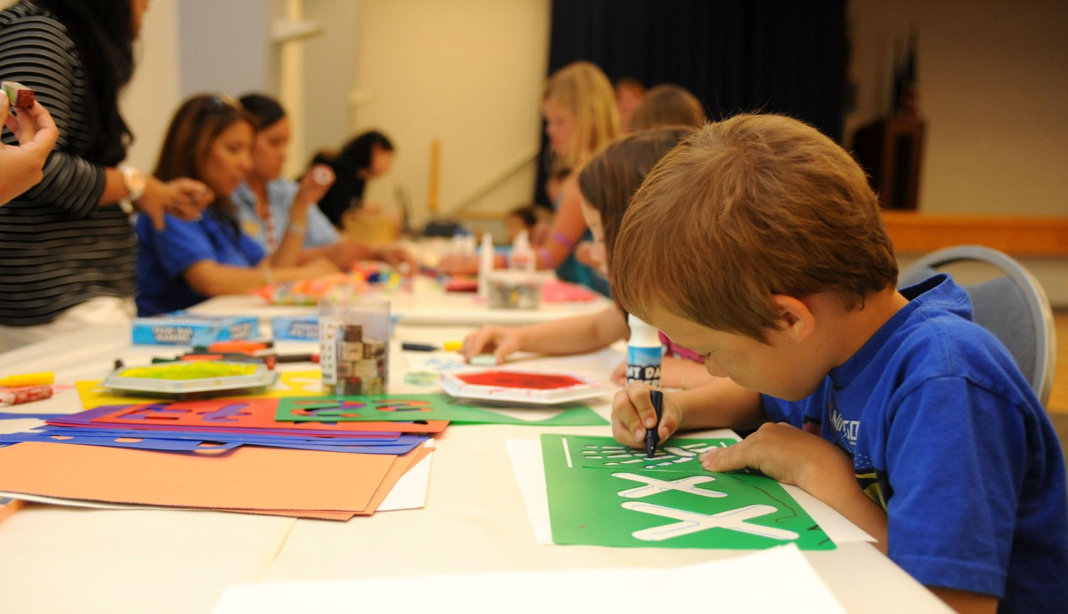
Craft Store Hook
Can my students make something that relates to my material?

Slide 27

Real World Hook
How can I show my students why learning this content is important in the real world?

Slide 28
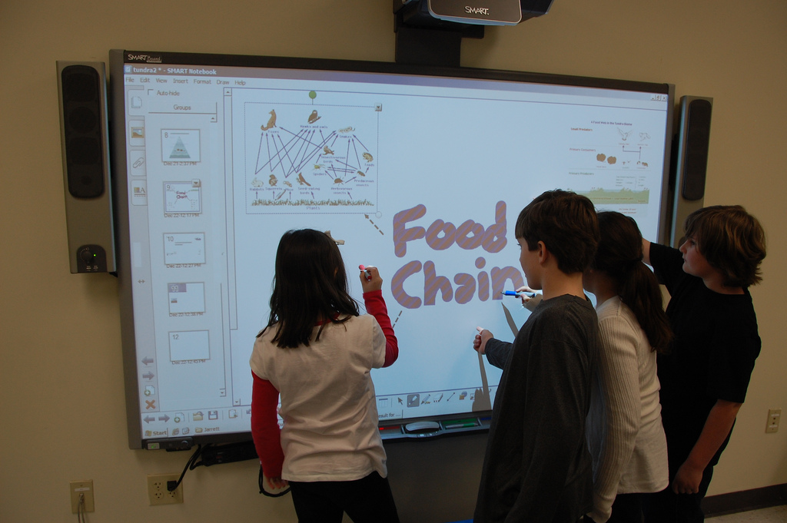
Board Message Hook
What can I write or project on my board that will immediately spark curiosity and interest?

Slide 29

Mystery Bag Hook
Can I bring a prop in a closed box or bag that relates to my lesson and will spark student engagement?

Slide 30
Contest Hook
How can I include a contest to build excitement to help review important skills?

Slide 31

Building a Better Pirate
Strive for greatness.
Will you see more in your paycheck for extra effort and time? No
Who benefits from your strive for greatness? Your students and your school. Striving for greatness is the ultimate act of unselfishness.

Slide 32
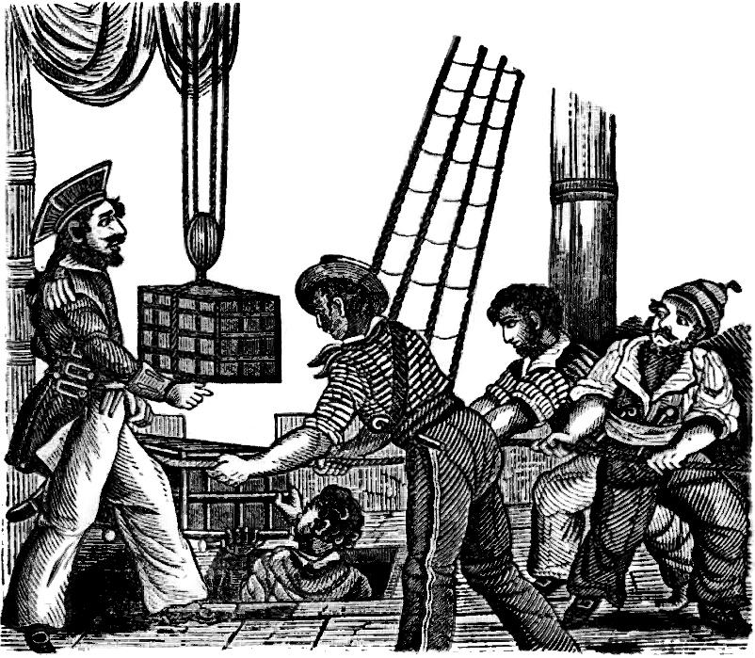
Finding a Crew
Don’t be limited by your subject, grade level, school , or even profession.
Take counsel from a wide variety of people and seek out multiple perspectives.

Slide 33
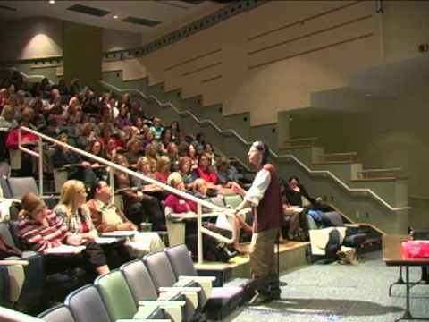
Wrap Up Video

Slide 34
Remember
PASSION
IMMERSION
RAPPORT
ASK AND ANSWER
TRANSFORMATION
ENTHUSIASM

