Slide 1
Required Forms for Sports

Slide 2
Required Forms
Physical
All athletes MUST have a Physical
They last for 1 calendar year
Must be signed by an Doctor
Concussion Form-signed every year
AHSAA Student Release-Form-signed every year
MCPSS Insurance & Waiver-Form-signed every year
Star Sportsmanship
Completed once during high school
Birth Certificate

Slide 3
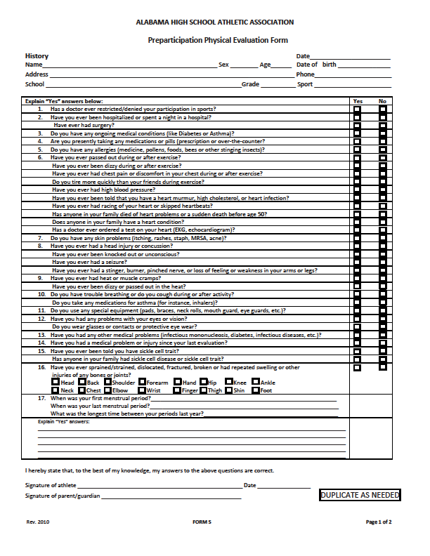
Athlete answers Yes or No

Slide 4
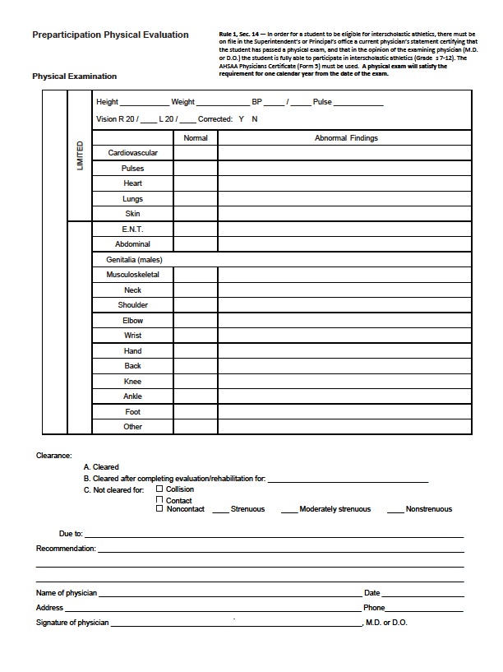
Doctor completes this section and signs below.
Must be an MD, NOT A NURSE

Slide 5
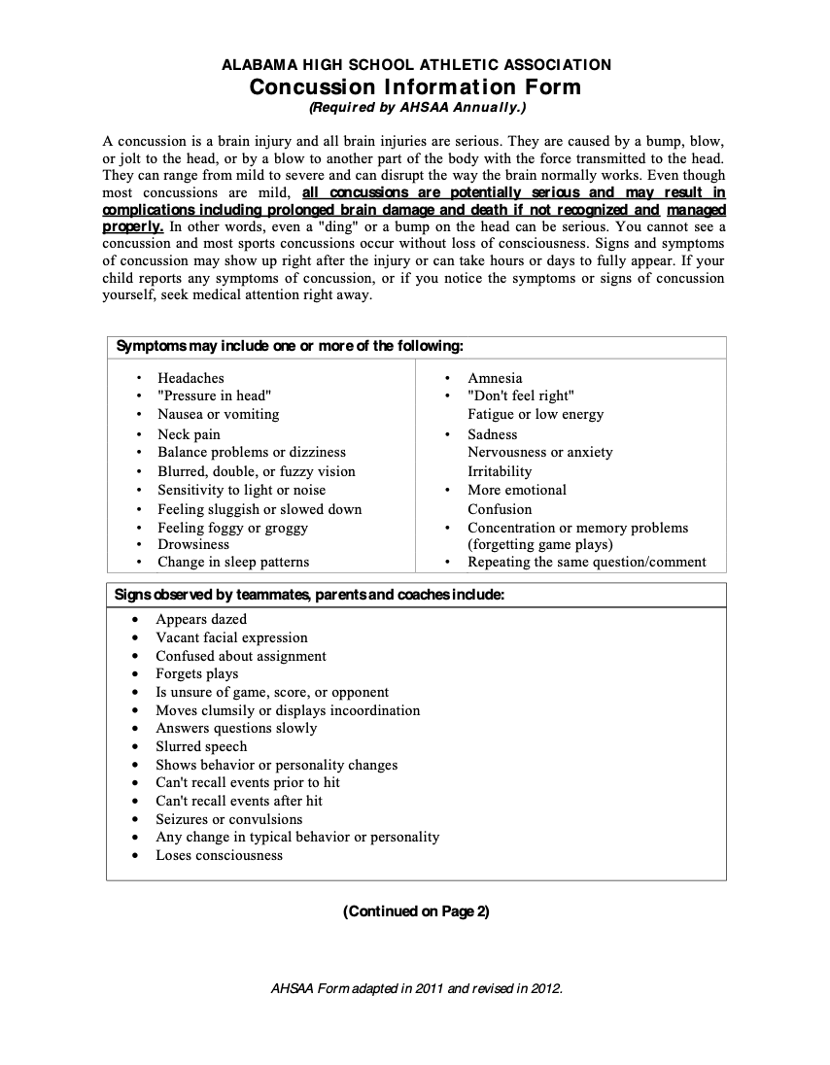

Slide 6
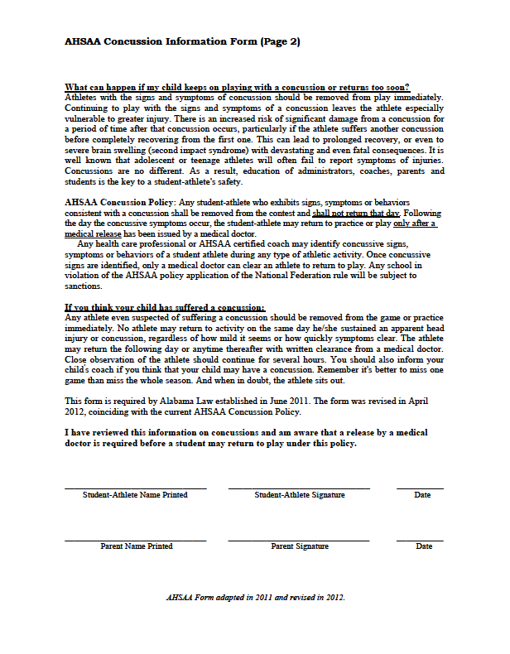
Parent & Athlete MUST Sign and date

Slide 7
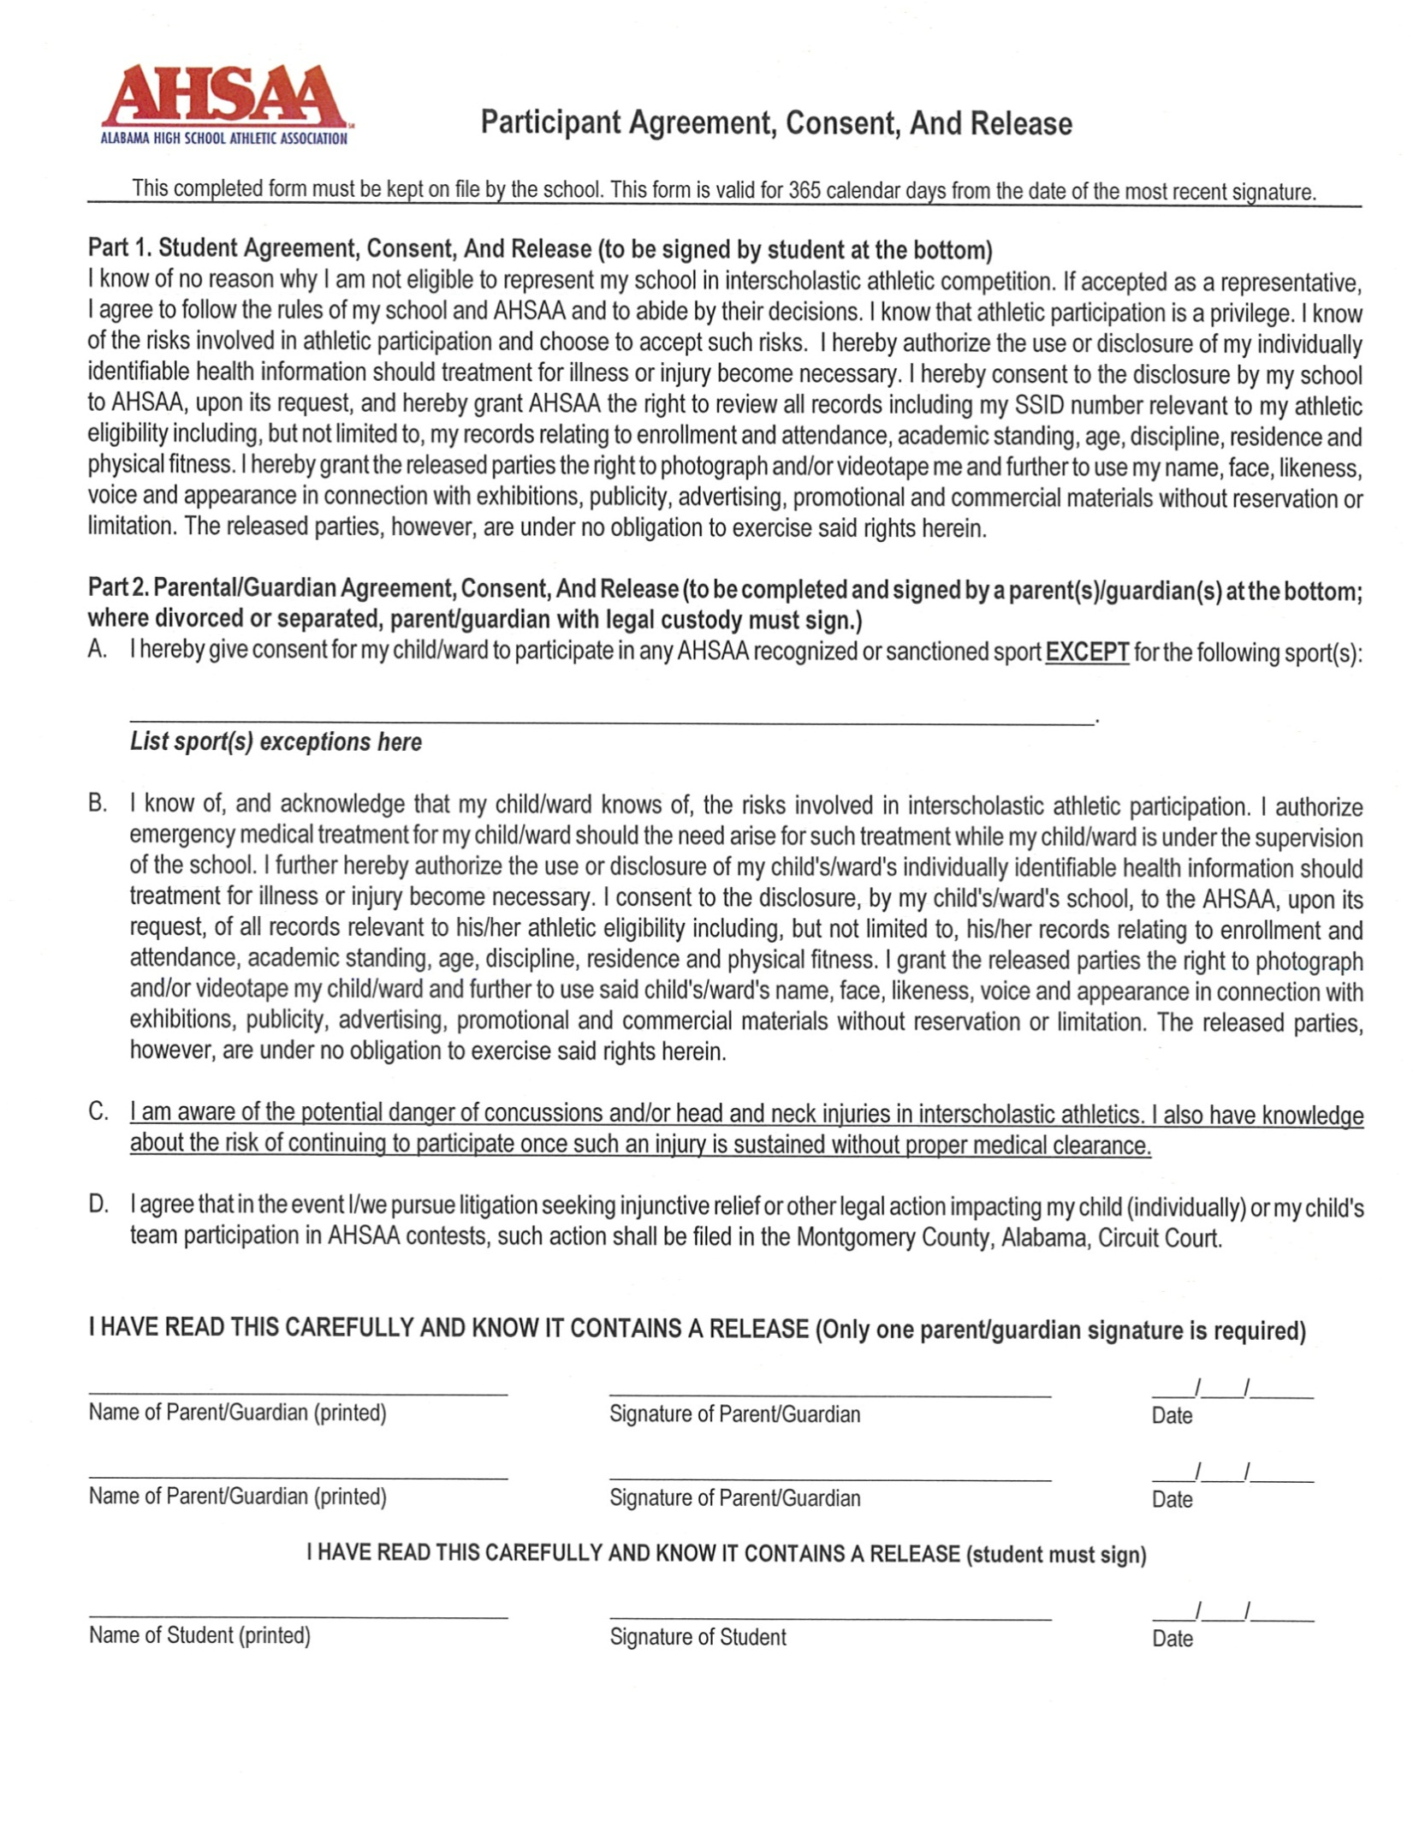

Slide 8
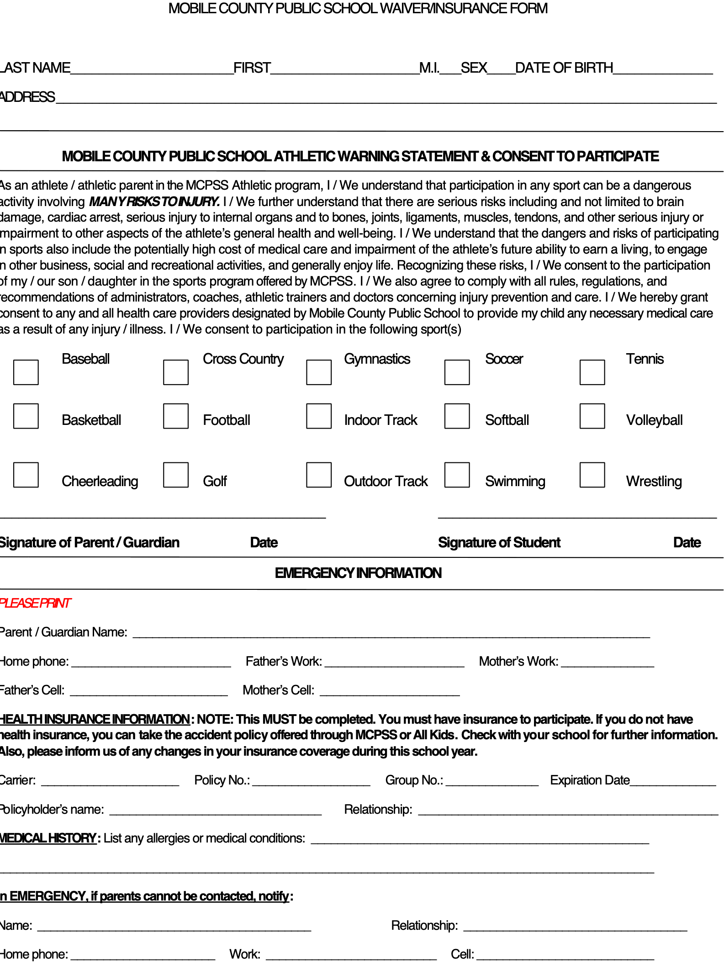
You MUST List insurance carrier & policy number or attach a copy of the card

