Slide 1
Circulatory System Systole and Diastole
DHO 7.8, pg 185

Slide 2
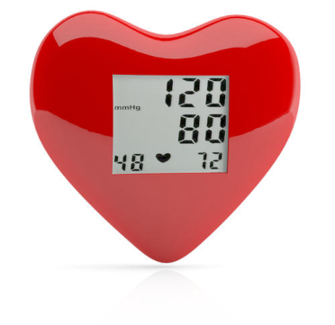
Cardiac Cycle
The R & L side of the heart work together. The heart is 2 pumps.
Systole=period of ventricular contraction
Diastole=period of ventricular rest (when ventricles aren’t contracting)
https://www.smm.org/heart/heart/top.html
About your heart-Science Museum of Minnesota
Notes:
https://www.youtube.com/watch?v=IS9TD9fHFv0 The Cardiac Cycle, Animation
https://www.youtube.com/watch?v=K_BWCw7s1Xo Where to listen for Heart Sounds - MEDZCOOL

Slide 3
Cardiac Cycle
Blood Pressure=measurement of the force of blood pushing against the artery walls
Top number is systolic
Bottom number is diastolic
If BP is too high, it puts strain on the arteries & heart
https://www.youtube.com/watch?v=qWti317qb_w
(Understanding BP) 2.49

Slide 4
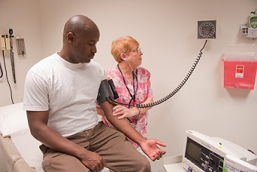
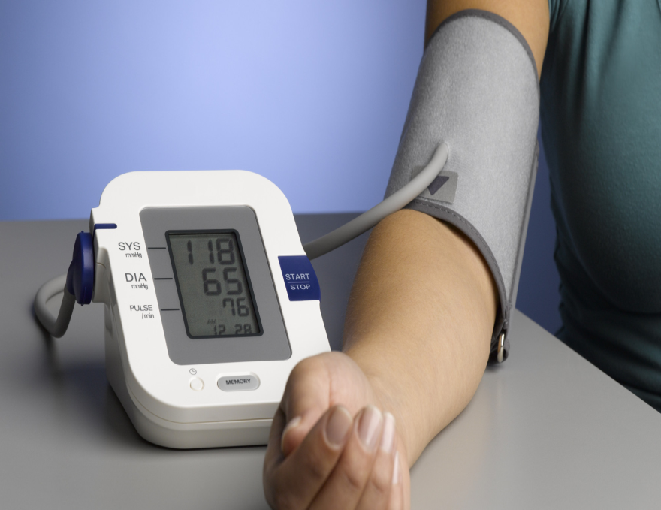
Cardiac Cycle
Normal BP 120/80
Hypertension (High BP) 140/90
https://www.youtube.com/watch?v=S648xZDK7b0
(Instructional Video for BP) 4.30

Slide 5
Cardiac Cycle
Heart Rate:
Number of times heart contracts in 1 min
Normal 60-100
Sounds you hear (Lub-dub) are the valves closing. First the AV valves and then the semilunar.
http://www.stethographics.com/main/physiology_hs_introduction.html
Notes:
https://www.youtube.com/watch?v=dBwr2GZCmQM Heart Sounds and Heart Murmurs, Animation.

