Slide 1
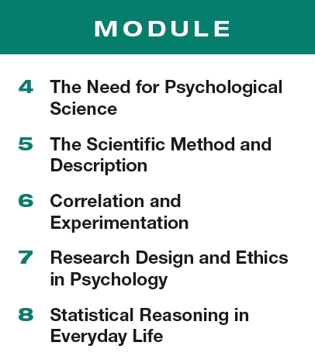
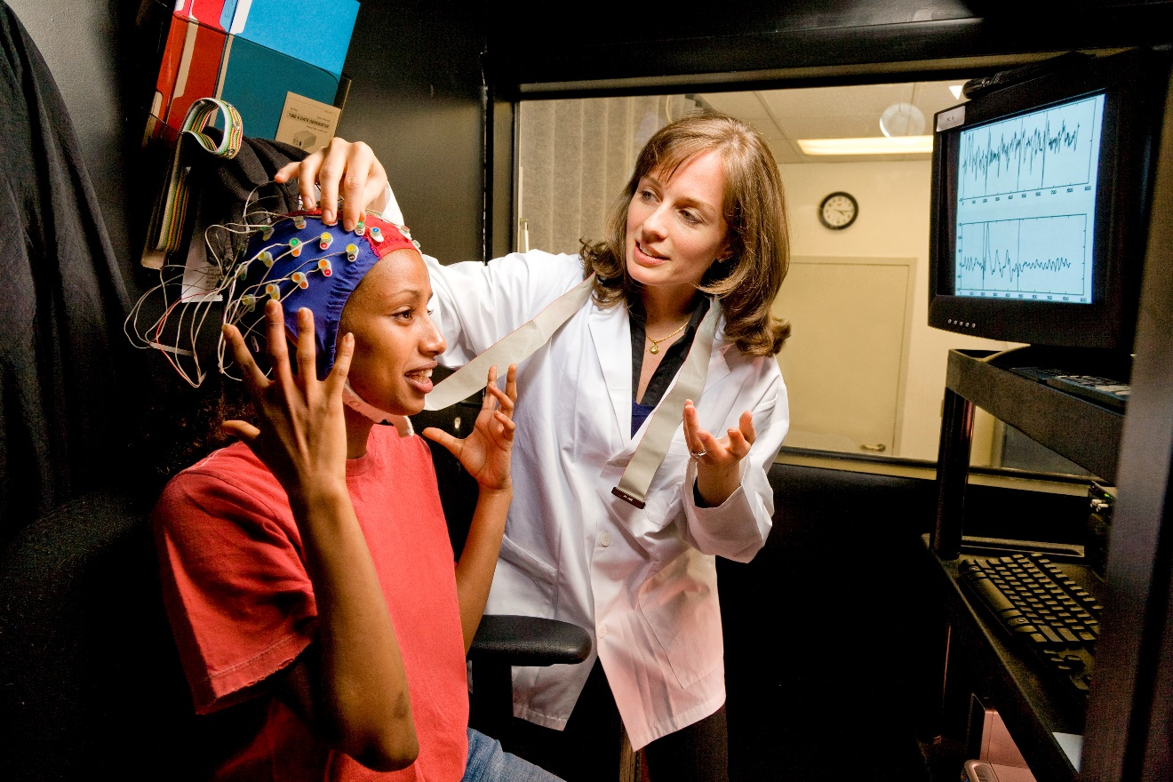
Unit 2 Research Methods: Thinking Critically With Psychological Science

Slide 2
Module 5 The Scientific Method and Description
Module 5
The Scientific Method and Description
Learning Targets
5-1 Describe how theories advance psychological science.
5-2 Explain how psychologists use case studies, naturalistic observations, and surveys to observe and describe behavior, and why random sampling is important.

Slide 3
In Module 1 we discussed the three elements of the scientific attitude.
curiosity
skepticism
humility

Slide 4
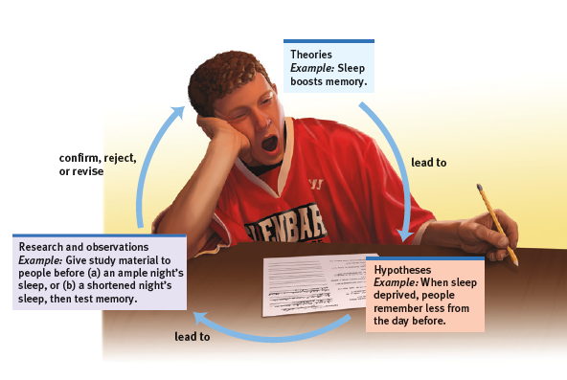
The Scientific Method
Psychologists use the scientific method to support their scientific attitude. It is a self-correcting process using observation and analysis to evaluate ideas.

Slide 5
How does a theory advance science?
an explanation using
an integrated set of principles
that organizes observations and
predicts behaviors or events
What is a theory?
So for instance…
If we observe over and over that a classmate who gets plenty of sleep is usually the one with the right answer…
we form a principle that sleep must improve memory.

Slide 6
TRY IT
What theories do you have about….
…how exercise relates to stress?
…the way caffeine impacts memory?
…how smiling impacts mood?

Slide 7
How does a hypothesis advance science?
a testable prediction,
often implied by a theory
What is a hypothesis?
So for instance…
To test our theory of sleep’s effects on memory,
our hypothesis might be that
when sleep deprived, people will
remember less from the day before.

Slide 8
What is the difference between a theory and a hypothesis?
theory
hypothesis
using our observations to explain behavior
predictions about behavior that can be tested

Slide 9
1. What Would You Answer?
1. What Would You Answer?
A testable prediction that drives research is known as a(n)
theory.
hypothesis.
operational definition.
guess.
random sample.

Slide 10
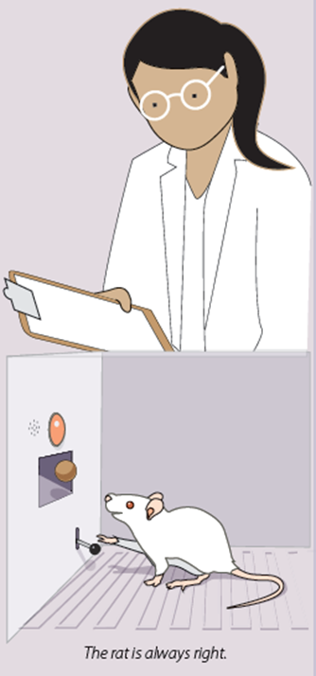
What comes next?
From theory to hypothesis to…
…research.
Remember.. The rat is always right.
The results of our experiment will
either support our theory or
lead us to revise or reject it.

Slide 11
Let’s consider this hypothesis:
When sleep deprived, people will remember less from the day before.
What do we mean by sleep deprived?
2 hours fewer than usual? No sleep at all for a week?
How will we know someone “remembers less”?
Less than what? Less than whom?

Slide 12
What is an operational definition?
A carefully worded statement of
the exact procedures (operations)
used in a research study.
For example, human intelligence may be
operationally defined as what an
intelligence test measures.
The variable would then need to be quantified…so in this instance, human intelligence would be the score on an intelligence test.

Slide 13
What is an operational definition for our hypothesis?
sleep deprived
We’ll define that as 2 fewer
hours than the subject’s normal
amount of sleep.
remember less
We can compare the number of words correctly recalled after a normal night of sleep with that of a shortened sleep night.

Slide 14
Why is an operational definition important?
If we specifically define what we mean by
“sleep loss” or “caffeine” or
“smiling”…
operational definition
…we can repeat the experiment precisely as it was conducted the first time.
Replication is confirmation.
replication

Slide 15
Work with a partner to develop a hypothesis for the theories below.
TRY IT
Music helps plants grow.
Ginger tea helps reduce hyperactivity in teens
Eating junk food causes weight gain.
Now that you have your hypothesis… practice operationally defining the terms.

Slide 16
Let’s think about operational definitions.
TRY IT
Plants that are exposed to music show increased growth.
What type of music will you play?
How loud will you play the music?
How long will the plants be exposed to music?
What types of plants will you use?
How will you measure growth?
How often will you take your measurements?

Slide 17
Let’s think about operational definitions again.
TRY IT
Drinking ginger tea reduces hyperactivity in teens.
How much tea will each subject drink?
What are the ingredients in the tea?
How often will the subject drink tea?
How will you measure hyperactivity?
What age are the teens?
Are the teens girls or boys?
Do the teens have ADHD?

Slide 18
Let’s think more about operational definitions.
TRY IT
Eating junk food causes weight gain.
How do you define junk food?
What brands and products will the subjects consume?
How much and how often will the subjects eat?
How will you measure weight gain?
What weight ranges are the subjects in at the start of the experiment?
How active are the participants?
Men or women?

Slide 19
How can we test hypotheses and refine theories?
descriptive methods
correlational methods
experimental methods

Slide 20
What are three descriptive methods?
case studies
naturalistic observation
surveys and interviews

Slide 21
What is a case study?
A descriptive technique
in which one individual
or group is studied in depth
in the hope
of revealing universal
principles.

Slide 22
How do psychologists use case studies to observe and describe behavior?
Patient H.M.
Little Hans
Genie (the feral child)
one individual
University of Tennessee women’s basketball team
Prison inmates in a group therapy study
one group

Slide 23
What are the strengths and limitations of the case study method?
strengths
limitations
Allow for examination of rare or unusual behavior.
Provide a large amount of qualitative data.
Suggest directions
for further study.
Atypical case studies can be misleading.
Results from one study may not be generalizable to the larger group.
Cannot determine cause and effect.

Slide 24
What is naturalistic observation?
A descriptive technique of observing
and recording behavior in
naturally occurring situations
without trying to manipulate or
control the situation.

Slide 25
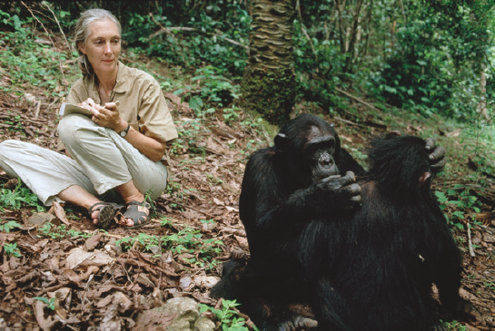
How do psychologists use the naturalistic observation method to observe and describe behavior?
watching chimpanzees in the jungle

Slide 26
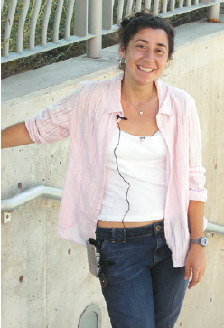
How else do psychologists use the naturalistic observation method to observe and describe behavior?
Psychologists Mehl and Pennebaker attached voice recorders to 79 college students to listen in on their day-to-day conversations.

Slide 27
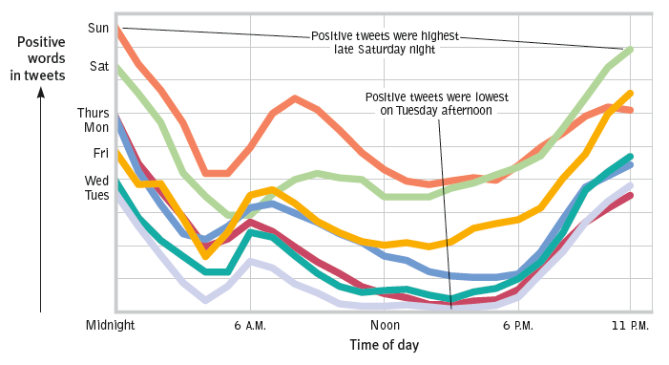
How can the naturalistic observation method describe behavior?
Counting positive and negative words in 504 million
Twitter messages from 84 countries

Slide 28
What are the strengths and limitations of the naturalistic observation method?
strengths
limitations
Subjects behave “normally” outside of a lab setting.
Data collection is unobtrusive (doesn’t disturb the subject).
Independent variable cannot be isolated.
Cannot determine cause and effect.
Observations by researchers may be subjective.

Slide 29
What is a survey?
a descriptive technique
for obtaining the self-reported
attitudes or behaviors of a
particular group, usually by
questioning a representative,
random sample of the group.

Slide 30
How do psychologists use the survey method to observe and describe behavior?
half of all Americans reported experiencing more happiness and enjoyment than worry
and stress on the previous day (Gallup, 2010).
1 in 5 people across 22 countries report believing that alien beings have come to Earth and now walk among us disguised as humans (Ipsos, 2010).
68 percent of all humans—some 5 billion people—say that religion is important in their daily lives (Diener et al., 2011).

Slide 31
2. What Would You Answer?
2. What Would You Answer?
Which of the following questions is best investigated by means of a survey?
Are people more likely to vote Republican or Democrat in the next election?
Are violent criminals genetically different from nonviolent criminals?
Does extra sleep improve memory?
What is the best study technique for AP® exams?
What role does exercise play in weight loss?

Slide 32
What are the strengths and limitations of the survey method?
strengths
limitations
able to take a “quick pulse” of people’s beliefs, behaviors or opinions
able to include many cases
response bias
wording effects can skew the outcomes
acquiring a random sample is difficult
cannot determine cause and effect

Slide 33
Which of the two phrases below would you be in favor of supporting?
TRY IT
Gun safety laws or gun control laws?
Aid to the needy or welfare?
Revenue enhancers or taxes?

Slide 34
Let’s consider the problem of wording effects in surveys:
Do you support aid to the needy?
Do you support welfare?
Turns out that more people respond favorably to the first statement than the second.
The way we word our survey has significant effects on the responses.

Slide 35
Let’s consider the problem of sampling bias in surveys:
Survey finds 94% of people support federal funding
of the space program.
What questions should I ask?
Where was the survey conducted?
Who was in the sample?

Slide 36
Why is the survey location a possible problem?
Survey finds 94% of people support federal funding
of the space program.
Where was the survey conducted? How could each of these survey locations change the results?
Washington D.C.
At a screening of Star Wars
In a small Iowa town
At a
political event

Slide 37
Why is the survey population a possible problem?
Survey finds 94% of people support federal funding
of the space program.
Who was in the survey sample? Do these subgroups have different goals? Priorities?
Naval aviators
Students at a technical college
Prison inmates
Teenagers

Slide 38
What is a representative sample?
If you wanted to survey students at your school, how would you choose whom to survey?
A representative sample has the same distribution of demographic qualities in it as the population as a whole. For instance…if the student population at the school is 25% Hispanic students, 30% Asian students, 35% African American students, and 10% Caucasian students, your sample should reflect those percentages.
If your school is 50% male and 50% female, equal numbers of both sexes should be represented in your sample.

Slide 39
What is a population and a random sample?
population
random sample
All those in a group
being studied,
from which samples
may be drawn.
A sample that
fairly represents a population
because each member
has an
equal chance
of inclusion.

Slide 40
If you wanted to survey high school students about drug use…
TRY IT
How would you identify your population?
How would you create a random sample?

Slide 41
3. What Would You Answer?
3. What Would You Answer?
Which of the following is most important when conducting survey research?
Choosing a representative sample.
Choosing a large sample.
Choosing a biased sample.
Choosing a sample that includes every member of the population.
Choosing a sample whose answers will likely support your hypothesis.

Slide 42
4. What Would You Answer?
4. What Would You Answer?
Dr. Cheema is interested in studying the prevalence of cheating on exams at her local high school.
Describe one advantage of using each of the following research methods to study this topic:
Case study
Naturalistic observation
Survey

Slide 43
Learning Target 5-1 Review
Describe how theories advance
psychological science.
Theories are explanations that generate hypotheses, predictions that can be tested and confirm, reject, or
revise theories.
To enable other researchers to replicate the studies, precise operational definitions of their procedures are used.
Replication increases confidence in the results.

Slide 44
Learning Target 5-2 Review
Explain how psychologists use
case studies, naturalistic observations,
and surveys to observe and describe behavior, and why random sampling is important
Description methods include case studies, naturalistic
observations, and surveys, show us what can happen and offer ideas for future research.
Generalizing about a population requires a representative sample; in a random sample, every person in the entire population being studied has an equal chance of participating.

