Slide 1
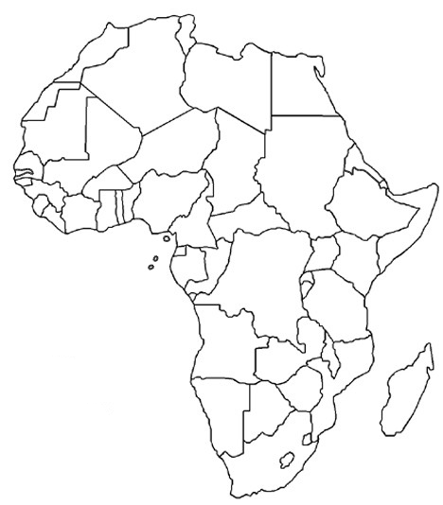
Label your paper like this!
Warm-Up #1 12/04/13
Directions: Number your paper from 1 to 7. Write in the correct name for each country:
1
2
3
4
5
6
7

Slide 2
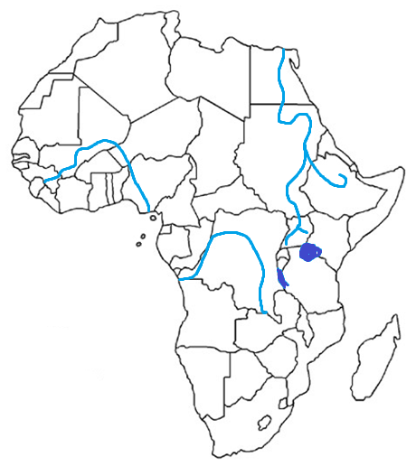
Label your paper like this!
Warm-Up #2 12/05/13
Directions: Number your paper from 1 to 7. Write in the correct name for each feature:
1
2
3
4
5
6
7

Slide 3
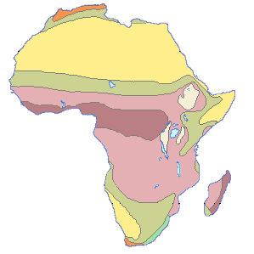
Label your paper like this!
Warm-Up #3 12/06/13
Directions: Number your paper from 1 to 4. Write in the correct name for each climate region:
1
2
3
4

