Slide 1
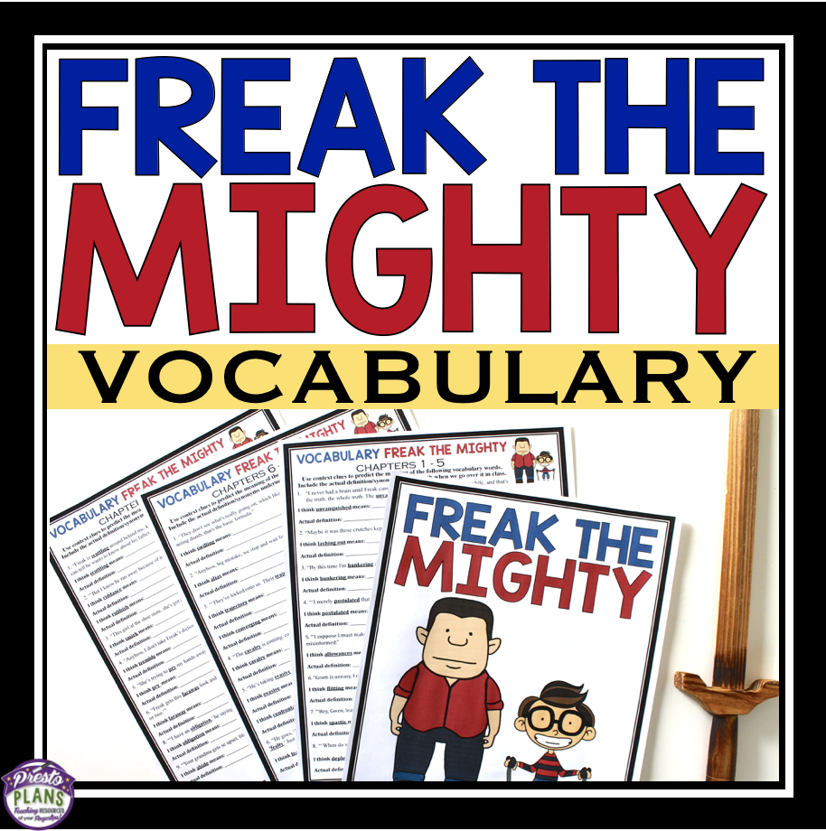

Slide 2
This presentation is for single teacher use. To purchase additional licenses at a discount, visit your My Purchases page. Redistributing, editing, selling, or posting this item or any part thereof on the Internet are strictly prohibited without first gaining permission from the author. Violations are subject to the penalties of the Digital Millennium Copyright Act. Please contact me at prestoplans@gmail.com for special permission.
You can visit my store at
http://www.teacherspayteachers.com/Store/Presto-Plans
© Presto Plans

Slide 3
DEFINING
DIFFICULT WORDS
If you were asked to define the word garrulous, what might you guess it means?
TKAMB
Journals
© Presto Plans

Slide 4
DEFINING
DIFFICULT WORDS
What if you read the word in a sentence?
Unlike his quiet and low key family, Brad is garrulous.
TKAMB
Journals
© Presto Plans

Slide 5
CONTEXT CLUES
Unlike his quiet and low key family, Brad is garrulous.
If you read these words in a sentence, you might be able to determine the meaning based on context clues. In this sentence, the context—the words surrounding the new vocabulary word—provide clues to help you determine garrulous means talkative.
TKAMB
Journals
© Presto Plans

Slide 6
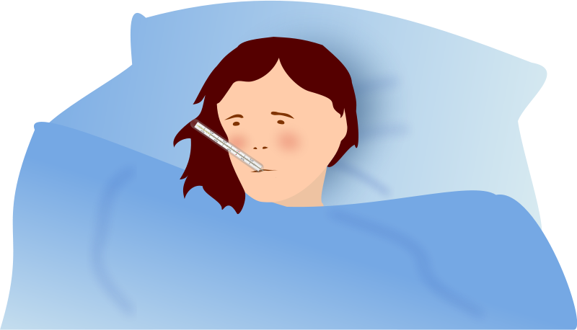
TYPES OF CONTEXT CLUES
1. Using Examples
An author may give you examples to help you understand the meaning of an unknown word.
“Suzanne had many ailments including a rash, allergies, and a chronic headaches” . The examples—rash, allergies, headaches— help you figure out that the word ailment means “a minor illness.”
TKAMB
Journals
© Presto Plans

Slide 7
TYPES OF CONTEXT CLUES
2. Using Synonyms
A context clue can be in the form of a synonym: a word that means the same or almost the same as the unknown word. A synonym may appear anywhere in a passage to provide the same meaning as the unknown word.
“My doctor said smoking could terminate my life. But I told him, ‘Everybody’s life has to end some time.’ ”
The synonym that helps you understand the word terminate is “end.”
TKAMB
Journals
© Presto Plans

Slide 8
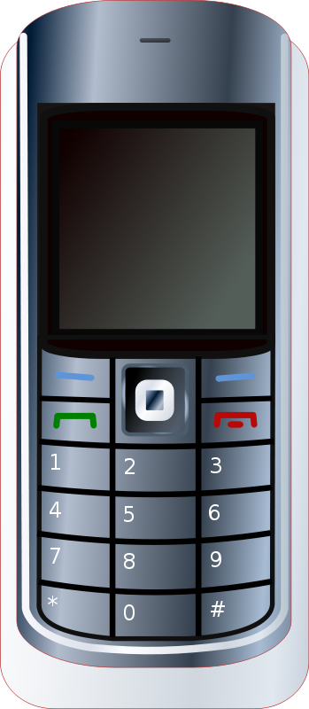
TYPES OF CONTEXT CLUES
3. Using Antonyms
An antonym is a word that means the opposite of another word. Antonyms as context clues are often signaled by words and phrases such as however, but, yet, on the other hand, and in contrast.
Many people have pointed out the harmful effects that cell phones in school have had, yet there are many salutary effects as well.
Using the antonym context clue ‘harmful’, we can figure out that salutary means beneficial.
TKAMB
Journals
© Presto Plans

Slide 9
TYPES OF CONTEXT CLUES
4. General Meaning
Sometimes it takes a bit more work to figure out the meaning of an unfamiliar word. When this happens, you must draw conclusions and ask questions about the information given with the word.
An employee, irate over being fired, stormed out of the office pushing everyone in his way.
Using the information in this
sentence, we can assume the
man is angry – which is the
meaning of irate.
TKAMB
Journals
© Presto Plans

Slide 10
Use what you have learned about context clues to determine the meaning of the following new words.
© Presto Plans

Slide 11
CHAPTERS 1 - 5
1. “I never had a brain until Freak came along and let me borrow his for a while, and that's the truth, the whole truth. The unvanquished truth.”
Not able to be conquered
or overcome
2. “Maybe it was those crutches kept me from lashing out at him, man those crutches were cool.”
To hit or kick out at someone
or something
© Presto Plans

Slide 12
CHAPTERS 1 - 5
4. “By this time I'm hunkering along in front of the place, trying to maintain a casual attitude.”
To squat or crouch down low
5. “‘I merely postulated that you call your grandfather Grim because he's grim.’”
To suggest or assume something
© Presto Plans

Slide 13
CHAPTERS 1 - 5
6. “‘I suppose I must make allowances for your ignorance. On the subject of robots, you were clearly misinformed.”
The act of regarding a mistake as
less serious or bad because of
special circumstances.
7. “Gram is uneasy, I can see her eyes flitting nervously around the room.”
To move swiftly and lightly
© Presto Plans

Slide 14
CHAPTERS 1 - 5
7. “‘Hey, Gwen, leave the guy alone, huh? You're going spastic.’”
Offensive, awkward, or clumsy
8. “‘When do we eat? My fuel cells are depleted.’”
To use up of the supply of
resources of something.
© Presto Plans

Slide 15
CHAPTERS 6 - 10
1. “They don't see what's really going on, which like I say is the dad's swilling beer and acting dumb, that's the basic formula.”
To drink something in large
quantities
2. “Anyhow, big mistake, we stop and wait
for Tony D., alias the bad-news Blade.”
Indicating that a person is
known by another name
© Presto Plans

Slide 16
CHAPTERS 6 - 10
3. "'They've locked onto us. Their trajectory is converging. Go to the left.'"
Trajectory: A path followed by a
projectile or flying object
Converging: Objects that come
together from different directions
© Presto Plans

Slide 17
CHAPTERS 6 - 10
4. “The cavalry is coming, can't you hear the bugle?”
Soldiers who fought on horseback.
5. “He's taking evasive action. Avoiding a confrontation. That's a very different thing right, Max?”
Evasive: To get around or avoid
something
Confrontation: A hostile or
argumentative situation
© Presto Plans

Slide 18
CHAPTERS 6 - 10
6. “Now swear on your heart that the data you are about to receive will be divulged to no one.”
To make known of sensitive information
7. “He goes, ‘Pledge me your fealty,’ and I say, ‘Huh?’ and he says, ‘never mind, there's no time to look up 'fealty.' Just promise you'll do what I say.’”
To give loyalty and faithfulness
to a lord.
© Presto Plans

Slide 19
CHAPTERS 11 - 15
1. “Freak is scuttling around behind me, keeping out of her way, but when she says that, I can tell he wants to know about his father, if maybe he really was a magician.”
To run hurriedly with short
quick steps
© Presto Plans

Slide 20
CHAPTERS 11 - 15
2. "But I know he ran away because of me." "And you know what?" "What?" "Good riddance to bad rubbish."
Riddance: The act of getting rid
of something unwanted
Rubbish: Waste material that is
considered unimportant
© Presto Plans

Slide 21
CHAPTERS 11 - 15
3. “This girl at the shoe store, she's got a little smirk and she goes, "13 Triple E? Do they make shoes that big?"
Smile in a smug, conceited, or silly way
4. “Anyhow, I don't take Freak’s dictionary along because my hands are trembly and I might drop it.”
To shake involuntarily, usually as a
result of excitement or anxiety
© Presto Plans

Slide 22
CHAPTERS 11 - 15
5. “She's trying to pry my hands away from my ears.”
Use force in order to move or open
something
6. “Freak gets this faraway look and he says, ‘I'm not sure. Dr. Spivak, she's my doctor, she says maybe a year or two.
Distant in space or time
© Presto Plans

Slide 23
CHAPTERS 11 - 15
7. “‘I have an obligation,’ he saying ‘A man has to protect his family.’”
A duty or commitment
8. “Your grandma gets so upset, bless her heart. Can't abide the idea of violence.”
Act in accordance with a rule or
recommendation
© Presto Plans

Slide 24
CHAPTERS 16 - 20
1. “You know how many Christmas Eves I've been deprived of my own blood kin?”
To deny the possession or use of
something
2. “Now, your grandparents say you're nothing but a dysfunctional retard, but no kid of mine is a retard, and that's a fact.”
Not operating normally
or properly in some way.
© Presto Plans

Slide 25
CHAPTERS 16 - 20
3. “He shakes his head real sorrowful. "That's a crime, not giving up my presents from his father.”
Feeling or showing grief
4. “It was like that, only these were kids,
they were adults who should know better,
except there so ignorant and hateful they
believe the worst.”
Lacking knowledge or awareness.
© Presto Plans

Slide 26
CHAPTERS 16 - 20
5. “I had a lot of time to plan this out. A lot of time to study people, figure out what makes them tick.”
What motivates someone
6. “What they love to hear about is a bad
man who has redeemed himself.”
Do something that makes up for
poor past behavior
© Presto Plans

Slide 27
CHAPTERS 16 - 20
7. “At first he’s surprised to see me trussed up, then he shrugs and doesn't look at me anymore.”
Tied up with arms at their sides
8. “Good old reliable H₂S0₄, an oily, colorless, corrosive liquid used in dyes, paints, explosives, and many chemical experiments."
Tending to cause something to
eat away.
© Presto Plans

Slide 28
CHAPTERS 21 - 25
1. “Dr. Spivack says my unique status as a marvel of genetic aberration makes me an object of…curiosity.”
Marvel: An astonishing person or thing
Aberration: A departure from
what is normal
2. “I kept trying to invent stuff - the wheel, central heating, indoor plumbing - but the Neanderthals were happy with just a campfire in a fur coat.”
An extinct species of human known
for being uncivilized and unintelligent
© Presto Plans

Slide 29
CHAPTERS 21 - 25
3. “I suppose this means you're going to be an obnoxious teenager.”
Extremely unpleasant
4. “‘Talk about a prodigy,’ Freak says ‘One year old and already he's on his way to ninth grade.’”
A young person with exceptional
qualities or abilities
© Presto Plans

Slide 30
CHAPTERS 21 - 25
5. “All I keep thinking is, what a gyp it is to have to go to the hospital on your birthday."
The act of cheating or stealing
6. "It's called a tracheotomy he says… standard procedure to facilitate breathing."
Tracheotomy: An incision in the windpipe
made to relieve an obstruction to breathing
Facilitate: To make a process easier
© Presto Plans

Slide 31
CHAPTERS 21 - 25
7. “When he starts to cough before I can say anything, the room is swarming with nurses.”
To be crowded or overrun
with people or things
© Presto Plans

