Slide 1
Seek Help before Harm
Brimfield CUSD #309

Slide 3
Safety Is Everyone’s Responsibility:
See Something...
Say Something...
Do Something.

Slide 4
Discussion Question:
Why are we sometimes scared to report concerns and/or ask for help?

Slide 5
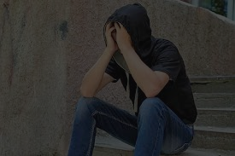
We must commit to helping each other seek help before harm.

Slide 7
Whether self-harm, bullying, or other threats to safety - help is available.

Slide 8
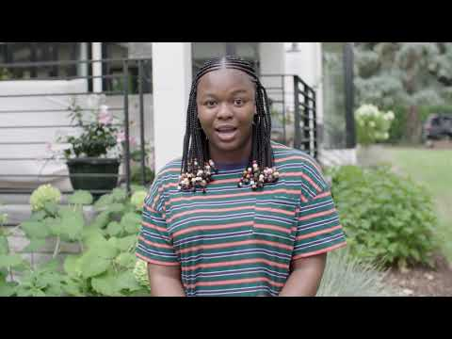
It Is Ok To Not Be OKAY.

Slide 10
What is Safe2HelpIL?

Slide 11
Safe2HelpIL @ Brimfield #309
Safe and Confidential Reporting
Available 24/7
The goal is safety and help, not school discipline

Slide 12
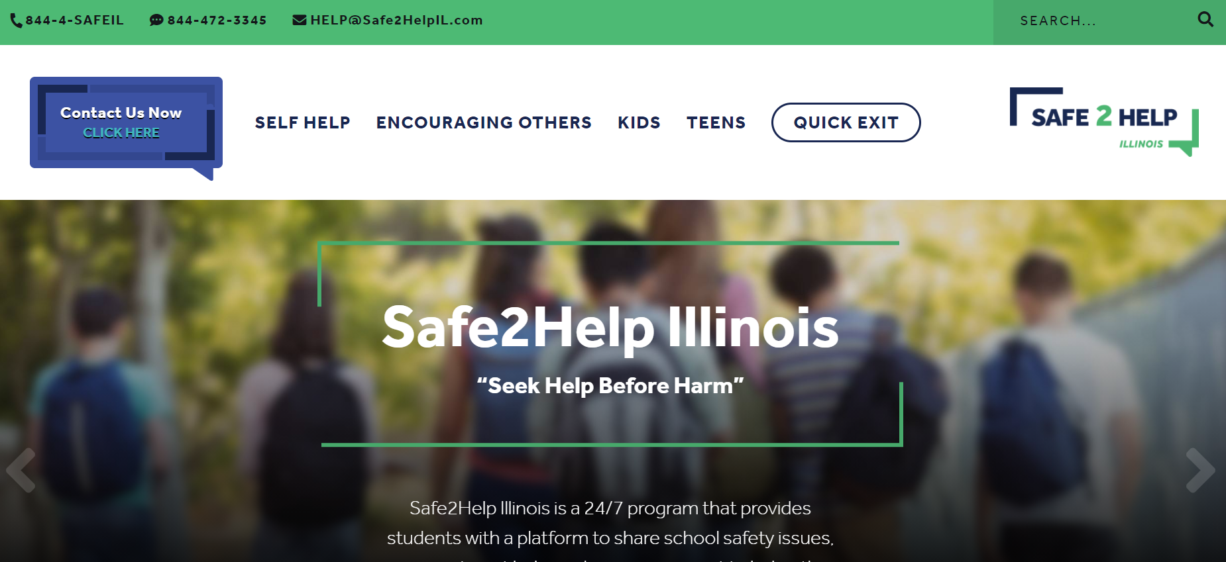
How do we get started?

Slide 13
Let’s Explore Safe2HelpIL Together:
Go to Safe2HelpIL.com
Spend 10-15 Minutes Exploring The Website - Especially “Self-Help” and “Encouraging Others”
As A Class, or With Those Near You, Share What Stood Out? What You Learned/Liked?

Slide 14
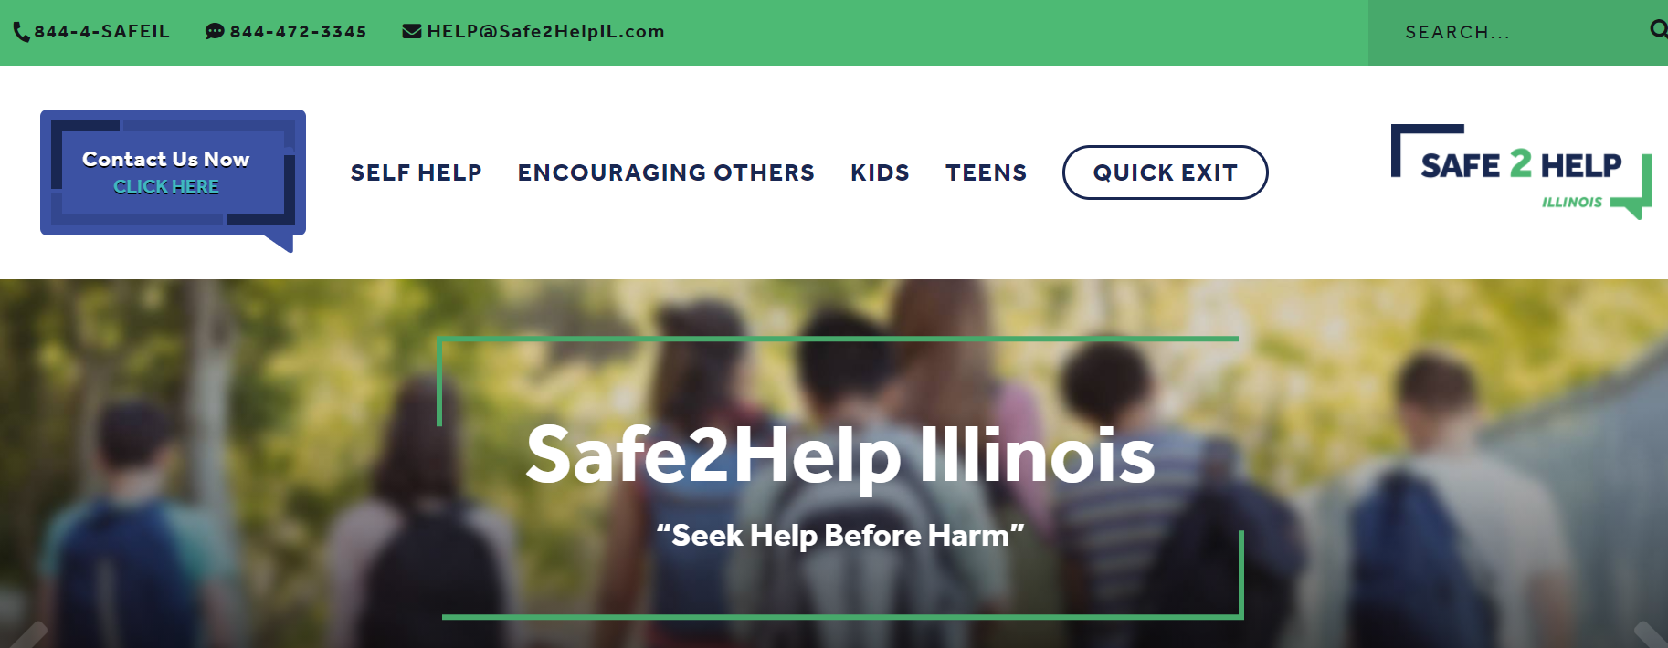
How Do We Use Safe2HelpIL?
Click “Contact Us Now” in the upper left hand corner of the Safe2HelpIL main page.

Slide 15
Save the Numbers and Download the App

Slide 16
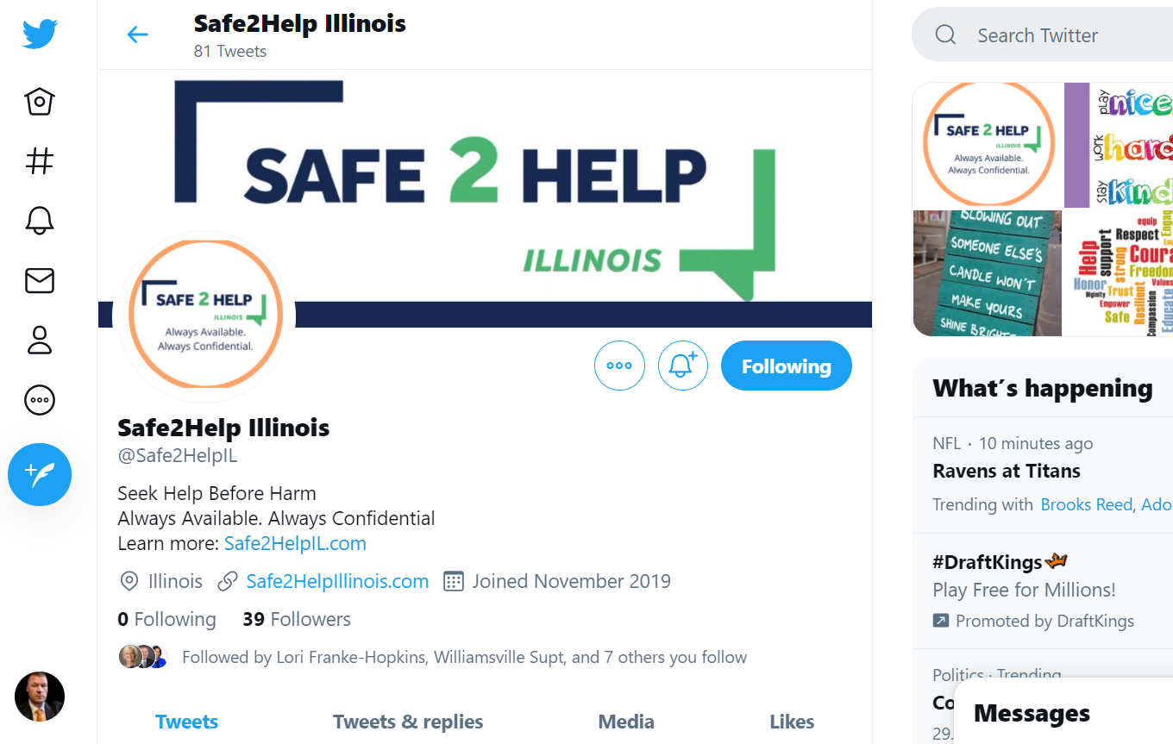
Follow Safe2HelpIL on Twitter and/or instagram

Slide 17
A Few Last Things...
You're a Hero!
Making a difference doesn't mean you are being a "tattletale." Nope. You are being a good friend and helping yourself or someone you know. That takes a lot of bravery. Thank you for being this brave!
To the pranksters
This is not a joke. We take every effort to contact us very seriously. Please don't share a concern that you know isn't true.
Thank you!
You are helping to keep your friends and yourself - safe and healthy. We're proud of you!

