Slide 5
The answer is B.

Slide 8
The answer is A.

Slide 11
The answer is C.

Slide 14
The answer is C.

Slide 17
The answer is C.

Slide 20
The answer is B.

Slide 23
The answer is A.

Slide 24
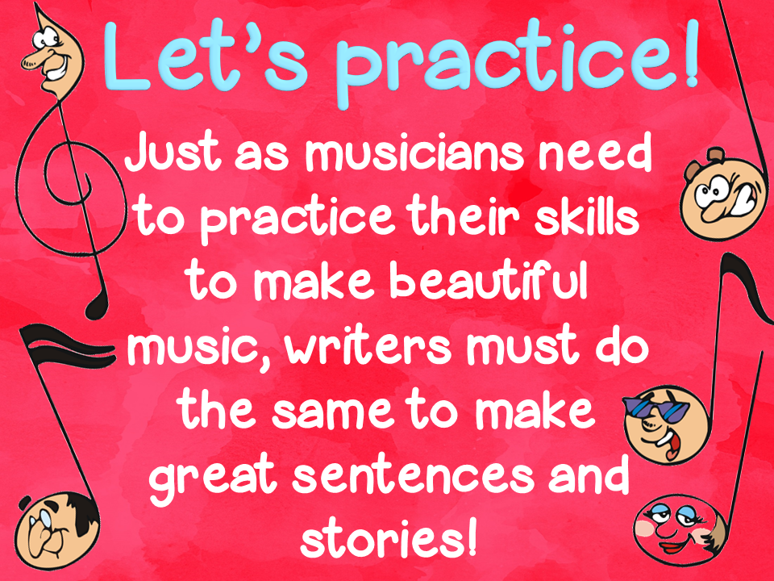

Slide 25
Hyperbole

Slide 26
Personification

Slide 27
Metaphor

Slide 28
Idiom

Slide 29
Onomatopoeia

Slide 30
Simile

Slide 31
D

Slide 32
Alliteration

Slide 33
Onomatopoeia

Slide 34
Hyperbole

Slide 35
Alliteration

Slide 36
B

Slide 37
Metaphor

Slide 38
Idiom

Slide 39
Simile
and
Hyperbole

Slide 40
A

Slide 41
Personification

Slide 42
Idiom

Slide 43
Alliteration

Slide 44
Simile

Slide 45
Onomatopoeia

Slide 46
Hyperbole

Slide 47
Metaphor

Slide 48
Idiom

Slide 49
C

