Slide 1
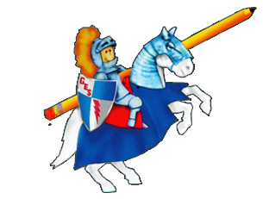
Daily Dose
Of
Second Grade
Week 2

Slide 2
What Can I do:
RL 2.9 Compare and contrast two or more versions of the same story.

Slide 3
READING
This week we are comparing and contrasting different versions of the same story. Remember compare means to tell how things are alike and contrast means to tell how things are different. We use a Venn diagram to compare and contrast.

Slide 4
READ ALOUD: Lon Po Po
Click link below.
https://www.youtube.com/watch?v=6kQM7KoIxd4&t=15s

Slide 5
Compare and Contrast
Compare and contrast the original version of Little Red Riding Hood and Lon Po Po.
Tell 3 ways the stories are alike.
Tell 3 ways the stories are different.

Slide 6
IDR TIME
Students read independently for 20 minutes on Raz-Kids, Epic, or book from home!
Ask yourself:
Who are the characters?
What is the setting?
What is the plot of the story? (beginning, middle and end)
What is the problem?
What is the solution?
How can you relate what you already know to the story?
How does the story you read compare to another story? Contrast?

Slide 7
Spelling
meant
sweat
thread
feather
sweater
gone
guess
laugh
any
through

Slide 8
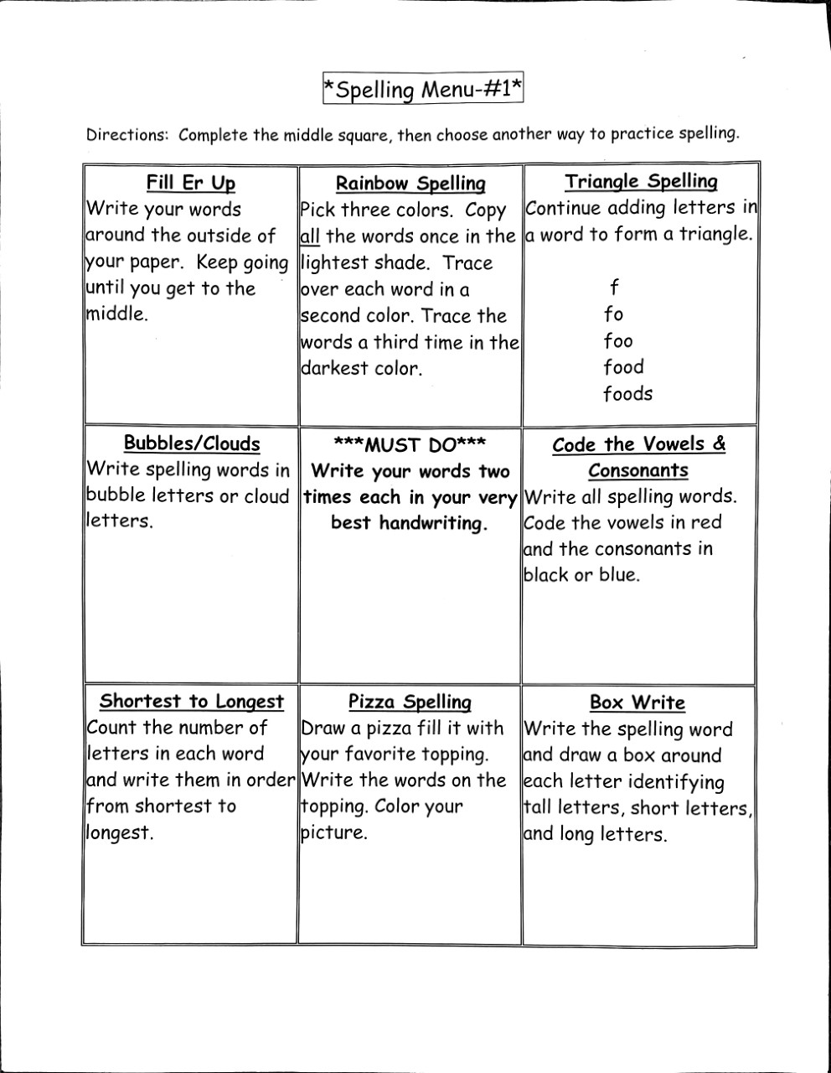
Spelling

Slide 9
Language Arts
L.2.2 Demonstrate command of the conventions of standard English capitalization, punctuation, and spelling when writing.

Slide 10
Capitalization
Always capitalize the pronoun I. I takes the place of a proper noun (a specific name).
Always capitalize the first word in a sentence.
Always capitalize the names of people and their titles of respect: Dr. Mr. Mrs. Ms. Miss
General President Commander Judge

Slide 11
Capitalization- Practice
Practice together.
mr john smith 2. aunt betty 3. judge judy
4. uncle mark 5. miss susan 6. general george washington
7. I 8. dr. bob smith 9. president lincoln

Slide 12
Capitalization- Practice
the spider crawled on ben’s leg.
my best friends are katie and margie.
i am really brave when i visit dr. jones.
judge smith read a story to my class.
mr. johnson is my teacher.
i like to read books with miss riley.
ms. reed and mrs. kirk are very nice.
president george washington is on the quarter.

Slide 13
Capitalization
Always capitalize the names of holidays.
Always capitalize days of the week and months of the year.
Always capitalize the names of brands (Nintendo, Sony, Apple).
Always capitalize the names of specific places (buildings, stores, restaurants, cities, states, countries, continents).

Slide 14
Capitalization and Punctuation- Practice
My favorite holiday is thanksgiving
We went to burger king on friday
My friend visited the statue of liberty in new york
Going to maryland in june was lots of fun
My sister got a new apple watch
We will go to target and kroger on tuesday
We attend school at greenbrook elementary

Slide 15
Scholastic News
Go to this website: https://sn2.scholastic.com
Click log in as a student. The password is gb2019.
Go to the issue: Look Both Ways, Elephants! Click explore.
Be sure to watch the videos and play the game!!!
ps://sn2.scholastic.com/etc/classroom-magazines/reader.html?id=12-030320

Slide 16
Questions from scholastic news
https://sn2.scholastic.com/content/dam/classroom-magazines/sn2/issues/2019-20/030420/SN2-030120-WildlifeCorridors-SKILL-Checkpoint.pdf

Slide 17
Writing
Kindness Counts.
Write about a time that someone did something kind for you. What did they do and how did it make you feel?
Include the following:
Hook/topic sentence
3 to 5 details
Closing sentence

Slide 18
Math

Slide 26
I can use addition and subtraction to solve word problems involving lengths using the same units.

Slide 27
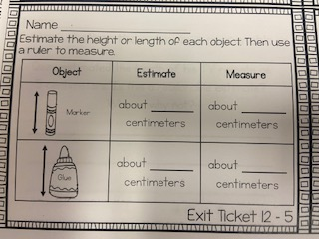

Slide 28
