Slide 1
So You Want to Be a Teacher?
Well, Here’s A Little Bit of Everything...
Patrick Durley
Regional Superintendent
Mason/Tazewell/Woodford ROE #53 www.roe53.net

Slide 2
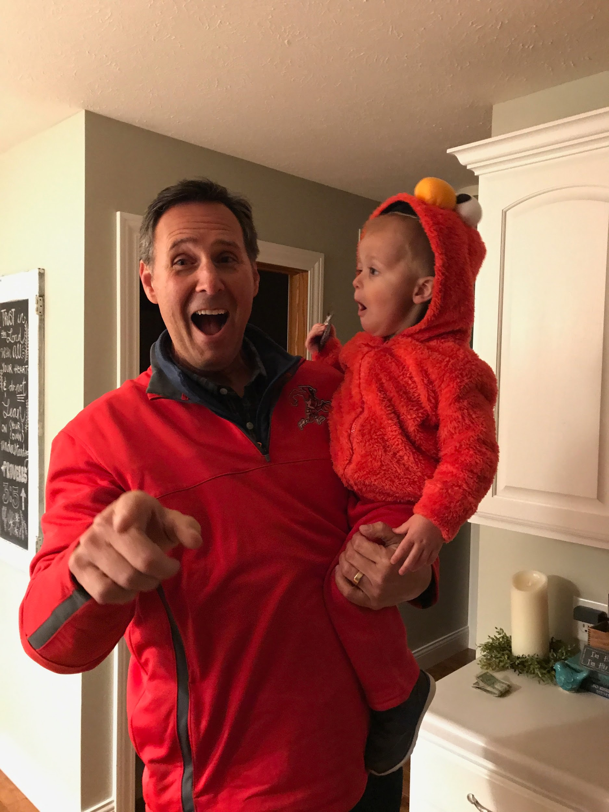
Ok fine, I’ll bore you with a little about me...

Slide 3
What does great teaching look like?

Slide 4
When might you see me at the ROE?

Slide 5
You’ll See Us for...
Testing (except EdTPA)
Fingerprinting/Background Checks
Clinicals
Student Teaching
Subbing
Bus Driving
Teaching Employment

Slide 6
OR...
Getting your license
Adding endorsements
Doing professional development (120 hours in 5 years)
Licensure questions
Renewing your license (every 5 years)
Substitute teaching

Slide 7
Speaking of Subbing...
Short-term Substitute’s License!
Get One!!
It’s worth it
Don’t be shy
Find your niche
Make connections
60 credit hours
Good through 2023

Slide 8
Let’s take a quick look at you!
http://bit.ly/ICCTeach

Slide 9
Current IL Influences...
Evaluation - Danielson & Student Growth
EdTPA
ESSA (Federal) – Replaces NCLB
Common Core State Standards – CCSS
Next Generation Science Standards NGSS
IAR, ISA & PSAT/SAT
Enhanced PE Standards and Assessments
Shortage Areas - Special rules to help fill positions

Slide 10
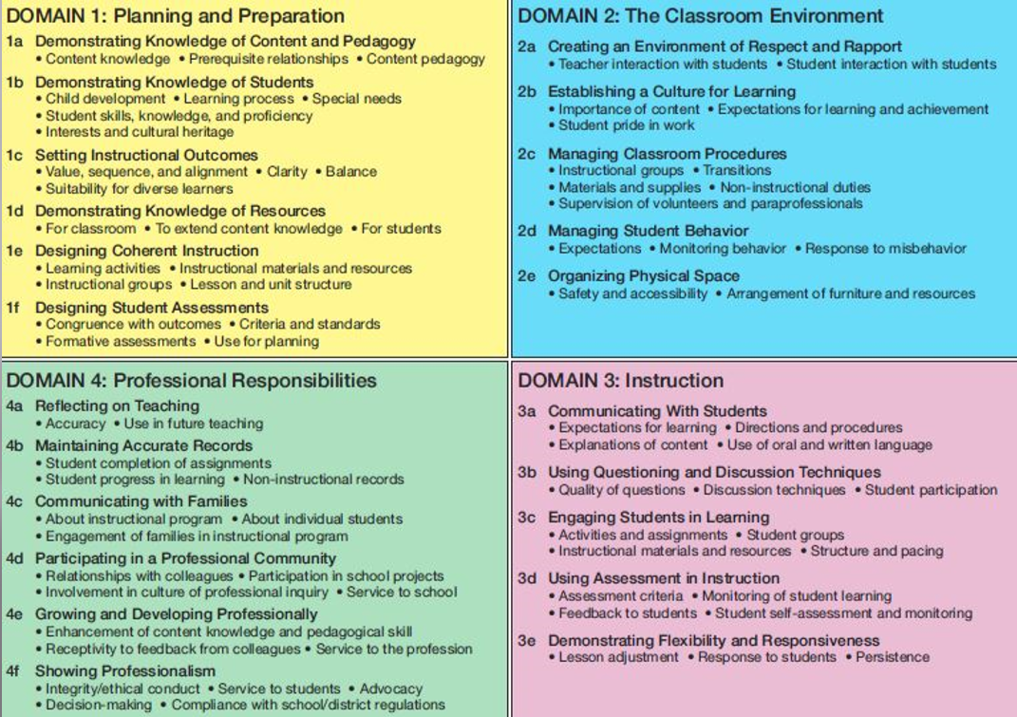

Slide 11
Important Note…
“Everything you do and every job you’re in is your interview for your next job.”
Kenneth Anderson, Belvidere, IL

Slide 12
What Are My Choices?
Pk-2
1-6
5-8
9-12
K-12

Slide 13
What are Principals Looking for?
Reliability Manage Classroom
Engage Students Know Content
CARE! It’s about the relationships
Effective collaborators & Facilitators
Effective Integrators of technology
Develop critical thinkers and understanding – not just share your ultimate wisdom

Slide 14
A Few Suggestions…
Take advantage of your clinicals – ask to assist or participate
Build your resume – find ways to work with kids
You all look the same on paper – find ways to make yourself stand out
Always be a student
Love what you do – have passion
Work towards more endorsements
Social Media – it is often the kiss of death

