Slide 1
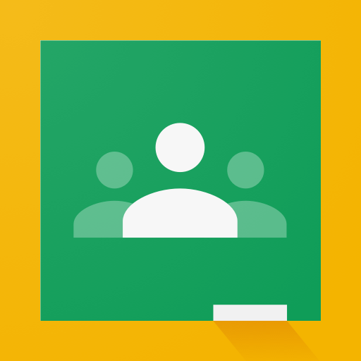
Accessing Google Classroom from Home

Slide 2
Step 1: Access Google
Not all browsers default to Google when accessing the Internet. In order to get to Google (if you aren’t there already) go to google.com.

Slide 3
Step 2: Click on the waffle in the top right corner.
(See next slide for visual!)

Slide 4
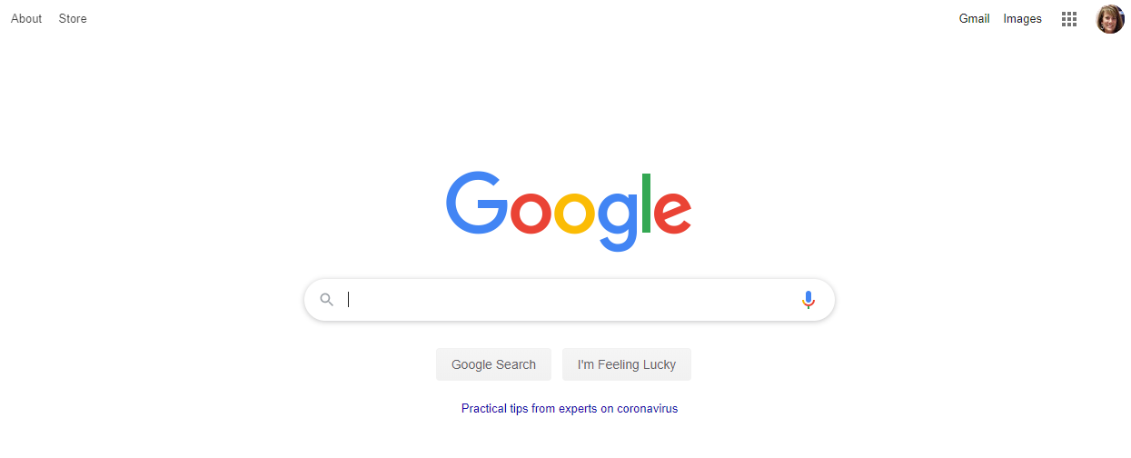

Slide 5
Step 3: Find Google Classroom App
Scroll through the apps that pop up after clicking the waffle. Click on Google Classroom.
Don’t see Google Classroom? Scroll to the bottom of the app listing and click More from Google. Continue to scroll through the page until you see a listing of all Google products. Select Google Classroom from that list.

Slide 6
Step 4: Username and Password
An email address must be entered as the username to access Google Classroom.
The student email is student#####@carrollcountyschools.com.
The password is the same as the Google password used on the Chromebook in class: ces0#####. (The ##### should be replaced with student lunch number.)

