Slide 1
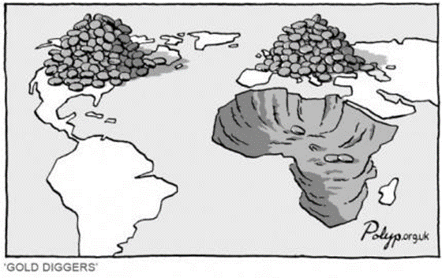
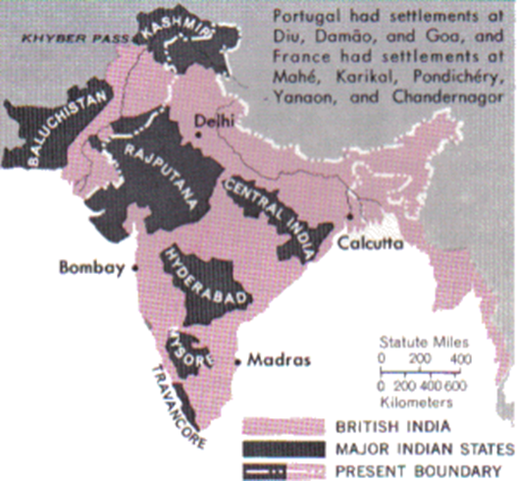
SSWH21:
Independence Movements
"In what ways did the colonial experience and the struggle for independence shape the agenda of developing countries in the second half of the twentieth century?"

Slide 2
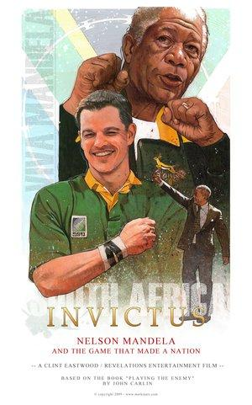
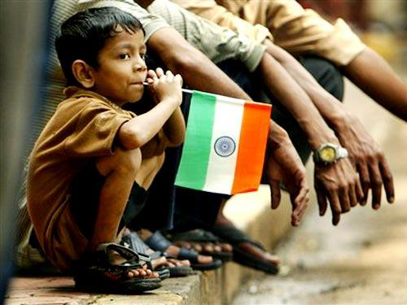

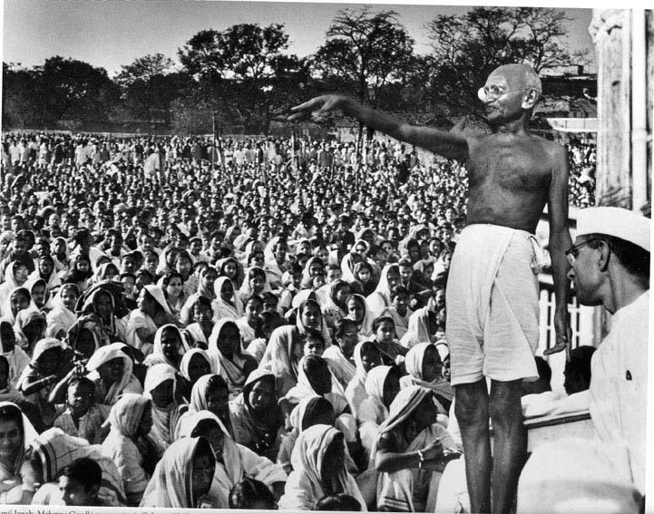
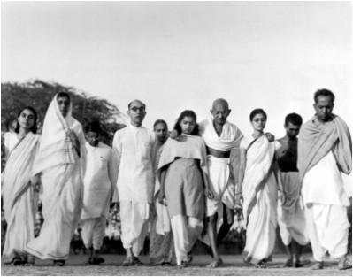
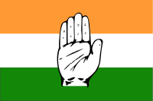
Imperial disintegration
What was distinctive about the end of Europe’s African and Asian empires compared to other cases of imperial disintegration?

Slide 3
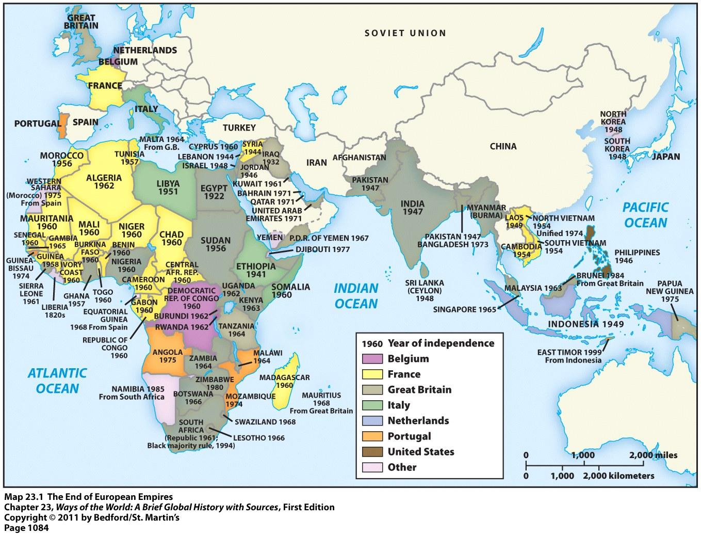
In the second half of the twentieth century, under pressure from nationalist movements, Europe’s Asian and African empires dissolved into dozens of new independent states.

Slide 4
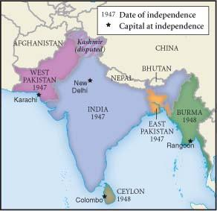
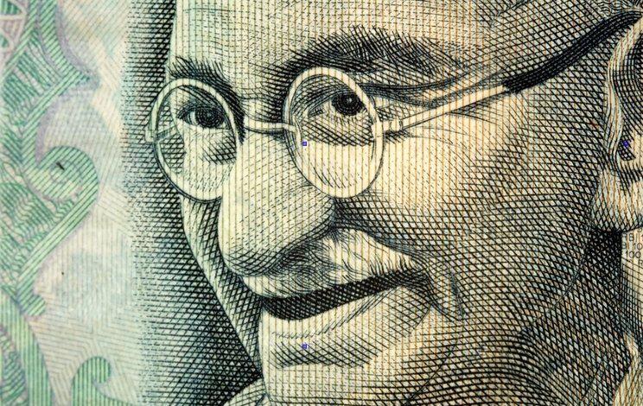
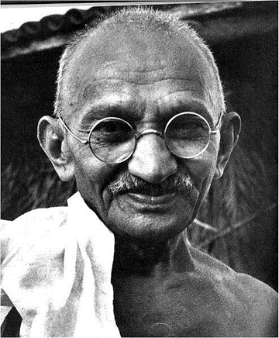
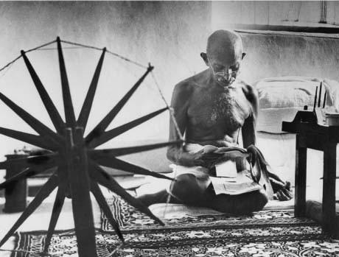
Indian Independence

Slide 5
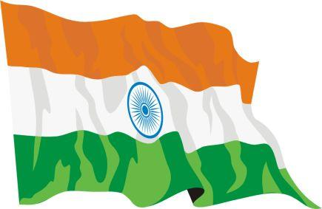
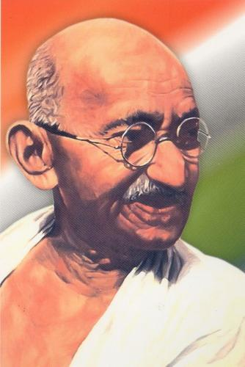
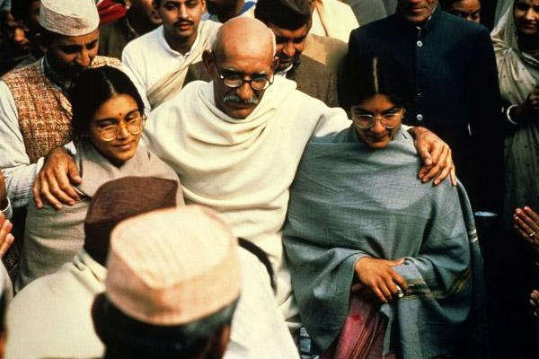
Gandhi, Mohandas K.
Usually referred to as “Mahatma” (Great Soul), Gandhi (1869–1948) was a political leader and the undoubted spiritual leader of the Indian drive for independence from Great Britain.
(pron. moh-HAHN-dahs GAHN-dee)

Slide 6
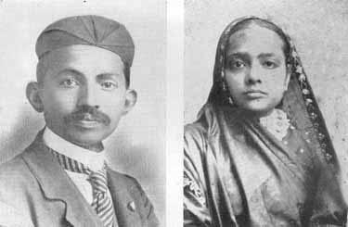
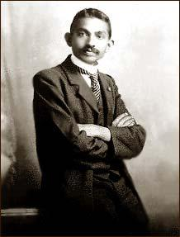
Who was Gandhi?
Gandhi was born in the province of Gujarat in western India to a pious Hindu family of the Vaisya, or business, caste.
Married at 13, had only a mediocre record as a student, and eagerly embraced an opportunity to study law in England at 18.

Slide 7
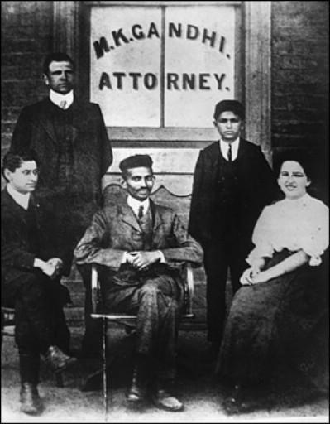
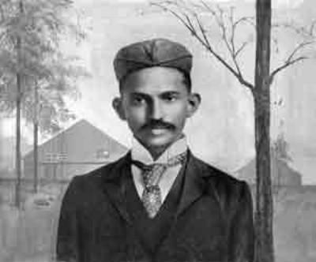
Returned as a shy and not very successful lawyer.
1893 he accepted a job with an Indian firm in South Africa, where a substantial number of Indians had migrated as indentured laborers during the 19th century.
While in South Africa, Gandhi personally experienced overt racism for the first time and as a result soon became involved in organizing Indians, mostly Muslims, to protest that country’s policies of racial segregation.

Slide 8
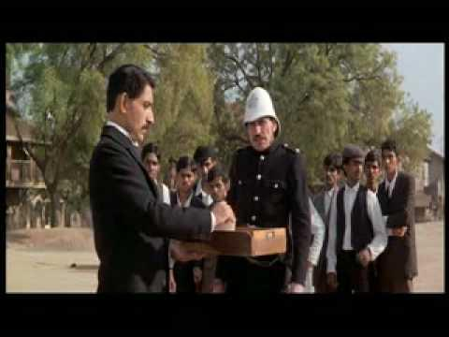
YouTube: Gandhi's first protest (in South Africa) clip from the movie "Gandhi"

Slide 9
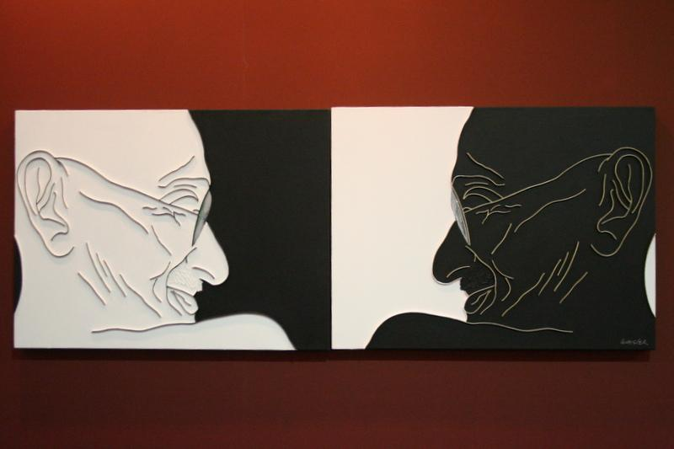
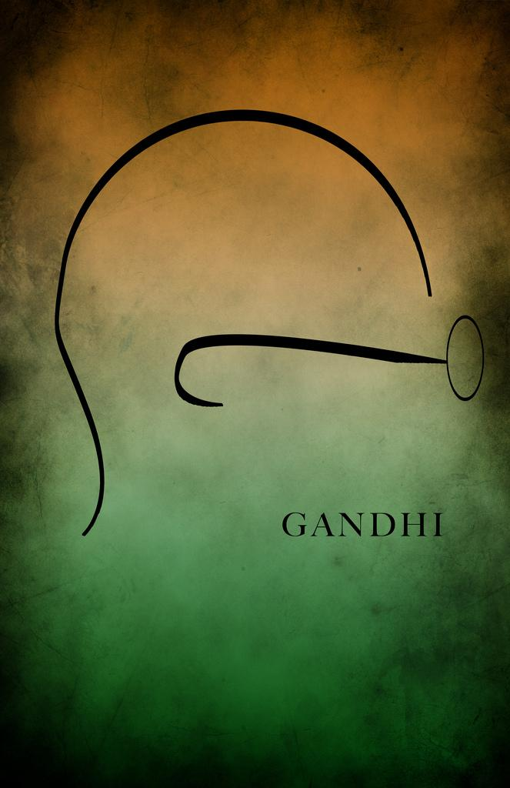
Who was Gandhi?
Developed a concept of India that included Hindus & Muslims alike
Pioneered strategies of resistance that he would later apply in India itself.
His emerging political philosophy, known as satyagraha (truth force), was a confrontational, though non-violent, approach to political action.

Slide 10
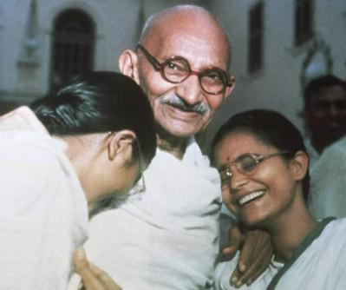
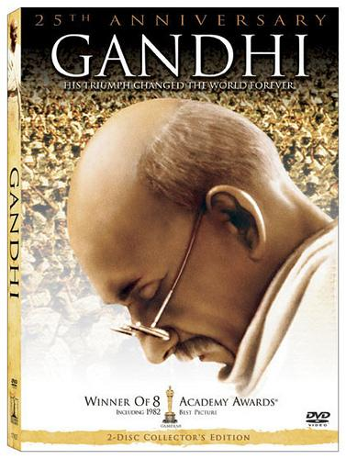
Who was Gandhi?
"Non-violence means conscious suffering. It does not mean meek submission to the will of the evil-doer, but it means the pitting of one’s whole soul against the will of the tyrant… [I]t is possible for a single individual to defy the whole might of an unjust empire to save his honour, his religion, his soul."

Slide 11
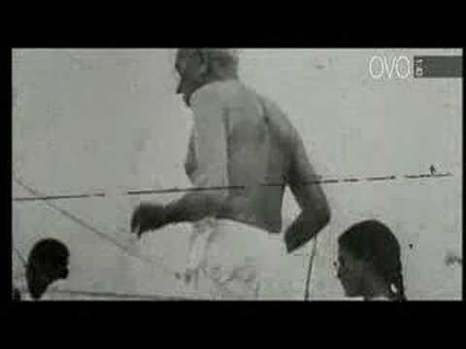

Slide 12
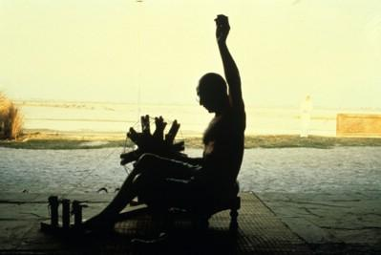
Indians had pushed for self-rule since the late nineteenth century, and demands grew louder following World War I.
During World War II, Mohandas K. Ghandi and the Indian National Congress started the Quit India movement in an effort to achieve immediate independence from the British.

Slide 13
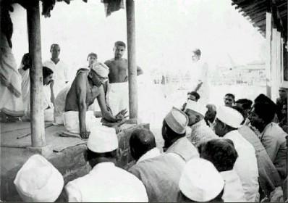
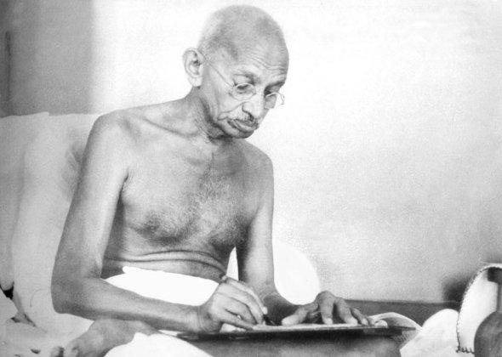
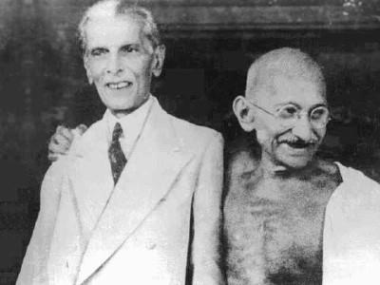
Gandhi did not call for social revolution but sought the moral transformation of individuals.
He worked to raise the status of India’s untouchables (the lowest and most ritually polluting groups within the caste hierarchy), he launched no attack on castes in general and he accepted support from businessmen and their socialist critics alike.
His critique of India’s situation went far beyond colonial rule.

Slide 14
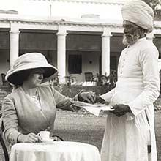
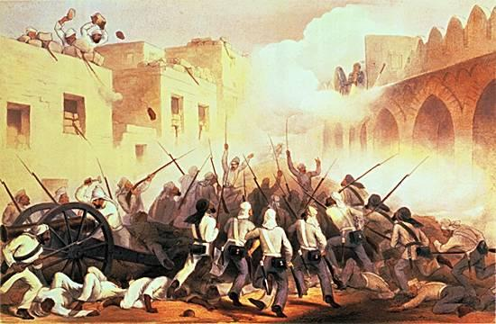
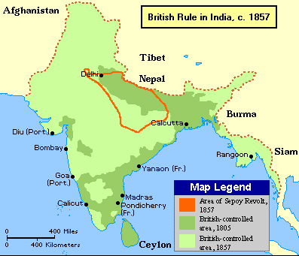
The British treated this movement as a rebellion, jailed Ghandi and 60,000 others.
Meanwhile, the Muslim minority wanted its own state, separate from the Hindus in India.
In 1947, the British left India after hastily partitioning the sub-continent into Hindu India and Muslim Pakistan.

Slide 15
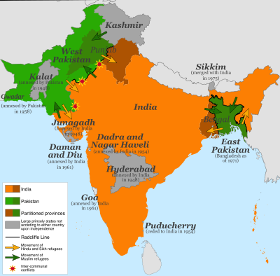

Slide 16
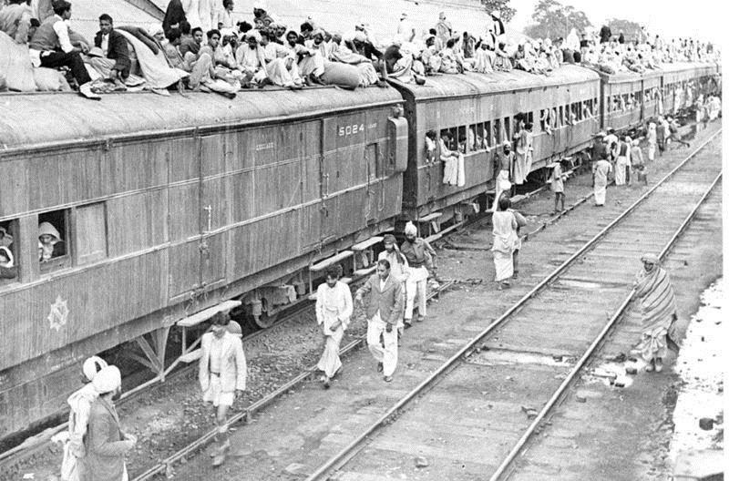
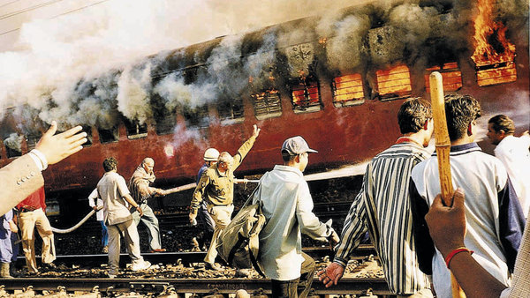
This partition was troubled from the start, however, as Hindus and Muslims were often neighbors.
Following independence Hindus and Muslims turned on one another, the violence resulting in the death of nearly a million Muslims and 10 million more as refugees.
Overcrowded train transporting refugees during the partition of India, 1947.
Violent attacks occurred/often especially on the refugee transportation vehicles.

Slide 17
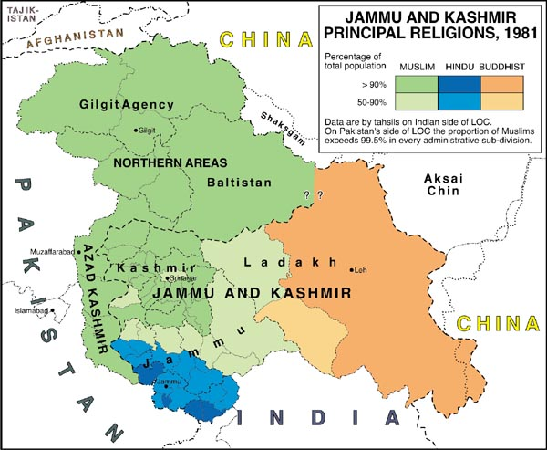
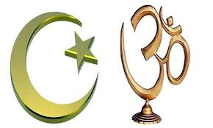
In January 1948, a Hindu extremist assassinated Ghandi for his tolerance of Muslims.
Border clashes continued for decades in the Kashmir province on the border between India and Pakistan.

Slide 18
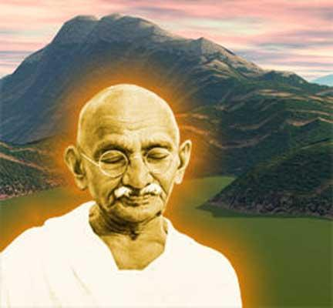
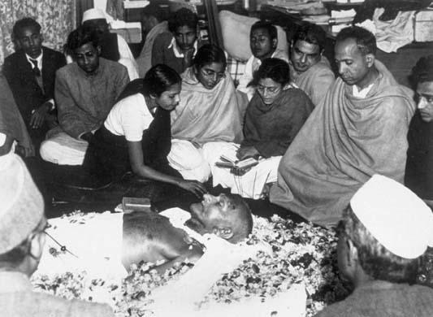
Gandhi’s assassination had the great triumph of independence, secured from the powerful British Empire, shadowed by an equally great tragedy in the violence of partition.

Slide 19
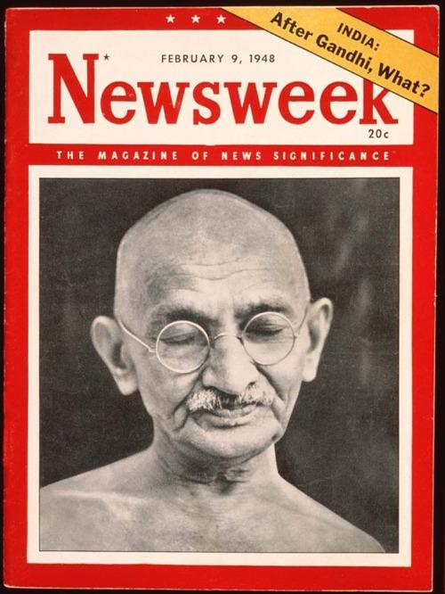
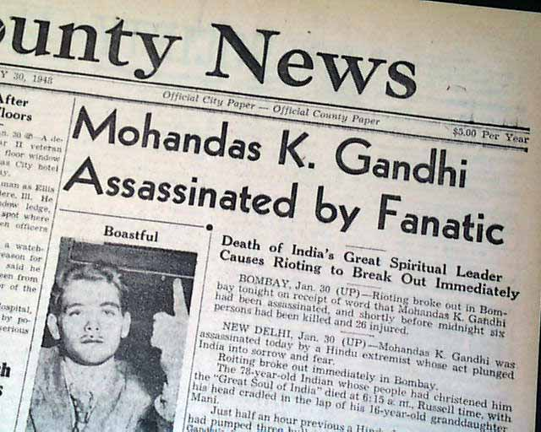
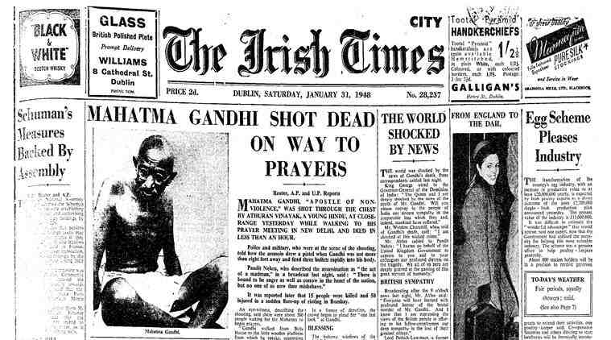

Slide 20
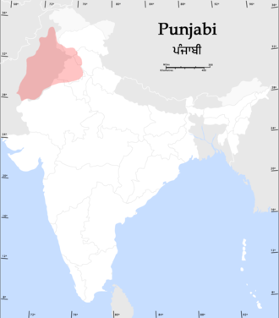
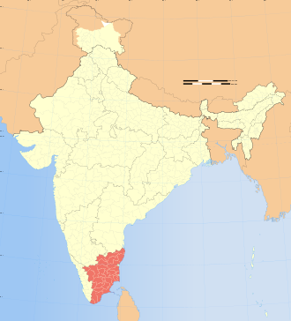
Other nationalist groups also wanted independence from India.
In the 1980s, Sikhs in the Punjab province fought for self-rule, a movement that was put down by Prime Minister Indira Ghandi.
A few years later, the Tamil-speaking Hindu minority in Sri Lanka also pushed for their own nation. The Indian government similarly squashed their efforts
Tamil Nadu location in India

Slide 21
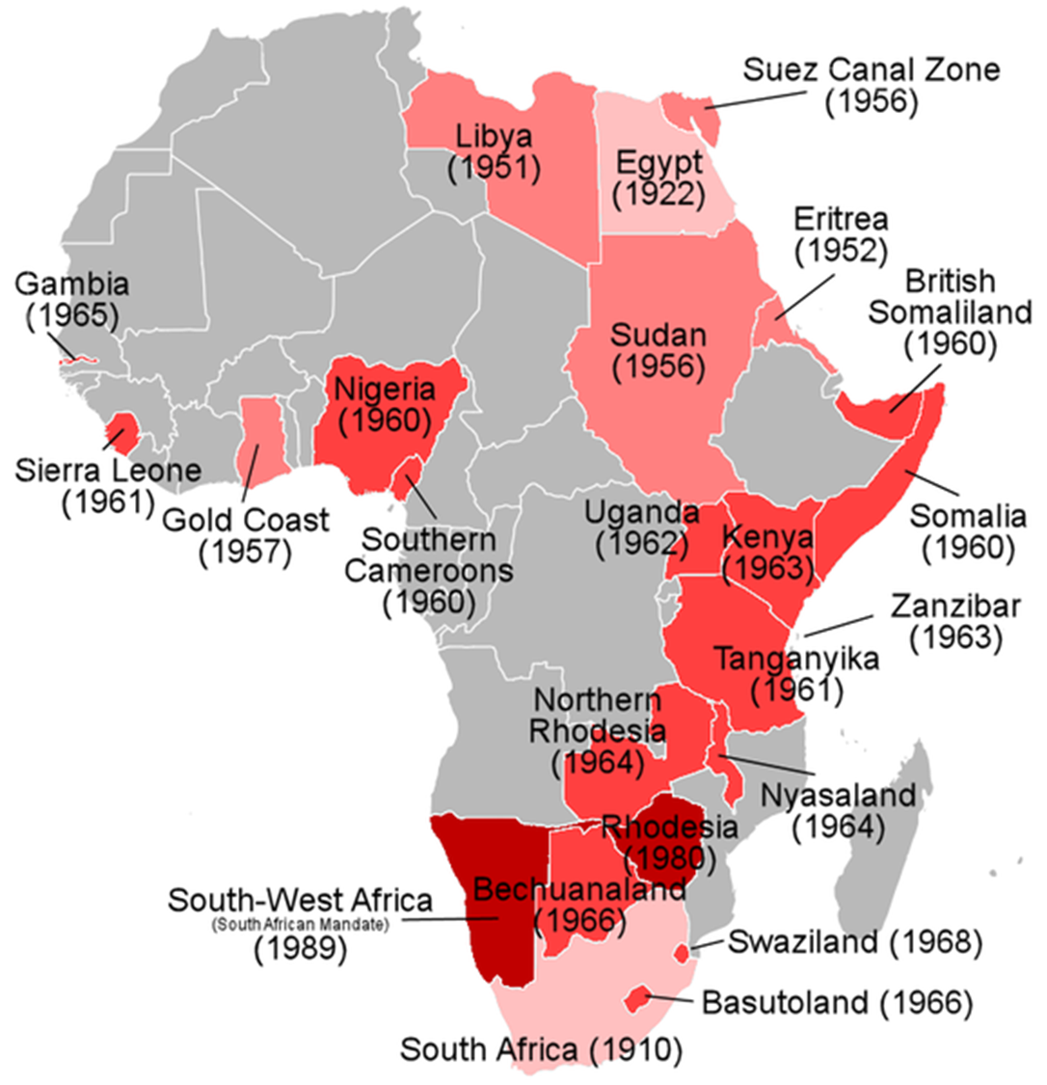
Independence in Africa
World War II created a powerful wave of nationalism in African colonies.
Africans began to push back against colonization, especially after India gained independence.
Each nation had its own struggle, and the European powers all responded differently.

Slide 22
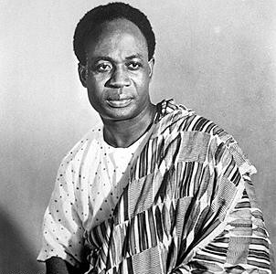
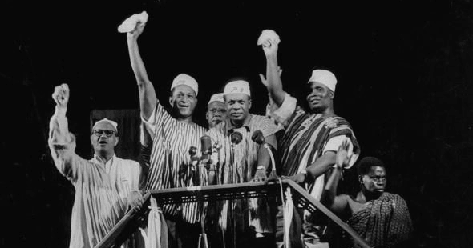
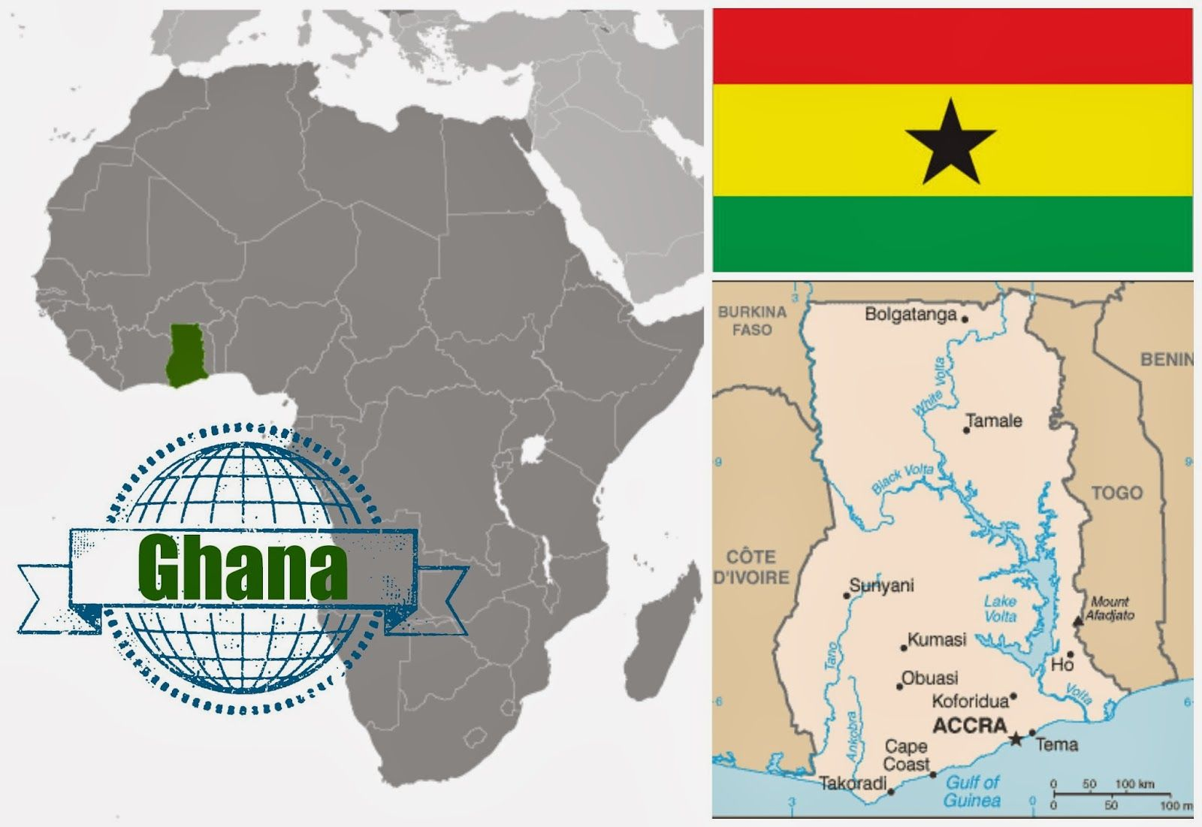
Africans in the Gold Coast
They were a British colony and also were the first to gain their independence.
Led by Kwame Nkrumah, a man inspired by U.S. civil rights efforts, Marcus Garvey, and Mohandas Gandhi, Africans held strikes and boycotts against the colonial power.
They achieved independence in 1957, electing Nkrumah as the first prime minister and changing the country’s name to an ancient African one, Ghana.

Slide 23
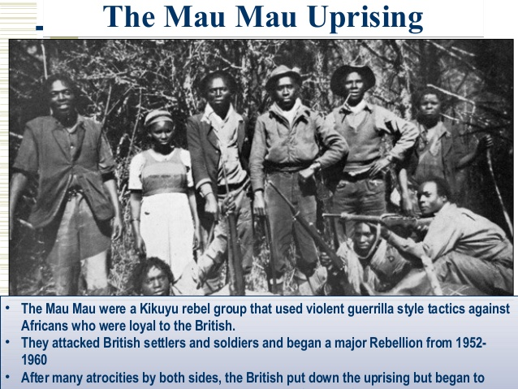
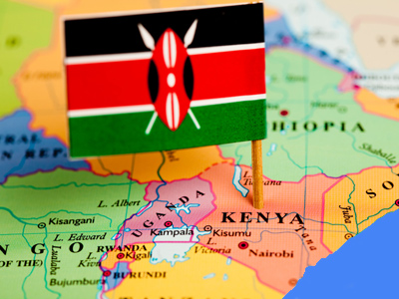

Africans in the East Coast
Ghana’s success provided more inspiration to other colonies. Kenya, though, had many more white settlers, who owned the majority of the colony’s fertile land.
Jomo Kenyatta led a nonviolent fight for the land, but radicals turned to guerilla fighting.
The British labeled these fighters the Mau Mau and put thousands in concentration camps and killed thousands more.
Kenyans finally achieved independence in 1963 and elected Kenyatta as their first president.

Slide 24



Africans in the East Coast
Southern Rhodesia was a self-governing British colony ruled by a small white minority.
This white minority claimed independence in 1965 in response to British pressure to govern by majority rule.
Africans responded with guerilla tactics and successfully opened the government to African majority rule.
Southern Rhodesia became Zimbabwe, and Robert Mugabe, the most radical candidate, won the first free election in 1980 after which he instituted a one-party system limiting political freedom.

Slide 25


French Controlled Africa
France anticipated that its colonies would become incorporated into France, but many Africans wanted their independence.
France struck a deal in 1958 that colonies like Senegal and Ivory Coast would be members of the French Community and France would remain in charge of foreign policy, but the colonies would have self-rule and would continue to receive French aid. In 1960, those colonies received full independence.
In Algeria, the National Liberation Front fought using guerrilla warfare from 1954 to 1962, when it finally won its independence from France.

Slide 26


Belgium and Portugal
Unlike Britain and France, Belgium had no intention of letting go of its colonies and did nothing to transition them toward independence.
As a result, when the Congo was thrust into sudden independence in response to violent protests, civil war ensued.
In 1965, army general Mobutu took control and built a brutal dictatorship that lasted over 30 years.
Mobotu Sese Seko, who wore a signature leopard-skin toque and thick-rimmed glasses, was the President of the Democratic Republic of the Congo.

Slide 27

Belgium and Portugal
African nationalists fought long wars against Portugal who held onto their colonies until 1974 when the military took over in Portugal and pulled out of Africa. Guinea-Bissau, Angola, and Mozambique were hurled into independence without a good foundation for either their governments or their economies.

Slide 28









African Independence
South African Independence, Mandela, and Apartheid

Slide 29




South African Apartheid
South Africa had achieved self-rule in 1910, but a white minority held all political and economic power.
In 1948 the Afrikaner National Party, made up of Dutch descendants, instituted apartheid, a rigid system of racial segregation designed to maintain white power.

Slide 30



African National Congress
The African National Congress (ANC) organized protests, and was banned by the government in 1960.
For the next three decades, South Africa helped white minorities in neighboring countries maintain their power as well.
In 1989, President F. W. de Klerk recognized the need for reform; he ended apartheid and the ANC ban.

Slide 31



African National Congress: South African political party, established in 1912 by elite Africans, advocating for the black African majority before being banned in 1960.
Sought to win full acceptance in colonial society; it only gradually became a popular movement that came to control the government in 1994.
Many of the political parties that had led the movements for independence in Africa were soon swept away by military coups.

Slide 32




Mandela, Nelson: (pron. man-DEL-ah)
South African nationalist (b. 1918)
Leader of the African National Congress Imprisoned for 27 years - treason, sabotage, & conspiracy to overthrow the apartheid government of South Africa
Elected president of South Africa in 1994, 4 years after he was finally released from prison.

Slide 33


Slide 34




Why did white rule last almost 50 years longer in South Africa than it did in India (1994 versus 1947)?
Sizeable & powerful community of permanent white settlers in South Africa, but not in India, controlled the country.
Bottom right pic: Young South African man holds up his identity card, which labels his race & restricts his movements & job opportunities under the Apartheid regime

Slide 35



Slide 36




S. Africa Differed from India: prominence of race
Unlike India, S. Africa had a mature & industrialized economy (gold, diamond mining)
South African situation: the overwhelming prominence of race, expressed most clearly in the policy of apartheid: attempted to separate blacks from whites in every conceivable way while retaining Africans’ labor power in the white-controlled economy.
Enormous apparatus of repression enforced that system.
Rigid “pass laws” monitored and tried to control the movement of Africans into the cities, where they were subjected to extreme forms of social segregation.
Rural areas: impoverished & overcrowded “native reserves,” or Bantustans, served as ethnic homelands that kept Africans divided along tribal lines.
Even though racism was present in colonial India, nothing of this magnitude developed there.

Slide 37





Slide 38






Slide 39




Soweto: (pron. sow-WAY-toe): Impoverished black neighborhood outside Johannesburg, South Africa
A series of demonstrations and protests led by black school children in South Africa that began on the morning of 16 June 1976. It was supposed to be a peaceful protest but was instead the site of a violent uprising in 1976 in which hundreds were killed; that rebellion began a series of violent protests & strikes that helped end apartheid years later.

Slide 40



Cry Freedom
1987 feature film directed by Richard Attenborough
Set in the late 1970s, during the apartheid era of South Africa.
South African journalist Donald Woods:
Forced to flee the country after attempting to investigate the death in custody of his friend the black activist Steve Biko.
Film was shot in neighbouring Zimbabwe
Although not banned in South Africa, cinemas showing the films were faced with bomb threats.
Film was seized by authorities on July 29, 1988. In some cases, there were reports that prints of the films were wrenched off the cinema projectors & the film remained unseen in South Africa until 1991.
Denzel Washington - nominated for an Academy Award for best actor in a supporting role for his portrayal of Steve Biko.

Slide 41



Slide 42
End Apartheid!
The combination of these internal and external pressures persuaded many white South Africans by the late 1980s that discussion with African nationalist leaders was the only alternative to a massive, bloody, and futile struggle to preserve white privileges.
The outcome was the abandonment of key apartheid policies, the release of Nelson Mandela from prison, the legalization of the ANC, and a prolonged process of negotiations that in 1994 resulted in national elections, which brought the ANC to power.

Slide 43

To the surprise of almost everyone, the long nightmare of South African apartheid came to an end without a racial bloodbath.
Archbishop Desmond Tutu: South African activist and Anglican bishop who rose to worldwide fame during the 1980s as an opponent of apartheid. He was the first black South African Archbishop of Cape Town, South Africa and primate of the Church of the Province of Southern Africa (now the Anglican Church of Southern Africa).

Slide 44


Slide 45

Why was Africa’s experience with political democracy so different from that of India?
• The struggle for independence in India had been a far more prolonged affair, thus providing time for an Indian political leadership to sort itself out.
• Britain began to hand over power in India in a gradual way well before complete independence was granted.
• Because of these factors, a far larger number of Indians had useful administrative or technical skills than was the case in Africa.

Slide 46

• Unlike most African countries, the nationalist movement in India was embodied in a single national party, the INC, whose leadership was committed to democratic practice.
• The partition of India at independence eliminated a major source of internal discord.
• Indian statehood could be built on cultural and political traditions that were far more deeply rooted than in most African states.

Slide 47




SSWH21: Changes in the world since the 1960s

Slide 48

Pan-Africanism
Pan-Africanism had its roots in the early 20th century, but reemerged in the 1960s and 1970s. It advocated for Black Nationalism and the unity and cooperation of African peoples in Africa and around the world.

Slide 49


Pan-Africanism
In the United States it manifested as the Black Power movement and inspired African Americans to explore African cultural roots.

Slide 50


Pan-Africanism
In Africa, in an effort to correct damage done by colonialism, the Organization for African Unity was formed in 1963. The African Union, influenced by the European Union, organized in 2002 to promote the political and economic integration of African countries.

Slide 51


Pan-Arabism
Pan-Arabism also had its roots in the early 20th century. This nationalist movement emphasized Arabs’ common history and language, and aimed to create a single Arab state.

Slide 52


Pan-Arabism
After the 1960s, however, the movement was much less about merging Arab states together, and more about creating institutions that would promote trade, foster cultural exchange, build up common economic goals, and provide military cooperation between Arab countries.

Slide 53


Pan-Arabism
It emphasized political cooperation while keeping the existing states intact. In reality, however, the Arab states did little to achieve these goals as trade barriers remained in place and the restricted movement of people continued.
The Persian Gulf War in the early 1990s highlighted the deep divisions that existed between Arab states.

Slide 54


Slide 55


The formation of the state of Israel and the Arab-Israeli Conflict
In 1939, Britain, who controlled Palestine, reversed its 1917 Balfour Declaration, which had promised to secure a Jewish homeland.
This deepened conflict between Jews and Arab Palestinians, both of whom had historical claims to the land.
Following World War II, Holocaust survivors poured into Palestine, and built up American support for their own nation-state.

Slide 56


The formation of the state of Israel and the Arab-Israeli Conflict
Tensions continued to grow, and in 1947 Britain turned the problem over to the United Nations.
In November 1947, the United Nations voted to separate Palestine into two separate states: one Jewish, one Arab.
This plan was accepted by Jews, but rejected by the Arabs.

Slide 57
The formation of the state of Israel and the Arab-Israeli Conflict
In May of the following year, Israel declared independence.
Its Arab neighbors quickly moved against the new nation.
The war ended with Israel winning the war and increasing its territory, while some 700,000 Palestinians were uprooted and left as refugees, their lands being given to Jewish immigrants.
This situation left peace unsettled in the region.

Slide 58


Slide 59


The formation of the state of Israel and the Arab-Israeli Conflict
In 1967, Israel responded to Egyptian military movements, and in six days of conflict won the Sinai Peninsula and Gaza Strip from Egypt, the Golan Heights from Syria, and the West Bank and Eastern Jerusalem from Jordan.
This resulted in much greater territory for Israel and many more Palestinian refugees.
The Palestinian Liberation Organization (PLO), led by Yasir Arafat gained support among Arab Palestinians. The PLO fought for the destruction of Israel through guerilla warfare including, bombings and airplane hijackings. Israel responded with force, and the conflict continued.

Slide 60
The formation of the state of Israel and the Arab-Israeli Conflict
In 1993, the PLO and Israel reached a peace agreement, known as the Oslo Accords.
This historic, yet fragile, deal gave Palestinians the Gaza Strip and the West Bank territories, where they could govern with limited self-rule.
This would be done under an independent Palestinian Authority, which recognized Israel and pledged to end terror attacks.
Both Jews and Arabs rejected the Oslo Accords – Jews because Israel gave up land, and Arabs because they didn’t secure their own state.
The Palestinian terror campaign and violent Israeli reprisals continued.

Slide 61




Slide 62


The formation of the state of Israel and the Arab-Israeli Conflict
In 2003, the United States, Russia, the European Union, and the United Nations presented a “road map for peace” to Israelis and Palestinians, with steps to take toward a settled peace in the region.
Little progress has been made, each side blaming the other for slow movement toward peace.

Slide 63


Slide 64
Ethnic Conflicts
In the mid to late 20th century and early 21st century ethnic conflicts have arisen throughout the world.
  Ethnic: people of the same nationality who share a distinctive culture\
Most conflicts occurred as a result of artificial boundaries (created by European Imperialists in Asia, Africa and the Middle East. The end of Soviet control in Eastern Europe, and genocide.
  Genocide movements of the late 20th and into the 21st Century include Cambodia, Bosnia, Sudan and Rwanda

Slide 65

Bosnia-Herzegovina
Following World War I, Bosnia and Herzegovina were joined with Serbia, Croatia, Montenegro, and Slovenia to form Yugoslavia, a country under Soviet influence.
Once Soviet rule ended in 1990, Yugoslavia, like other countries in Eastern Europe were politically free, but in poor economic condition.
Ethnic tensions came quickly to the surface.

Slide 66

Bosnia-Herzegovina
Yugoslavia, though united by a common language was both ethnically and religiously diverse.
In 1991, Croatia and Slovenia asserted their independence.
Bosnia followed suit in 1992, but Bosnia was less homogenous than Croatia or Slovenia, and was plagued by violence from the start.

Slide 67


Slide 68



Bosnia-Herzegovina
Muslims were the largest group, but not a majority.
Bosnian Serbs, a smaller minority, wanted to remain with Serbian-controlled Yugoslavia.
Bosnian Serbs began a system of ethnic cleansing, using terror and murder, to rid Bosnia of Muslims.

Slide 69


Bosnia-Herzegovina
Foreign powers were slow to intervene.
When the UN made efforts to protect Muslims, Serbs continued to bomb Muslim area and UN safe zones.
NATO intervened in 1995, bombed Serbian targets and brought them to peace talks.

Slide 70


Bosnia-Herzegovina
The talks resulted in the Dayton Accord, which gave Bosnian Serbs control over limited territory while recognizing the authority of the Muslim-controlled state government.

Slide 71


Rwanda
Foreign powers were again slow to intervene in Rwanda in 1994 when Hutus massacred approximately 800,000 Tutsis in a matter of 100 days.
The roots of this genocide date back to German colonial rule which strengthened the Tutsi minority and set up a Tutsi monarchy.

Slide 72


Rwanda
In 1961, a Hutu coup set up a Hutu national government.
Periodic violence flared up throughout the 1960s and 1970s, and again in 1991, which led to negotiations that would allow Tutsis to be part of the government.
Hutu extremists opposed this move.

Slide 73


Rwanda
The organized massacre of Tutsis and moderate Hutus began when a plane carrying the Rwandan president was shot down over the capital.
The extremists encouraged and estimated 200,000 Hutus across the country to participate in the genocide by killing their Tutsi neighbors.

Slide 74


Rwanda
The killing ended as the Tutsis fought back and took over the capital.
UN peacekeeping forces arrived in meaningful numbers in June, after 700,000 were already dead and millions more had fled to neighboring countries, mostly Zaire.

Slide 75



Sudan
The Darfur genocide refers to the systematic killing of Darfuri men, women, and children which occurred during the ongoing conflict in Western Sudan. It has become known as the first genocide of the 21st century.

Slide 76





Cambodia
The Cambodian genocide (Khmer) was carried out by the Khmer Rouge regime under the leadership of Pol Pot, and it resulted in the deaths of between 1.671 and 1.871 million people from 1975 to 1979, or 21 to 24 percent of Cambodia's 1975 population.

Slide 77



Young Turks/Armenian Genocide
Armenian Genocide, campaign of deportation and mass killing conducted against the Armenian subjects of the Ottoman Empire by the Young Turk government during World War I (1914–18). Armenians charge that the campaign was a deliberate attempt to destroy the Armenian people and, thus, an act of genocide. The Turkish government has resisted calls to recognize it as such, contending that, although atrocities took place, there was no official policy of extermination implemented against the Armenian people as a group.

Slide 78


Slide 79


Khrushchev and Gorbachev and the breakup of the Soviet Union
When Nikita Khrushchev came to power in 1958 he embarked on a policy of de-Stalinization. He criticized and made Stalin’s crimes known. He eased censorship, softened restrictions on artists and intellectuals, freed political prisoners, and ended the secret police’s fear tactics. He also enacted economic reforms that gave more control to local communities and tried to refocus the economy to create more consumer goods.

Slide 80


Khrushchev and Gorbachev and the breakup of the Soviet Union
Mikhail Gorbachev took power in 1985 and issued broad reforms in the Soviet Union that then got away from him. His reform efforts were two-pronged. Glasnost referred to “openness.” It ended censorship and allowed people to openly discuss problems in the Union and with the Communists. Perestroika, meaning “restructuring,” aimed to remake the government and the economy to allow for more efficiency and more productivity.

Slide 81


Khrushchev and Gorbachev and the breakup of the Soviet Union
He worked to streamline bureaucracy and allowed for limited private enterprise. These changes resulted in economic turmoil, food shortages, and high prices. The reforms also opened the way for political unrest as dissidents were allowed to have a voice. Eastern European countries, seeing the Soviet’s weakness, declared independence, and nationalism rose throughout the Soviet Union. Gorbachev was unable to hold them all together.

Slide 82
Khrushchev and Gorbachev and the breakup of the Soviet Union
A coup by hardline communists against Gorbachev in 1991 failed, but it severely weakened his ability to govern and maintain the Soviet Union. He resigned later in the year, ending the Soviet Union. As the Soviet Union fell apart, the remaining republics each declared their independence.

Slide 83


Slide 84


Terrorism
Terrorism is an ancient tactic, but its use around the world has increased since the 1960s.
Terrorism refers to violence against civilians for political purposes.
It is meant to get the attention of governments, and terrorists believe that even harsh reprisals are productive by garnering sympathy for their causes.
Terrorist acts include bombings, hijackings, kidnappings, and shootings

Slide 85
Terrorism in Ireland
During the 1960s and 1970s, both sides of the conflict in Northern Ireland, Catholics and Protestants, used terrorist tactics. The British sent in troops who violated the civil rights of IRA (Irish Republican Army) members and Catholic communities. Peace was finally reached in 1998 with the Good Friday Agreement.
Terrorism in Latin America
Since the 1960s, urban terrorists in Latin America have targeted banks, stores, police departments, public buildings and military posts in fights against repressive governments and U.S. economic domination. Terrorist organizations plagued civilians and governments throughout Latin America, notably in Peru, Columbia, Brazil, and Mexico. Some were Marxist organizations; others were motivated by nationalism.

Slide 86


Al-Qaeda
In the 1990s, the terrorist organization al-Qaeda, led by Osama bin Laden, targeted the foreign influence in Arab countries, specifically by the United States.

Slide 87



Al-Qaeda
In 1998 al-Qaeda built its terror brand with the bombings of United States embassies in Kenya and Tanzania, and again with the bombing of the USS Cole in 2000.

Slide 88
Al-Qaida
Then, on September 11th of 2001, Al-Qaida orchestrated the hijacking of four airplanes in the United States and flew two of them into the World Trade Center Towers in New York City, and one into the Pentagon outside Washington, D.C. The fourth plane was retaken by the passengers who crashed it into a field in Pennsylvania.

Slide 89




Slide 90


Al-Qaida
American reprisals were swift and harsh. Within a month, U.S. forces were deployed to Afghanistan where it was believed that the Taliban was harboring bin Laden. The government also responded with increased watchfulness and a global “war on terrorism.”

Slide 91
Response to Terrorism
U.S. has made national security top priority
Reorganized intelligence services & new counter terrorism laws
Rigorous security in air ports & public buildings
Measures to cut off terrorists’ $ money supply & limiting their activities
Some people believed the Federal government is using the threat of terrorism to increase its power & violate the constitutional rights & freedoms of its citizens

Slide 92



Golda Meir
Golda Meir became the first female prime minister of Israel in 1969. She had been a leader of the Zionist movement in the 1920s when she migrated to Israel, and she supported the unrestricted immigration of Jews to Israel. She soon became a leader of the Jewish Agency and signed Israel’s Declaration of Independence in 1948.

Slide 93



Golda Meir
She became a member of the Knesset, Israel’s parliament, and served as foreign minister in 1956.
As prime minister, Meir instituted major programs in housing and road construction.
She also tried to form enduring peace agreements with Arab countries, but these efforts came to an unsuccessful end with the Yom Kippur War in 1973.

Slide 94


Margaret Thatcher
Margaret Thatcher led the Conservative Party in Britain from 1979-1990 as the first female prime minister in Europe.
She fiercely opposed communism and embraced a free-market economy.
This led her to dramatically cut social welfare programs, ease government controls on business, reduce labor unions’ power, and privatize state-run industries.

Slide 95

Margaret Thatcher
She maintained close ties with the United States throughout her tenure.
Her political decline came when she replaced the property tax with the poll tax.
The poll tax was the same percentage of income, regardless of income level.
It proved very unpopular, and seeing that she would not win another election, Thatcher resigned in 1990.
Golda Meir and Margaret Thatcher, April 1976, Tel Aviv

Slide 96

Indira Gandhi
Indira Gandhi grew up in the Indian independence movement and was jailed by the British for her efforts.
In 1964, she became the nation’s second prime minister, after her father, and initially proved popular and energetic.
She was voted out of office in 1977, but voted back in 1980.
Is Indira Gandhi related to Mahatma Gandhi?
The Gandhi surname came from Feroze Jehangir Ghandy, who was not related to Mahatma Gandhi. Indira Priyadarshini Nehru(the daughter of Jawaharlal Nehru) married Feroze Gandhi in 1942 and adopted his surname.

Slide 97


Indira Gandhi
Soon after, Sikhs in the Punjab region began to protest for an independent state.
Thousands occupied the Golden Temple in Amritsar, the holiest site for Sikh worship.
Gandhi sent troops to attack the demonstrators and killed more than a thousand Sikhs.
In response, two of Gandhi’s Sikh bodyguards assassinated her within a few months.

Slide 98
SSWH22: Globalization and the Contemporary World

Slide 99
Multinational corporations
Multinational corporations have been agents of technological change and global transfers of wealth.
Companies in industrialized nations had the economic power to invest directly in mines and plantations in poorer countries.
This was made even easier by international trade agreements and open markets.
Trade agreements also made it possible for companies to relocate to escape restrictions and regulations imposed by any one nation, especially those in the industrialized world.
Developing nations, desperate for foreign investment offered fewer regulations, usually resulting in lower wages and fewer environmental protections in these countries

Slide 100


Slide 101
United Nations
Countries around the world joined together in 1945 to create the United Nations.
It was designed to maintain peace and security for member nations, and promote international cooperation culturally, politically, and economically.
It is made up of a General Assembly in which each member nation has one vote and a Security Council with ten rotating member states and five permanent state members. These permanent members have veto power.

Slide 102





United Nations
The UN administers several organizations that promote peaceful cooperation globally, for example…
  the World Health Organization to fight disease
  the Food and Agricultural Organization to guard against food scarcity.
  UNICEF works to protect children around the world.
  UNESCO coordinates international cooperation as it relates to education, science, and culture.

Slide 103


Slide 104


World Trade Organization
The WTO was established following WWII
  Promotes free trade between nations
  Wants to reduce trade barriers such as tariffs, quotas, and subsidies

Slide 105
Human Effects on Environment
Industrialization around the world plundered natural resources and polluted the environment and nations struggled to come together on solutions.
Strip mines ruined land, pesticides destroyed soil, water, and insects, oil spills killed marine life, air pollution led to acid rain, and the emission of greenhouse gases contributed to global climate change.

Slide 106






Slide 107


Human Effects on Environment
In 1984, a leak at a pesticide plant in India killed over 3,500 people.
The meltdown of the Chernobyl nuclear power plant in Russia exposed thousands to lethal levels of radiation.
As developing nations worked to gain economic footing through industrialization, solutions to overpopulation and environmental damage are challenging.

Slide 108
Human Effects on Environment
These nations opposed environmental treaties that would regulate pollution in a way that inhibits their industrial growth.
They point to the deforestation and pollution caused by industrialized countries in decades and centuries past.
The Kyoto Protocol adopted by over 100 nations at a meeting in 1997, as part of the United Nations Framework Convention on Climate Change, bound participating nations to meet certain emission reduction targets. It was ultimately unsuccessful as many major countries did not join (US included)

Slide 109


Slide 110

Population density (people per km2) by country, 2014

Slide 111


Slide 112


Slide 113


Slide 114
THE END!!
NO MORE NOTES IN MRS. MCDANIEL’S CLASS!

