Slide 1
Subtracting Across Zero
Lesson 3-9
CCSS 3.NBT.2

Slide 2
Warm up
Subtract.
1,341 – 984
3,279 – 526
5,277 – 4,328
Notes:
Literature Link:

Slide 3
Think and write
What is regrouping? When do you need to regroup while subtracting?

Slide 4
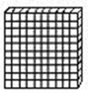
Subtracting across zero
302 – 164
First, show 302 with place value blocks.
Regroup a hundred into 10 tens, and regroup a ten into 10 ones. Now subtract. What is your answer?

Slide 5
Problem 1
There are 403 students at West Intermediate School. 186 of those students are third graders. How many students are not third graders?

Slide 6
Problem 2
Howell Middle School has 300 fifth graders and 226 sixth graders. How many more students are there in fifth grade?

Slide 7
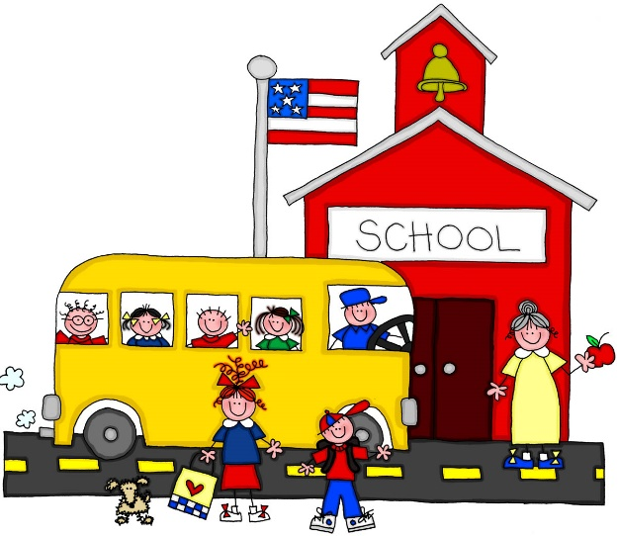
Problem 3
There are 300 students at Middleton Elementary. Young Elementary has 135 students. How many more students are there at Middleton Elementary?

