Slide 1
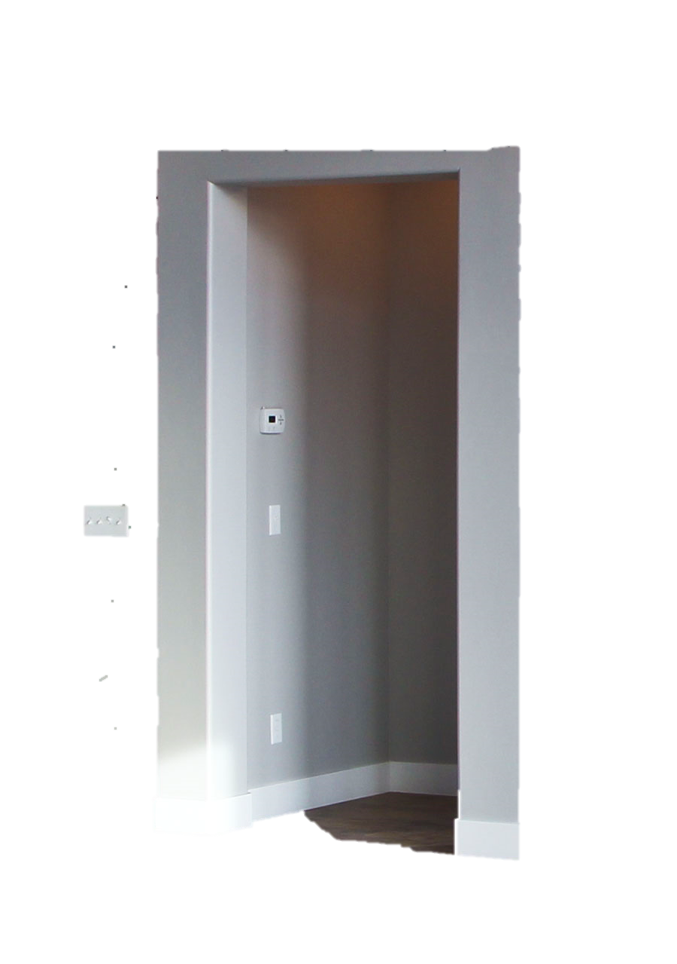
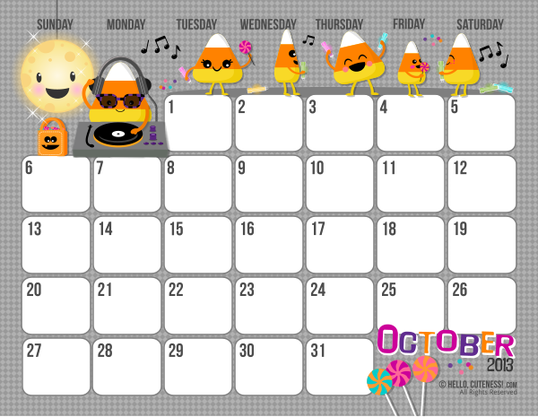
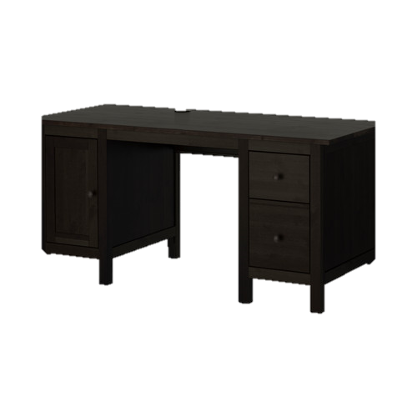
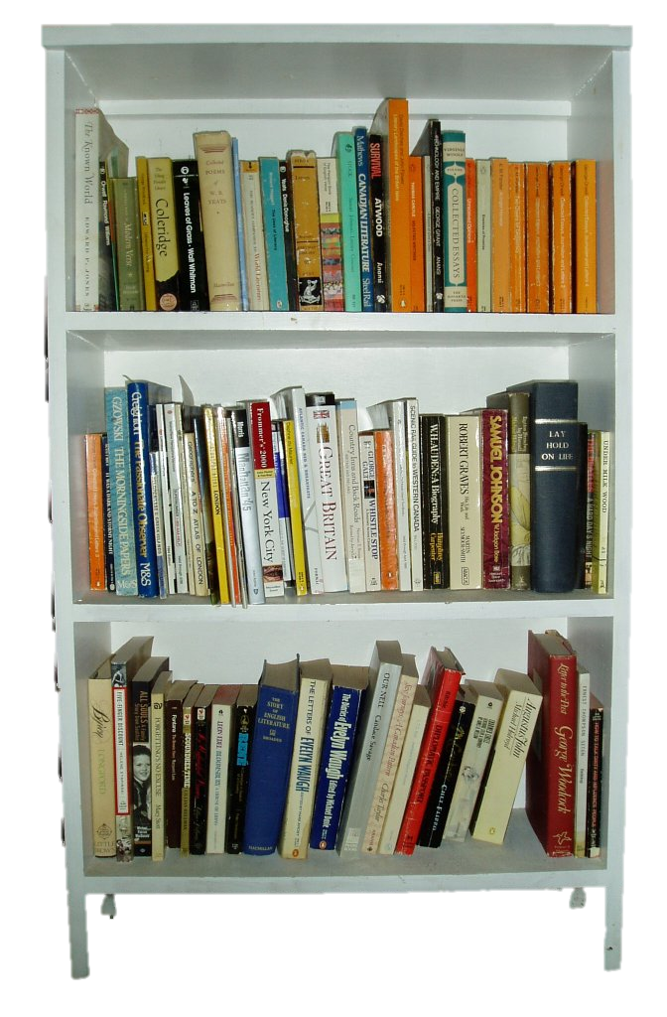
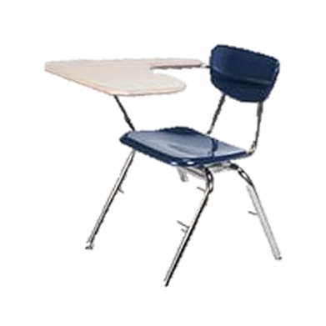
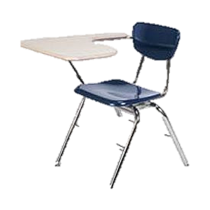
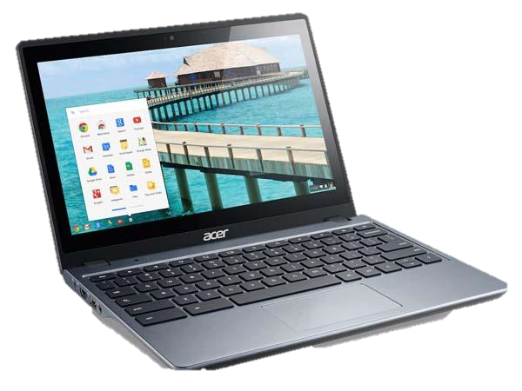
ELL Teacher
Click on items and people in the room to learn more about our school.

Slide 2
Student handbook
The student handbook includes guidelines and rules for Prattville Junior High School. Each student will receive a copy of this the first day of school or upon registration.
Click the rule book to view

Slide 3
School Schedule
Call-In 7:50-7:56
Homeroom 7:56-7:59
Change 7:59-9:01
1 ST Period (62 min) 9:01-9:05
Change 9:05-10:07
2 nd Period (62 min) 10:07-10:17
Break 10:21-11:23
3 rd Period (62 min) 11:23--11:27
Change 11:27-12:29
7 th Grade 4 th Period (62 min) 12:29-12:33
7 th Change Change 12:33-2:05
7 th Grade 5 th & Lunch (62) (30 Lunch) 11:27-12:59 8 th Grade 4 th & Lunch (62) (30 Lunch) 12:59-1:03
8 th Change Change 1:03-2:05 8 th Grade
5 th Period (62 min) 2:05-2:09 Change 2:09-3:11
6 th Period (62 min)
Click the clock to view the full schedule and activity schedules.

Slide 4
Meet the Principal
Click on the well-dressed lady to view information about Prattville Junior High School’s principal.

Slide 5
Teacher Websites
Click on the lady to view each teacher’s photo, contact information, and classroom website.
The teacher websites include weekly lesson plans and other important documents for that class.

Slide 6
English second language teacher eSL
ELL TEACHER
Click on the word, TEACHER to view the English Language Learner teacher’s website. You may also obtain contact information.

Slide 7
Technology: Alabama virtual library
Click the computer to view the Alabama Virtual Library (AVL) site.
Prattville Junior High School has two computer labs and 30 Chromebooks for each department.
Teachers use AVL for research.

Slide 8
Breakfast and Lunch Menus and pricing
Click the apple to view breakfast and lunch prices and menus.

Slide 9
Student Grades iNOW
Click the report card to view iNow and log in.
iNow is the grading system used to input student grades. Parents and students need a log-in.
You may obtain the log-in by completing a form that can be obtained from the homeroom teacher.

Slide 10
Student involvement
Click the student to learn about the different clubs and organizations at Prattville Junior High School.

Slide 11
Sports
Click the sports equipment to learn about the different sports offered at Prattville Junior High School

Slide 12
School calendar
Click the calendar to view the school’s calendar for holidays, progress reports, and testing dates.

Slide 13
Library
Click the bookshelf to view information about Prattville Junior High School’s library program.

Slide 14
Safe School
Click the fire extinguisher to learn about Prattville Junior High School’s safety initiatives.

Slide 15
Nurse
Click the nurse to find out information and procedures for medications and visiting the nurse at school

Slide 16
Guidance Counselor
Click the picture to find out about and meet the school counselors.

Slide 17
Student and family resources
Click the lighthouse to learn about organizations that help families in need.

Slide 18
Homework help
Click the students to learn about free homework help for any subject.

Slide 19
Notify Me
Click the cell phone to learn how to stay informed with all of the news from Prattville Junior High School.
Notify Me is a system that sends voice messages and email messages to those who are registered.
Register today! Stay informed.

Slide 20
City of Prattville
Click the picture to learn more about the City of Prattville. Learn about special events and city sports programs.

Slide 21
The YMCA
Click the Y to learn more about the YMCA programs in Prattville.
The YMCA offers an array of services such as childcare, sports, exercise programs, pool access, swim lessons, dance lessons, and more!

Slide 22
Google Translate
Click the picture to view Google Translate.
This site will translate documents and information into the language of your choice.

Slide 23
Google Classroom
Click on the picture to access Google Classroom.
Most teachers at Prattville Junior High School use Google Classroom inside and outside of class. Google Classroom is an online classroom portal for students and teachers.
Parents may email the teacher to gain parent access to Google Classroom.

Slide 25
Supply Lists
Current School Supply Lists for 7th and 8th Grade

