Slide 1
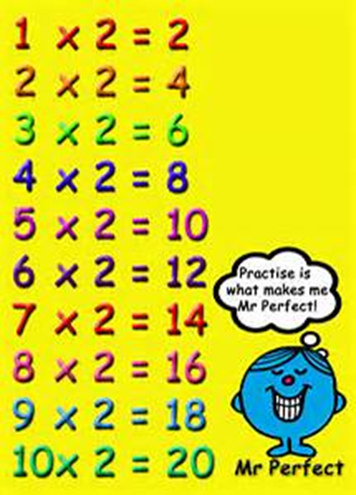
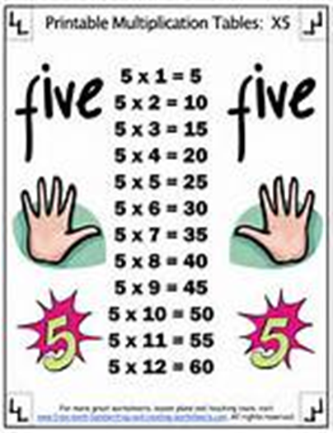
2 and 5 as Factors
Lesson 5-1
CCSS 3.OA.3, 3.OA.9, 3.NBT.3

Slide 2
Vocabulary

Slide 3
Objective
I can use patterns to multiply with 2 and 5 as factors.

Slide 4
Connect
What are some things that come in pairs, or sets of 2?

Slide 5
Pose the Problem
How can you find how many legs there are altogether in a group of 9 chickens? Be ready to share your thoughts with the class.

Slide 6
Link to Prior Knowledge
How do you skip count by twos?
2, ___, ___, ___, ___, ___,
How do you skip count by fives?
5, ___, ___, ___, ___, ___,

Slide 7
Small Steps Teaching Tool 36
You can use skip counting patterns to find the multiplication facts for two. Look at the first row of the first column in Teaching Tool 36. What is 0 times 2?
Record the factor and the product in the spaces.
Now, think about the Commutative Property. What does it tell you?
So, how can you use the Commutative Property to find what to write in the first row of the second column?

Slide 8
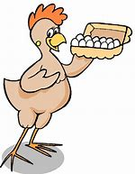
Small-Group Interaction
Work with your partner to complete the rest of the table for the twos facts. Where on this table does it show how you can find how many legs are on 9 chickens?

Slide 9
Academic Vocabulary
Every answer, or product, in your table for the twos facts is 2 times another number. These numbers are called multiples of 2. Which numbers do the multiples of 2 always end with?
(0, 2, 4, 6, 8,)

Slide 10
Find Each Product
2 x 3 =
2 x 5 =
2 x 7 =
5 x 3 =
5 x 5 =
5 x 7 =

Slide 11
Vocabulary Review
Multiples: The products of a number and other whole numbers.
Multiples of 2 are 2, 4, 6, 8, 10, 12 and so on. You can find multiples of 2 by multiplying 2 by any whole number. What do you notice about multiples of 2?
Now, try listing multiples of 5 up to 50.

