Slide 1
Endocrine & Cell Communication Part II:
The Endocrine System
Notes:
You may wish to print copies of Slide 7 & Slide 20 prior to class. Students are asked to label that diagram as we proceed throughout this lesson.

Slide 2
AP Biology Curriculum Frameworks
EK 3.D.1 Cell communication processes share common features:
d. In multicellular organisms, signal transduction pathways coordinate the activities within individual cells.
EK 3D.2 Cells communicate with each other through direct contact with other cells or from a distance via chemical signaling.
c. Signals released by one cell type can travel long distances to target cells of another cell type.
1. Endocrine signals are produced by endocrine cells that release signaling molecules, which are specific and can travel long distances through the blood to reach all parts of the body.

Slide 3
To trust or not to trust? Ask Oxytocin
Some people trust others easily while others require additional time to decide if a person is trustworthy.
A recent article in Scientific American indicates that the hormone oxytocin known for its role in social attachment and interaction may also play an important role in our ability to trust.
Notes:
Oxytocin’s role in social attachment, social interaction and trust is one example of the importance of hormones in humans. A recent study of patients with Williams syndrome indicate a direct connection between oxytocin and trust. Williams syndrome (WS or WMS; also Williams–Beuren syndrome or WBS) is a rare neurodevelopmental disorder characterized by a distinctive, "elfin" facial appearance, along with a low nasal bridge, an unusually cheerful demeanor and ease with strangers; developmental delay coupled with strong language skills; and cardiovascular problems, such as supravalvular aortic stenosis and transient hypercalcaemia.
It is caused by a deletion of about 26 genes from the long arm of chromosome 7. The syndrome was first identified in 1961 by New Zealander Dr. J. C. P. Williams and has an estimated prevalence of 1 in 7,500 to 1 in 20,000 births.

Slide 4
Endocrine System
The human endocrine system is composed of a collection of glands that secrete a variety of hormones.
These chemicals use long distance communication to control the daily functioning of the cells of the body.
Notes:
The endocrine system is in contrast to the exocrine system, which secretes its chemicals using ducts. The word endocrine derives from the Greek words "endo" meaning inside, within, and "crinis" for secrete. The endocrine system is an information signal system like the nervous system, yet its effects and mechanism are classifiably different. By contrast, the endocrine system's effects are slow to initiate, and prolonged in their response, lasting from a few hours up to weeks.

Slide 5
Endocrine System
The endocrine system produces more than 30 different chemicals used by your body to maintain homeostasis and promote normal body function.
This system contains 9 primary glands as well as endocrine cells found within major organs.
The endocrine system is a ductless system that employs the circulatory system when delivering chemical signals over long distances.
Notes:
The nervous system sends information very quickly, and responses are generally short lived. Hormones are substances (chemical mediators) released from endocrine tissue into the bloodstream where they travel to target tissue and generate a response. Hormones regulate various human functions, including metabolism, growth and development, tissue function, sleep, and mood. The field of study dealing with the endocrine system and its disorders is endocrinology, a branch of internal medicine.
Features of endocrine glands are, in general, their ductless nature, their vascularity, and usually the presence of intracellular vacuoles or granules storing their hormones. In contrast, exocrine glands, such as salivary glands, sweat glands, and glands within the gastrointestinal tract, tend to be much less vascular and have ducts or a hollow lumen (interior).

Slide 6
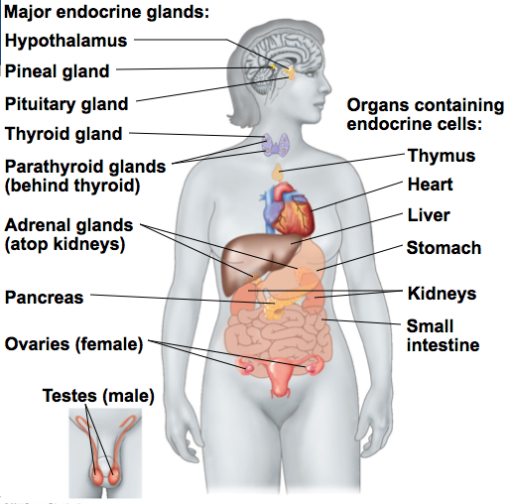
Notes:
While it is not necessary to memorize every cell type or gland found within the system, it will be helpful to recognize the endocrine glands and the function of the hormones produced by select glands to use as examples of how both short and long distance chemical communication occurs.
In addition to the specialized endocrine organs mentioned above, many other organs that are part of other body systems, such as the kidney, liver, heart and gonads, have secondary endocrine functions. For example the kidney secretes endocrine hormones such as erythropoietin and renin.

Slide 7
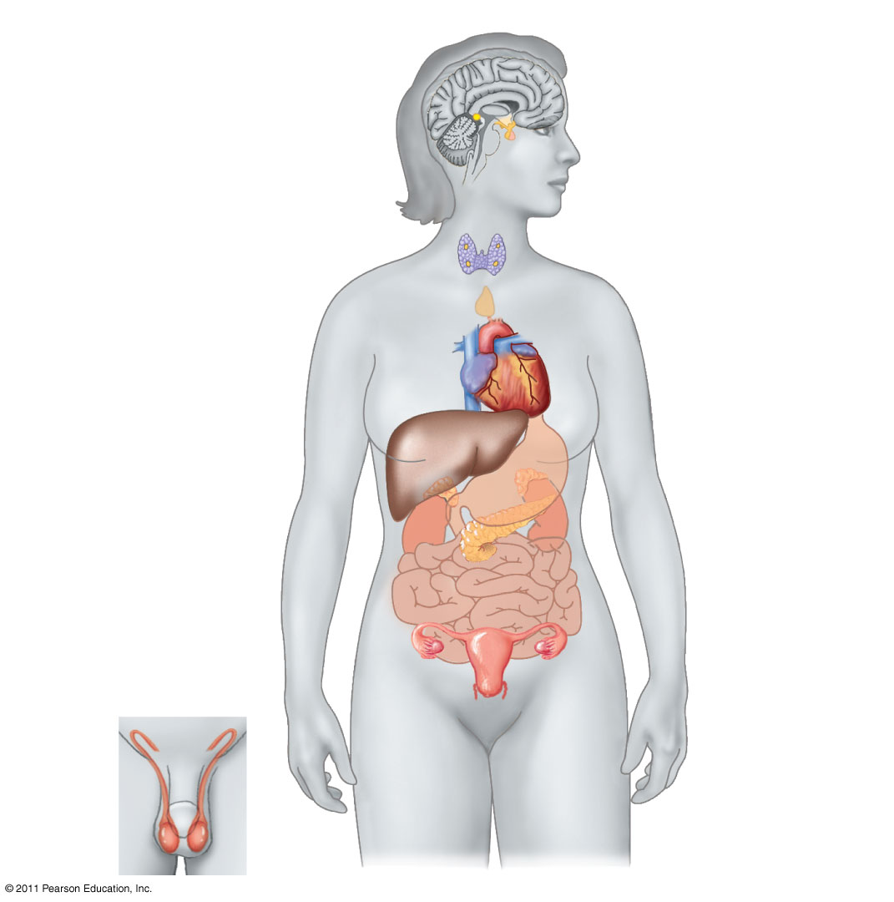
Notes:
Take a moment to label as many endocrine glands as you can remember.
Now beside each of your labels let’s put at least one prominent hormone produced by that gland.
Hypothalamus-thyotropin releasing hormone
Pineal-melatonin
Pituitary- Growth Hormone
Thyroid- calcitonin
Parathyroid - PTH
Adrenal – adrenalin (epinephrine)
Pancreas -insulin
Ovary - estrogen
Testes- testosterone

Slide 8
Notes:
Give the students time to compare their results and make any necessary adjustments. You may need to review the major hormone produced by each gland.
Hypothalamus-thyotropin releasing hormone
Pineal-melatonin
Pituitary- Growth Hormone
Thyroid- calcitonin
Parathyroid - PTH
Adrenal – adrenalin (epinephrine)
Pancreas -insulin
Ovary - estrogen
Testes- testosterone

Slide 9
The Endocrine System works with the Nervous System
Two systems coordinate communication throughout the body: the endocrine system and the nervous system.
The endocrine system secretes hormones that coordinate slower but longer-acting responses including reproduction, development, energy, metabolism, growth, and behavior.
The nervous system conveys high-speed electrical signals along specialized cells called neurons; these signals regulate other cells.
Notes:
The endocrine system is made of a series of glands that produce chemicals called hormones. A number of glands that signal each other in sequence are usually referred to as an axis, for example, the hypothalamic-pituitary-adrenal axis.

Slide 10
Coordination of Endocrine and Nervous Systems in Vertebrates
The hypothalamus receives information from the nervous system and initiates responses through the endocrine system.
Attached to the hypothalamus is the pituitary gland, composed of the anterior pituitary and the posterior pituitary.
The anterior pituitary makes and releases hormones under regulation of the hypothalamus.
The posterior pituitary stores and secretes hormones that are made in the hypothalamus.
© 2011 Pearson Education, Inc.
Notes:
Ask students if they know the locations of the hypothalamus, anterior pituitary gland and posterior pituitary gland. They illustrated on the next slide.

Slide 11
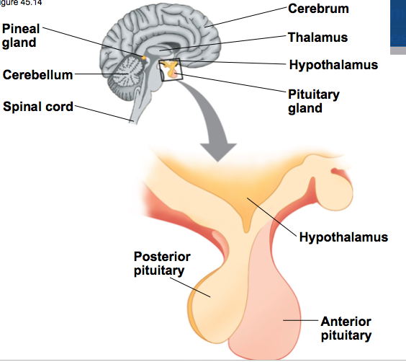
Anterior and Posterior Pituitary
© 2011 Pearson Education, Inc.

Slide 12
Posterior Pituitary Hormones
The two hormones released from the posterior pituitary act directly on nonendocrine tissues.
Oxytocin regulates milk secretion by the mammary glands and stimulates contraction of the uterus.
Antidiuretic hormone (ADH) promotes retention of water by the kidneys.
Notes:
Discuss with students the implications of alcohol and diabetes on ADH. Alcohol consumption reduces ADH production resulting in an increase in production of urine. In diabetes insipidus, the pituitary gland produces insufficient ADH which again increases the production of urine.

Slide 13
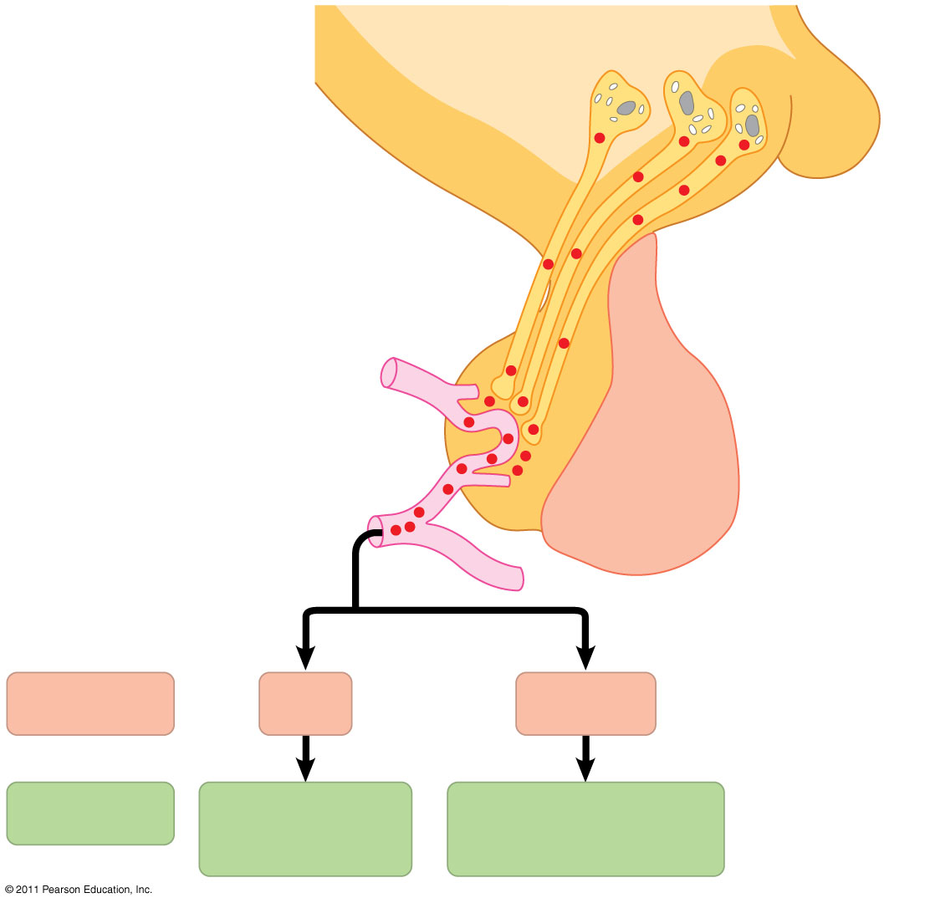
Production and Release of Posterior Pituitary Hormones
Neurosecretory cells of the hypothalamus
Hypothalamus
Neurohormone
Axons
Posterior pituitary
Anterior pituitary
HORMONE
ADH
Oxytocin
TARGET
Kidney tubules
Mammary glands, uterine muscles
Notes:
Production and release of posterior pituitary hormones.

Slide 14
Anterior Pituitary Hormones
Hormone production in the anterior pituitary is controlled by releasing and inhibiting hormones from the hypothalamus.
For example, prolactin-releasing hormone from the hypothalamus stimulates the anterior pituitary to secrete prolactin (PRL), which has a role in milk production and secretion.
Another example is Thyroid Stimulating Hormone (TSH), which stimulates the thyroid gland to produce thyroxine which stimulates and maintains metabolic processes.
Notes:
Ask students if they know what “lactose intolerant” means. Don’t miss the opportunity to make the connection between lactose (milk sugar) and prolactin.

Slide 15
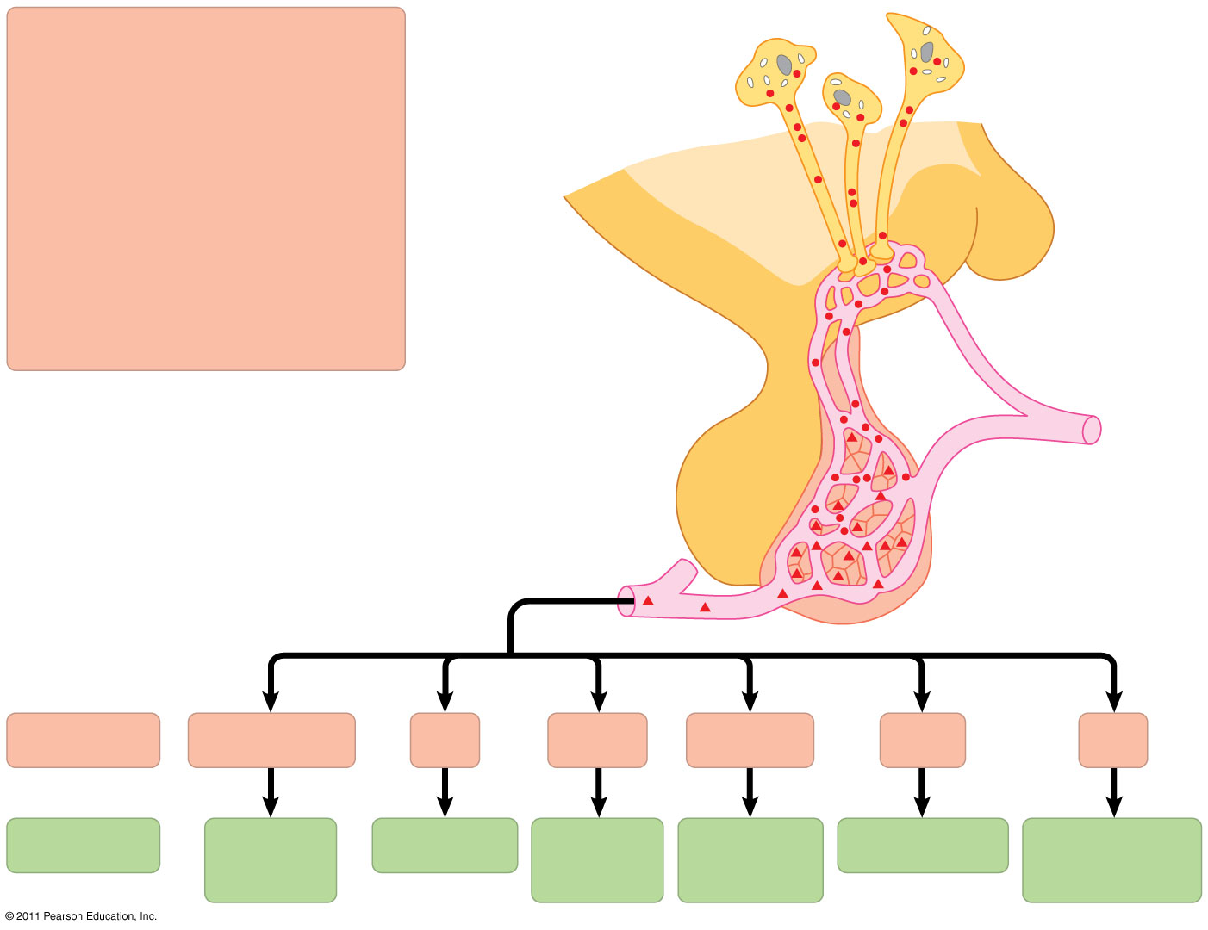
Figure 45.16
Tropic effects only: FSH LH TSH ACTH
Neurosecretory cells of the hypothalamus
Nontropic effects only: Prolactin MSH
Nontropic and tropic effects: GH
Hypothalamic releasing and inhibiting hormones
Portal vessels
Endocrine cells of the anterior pituitary
Posterior pituitary
Pituitary hormones
HORMONE
FSH and LH
TSH
ACTH
Prolactin
MSH
GH
TARGET
Testes or ovaries
Thyroid
Adrenal cortex
Mammary glands
Melanocytes
Liver, bones, other tissues
Notes:
Production and release of anterior pituitary hormones. “Tropic” hormones are those that target other endocrine glands; so “tropic effects” above refers to hormones produced by the anterior pituitary that in turn stimulate/control other endocrine glands.

Slide 16
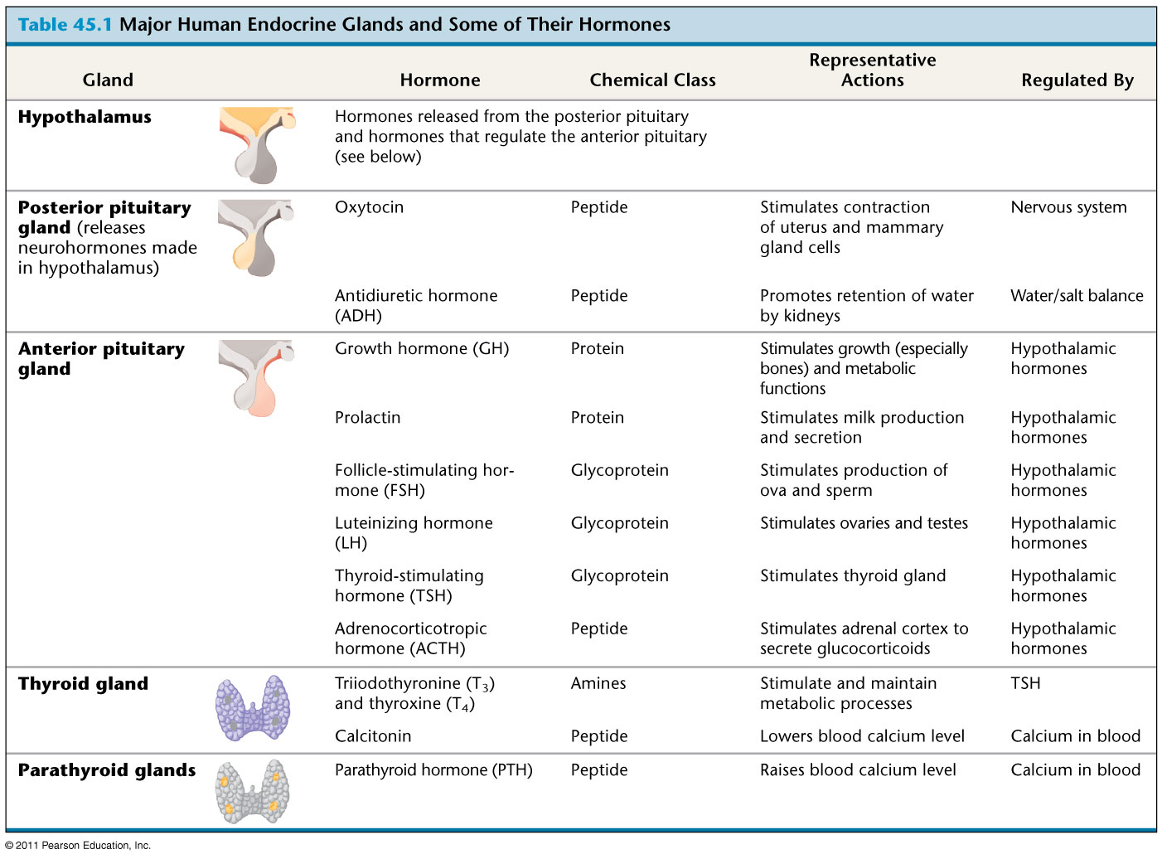
Table 45.1a
Notes:
Major Human Endocrine Glands and Some of Their Hormones. Have students “pick a favorite” from either this slide or the next so they can use it as an example in their free-response writing.

Slide 17
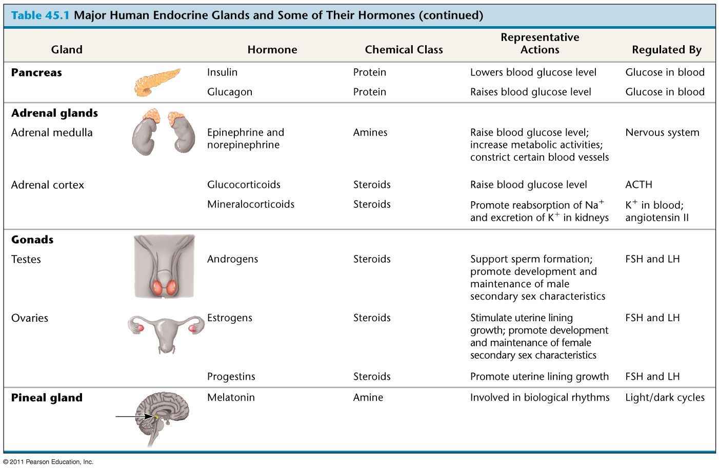
Table 45.1b
Notes:
Major Human Endocrine Glands and Some of Their Hormones

Slide 18
Thyroid Regulation: A Hormone Cascade Pathway
A hormone can stimulate the release of a series of other hormones, the last of which activates a nonendocrine target cell; this is called a hormone cascade pathway.
The release of thyroid hormone results from a hormone cascade pathway involving the hypothalamus, anterior pituitary, and thyroid gland.
Hormone cascade pathways typically involve negative feedback.

Slide 19
An Example of Negative Feedback
Notes:
Scroll over the bottom of the image to activate the animation controls and press PLAY.

Slide 20
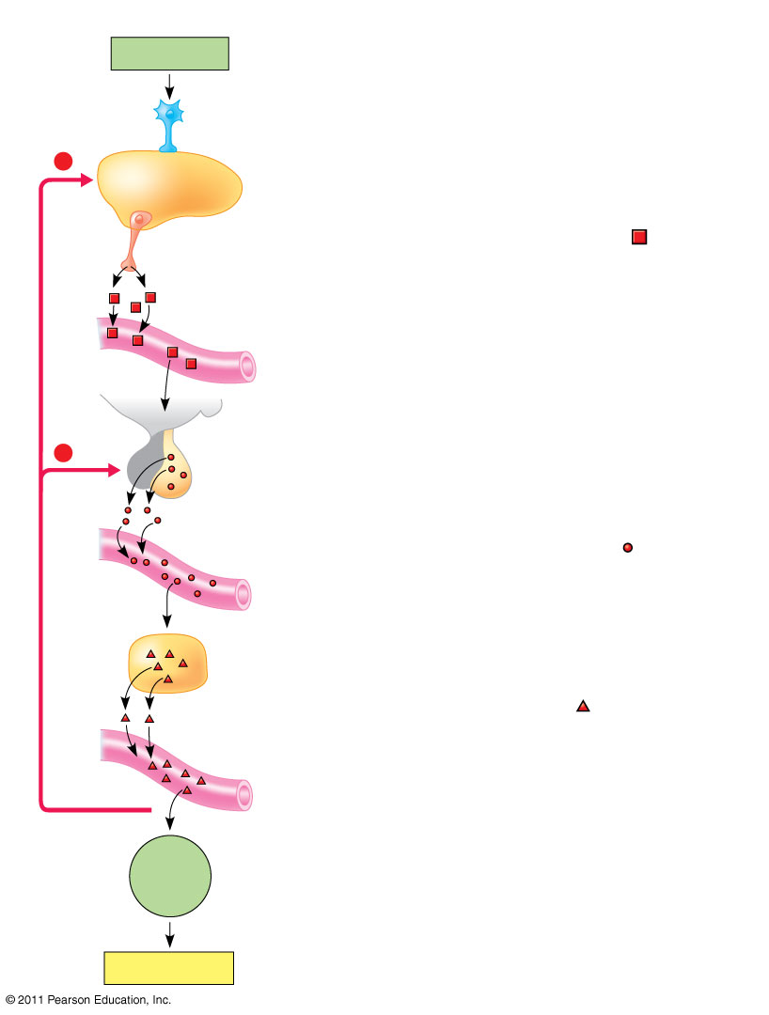
Figure 45.17
Example
Pathway
Stimulus
Cold
Hypothalamus
−
−
Negative feedback
Target cells
Increased cellular metabolism
Response
Notes:
Work with a partner to explain how our body responds to a stimulus indicating that the body is cold. Label and describe the pathway and explain how it is regulated via negative feedback.

Slide 21
Figure 45.17
Example
Pathway
Stimulus
Cold
Sensory neuron
Hypothalamus
−
Hypothalamus secretes thyrotropin-releasing hormone (TRH).
Neurosecretory cell
Releasing hormone
Blood vessel
−
Anterior pituitary secretes thyroid-stimulating hormone (TSH, also known as thyrotropin).
Anterior pituitary
Tropic hormone
Negative feedback
Thyroid gland secretes thyroid hormone (T₃ and T₄).
Endocrine cell
Hormone
Target cells
Body tissues
Increased cellular metabolism
Response
Notes:
How accurate were you?

Slide 22
Created by:
Debra Richards
Coordinator of Secondary Science Programs
Bryan ISD
Bryan, TX

