Slide 1
Circulatory System Blood Composition
DHO 7.8, pg 187
HS1

Slide 2
Blood
Tissue that flows through the CV system
Adults have 4-6 quarts of blood
Transports:
O2 (from lungs)
CO2 (to the lungs)
Nutrients (from digestive system)
Metabolic & waste products
(from cells to organs of excretion)
Heat (from body parts)
Hormones (from endocrine glands)
Notes:
(from lung to body cells)
(from body cells to lungs)

Slide 3
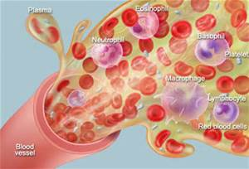
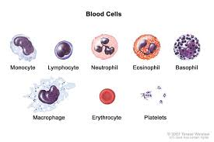
Blood https://www.youtube.com/watch?v=R-sKZWqsUpw The Components of Blood and Their Importance (52sec)
Made of 2 items:
1) Liquid portion called plasma
2) Solid portion called blood cells

Slide 4
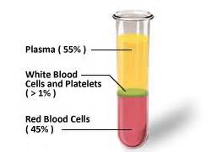
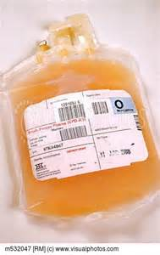
Plasma
Fluid portion of blood
90% water
Contains many dissolved substances such as:
Clotting factors
Nutrients
Minerals and electrolytes
Gases
Metabolic and waste products
Hormones
Enzymes

Slide 5
Blood Cells
Solid elements in blood
3 types of blood cells
Erythrocytes
Leukocytes
Thrombocytes

Slide 6
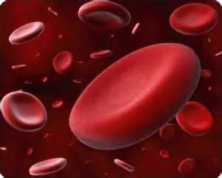
Erythrocytes
AKA RBC
Made in red bone marrow
Live 120 days
4.5-5.5 million per cubic mm (1 drop)
Broken down by liver & spleen
Disk shape with thinner central area
No nucleus
Contain hemoglobin-complex protein that carries O2 & CO2

Slide 7
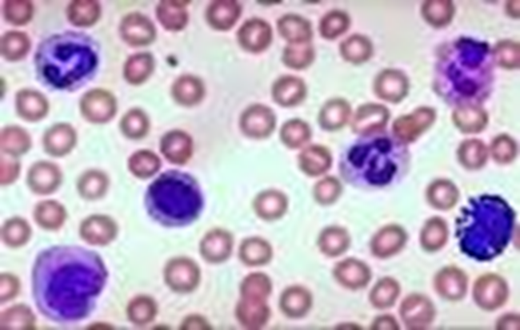
Leukocytes
AKA WBC
Made in bone marrow & lymph tissue
Live 3-9 days
5,000-9,000 per cubic mm (1 drop)
Can pass through capillary walls & enter body tissue
Main function-fight infection
Able to engulf, ingest, and destroy pathogens by process=phagocytosis

Slide 8
Leukocytes
5 types of leukocytes:
Neutrophils – phagocytize bacteria by secreting an enzyme called lysozyme
Eosinophils – remove toxins & defend the body from allergic reactions by producing antihistamines
Basophils – play a role in body’s inflammatory response; produce histamine (vasodilator) & heparin (anticoagulant)

Slide 9
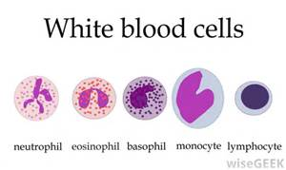
Leukocytes
Monocytes – phagocytize bacteria & foreign materials
Lymphocytes – help body’s immunity by making antibodies; protect against formation of cancer cells

Slide 10
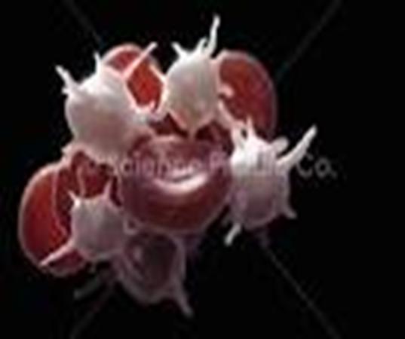
Thrombocytes
AKA platelets
fragments or pieces of cells
No nucleus
Vary in shape & size
Made in bone marrow
Live 5-9 days
250,000-400,000 per cubic mm (1 drop)
Functions in clotting process (stops bleeding)

Slide 11
Blood Types
Important for blood transfusions and medical-legal issues
Determined by presence or absence of certain proteins (aka antigen)
Antigen=substance that can trigger your body’s immune system to attack
RBCs have 3 antigens: A, B, and Rh factor

Slide 12
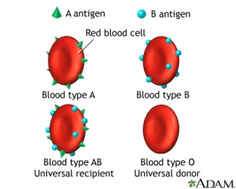
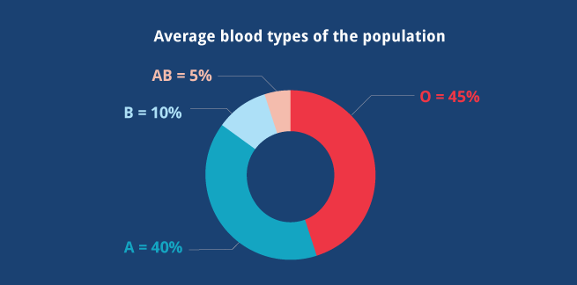
Blood Type https://www.youtube.com/watch?v=dCTV2JF0pU0 Why Do We Have Different Blood Types? (3:49)
Blood types are due to a combination of these 3 antigens

Slide 13
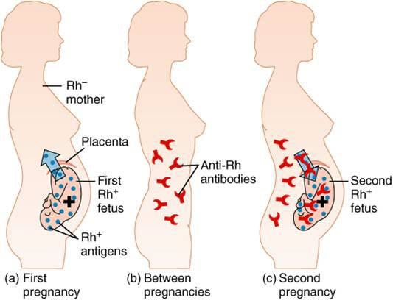
Rh Factor
Another protein found on RBC
Important to know for pregnancy and transfusions
Indicated by a – or + sign (85% US pop +)
Rh- has no Rh protein
Rh+ has Rh protein
Like accepts Like!
Rh- important!

