Slide 2
7
Kitchen and Dining Areas

Slide 3
Objectives
Describe the three major work centers in a kitchen and the six basic kitchen floor plans.
Explain considerations in choosing functional surface materials and fixtures for kitchens and dining areas.
Identify different kinds of tableware and list selection factors applicable to each.
Set a table attractively.

Slide 4
Planning the Kitchen and Dining Areas
Kitchens have three main work centers
  food preparation and storage
  cooking and serving
  cleanup
Some kitchens have additional work centers for tasks like planning and laundry
continued

Slide 5
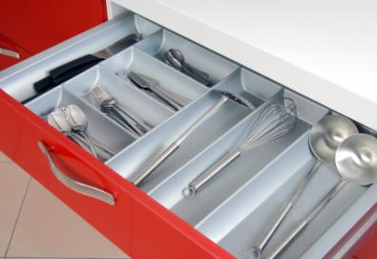
Planning the Kitchen and Dining Areas
Store items where they will be used and where it is most convenient to find them
Place more frequently used items in the front of cupboards and drawers
© photo25th/Shutterstock
continued

Slide 6
Planning the Kitchen and Dining Areas
Each kitchen work center needs storage space for items that are used there
The path that connects the three major work centers forms the work triangle
sink
continued
refrigerator
range

Slide 7
Planning the Kitchen and Dining Areas
The shape and size of the room and the placement of the major work centers determine a home’s basic kitchen floor plan
  U-shaped kitchen
  L-shaped kitchen
  corridor kitchen
  one-wall kitchen
  island kitchen
  peninsula kitchen
continued

Slide 8
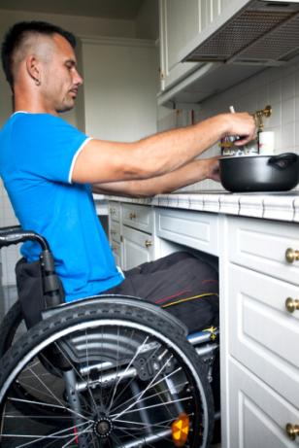
Planning the Kitchen and Dining Areas
Peninsula, U-shaped, and L-shaped kitchens are universal designs, which provide the most space in a kitchen
To accommodate many, work surfaces need to be at a variety of levels
© peppi18/Shutterstock
continued

Slide 9

Planning the Kitchen and Dining Areas
A kitchen, separate dining room, living room section, and outdoor space may all serve as dining areas
© Monkey Business Images/Shutterstock

Slide 10
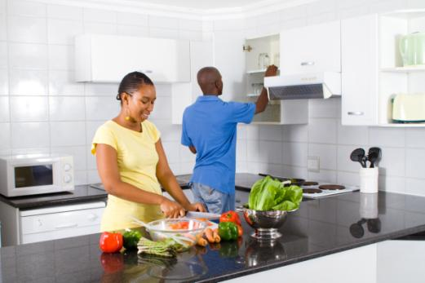
In Your Opinion…
How will being aware of the activities that take place in the three major work centers help someone better organize a kitchen?
© michaeljung/Shutterstock

Slide 11
Functional Surfaces and Fixtures
Wall and floor coverings in kitchen and dining areas need to be easy to clean
Countertops need to provide efficient workspace and cabinets must supply storage
Researching factors such as cost, care requirements, and durability will help maximize the functionality of surface materials and fixtures
continued

Slide 12
Functional Surfaces and Fixtures
If natural light is insufficient, artificial light can be added to provide comfort and safety
Ventilation is needed for comfort and to remove steam, heat, and cooking odors
Sufficient electricity affects kitchen functionality
Grounded appliances and adequate wiring will help ensure electrical safety

Slide 13

Think Further
What are the warning signs of overloaded electrical circuits?
© Alfgar/Shutterstock

Slide 14
Table Appointments
Table appointments include all items used to present and serve a meal
  Dinnerware
  Flatware
  Beverageware
  Holloware
  Linens
  Centerpieces
continued

Slide 15
Table Appointments
The choice of table appointments can affect a dining atmosphere
  Consider the durability, cost, and appearance of dinnerware, which are affected by the material from which it is made
  Examine the shape, weight, and feel of each piece of flatware
continued

Slide 16
Table Appointments
  Inspect appearance, quality, feel, and function of beverageware, including both tumblers and stemware
© Aaron Amat/Shutterstock
continued

Slide 17
Table Appointments
Holloware may be chosen to match or complement other tableware
Tableware includes dinnerware, flatware, beverageware, and holloware
When purchasing, consider lifestyle and budget and check to see whether items are sold as open stock or in place settings or sets
continued

Slide 18
Table Appointments
To extend use of tableware,
  rinse tableware as soon as possible after use
  handle fragile tableware with extra caution and store in drawer or cabinet
Care requirements for table linens depend on the materials from which they are made
continued

Slide 19
Table Appointments
To create interest to the dining table, add a centerpiece
Proportion with the table and eye level of guests should be considered when choosing centerpieces
Avoid using potted plants to prevent contamination

Slide 20

In Your Opinion…
What types of tableware would be most appropriate for elegant dining?
What types would be most appropriate for casual dining?
© Bochkarev Photography/Shutterstock

Slide 21
Setting the Table
The occasion, style of service, size of the table, and menu will help determine how to set a table
At a properly set table, each diner’s cover should provide the tableware pieces needed for the meal being served

Slide 22
Review
What are the three main work centers found in kitchens?
  food preparation and storage center, cooking and serving center, cleanup center

Slide 23
Review
What factors determine a home’s basic kitchen floor plan?
  the shape of the room and the placement of the three major work centers

Slide 24
Review
How can the functionality of surface materials and fixtures for kitchen and dining areas be maximized?
  by researching factors such as cost, care requirements, and durability

Slide 25
Review
Name the six types of table appointments.
  Dinnerware, flatware, beverageware, holloware, table linens, centerpieces

Slide 26
Review
What factors will help determine how to set a table?
  occasion, style of service, size of the table, menu

