Slide 1
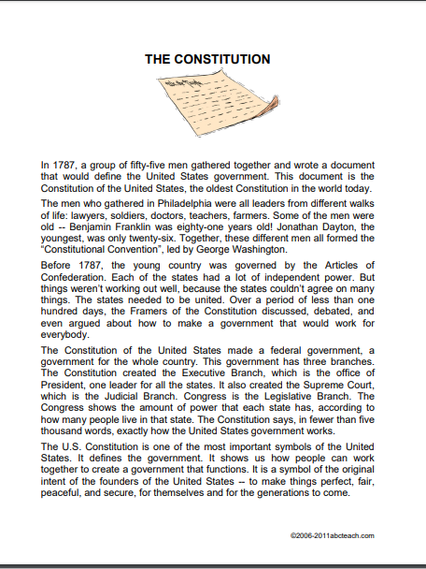
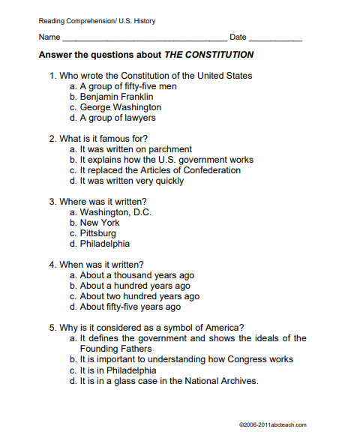
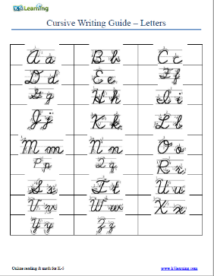
Monday, September 9, 2019
Monday: Classworks – Math
Amiyah
Jaiden
Jaylie
Macon
SIPPS with Mrs. Thompson - Landon
Practice writing “t” in cursive when finished.
7:55 – 8:30

Slide 2

Guest Reader☺

Slide 3
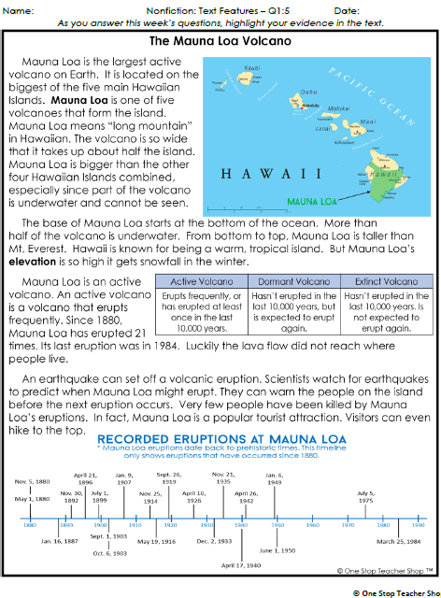
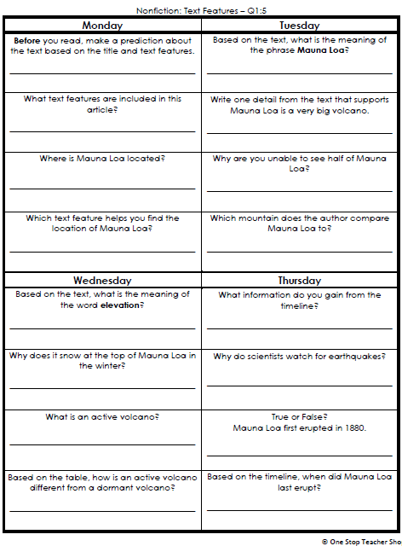
Reading Homework

Slide 4
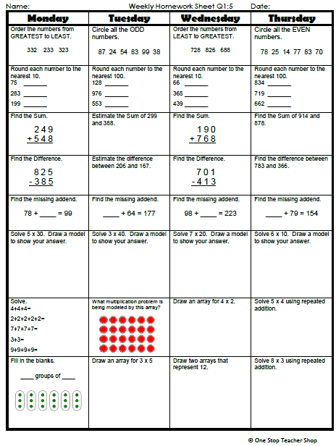
Math Homework

Slide 5

CHOMP TIME
F.A.S.T. Groups
Focused Academic Support Time

Slide 6
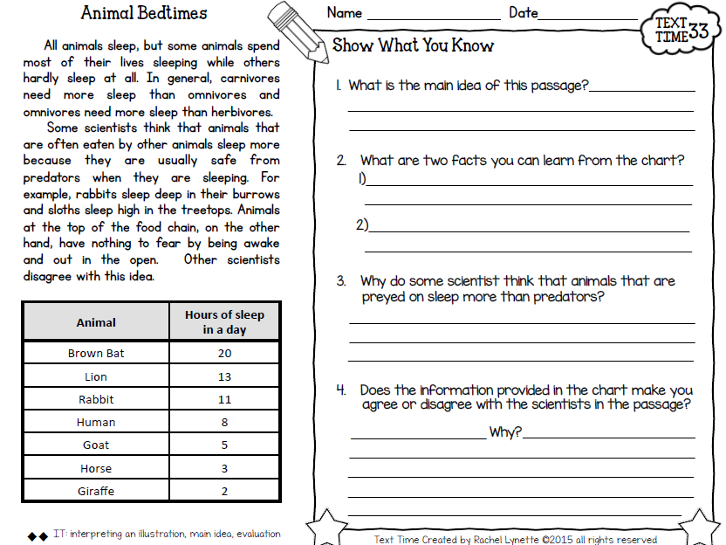
F.A.S.T. Designations
Computers – EPIC: Jordyn – 1 Lexi - 2 Caydance - 3 Emma - 4 Aiden - 5 Jearon - 6 Katelynn - 7 Kaylee - 8 Amiyah – 9 Cohen - TC | Mrs. Roby: LLI Kaylah Macon Carleen Adalyn | Mrs. Thompson: LLI and/or Dibels-Progress Monitoring Landon Paisleigh Jaiden | Paired Partners Complete passage: Cayli - Brena Khamani -Jaylie McKenzie - Elin Noah - Erin
8:40 – 9:10

Slide 7

Restroom Break
9:10 – 9:20

Slide 8

Reading Time
Objective: RL.3.5
I can refer to parts of stories, dramas, and poems when writing or speaking about a text, using terms such as chapter, scene, and stanza; I can also describe how each successive part builds on earlier sections..
9:20 – 9:55
Objective: RL.3.7
I can explain how specific images and illustrations contribute to or clarify a story.
Objective: SL.3.1c
I can ask questions to check understanding of information presented, stay on topic, and link my comments to the remarks of others.

Slide 9

Writing About Reading
What are some of the stories Aunt Flossie tells about her hats?
What is your favorite hat story?
What happens in that story?
Why is that your favorite?
Watch as I respond to this writing prompt: What is your favorite hat story in Aunt Flossie’s Hats (and Crab Cakes Later), and why?

Slide 10

Your turn to Write about Reading
Return to your desk, and on notebook paper, answer the following prompt:
What is your favorite hat story in Aunt Flossie’s Hats (and Crab Cakes Later), and why?

Slide 11

Computers – Classworks – R and Epic*:
  Jaiden - 1
  *Macon -2
  Paisleigh - 3
  Lexi - 4
  *Aiden - 5
  *Kaylah - 6
  *Katelynn - 7
  *McKenzie - 8
  *Erin - 9
  *Elin - TC
Independent Daily Reading & Teacher Conferences
  Mrs. Roby:
  LLI
  Emma
  Caydance
  Kaylee
  Jordyn
  Mrs. Thompson:
  LLI
  Jaylie
  Jearon
  Amiyah
  Cohen
9:55 – 10:25

Slide 12



Vocabulary & Grammar Time
Snack Time
10:25 – 10:40

Slide 13
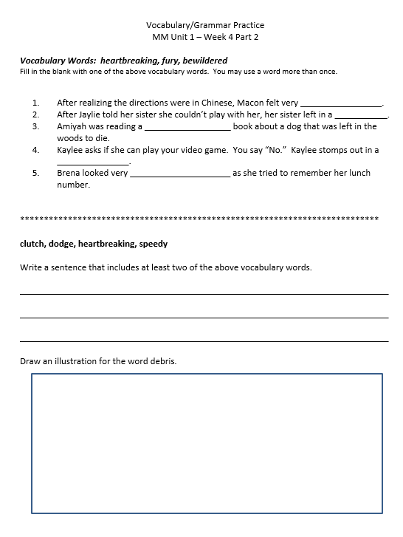
Vocabulary Practice!

Slide 14
Out of Classroom!
Recess 10:40 – 11:05

Slide 15



Writing Time
Objective: W3.3
I can write narratives to develop real or imagined experiences or events using effective technique, descriptive details, and clear event sequences.
11:05 – 11:35

Slide 16

Gather at the Carpet…
Was it a perfect transition?

Slide 17

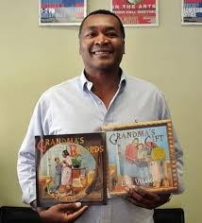
Eric Velasquez
Today you will hear a personal narrative about growing up in New York City in the 1960’s.

Slide 18

Let’s read the dedication.
What does the dedication tell us about the reader?
In this book, the author describes memories of summers he spent with his grandmother.

Slide 19
Let’s read and listen carefully. Thin about what it might be like to write about your own memories.
In this story, Eric writes about special things he did with someone he loved. What special things does he write about?
https://www.youtube.com/watch?v=I6TO6kemVUA

Slide 20


Quick Write
If you wanted to write about special things you’ve done with someone you love, what could you write about? Turn to your partner
Open to the next blank page in your writing ideas section.
Label it…”Special Things I’ve Done,” and list some special things you have done with a loved one.

Slide 21


Writing Time
Writing Journal
Remember:
Write silently
Double-space, or skip every other line
Continue writing until time is up
Write about something special you’ve done with someone you love.
Write about anything that interests you.
Objective:

Slide 22
Sharing and Reflecting
Who wrote about something special you did with a loved one? Tell us about it.
What other topics did you write about? Tell us about them.
What did you find out about your partner today?

Slide 23
Math Fluency & Focus Lesson!
11:35 – 11:55

Slide 24
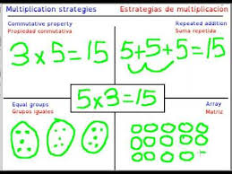
Review Multiplication Strategies!
Array Model
Equal Groups
Repeated Addition

Slide 25
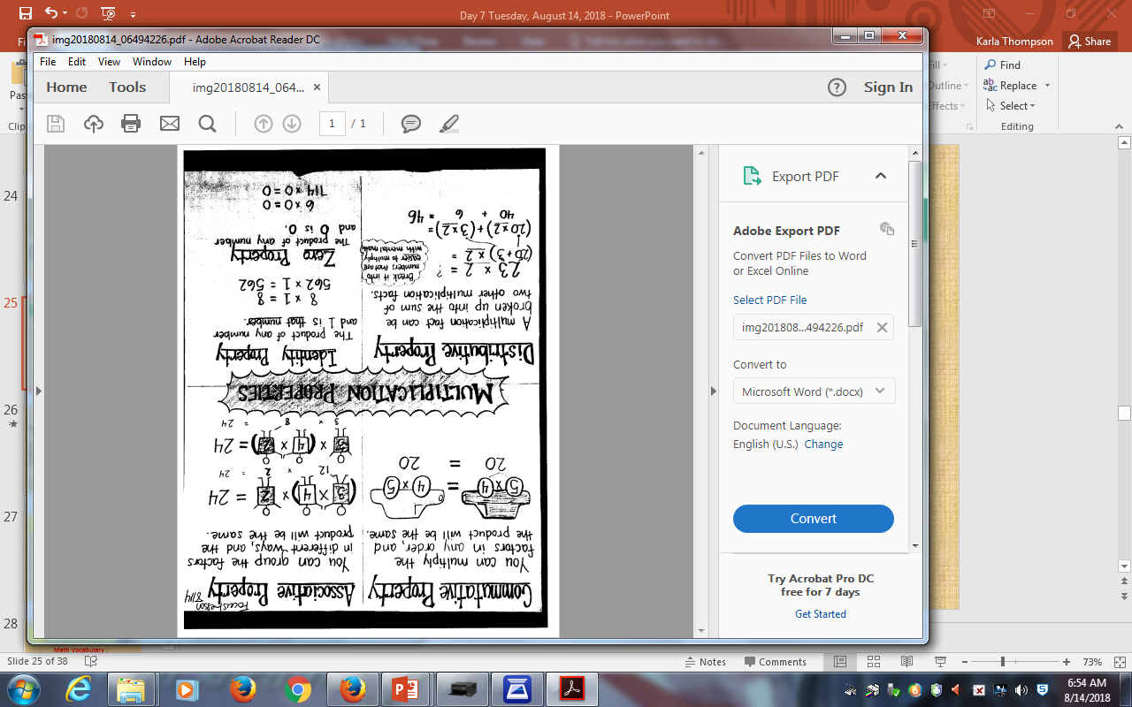
Focus Lesson!
I can interpret products of whole numbers.
I can apply properties of operations as strategies to multiply and divide.

Slide 26

Math Stash
Let’s Practice!
Let’s throw in some unknown numbers too!

Slide 27
Focus Lesson!
1:55 – 2:05
I can interpret products of whole numbers.
I can apply properties of operations as strategies to multiply and divide.

Slide 28
Math Stash
Let’s Practice!

Slide 29
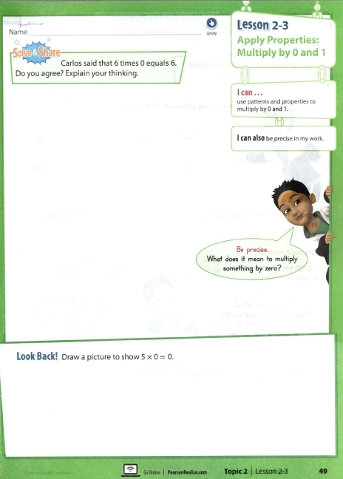

Slide 30
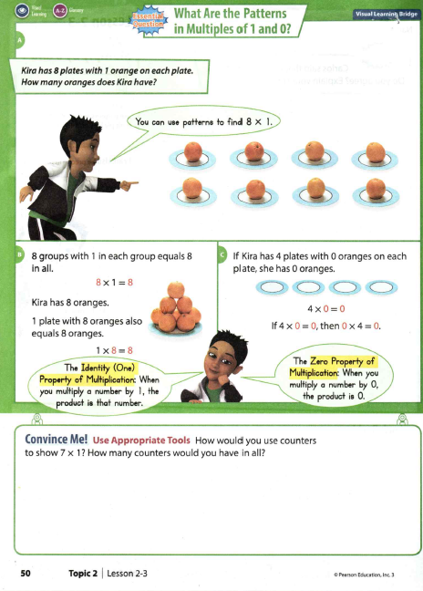
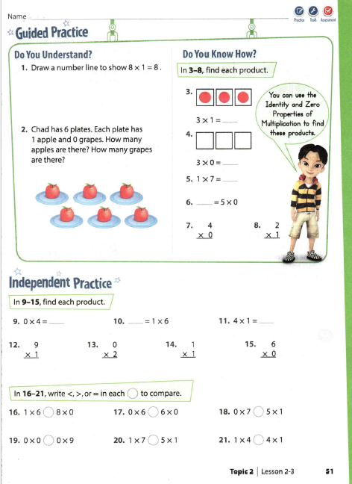

Slide 31
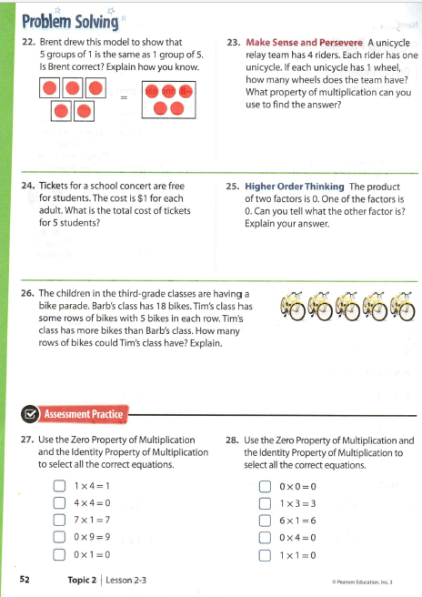

Slide 32
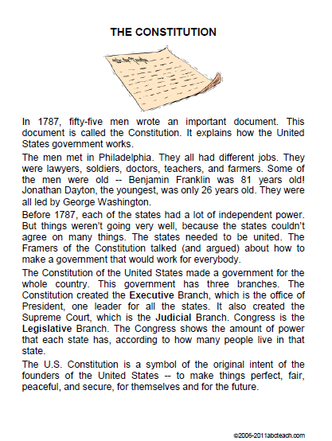
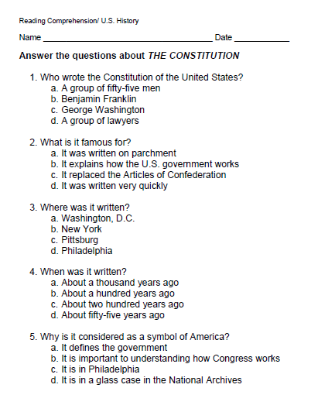
Bring to Mrs. Thompson’s Table

Slide 33
Small Group Rotations 1 & 2
  Rotation #1 - 11:55 – 12:15
Group 1 – Computers (TC, A, B, C, D): Epic
Group 2 – Mrs. Roby: p51,52 even numbers
Group 3 – Computers (E, F, G, H, I): Imagine Math
Group 4 – Mrs. Thompson: Reading Passage
Group 5 – Independent Practice p51,52 odd numbers
  Rotation #2 - 12:15 – 12:35
Group 5 – Computers (TC, A, B, C, D): Epic
Group 1 – Mrs. Roby: p51,52 even numbers
Group 2 – Computers (E, F, G, H, I): Imagine Math
Group 3 – Mrs. Thompson: Reading Passage
Group 4 – Independent Practice p51,52 odd numbers

Slide 34

Out of Classroom!
Lunch 12:35 – 1:05

Slide 35
Restroom Break
1:05 – 1:10

Slide 36

Out of Classroom!
Activity 1:10 – 1:55

Slide 37
Small Group Rotations 3 & 4
  Rotation #3 - 1:55 – 2:15
Group 4 – Computers (TC, A, B, C, D): Epic
Group 5 – Mrs. Roby: p51,52 even numbers
Group 1 – Computers (E, F, G, H, I): Imagine Math
Group 2 – Mrs. Thompson: Reading Passage
Group 3 – Independent Practice p51,52 odd numbers
  Rotation #4 - 2:15 – 2:35
Group 3 – Computers (TC, A, B, C, D): Epic
Group 4 – Mrs. Roby: p51,52 even numbers
Group 5 – Computers (E, F, G, H, I): Imagine Math
Group 1 – Mrs. Thompson: Reading Passage
Group 2 – Independent Practice p51,52 odd numbers

Slide 38
Small Group Rotation 5
  Rotation #5 - 2:35 – 2:55
Group 2 – Computers (TC, A, B, C, D): Epic
Group 3 – Mrs. Roby: p51,52 even numbers
Group 4 – Computers (E, F, G, H, I): Imagine Math
Group 5 – Mrs. Thompson: Reading Passage
Group 1 – Independent Practice p51,52 odd numbers

Slide 39

Student Debrief
Compare your answers with your partner’s answers
Who would like to share what they noticed?
Review Independent Practice!

Slide 40

3:00 – 3:10

Slide 41
Review of
7 Habits of Highly Effective People
Habit #1: Be Proactive
Habit #2: Begin with the End in Mind
Habit #3: Put First Things First
Habit #4: Think Win-Win
Habit #5: Seek First to Understand, Then to Be Understood
Habit #6: Synergize
Habit #7: Sharpen the Saw

Slide 42
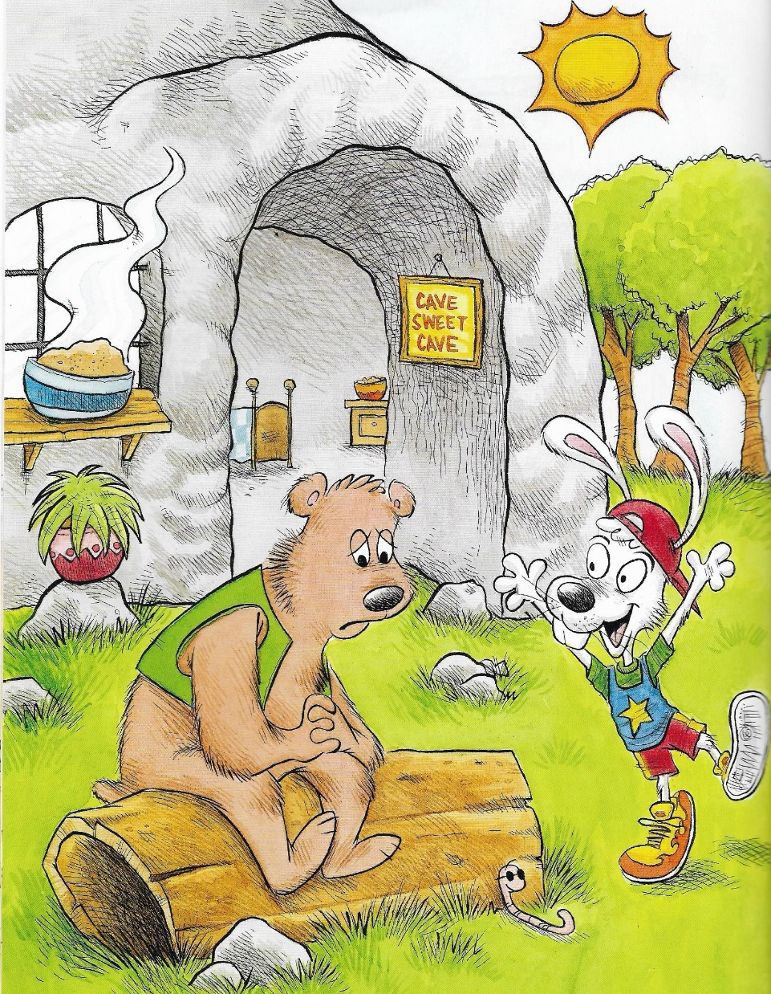
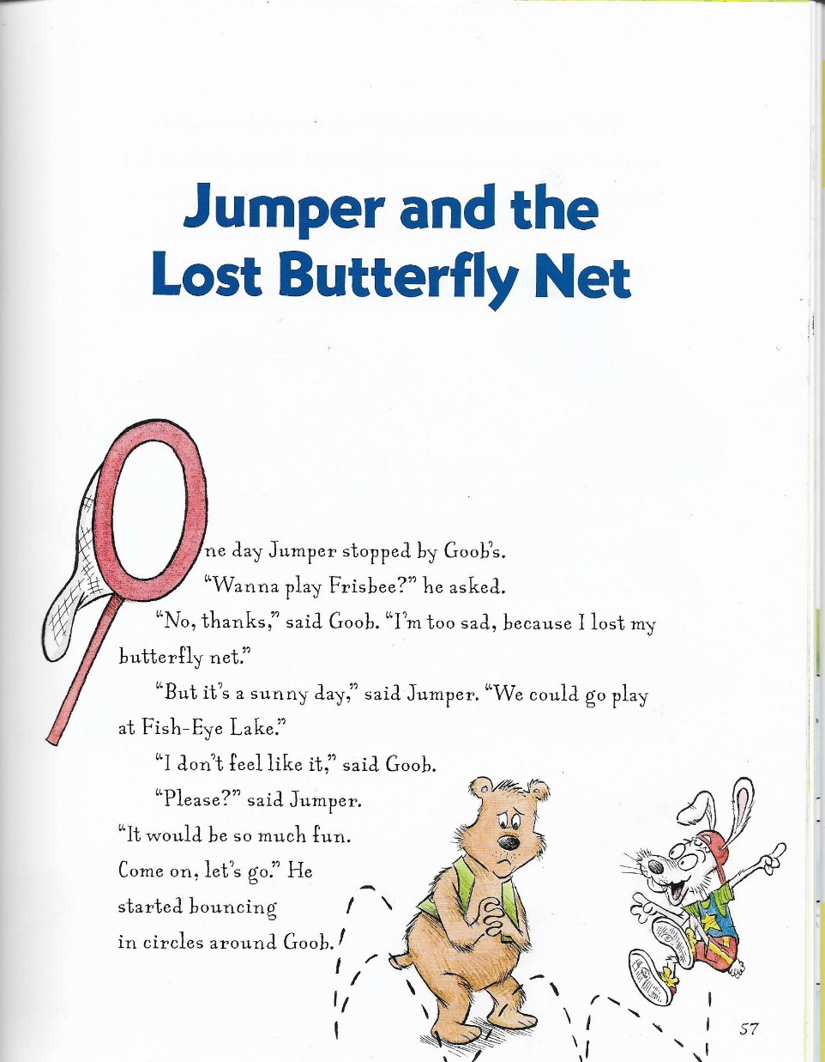

Slide 43
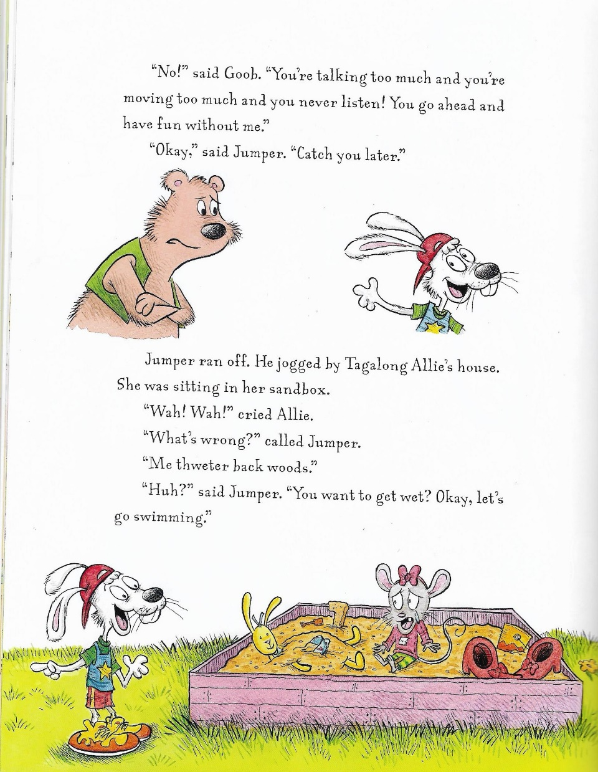
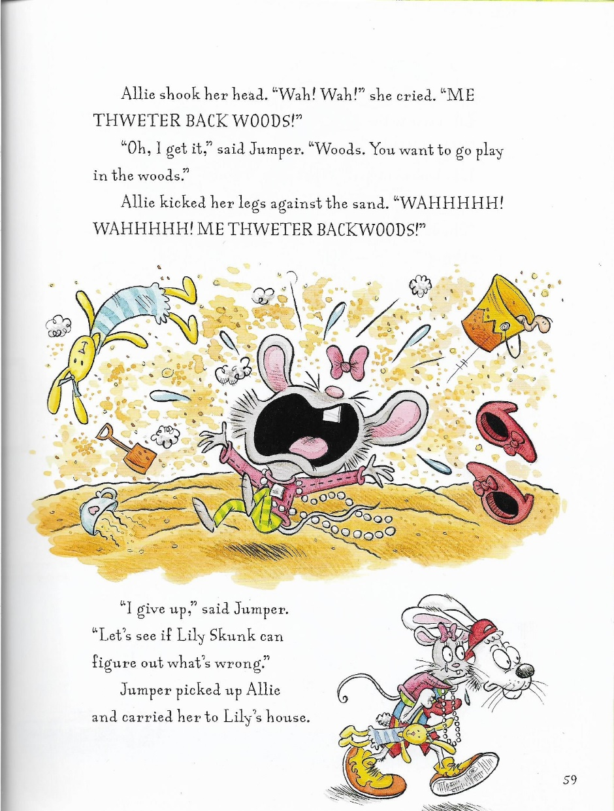

Slide 44
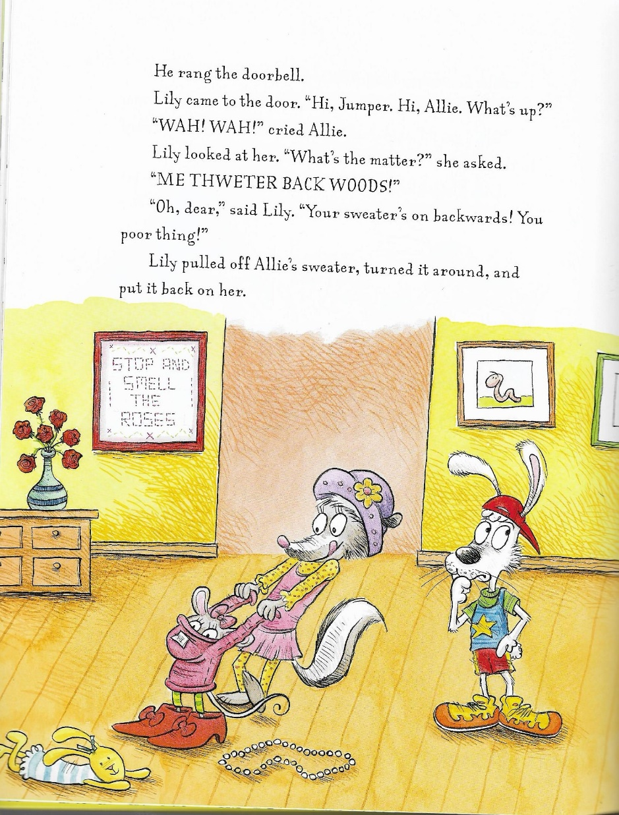
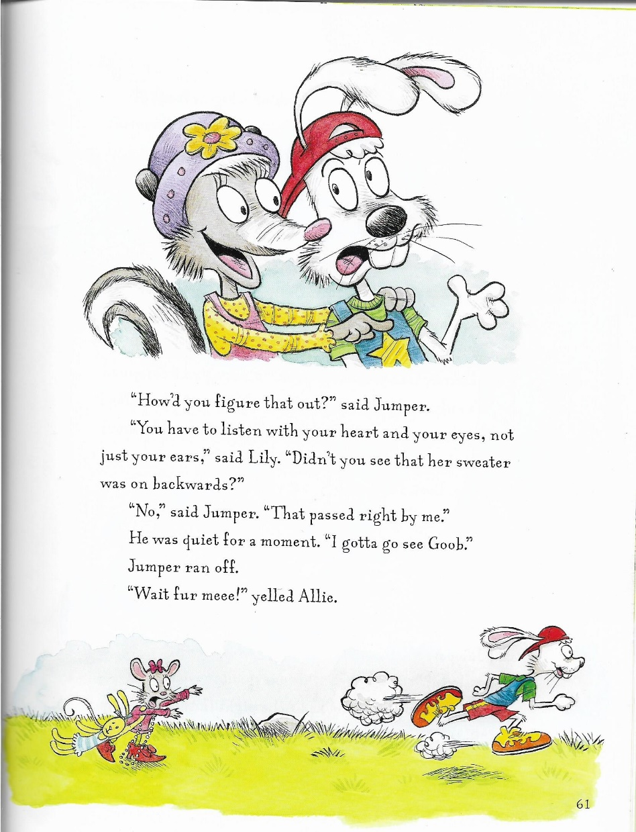

Slide 45
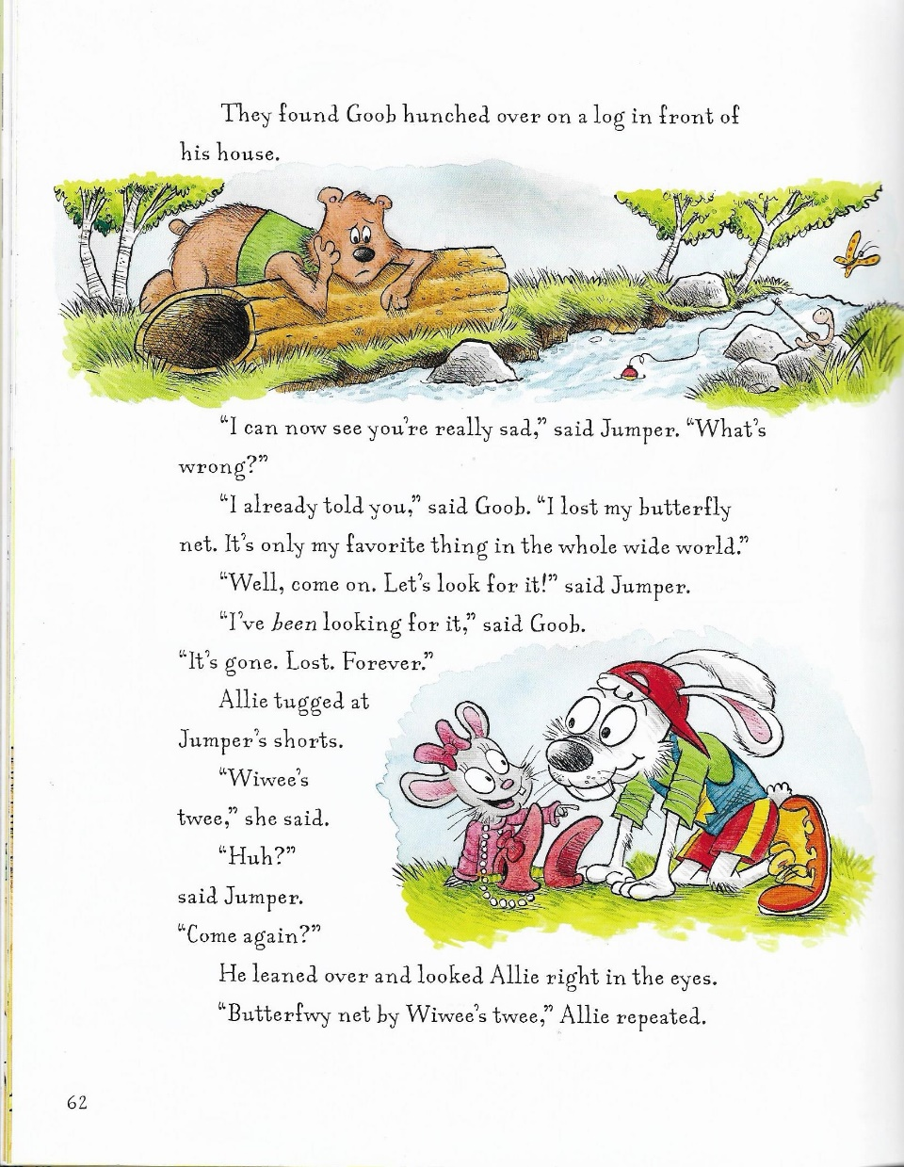
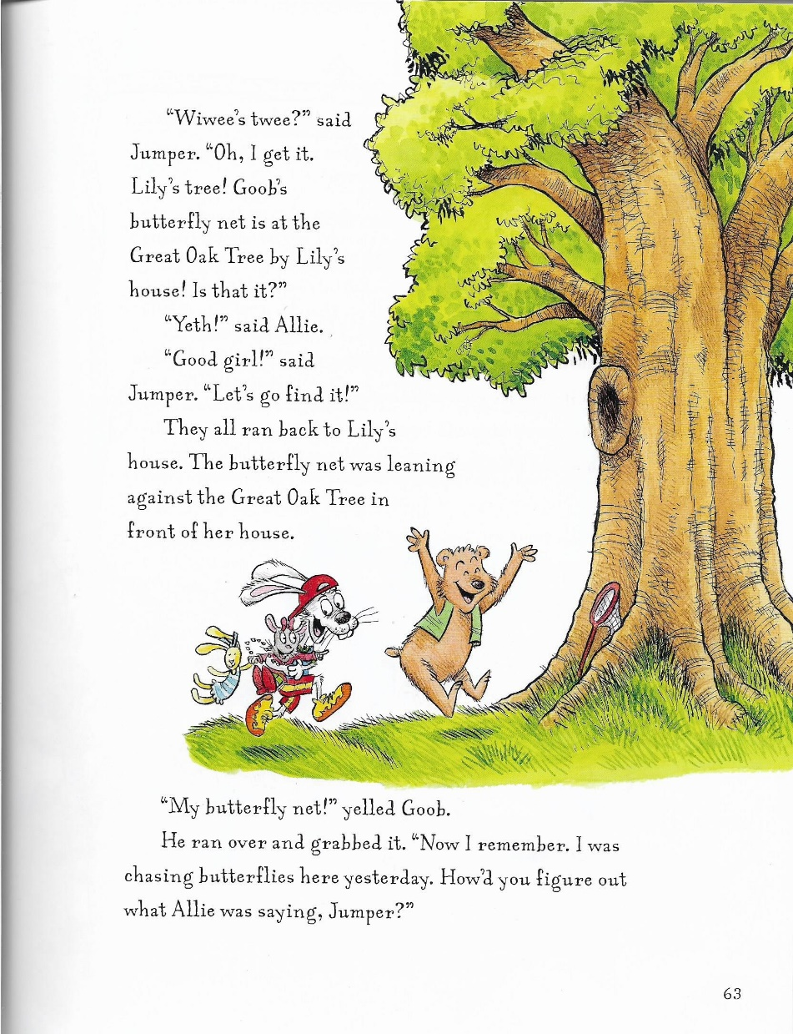

Slide 46
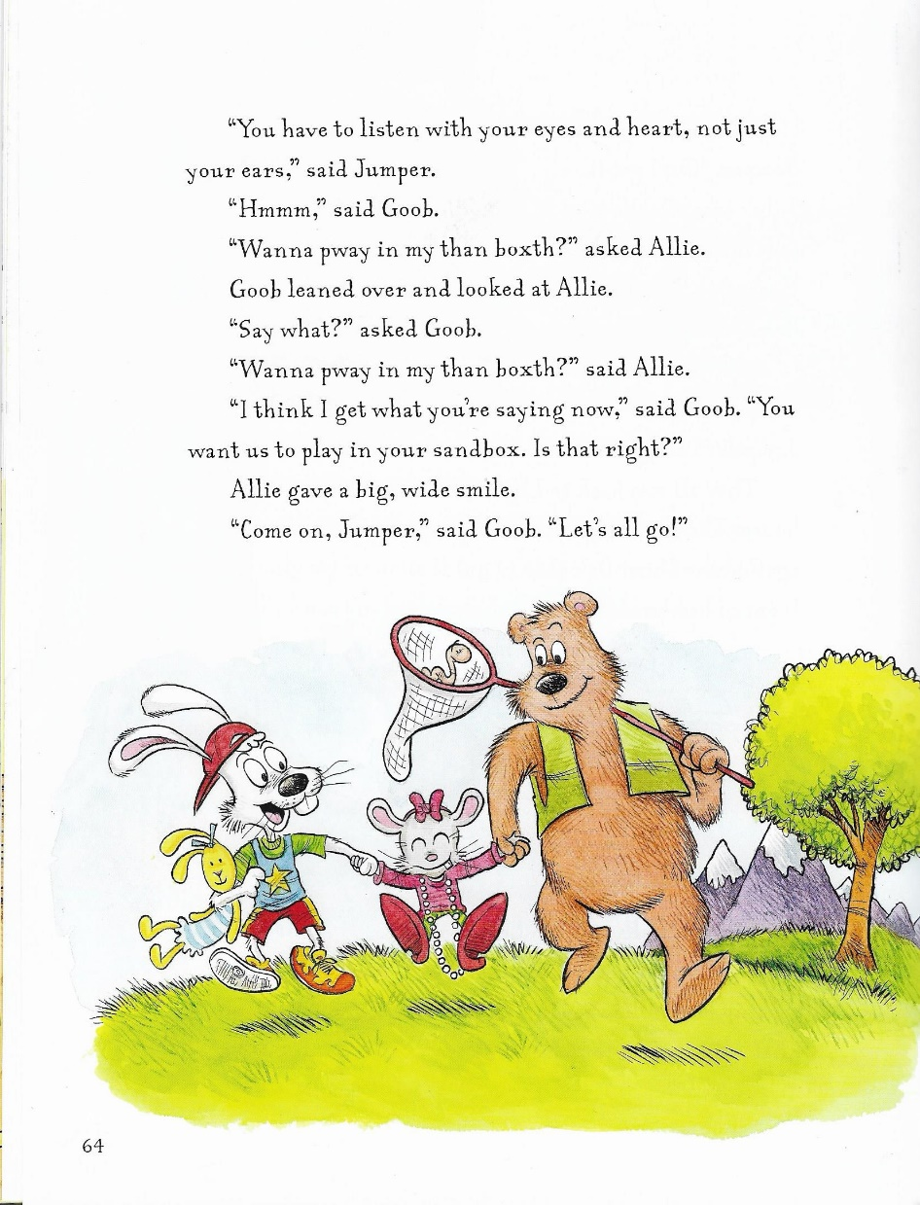
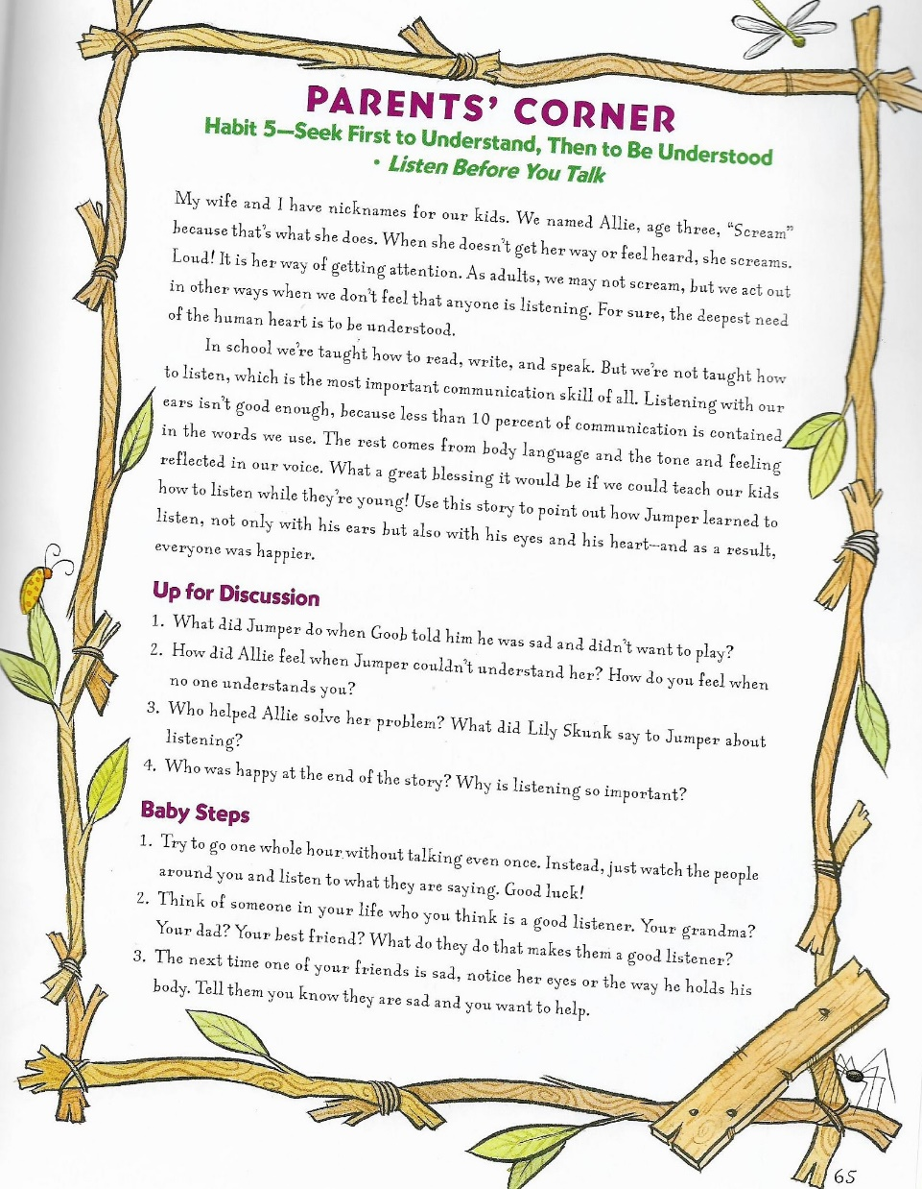

Slide 47
Restroom Break
3:10 – 3:15

Slide 48




3:10 – 3:15 Wrap Up!
Pair-Up back to back and share one thing you learned in class today with your partner
Pack-Up
Office will announce:
Car Riders – Leave around 3:20
Bus Riders – (listen to intercom for dismissal)
2:30 – 3:20
How much time has elapsed?

