Slide 1
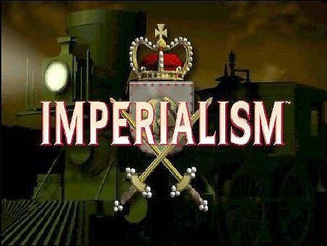
Imperialism to independence
Outcome: Consequences of Imperialism

Slide 2
Consequences of Imperialism
Setting the Stage:
Imperialism often makes one group(s) subjects of another group.
This results in racism, economic disparities, and hatred
Eventually that hatred causes reactions as seen in Rwanda, Darfur, India, and The Balkans region of Europe

Slide 3
Unrest in the Balkans

Slide 4
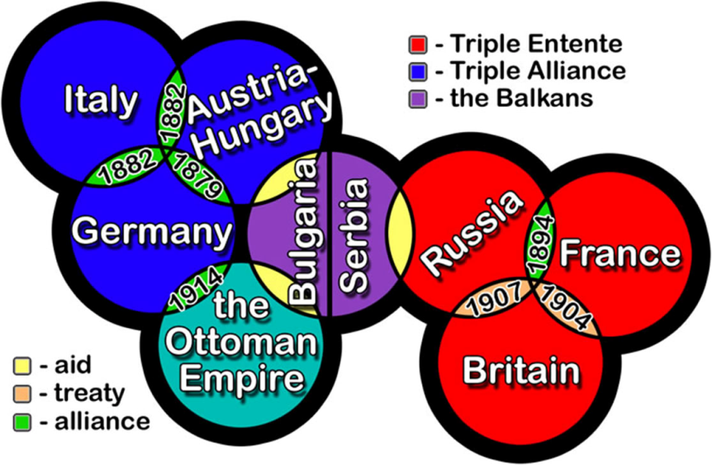
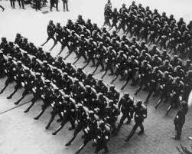
Consequences of Imperialism
Unrest in the Balkans
Rivalries in Europe caused many nations to compete with one another leading to a rise in Nationalism
Secret alliances were formed between countries in case of armed conflict
Competition for materials and markets grew and territorial disputes became more intense
The Berlin Conference was meant to keep European countries from going to war over Africa but imperialism and militarism back home were causing tensions to rise

Slide 5
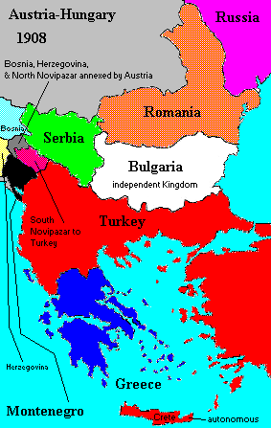
Consequences of Imperialism
The Balkan region of Europe in the Southeast, saw many groups struggling to free themselves from the declining Ottoman Empire
Nationalism was growing in Serbia, Bulgaria, Romania, and among other ethnic groups who wanted independence
Austria-Hungry opposed Serbia’s attempts at united Slavic people
1908 Austria annexed or took over Bosnia and Herzegovina with large Slavic populations and threatened to crush any Serbian effort to undermine its authority

Slide 6
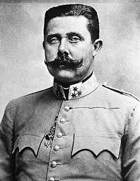
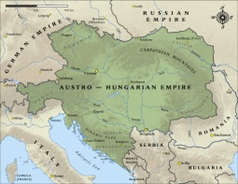
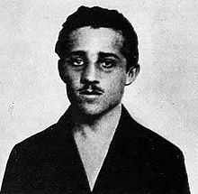
The Spark That Started WWI

Slide 7
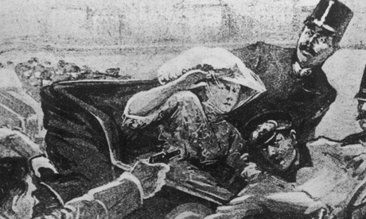

Slide 8
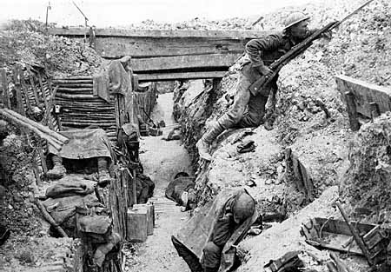
Consequences of Imperialism
Gavrilo Princip, and 19 year old Serbian, decided to shoot Austria-Hungary’s heir to the throne Archduke Franz Ferdinand and his wife and point blank range while they were on a visit to Sarajevo on June 28, 1914
Austria-Hungary declared war on Serbia and the alliance system brought all of Europe into War by August 1914; World War I had begun

Slide 9
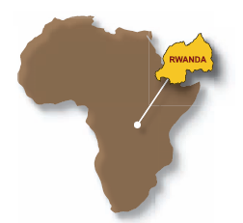
Rwanda

Slide 10
Consequences of Imperialism
Rwanda Genocide
Controlled by Belgium from 1919 to 1962
Most of Rwanda’s population belong to Hutu or Tutsi ethnic groups
For 600 years the two shared business of farming and language/culture
Hutus naturally outnumbered Tutsis
When the Belgians arrived, they favored the Tutsis as more aristocratic in appearance and drove a political wedge between the two ethnic groups

Slide 11
Consequences of Imperialism
Rwanda Genocide (Continued)
Europeans also brought new weapons and Christianity, which taught the Hutu to see themselves as oppressed; in 1956 the Hutu rebellion began
April 6, 1994 the plane carrying Rwanda’s president was shot down and was the trigger needed for the Hutus planed ‘Final Solution’ and started the genocide
Hutus killed Tutsis with mostly machetes and clubs killing as many as 800,000

Slide 13
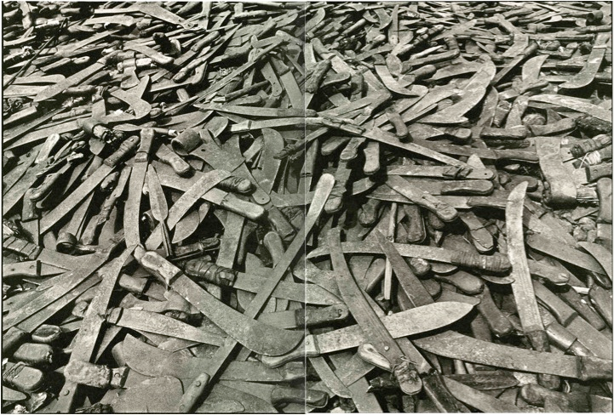
Machetes

Slide 14
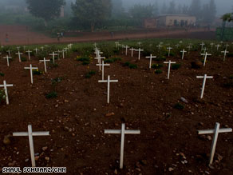

Slide 15
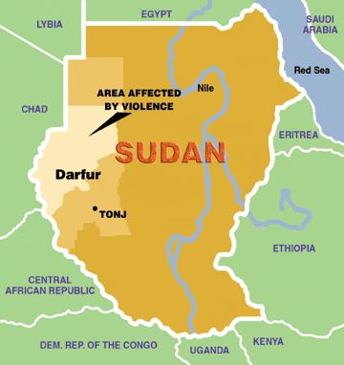
Darfur

Slide 16
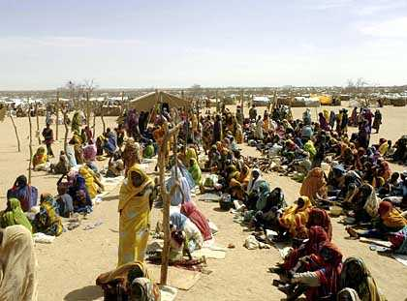
Modern Africa
Darfur
Located in western Sudan and formerly controlled by Egypt and the UK
Civilians have been killed, tortured, raped, displaced, & homes burnt
Since 2003, 300,000 men, women, and children have died and 2.6 million have been displaced from their homes and live in refugee camps

Slide 17
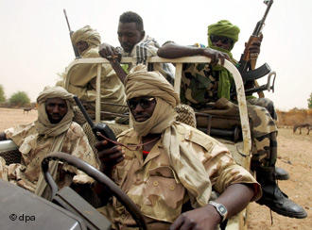
Modern Africa
Darfur
The government of Sudan and the Janjawid or Janjaweed are responsible
Janjawid: term used to describe mostly armed gunmen in Darfur

Slide 18
Consequences of Imperialism
Darfur
In the past, Janjawid have been at odds with Darfur’s population over natural grazing grounds and farmland as rainfall and water became scarce
Humanitarian efforts have been difficult due to the remoteness of the area, attacks by armed assailants on aid workers, and roads being under Janjawid control
The UN and Amnesty International are attempting to move in and stop the atrocities today but a peaceful political end has not yet been achieved

Slide 19
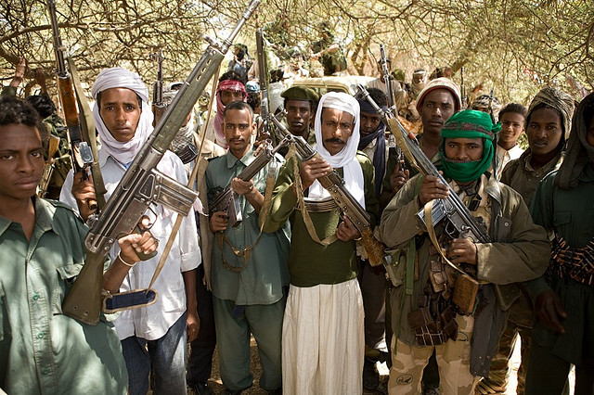
Janjaweed

Slide 20
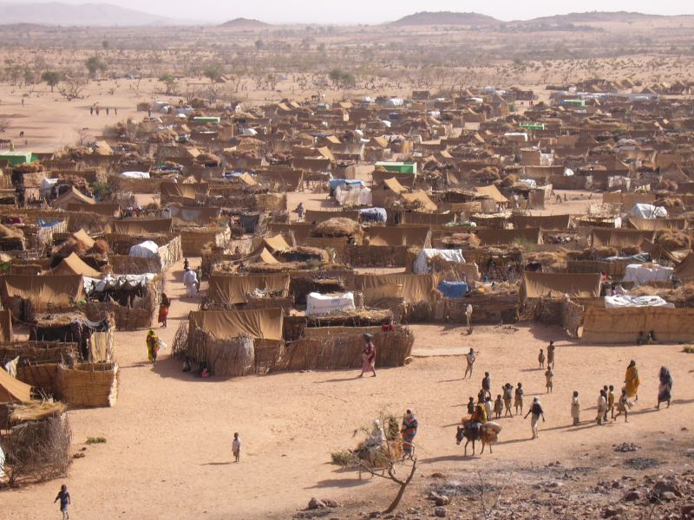
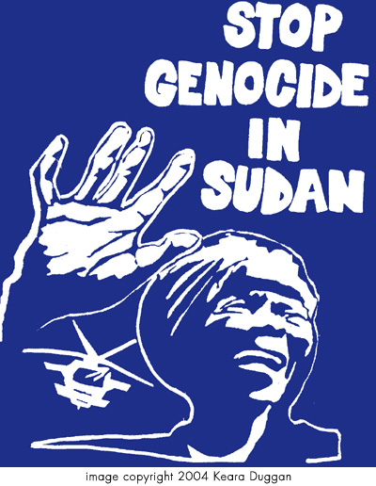
Refugee Camp

Slide 21
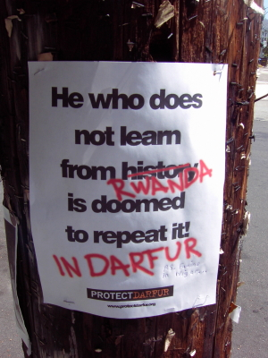

Slide 22
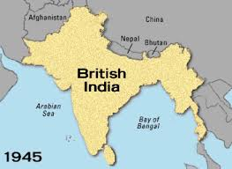
Consequences of Imperialism
Gandhi Uses Civil Disobedience in India
Over 1 million Indians enlisted in the British army during World War I
They were promised reforms that would eventually lead to self-government, but when they returned from the war, they were treated as 2nd class citizens again; lead to acts of violence
The British passed the Rowlatt Acts that allowed them to imprison dissenters without a trial for up to 2 years

Slide 23
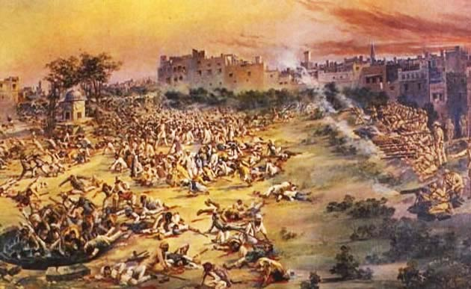
Consequences of Imperialism
10,000 Hindus and Muslims flocked to city of Amristar to protest; British opened fire and killed 400 Indians and wounded 1200. Known as Amristar Massacre

Slide 24
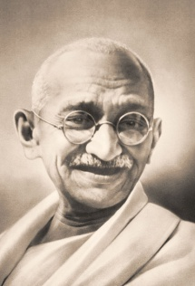
Consequences of Imperialism
Mahatma Gandhi encouraged the Indian National Congress to follow a policy of noncooperation with the British by use of civil disobedience
Civil Disobedience: the deliberate and public refusal to obey an unjust law through use of nonviolence
Gandhi organized boycotts of British goods, government schools, and refusal to pay British taxes

Slide 25
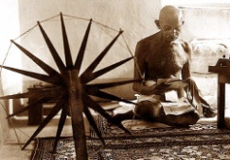
Consequences of Imperialism
Encouraged Indians to weave their own cloth and not buy British cloth

Slide 26
Consequences of Imperialism
Demonstrations often turned to riots, despite Gandhi’s pleas; Thousands of Indians arrested for strikes and demonstrations
Gandhi organized the Salt March; Indians marched 240 miles to the coast to collect seawater, let it evaporate, and collect the salt to avoid paying government taxes on salt
Another march to a salt processing site saw the British attack peaceful demonstrators with steel-tipped clubs. 60,000 arrested including Gandhi. The demonstration was carried in newspapers across the globe
1935, the British Parliament passed the Government of India Act which provided local self-government and limited democratic elections

Slide 27
The Salt March

Slide 28
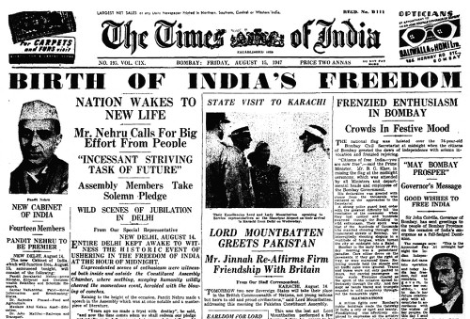
India’s Independence

Slide 29
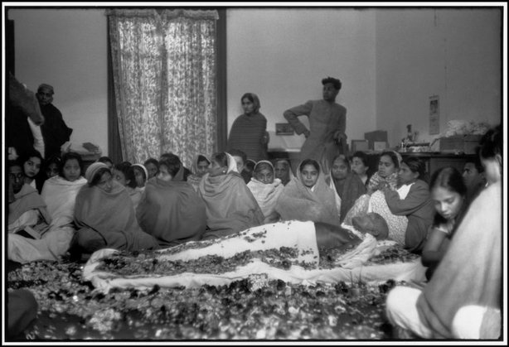
Death of Gandhi

Slide 30
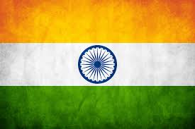
Consequences of Imperialism
Result: The tragic events in Rwanda, Darfur, India, and Europe prove that imperialism can have catastrophic results.

