Slide 1
9 as a Factor
Lesson 5-2
CCSS 3.OA.3, 3.OA.7, 3.OA.8, 3.OA.9

Slide 2
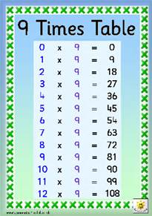
Essential Understanding
There are patterns in the products for multiplication facts with a factor of 9.

Slide 3
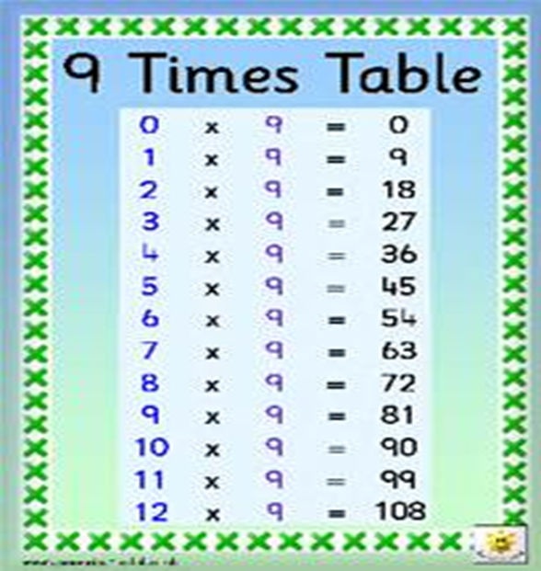
Objective
I can use patterns to multiply with 9 as a factor.

Slide 4
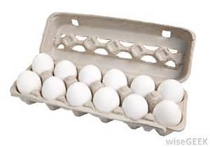
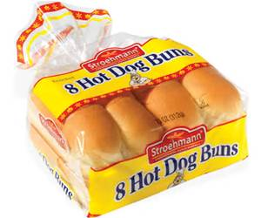
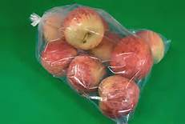
ConnEct
What kind of foods come with many items in a package?

Slide 5
connect
Suppose you buy 2 or more packages of hot dog buns. What operation would you use to quickly find the total number of buns you purchased?
MULTIPLICATION

Slide 6
Pose the problem
Maria bought 4 packages of bottled water. There are 9 bottles in each package. How many bottles did she buy? Discuss with your partner how you would solve this problem.

Slide 7
Demonstrate
One way to find the products for the 9s facts is to use counters arranged in arrays.
1 x 9 = 9
9 x 1 = 9
This is the Commutative Property.

Slide 8
Teaching Tool 37
Complete the table starting with 0 x 9 and 9 x 0. Next, complete the table for 1 x 9 and 9 x 1. At the bottom of your paper, start drawing your array with 1x 9 or 9 x 1.
Build your array by drawing a row of 9 counters until your drawings have 9 rows. After you draw each row, write the product on your recording sheet.
Which fact in your table tells how many bottles of water Maria bought all together?

Slide 9
Do you see any patterns in your table? (Hint: Look at the ones place and the tens place)

Slide 10
Another Look
If you add the numbers in the product of a nines multiplication fact, the sum will be 9.
2 x 9 = 18
1 + 8 = 9
5 x 9 = 45
4 + 5 = 9
7 x 9 = 63
6 + 3 = 9

Slide 11
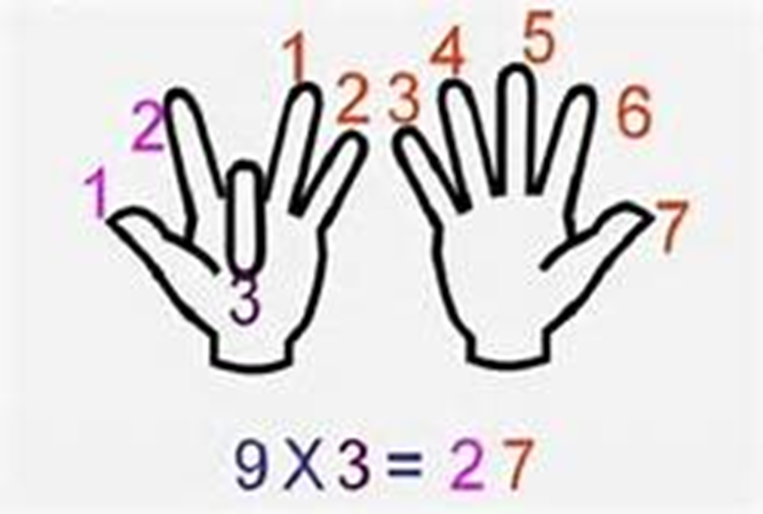
The Nines Trick
VIDEO

Slide 12
Write to Explain
You have learned different strategies to help you find the 9s facts. Which strategy do you like best? How does it work? Describe how to use that strategy to solve 9 x 7.

Slide 13
Writing to Explain - Rubric

Slide 14
1 point - weak
9 x 7 = 63
6 + 3 = 9
So, it works.

Slide 15
2 points
I used the pattern with the hint about the tens digit. Then, I figure out the ones. 9 x 7 is 9 groups of 7, so the product starts with 6. I know that
6 + 3 = 9, so the answer is 63.

Slide 16
3 points – Strong!
I like the pattern where you know what the tens digit should be. This gives me a big head start. Then, I figure out the ones digit. For 9 x 7, I know the product is in the 60s. Then, I need to know what to add to 6 to get 9, and that is 3. This pattern tells me that 9x.7 is 63.

