Slide 1
Ionic Nomenclature Recap
Cation is ALWAYS written first.
If monoatomic, use the name of the element.
If polyatomic, use the name of the polyatomic ion.
Anion is ALWAYS written second.
If monoatomic, use -ide as the suffix.
If polyatomic, use the name of the polyatomic ion.

Slide 2
Covalent Bonding

Slide 3
Covalent Bonds
What happens to electrons in covalent bond?
Electrons shared between atoms, not given or taken completely.
Atomic orbitals are combined to form molecular orbitals.
Generally bond between nonmetal and nonmetal.
Why? 3 trends need to be taken into account…
Example: CH₄

Slide 4
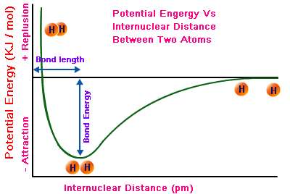
Formation of Covalent Bond
Nature favors chemical bonding…why?
Potential energy is lowered when the atoms are bonded. Lower energy = more stable.

Slide 5
Characteristics of a Covalent Bond
Bond length—the average distance between two bonded atoms.
Depends on type of bond: single, double, or triple.
Bond Dissociation Energy—The energy required to break 1 mol of a specific chemical bond (always endothermic).
Indicates strength of a bond

Slide 6
Covalent Compounds—Nomenclature
Rules—Binary Compounds
Element with smaller group # is always given first (similar to cation in ionic bonding).
Second element combines prefix with suffix –ide.
If second element begins with vowel, the –o- or –a- in the prefix is dropped.
Example—pentoxide
Prefixes:
Mono = 1
Di = 2
Tri = 3
Tetra = 4
Penta = 5
Hexa = 6
Hepta = 7
Octa = 8
Nona = 9
Deca = 10
Practice:
N₂O
As₂O₅
Carbon Tetrafluoride
CO
Sulfur Trioxide

Slide 7
Acids
2 types:
Binary Acids—contain H and another element, usually a halogen.
1.) Put hydro- as prefix for H.
2.) Use –ic as suffix for second element.
Example—HCl = hydrochloric acid
Oxyacids—contain H, O, and a third element (mostly H paired with a polyatomic ion).
1.) Identify anion.
2.) if the anion suffix is –ate replace it with –ic
3.) if the anion suffix is –ite replace it with –ous
Example—HNO₃ = Nitric Acid

Slide 8
Name the following molecules:
HCl
H₃PO₄
MgCl₂
As₄O₁₀

Slide 9
Octet Rule
Atoms undergo bonding in order to satisfy the octet rule.
Octet rule: Atoms want to be “noble gas-like”.
Diatomic molecule: A molecule in which there are only two atoms.
F₂, Cl₂, Br₂, I₂, H₂, O₂, N₂,

Slide 10
Exceptions to Octet Rule
Hydrogen—forms only one bond to have two valence electrons.
Boron—Has three valence electrons. Tends to form three bonds.
Some elements can form an expanded octet if bound to highly electronegative atoms.
Example: SF₆
Expanded octet involves empty d orbitals to fit extra electrons.

Slide 11
Lewis Structures
What are they??
A formula where atomic symbols represent nuclei and inner shell electrons, and dot pairs represent valence and bonded electrons.
What are they used for??
Gives us a way to visualize bonding between atoms
Represents where electrons are located
Gives relative bond strengths to establish reactivity of molecules.

Slide 12
Six Steps:
1.) Determine types of atoms in molecule.
Example: CH₃I
2.) Write electron dot notation for each atom.
3.) Determine the total number of valence electros available.
4.) Arrange atoms with LEAST electronegative atom in the center (exception: H), and place one shared pair of electrons between each of the atoms.
5.) Fill in valence shells of atoms with unshared electrons (lone pairs).
6.) Count electrons to make sure all available valence electrons are accounted for.

Slide 13
Practice with Lewis Structures
Draw the Lewis structures for the following molecules:
NH₃
H₂S
SiH₄
PF₃

Slide 14
Before we go any further…
Try the Lewis structure for C₂H₄.

Slide 15
Single and Multiple Covalent Bonds
Single bond – two electrons shared
Also called sigma bond, or σ bond.
Examples: H₂
Double bond – four electrons shared
Consists of one sigma and one pi bond.
Example: O₂
Triple bond – six electrons shared
Consists of one σ and two π bonds.
Example: N₂

Slide 16
Lewis structures with multiple bonds
Multiple bonds become evident in lewis structures when there are not enough valence electrons after adding lone pairs.
Examples:
CH₂O
CO₂
HCN

Slide 17
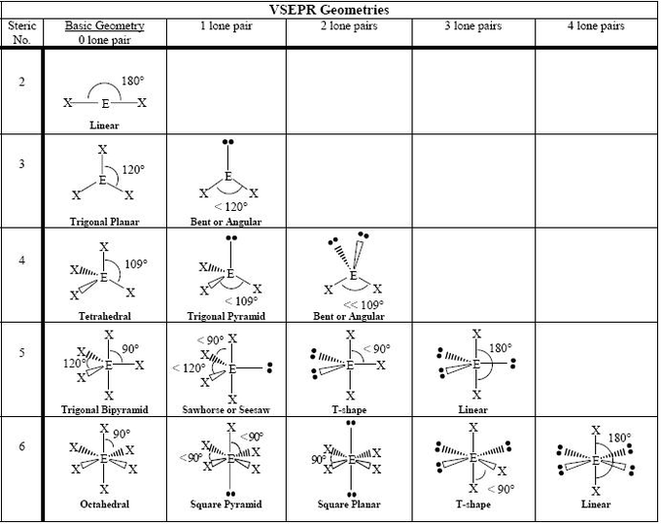

Slide 18
Relative Bond Lengths and Strengths
Bond length—the more shared pairs = the shorter the bond.
Single > Double > Triple
Bond Strength—the more shared pairs = the stronger the bond.
Triple > Double > Single

Slide 19
Resonance Structures
In molecules with multiple bonds, electrons are delocalized due to shared orbitals.
electrons are delocalized, a single lewis structure cannot account for all of the possible locations of electrons.
Only electron locations vary, NEVER atom arrangement.

Slide 20
Polarity
Based on electronegativity differences.
Polar molecule = uneven distribution of electrons
Nonpolar = even distribution

Slide 21
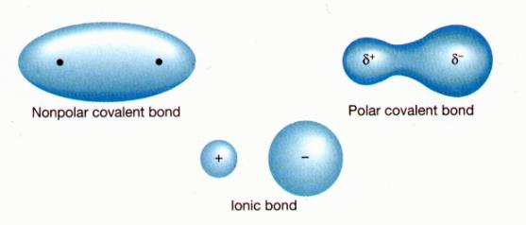
Polar Covalent Bonds

Slide 22
Identify the bond as polar or nonpolar
C—H
O—Cl
C—Cl
H—N
B—F
F—F

Slide 23
Non-polar and Polar Covalent Bonds
Dipole—a molecule that contains both positively and negatively charged regions (unequal sharing of electrons).
Nonpolar bonds do not contain a dipole.

Slide 24
Identify the dipole in the following molecules…
NH₃
CH₃F
SF₆
BF₃
CCl₄

Slide 25
Hybridization
Orbitals of similar energy mix to produce new orbitals (hybrids)
Creates optimal space around nucleus for atoms to bond.
Example: Carbon

Slide 26
Hydrocarbons
Hydrocarbons = the simplest organic compounds
Contain only carbon and hydrogen
Can be straight-chain, branched chain, or cyclic molecules
3 types of straight-chain hydrocarbons
Alkanes—completely saturated hydrocarbons (no double or triple bonds)
End in suffix -ane
Alkenes—contain a double bond
End in suffix -ene
Alkynes—contain a triple bond
End in suffix -yne

Slide 27
Formal Charge
Used to determine the most viable Lewis structure.
Formal Charge = V - N - B/2
Draw the Lewis structure for Fulminic acid (HCNO)

