Slide 1
GES Kindergarten
Week 2- (March 30 - April 3)

Slide 2
Standards
Reading:
R.L.K.1: Ask and answer questions when reading.
R.L.K.3: Name characters, setting, and events in the story.
Writing:
W.K.1: Use a combination of drawing, dictating, and writing when composing opinion, narratives, and informative texts.
L.K.2: Use g appropriate capitalization, punctuation, and spelling when writing.
Phonics:
R.F.K.2: Demonstrate understanding of sounds (middle sounds, short vowels).
Sight Words:
R.F.K.3: Read common high frequency words by sight.
Math: KCC3: Write and represent numbers 1 to 100.

Slide 3
Reading
Essential Questions:
How did the author/illustrator help me understand the text?
What can you say about the difference between wild and tame animals?
I Can:
I can state how the author and illustrator help me understand the text more clearly.
I can tell the difference between wild and tame horses.

Slide 4
Reading
Activity: Read the books to a sibling, parent, pet, or toys. Non-fiction:Ponies
If you have the app Epic, You can search for the book of the week Ponies in this app. You can also read many other books in this app. It is currently free to create an account and some students may have an account through their teacher.
If you do not have this app, students can also access the book via youtube. There are two links available to YouTube. One is of one of a GES k teacher reading the book!
https://youtu.be/1kHS4OR7jLI
https://youtu.be/ZOgE9WBu2xA

Slide 5
Day 1
Read for fun!
Make a list of things you know about horses before reading.
Add new learning after you read the text.
Capture This and That Activity:
Illustrate a wild horse and a tame horse in their surroundings.

Slide 6
Day 2
Reread the text. Review and discuss the essential questions. Ask your child to recall facts learned on day 1.
Listen and Draw Activity:
Illustrate shelter for a horse and a herd of horses

Slide 7
Vocabulary
Breed- a group of animals that live together
Mare- a female horse
Shelter- a safe place that gives protection from bad weather
Tame- take away from a wild state
Wild- living in nature without human care

Slide 8
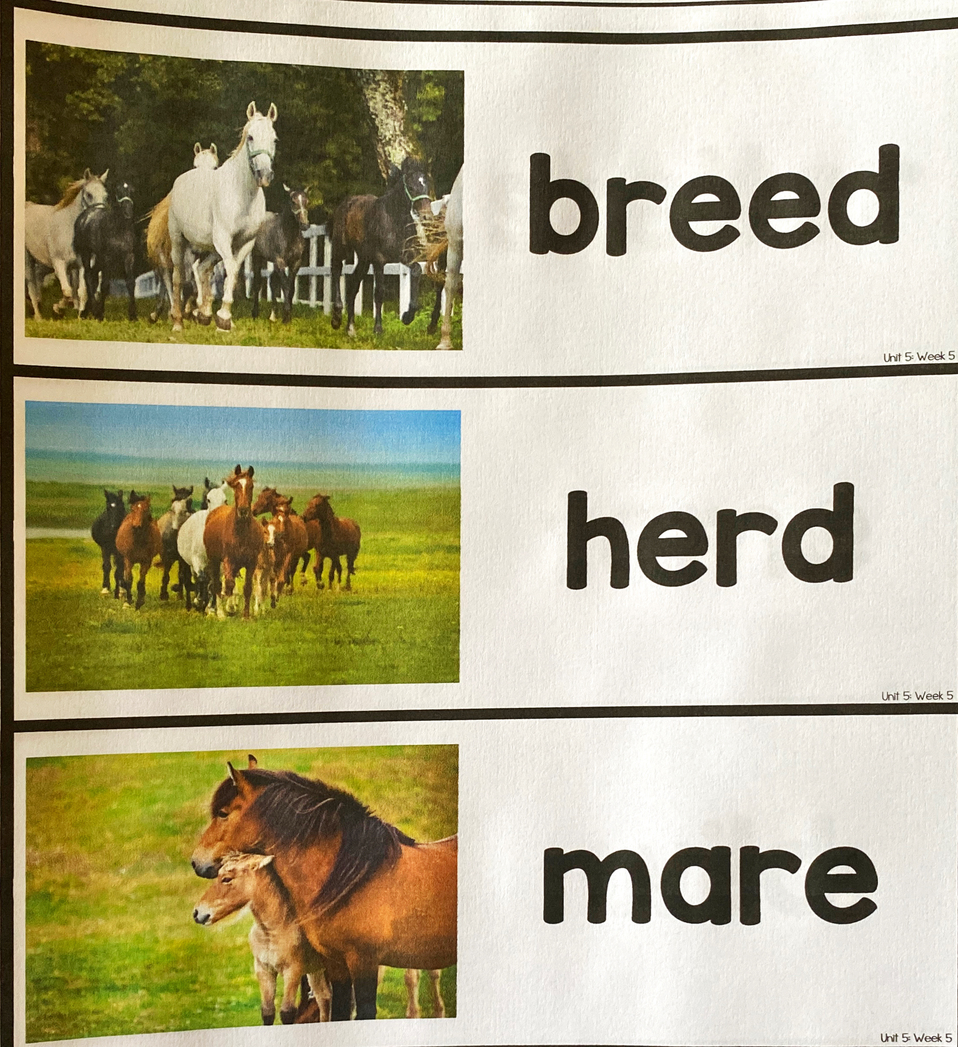
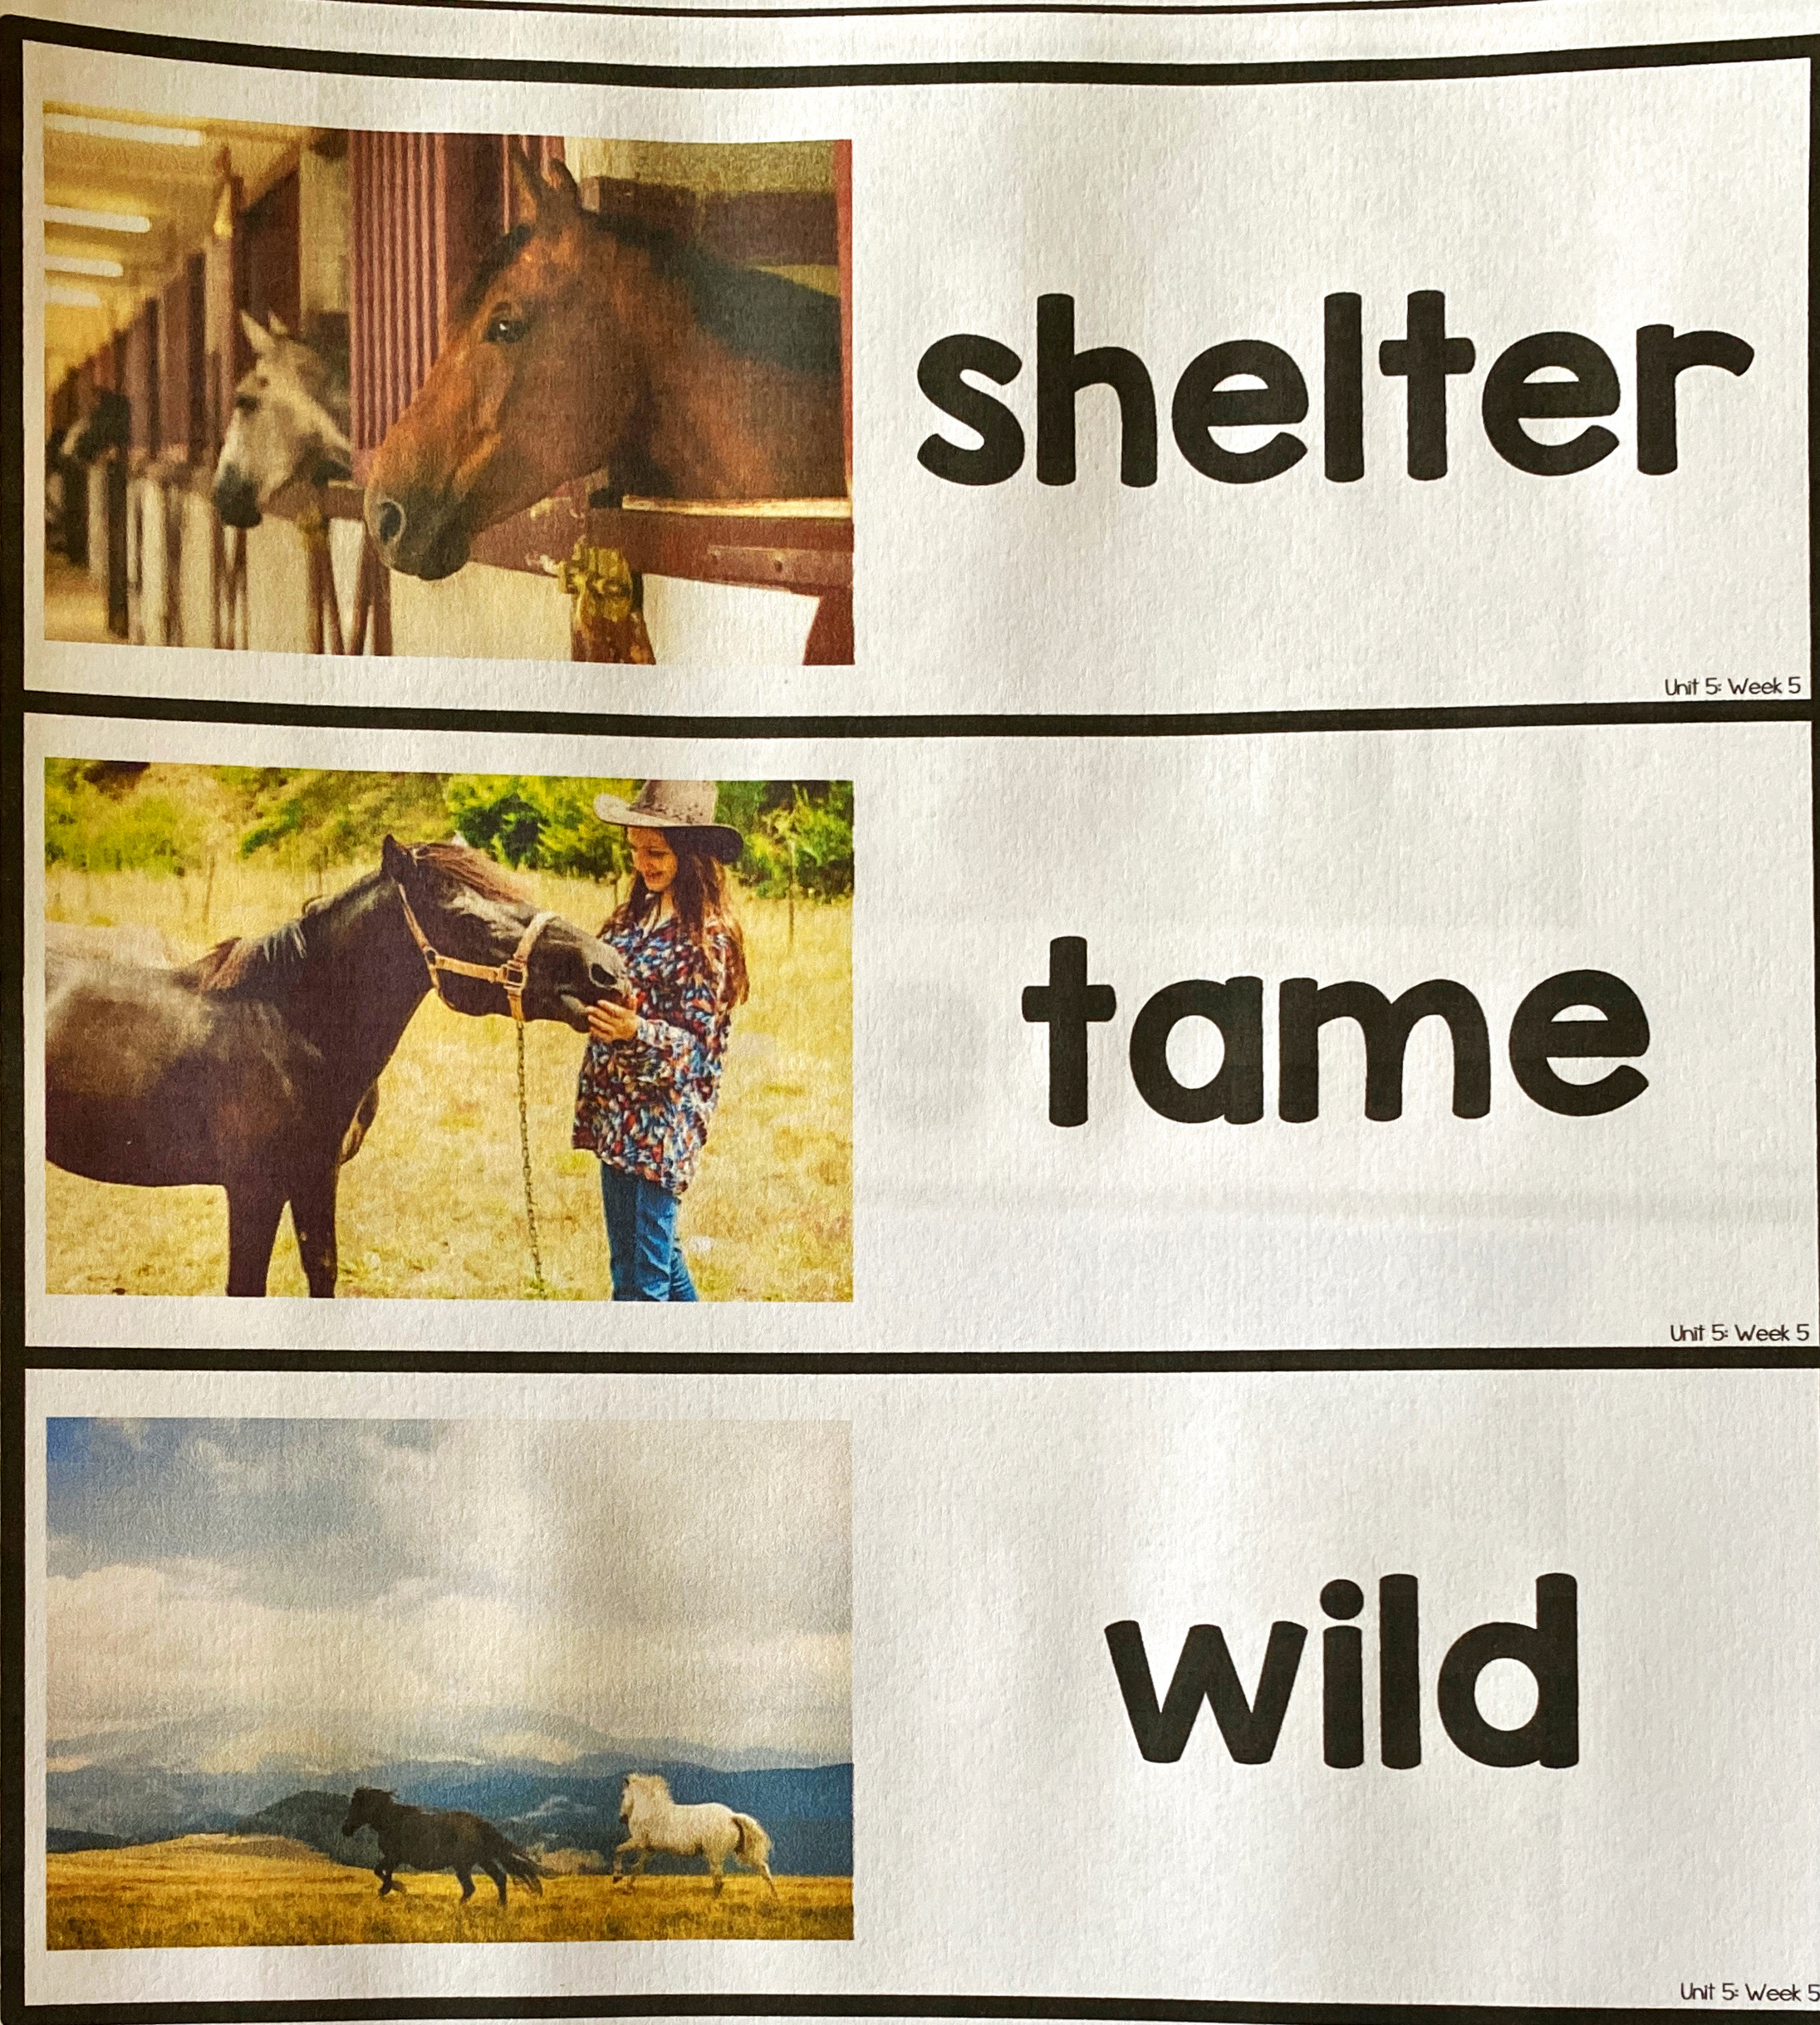
Vocabulary Cards

Slide 9
Day 3
Reread parts of the text then have a discussion with your child based on the questions below.
Discussion Questions
Based on page 4, how does the author feel about ponies?
Not all horses live on farms. What evidence from the test supports this?
Use evidence from the story to support how ponies are a lof of work to take care of.
Label It Activity:
Label the parts of a horse.

Slide 10
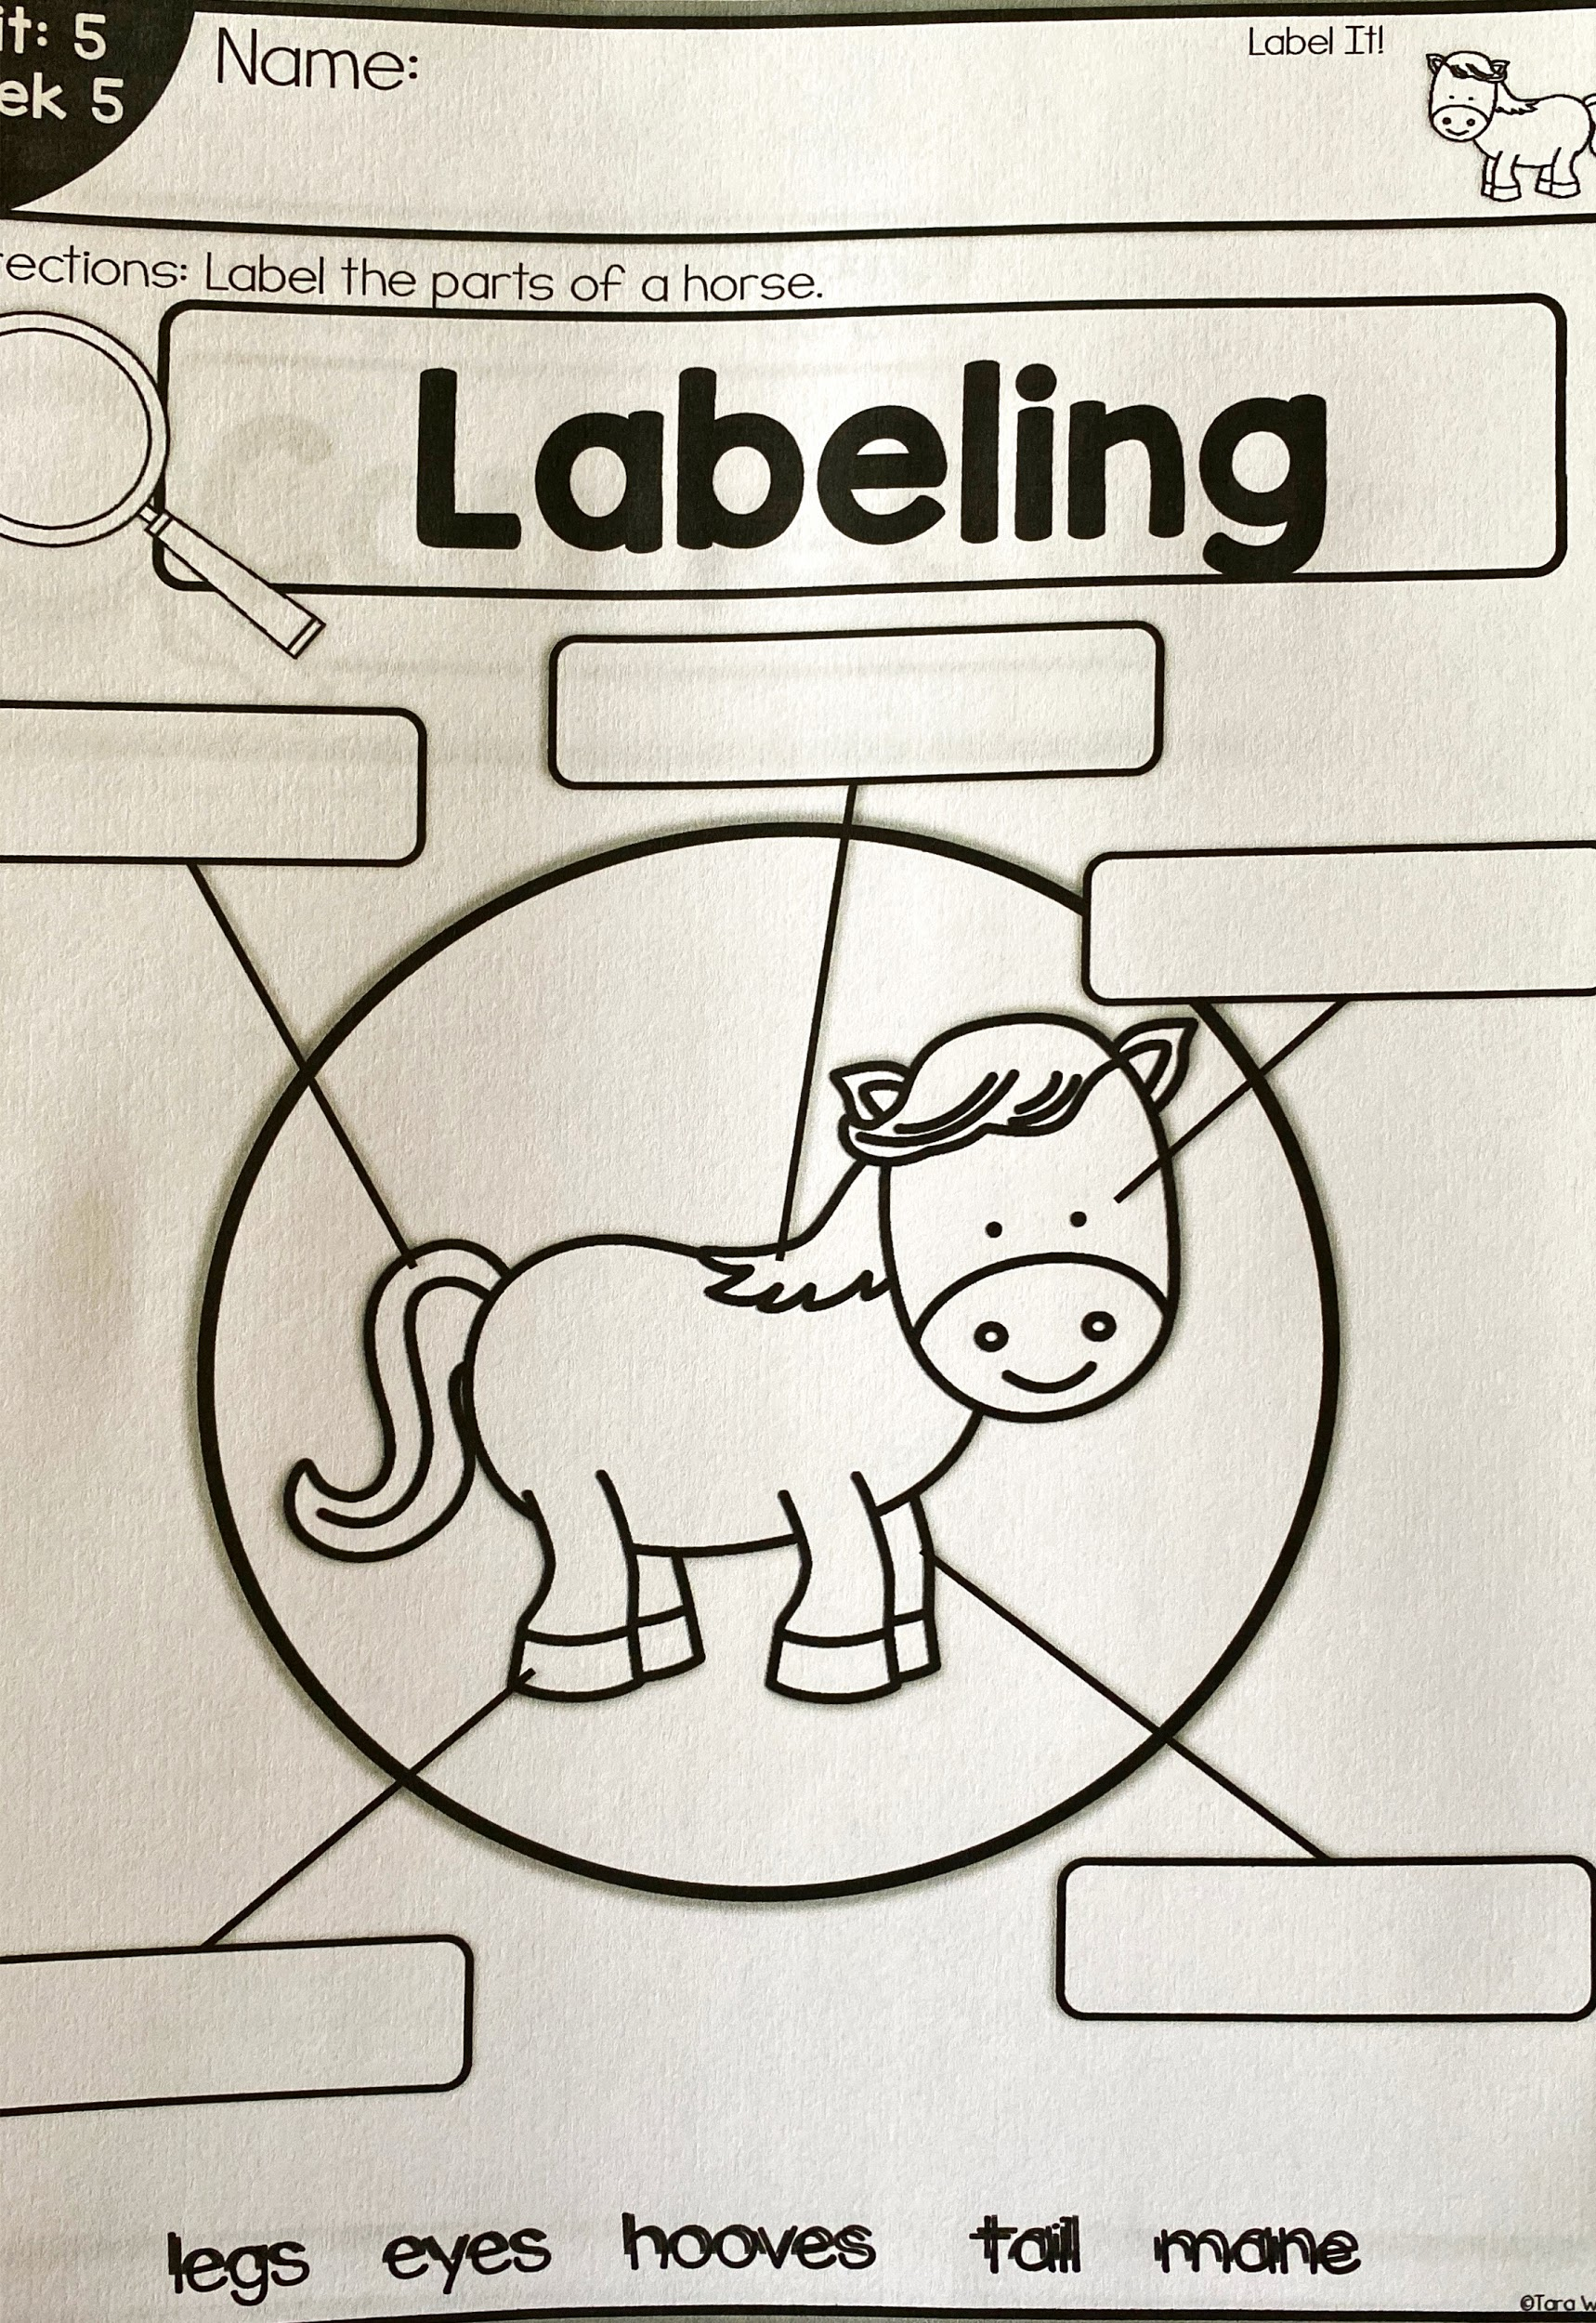

Slide 11
Day 4
Review vocabulary words.
What other animals travel in herds?
Do ponies and people need the same type of shelter? Why/why not?
What type of pony would make a better pet- a tame pony or a wild pony?
What are some other animals that come in different breeds?
Connect It!
Directions: In our text, it stated that taking care of ponies is a lot of work. What is something else you do or take care of that is a lot of work.

Slide 12
Day 5
Wrap up:
What is the difference between a wild horse and a tame horse?
What do you need to do if you have a horse as a pet?
Theme craft: Draw a herd of horses on a farm.

Slide 13
MATH:
Give your child a number between 11 and 19 and have them make that number using tens and ones. Use play dough to make a ten bar ( a long piece of playdough ) and roll balls to make ones OR they can draw it out on paper.

Slide 14
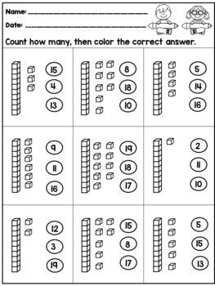

Slide 15
Science
StandarL.K.3A.2 Construct explanations using observations to describe and report what animals need to live and grow (food, water, shelter, and space).
Activity:
Watch the video about horses a couple of times this week.
https://youtu.be/ZxrEgghMA_k
I
Continued on next 2 pages...

Slide 16
Horses
Activity:
After watching the video, discuss these questions with your child:
How long do horses live? (about 25 years)
What do they eat?(plants)
How is this like what you eat? (You eat plants. What kind?)
How do horses sleep? (standing or lying down)
How are horses hooves like your fingernails? (They need to be trimmed)

Slide 17
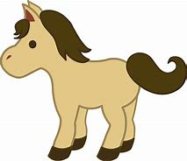
Draw or write about Horses and Ponies
Draw a picture and/or write about something you learned from the video or book.
If possible send and picture of your work to your teacher.

Slide 18
Writing
Activity:
Choose 1:
Write three sentences about your favorite cereal.(opinion)
see science slide (informative)
Write three sentences about a rainy day-page on next slide. (narrative)

Slide 19
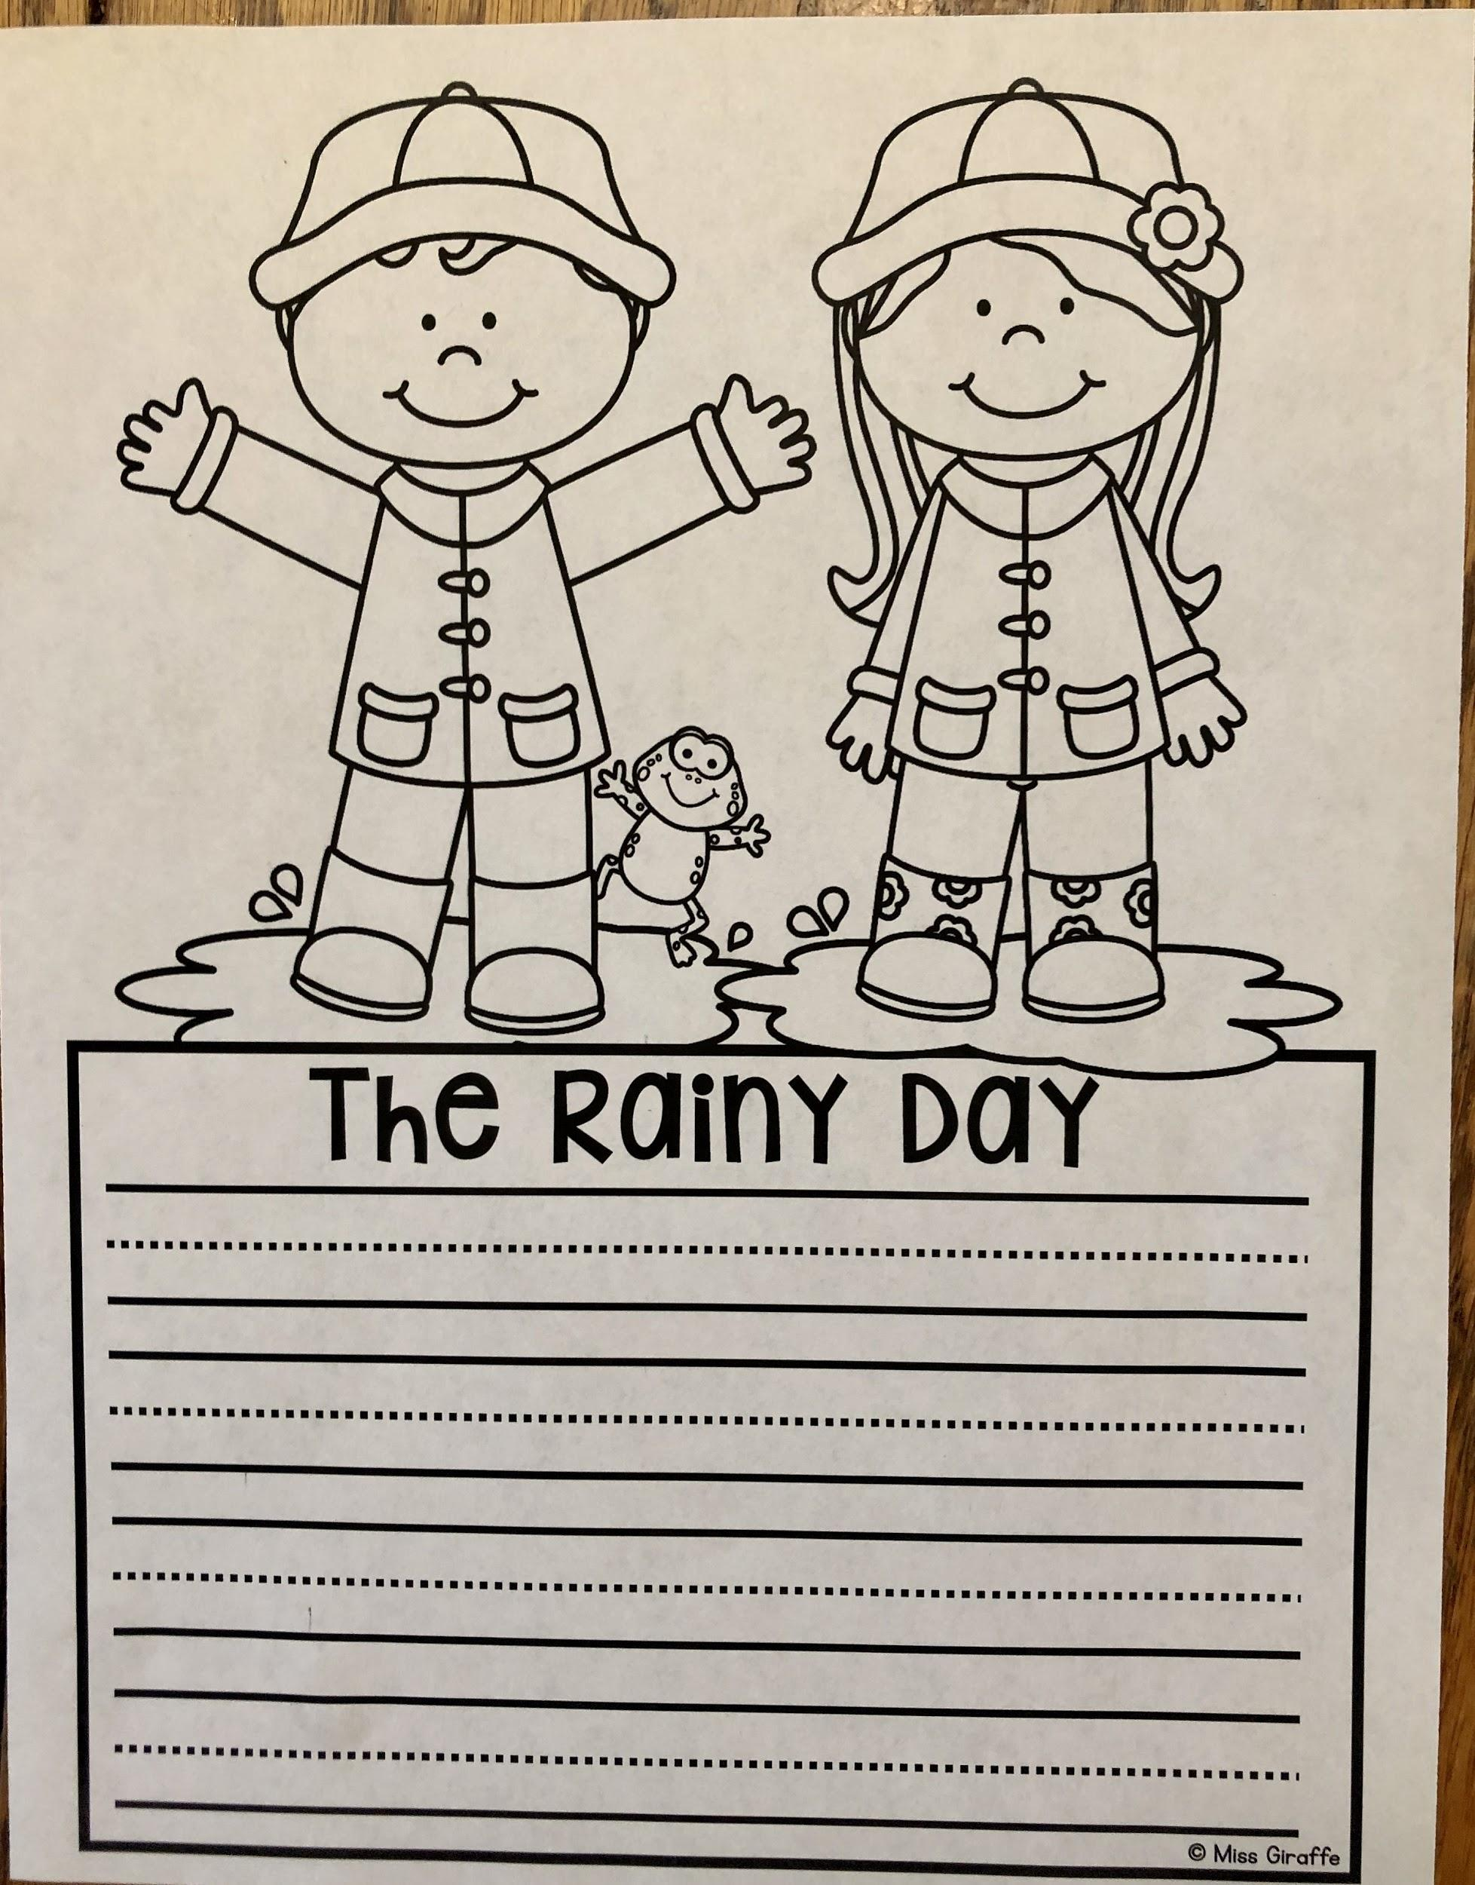

Slide 20
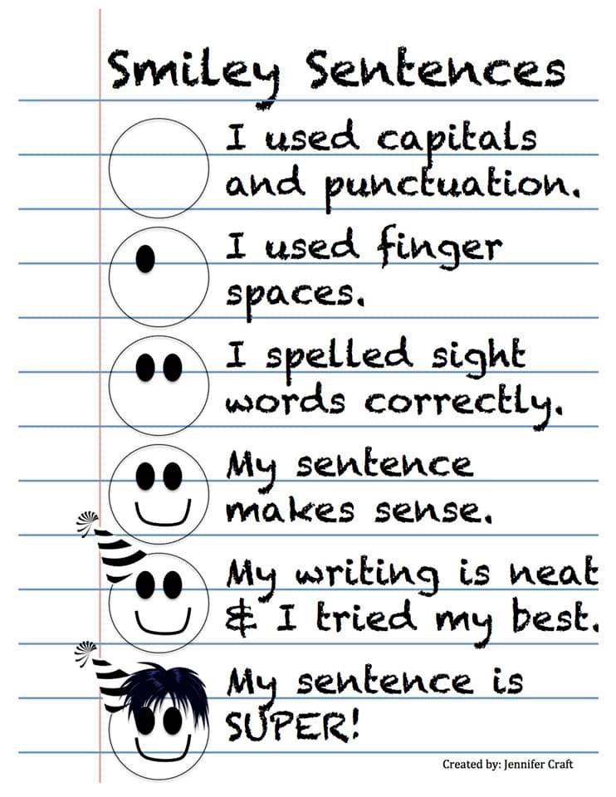

Slide 21
Phonics
The following word list includes words that use our short vowel addressed on the phonics worksheet given. You may practice these words all week by sounding them out and reading them, writing them with different fun materials, coming up with words that rhyme with these words, and even using them in sentences. At the end of the week a spelling test can be given to see if the words have been mastered.
Well
Leg
Ten
Let
Fell
Get
Wet
Bell
Pen
Jet
Bonus word: went

Slide 23
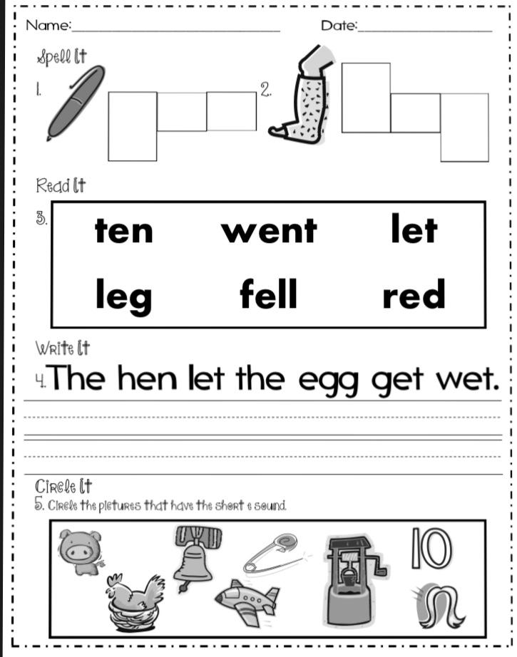

Slide 24
Sight Words
Sight words: now, people, my, made
Activity: Get a baking sheet and flour, shaving cream, or sugar. Using your finger, write your sight words on the pan. After each word, erase and write the next word.

Slide 25
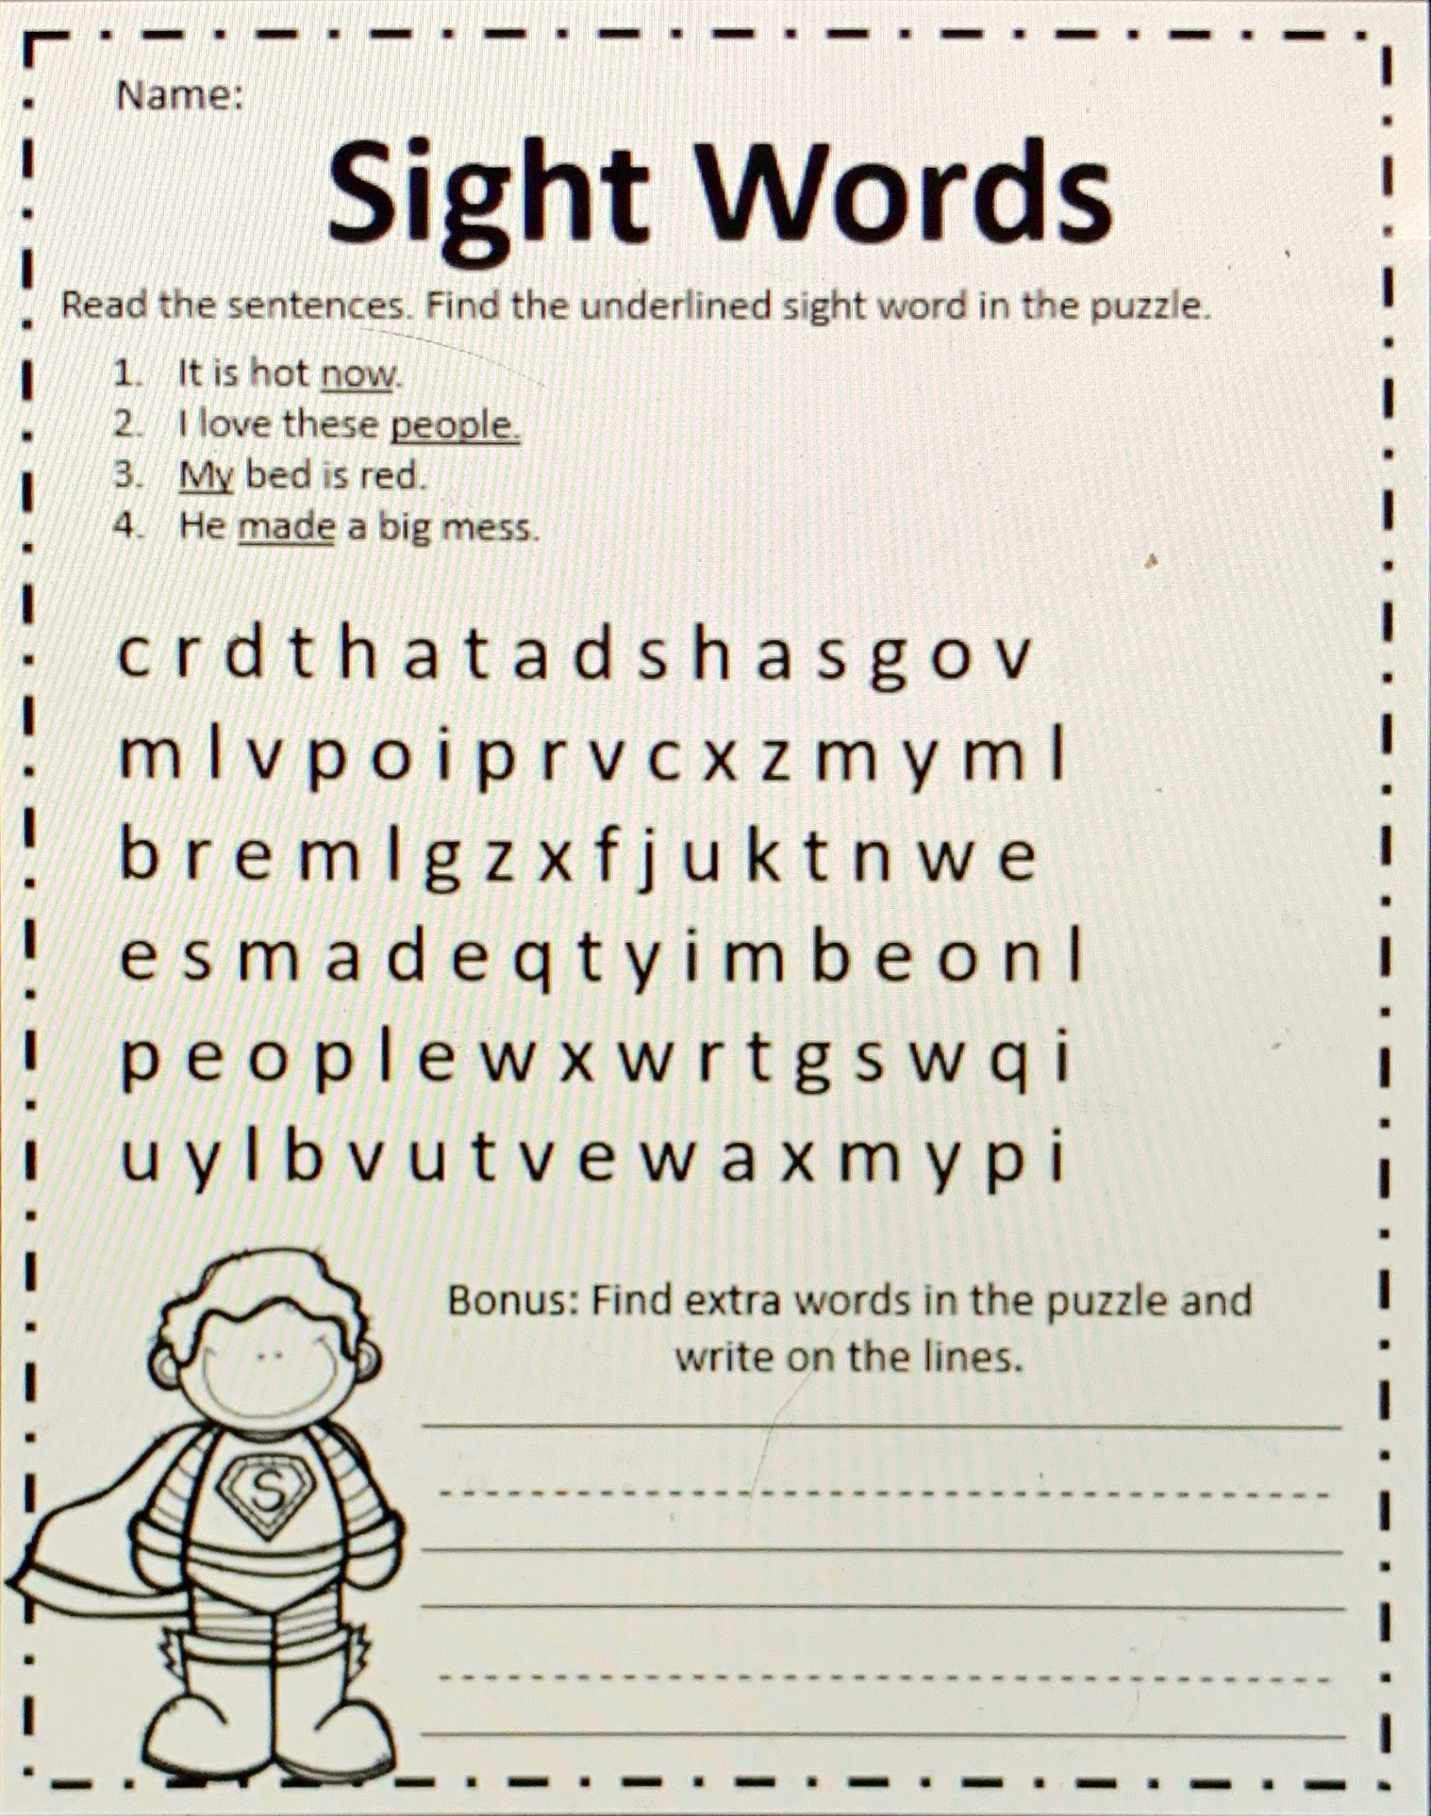

Slide 26
Online Resources Section
These are not links. On this page you will have to type the website name in the web browser, but these are great YouTube alternatives during this time of distance learning and all throughout the year!

Slide 27
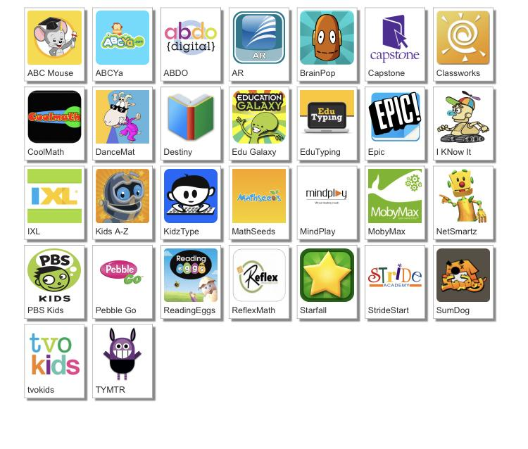
http://www.dcsdms.org/ll/

Slide 28
Message from the Teachers
We miss you guys. We are so proud of all of the hard work you guys have done. Listen to your parents. They are your teachers right now. We may do things differently, but we are all working together to do all that we can for you guys. We would love to see a picture of you working hard. You can send these to us via Remind. Keep working hard, and we hope to see you soon! :)

Slide 29
Note to the parents, thank you for investing in your child’s education!

