Slide 1
Unit 6 Review
Reactions to Industrialization: Imperialism, Native Responses, and Migration
1750 - 1900

Slide 2
6.1
Rationales for Imperialism
Context:
Competition among industrialized states increased the need for colonies.
Social Darwinism was used to justify expansion.
Essential Question: What ideologies contributed to the development of imperialism between 1750 and 1900?

Slide 3
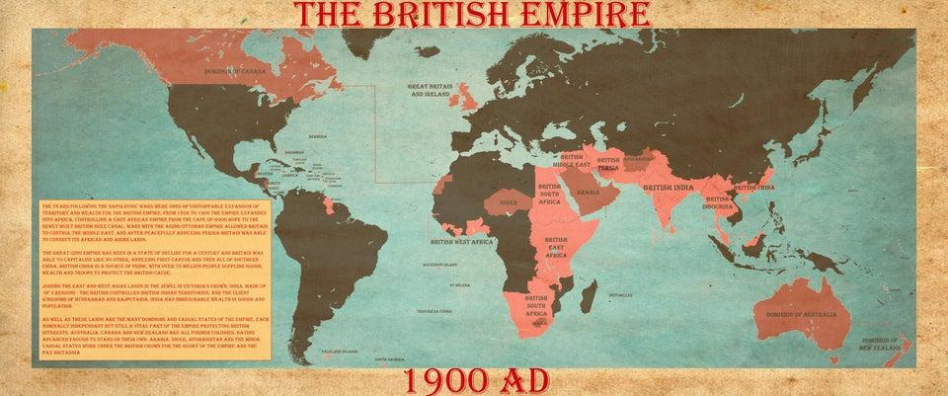
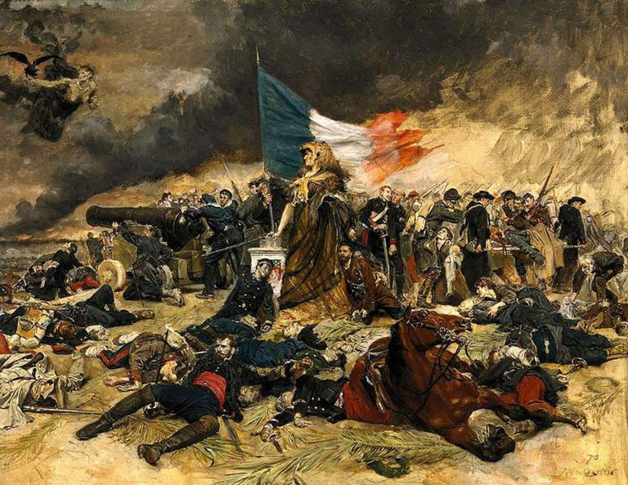
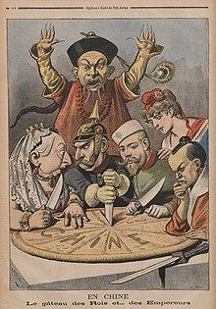
6.1 - Motives for Imperialism
Imperialism: the establishment of overseas empires motivated by a belief in nationalism, a desire for economic wealth, a sense of religious duty, and a belief Europeans were biologically superior.
European Nationalism
Great Britain needed to expand its empire and gain resources after losing American colonies.
Expanded influence in Australia, South Asia, India, and Southeast Asia.
France expanded its territory to increase prestige after losing in the Franco-Prussian War (1870 - 1871)
Algeria in N. Africa, islands in the S. Pacific, Senegal in W. Africa, Indochina in SE Asia.
Italy and Germany were newly united nations and wanted to gain prestige and economic power.
Spain, despite dominating 16th C. colonization, did not imperialize much.
Japanese Imperialization
Use national pride to defend going into Korea.
This upset China who had been there for centuries.
Resulted in the Sino-Japanese War (1894 - 1895).
Japan won and gained access to Korea and Taiwan
Weakened China.

Slide 4
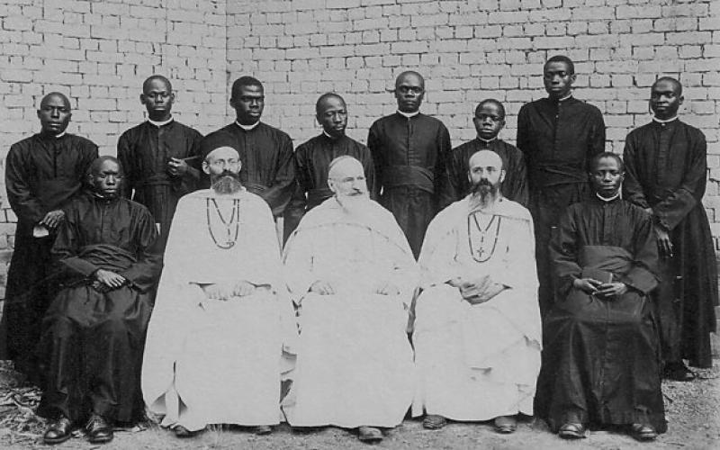
6.1 - Cultural and Religious Motivations for Imperialization
Racial Ideologies
FAKE SCIENCE (Pseudoscience)
Colonial powers believed they were inherently superior to others.
Phrenologists - studies skull sizes.
Non-white skulls were smaller (wrong)
Said this proved mental feebleness of Africans, indigenous Americans, and Asians.
Social Darwinism - Modified Charles Darwin’s “survival of the fittest” ideas.
Spread os US and European power proved they were biologically superior
FAKE NEWS
Cultural Ideologies
Imperialists believed they were culturally superior.
Combined many local cultures into one colony.
Introduced language, political, religious, and educational institutions in colonized areas.
Exerted cultural influence on architecture and recreation.
Religious Ideologies
Missionaries also moved into imperialized areas.
Criticised for encouraging natives to give up traditional beliefs in favor of Christianity
This leaves them open for Economic Imperialism
Pros of Missionaries:
Set up Schools
Improved medicine
Many worked to end slavery.

Slide 5
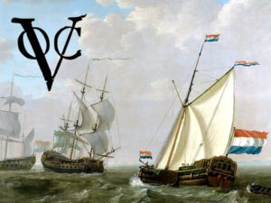
6.1 - Economic Motivations for Imperialism
Ideological motivations were used to justify economic imperialism. Europeans first established trading posts through treaties with local Indian, E. African, and E. Indies rulers. Companies moved into the region for the spice trade and had some governmental powers (armies, conquering territory). Industrialization sped up this search for resources creating competition between imperial powers.
British East India Company (EIC)
Monopolized British trade with India beginning in 1600. (Cotton, Silk, Spices)
Expanded to E. Asia.
By 1834, was the British Governments managing agency in India.
Engaged in slave trade.
Exported Opium to China (illegally)
Dutch East India Company (VOC)
Monopolized trade between S. Africa and the Straits of Magellan in S. America.
Concentrated on islands around Java.
Dutch government took control of company in 1799 due to corruption and dept, creating Indonesia. (Dutch East Indies)
The “New Imperialism”
Great Britain was the first major imperialist power.
Colonies gave raw goods to be worked in factories, provided new markets for finished goods, and food.
Second IR other nations began to look to create imperial empires.

Slide 6
6.2
State Expansion
Context:
Joint-Stock Companies like the BEIC and the VOC had monopolized trade in India regions between Africa and South America
Over time, states took over control of these companies.
Industrialization gave nations an advantage over non-industrialized nations (military, etc.)
Essential Question: By what process did state power shift in various parts of the world between 1750 and 1900?

Slide 7
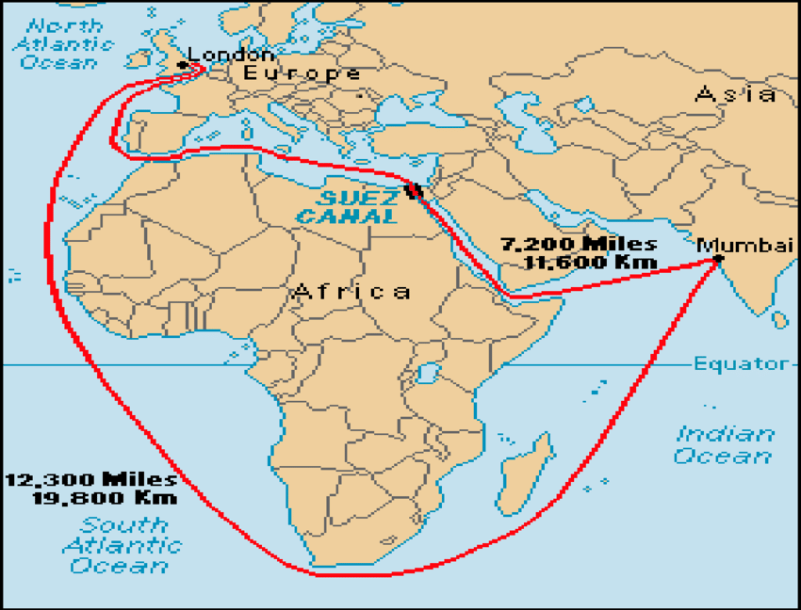
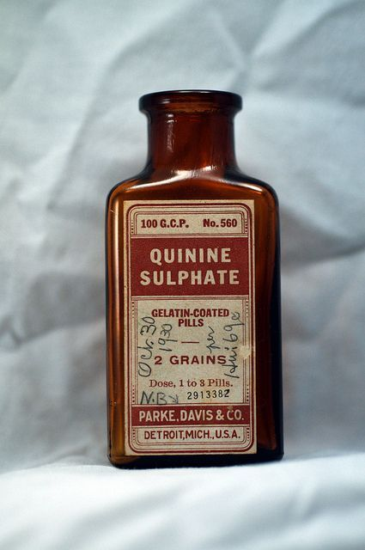
Imperialism in Africa
European nations had a long standing relationship with Africa due to the slave trade. After slavery was made illegal, Europe continued to export guns, alcohol, and manufactured good to Africa and import palm oil, gold, ivory, and diamonds from Africa.
Shift from Trading Posts
Discovery of medicines like quinine (malaria) reduced the dangers of Europeans living in Africa.
Advanced military technology made it easier to overtake African nations.
British Control of Egypt
Great Britain seized control of Egypt from the Ottoman empire to ensure the construction of the Suez Canal
Saved the trip around Africa to get from W. to E.
Built by corvee laborers - 1.5 million Egyptian forced workers.
1000’s died.
British in W. Africa
GB spread W. education, English, and Christianity.
Sierra Leone - 1787 - home for former slaves from B. Empire.
Gambia - 1816 - base to stop slave trade.
Lagos - 1861 - Base for annexation of Nigeria
Used treaties first
Recognize rulers power in exchange for resources.
Were mostly meaningless.
French in Africa
Drove the Ottomans out of Algeria in 1830.
Became Settler Colony - somewhere people move to live - for Spanish, Italian, and French Immigrants.
EST. trading posts in Guinea, Ivory Coast, and Niger to compete with British W. African colonies.

Slide 8
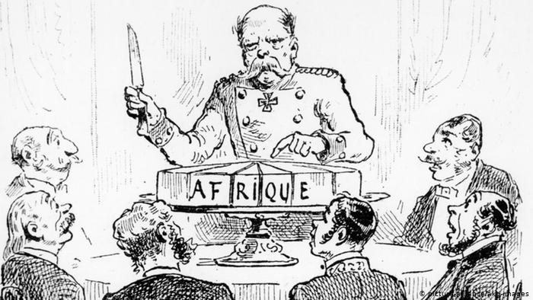
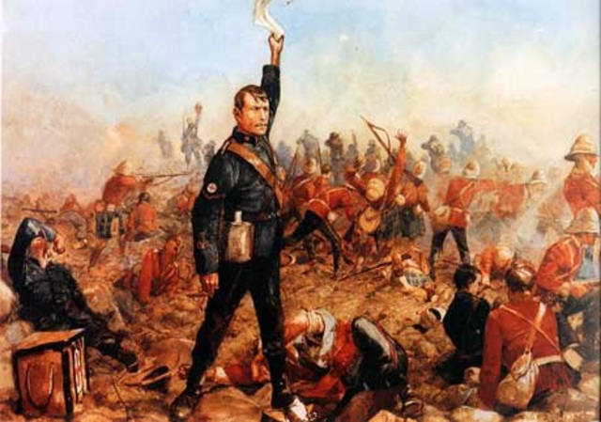
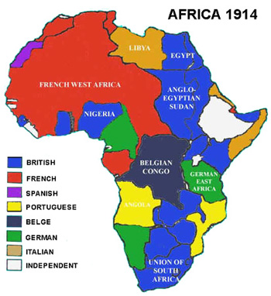
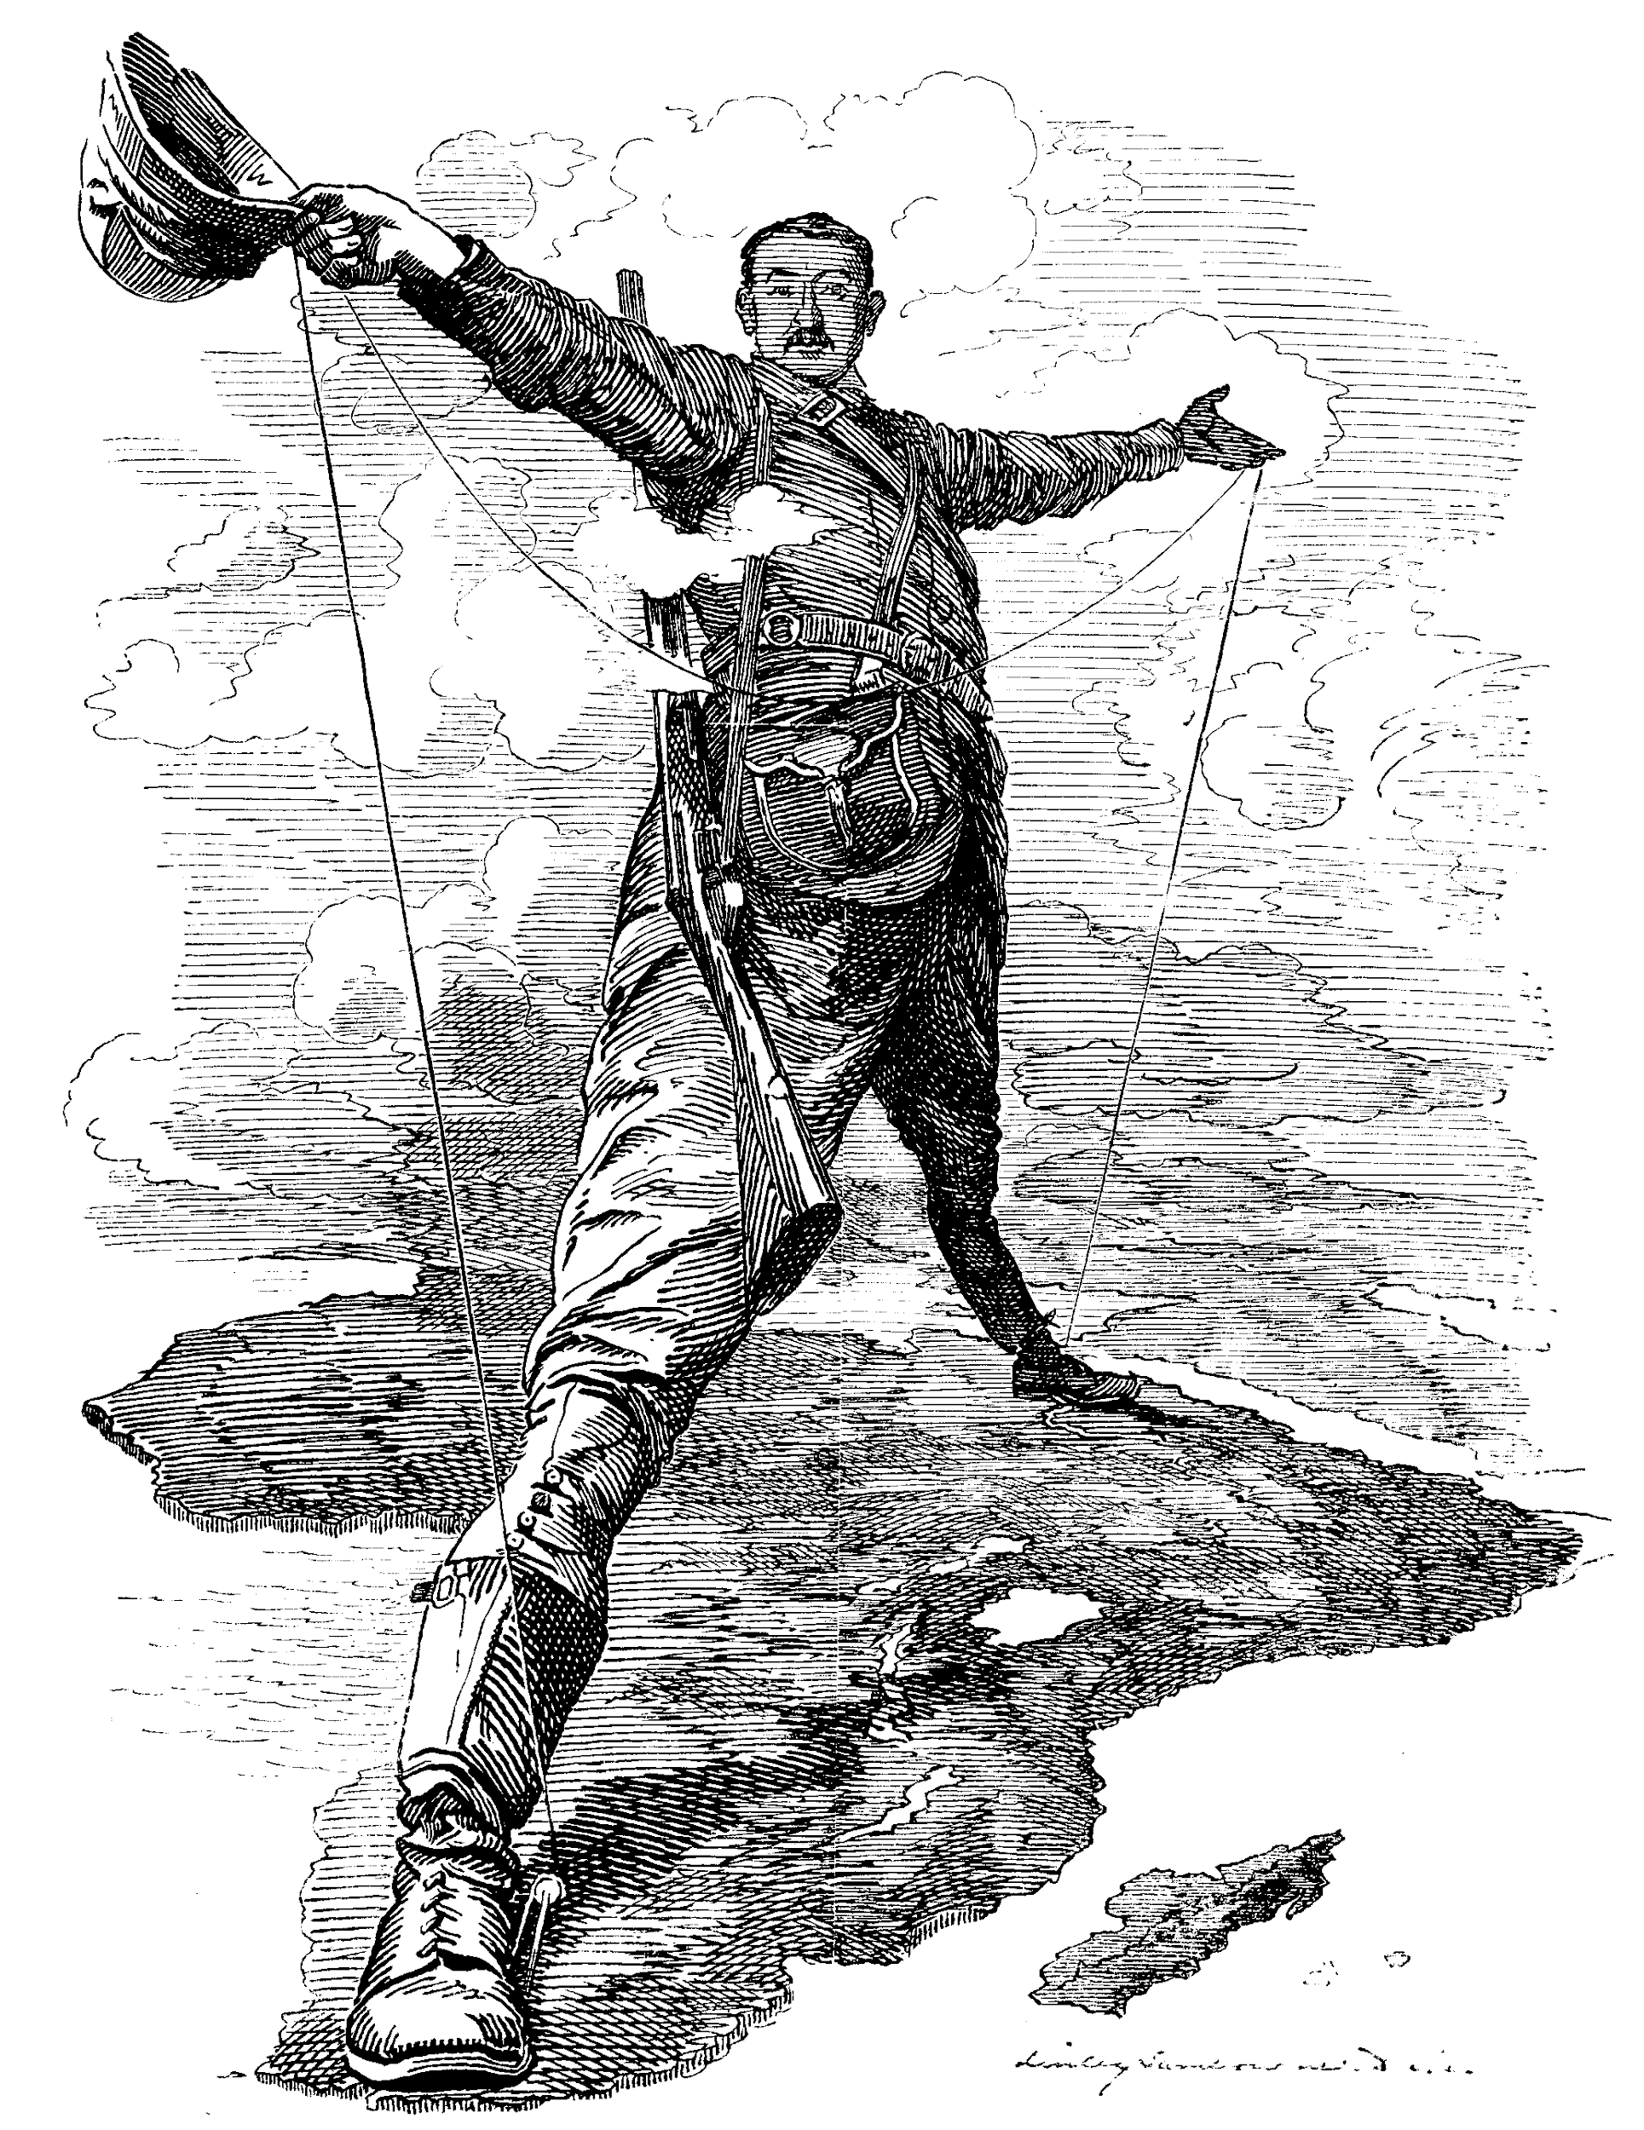
European Scramble for Africa
Scramble for Africa: Competing efforts of Europeans to colonize Africa in search of natural resources.
Berlin Conference:
Germany’s Otto Von Bismarck wanted to keep the peace in Europe - hosted the Berlin Conference in 1884.
Orderly Colonization of Africa.
No Africans invited.
Made colonial boundaries
Ignored existing tribal boundaries.
This causes centuries of unrest.
Free movement of goods on major rivers.
Liberia and Ethiopia (Abyssinia in the 19th c. ) were the only unclaimed African countries by 1900
Liberia had a relationship with US - home for former US Slaves.
Boer Wars in South Africa
Dutch first colonized South Africa before being push out by British in the Napoleonic Wars (1799 - 1815)
Afrikaners (Dutch descendants) clashed with native populations and British over land. - Led to Boer Wars
Brutal Conflict.
British push natives and Afrikaners from lands, forcing many into concentration camps
Angered activists.
15,000 of 100,000 black people interned died.
British absorbed Southern Africa into empire.
Millions of Afrikaner and black African farmers were displaced onto bad farming land making life very hard.

Slide 9
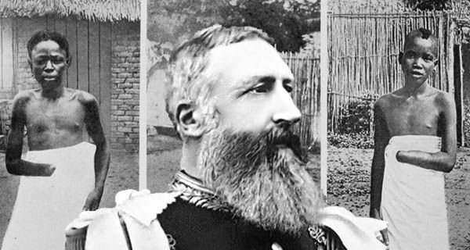
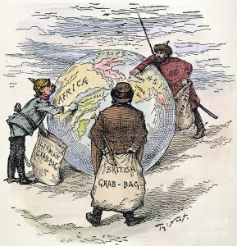
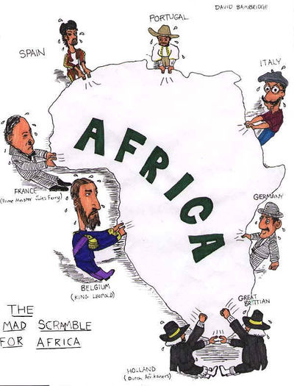
European Scramble for Africa
Congo:
King Leopold II wanted Belgium to colonize Africa.
They were resistant, so he used his personal money to invade and colonize Congo.
He personally made 1.1 billion dollars (in today’s world through economic imperalization.
Harvested ivory and rubber
Brutal working conditions for Africans.
People were beaten and killed, or scared into submission.
Essentially, the workers were slaves, and their spouses were held captive while they worked.
As many as 8 million Africans died under King Leopold.
In 1907 Belgium took over control of the Congo as a colony and conditions improved.

Slide 10
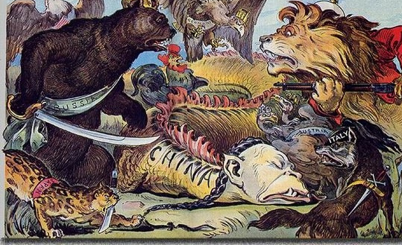
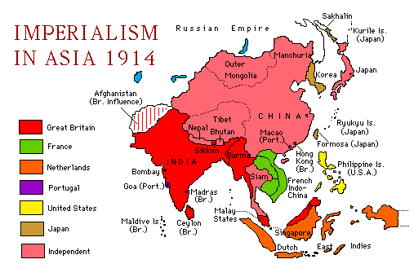
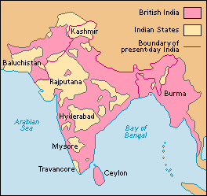
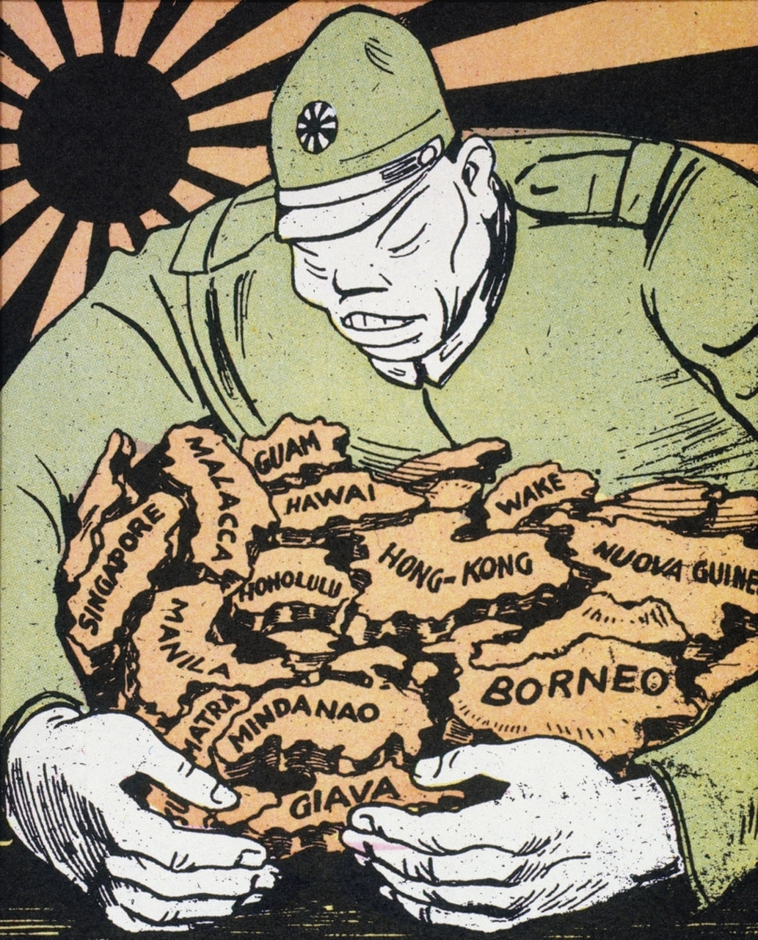
Imperialism in Asia
South Asia (India)
Portugal, France, and England competed for Indian spices, gems, and eastern trade.
Portugal est. trading posts in the 16th c. but never moved inland.
France est. ports in 17th c.
Was pushed out of India in the 7 years war against GB (1756 - 1763)
BEIC encroached on land of Mughal Empire
Slowly gains control of the entire Indian continent using Sepoys.
East Asia
In the late 19th and early 20th c. China was weakened by the Taiping rebellion, the Yellow River changing course causing drought and famine, and the Boxer Rebellion, (See speaker notes for more info on each)
This allowed European powers to carve of Spheres of Influence in China.
They had exclusive trading rights with China in their region.
Japan
Was industrialized and wanted in on the colonies!
Isolated nation with little farmable land - so it looked for natural resources elsewhere.
To relieve population pressure:
Encouraged workers to work seasonally in Hawaii and Guam.
Colonization Society formed in 1893 tried to colonize Mexico and Latin America and create ports in China, Korea, SE Asia, and the Pacific Islands
From 1890 to end of WWII
Notes:
Taiping Rebellion - 1850 - failed civil servant applicant and starving peasants, workers, and miners attempted to overthrow Qing Dynasty. France, GB, and Chinese warlords stepped in to stop rebellion in 1864.
Yellow River - Changed course in the middle of the Taiping Rebellion flooding some farmland and making other areas dry. Resulted in famine. Then the plague broke out! 20 million Chinese died between this and the rebellion.
Boxer Rebellion - Anti - imperialists called the Boxers began attacking Chinese Christians and Western missionaries. Dowager Cixi (remember her from unit 5? She was pretty anti-industrialization and reform in China except removing the civil service exam) encouraged the Boxers. Only about 250 foreigners were killed, but about 100,000 Chinese Christians were killed. The empress and the Qing dynasty suffered great blows to their legitimacy.

Slide 11
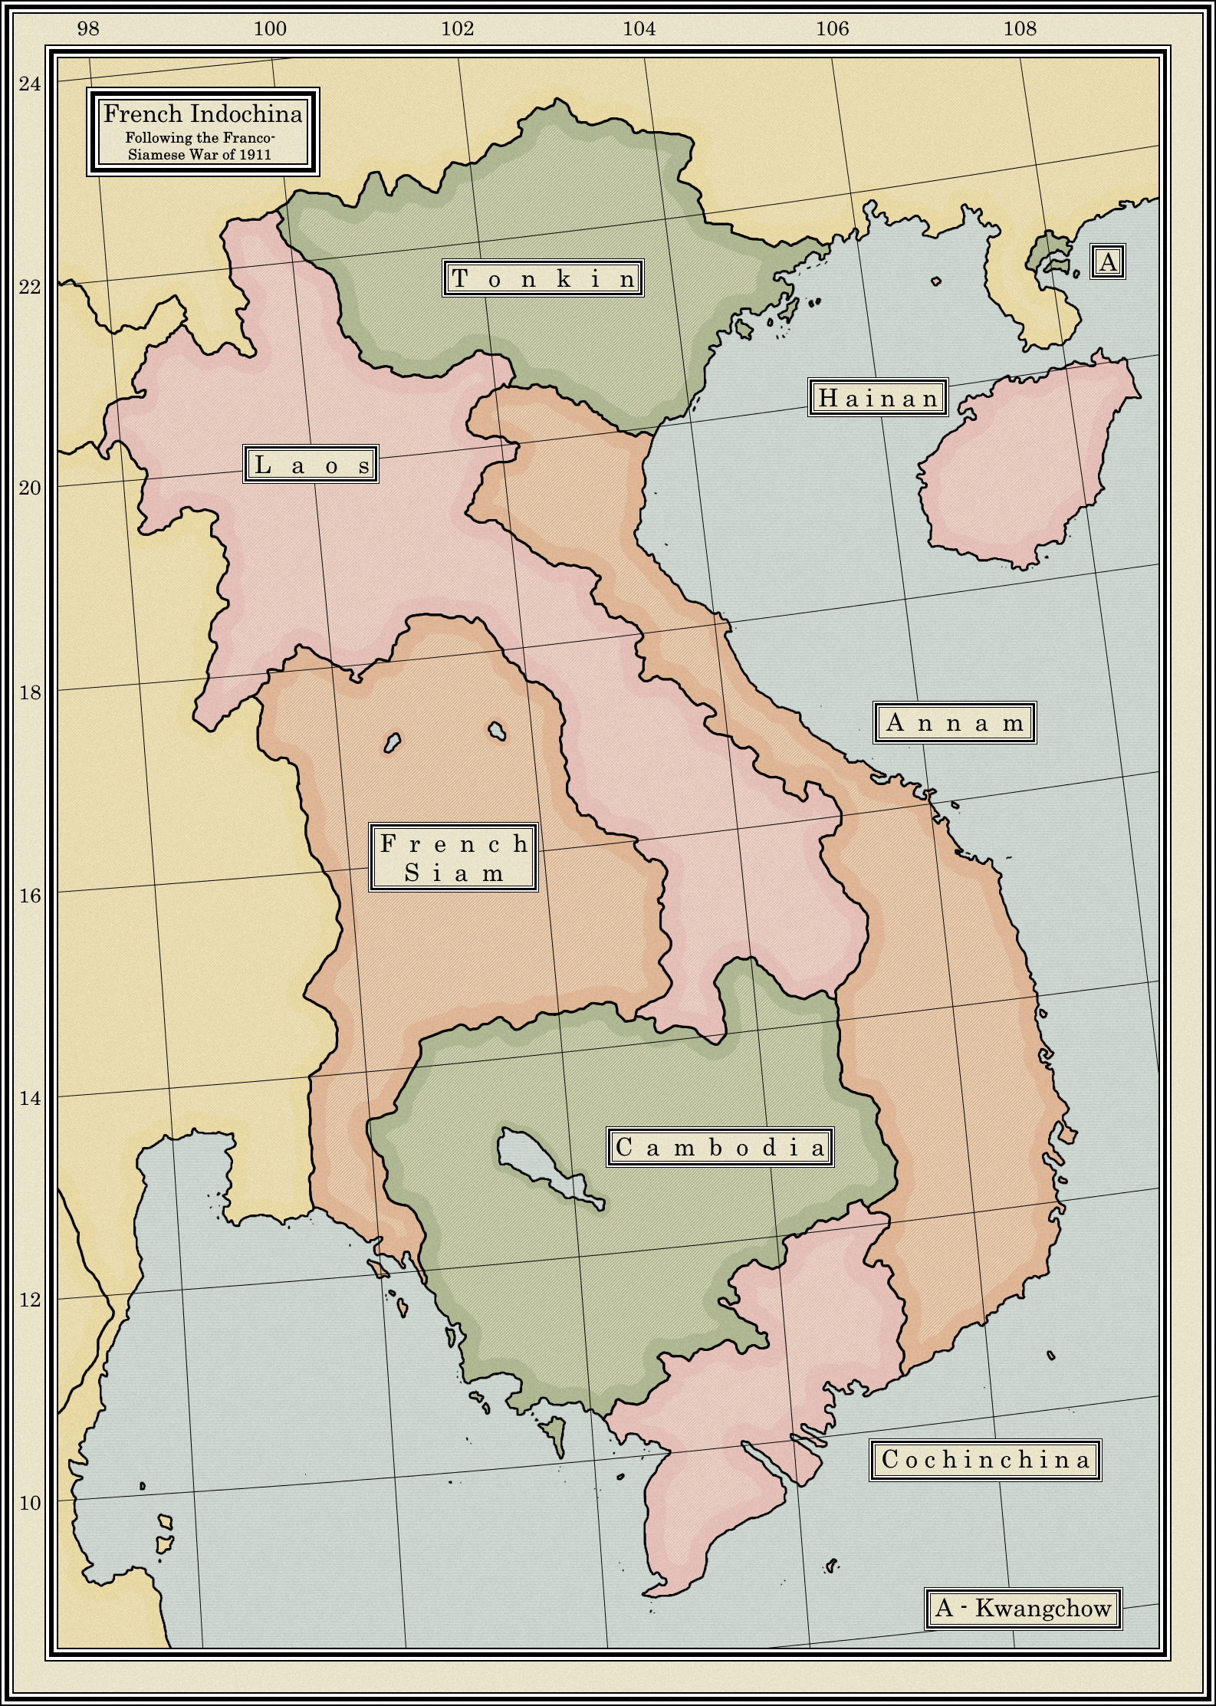
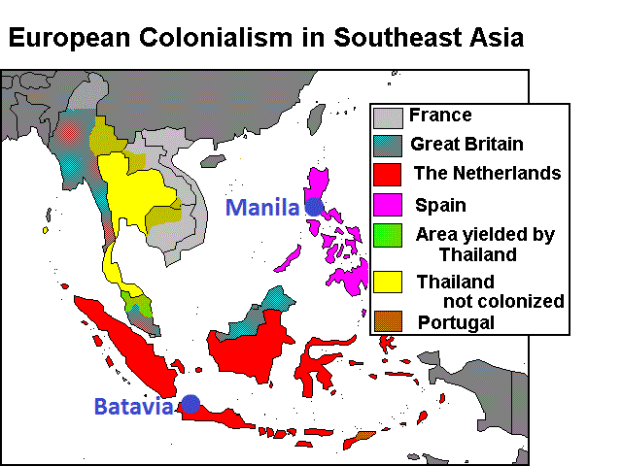
Imperialism in Southeast Asia
Dutch in Southeast Asia
Dutch East India Company (VOC) took control of the Spice Islands (now Indonesia) first.
Took over spice trade from Portuguese
Set up lots of trading posts.
Trade was profitable, but the company was corrupt.
After the VOC went bankrupt in 1800, the Dutch Government took over and established the Dutch East Indies.
Produced tea, rubber, sugar for export.
Limited local rice production creating hardship for Indonesian farmers.
Government tried to pass reforms, but they failed.
French in Southeast Asia
France gained control of Vietnam after defeating China in the Sino - French War (1883 - 1885).
Took control of Cambodia and Laos from Siam.
All of the French holdings came to be known as French Indochina.
Imperialised for cash crops.
Cultivated rubber in Cambodia and Vietnam hurting local food agriculture.
Through diplomacy and state sponsored industrialization, Siam - modern day Thailand - is the only area in the region to avoid 19th C. European Imperialism.
British in Southeast Asia
BEIC moved into SE Asia by getting Penang, and island off the Malay peninsula in 1786.
Interested in mineral wealthy like tin and gold.
Encouraged production of pepper, tobacco, palm oil, and rubber in region.
Mayla becomes world’s biggest rubber producer.
1825 - GB founded port of Singapore - eventually most important port in SE Asia.
GB eventually controlled all of Malay Peninsula.
Notes:
Taiping Rebellion - 1850 - failed civil servant applicant and starving peasants, workers, and miners attempted to overthrow Qing Dynasty. France, GB, and Chinese warlords stepped in to stop rebellion in 1864.
Yellow River - Changed course in the middle of the Taiping Rebellion flooding some farmland and making other areas dry. Resulted in famine. Then the plague broke out! 20 million Chinese died between this and the rebellion.
Boxer Rebellion - Anti - imperialists called the Boxers began attacking Chinese Christians and Western missionaries. Dowager Cixi (remember her from unit 5? She was pretty anti-industrialization and reform in China except removing the civil service exam) encouraged the Boxers. Only about 250 foreigners were killed, but about 100,000 Chinese Christians were killed. The empress and the Qing dynasty suffered great blows to their legitimacy.

Slide 12
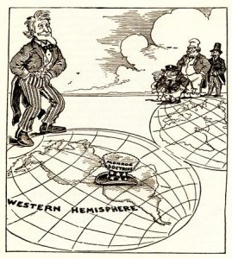
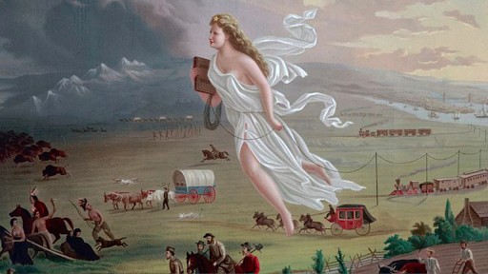
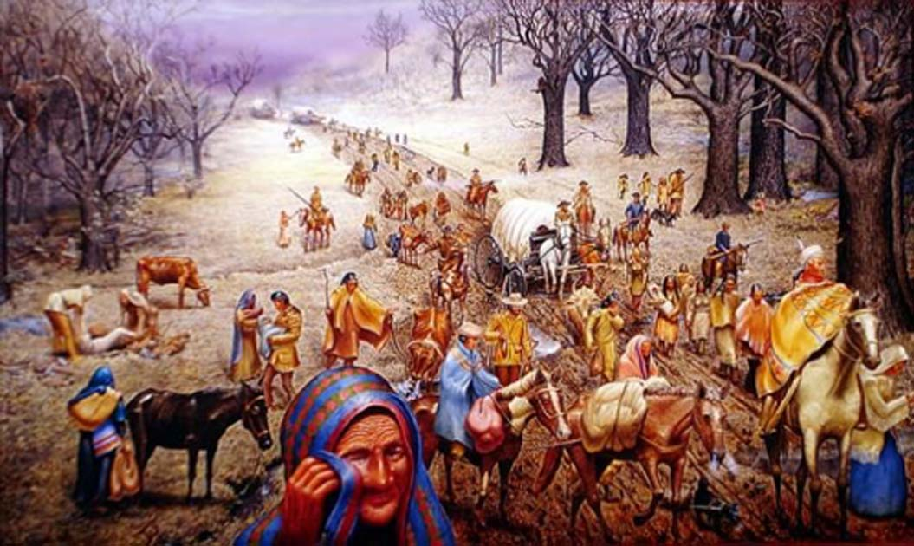
American Imperialism in Latin America
Expansion on Land
Manifest Destiny - inevitable US expansion to Pacific Ocean.
Bought Alaska from Russia in 1867.
1869 completion transcontinental Railway
Encouraged development of American West.
Natives were forced on reservations.
Expansion Overseas
Economic considerations, the second IR, and nationalism drove US to imperialize overseas.
1895 overthrew Hawaii’s constitutional monarchy.
1898 Spanish-American war gave US Guam, Cuba, Puerto Rico, Philippines
1904 Roosevelt Corollary (he was a Social Darwinist) to the Monroe Doctrine said any LA country showing “instability” would be inverted on by the US
They did so several times like in the Caribbean and Dominican Republic
Removal of Indigenous Peoples
US continued its tradition of taking land from native populations in the 19th c.
Forced the relocation of Eastern Woodlands people from the SE US to Indian Territory in Oklahoma
So many died from malnutrition, disease, exhaustion if is called Trail of Tears.
Monroe Doctrine
1823 - President Monroe says Europe should not interfere with Western Hemisphere.
US wanted to be imperial power in the Americas
Mexican-American War - US takes lots of land in SW from Mexico.

Slide 13
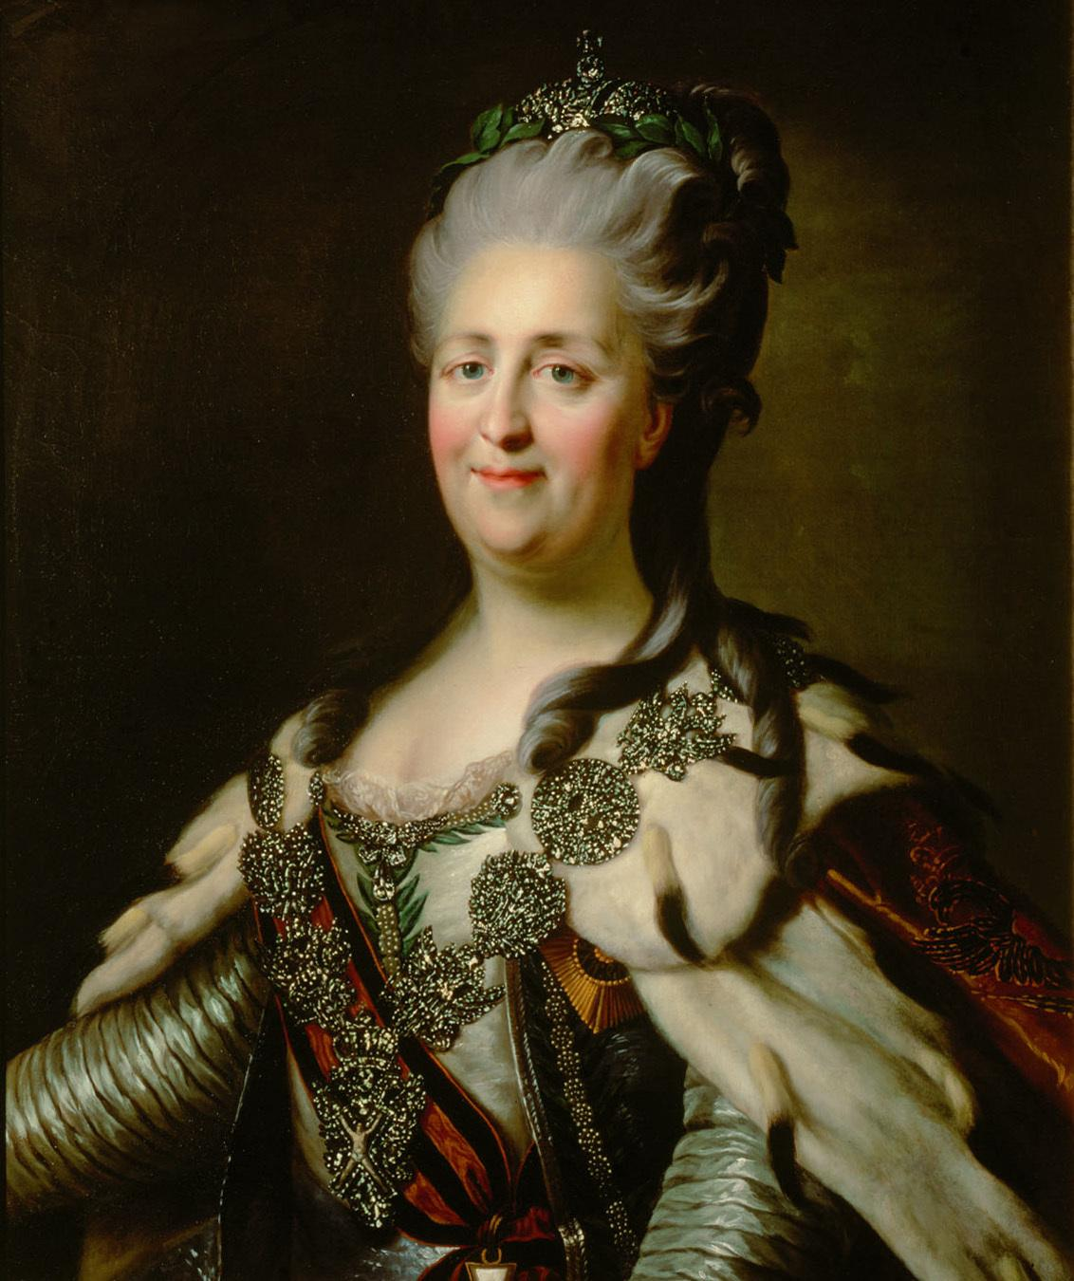
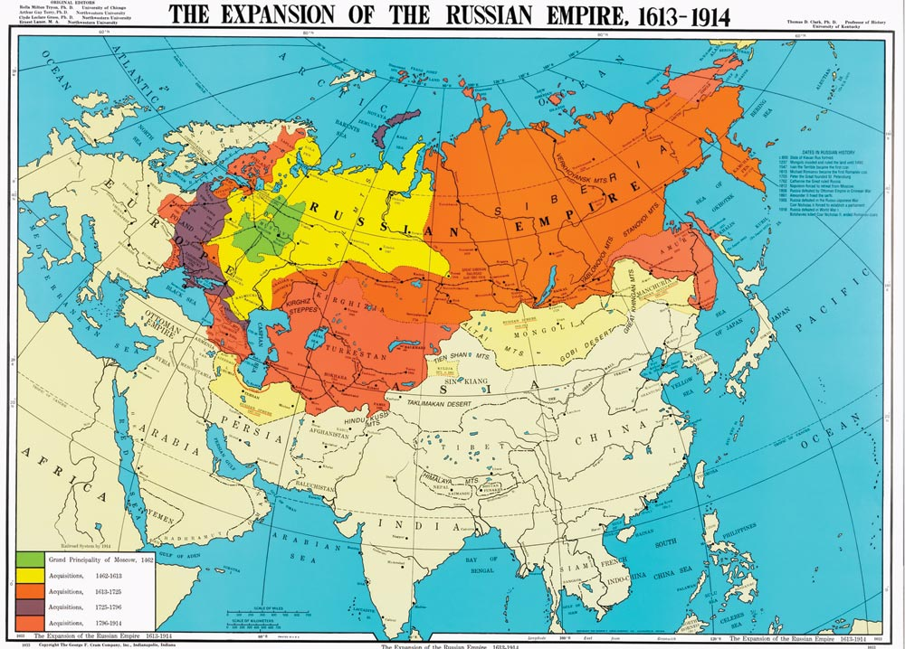
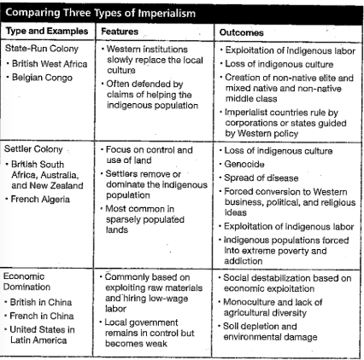
Outcomes of Imperialism
Russian Expansion:
Catherine the Great (II) expanded Russia in all directions during her rule (1815 - 1825) and annexed half of Poland and territory from the Ottoman Empire
Her grandson Alexander I annexed Finland, Moldova, Georgia, Azerbaijan, and part of Armenia during his reign (1815 - 1825).
In the 1740’s Russian merchanged voyaged to Alaska
A Joint-stock company type comapny called the Russian - American Company established headquartered in Alaska and explored the West Coast of N. America but abandoned N. America to the US by 1867.
Rivalry with GB grew as they pushed into Central Asia.
The Great Game was the struggle for Afghanistan between Russia and GB - both were unsuccessful.
Took land from China - including large parts of Manchuria.
Australia and New Zealand:
GB sent prisoners to Australia colony beginning in 1788, but switched to production of goods like wool in the 1830s. Settlers began moving to Australia and were encouraged by the discovery of copper and gold in the 1850s.
Created settler colony in New Zealand in 1839. Said they would protect Maori’s in Treaty of Waitangi, but there were lots of clashes anyways. Grew to make food for growing Australian colony

Slide 14
6.3
Indigenous Responses to State Expansion
Context:
Enlightenment ideas and Western style education began moving to Africa, Asia, and South America.
Nationalist movements emerged as a result of European imperialism.
Essential Question: How and why did internal and external factors influence state building between 1750 and 1900?

Slide 15
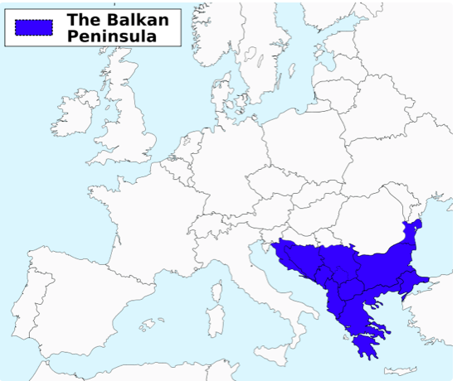
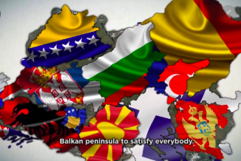
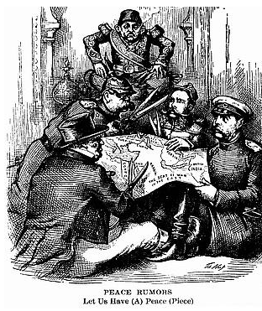
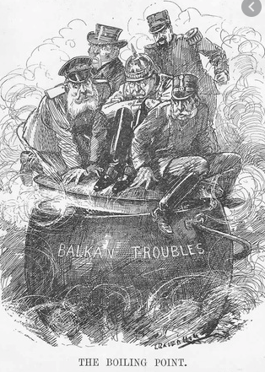
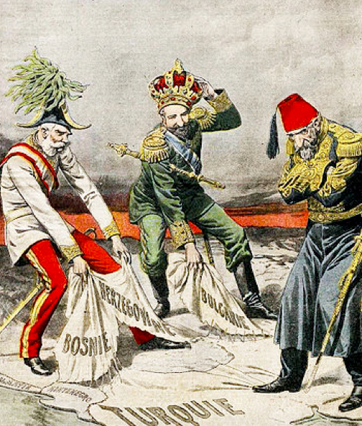
6.3 - Balkan Nationalism
The Ottoman Empire had stretched deep into Europe at its height. However, by the 9th C. it was losing its hold on the remaining European territories in the Balkan Peninsula.
.
Nationalist/Independence Movements:
Serbia (1815) - Won War
Greece (1832) - Won War
Rebelled against Ottoman Rule:
Bosnia and Herzegovina
Montenegro
Bulgaria
1877, Serbia and Russia came to their aid in the Russo-Turkish War.
Treaty of Berlin freed Bulgaria, Romania, and Montenegro, but gave Bosnia and Herzegovina to Austria-Hungary
Balkan Nationalism:
Inspired by the French Revolution
Growing ethnic nationalism led the people of the Balkans to seek independence.
These tensions eventually lead to WWI.
.

Slide 16
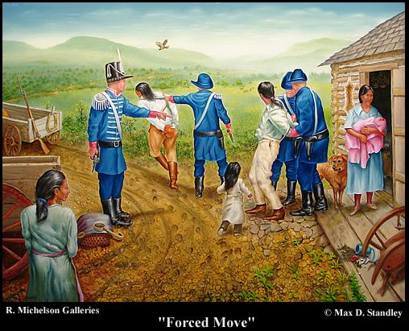
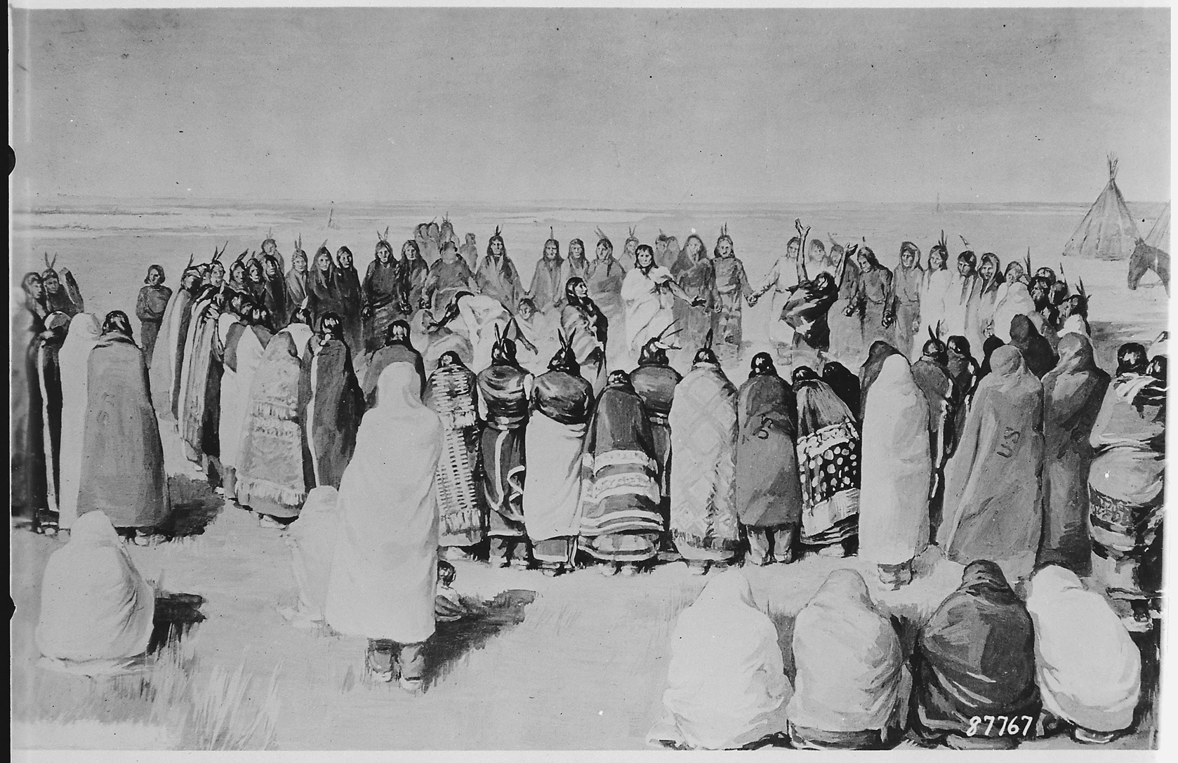
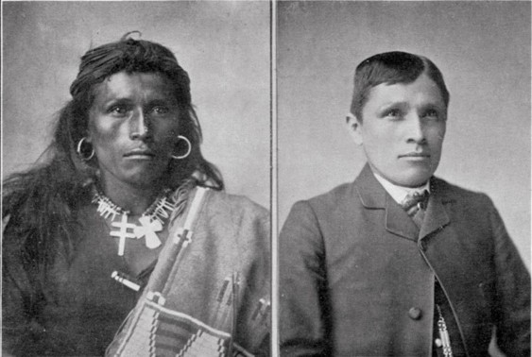
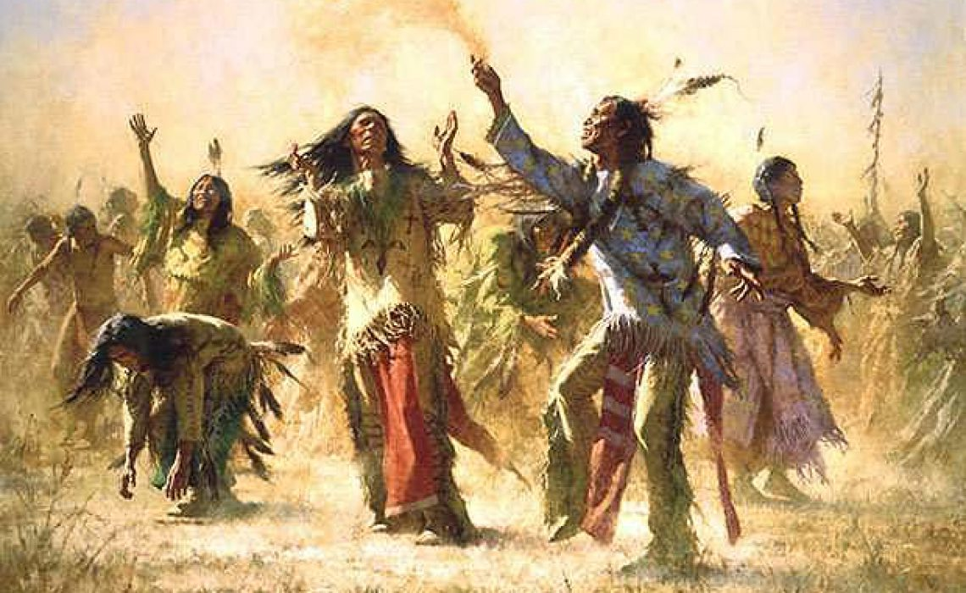
6.3 - Resistance and Rebellion in the Americas
.
Great Britain had tried to recognize the land of natives with the Proclamation of 1763, but this angered colonists who then fought for their independence and took land from natives.
Ghost Dance
Resistance movement that spanned native populations all over US.
Ritual ghost dances would be used to encourage the dead to come back and drive out the whites.
Ended at the wounded Knee Massacre in 1890-
End of the “Indian Wars”
Cherokee Nation
After 1800 the Cherokee nation worked to assimilate with white settler culture.
US style constitution, literacy, farming, weaving, architecture.
Forced to relocate to Indian Territory after gold was discovered on their land in 1829.
Religious movements often encouraged rebellions.
Notes:
Proclamation of 1763: Act passed by Great Britain in North America that reserved all the land between the Appalachian Mountain and the Mississippi River for Native Americans. Upset the American colonists because it was the end of salutary neglect.

Slide 17
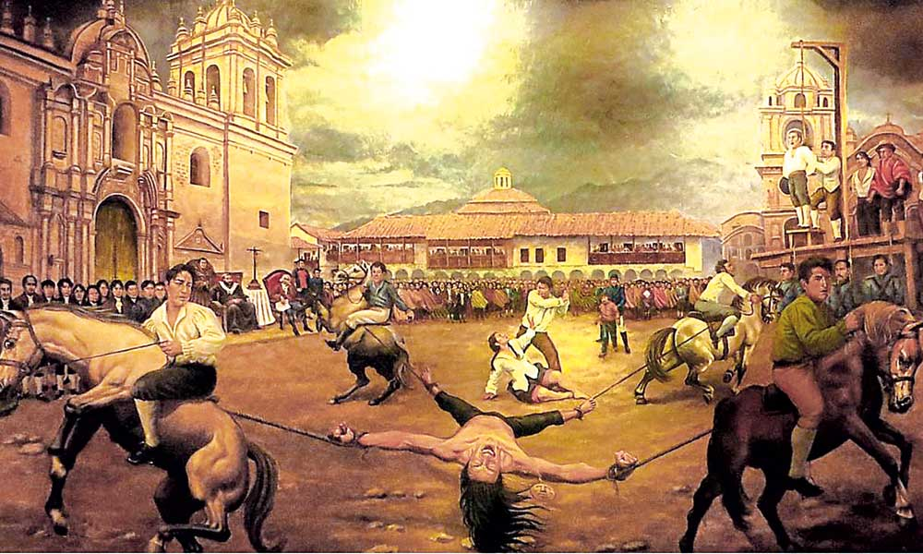
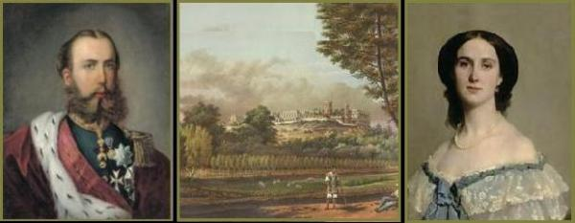
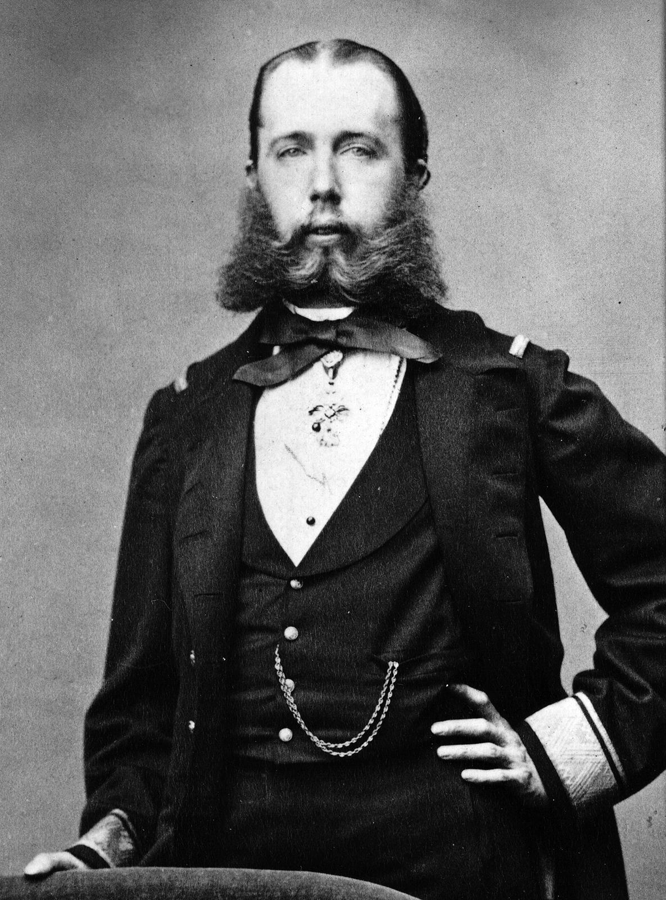
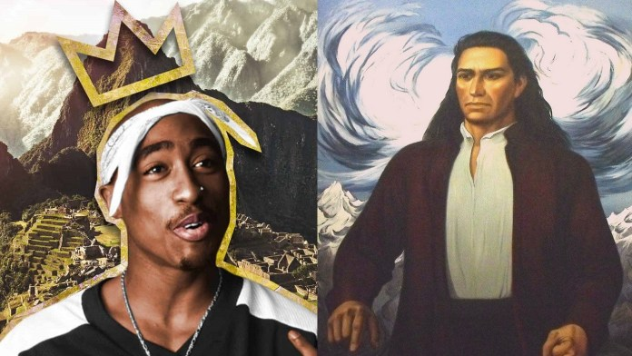
6.3 - Resistance and Rebellion in the Americas
.
Tupac Amaru II
Educated Jesuit - descendant of Incan ruler.
Led a revolt in Peru, Bolivia, and Argentina that began with killing colonial officials for cruelty.
Led to a general Indian revolt against Spain, supported by many creoles.
He was captured with his family in 1781.
Tortured or killed by the Spanish
French Intervention in Mexico
Mexican conservatives worked with Napoleon III of France to overthrow Benito Juarez in Mexico.
France wanted to imperialize and Mexico owed them money, so this seemed right.
Archduke Maximilian was made Emperor of Mexico in 1864
Warred with France for 3 years, Mexico eventually won
Maximilian was executed in 1867 - Juarez resumed his presidency.
Notes:
Interested in more information on Archduke Maximilian and his wife? There’s a great podcast called “Noble Blood” - Episode 16 (i think) “Today we leave for Mexico”

Slide 18
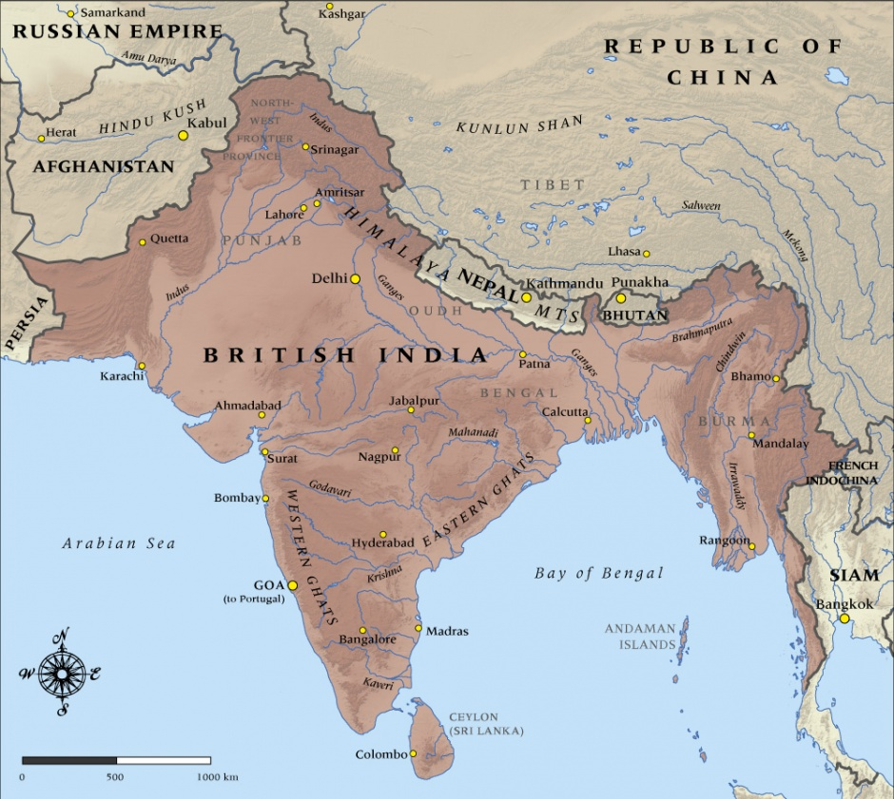
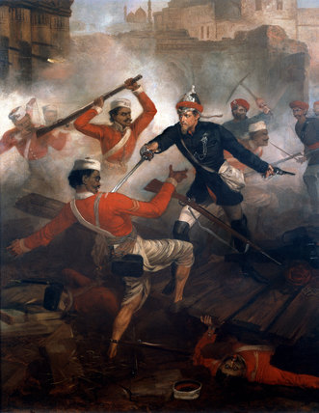
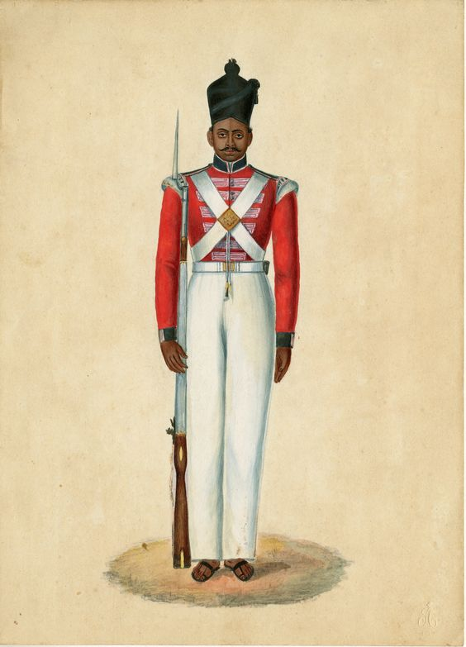
6.3 - South Asian Movements
.
Indian Rebellion of 1857 (Sepoy Rebellion)
Indian Muslim and Hindu soldiers in the British army in India led a rebellion against GB.
Upset about perceived forced conversions and British disrespect (pig pig fat on guns).
Spread throughout N. India.
Violently crushed by GB.
Social divisions made it hard to Indian to unite against GB
Rise of Indian nationalism.
Nationalism encouraged by education, communication, and transportation.
Outcomes:
GB exiled Mughal emperor for involvement in rebellion.
Ended the Mughal Empire.
GB took an active role in governing India.
The British Raj ruled India from 1858 - 1947.
Many Indians attended British Universities.
Indian National Congress established in 1885 by British-educated Indians.
Began to air grievances against GB
Became a call for self-rule

Slide 19
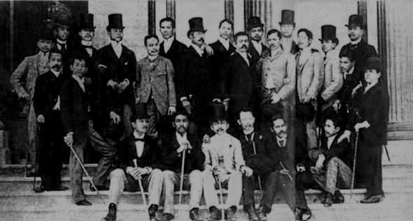
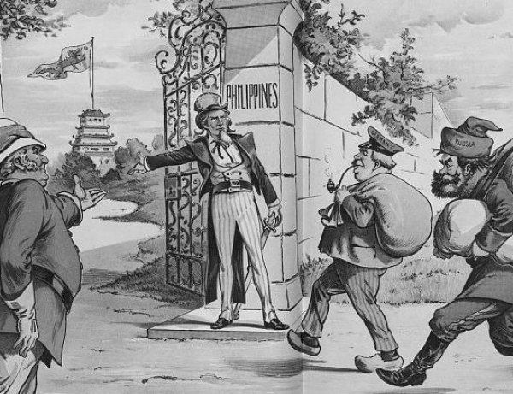
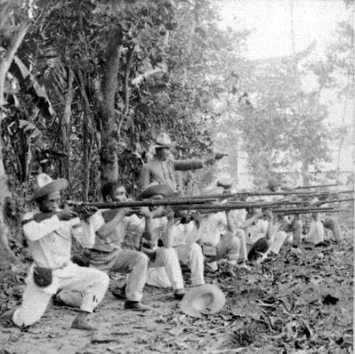
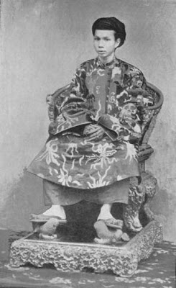
6.3 - Southeast Asian Movements
.
By the 1880s, the only independent country in SE Asia was Siam (Thailand). The rest was under the control of the Spanish, Dutch, British, and French
Vietnam:
Vietnam consistently resisted French imperialism.
Many rallied behind 12 yr old emperor Ham Nghi
The French raided the royal palace.
In 1888 Nghi was exiled to Algeria
Resistance continued under Phan Dinh Phung
Philippine Resistance:
Education began in the Philippines in 1863
Led to Enlightenment inspire movements like the Propaganda movement under Jose Rizal (remember him from unit 5?) He was killed which was shocking.
Education + Nationalism led to the 1896 Philippine Revolution
Many revolutionaries were exiled, but after the US beat Spain in the Spanish-American War they returned expecting freedom.
Treaty of Paris gave Philippines to US in 1899.
Led to Philippine - American War.
US won in 1902 (about 20,00 troops and 20,000 civilians died
Resistance continued in the region, but remained a US possession until 1496

Slide 20
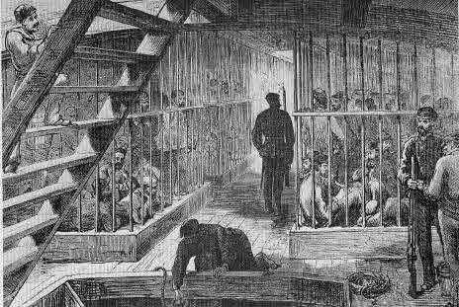
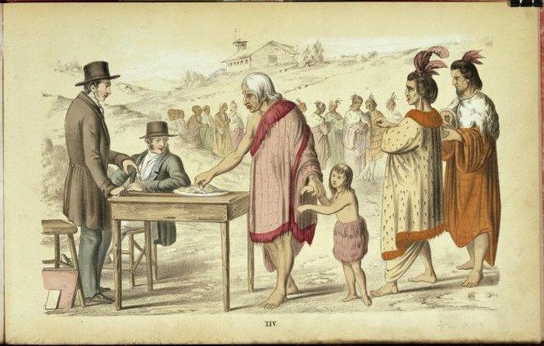
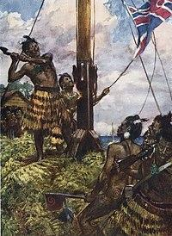
6.3 - Resistance in Australia and New Zealand
.
Aboriginal peoples in Australia had existed for around 50,000 years in one of the oldest continuous cultures on earth.
New Zealand
1840 Treaty of Waitangi, British said they would protect property of the Maori
Fears over land led to the Maori Wars
GB won in 1846.
Maori continued to try and protect land.
1861, GB ignored the treaty and sent troops to take land.
Another war.
Uneasy peace in 1872
By 1900, most Maori land was lost.
Australia:
British penal colony beginning in 1788.
Said to treat Aboriginals kindly
But did not recognize their land ownership.
Aboriginals were not British citizens, so were not protected by British law.
1,000s of Aboriginals killed trying to protect their land.

Slide 21
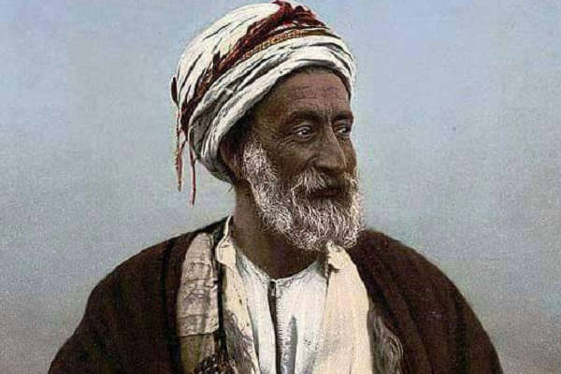
6.3 - African Resistance
.
African resistance developed later than Indian resistance because Europeans had been in India longer. By WWi, however,Western educated Africans had a shared nationalistic identity known as Pan-Africanism.
South Africa
Native Xhosa people did not want to be ruled by Europeans and fought British from 1811 - 1858.
Xhose cattle began getting sick from the British cattle.
Xhose killed cattle and destroyed crops in the Xhosa Cattle Killing Movement to awaken spirits to drive out Europeans.
Led to famine and death of 1000s
British also defeated the Zulu kingdom in the Anglo-Zulu War.
Sokoto Caliphate
New nation established by Usman dan Fodio
Goal was to purify Islam in the Hausa tribes.
Focused on slave trade, despite British trying to end it, for Economic opportunity. .
British tried to stop slave ships.
Largest African empire since 16th c. until GB absorbed it into Nigeria.

Slide 22
6.3 - African Resistance
.
Samory Toure War
West Africa in 1868 Samory Toure led warriors to establish kingdom in Guinea.
Opposed French annexation in 1883.
French succeeded, so he tried to extend empire in other directions.
Captured and exiled in 1898.
Yaa Asantewaa War
1823 - GB wanted Asantee Empire in present-day Ghana (W. Africa)
Four wars were unsuccessful for GB
5th War - Yaa Asantewaa War
March 1900 Yaa Asantewaa, a warrior queen, led rebellion against British.
Last African war led by a woman.
British won in 1900 - she was exiled
Asante become part of Gold Coast.
Mahdist Revolt
East Africa - 1881 - Muhammad Ahman declared himself “Mahdi” (guided one) - said he would restore glory to Islam.
Helped Sudan use religion to fight against Egypt
By 1882 Mahdists had control of the region.
GB and Egypt came together to push the Madhists out.
Madhists initially won in 1885.
Ahmad died in June of 1885
Movement disintegrated
British took Sudan in 1898

Slide 23
6.4
Global Economic Development
Context:
Industrialization encouraged nations to look to Asia and Africa for raw materials like cotton, copper, and rubber.
America looked South for fertilizer and new markets for goods.
Colonial workers provided cheap labor.
Essential Question: How did environmental factors contribute to the global economy from 1750 - 1900?

Slide 24
Technological Advancements
Railroads - Colonial roads were poorly constructed, few in number, and unusable during wet seasons.
Railroads allowed for travel to the interior of a colony.
Lowered the cost of transporting goods to Europe.
Used railroads as an example of positive imperialism.
Cecil Rhodes wanted to build trans-African railway, but GB never got all of the land it needed.
Help mobilize for war.
Help trade in British African colonies.
Steamships - Initially couldn’t travel very far because it used too much coal, but could transport people, goods, mail, across rivers in Africa.
1870s - ships become more efficient for long travel.
Refrigeration makes transport of meat possible across oceans.
Telegraph -
1832 - Communication is instantaneous.
By 1874, the entire work was connect with telegraph lines.

Slide 25
Raw Materials
The demand for raw materials that could be processed in factories and shipped away for purchase - usually back to the imperial colony - turned colonies into export colonies.
Cotton - GB banned Indian cotton in 1721 (competition)
Got cotton from US.
Civil War halts cotton production.
Egypt and India benefitted
Had long traditions of cotton production
End of 19th c. - 93% of Egypts export revenue came from cotton.
Rubber - 1839 - Charles Goodyear vulcanization process created modern rubber.
Important to industrialization
Native to Amazon and S. America - couldn’t keep up with demand.
GB takes tree seeds to Sri lanka and Singapore
Cleared 100s of acres for rubber trees.
“Rubber Barons” run rubber tree farms
Forced indigenous people into slavery
Brutal conditions

Slide 26
Raw Materials
Palm Oil- Kept machines in factories lubricated. Made candles.
Originated in W. Africa
So important, it was used as money.
Became cash crop farmed by prisoners of tribal war.
Palm plantations in Malaya and Dutch East Indies.
Ivory - Trade with ivory - prized for beauty and durability
Piano keys, pool balls, knife handles, etc.
Ivory Coast in Africa - France set up trading posts for ivory and slaves.
Minerals - Mineral ore used in manufacturing - $$$
Mexico - silver
Chile, Rhodesia, Belgian Congo - Copper for electrical cables and power lines.
Tin - for food storage - Bolivia, Nigeria, Malaya, DEI
Australia, S. America, Africa, W. Africa, Alaska - Gold.
Diamonds - Cecil Rhodes and De Beer Mining Co = 90% of diamond production by 1880.
Rhodes became most powerful man in S. Africa by age 29.
1890 became Prime Minister of the Cape Colony
Racist policies led to apartheid

Slide 27
Agricultural Products
Global Consequences
Most African, SE Asian, and Latin American economies were agricultural
Subsistence farming
Demand for cash crops like tea, cotton, sugar, rubber, palm oils, etc. were grown for commercial value.
Subject nations stopped growing as much food - food prices rise.
Argentina, Brazil, Uruguay - raised cattle to meet demand for meat in middle class Europe.
Peru and Chile - Mined guano to be used as fertilizer.
Local food production replaced by cash crops.
Led to monocultures - lack of agricultural diversity.
Soil depleted, crop disease and pests spread.
Former colonies have struggled to diversify their land.
Have to import agricultural needs, still dependent on more developed nations.

Slide 28
6.5
Economic Imperialism
Context:
GB pushed India out of the finished textile market. India only created raw cotton to be sold to British factories, with finished goods being sold back to them at inflated prices.
GB entered the Chinese market selling Opium.
Essential Question: What economic factors contributed to imperialism in the global economy between 1750 and 1900?

Slide 29
6.5 - Rise of Economic Imperialism
Context - Industrial revolution created a need for raw goods. Technological ability like steamships, railroads, and military weapons allowed industrial nations to control other territories.
Economic Imperialism - Foreign business interests have economic power of influence over natural resources beyond their borders.
Exploited people, raw materials, minerals.
Export Economies - Colonial states that produced goods not for sale at home, but to be sent to colonial powers and then sold for profit.
Focused on cash crops and raw materials.
Economic Imperialism in Hawaii:
American sugar planters and business men went to HW in 1892 hoping to overthrow its monarchy and have it annexed into US.
1898 - Hawaii becomes a territory of the US
1959 becomes 50th US state.

Slide 30
6.5 - Economic Imperialism in Asia
Context: England defeated the Spanish Armada in 1588 allowing the British and Dutch to talk over the Asian Spice trade from the Spanish and Portuguese
.
India: 1600 - British East India Company (Joint stock company, BEIC) formed to take part in spice trade.
Ran into competition from Dutch
Abandoned spices to focus on cotton and silk textiles.
By late 1700s, dominated global textile trade.
Indian weavers weaved European styles.
India mostly provided Raw cotton to GB to be finished in GB and sold.
Dutch East Indies: Dutch East India Company (VOC) Monopolized trade with Dutch East Indies (Indonesia) and Spice islands.
Corrupt and went bankrupt - 1799 Dutch government took control of region.
Culture System - Forced farmers to set aside ⅕ of land for cash crop farming OR work 66 days in the field for free (corvee labor - required, unpaid, work)

Slide 31
6.5 - Economic Imperialism in China
Second Opium War: GB and China were unhappy with the first treaty, and GB really wanted Opium to be legal.
France joined GB in second war.
Treaty of Tientsin allowed foreigners to live in Beijing, opened new ports to the West, allowed free movement of Christian missionaries, legalized Opium, and gave GB more land.
Led to China’s decline and increase influence of GB and France in China.
Spheres of Influence: China was weak.
Japan, France, Germany, Russia, US forced China to give them spheres of exclusive trade.
Open Door Policy - US said trade in China should be open to all countries equally to prevent someone from dominating China.
Context: Chinese goods like silk, tea, and porcelain were in high demand in GB, but China did not import finished goods from GB creating a trade imbalance so GB started selling Opium - a powerful drug - in China.
First Opium War (1839 - 1842)- China criminalized opium in 1729 which made GB mad. China set up a blockade and they went to war.
China was shocked how much power the industrialized nation.
Showed the world that industrial powers would be able to dominate nonindustrial ones.
Treaty of Nanking - required China to open 4 ports, give Hong Kong to Britain, and allow free trade with GB, including opium.
Example of Economic Imperialism
Notes:
*Industrialization led to the belief that they were more advanced that China.

Slide 32
6.5 - Economic Imperialism in Africa
Context: Africa was mostly agricultural, but converted to cash crop production to meet European needs. Unequal trade made Africa reliant on imperial powers.
Reliance on cash crops left Africans vulnerable during drought or economic decline.
Food production declined causing prices to go up.
Most good land devoted to cash crop growing.
Cotton - Major cash crop in Egypt (93% of all exports), Sudan, and Kenya.
Soon replaced people and ivory as chief African export
Kenya - Groups like the Kikuyu were forced off of land for white farmers to grow cash crops.
Moved to poor land, not allowed to grow cash crops.
Gold Coast - Cocoa introduced by missionaries were major cash crop.
Largest cocoa producer in the world.
West Africa - Palm oils, peanuts
Slave in Africa - Banned in British colonies in 1833, but persisted elsewhere.
French colonies did it.
Slaves used to produce cash crops.
Some companies stopped buying African goods produced by slaves like Cadbury

Slide 33
6.5 - Economic Imperialism in Latin America
Context: Britain replaced Spain as largest investor in LA. ($10 Billion between 1870 and 1919) Both GB and US imperialized.
United States: Second IR made US rich.
Corporate investments focused in Mexico and Cuba
Supported railroads and infrastructure.
Mined guano and meat.
1823 - Monroe doctrine.
Investment in Argentina - GB invested more in Argentina than India!
Made A. richest country in LA
Helped with farmine, building railroads and telegraphs, and new ports.
Mining in Chile - Agriculture exports and the mining of copper made Chile completely dependant on its trade relationships with Spain.
Rubber in Brazil - Booming industry declined after cheaper rubber was made in Malaysia.
Illustrates how trade always benefits the industrialized nation, and trade power is always fragile.
Central America and the Caribbean - United Fruit Company worked with US and LA governments to keep trade profitable for company.
“Banana Republics” - Small CA countries under the economic power of foreign-based corporations.
Politically unstable with economy dependant on export of one of two limited goods.

Slide 34
6.6
Causes of Migration
Context:
Imperialism led to a global economy that encouraged migration in search of opportunity.
Industrialization pushed many people to urban centers.
The demand for new forms of labor after the abolition of slavery led to new forms of forced, coerced, and semi-coerced migration.
Essential Question: What environmental and economic factors contributed to patterns of migration between 1750 and 1900?

Slide 35
6.6 - Migration through Labor Systems
Context: Slavery was ending around the world, but the demand for resources was continuing to increase. This resulted in European states looking for new types of laborers to work on plantations.
Indian laborers went to British colonies.
Chinese laborers went to California and British Malaya to work on railroads.
Japanese labors went to Hawaii, Peru, and Cuba to work on sugar plantations.
Slavery - Was being abolished in most places, but the practiced continued for many years.
US (1865), Cuba (1886), Brazil (1888) were some of the last places to end slavery.
Africans continued to enslave one another well into the 1900s.
Indentured Servitude - A way for the very poor to get more opportunities.
Work for a certain number of years in exchange for opportunity then get freedom.
Some stayed temporarily, some moved permanently.
Asian Contract Laborers - Forced or tricked into work to replace slaves.
The media hailed this practice as a new form of slavery.
Banned in most places by 1870s
Notes:
Statue of Genghis Khan in Mongolia

Slide 36
6.6 - Migration through Labor Systems
French Penal Colonies - Prisoners sent to penal colonies in Africa, New Caledonia, French Guiana.
Housed convicts and political prisoners.
“Devil’s Island” - French penal colony in Guiana (Africa)
Notorious for terrible treatment of convicts.
Underfed and hard labor.
Practice ended in 1938.
British Penal Colonies - British convicts initially sent to Georgia, but after revolution were sent to Australia.
Convicts came from all parts of the British Empire.
Hard labor and hash punishments.
Were not actually imprisoned, but worked for free settlers, on government projects, or government posts.
Some were never allowed to return home.
Some chose not to because travel was expensive.
Practice ended in 1850 because it wasn’t seen as much punishment.
Free settlers started coming to Australia in the gold rush of 1851.
Notes:
Statue of Genghis Khan in Mongolia

Slide 37
6.6 - Migration in the Face of Challenges
Diaspora: Mass emigration from one place over time. African slave trade is biggest diaspora.
Most diasporas result of poverty, political conditions, famine.
India: - Most left due to poverty.
Many left as indentured servants to work on plantations for 5 year contracts.
1.5 million Indians went to colonies before 1916 when indentured servitude was ended.
China - Middle of the 19th century.
Left to escape poverty or famine.
Unrest in China from Taiping Rebellion and Opium Wars
Illiterate, landless, peasants looking for opportunity.
Most were male planned to return home, but left as indentured servants to work on railroads in the US, Canada, and South Australia.
Notes:
Statue of Genghis Khan in Mongolia

Slide 38
6.6 - Migration in the Face of Challenges
Ireland:
Political Reasons - GB absorbed Ireland into United Kingdom and got rid of Irish Parliament in 1801.
Roman Catholics and Protestants faced religious discrimination
Tenant farmers were being evicted from their land.
Great Famine - 4 year long potato famine that pushed 3 million people out of Ireland.
Went to US and GB to help build railroads and canals.
Italy: Italian Unification led to poverty
7 million Italians leave over the course of 40 years.
Most went to Europe (½) with the other half going to the Americas and New Zealand.
Mostly men with skills and farmers escaping hard conditions.
Some left for political reasons, other economic like escaping organized crime.
Notes:
Statue of Genghis Khan in Mongolia

Slide 39
6.6 - Migration to Settler Colonies
Most who moved permanently around the British empire went to settler colonies like Canada, South Africa, Australia, or New Zealand. Those who went to other colonies did not usually plan to live permanently.
Technical Experts: Engineers and geologists migrated to South Asia and Africa.
Andrew Geddes Bain went to Cape Town S. Africa - first geological map of Africa.
British engineers were so numerous they spread Western science and technology around the world.
Blended their knowledge with engineers from colonial lands.
Argentina: Britain's “Informal” empire. Businessmen, traders, bankers moved to found banks and develop trade in the area.
Japan: The Colonization Society was formed to help Japan imperialize
Wanted places to send surplus people and goods.
Unsuccessful settler colony in Mexico.
Japanese men were leaving Japan to study in US.
1907 - Gentleman's Agreement - US won’t pass laws against immigration if Japan stops sending immigrants. (Informal)
Notes:
Statue of Genghis Khan in Mongolia

Slide 40
6.6 - Migration, Transportation, Urbanization
Improvements in transportation allowed some people to migrate permanently, and others to come home eventually.
1885 - Japan and Hawaii made an agreement.
Japanese can freely come to work on plantations under 3 year contracts then go home.
29,000 Japanese go to Hawaii over the next 9 years.
Italy had a similar agreement with Argentina.
Most immigrants settled in cities.
Notes:
Statue of Genghis Khan in Mongolia

Slide 41
6.7
Effects of Migration
Context:
Migration led to demographic changes.
Most migrants were male, leading to changes on home cultures.
New and old cultures mixed.
Racial and ethnic prejudice rose.
Essential Question: How and why did patterns of migration affect society between 1750 and 1900?

Slide 42
6.7 - Changes in Home Societies
Migrant experiences and the effect their migration had on their home culture varied by location. Most migration causes shifting demographics and gender roles at home.
Roles of Women: Experience varied by home country.
In some places, males didn’t leave until a male relative could take over their family.
Women’s role unchanged.
Some women gained roles outside of the home and traditional role when men left.
Some women followed their husbands.
Usually played a larger role in family decisions.
If husbands returned, women often continued to play a larger role outside of the home.
Remittances - Money sent home from migrant to family.
If remittance was large enough, women could work less and spend more time with family.
Woman had considerable power in determining how remittance was spent.
Remittance often led to young children staying in school longer.

Slide 43
6.7 - Effects of Migration on Receiving Societies
Immigrants wanted a new economic start, but wanted to continue practicing their culture. Many formed ethnic enclaves - clusters or neighborhoods of people from the same foreign country. They retained the language, food, and customs from home while absorbing some new parts of culture.
Chinese Enclaves - MIgrated in search of work.
Southeast Asia - Thriving!
Managed opium farms and distribution to GB.
Held posts with colonial government.
Became business owners and traders.
Chinese controlled trade in region.
The Americas -
Came to US for gold, stayed to work on the railroads.
225,000 Chinese laborers coerced into 8 year contracts to work in Cuba and Peru on sugar plantations.
Helped build Andean railroad and mine guano.
Left their cultural stamp like Chinese fusion food in peru.
Sometimes married locals.
Italians in Argentina - Argentina was immigrated to 2nd most globally behind US.
Encouraged immigration AND provided immigrants civil rights.
Influenced culture and language.
Italians made up ½ of immigrants to Argentina.
55% of population today is Italian immigrants.
Why?
Low population
Fertile land
High labors
Low cost of living
Immigrants raised their standard of living.

Slide 45
6.7 - Effects of Migration on Receiving Societies
The British ended slavery in 1833 but replaced it with indentured servitude. Indians were among the first indentured servants.
Indians in Africa: Many Indians went to islands off the coast of Africa (Mauritius), or South Africa (Natal) as indentured servants to work on sugar plantations and build railroads.
Hindus and Muslims emigrated, bring caste system with them.
Eventually abandoned castes, but kept other religious traditions.
Suffered lots of prejudice and injustice.
Mohandas Gandhi - Indian who came to Africa to practice law in 1893.
Experienced racial discrimination
Became an activist.
Natal Indian Congress - He made it to show world discrimination Indians faced in S. Africa.
1914 - Went back to India to work for Indian independence from GB.
Indians in Southeast Asia: - Biggest source of labor for British colonies in malaya, Ceylon, and Burma.
Went as indentured servants.
Replaced by Kanani System - entire families recruited to work on tear, coffee, and rubber plantations.
Lives were less restricted, and had their families with them.
6 million Indians went to SE Asia before the end of the Kangani System.
Kept close ties with India.
Indians in the Caribbean: Largest ethnic group in Guyana and Trinidad and Tobago - worked on plantations.
Huge part of population everywhere in Caribbean
Blended with home culture.
Arrival of Indians celebrated to this day! .

Slide 46
6.7 - Prejudice and Regulation of Immigration
Became migrants often worked for lower wages than native workers, resentment and institutionalized discrimination rose.
Regulations in the US: resistant to low cost migrant labor.
California Constitution of 1879:
Prohibited state, county, and local jobs from hiring Chinese.
Non-white people could not be citizens.
Encourage Chinese removal and segregation from towns.
Chinese Exclusion Act - 1882
Banned Chinese immigration for 10 years, which was extended and made permanent in 1902. Repealed in 1943.
Mexican Reaction -
President Porfirio Diaz encouraged Chinese immigration to Mexico.
White Australia: Chinese immigration to Australia switched from indentured servants to settlers after the gold rush. 50,000 Chinese came into Australia.
1855 - Chinese Immigration Act - Limited the # of Chinese that could get off of a boat.
Started landing in South Australia instead.
1860 - White miners attacked Chinese migrant quarters killing several.
Chinese Immigration Regulation and Restriction Act in 1861
Restricted how many Chinese could enter colony.
Influx of Chinese Restriction Act
Chinese immigrants had to pay a tax.
Chinese immigrants made huge economic contributions to Australia, but discrimination grew.
White Australia Policy - limited all non-British immigration.
Stayed until the 1970s!

Slide 47
THE END
Go forth and study.

