Slide 1

North Panola School District Technology Department
2016-2017

Slide 2
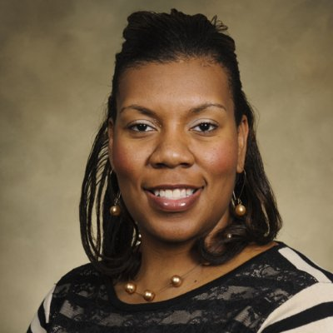
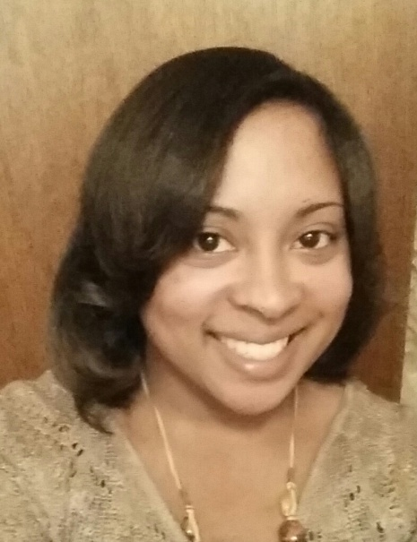
Technology Staff
Carla Malone
Tanisha Hurt
Director of Technology
Hardware/Software
Technology Integration Specialist
Software

Slide 3
Technology Vision
To be a technology driven district that fosters a creative and innovative learning environment that provides students with career and/or college-ready skills for success.

Slide 4
Communication

Slide 5
Contacting the
Technology Department
All request for help must be submitted through the Helpdesk application.
  No emails or phone calls
Unless you are a school or district administrator, please do not call our cell phones for help. That is reserved for administration only. If you have a dire emergency, contact your principal and he/she will contact us.
  We will more than likely be in your building at least once a week.

Slide 6
HELPDesk

Slide 7
Account Registration
If you do not currently have an account with Helpdesk, you must create one before you can submit a ticket.

Slide 8

Creating a Helpdesk Account
To register for an account:
  Click the Helpdesk icon in the upper left corner on the homepage and complete the “Register-Required” section and the “Password Retrieval-Required” section.
  Click “Register.”
You have successfully created a helpdesk user account.

Slide 9
Creating a Ticket/Task
Login to the Helpdesk application.
  Access from the district website.
Click “Create Task.”
Select your location from the “Task Manager Group.”
Select the “Priority” level.
Change the status to “Open.”
Enter your information in the “User Info” section.
Select the “Task Group,” “Category,” and provide a description of the problem.
Click “Create Task.”

Slide 10
Helpdesk Tips/FAQs
The best way to access the Helpdesk application is from the district website. Click the Helpdesk icon in the upper left corner on the homepage.
Submitting a ticket/task is the only way to ensure your needs are not forgotten.
Tickets will be closed/resolved by a member of the technology department.

Slide 11
Helpdesk FAQs
How often is the Helpdesk application checked?
  Tickets/Tasks are checked daily.
How long will it take for tickets to be completed?
  Tickets will be completed based on the severity of the issue.
    Minor
    Major

Slide 12
Network, EMAIL, and Media Streaming

Slide 13
Network
Network Login
  Always use CTRL-ALT-DEL to login and the domain should always say :”NPSD.” The same sequence can be used to lock your screen and change your network password.
  Username are typically your first initial and last name and the default password is “npsd2016.”
  The system will lock you out for 2 minutes if you use the wrong password 3 times in a row. The lockout will automatically clear itself after 2 minutes have elapsed..
    Do not create a task/ticket for this.
    Always check to make sure your CAPS or NUMLOCK is not on.

Slide 14
Email
NPSD uses the Gmail system for email.
  You can access it from the district webpage or from gmail.
  If you access it from gmail, you must enter firstinitallastname@northpanolaschools.org and your password.
  You have 25 GB of storage capacity.
  You also have access to Google Apps

Slide 15
Email (cont’d)
All student grades 6-12 have their own Gmail logins.
  Their logins are typically their first initial and lastname followed by the last 4-digits of their MSIS numbers.
  This allows them to use Chromebooks.

Slide 16
Media Streaming
In an effort to limit the amount of bandwidth that each schools demands from the District Office, we block high traffic/streaming sites such as:
  YouTube
  Netflix
  Internet Radio Sites (Pandora, iHeart, etc.)
  Graphic intensive game sites
  Any site that does not have an educational use.

Slide 17
Media Streaming (cont’d)
Why do we block sites?
CIPA = Children’s Internet Protection
  CIPA governs the use of technology in schools and libraries in the United States that receive federal funding. It states that schools must take measures to prevent any harmful or inappropriate internet activity by students (and staff). It was recently amended to include cyber-bullying.

Slide 18
Media Streaming (cont’d)
iBoss
  The NPSD network uses iBoss network filtering to provide for CIPA compliance. When using a school district Windows computer, the iBoss can identify that you are a teacher and will allow you to visit more sites than a regular student.
  If you are using a non Active Directory machine (Apple, Chromebooks, etc) then you may have to use a secondary login. Otherwise you will be placed on a more restrictive allow list.

Slide 19
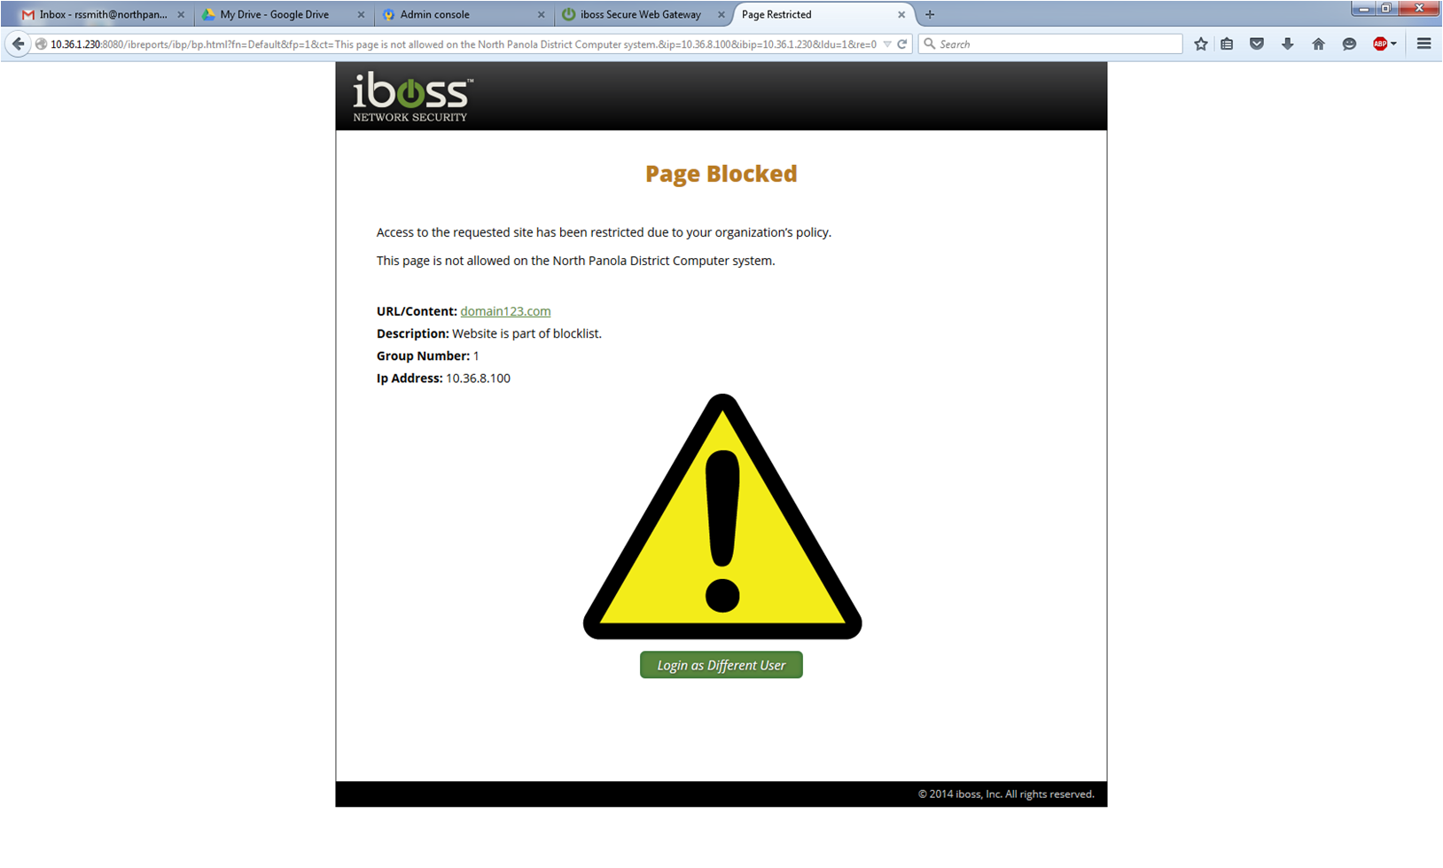
Media Streaming (cont’d)

Slide 20
Social Media

Slide 21
Social Media
It is the opinion of the District Office that teachers are not to be ‘friends” or otherwise interact with their students through social media sites.
Do not place pictures or videos of students on a public website without approval/permission.

Slide 22
Purchases

Slide 23
Classroom Materials
We do not purchase classroom materials.
  VGA splitters
  Monitors
  CPUs
  Printers and printer parts
We will provide a list of what needs to be purchased to each principal.
Contact your school office for any equipment needs.
  This includes ink and toner for printers.

Slide 24
Site Software AdminIstrators

Slide 25
Crenshaw
Mrs. Prince
  iReady
  STAR
  Case 21
  ELS
Mrs. Hooper
  Webmaster

Slide 26
Greenhill
Mrs. Birge and Mrs. Henson
  iReady
  ELS
  STAR
Mrs. Williams
  Case 21
Mr. Chadd
  Webmaster

Slide 27
Como Elementary
Mr. Walker
  iReady
  STAR
  ELS
  Case 21
  Webmaster

Slide 28
Junior High
Mrs. Gardner and Mrs. Berry
  iReady
  STAR
  Webmaster
Mrs. Oatis and Mrs. Edwards
  ELS
  Case 21

Slide 29
High School
Mrs. Taylor and Mrs. Lowe
  iReady
  STAR
  ELS
  Credit Recovery
  Webmaster

Slide 30
CTC
Mrs. King
  All instructional programs
  Webmaster

Slide 31

Active Resources
Contact: Faye Robertson
  You cannot access Active Resources from home.
  You must be in the district to access Active Resources.
  You can access Active Resources through the district website by clicking the Active Resources icon.

Slide 32
Promethean BOARDS

Slide 33
Do’s and Don’ts
Do’s
Don’t
Do calibrate your board daily.
Do turn your board off when it will not be used for more than 30 minutes. This will help preserve bulb life.
Do turn your boards off daily before leaving work
Do not tape any paper to the board.
Do not use anything sticky on the board
Do not write on the boards or allow students to write on the board with markers or pens.

Slide 34
Classroom Usage
The board should be used for more than a display.
Allow the students to interact with the board.
Promethean Planet
  http://www.prometheanplanet.com/en-us/resources/
  Provides pre-built lesson by subject area and grade level.
  Create an account

Slide 35
Promethean Filters
It is the responsibility of the teacher or school staff to clean the filters on the projectors.
They need to be cleaned weekly.
  Due to the number of board in the district, monthly will suffice.
We are happy to demonstrate the procedure.
  This can be done by the janitorial staff.
    How to Clean Promethean Projector Filters [1:11]
      Black/gray
    Promethean Projector Cleaning Demo [5:01]
      Orange

Slide 36
Technology Lessons

Slide 37
Preparation
Please test all technology needed for lessons before class time.
Always have a backup lesson in case there are issues with technology.
If you need videos from YouTube for your lesson, check to see if they are on TeacherTube or download them by using the Easy YouTube Downloader add-on for Firefox and save them to a USB drive.

Slide 38
Web Toolbox

Slide 39

What is a Web Toolbox?
A web toolbox is a personal box of web tools that you have to pull from for classroom activities.
Your toolbox should include:
  Lessons
  Activities
  Educational Games
  Web 2.0 tools

Slide 40
HouseKeeping

Slide 41
Housekeeping
AUP = Acceptable Use Policy
  You must have one on file. A grace period has been provided.
  Deadline: September 20th
Computers are assigned to rooms, not teachers. Do not move computers between rooms.
  The tech staff does not move computers.

Slide 42
Housekeeping
Do not plug any unauthorized device the school computer network.
  Specifically unsecured routers.
  This is a CIPA violation and can cause the district federal funding.

Slide 43


Slide 44

Have a Great Year!

