Slide 1
AP Calculus Midterm Review
KOOSH BALL
Game!
Play!

Slide 2
50
50
50
100
500
500
1000
1000
250
500
250
1000
50
500
1000
100
1000
500
500
100
500
100
50
1000
1000
250
1000
500
100
500
250
250
500
500
50
50
50
1000
250
1000
500
100
250
1000
500

Slide 3
50 POINTS
ANSWER
E
BACK

Slide 4
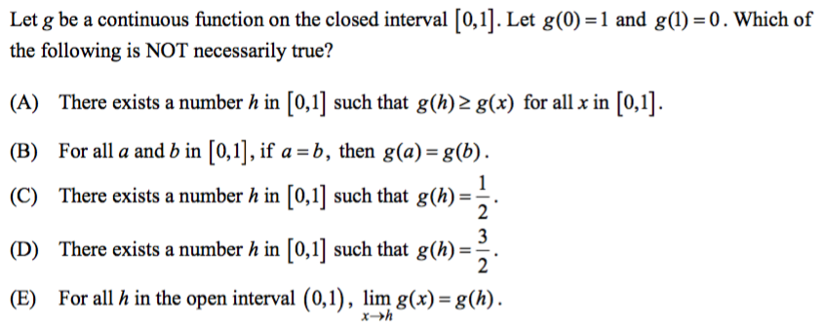
50 POINTS
ANSWER
D
BACK

Slide 5
50 POINTS
ANSWER
E
BACK

Slide 6
50 POINTS
ANSWER
C
BACK

Slide 7
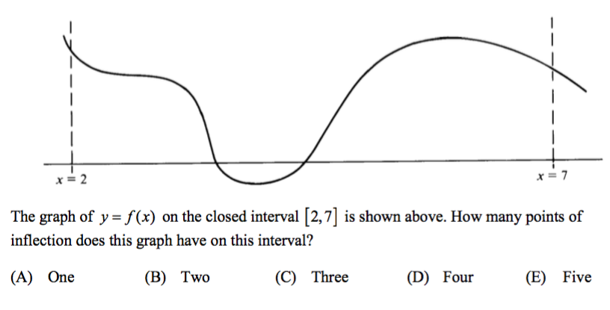
50 POINTS
ANSWER
C
BACK

Slide 8
50 POINTS
ANSWER
B
BACK

Slide 9
50 POINTS
E
ANSWER
BACK

Slide 10
50 POINTS
ANSWER
C
BACK

Slide 11
100 POINTS
ANSWER
A
BACK

Slide 12
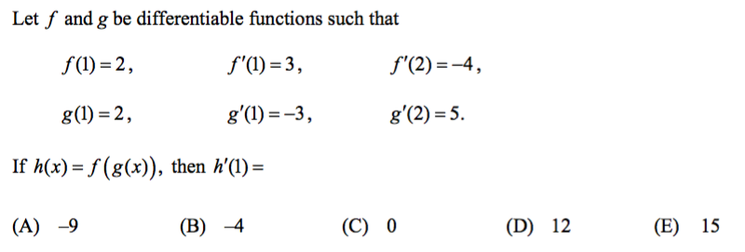
100 POINTS
ANSWER
D
BACK

Slide 13
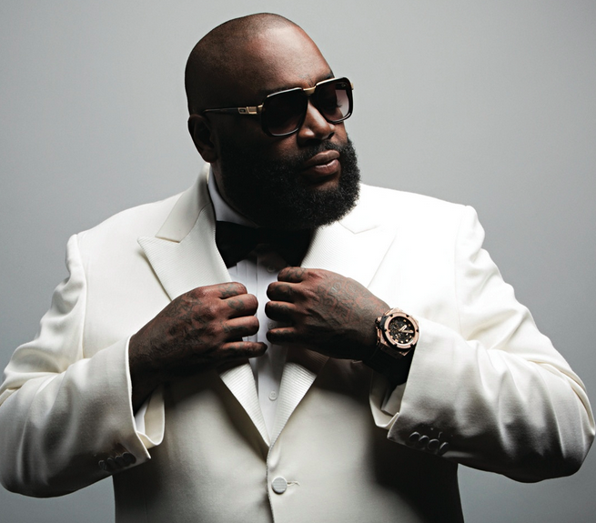
100 POINTS
Name that Celebrity.
ANSWER
Rick Ross
BACK

Slide 14
100 POINTS
ANSWER
A
BACK

Slide 15
100 POINTS
ANSWER
A
BACK

Slide 16
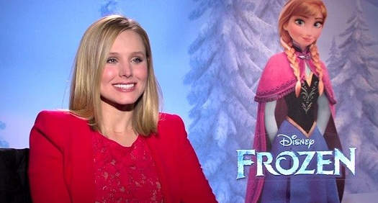
100 POINTS
Name that Celebrity.
ANSWER
Kristen Bell
BACK

Slide 17
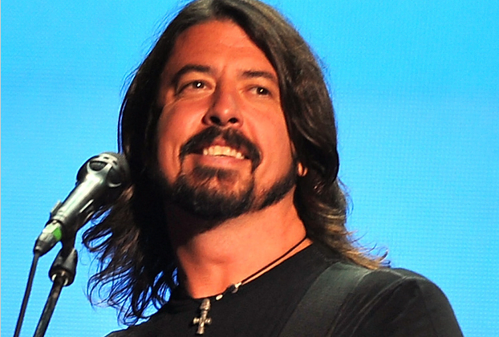
250 POINTS
Name that Celebrity.
ANSWER
Dave Grohl
BACK

Slide 18
250 POINTS
ANSWER
D
BACK

Slide 19
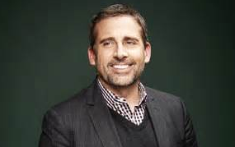
250 POINTS
Name that Celebrity.
ANSWER
Steve Carell
BACK

Slide 20
250 POINTS
ANSWER
C
BACK

Slide 21
250 POINTS
ANSWER
D
BACK

Slide 22
250 POINTS
ANSWER
B
BACK

Slide 23
250 POINTS
ANSWER
E
BACK

Slide 24
500 POINTS
ANSWER
A
BACK

Slide 25
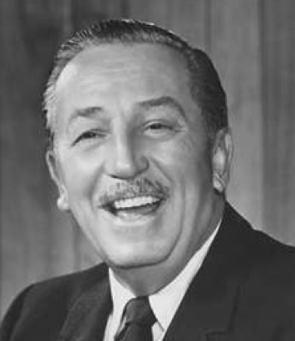
500 POINTS
Name that Celebrity.
ANSWER
Walt Disney
BACK

Slide 26
500 POINTS
ANSWER
E
BACK

Slide 27
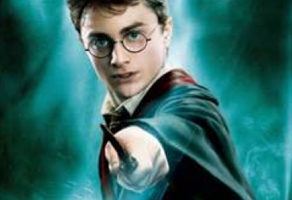
500 POINTS
Name that Celebrity.
Daniel Radcliffe
ANSWER
BACK

Slide 28
500 POINTS
ANSWER
B
BACK

Slide 29
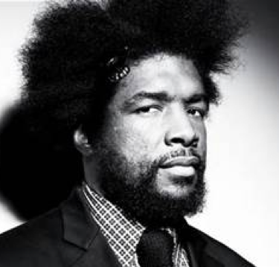
500 POINTS
Name that Celebrity.
ANSWER
Questlove
BACK

Slide 30
500 POINTS
ANSWER
D
BACK

Slide 31
500 POINTS
ANSWER
B
BACK

Slide 32
500 POINTS
B
ANSWER
BACK

Slide 33
500 POINTS
ANSWER
C
BACK

Slide 34
500 POINTS
ANSWER
D
BACK

Slide 35
500 POINTS
ANSWER
C
BACK

Slide 36
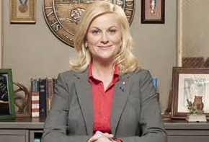
500 POINTS
Name that Celebrity.
Amy Poehler
ANSWER
BACK

Slide 37
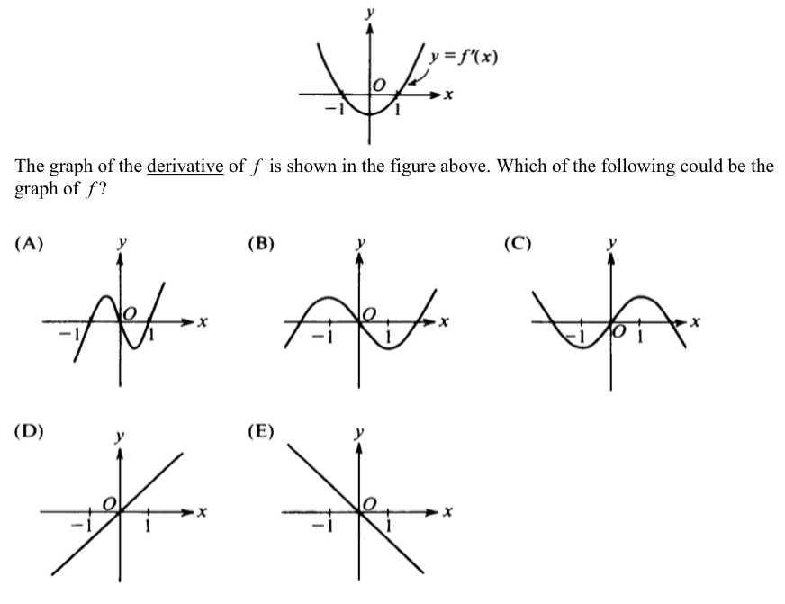
1000 POINTS
B
ANSWER
BACK

Slide 38
1000 POINTS
ANSWER
D
BACK

Slide 39
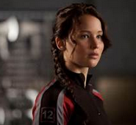
1000 POINTS
Name that Celebrity.
ANSWER
Jennifer Lawrence
BACK

Slide 40
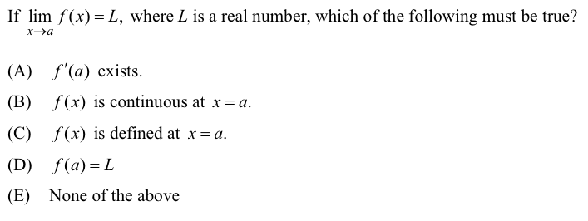
1000 POINTS
ANSWER
E
BACK

Slide 41
1000 POINTS
ANSWER
B
BACK

Slide 42
1000 POINTS
ANSWER
D
BACK

Slide 43
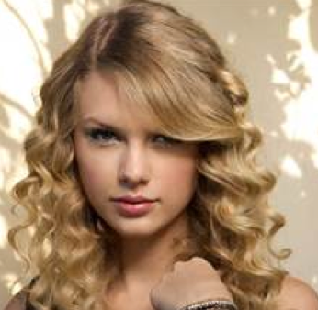
1000 POINTS
Name that Celebrity.
ANSWER
Taylor Swift
BACK

Slide 44
1000 POINTS
ANSWER
E
BACK

Slide 45
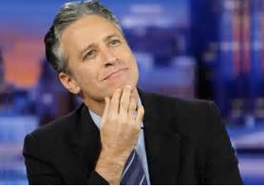
1000 POINTS
Name that Celebrity.
Jon Stewart
ANSWER
BACK

Slide 46
1000 POINTS
ANSWER
B
BACK

Slide 47
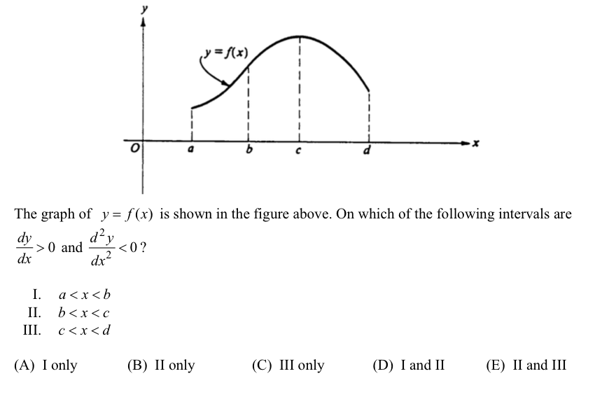
1000 POINTS
ANSWER
B
BACK

Slide 48
Thank you for
purchasing this game!
Please stop back at my store and let me know how it went!
http://www.teacherspayteachers.com/Store/Gina-Wilson
For help with editing, email me at
allthingsalgebra@gmail.com
If you wish to share this product with your team or colleagues, you may purchase additional licenses at a discounted rate. Just return to your “My Purchases” page to purchase at the new price.
Products by Gina Wilson may be used by the purchaser for their classroom use only.
All rights reserved. No part of this publication may be reproduced, distributed, or transmitted without the written permission of the author.

