Slide 1
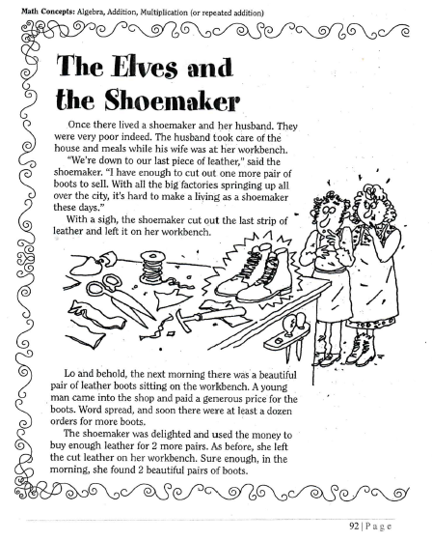
Thursday, September 26, 2019
Thursday: Classworks
M - Amiyah - 1
M – Erin - 2
M – Jaiden – 3
R – Kaylah - 4
M – Jaylie – 5
R – Paisleigh – 6
R - Kaylee - 7
M – Jearon - 8
M – Carleen - 9
LLI – Landon & Macon (Mrs. Thompson)
7:55 – 8:30

Slide 2
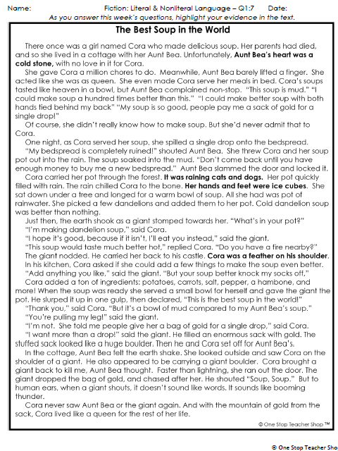
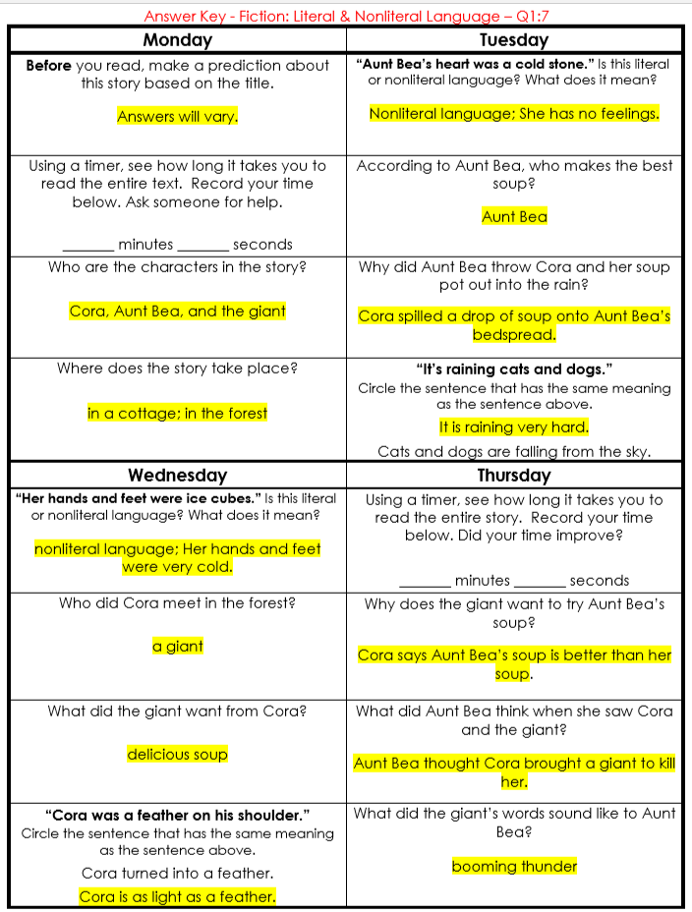
Reading Homework

Slide 3
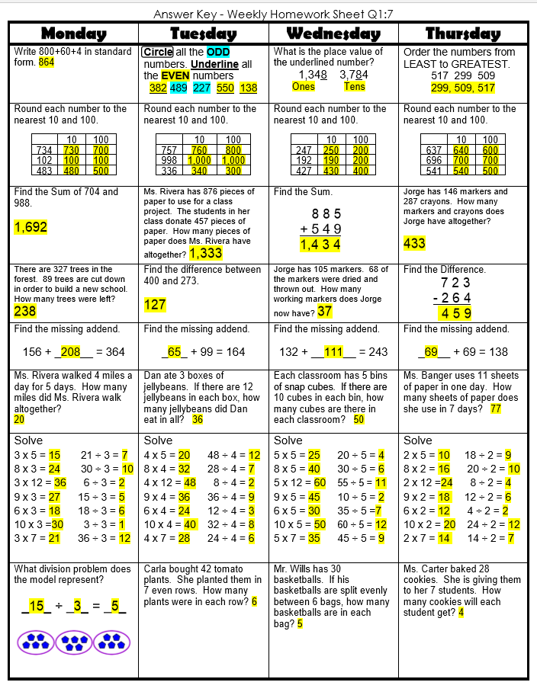
Math Homework

Slide 4

CHOMP TIME
F.A.S.T. Groups
Focused Academic Support Time

Slide 5
F.A.S.T. Designations
Computers – Classworks: R - Aiden- 1 M - Erin - 2 R - Jearon - 3 R - Kaylah - 4 R – Emma – 5 R – Adalyn - 6 R - Alexis - 7 R - Brena - 8 R - Carleen – 9 | Mrs. Roby: LLI Paisleigh Jaiden | Mrs. Thompson: SIPPS Jaylie Amiyah Cohen Caydance Kaylee | Paired Partners Book Club: Khamani - Katelynn McKenzie - Elin Noah - Cayli
Landon to Ms. Page for Phonics First
Macon to Ms. Bess for SIPPS
8:40 – 9:10

Slide 6

Reading Time
Objective: RL.3.5
I can refer to parts of stories, dramas, and poems when writing or speaking about a text, using terms such as chapter, scene, and stanza; I can also describe how each successive part builds on earlier sections..
9:10 – 9:45
Objective: RL.3.7
I can explain how specific images and illustrations contribute to or clarify a story.
Objective: SL.3.1c
I can ask questions to check understanding of information presented, stay on topic, and link my comments to the remarks of others.

Slide 7

Gather at the Carpet with your MM student response book.
Are we still the best?

Slide 8
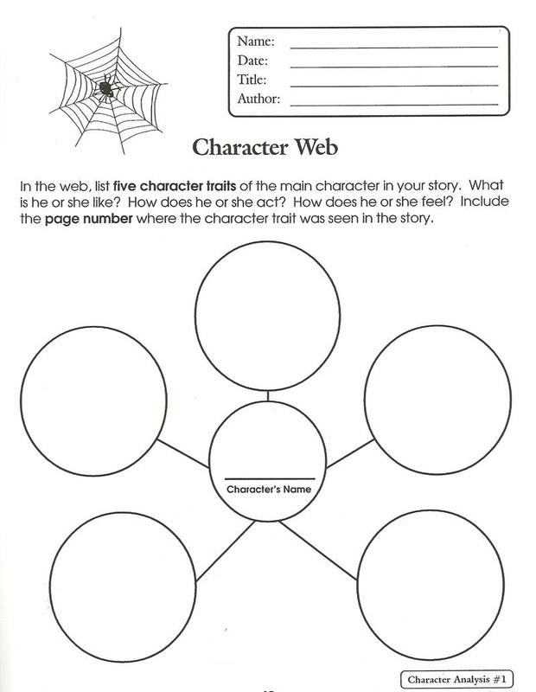
Last week we completed a character web for Lilly, the main character in Julius, the Baby of the World.

Slide 9

Today, we will listen to the story Boundless Grace again; think and talk more about the main character, Grace; and create your own character web for her – with a focus on how she feels and evidence to back it up or support your inference.

Slide 10
Let’s listen – I will not show you the illustrations today.
What do you know about Grace? What does she say, do, or think that helped you figure that out? Turn to your Partner

Slide 11
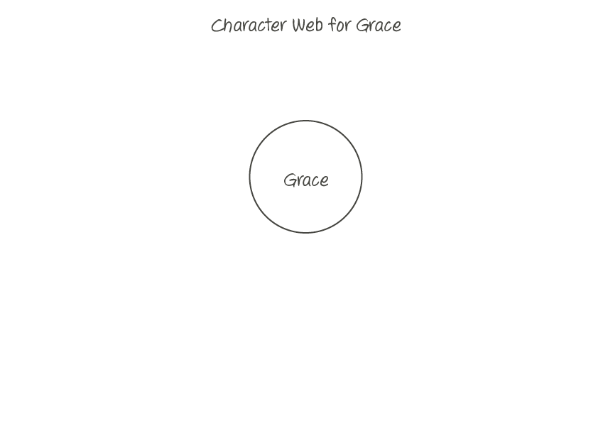
Let’s start our web!

Slide 12
What is one thing you and your partner know about Grace? Turn to your Partner

Slide 13
Let’s add your inferences to the web!

Slide 14
Turn to MM Student Response book page 7
You will complete a character web for Grace by each writing two inferences that are different from what we have discussed as a class.
Be prepared to share with the class the clues in the story that helped you make your inferences.

Slide 15
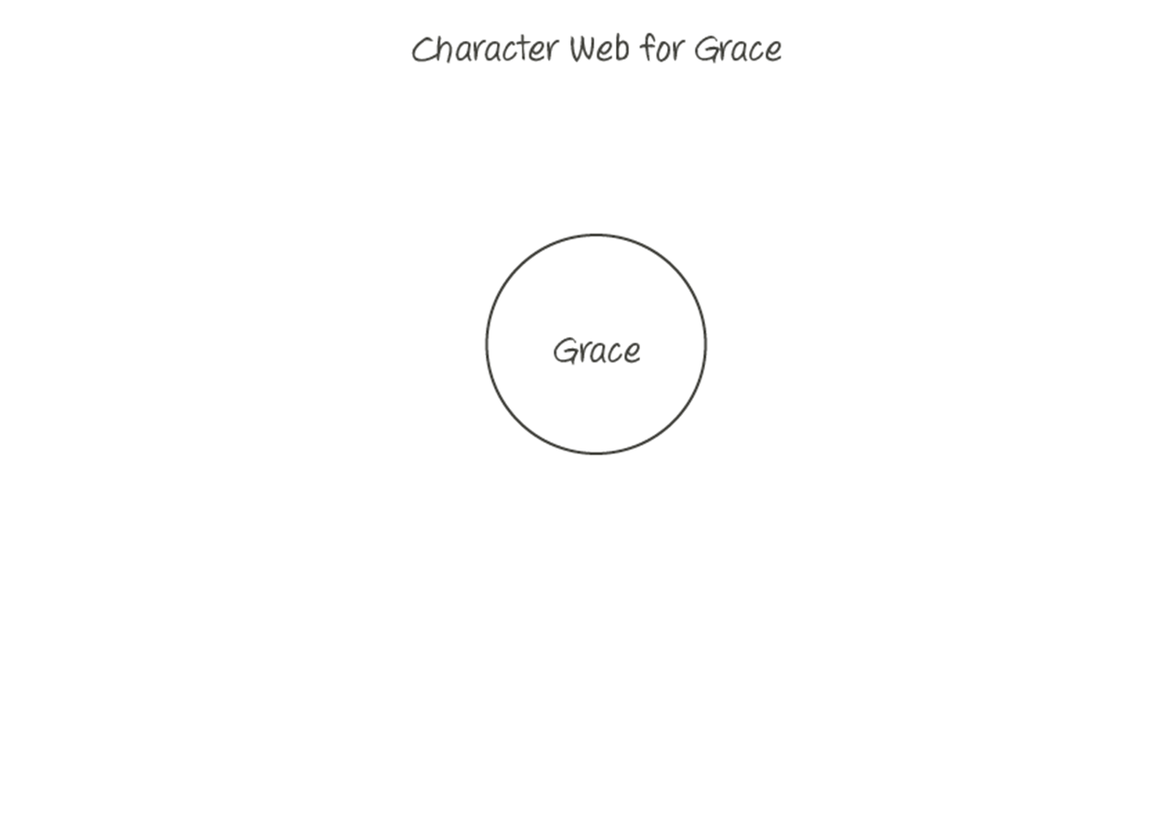
Classroom Discussion
What did you write about Grace on your web? What clues in the story helped you figure that out?
Do you agree? Why or why not?

Slide 16

Restroom Break
9:45 – 9:55

Slide 17

Computers – Classworks:
  R - Khamani - 1
  R – Katelynn -2
  R – McKenzie - 3
  R – Elin - 4
  R - Noah - 5
  R - Cayli - 6
  R – Jaiden - 7
  R - Paisleigh - 8
  R - Caydance – 9
  R – Kaylee - TC
Independent Daily Reading & Teacher Conferences
  Mrs. Roby:
  IDR check in
  Aiden
  Alexis
  Cayli
  Khamani
  Mrs. Thompson:
  LLI
  Amiyah
  Jaylie
  Jearon
  Cohen
Everyone else – Independent Novel
9:55 – 10:25

Slide 18
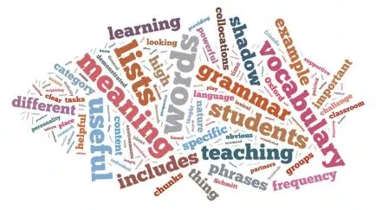


Vocabulary & Grammar Time
Snack Time
10:25 – 10:40

Slide 19
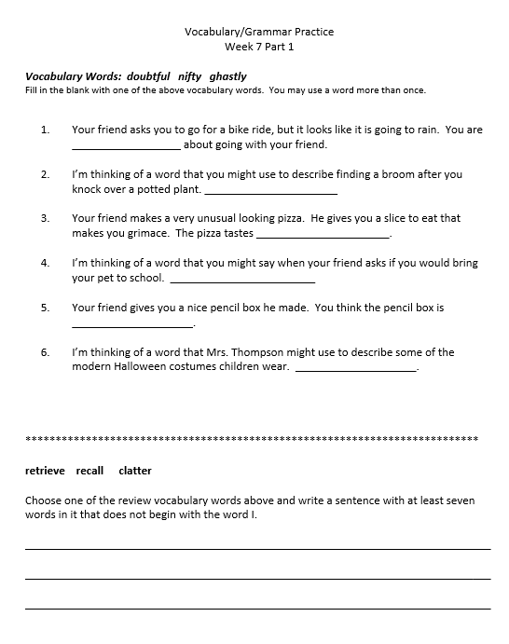

Slide 20
Out of Classroom!
Recess 10:40 – 11:05

Slide 21
Math Fluency & Focus Lesson!
11:05 – 11:55

Slide 22
Application Problem
Miss Brown bought 4 packs of yogurt. She had exactly enough to give each of her 24 students 1 yogurt cup. How many yogurt cups are there in 1 pack?
RDW = Read, Draw, Write
Read the problem
Draw and label items
Write an equation.
Write a word sentence (statement).

Slide 23
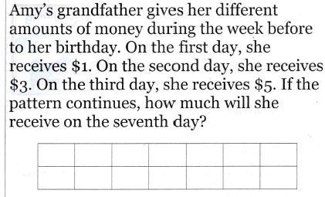

Slide 24
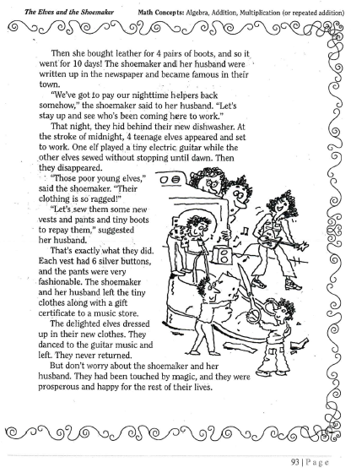

Slide 25
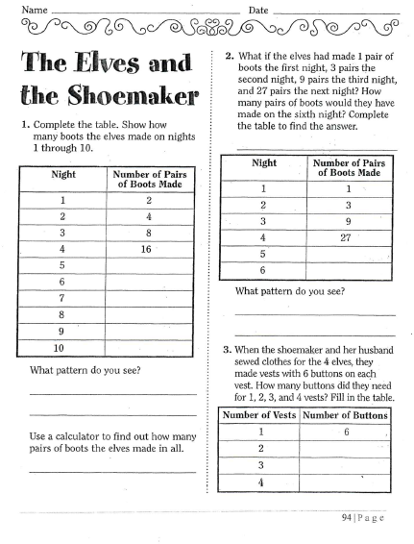

Slide 26
Small Group Rotations 1 & 2
  Rotation #1 - 11:55 – 12:15
Group 1 – Computers (TC, A, B, C, D): Classworks Reading
Group 2 – Mrs. Roby: Lesson 4-4
Group 3 – Computers (E, F, G, H, I): Imagine Math
Group 4 – Mrs. Thompson: Math Practice
Group 5 – Independent Practice
  Rotation #2 - 12:15 – 12:35
Group 5 – Computers (TC, A, B, C, D): Classworks Reading
Group 1 – Mrs. Roby: Lesson 4-4
Group 2 – Computers (E, F, G, H, I): Imagine Math
Group 3 – Mrs. Thompson: Math Practice
Group 4 – Independent Practice

Slide 27

Out of Classroom!
Lunch 12:35 – 1:05

Slide 28
Restroom Break
1:05 – 1:10

Slide 29

Out of Classroom!
Activity 1:10 – 1:55

Slide 30
Small Group Rotations 3 & 4
  Rotation #3 - 1:55 – 2:15
Group 4 – Computers (TC, A, B, C, D): Classworks Reading
Group 5 – Mrs. Roby Lesson 4-4
Group 1 – Computers (E, F, G, H, I): Imagine Math
Group 2 – Mrs. Thompson: Math Practice
Group 3 – Independent Practice
  Rotation #4 - 2:15 – 2:35
Group 3 – Computers (TC, A, B, C, D): Classworks Reading
Group 4 – Mrs. Roby Lesson 4-4
Group 5 – Computers (E, F, G, H, I): Imagine Math
Group 1 – Mrs. Thompson: Math Practice
Group 2 – Independent Practice

Slide 31
Small Group Rotation 5
  Rotation #5 - 2:35 – 2:55
Group 2 – Computers (TC, A, B, C, D): Classworks Reading
Group 3 – Mrs. Roby Lesson 4-4
Group 4 – Computers (E, F, G, H, I): Imagine Math
Group 5 – Mrs. Thompson: Math Practice
Group 1 – Independent Practice

Slide 32
Exit Problem
A parking structure has 10 levels. There are 3 cars parked on each level. How many cars are parked in the structure?
RDW = Read, Draw, Write
Read the problem
Draw and label items
Write an equation.
Write a word sentence (statement).

Slide 33
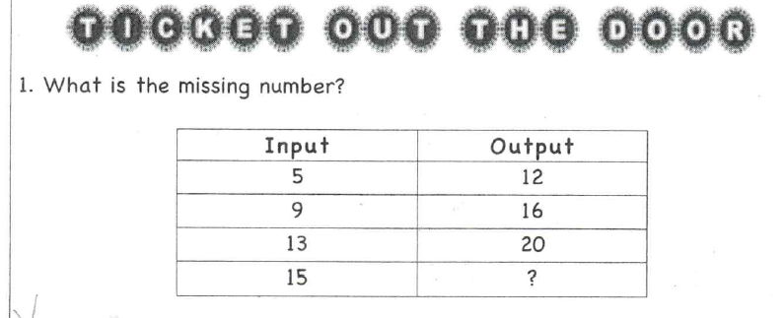

Slide 34
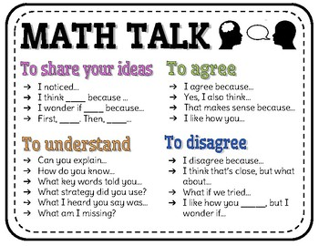
Student Debrief
Compare your answers with your partner’s answers
Who would like to share what they noticed?

Slide 35
Restroom Break
3:10 – 3:15

Slide 36

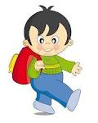


3:10 – 3:15 Wrap Up!
Pair-Up back to back and share one thing you learned in class today with your partner
Pack-Up
Office will announce:
Car Riders – Leave around 3:20
Bus Riders – (listen to intercom for dismissal)
2:30 – 3:20
How much time has elapsed?

