Slide 1
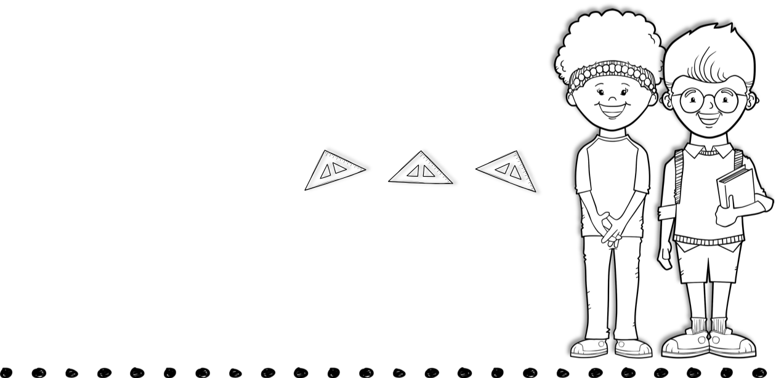
March 22nd -26th
Skills for the Week
Contact Me
Reading- compare & contrast
Writing-opinion writing
Math-measurement
Language-commas in a series
Spelling and math test Friday.
662-429-9117
mariann.word@dcsms.org
Text
Vocabulary Words
Activity
compare-how things are the same, or similar, or what they have in common
contrast-how things are different from one another
central message- the lesson, or moral, that the author wants the reader to learn
similarity-being alike in some way or ways
difference-the way that two or more things are not alike
Monday-Computer
Tuesday-Library
Wednesday-Music
Thursday-PE
Spelling Words
joy frosty coin
south wife chose
shake window join
clay grow branch
tray brave long
many enough buy
answer ocean
Upcoming Events
April 2nd- Good Friday Holiday
April 5th- Easter Holiday

