Slide 1
The First Alabamians
From about 11, 000 BC to AD 1700
Source: Alabama –The Making of an American State
By Edwin C. Bridges

Slide 2
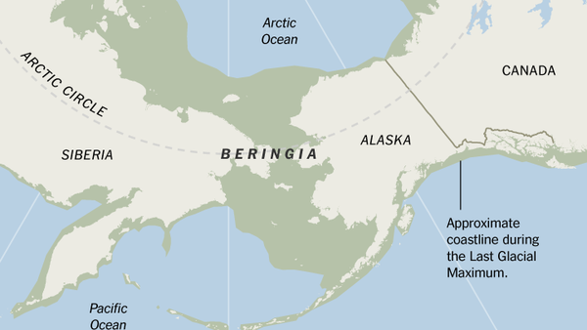
First Arrival in Alabama
Asiatic people crossing through Alaska were the first settlers of the Western Hemisphere.
The first Alabamians arrived during the Ice Age
Their story resembles that of people in other parts of the world where life progressed from a Stone Age Culture to an agriculture- based civilization.
During the Ice Age, oceans levels were much lower than they are today because so much water was locked in huge glacial masses. The shallower seas exposed a large land area between Siberia and Alaska that is called Beringia. People from Asia moved into Beringia and lived there for thousands of years., and from them migrated from there into the Americas.

Slide 3
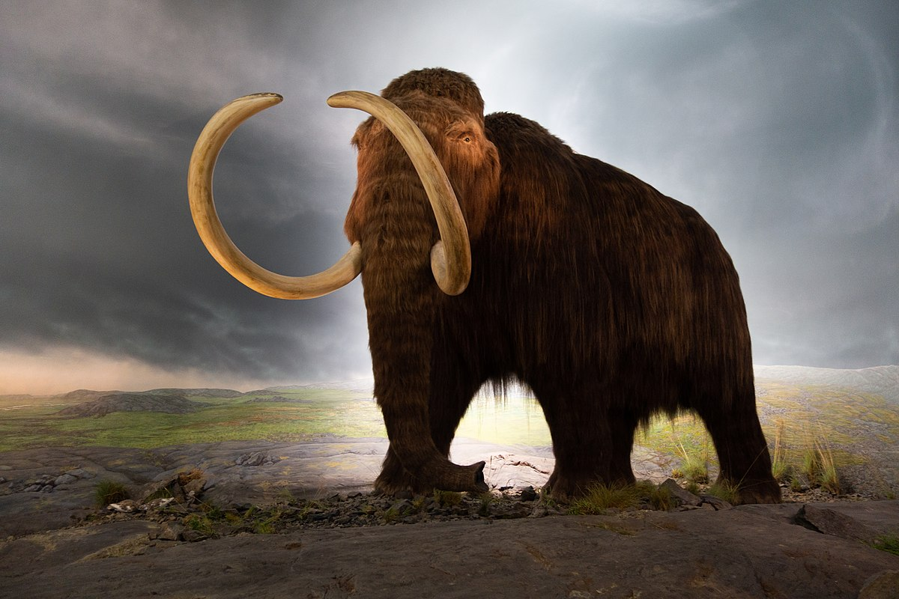
The Paleo Period (11,000 BC to 8,000 BC)
Projectile points are large pieces, sharp enough to pierce the thick hide of mammoths.
Archaeologists refer to the earliest settlers as Paleo (from the Greek word old)
They were Stone Age people.
Lived in small bands, ranging from 20 to 50 or more people and composed mostly of extended family members.
Bands met together for trade, ceremonial occasions, hunting , and finding mates.
They also fought against different bands over territory etc.
Were foragers and hunters- moving seasonally to take advantage of food sources.
In Alabama, their numbers would have been in the thousands rather than tens of thousands.
North America was then home to many different kinds of large animals including mammoths, mastodons, giant bison, ground sloths, saber-toothed cats, camels, and wild horses.

Slide 4
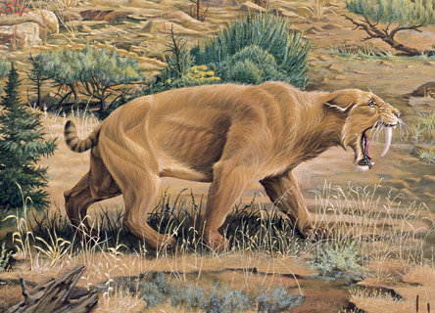
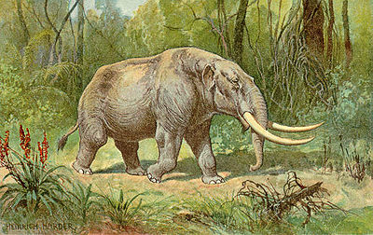
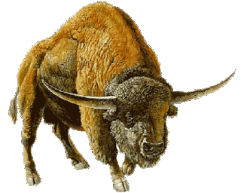
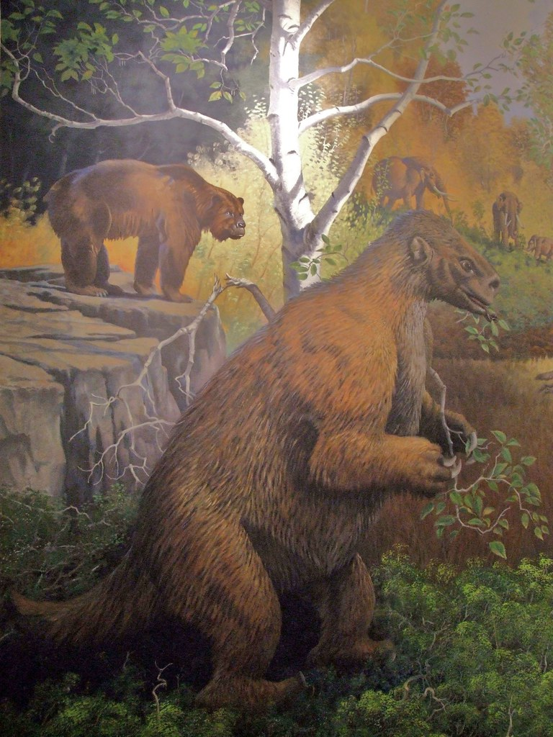
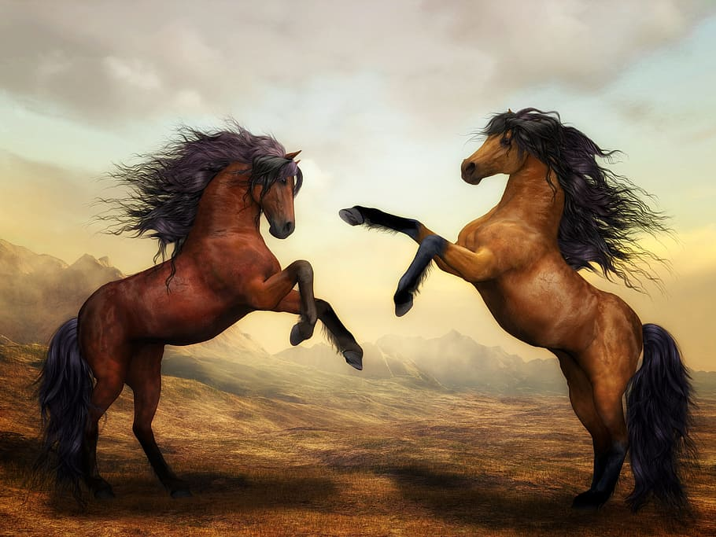
The Paleo Period (11,000 BC to 8,000 BC)

Slide 5
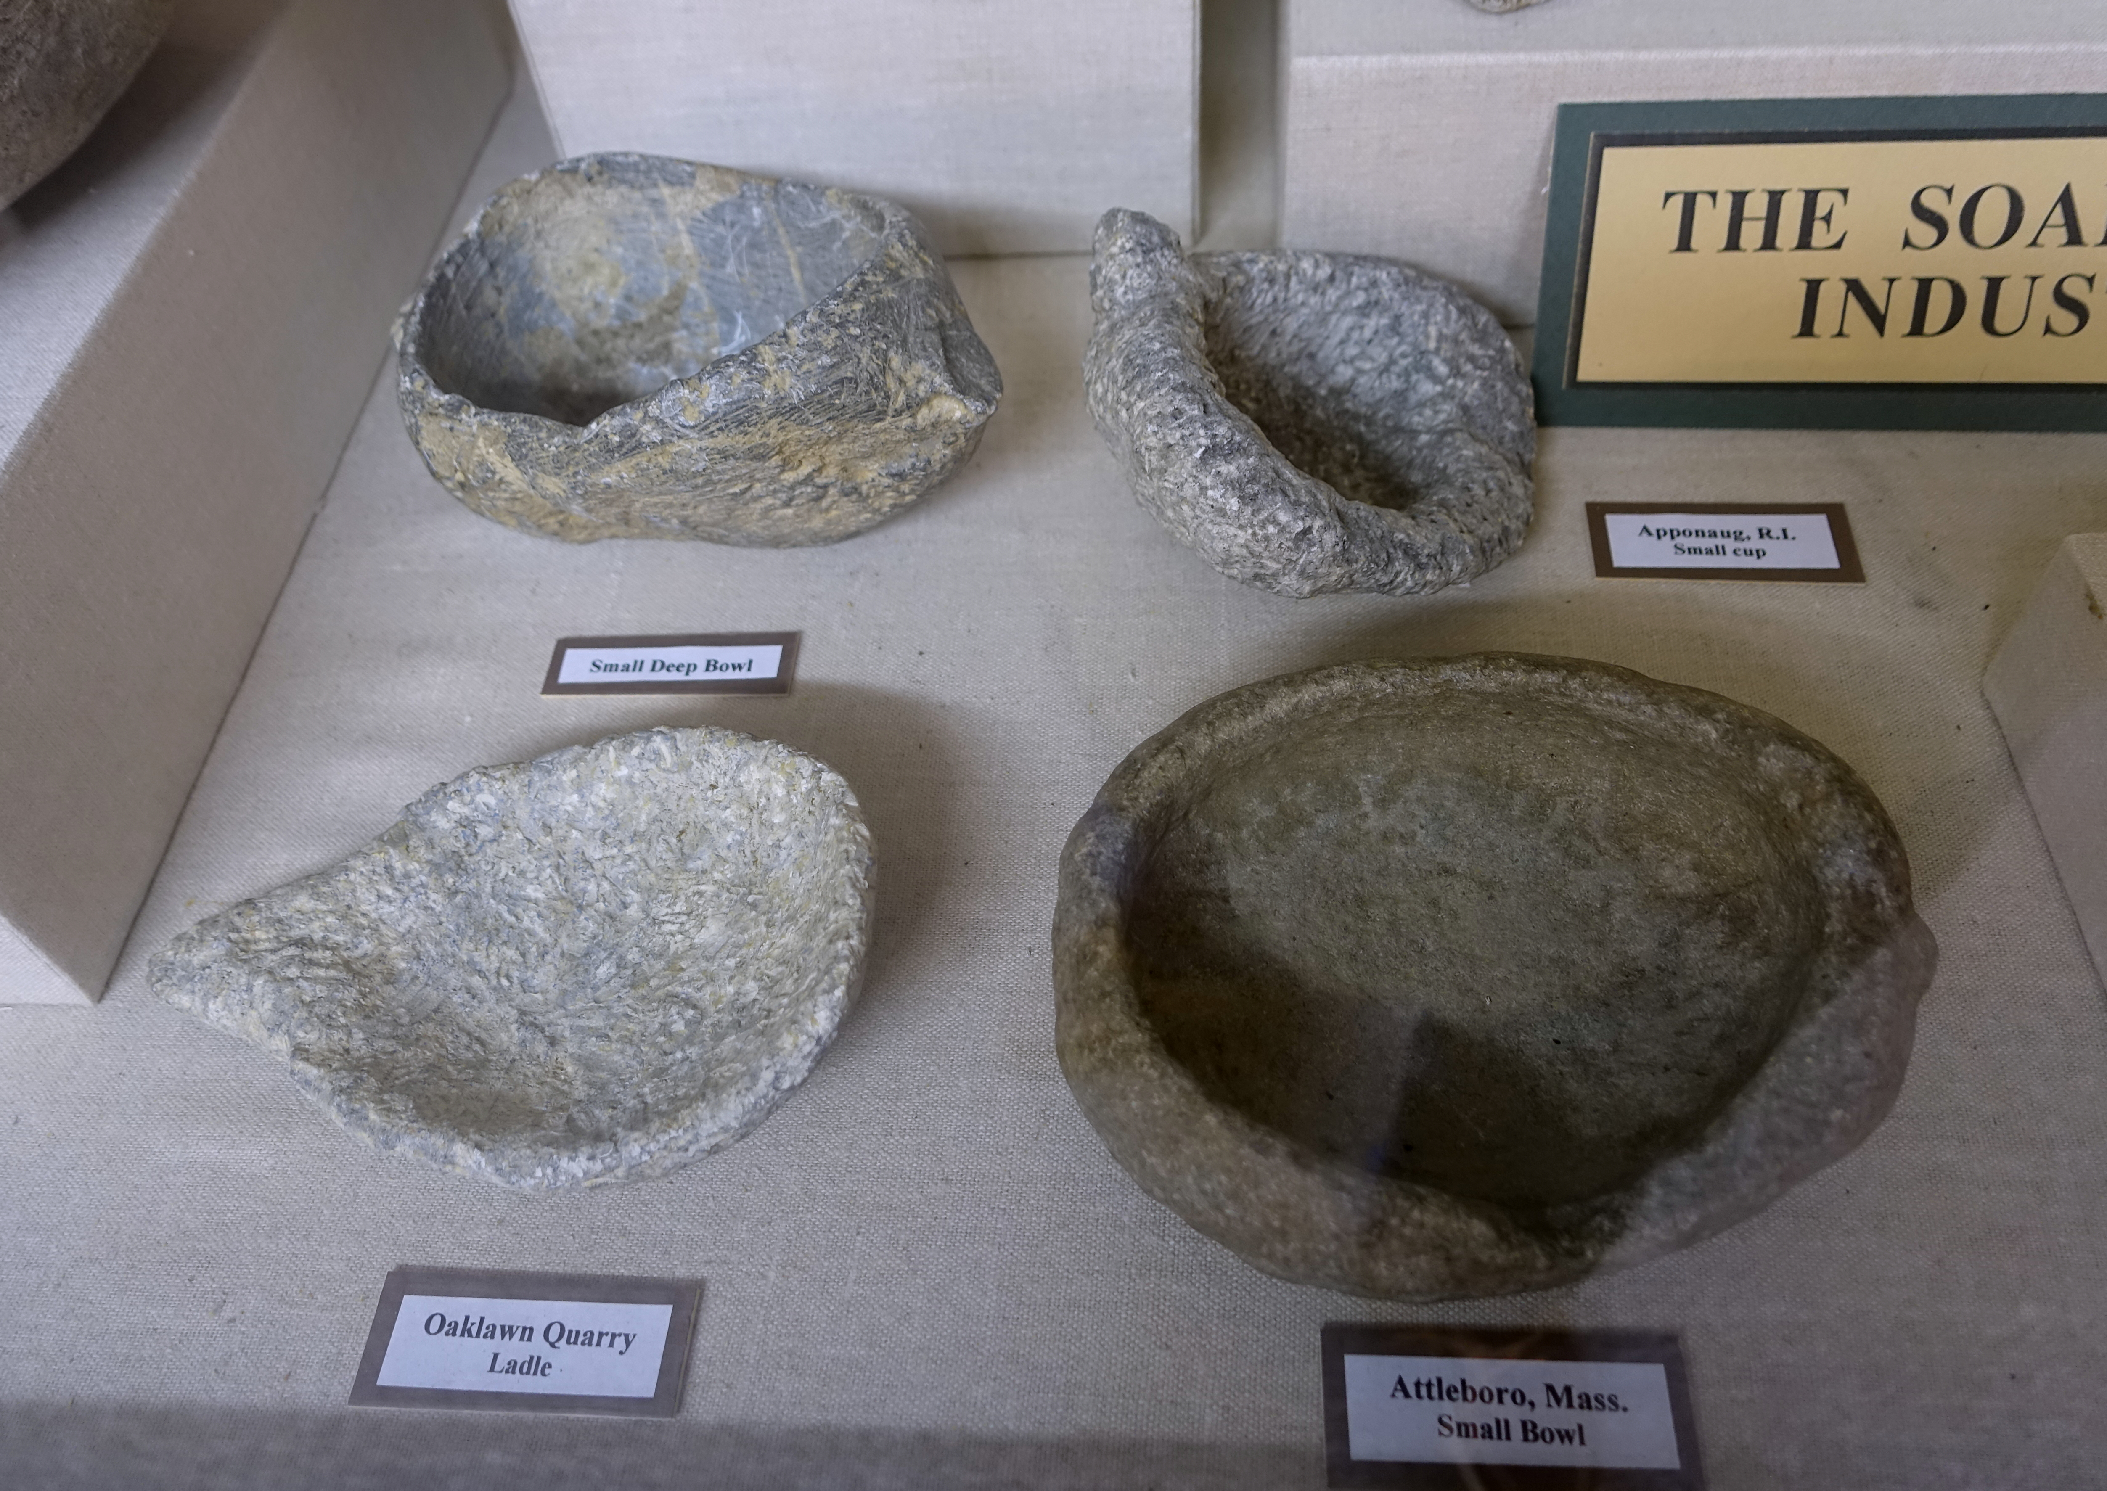
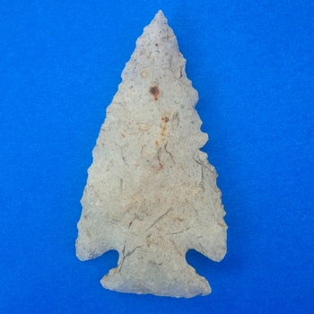
The Archaic Period (8,000 BC to 1,000 BC)
By 8,000 BC temperatures began to warm and the climate changed to something like what it is now. This brought changes to the lives of the American Indians
New plant life and animal life began to emerge
Melting icepacks caused a rise in sea levels that covered Beringia.
The great animals of the Ice Age are gone but the new climate supported species of smaller animals.
Meat sources now included deer, rabbits, turkeys, squirrels, raccoons, ducks and turtles.
Streams and rivers yielded fish and mussels.
Plant food consisted of nuts, acorns, berries, roots, and greens. They also planted squash, sunflowers and even some grains.
Projectile points are large pieces, sharp enough to pierce the thick hide of mammoths.
Paleo Indians developed new and better vessels for cooking foods. They used soapstone to make many of their tools.

Slide 6
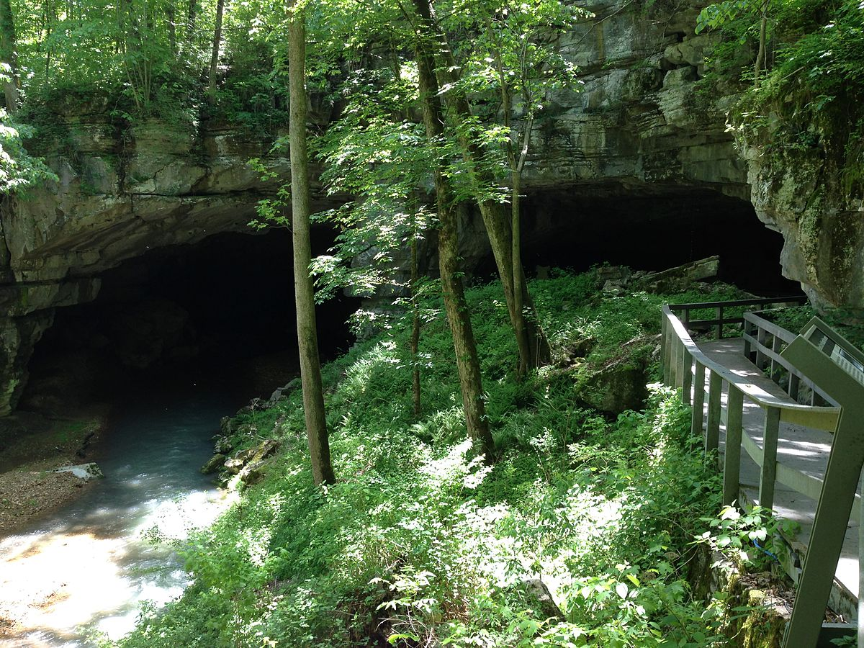
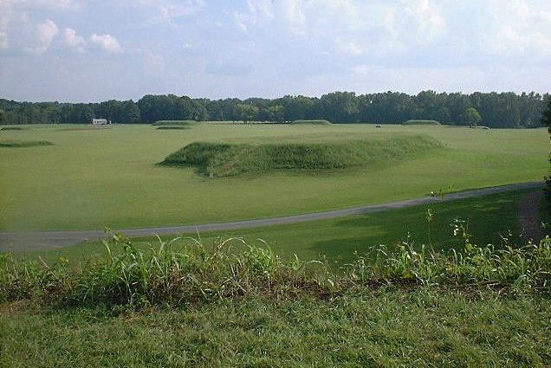
The Archaic Period (8,000 BC to 1,000 BC)
Changes in weapons and tools
No longer needed the projectile points for piercing a mammoth’s hide. A throwing device called an atlatl. It added range and power to the thrust of Indian spears.
Other tools were fashioned from bone, hide and wood.
These supplies also helped the Indians with preparing and cooking food, as well as making clothing, and building shelters.
The Archaic Indians also built earthen mounds for both ceremonial and burial purposes.
As Archaic Indians gained greater mastery over the environment, their numbers increased and their lives more comfortable.
Tools became more sophisticated as their system of trading brought good from miles away

Slide 7
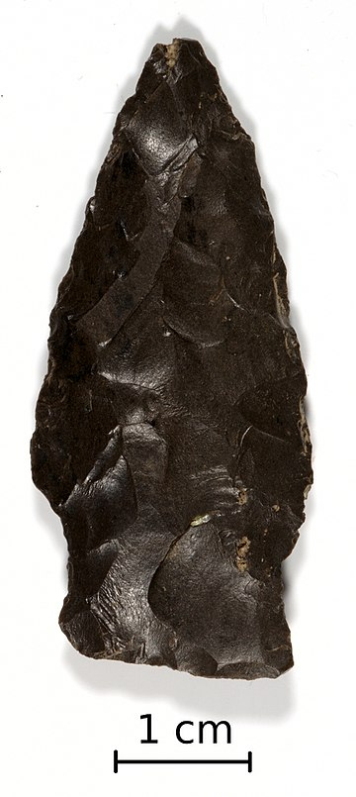
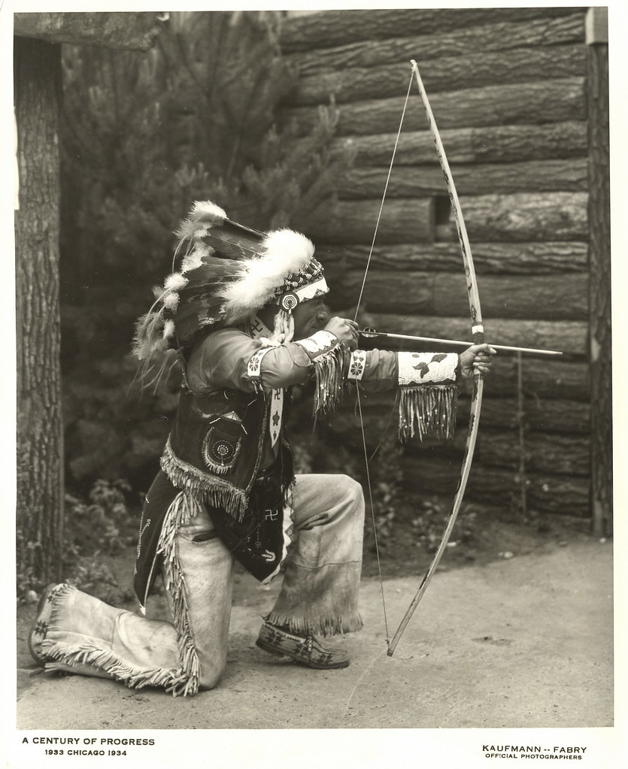
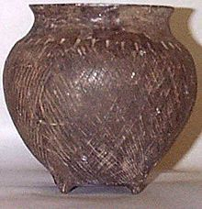
The Woodland Period (1,000 BC to AD 1000)
Food and Lifestyle
Woodland people kept regular gardens
They grew plants such as: beans and grains
Their reliance on plants for food increased because both their need and their ability to stay longer in the same place.
A more settled lifestyle allowed them to build larger and more long-lasting structures for home and community life.
Changes all around: more people, more tools, more systematic agriculture, and more settled community life
Pottery making was the standard of life and included different vessels, ornamental styles, and clay.
The variety of motifs and increased beauty of design showed an expanded aesthetic consciousness.
Woodland Innovations
Two significant innovations were cloth and the bow and arrow.
Woodland women learned how to dry, work, and then hand-spin vegetable fibers into thread.
The bow and arrow increased the hunter ability to kill game.

Slide 8
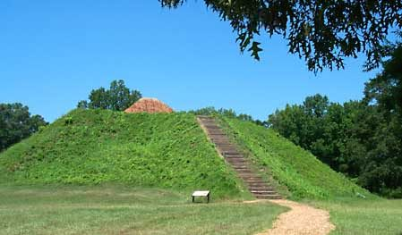
The Mississippian Period (AD 1000 to AD 1550)
Food and Lifestyle
Populations increased
Less time for full time food gathering and more time for leisure activities and family
Lived in small, one-room houses.
The people of the Mississippian period built on the achievements of their Woodland ancestors, creating a substantial and prosperous society.
Major increase of corn production
The ability to produce and accumulate surpluses of food that could be stored and used whenever was HUGE!!
Agricultural Revolution- production of corn and other food through systematic planting.
Increased production of food led to increased population, and growth of the first towns and cities.
Lack of larger beasts for hunting but many areas were rich with forests and rivers nearby. They continued to hunt, fished, and ate nuts berries and greens they gathered.
Mississippian towns in Alabama:
Moundville, (along the Black Warrior River) estimated at 1,000 living there. At one time Moundville was one of the largest Mississippian towns in North America.
Other towns in Alabama:
Bessemer, Bottle Creek in Mobile, Florence and Hobbs Island in the Tennessee Valley
All these towns were located along streams or rivers rich in alluvial soil
Some towns were surrounded by protective walls.

