Slide 1
GES Kindergarten
Week 7- May 4 - May 8

Slide 2
Standards
Reading:
R.I.8- Identify Main Idea and key details in a text
Writing:
W.K.1: Use a combination of drawing, dictating, and writing when composing opinion, narratives, and informative texts.
L.K.2: Use g appropriate capitalization, punctuation, and spelling when writing.
Phonics:
R.F.K.2: Demonstrate understanding of sounds (middle sounds, short vowels).
Sight Words:
R.F.K.3: Read common high frequency sight words.
Math:
KOA1 add/subtract in many ways within 10

Slide 3
Standards
Science:
L.K.2 Students will demonstrate an understanding of how living things change in form as they go through the general stages of a life cycle.

Slide 4
Reading
Essential Questions:
What is the life cycle of a butterfly?
I Can:
I can restate the butterfly life cycle in sequential order.

Slide 5
Reading
Activity: Read the books to a sibling, parent, pet, or toys.
Nonfiction:
The Life of Butterfly
Fiction:
The Very Hungry Caterpillar

Slide 6
Day 1
Read for fun!
Make a list of things you know about butterflies.
Add new information after you read/listen to the book.
Capture This and That Activity:
Illustrate your very own butterfly.

Slide 7
Day 2
Reread the text.
Ask and answer simple recall questions.
Write a sentence about a fact you learned today about plants.
Listen and Draw Activity:
Illustrate a chrysalis.

Slide 8
Day 3
Discussion:
*How do the labels help you learn more about butterflies?
*What are the parts of butterfly?
Follow-up Activity:
Draw the life- cycle of a butterfly,

Slide 9
Day 4
Part 1: Read The Very Hungry Caterpillar
Part 2:
Directed drawing

Slide 10
Day 5
Wrap up:
Discussion: Restate the life cycle of butterflies.
Journal Prompt: What kind of butterfly would you like to be?

Slide 11
Science
Make the life cycle of a butterfly.
Materials:
Paper plate Various colors of construction paper
Directions:
Cur dime size pieces of construction paper to make eggs and laeva.
Cut an oval piece of brown paper to be the pupa.
Use different colors to make your butterfly.
Draw arrows to connect the life life sycle
See next slide for examlpe.

Slide 12
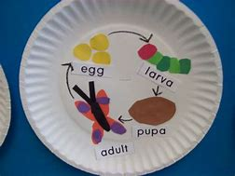
Life Cycle of a ButterFly

Slide 13
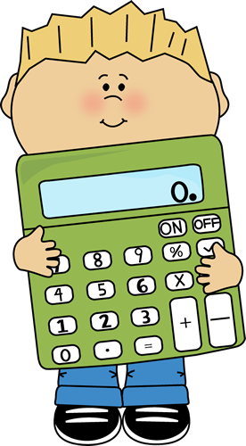
MATH:
Get 6 pieces of paper- write 3 subtraction problems and 3 addition problems, crumble the papers up like a ball and throw them in the air. Pick a “ball” and solve the problem.

Slide 14
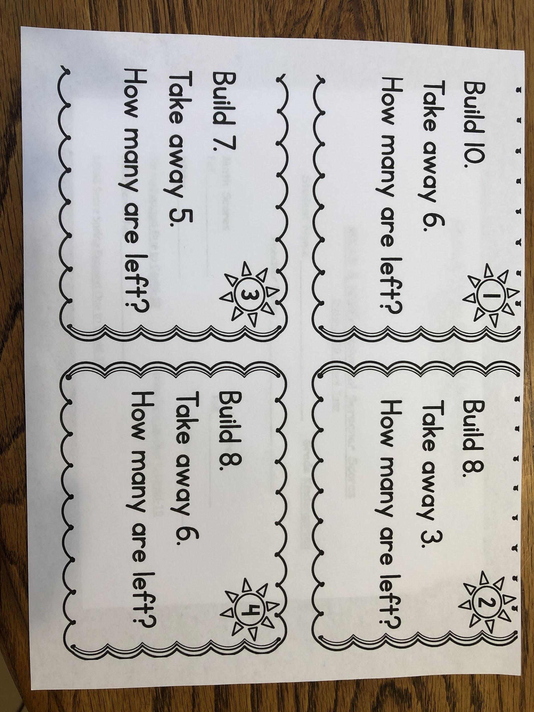
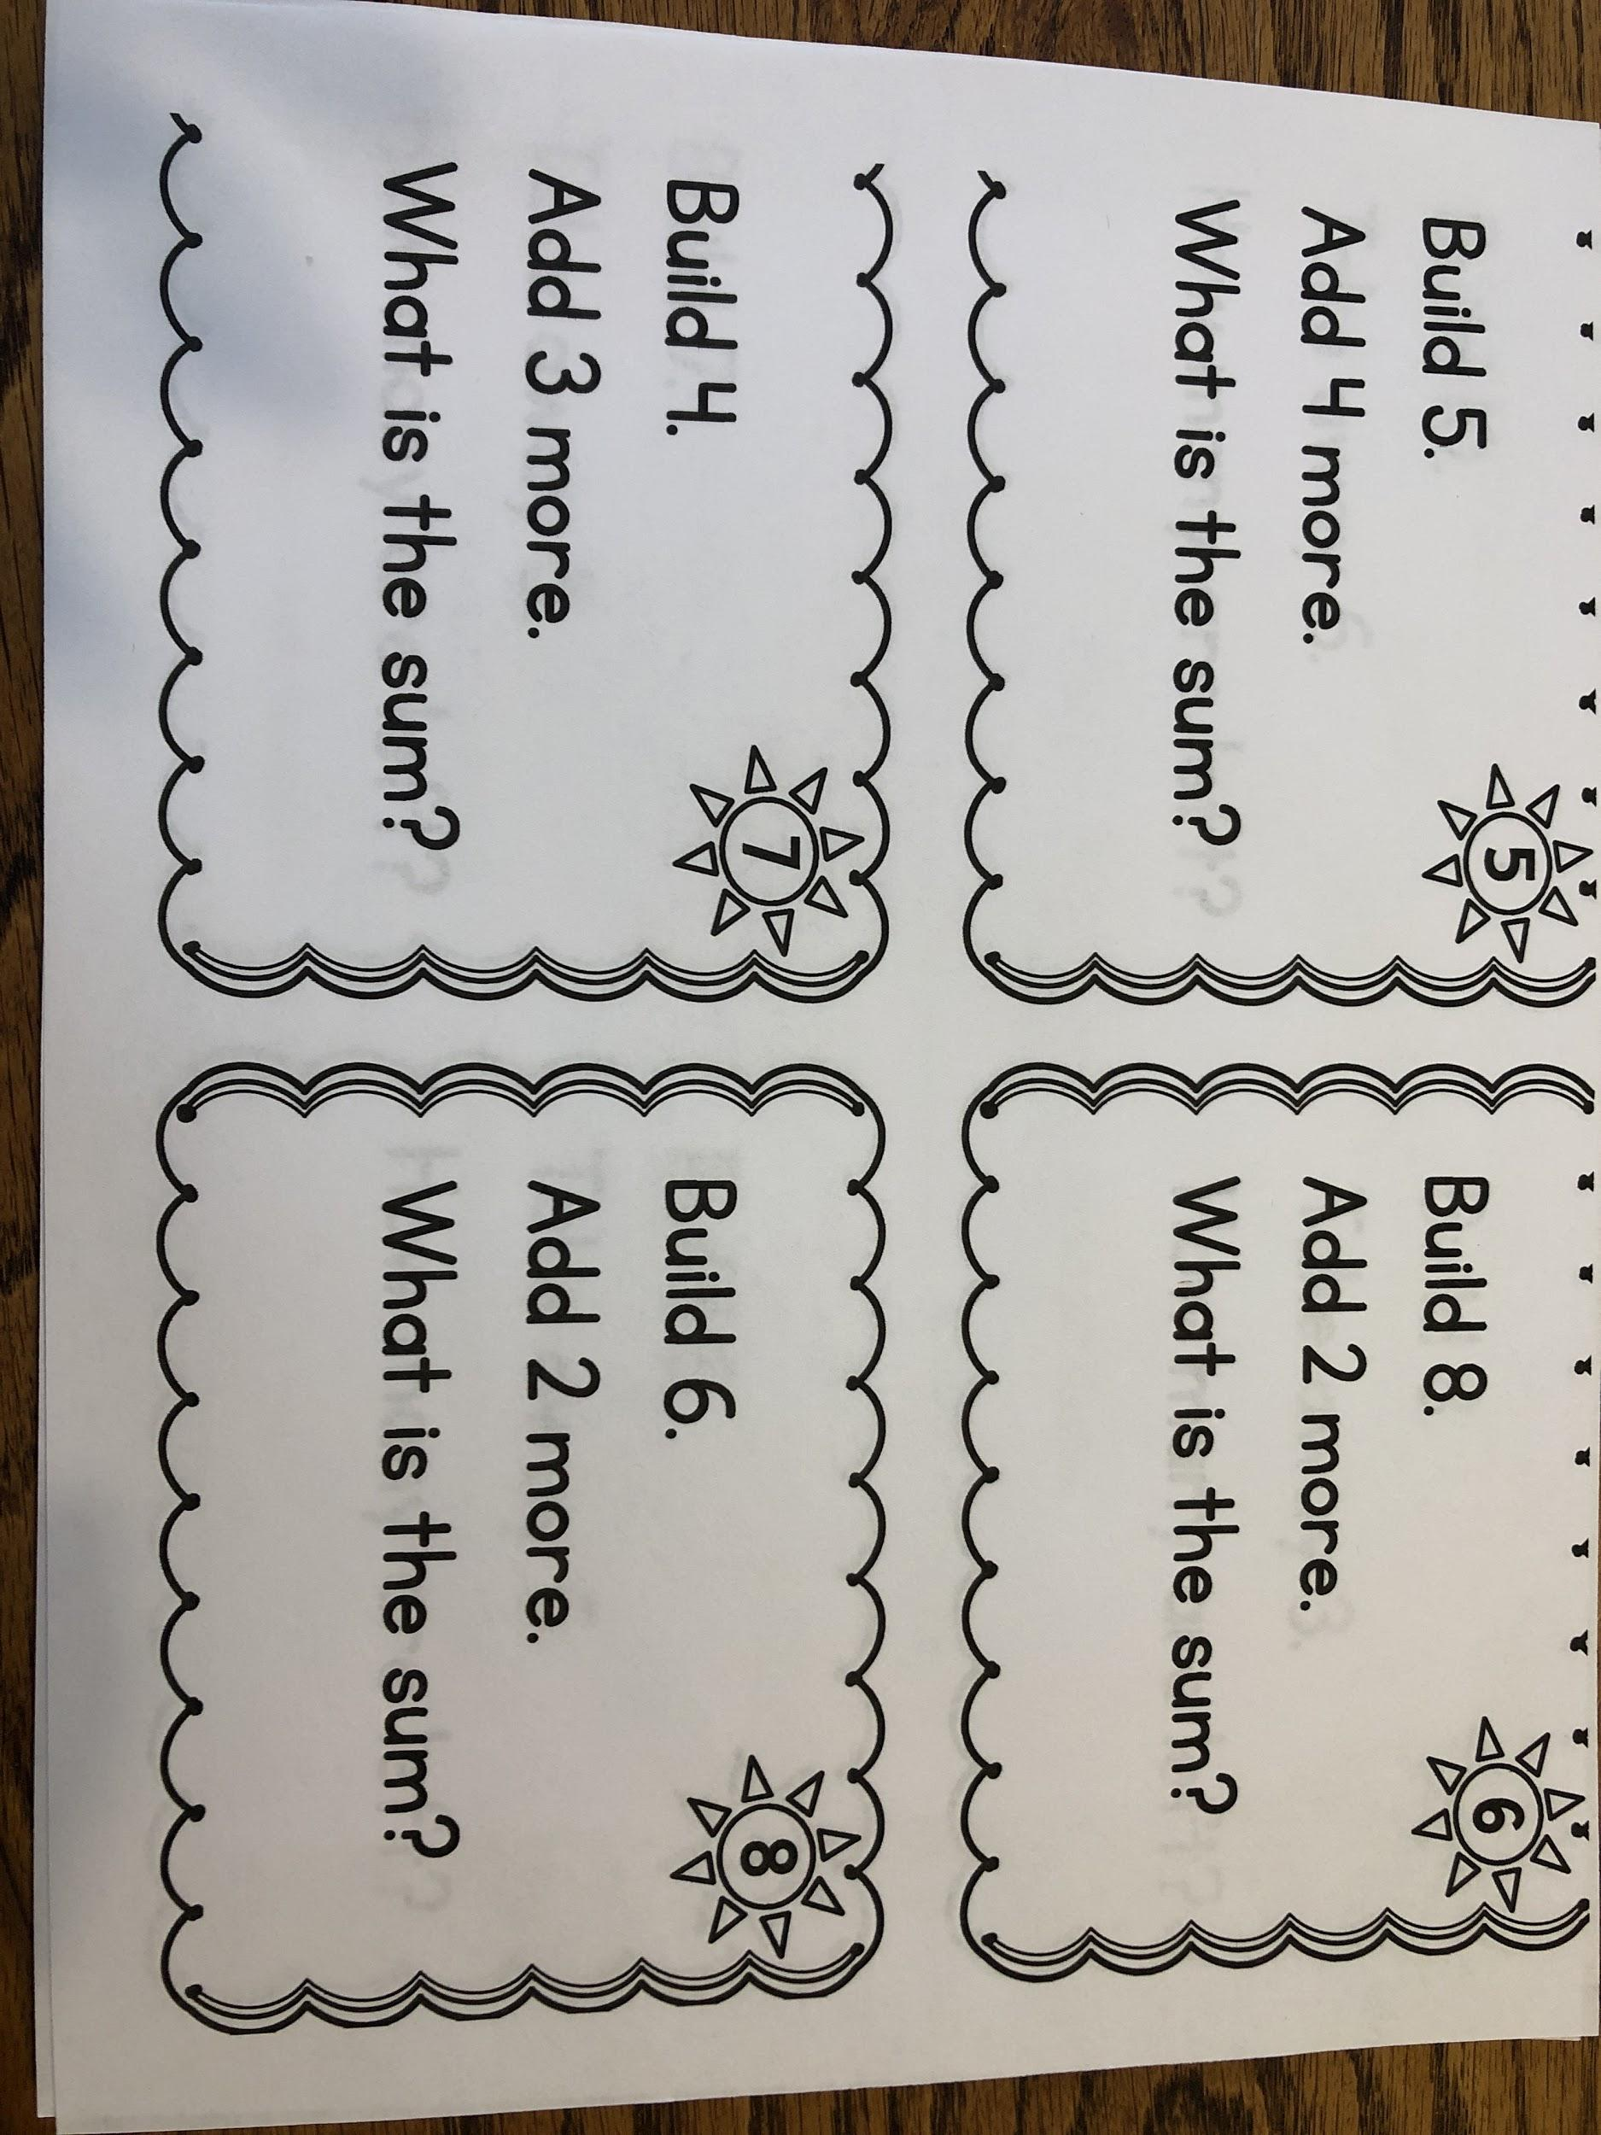

Slide 15
Writing
Activity:
Choose 1:
Write whether you like butterflies or grasshoppers more.(opinion)
Write about where you would fly and what you could see if you were able to fly. (narrative)
Write about the stages in the lifecycle of a butterfly.(informative)

Slide 16
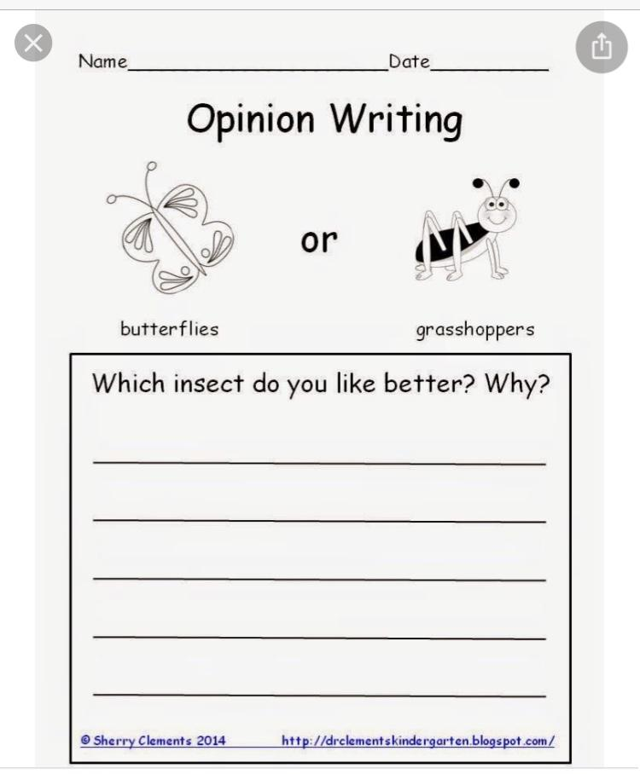

Slide 17
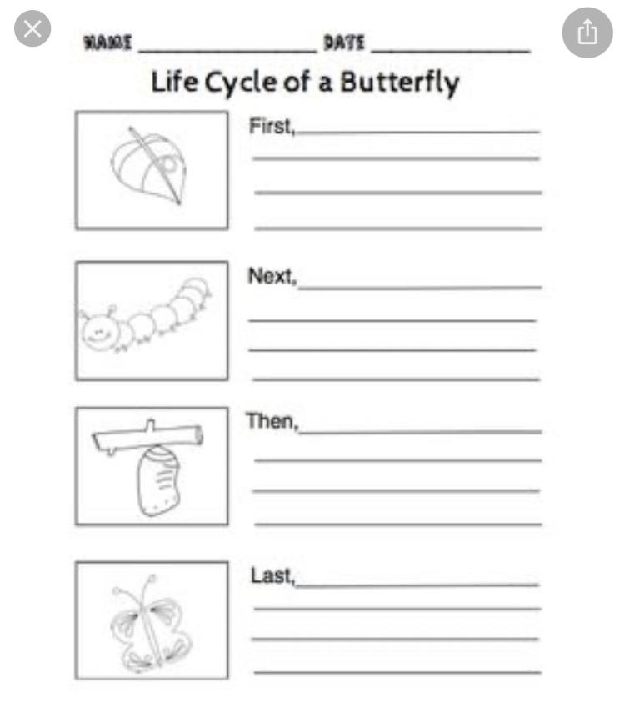

Slide 18
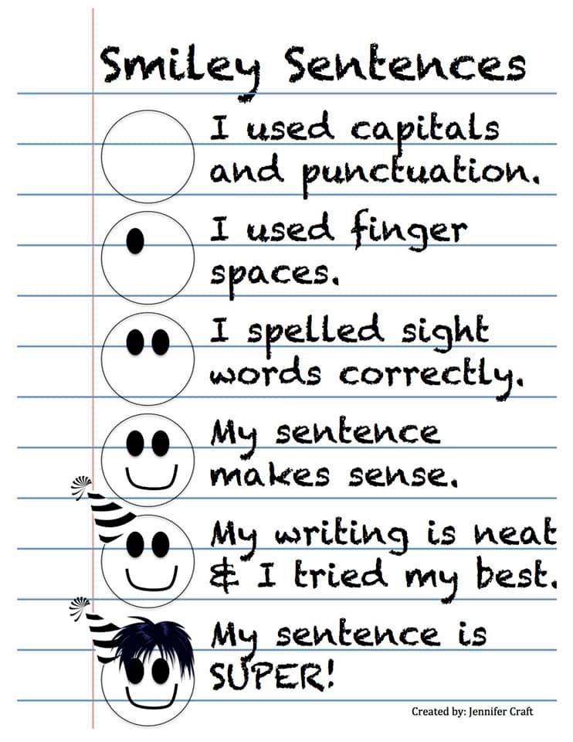

Slide 19
Phonics- Short Vowel Review week 2
This week is our second week to review short vowels. There will not be a set of 10 words to study and quiz.
This week Instead of a spelling word list we are giving you the following short vowel CVC Bingo word list (see following phonics slides). The students may write 24 words on their bingo card. Encourage siblings and parents to make a card and join in. At the end of the week parents can take their student’s bingo card and quiz them on some of the 24 words. Differentiating between short vowel sounds can be a tricky skill for young readers, so the more practice the better.
For extra fun and practice reading, let the student take turns being the Bingo caller!

Slide 20
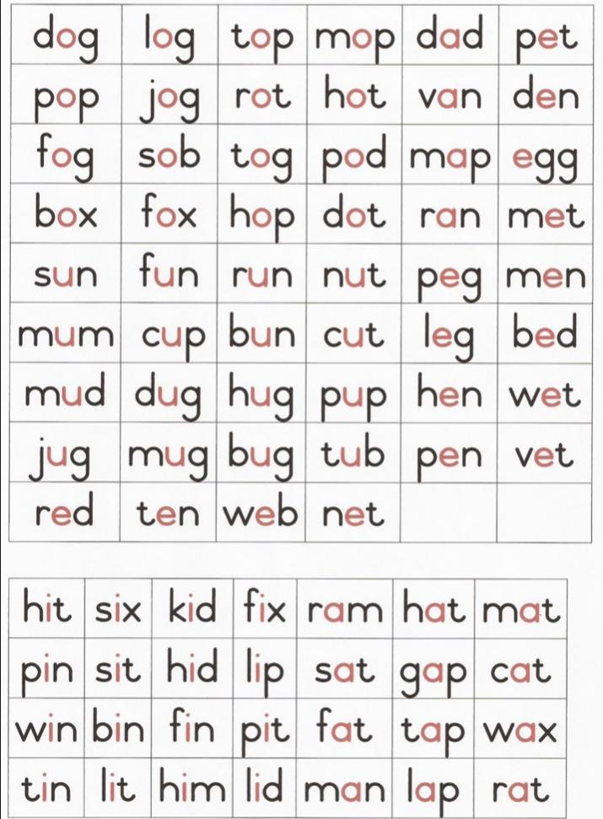

Slide 21
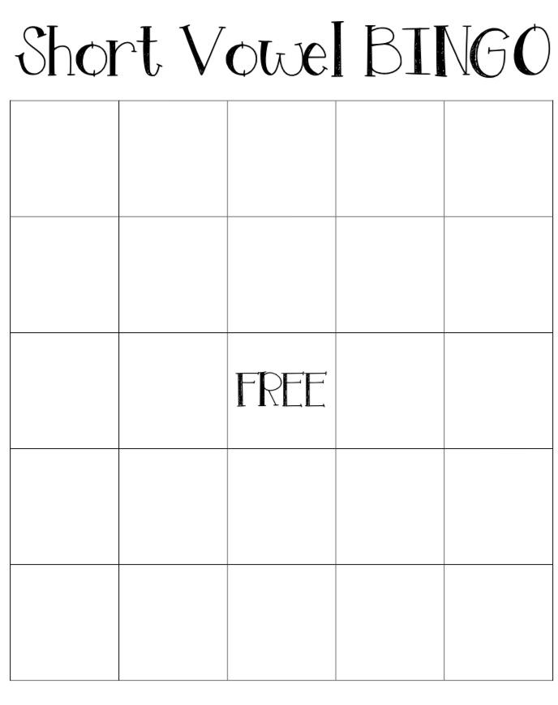

Slide 22
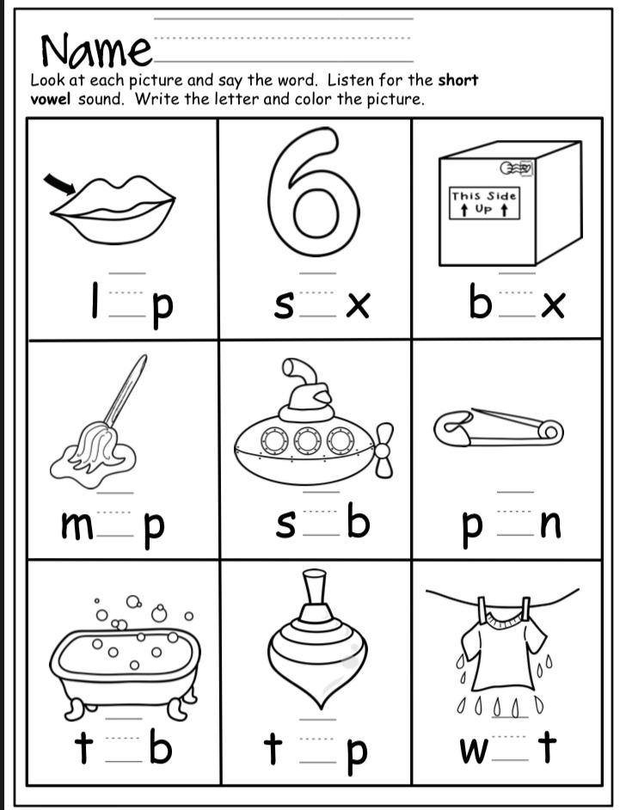
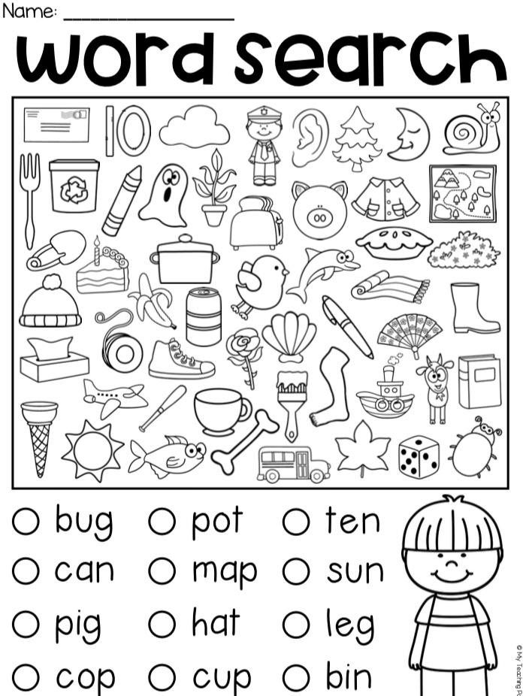

Slide 24
Sight Words
Sight Words: sit, day, come, love
Activity: Find words that rhyme with each sight word, and write them on a piece of paper.
After you rhymed each word, use the
rhyming words to make a song.

Slide 25
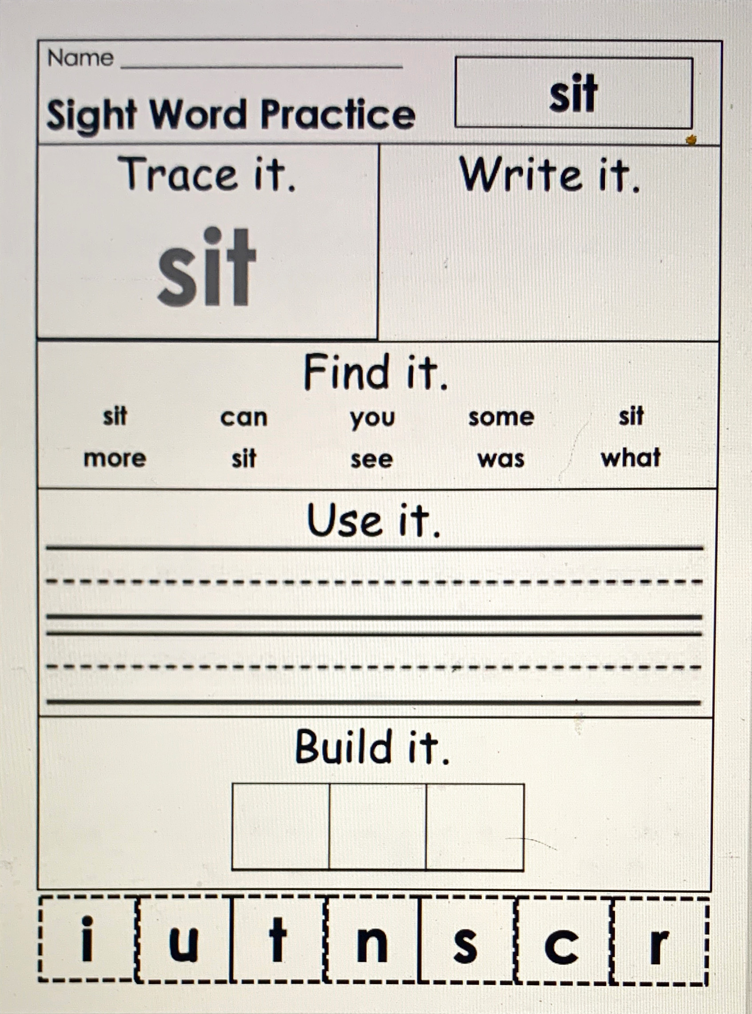

Slide 26
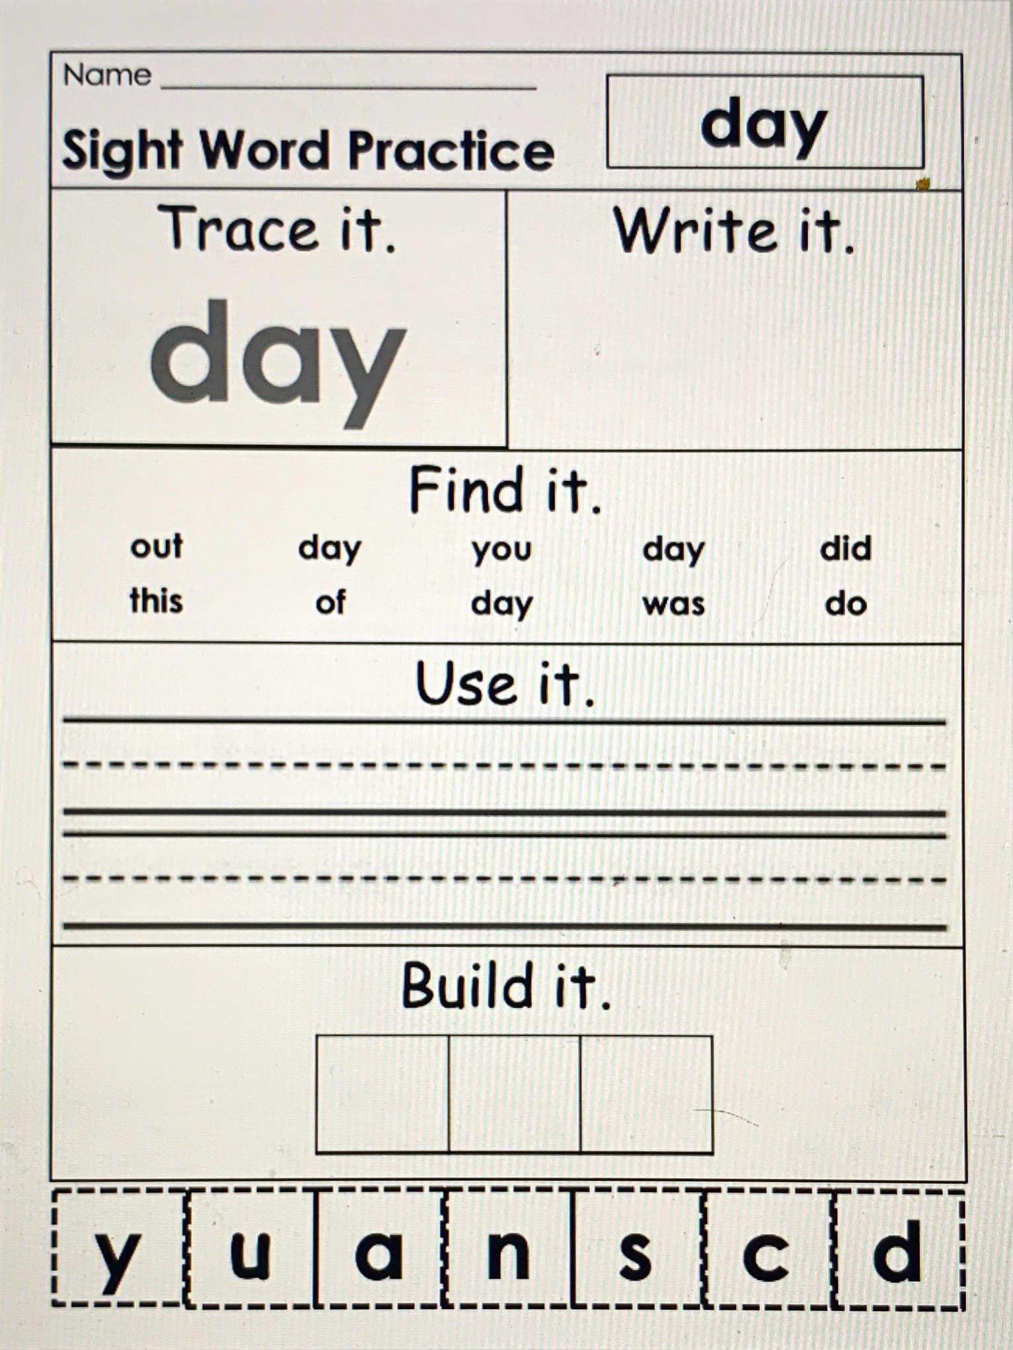

Slide 27
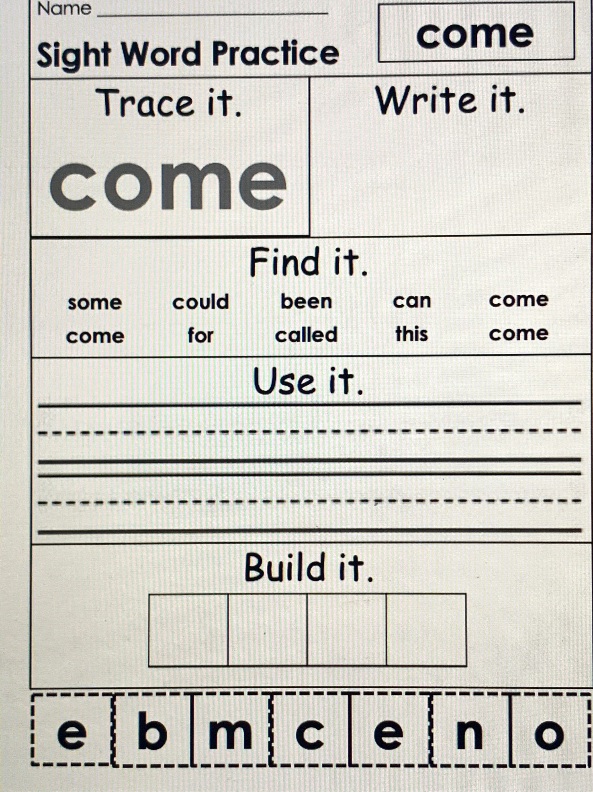

Slide 28
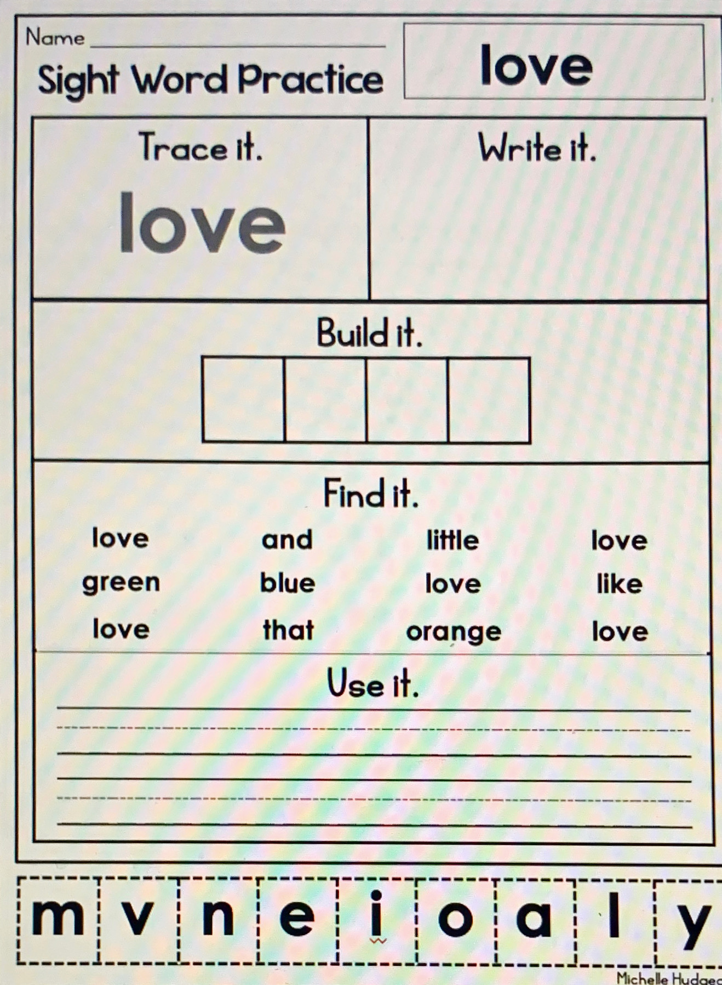

Slide 29
Baseball Words.mp4
Basketball words.mp4
Soccer ball words.mp4
These are review videos of our sight words with flash cards. Remember, though some words can be sounded out, you should remember these words and read them automatically. 😊

Slide 30
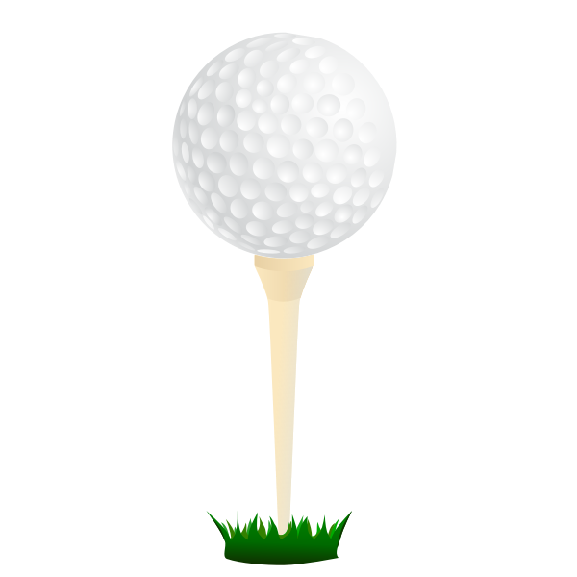
Football words.mp4
Volleyball words.mp4
Golfball words.mp4
These are review videos of our sight words with flash cards. Remember, though some words can be sounded out, you should remember these words and read them automatically. 😊

Slide 31
Tennis ball words.mp4
Bowling ball words.mp4
Hockey puck words.mp4
These are review videos of our sight words with flash cards. Remember, though some words can be sounded out, you should remember these words and read them automatically. 😊

Slide 32
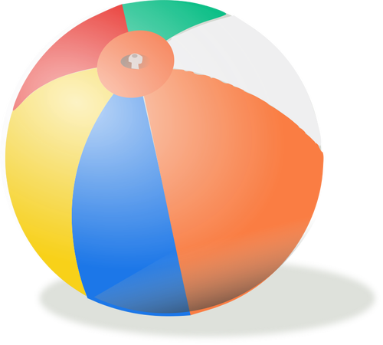
These are first grade words. Study these to get ready for first grade. :)
Top banana words.mp4
Beachball words.mp4
These are review videos of our sight words with flash cards. Remember, though some words can be sounded out, you should remember these words and read them automatically. 😊

Slide 33
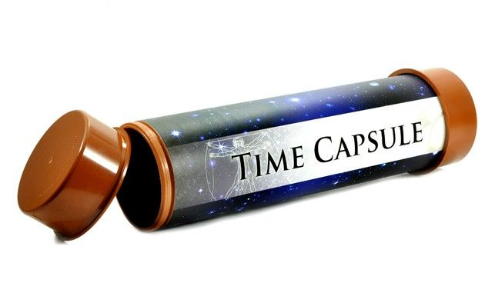
Optional Activity:
We are living in a moment in history and an unprecedented time. The students may not realize it right now, but one day they will think back on these times. This is an idea of a time capsule you could make to help them recall these times years from now.You can make an actual time capsule or you can just keep the paper somewhere safe. We will add a few new sheets each week that you can do with your child to keep in the capsule.

Slide 34
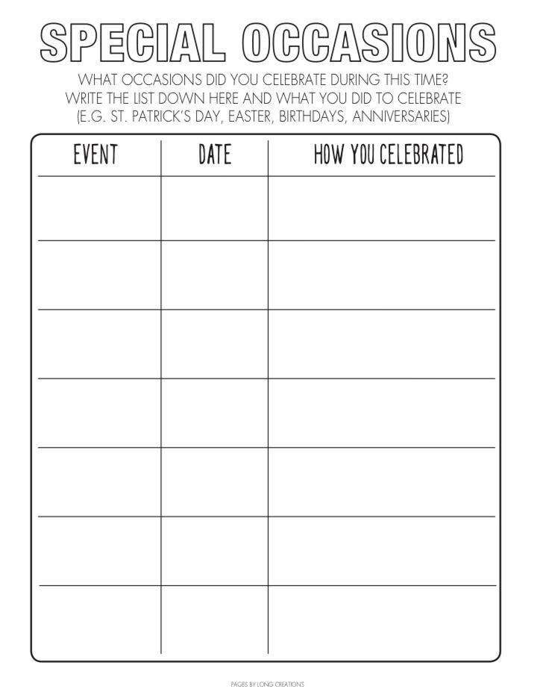

Slide 35
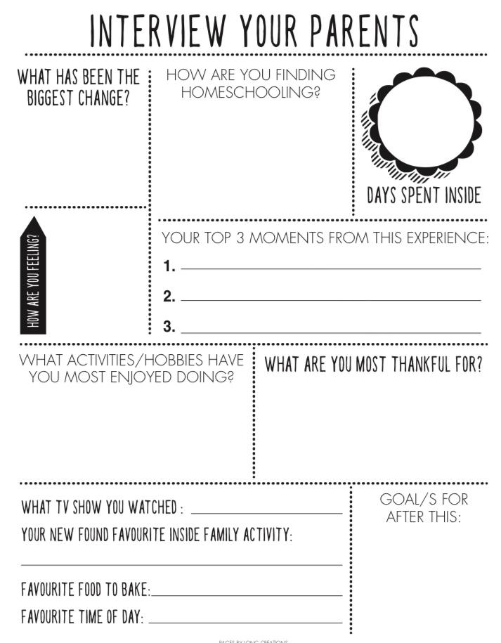

Slide 36
Online Resources Section
These are not links. On this page you will have to type the website name in the web browser, but these are great YouTube alternatives during this time of distance learning and all throughout the year!

Slide 37
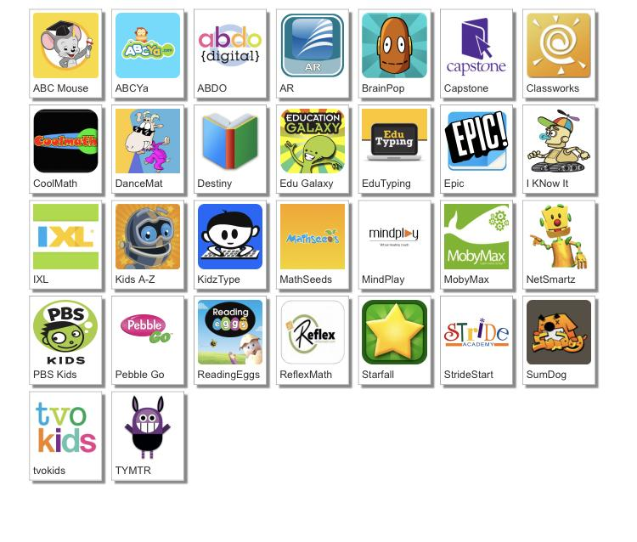
http://www.dcsdms.org/ll/

Slide 38
Message from the Teachers
We miss you guys. We are so proud of all of the hard work you guys have done. Listen to your parents. They are your teachers right now. We may do things differently, but we are all working together to do all that we can for you guys. We would love to see a picture of you working hard. You can send these to us via Remind. Keep working hard! :)

Slide 39
Note to the parents, thank you for investing in your child’s education!

