Slide 1
The Executive Branch
Page 342

Slide 2
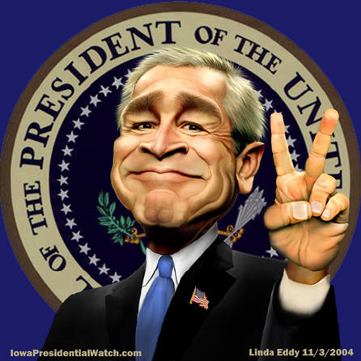

Slide 3
Review from last class
National Government.
The Legislative Branch.
Common man
The tenth amendment
A Federal system of government
House of
Representatives
Senate

Slide 4
Objectives :
Explain how civic responsibilities are important to Mississippians as citizens of the United States and residents of a global setting. MS5
Explain the necessity of politics and government. MS5a
Explain how the United States Constitution grants and distributes power to national and state government. MS5c

Slide 5
What office has the greatest effect on you and the world?
People in the United States do not vote.

Slide 6
Overview
Executive Branch
Judicial Branch

Slide 7
Who is the head of the Executive Branch?
The President

Slide 8
How do we elect the President of the U.S.?
Electoral College
Electoral College vote counting ceremony

Slide 9
When I cast a ballot for the president who do I vote for?
Electors

Slide 10
How many Electoral College votes are their?
538

Slide 11
How many does each state have?
# of Senators and # of House members

Slide 12
538 Electors
100 – senators 435 – House members 003 – District of Columbia
538 – Total
100 – senators 435 – House members
535 – Total

Slide 13
Electors
2 – senators 4 – House members
6 – Total

Slide 14
To run for the office of the President, you must be?
35 years or older.
Natural-born Citizens
In U.S. the least 14 years.

Slide 15
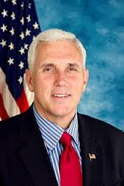
Who takes the Presidents place if he/she can not perform the duties of the office?
The Vice President
Mike Pence

Slide 16
Who takes the Vice Presidents place if he/she can not perform the duties of the office?
Figure 30
Presidential Line of Succession
1. Vice President
2. Speaker of the House of Representatives
3. President pro Tempore of the Senate
4. Secretary of State
5. Secretary of the Treasury
6. Secretary of Defense
7. Attorney General
8. Secretary of the Interior
9. Secretary of Agriculture
10. Secretary of Commerce
11. Secretary of Labor
12. Secretary of Health and Human Services
13. Secretary of Housing and Urban Development
14. Secretary of Transportation
15. Secretary of Energy
16. Secretary of Education
17. Secretary of Veterans Affairs
18. Secretary of Homeland Security
Page 344

Slide 17
Who takes the Vice Presidents place if he/she can not perform the duties of the office?
Speaker of the House
Paul Ryan

Slide 18
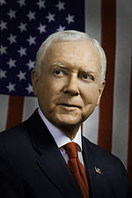
Who takes the Speaker of the House’s place if he/she can not perform the duties of the office?
President pro Tempore of the Senate
Orrin Hatch

Slide 19
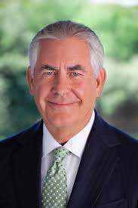
Who takes the President pro Tempore place if he/she can not perform the duties of the office?
Secretary of State
Rex Tillerson

Slide 20
Does the order make sense?
Figure 30
Presidential Line of Succession
1. Vice President
2. Speaker of the House of Representatives
3. President pro Tempore of the Senate
4. Secretary of State
5. Secretary of the Treasury
6. Secretary of Defense
7. Attorney General
8. Secretary of the Interior
9. Secretary of Agriculture
10. Secretary of Commerce
11. Secretary of Labor
12. Secretary of Health and Human Services
13. Secretary of Housing and Urban Development
14. Secretary of Transportation
15. Secretary of Energy
16. Secretary of Education
17. Secretary of Veterans Affairs
18. Secretary of Homeland Security

Slide 21
Any presidents serve their entire term without a vice president?
4

Slide 22
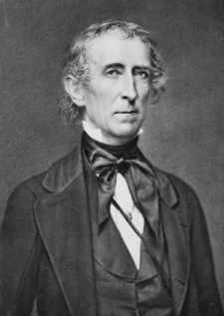
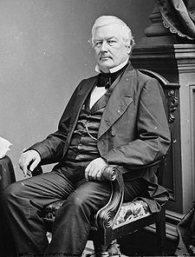
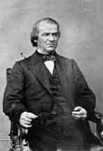
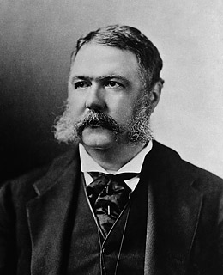
Which presidents serve their entire term without a vice president?
John Tyler, Jr.
Millard Fillmore
Andrew Johnson
Chester Alan Arthur
April 4, 1841 – March 4, 1845
July 9, 1850 – March 4, 1853
April 15, 1865 – March 4, 1869
September 19, 1881 – March 4, 1885

Slide 23
What is the 25th Amendment?
Succession to the Presidency and establishes procedures both for filling a vacancy in the office of the Vice President, as well as responding to Presidential disabilities.
Ratified in 1967.

Slide 24
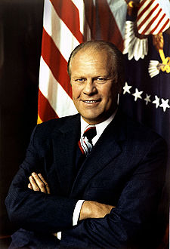
Who is the only President not to be elected president or vice president?
Gerald Rudolph Ford, Jr.
August 9, 1974 – January 20, 1977

Slide 25
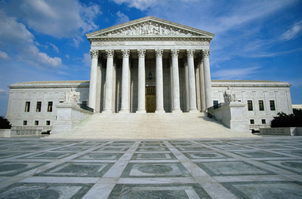
The Judicial Branch

Slide 26
What are the 2 major court systems?
Federal
State

Slide 27
How is the Federal Court System ordered?

Slide 28
U.S. Supreme Court
U.S. Courts of Appeals
12 Circuit
U.S. Courts of Appeals for the Federal Circuit
U.S. Courts of Appeals for the Armed Forces
94 District Courts
and
3 Territorial Courts
U.S. Tax Court
U.S. Court of Inter-national Trade
U.S. Court of Federal claims
U.S. Court of Veterans Appeals
Army, Navy, Air Force, Marines, Coast Guard, Courts of Criminal Appeals

Slide 29
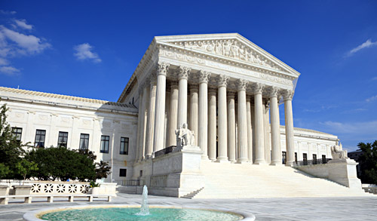
What is the highest court?
The United States Supreme Court

Slide 30
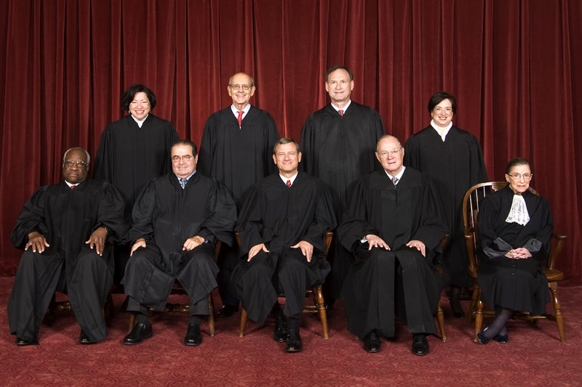
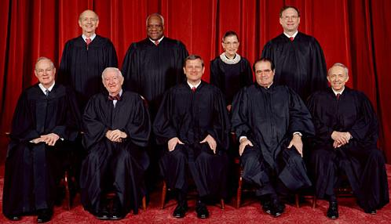
How many justices?
A chief justice and 8 associate justices (9).

Slide 31
How do you become a Supreme Court justices?
The president nominates and confirmed with the “advice and consent” (majority vote) of the Senate.

Slide 32
How long do they serve Supreme Court justices?
Serve for life or until they retire.

Slide 33
What is jurisdiction?
Area of authority.

Slide 34
What is judicial review?
The ability to set aside the actions of the legislative or executive branches of any government agency.

Slide 35
What is injunction?
Prevent executive action (forbid the action).

Slide 36
How does a case end up in the Supreme Court?
The Chief Justice choose the cases it will hear.

Slide 37
U.S. Supreme Court
U.S. Courts of Appeals
12 Circuit
U.S. Courts of Appeals for the Federal Circuit
U.S. Courts of Appeals for the Armed Forces
94 District Courts
and
3 Territorial Courts
U.S. Tax Court
U.S. Court of Inter-national Trade
U.S. Court of Federal claims
U.S. Court of Veterans Appeals
Army, Navy, Air Force, Marines, Coast Guard, Courts of Criminal Appeals

Slide 38
United States Circuit Court Districts
11 Judicial Circuits (areas), plus the District of Columbia Circuit Court

Slide 39
United States District Court Districts

Slide 40
U.S. Supreme Court
U.S. Courts of Appeals
12 Circuit
U.S. Courts of Appeals for the Federal Circuit
U.S. Courts of Appeals for the Armed Forces
94 District Courts
and
3 Territorial Courts
U.S. Tax Court
U.S. Court of Inter-national Trade
U.S. Court of Federal claims
U.S. Court of Veterans Appeals
Army, Navy, Air Force, Marines, Coast Guard, Courts of Criminal Appeals

Slide 41
Summary
Executive Branch
Judicial Branch
Electoral College
Requirements for office.
Line of Succession
Supreme Court
Other Courts

Slide 42
Assignment
Please read pages 348 to 356.

