Slide 1
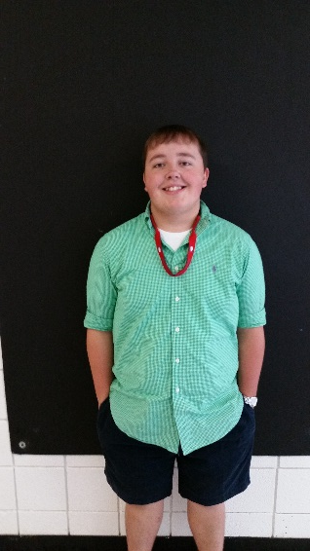
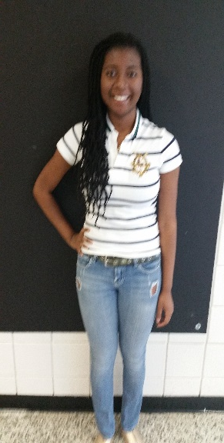
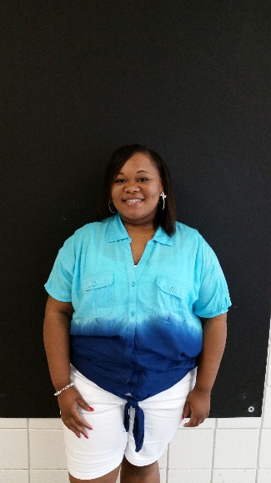
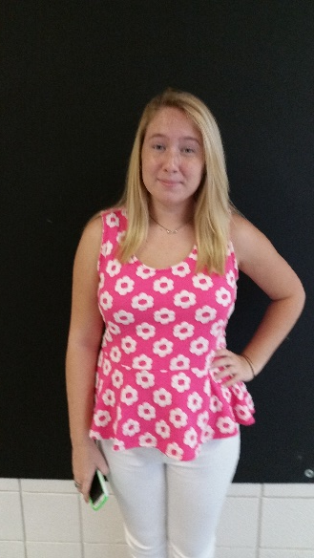
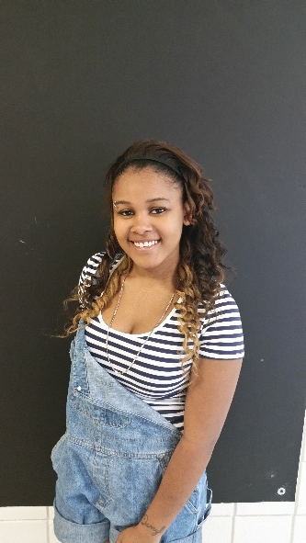
FBLA FUTURE BUSINESS LEADERS OF AMERICA
Josh Harbold
President
Ciara
Booker
VP
Ambreonna Bussell
VP
Lauren
Knox
Secretary
Dejanique
Woodfolk
Parliamentarian
Makayla
Harris
Historian
Lily
Colley
Treasurer

Slide 2
What is FBLA?
FBLA stands for the Future Business Leaders of America.
FBLA is a non-profit organization that prepares today’s students for success in their future careers.
2014-2015 FBLA THEME:
“SUIT UP FOR THE CHALLENGE”

Slide 3
What we do!
Projects
Competitions: Regional, State, and Nationals
Business Development
Conferences
Leadership Opportunities
Community Service

Slide 4
Projects
FBLA provides many opportunities for recognition for both individuals and chapters:
Business Achievement Awards
Go Green Project
Community Service Projects
American Enterprise Day

Slide 5
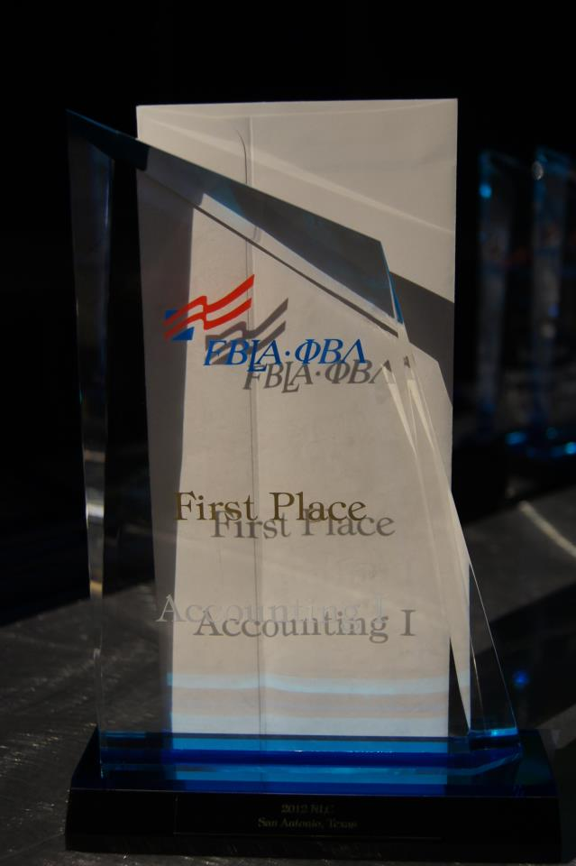
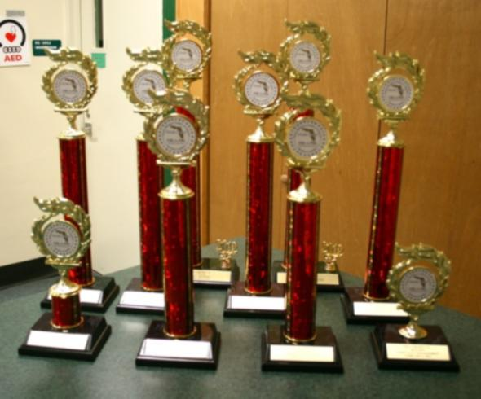
Competitions
For the competitive spirit, FBLA gathers students from across the nation to compete in business-related competitions
Those who qualify at the state level will advance to the national level

Slide 6
Competitions
Over 50 different competitive events, including:
Business Math
Public Speaking
Computer Applications
Business Law
Sports Management
Video Game & Simulation Development
Health Care Administration

Slide 7
Business Development
FBLA gives members opportunities to develop business skills:
Build a business portfolio
Business tours
Inspiring speakers
Partnership with businesses project

Slide 8
Conferences
State Leadership Conference, Institute for Leaders, National Leadership Conference, and National Fall Leadership Conference:
Compete and network with members across the nation
Attend workshops by business professionals
Compete in aggressive competitions
Tour and sight see in cities across the nation

Slide 9
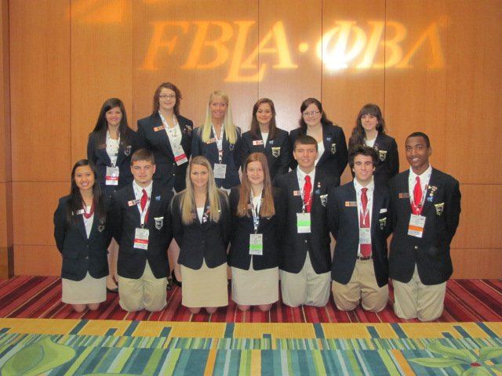
Leadership Opportunities
Develop speaking, presenting, organizational, discussion, and networking skills
Run for:
Local chapter officer positions
Regional officer positions
State officer positions
National officer positions

Slide 10
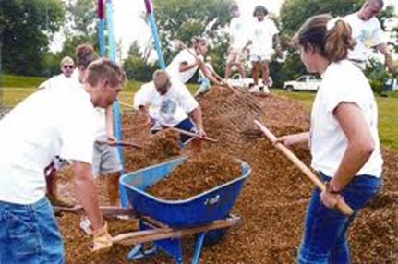
And More!
Community Service
Socials
Networking opportunities

Slide 11
How You Benefit?
Experience everything that FBLA does
Develop business and leadership skills
College and career ready
Meeting new friends
Competitive recognition
Looks amazing on your college application
Scholarships

Slide 12
Reminders
Dues:
$ 20 for membership
Turn into Mr. Harness with membership form- Room #203

