Slide 1

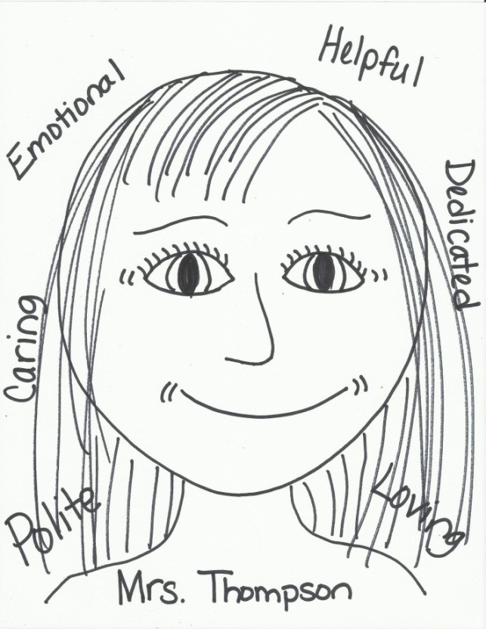
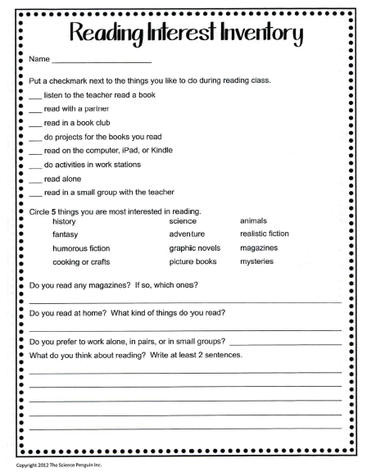
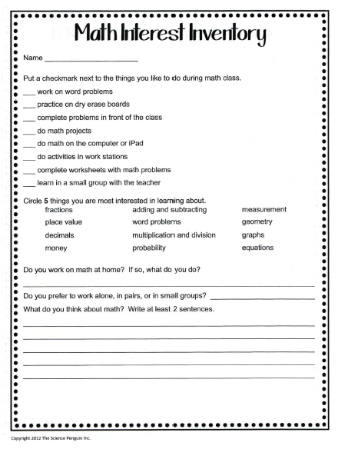
August 7, 2019
Welcome to Our
3rd Grade Classroom
Please Complete: *Self Portrait with your character traits (use adjectives)
(your portrait will be displayed )
Example:
Thought of the Day…
“Be a reflection of what you’d like to see in others. If you want love, give love. If you want honesty, give honesty. If you want respect, give respect. You get in return what you give.”
7:55 – 8:30

Slide 2
Classroom Getting to Know You Activity!
8:30 - 8:40

Slide 3
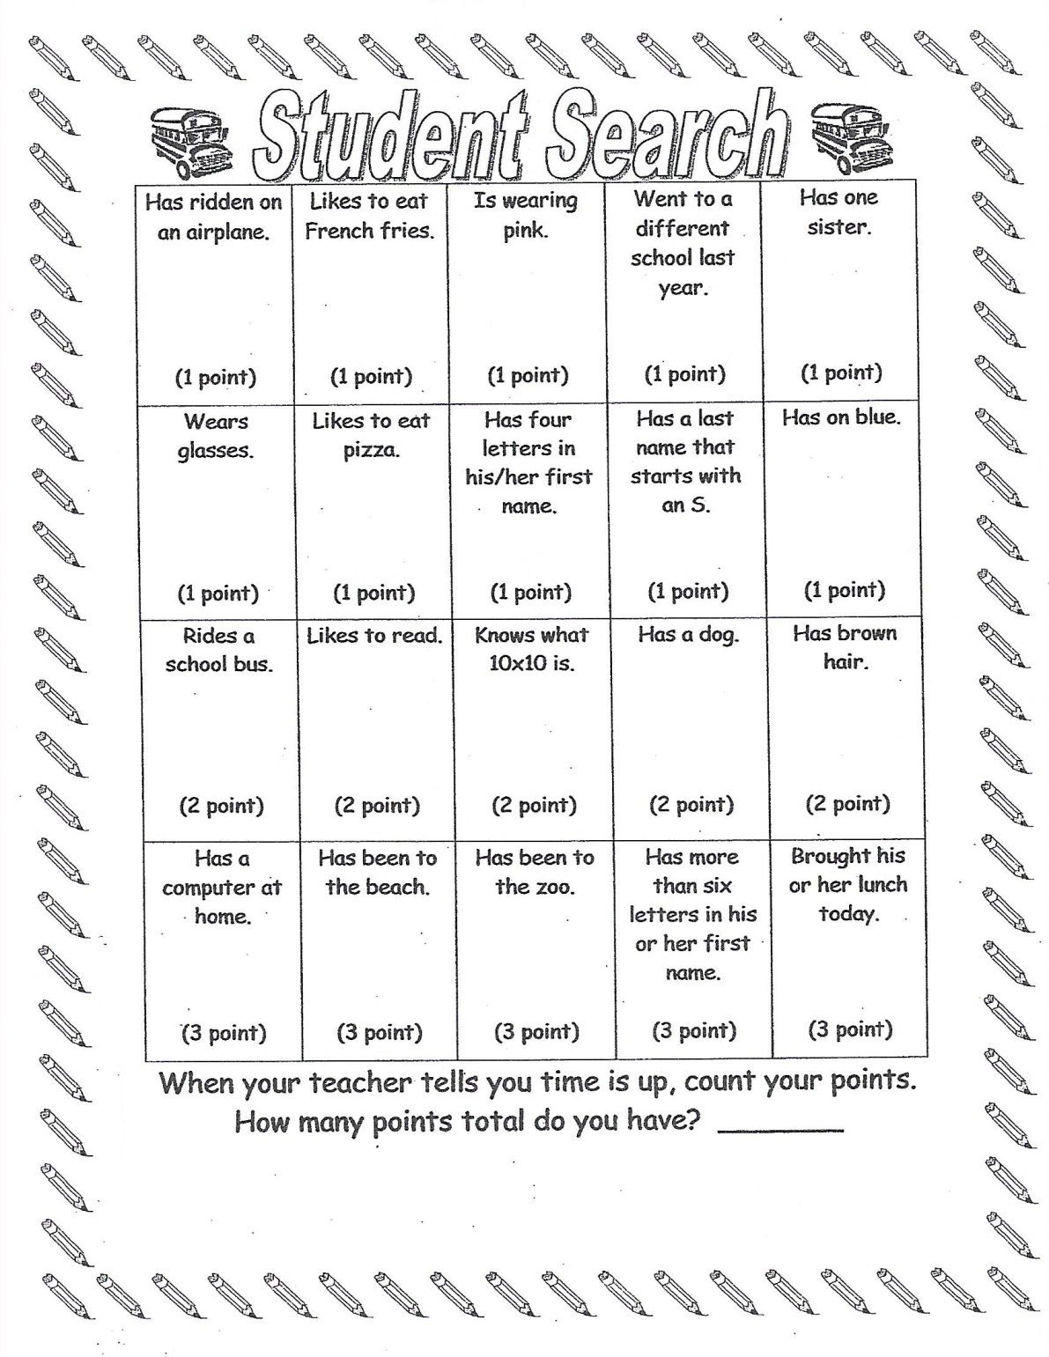

Slide 4

CHOMP TIME
F.A.S.T. Groups
Focused Academic Support Time
8:40 – 9:10

Slide 5

Today is the first day of school, so our time today will be a little different…
Thought of the Day…
“Be a reflection of what you’d like to see in others. If you want love, give love. If you want honesty, give honesty. If you want respect, give respect. You get in return what you give.”

Slide 6

Goals for
Gathering at the Carpet
We will be creating our classroom family, our classroom reading community.
We want everyone to succeed, so we will need to support each other and think optimistically, or positively.
We will hear books read aloud, learn comprehension strategies and share our thinking with each other which means respectful listening is extremely important.

Slide 7

Procedures for
Gathering at the Carpet
Walk quickly and quietly without bumping into one another
Sit so that others have room on the rug
Wait quietly until everyone is seated

Slide 8
Let’s Practice…
Gather at the Carpet!
Do we need to try again?
Was this time perfect or should we try again?

Slide 9

  S.O.S. – See it,
  Own it,
  Solve it
Can you think of any examples when this might be relevant to you?

Slide 10
7 Habits of Highly Effective People
Habit #1: Be Proactive
  I am a responsible person.
  I take initiative.
  I choose my actions, attitudes, and moods.
  I do not blame others for my mistakes.
  I can only be offended if I choose to be.

Slide 11


This slide will show up every now and then to see what you learned from a part of our day.
This is not a test; it does not have a right or wrong answer. It simply is a time for me to check our understanding of what I have shared with you.
Others can add on to what our chosen Learning Leader begins with, but we have to limit our time to no more than 2 minutes. ☺ So much to learn!!
Please share what you learned from this part of our lesson.

Slide 12

Intro Turn and Talk Procedures
Turn to your partner
  Shoulder partner
  Face partner
  Tri-pod
Turn and Talk means – showing respectful communication: taking turns and listening intently to what your partner is saying so you will be able to share with the class what they have shared with you
Objective: SL.3.1b Follow agreed-upon rules for discussions (e.g., gaining the floor in respectful ways, listening to others with care, speaking one at a time about the topics and texts under discussion).

Slide 13

Let’s Practice: Turn and Talk ☺
Take turns sharing your sentences with your shoulder partner. Be sure to ask if you want your partner to explain their sentence so you can understand it.
Objective: L.3.1a Explain the function of nouns, pronouns, verbs, adjectives, and adverbs in general and their functions in particular sentences.
Objective: SL.3.1b Follow agreed-upon rules for discussions (e.g., gaining the floor in respectful ways, listening to others with care, speaking one at a time about the topics and texts under discussion).
Objective: SL.3.1c Ask questions to check understanding of information presented, stay on topic, and link their comments to the remarks of others.
Objective: SL.3.1d Explain their own ideas and understanding in light of the discussion.

Slide 14
Focus Lesson:
Character Traits!
There are two ways we can describe ourselves and others (including characters in a book)
  physical description
  behavioral tendencies
Share time! Let’s share some of the character traits we listed around our pictures of ourselves that we drew this morning. Don’t forget to be respectful to each other and listen carefully for clues about how we view ourselves.
Now let’s look at some common character traits.

Slide 15
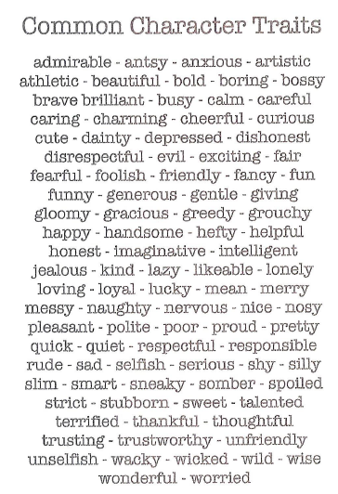
Let’s silently read some of these character traits.
Is there a word you’re not sure about?
Do you see a word you’d like to add to your picture that describes you?

Slide 16
Please share what you learned from this part of our lesson.

Slide 17

Restroom Break
9:10 - 9:20

Slide 18
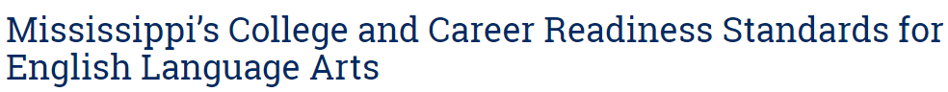

Reading Time
9:20 – 10:40
Objective: RL.3.1
I can ask and answer questions to demonstrate understanding of a text, referring explicitly to the text as the basis for answers.
Objective: RL.3.3
I can describe characters in a story and explain how their actions contribute to the sequence of events.

Slide 19

Our Reading Lives…
Let’s build our reading community and hear from a few of you today, then some more of you later.
What kind of books do you like to read? Why?
Where is your favorite place to read?
What kinds of books do you want to read this year?
9:20 – 9:30

Slide 20

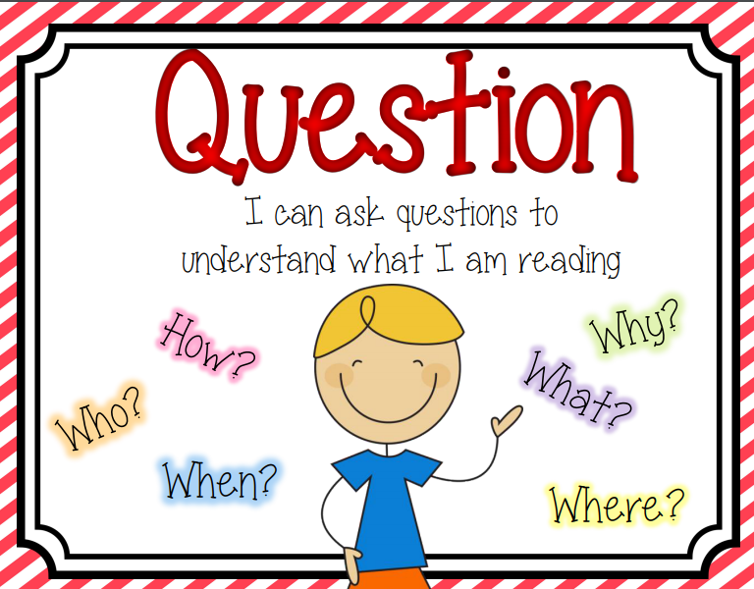
Become a better reader by using READING STRATEGIES:
Reading Strategy of the Week: Questioning
You and your parents can help your reading by
asking questions as you read:
Who…?
What…?
Where…?
When…?
Why do you think…?
How could ….?
What if…?
I wonder…
I was confused when…
I don’t understand…but I think…

Slide 21
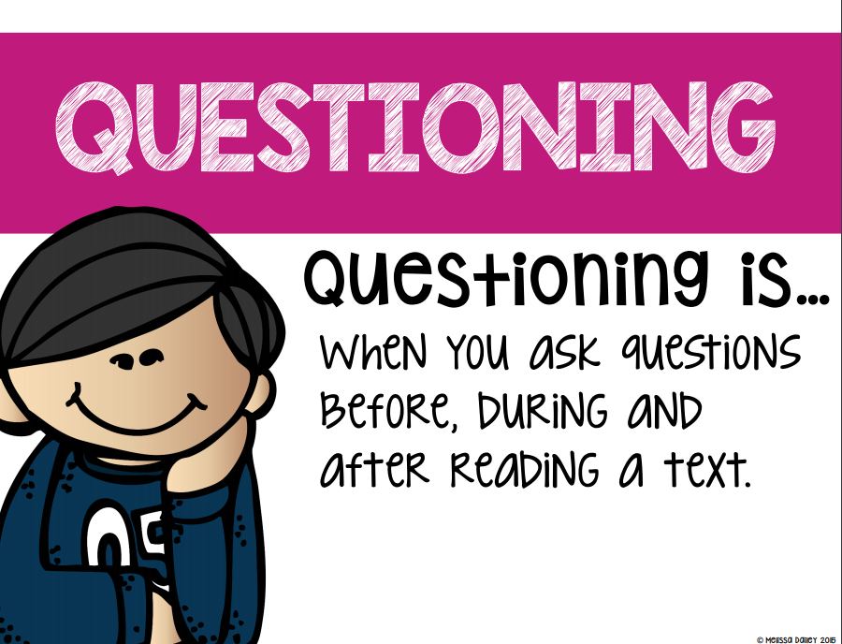

Reading Strategy with a food item…
Who, what, where, when, why, and how,
We will learn our question words now!!
Anchor Chart
9:30 – 9:45

Slide 22
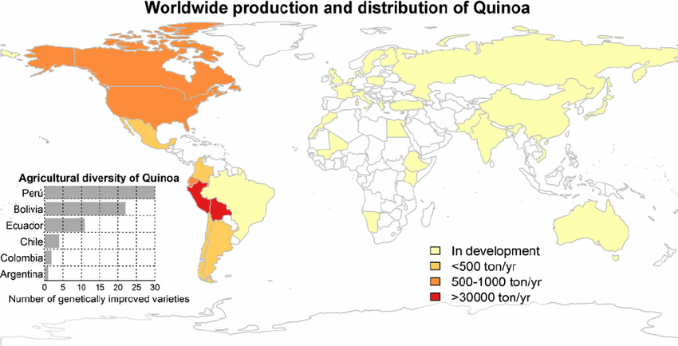
Quinoa is an annual seed-producing flowering plant grown as a grain crop. It is a pseudocereal, not a grass, unlike wheat and rice. It is botanically related to spinach. Quinoa seeds are rich in protein, dietary fiber, B vitamins, and dietary minerals in amounts greater than in many grains. It is gluten-free.

Slide 23
Please share what you learned from this part of our lesson.

Slide 24
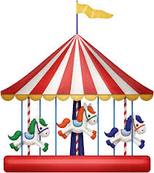
Classroom
Getting to Know You Activity!
9:45 – 9:55

Slide 25

Classroom Community Carousel
Write your name on five post-it notes
Each student will have 1 minute with their group at each rotation to place their post-it note under their choice of each poster topic and then discuss their choices with their group.
We will discuss the results when finished.
Poster topics:
  What is your favorite activity?
  What is your favorite sport?
  What is your favorite subject?
  How do you do your best work?
  How do you feel about 3rd grade?

Slide 26
Please share what you learned from this part of our lesson.

Slide 27

Gather at the Carpet…
Are you proud of how you moved to the carpet?
Do we need to try again?

Slide 28
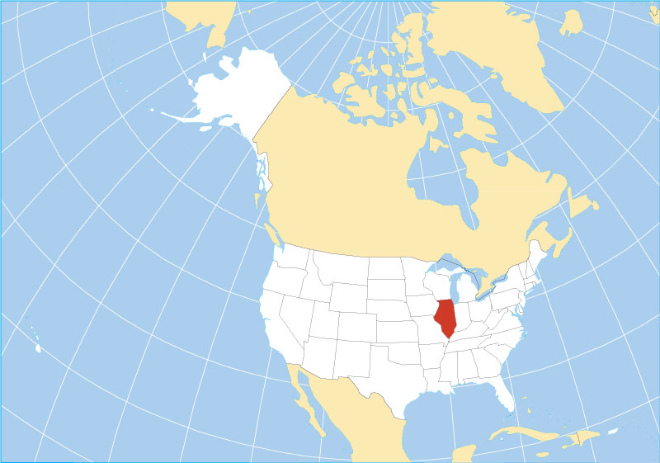

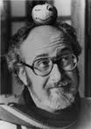

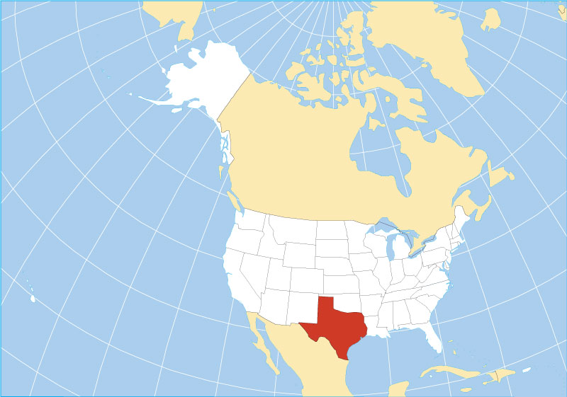
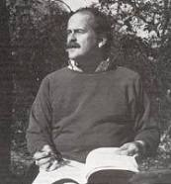
New Read Aloud!
Born in Illinois
Author: Harry Allard
Illustrator: James Marshall
9:55 – 10:20
Born in Texas

Slide 29
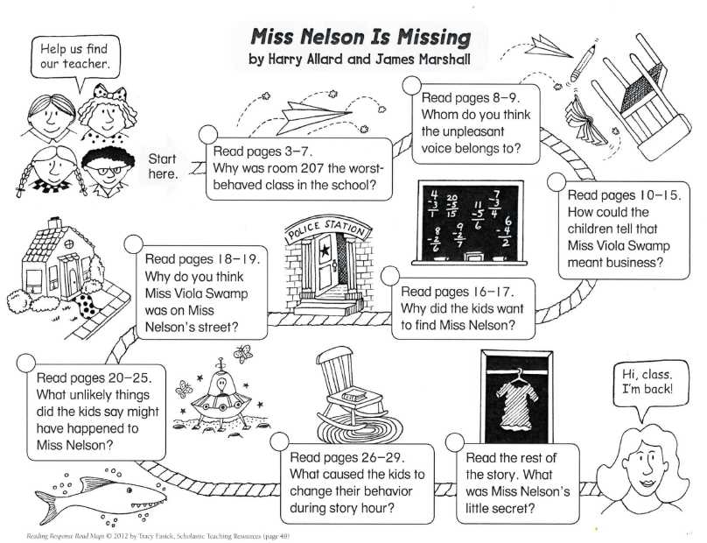
Let’s apply questioning to our book Miss Nelson is Missing.

Slide 30


Classroom Discussion
What happens in this story?
Why do you think the kids in Room 207 improve their behavior?

Slide 31
Please share what you learned from this part of our lesson.

Slide 32


Introduce IDR Time &
Classroom Library (Genres)!
Independent Daily Reading and individual teacher-student book conferences
10:20 – 10:40

Slide 33

Argument/Opinion
Reports, Directions, etc.
Fiction, Comics, etc.

Slide 34



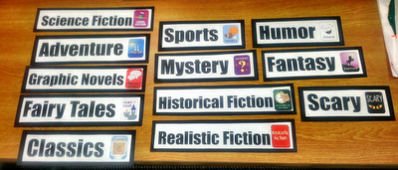

Now let’s look at how our Classroom Library is mapped out!

Slide 35
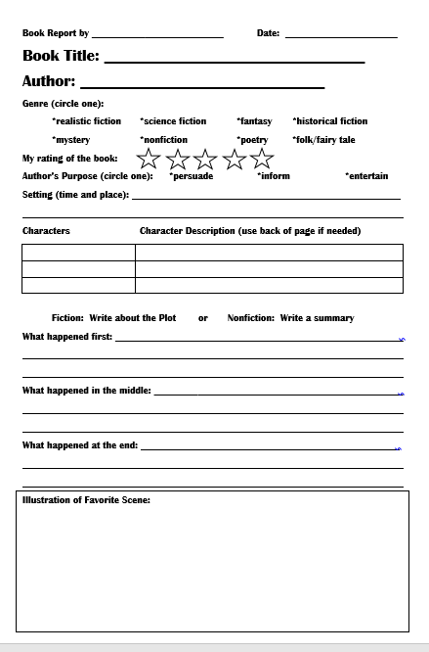
Classroom Library Book Selection!
In groups you will visit the classroom library and then individually select a book to read for our 1st semester 10 chapter book challenge – Epic Celebration in December!
Those that are waiting can finish their self-portrait from this morning or read independently.

Slide 36

Out of Classroom!
Recess 10:40 – 11:05

Slide 37
Reading Time
11:05 – 12:00
Objective: RL.3.1
I can ask and answer questions to demonstrate understanding of a text, referring explicitly to the text as the basis for answers.
Objective: RL.3.3
I can describe characters in a story and explain how their actions contribute to the sequence of events.

Slide 38



Listening & Writing Time
11:05 – 12:00

Slide 39
Gather at the Carpet…
Are you proud of how you moved to the carpet?
Do we need to try again?

Slide 40

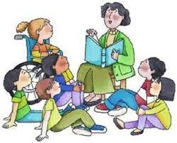


Slide 41
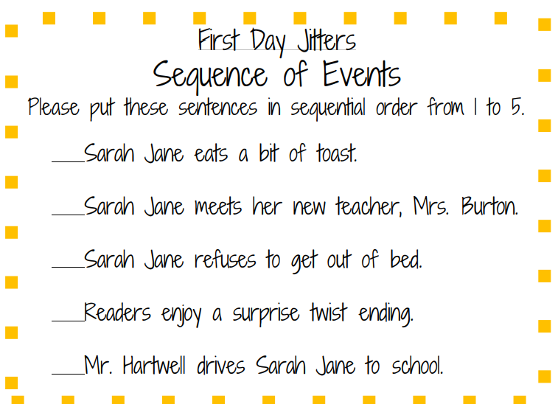
How well did you listen?
Let’s practice: “Thinking before we speak.”
Objective: RL.3.1 Ask and answer questions to demonstrate understanding of a text, referring explicitly to the text as the basis for answers.
Objective: RL.3.7 Use information gained from illustrations, other visual elements, and the words in a text to demonstrate understanding of the text.
Objective: SL.3.1b Follow agreed-upon rules for discussions (e.g., gaining the floor in respectful ways, listening to others with care, speaking one at a time about the topics and texts under discussion).

Slide 42
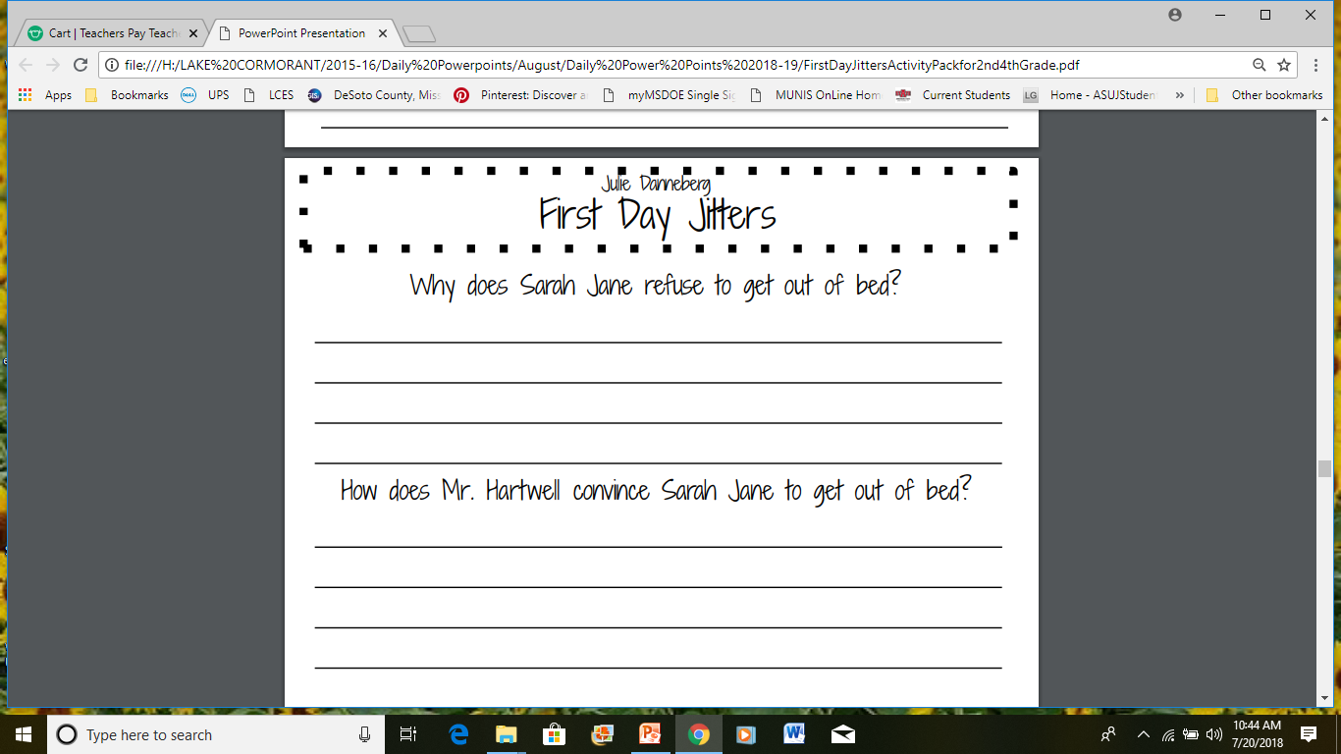
Let’s practice restating the question to help us understand how to answer.
Sarah Jane refuses to get out of bed because…
Mr. Hartwell convinces Sarah Jane to get out of bed by…

Slide 43
Please share what you learned from this part of our lesson.

Slide 44
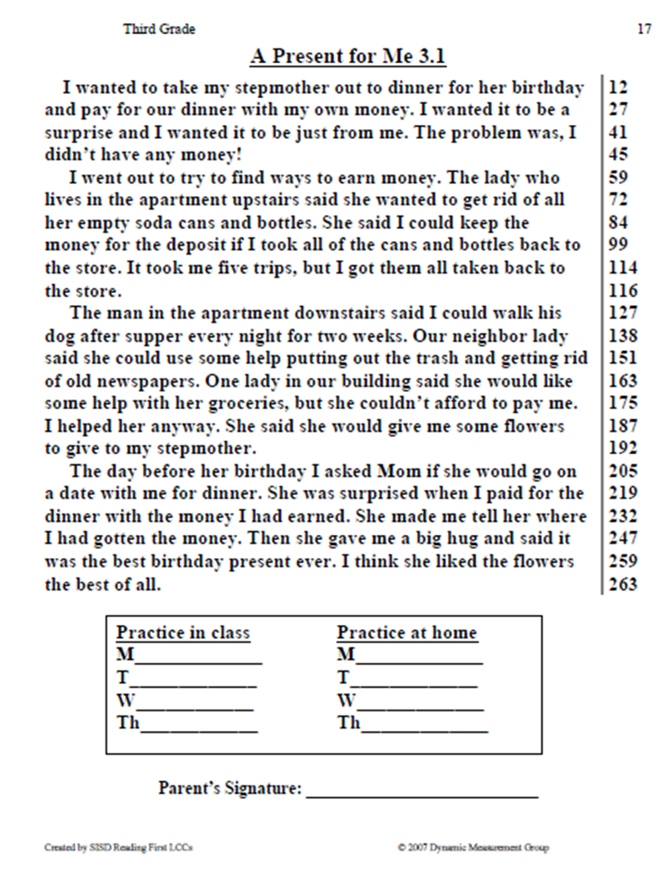
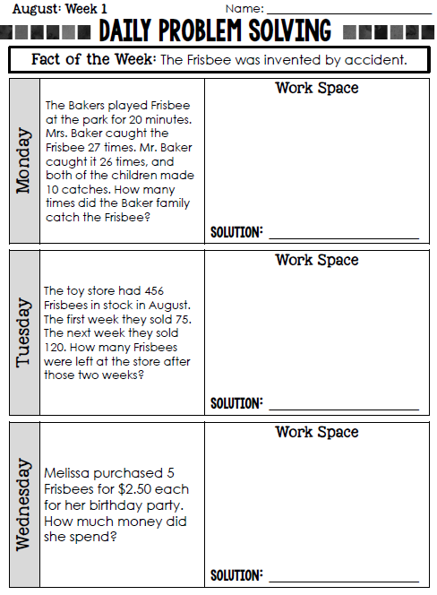
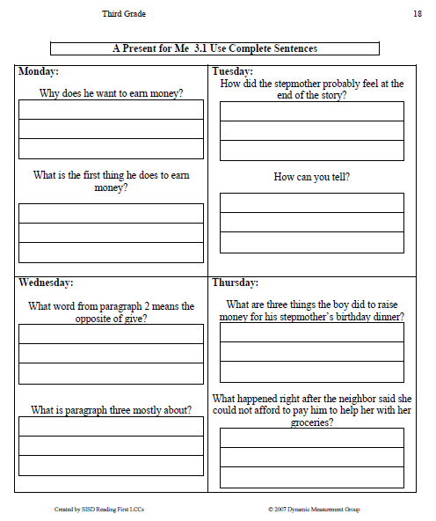
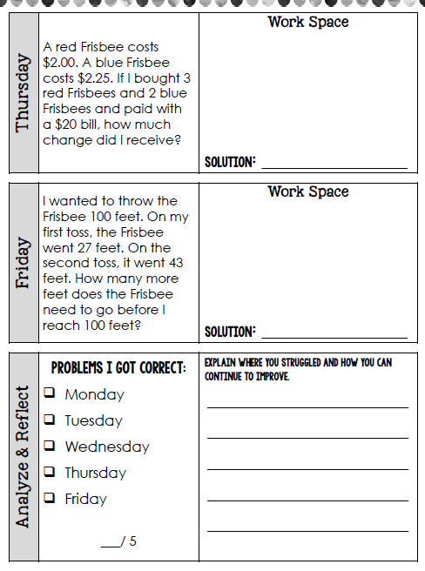
Homework Introduction

Slide 45
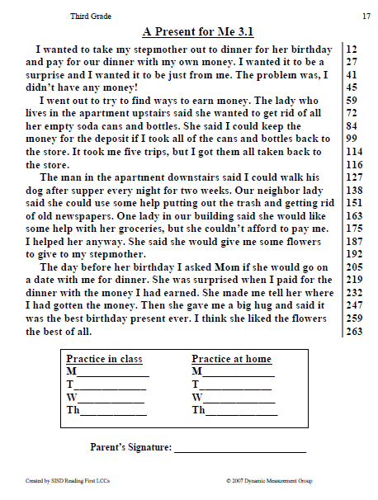
Reading Homework – Let’s complete Monday and Tuesday in class

Slide 46
Read, then complete Monday

Slide 47
Let’s Check Monday!

Slide 48
Read again, then complete Tuesday

Slide 49
Now, Let’s Check Tuesday

Slide 50
Please share what you learned from this part of our lesson.

Slide 51


Out of Classroom!
Lunch 12:35 – 1:05
Restroom (1:05 – 1:10)
Activity 1:10 – 1:55

Slide 52
Math Time!
1:55 – 2:55

Slide 53
Let’s Complete Monday

Slide 54
Now, let’s look at Tuesday

Slide 55

Let’s think back to our homework page…
Math Stash - Page 1
RDW = Read, Draw, Write
Read the problem
Draw and label items
Write an equation.
Write a word sentence (statement).
What do I see?
Can I draw something?
What conclusions can I make from my drawing?

Slide 56
Please share what you learned from this part of our lesson.

Slide 57
Gather at the Carpet…
Are you proud of how you moved to the carpet?
Do we need to try again?

Slide 58
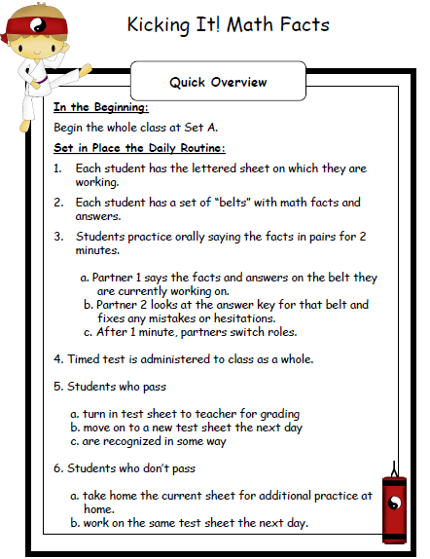
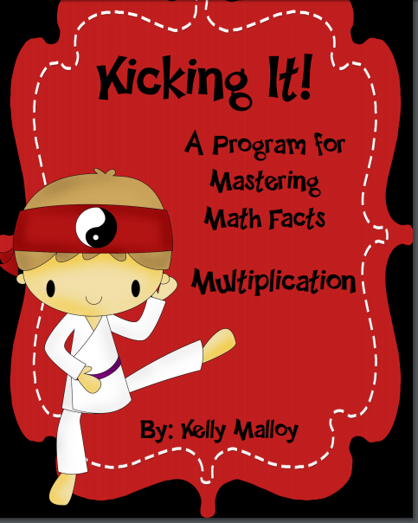
Fluency Practice, Part 1
Kicking It!
Math Facts Introduction
http://studyjams.scholastic.com/studyjams/jams/math/multiplication-division/multiplication.htm

Slide 59
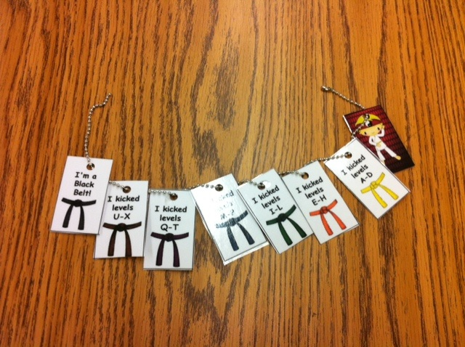
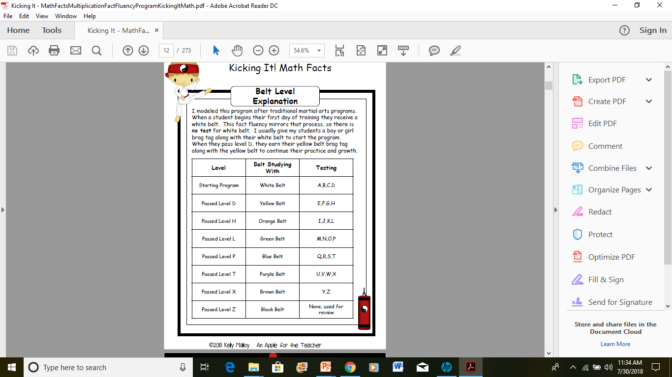


Slide 60
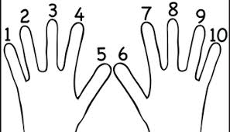

Fluency Practice, Part 2
Count to 20 forward and backward (watch my fingers so you know if I’m going up or down)
  Whisper every other number (whisper odd numbers)
  Hum every other number (hum odd numbers – hum, 2, hum, 4, hum, 6)
  Think every other number (think odd numbers)
  What did we just count by – now lets count by twos
Closed fist means stop
http://studyjams.scholastic.com/studyjams/jams/math/problem-solving/pscreating-equations.htm
Objective: 3.OA.1 Interpret products of whole numbers, eg. interpret 5x7 as the total
number of objects in 5 groups of 7 objects each .

Slide 61
Please share what you learned from this part of our lesson.

Slide 62

SCIENCE TIME
Objective: P.3.5.1 I can plan and conduct scientific investigations to determine how changes in heat (i.e., an increase or decrease) change matter from one state to another (e.g., melting, freezing, condensing, boiling, or evaporating).
2:55 – 3:20

Slide 63
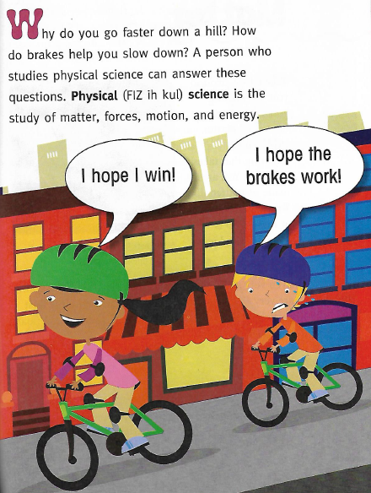


Slide 64
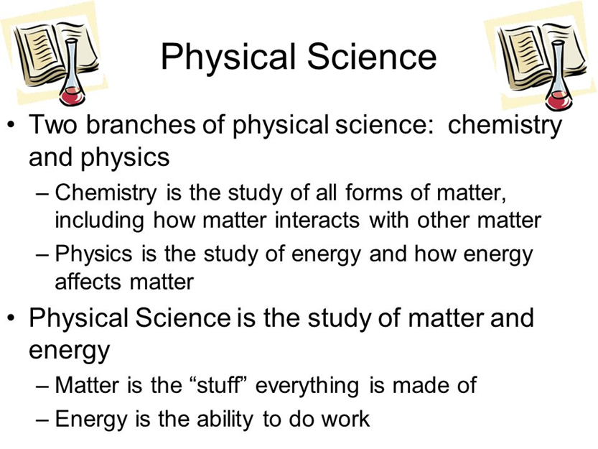
FYI…future lessons!
Objective: P.3.5.1 Plan and conduct scientific investigations to determine how changes in heat (i.e., an increase or decrease) change matter from one state to another (e.g., melting, freezing, condensing, boiling, or evaporating).

Slide 65
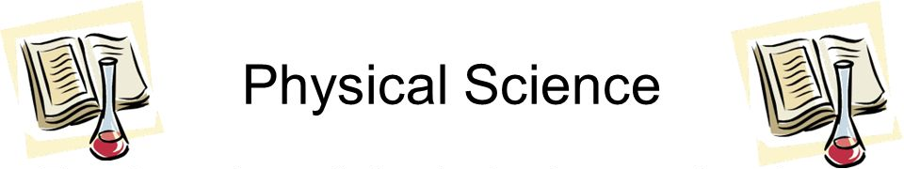
S.T.A.R. - Page 1

Slide 66
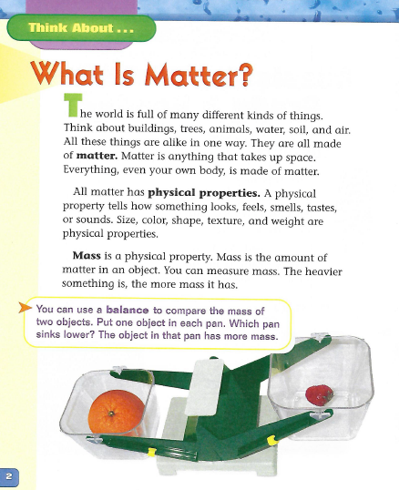
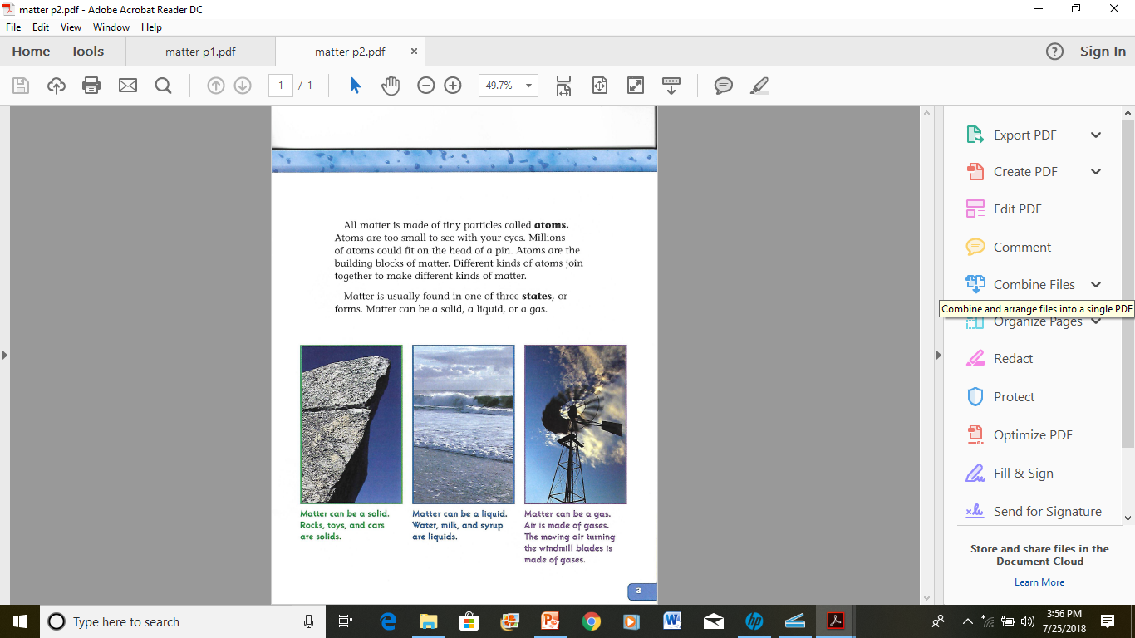

Slide 67
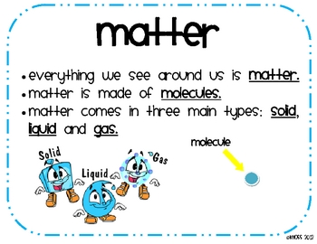
S.T.A.R. - Page 2
http://studyjams.scholastic.com/studyjams/jams/science/matter/properties-of-matter.htm

Slide 68
Please share what you learned from this part of our lesson.

Slide 69
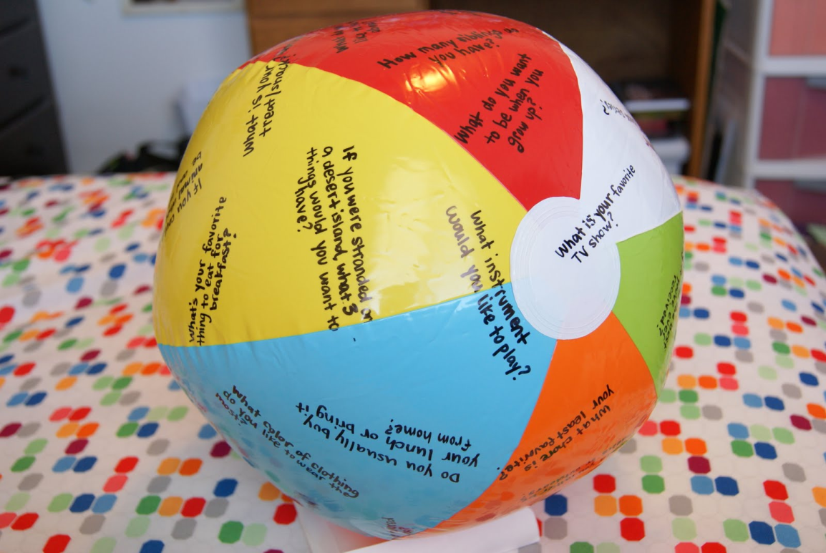
Classroom Connections!
Beach Ball Bounce – let your right thumb choose the question! ☺
Notes:
Questions to place on the ball:
What is your favorite TV show?
What instrument would you like to play
If you were stranded on a desereted island what 3 things would you want to have?
What do you want to be when you grow up?
What was the best gift you've ever received?
Do you usually buy your lunch or bring it from home?
What chore is your least favorite?
What is your favorite game to play?
What is your favorite cartoon character?
How many siblings do you have?
What do you like to learn about?
What was your favorite part of summer?
Name 3 things that make you happy.
What is your favorite animal?
What is your favorite book or book series?
Would you rather be indoors or outdoors?
If you could have a super power what would it be and why?
What is your favorite toy to play with?
What is your favorite color?
Do you like sports? Which one?
What job would you never do and why?
What do you like to do for fun?
What food will you never eat and why?
What do you like to do for fun?
Are you a cat-person or dog-person? Both? Neither?
What famous person would you like to meet?
What's your favorite school subject?
When do you usually do your homework?
What would you do if you won $10,000?
If you could have any pet you want, what would it be?
What king of movies do you like?
Do you prefer white or colored socks?
What was your favorite part of summer?
Where were you born?
What color of clothing do you like to wear the most?
What is your favorite home-cooked meal?
What is your favorite food?
What is your favorite treat/snack?
Do you like having dreams? Why or why not?
What are you going to be for Halloween?
What are three adjectives to describe you?
Are you more a talker or a listener?
What place would you like to visit?
Do you have a favorite singer or band?
Do you have a nickname? What is it?

Slide 70




3:20 – 3:25 Wrap Up!
Pair-Up back to back and share one thing you learned in class today with your partner
Pack-Up
Office will announce:
Car Riders – Leave around 3:25
Bus Riders – (listen to intercom for dismissal)
2:30 – 3:20
How much time has elapsed?

