Slide 1
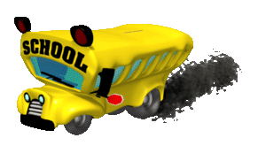
Unit 3
Lesson 3
Grammar on the Go! PowerEd Express
Make the sentence
corrections in red.
Write the vocabulary words
in your personal dictionary.
PowerEd Plans 2014

Slide 2
Grammar on the Go! PowerEd Express
Unit 3-3
Sentence
Though I didnt tell mom i really loathed spaghetti and had since it made me sick in fourth grade I know I would need to eat a significant snack to avoid hunger.
Sentence Identification – Compound, Complex, Simple, Compound/Complex
Type of Sentence(s) – Declarative, Imperative, Interrogative, Exclamatory
PowerEd Plans 2014

Slide 3
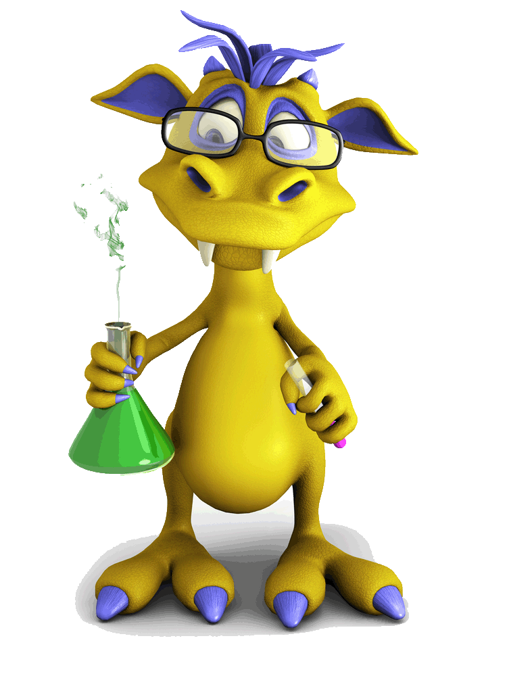
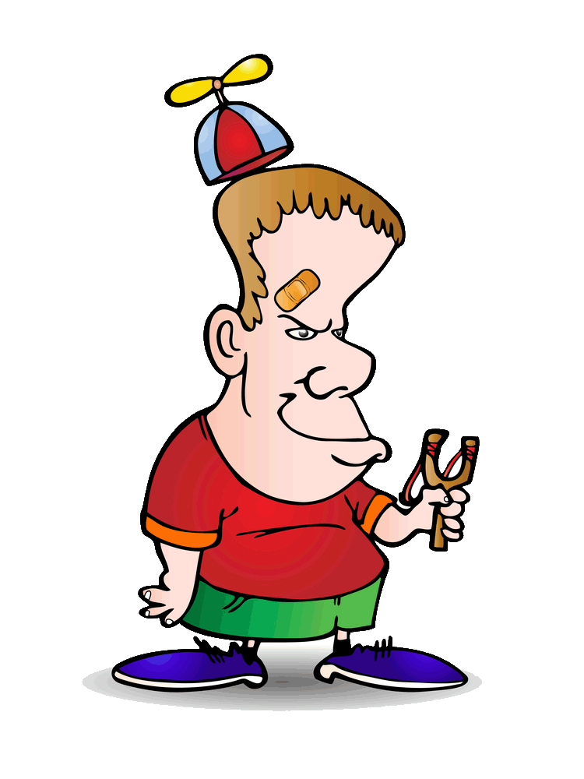
Unit 3-3
Corrections
Grammar on the Go! PowerEd Express
\
¶ Though I didn’t tell Mom, I really loathed spaghetti - and had since it made me sick in fourth grade. I knew I would need to eat a significant snack to avoid hunger.
Complex Simple Declarative
New Paragraph
Capitalization
Apostrophe
Subordinate Clause
Non-restrictive Clause
Run-on Sentence
Verb Tense Agreement
PowerEd Plans 2014

Slide 4
Unit 3-3
Paragraph
Grammar on the Go! PowerEd Express
Paragraph ¶
Begin a new paragraph when starting a new topic.. Indent the first line of the new paragraph.
¶Though I didn’t tell Mom, I really loathed spaghetti - and had since it made me sick in fourth grade. I knew I would need to eat a significant snack to avoid hunger.
PowerEd Plans 2014

Slide 5
Unit 3-3
Apostrophe
Grammar on the Go! PowerEd Express
Apostrophes
Use the apostrophe with contractions. The apostrophe is always placed at the spot where the letter(s) has been removed.
cannot = can’t It is = It’s
Use the apostrophe to show possession.
Caroline’s sweater the students’ papers
Though I didn’t tell Mom, I really loathed spaghetti - and had since it made me sick in fourth grade. I knew I would need to eat a significant snack to avoid hunger.
PowerEd Plans 2014

Slide 6
Unit 3-3
Capitalization
Grammar on the Go! PowerEd Express
Capitalization
Writing a word with its first letter as a capital letter (upper-case letter) and the remaining letters in lower case.
Capitalize a person’s title when it takes the place of a name.
Capitalize the word “I” when referring to oneself in the first person.
Though I didn’t tell Mom, I really loathed spaghetti - and had since it made me sick in fourth grade. I knew I would need to eat a significant snack to avoid hunger.
PowerEd Plans 2014

Slide 7
Unit 3-1
Subordinate Clause
Grammar on the Go! PowerEd Express
Subordinate Clause
A subordinate clause begins with a subordinating conjunction and is followed by a subject and a verb.
If it is used at the beginning of the sentence, it must be followed by a comma.
A subordinate clause is a dependent clause and does not make sense by itself.
Though I didn’t tell Mom, I really loathed spaghetti - and had since it made me sick in fourth grade. I knew I would need to eat a significant snack to avoid hunger.
PowerEd Plans 2014

Slide 8
Unit 3-3
Non-restrictive clause
Grammar on the Go! PowerEd Express
Non-restrictive Clause
A relative clause that describes or supplements but is not essential in establishing the identity of the antecedent and is usually set off by commas or dashes in English. Also called descriptive clause.
Though I didn’t tell Mom, I really loathed spaghetti - and had since it made me sick in fourth grade. I knew I would need to eat a significant snack to avoid hunger.
PowerEd Plans 2014

Slide 9
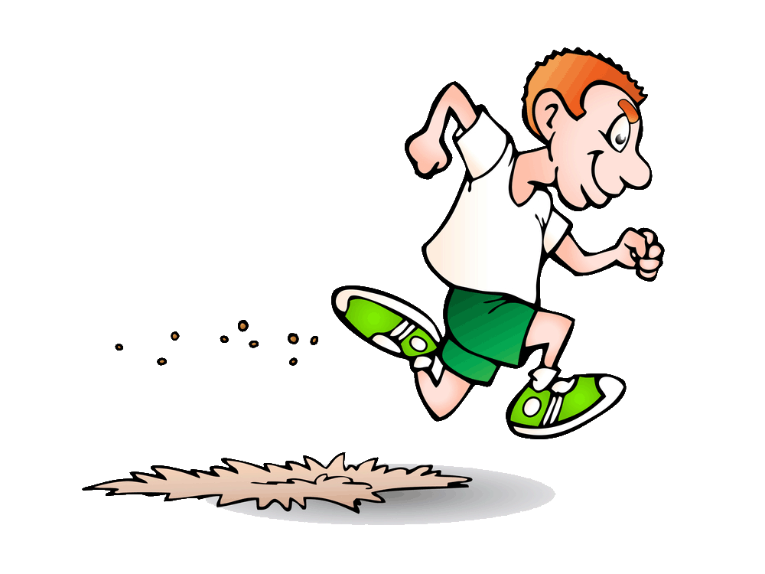
Unit 3-3
Run-on Sentence
Grammar on the Go! PowerEd Express
Run-on Sentence
A run-on sentence is a sentence in which two or more independent clauses with more than one complete idea are joined without appropriate punctuation or a conjunction.
Though I didn’t tell Mom, I really loathed spaghetti - and had since it made me sick in fourth grade. I knew I would need to eat a significant snack to avoid hunger.
PowerEd Plans 2014

Slide 10
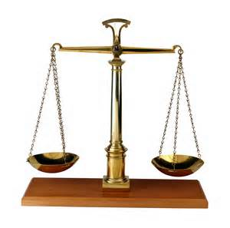
Unit 3-3
Verb Tense
Grammar on the Go! PowerEd Express
Verb Tense Agreement
The tenses of the verbs (past, present, future) in a sentence must be the same (agree).
When I complain, they chastised me for getting upset.
When I complained, they chastised me for getting upset.
Though I didn’t tell Mom, I really loathed spaghetti - and had since it made me sick in fourth grade. I knew I would need to eat a significant snack to avoid hunger.
PowerEd Plans 2014

Slide 11
Unit 3-3
Complex Sentence
Grammar on the Go! PowerEd Express
Complex Sentence
A complex sentence has an independent clause joined by one or more dependent clauses. A complex sentence always has a subordinator such as because, since, after, although, or when or a relative pronoun such as that, who, or which.
Though I didn’t tell Mom, I really loathed spaghetti - and had since it made me sick in fourth grade. I knew I would need to eat a significant snack to avoid hunger.
PowerEd Plans 2014

Slide 12
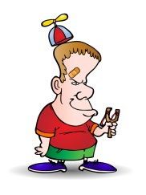
Unit 3-3
Simple Sentence
Grammar on the Go! PowerEd Express
Simple Sentence
A simple sentence contains a subject and a verb, and it expresses a complete thought.
Though I didn’t tell Mom, I really loathed spaghetti - and had since it made me sick in fourth grade. I knew I would need to eat a significant snack to avoid hunger.
PowerEd Plans 2014

Slide 13
Unit 3-3
Declarative
Grammar on the Go! PowerEd Express
Declarative Sentence
A sentence in the form of a statement. In a declarative sentence, the subject normally precedes the verb. A declarative sentence ends with a period.
Though I didn’t tell Mom, I really loathed spaghetti - and had since it made me sick in fourth grade. I knew I would need to eat a significant snack to avoid hunger.
PowerEd Plans 2014

Slide 14
Unit 3-3
Vocabulary
Grammar on the Go! PowerEd Express
significant
Adjective
sufficiently great or
important to be
worthy of attention;
noteworthy
PowerEd Plans 2014

