Slide 1
The Integumentary System
Chapter 6

Slide 2
Introduction
A. Organs are body structures composed of two or more different tissues.
B. The skin and its accessory organs make up the integumentary system.

Slide 3
Types of membranes
Serous membranes
1. line body cavities that lack openings to the outside
2. They line the thorax and abdomen and cover the organs within these cavities.
3. Serous membranes are made up of epithelium and loose connective tissue and secrete serous fluid that acts as a lubricant.

Slide 4
Types of membranes
Mucous membranes
1. line body cavities and openings that lead to the outside of the body
** Including: Oral & nasal cavities; openings of the digestive, reproductive, respiratory, & urinary systems**
2. consist of epithelium and connective tissue with specialized cells that secrete mucus

Slide 5
Types of membranes
Synovial membranes
1. line the joint cavities
2.These membranes consist of only connective tissue and they secrete Lubricating synovial fluid.
Cutaneous membrane
1. Consist of the skin

Slide 6
Skin and its tissues
A. The skin is a large organ responsible for maintaining homeostasis through:
1. protection of underlying tissues
2. temperature regulation
3. retardation of water loss
4. housing sensory receptors
5. synthesizing certain chemicals
6. excreting wastes

Slide 7
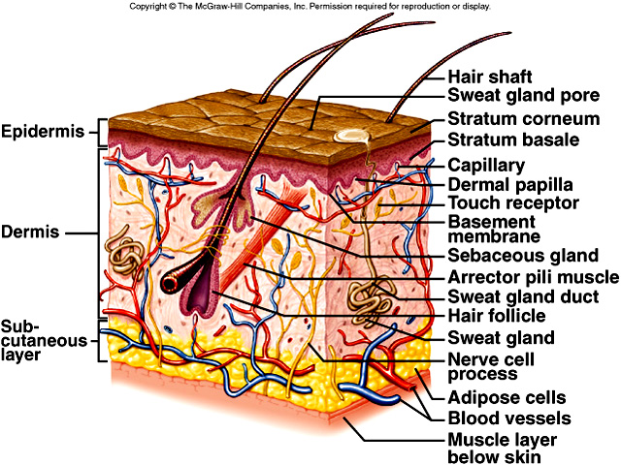
Skin and its tissues
B. The skin consists of an outer epidermis and a dermis, connected to underlying tissue by the subcutaneous layer (hypodermis).
* Picture on page 129

