Slide 1
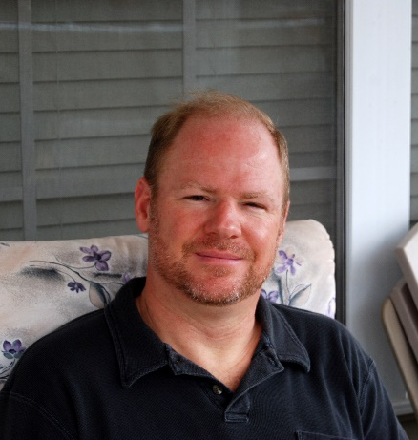
Mr. Pinckley
My name is Jeff Pinckley and I grew up in Lawrenceburg, TN. I retired from the U.S. Air Force after a 25 year career before starting my teaching career. I have been married to my wife Tonya, who is also an educator, for 18 years. We have four wonderful children. Richard (36), James (33), Rebecca (30), and William (28). This is my 3rd year teaching and my 7th year at Perry Middle. #PantherProud
Jeffrey.Pinckley@hcbe.net
478-988-6285 ext 3004
Amazon, Barbaritos, The Bike Store, Starbucks, LongHorn Steakhouse, bicycling, technology, my family, outdoor adventures, mechanical pencils
Associates’s Community College of the Air Force
Bachelor’s Middle Grades Mercer University
Welcome to 8th grade Georgia History! I am excited about being your teacher and to be back in school learning together. This year will be full of MANY new discoveries.

