Slide 1
Standard-Based Feedback, Teaching and Reporting Secondary

Slide 2
Foundational Shift: From one big score to a bunch of little scores

Slide 3
Decision Points

Slide 4
How Topics Are Articulated and Assessed
Broad topics assessed using traditional measures only
Topics articulated as proficiency scales (i.e. learning progressions) and assessed using multiple forms of assessment

Slide 5
How Topics Are Articulated and Assessed
Broad topics assessed using traditional measures only
Topics articulated as proficiency scales (i.e. learning progressions) and assessed using multiple forms of assessment

Slide 6
Reporting Topics for Language Arts
Word recognition and vocabulary
Reading comprehension
Literary analysis
Spelling
Language mechanics and conventions
Research and technology
Evaluation and revision
Listening comprehension
Analysis of oral media
Speaking applications

Slide 7
Many districts like to organize reporting topics into strands.

Slide 8
Language Arts Strands and Topics
Reading
Word recognition and vocabulary
Comprehension
Literary analysis
Writing
Spelling
Language mechanics and conventions
Research and technology
Evaluation and revisions
Listening and Speaking
Listening comprehension
Speaking applications

Slide 9
Reporting Topics for Mathematics
Number sense and number systems
Operations and estimation
Addition and subtractions
Multiplication and division
Patterns, relations, and functions
Algebraic representation
Lines, angles, and geometric objects
Transformation, congruency, and similarity
Measurement systems
Perimeter, area, and volume
Data organization
Probability

Slide 10
Math Strands and Topics
Numbers and Ops
Number sense and systems
Operations and estimation
Computation
Addition and subtraction
Multiplication and division
Algebra and Functions
Patterns, rels, functions
Algebraic representation
Geometry
Lines, angles, and objects
Transformations, congruency, and similarity
Measurement
Measurement systems
Perimeter, area, volume
Data Analysis and Probability
Data organization
Probability

Slide 11
Cizek (2007)
State test for a large Midwestern state: reliability = .87
Subscales: Estimation and mental computation, geometry, measurement, number and number relations, patterns, algebra, problem solving
Subscale reliabilities = .33 to .57

Slide 12
Cizek (2007)
State test for a large Midwestern state: reliability = .87
Subscales: Estimation and mental computation, geometry, measurement, number and number relations, patterns, algebra, problem solving
Subscale reliabilities = .33 to .57
Reliability of differences scores = .015

Slide 13
It might be that the dependability of conclusions about differences in sub-area performance is nearly zero. In many cases, a teacher who flipped a coin to decide whether to provide the pupil with focused intervention in algebra (heads) or measurement (tails) would be making the decision about as accurately as the teacher who relied on an examination of sub-score differences for the two areas.

Slide 14
Two students with a score of 70
Test covers two dimensions: patterns and data analysis
65 points for patterns; 35 points for data analysis
Student #1: 65/65 for patterns; 5/35 for data analysis = 70
Student #2: 35/65 for patterns; 35/35 for data analysis = 70

Slide 15
How Topics Are Articulated and Assessed
Broad topics assessed using traditional measures only
Topics articulated as proficiency scales (i.e. learning progressions within a level) and assessed using multiple forms of assessment

Slide 16
Example Proficiency Scale
Insert learning goals into the proficiency scale

Slide 17
At a very basic level, a proficiency scale is nothing more than thinking about the content for an important topic in terms of three levels of difficulty.

Slide 18
4 | More complex learning goal
3 | Target learning goal
2 | Simpler learning goal

Slide 19
Topic: Atmospheric Processes and Water Cycle
4
3 | An understanding of: How the water cycle processes (condensation, precipitation, surface run-off, percolation, evaporation) impact climate changes The effects of temperature and pressure in different layers of Earth’s atmosphere
2
1
0

Slide 20
4 | More complex learning goal
3 | Target learning goal
2 | Simpler learning goal

Slide 21
Topic: Atmospheric Processes and Water Cycle
4
3 | An understanding of: How the water cycle processes (condensation, precipitation, surface run-off, percolation, evaporation) impact climate changes The effects of temperature and pressure in different layers of Earth’s atmosphere
2 | Recognize and recall basic terms: climatic patterns, atmospheric layers, stratosphere, troposphere. Recognize or recall isolated details such as: Precipitation is one of the processes of the water cycle. The troposphere is one of the lowest portions of the Earth’s atmosphere.
1
0

Slide 22
4 | More complex learning goal
3 | Target learning goal
2 | Simpler learning goal

Slide 23
Topic: Atmospheric Processes and Water Cycle
4 | Describe and defend what might occur to climatic patterns in a specific location given a dramatic change in one specific process of the water cycle.
3 | An understanding of: How the water cycle processes (condensation, precipitation, surface run-off, percolation, evaporation) impact climate changes The effects of temperature and pressure in different layers of Earth’s atmosphere
2 | Recognize and recall basic terms such as: climatic patterns, atmospheric layers, stratosphere, troposphere. Recognize or recall isolated details such as: Precipitation is one of the processes of the water cycle. The troposphere is one of the lowest portions of the Earth’s atmosphere.
1
0

Slide 24
4 | More complex learning goal
3 | Target learning goal
2 | Simpler learning goal
1 | Demonstration of partial competence with help
0 | Even with help no demonstrated competence

Slide 25
Daily targets can be expressed as “I can” statements and posted as separate items while they are the subject of instruction.

Slide 26
Topic: Atmospheric Processes and Water Cycle
4 | Describe and defend what might occur to climatic patterns in a specific location given a dramatic change in one specific process of the water cycle.
3 | An understanding of: How the water cycle processes (condensation, precipitation, surface run-off, percolation, evaporation) impact climate changes The effects of temperature and pressure in different layers of Earth’s atmosphere
2 | Recognize and recall basic terms such as: climatic patterns, atmospheric layers, stratosphere, troposphere. Recognize or recall isolated details such as: Precipitation is one of the processes of the water cycle. The troposphere is one of the lowest portions of the Earth’s atmosphere.
1
0

Slide 27
I can describe the characteristics of the troposphere and explain how it fits into the earth’s atmosphere

Slide 28
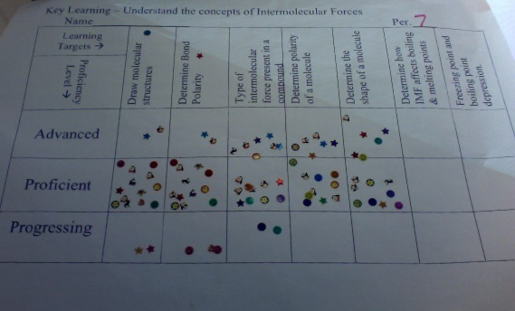
Erik, AP Chemistry, ThunderRidge HS, DCSD

Slide 29
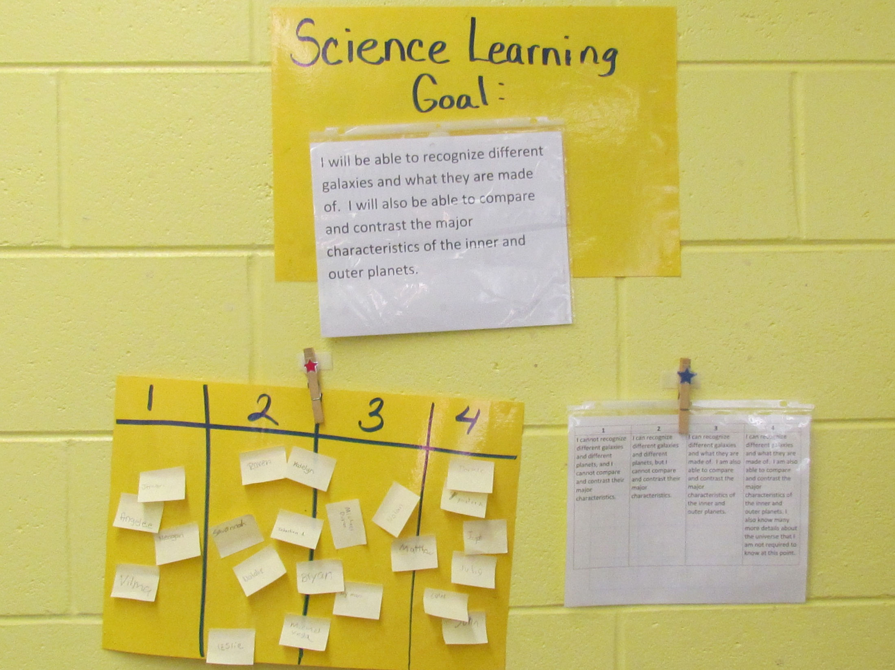

Slide 30
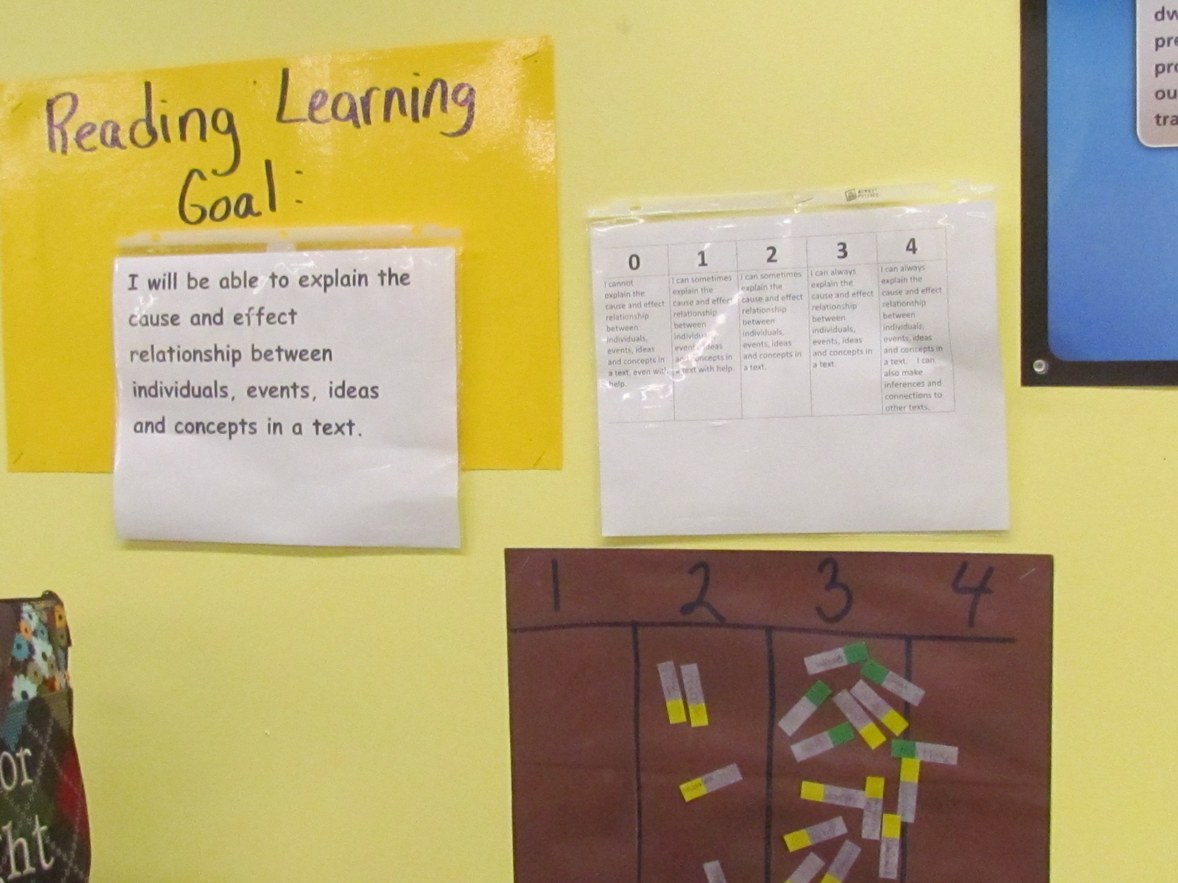

Slide 31
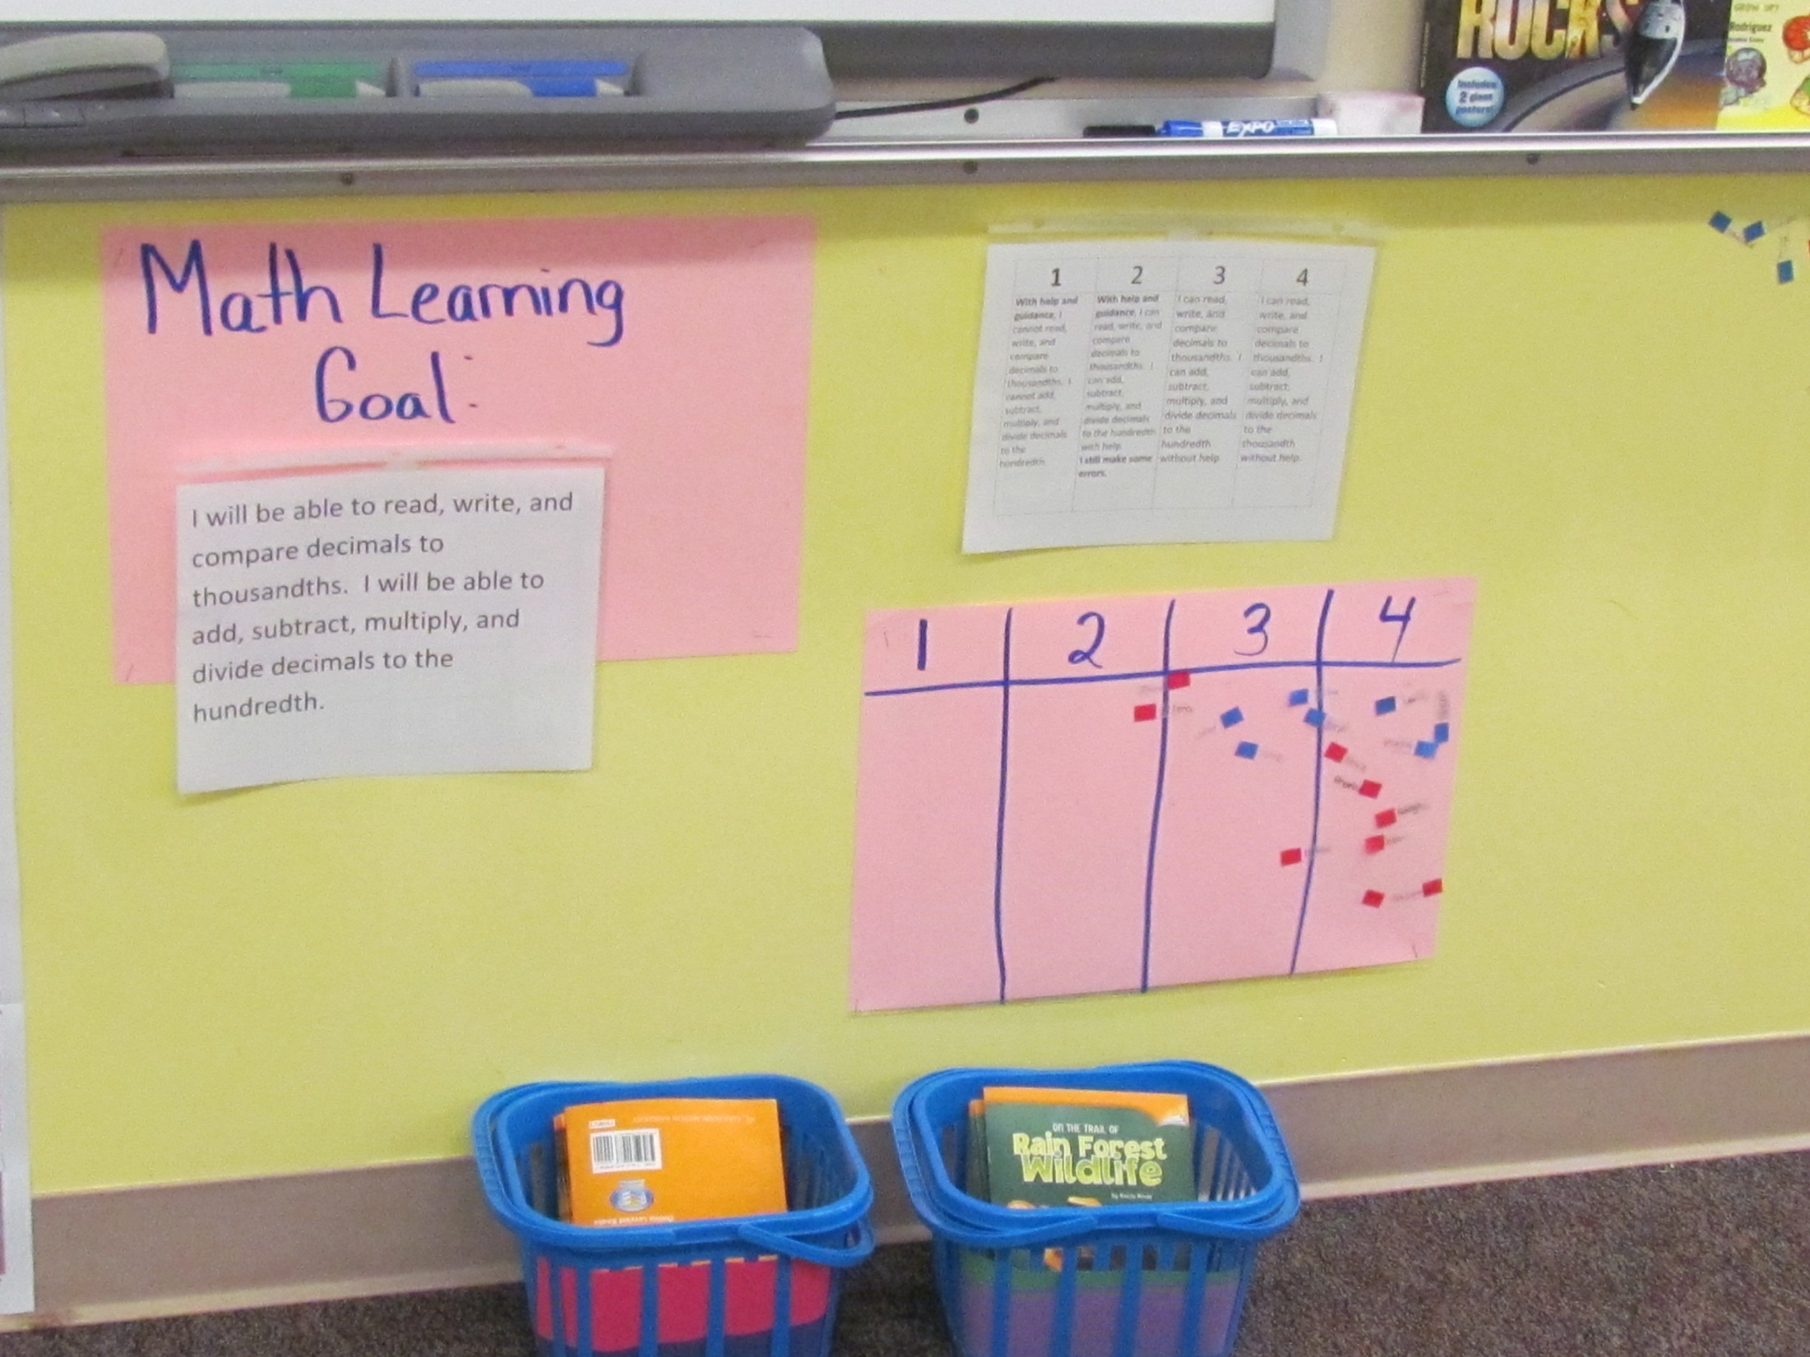

Slide 32
Forms of Assessment Available
Obtrusive
Unobtrusive
Student-Generated

Slide 33
A Natural Progression: Standards-Referenced to Competency-Based

Slide 34
Example Proficiency Scale

Slide 35
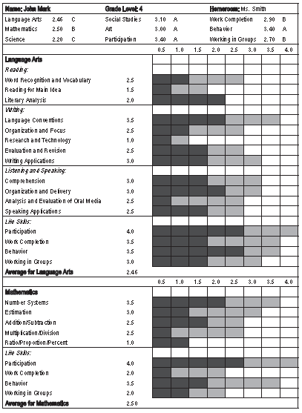
Critical Aspect Standards-Referenced Reporting
Report status and growth on the report card using proficiency scales

Slide 36
3.00 – 4.00 = A
2.50 – 2.99 = B
2.00 – 2.49 = C
1.50 – 1.99 = D
Below 1.50 = F

Slide 37
Conversion to %
4.0 = 100%
3.5 = 95%
3.0 = 90%
2.5 = 80%
2.0 = 70%
1.5 = 65%
1.0 = 60%
Below 1.0 = 50%

Slide 38
 | .00 | .5 | 1.0 | 1.5 | 2.0 | 2.5 | 3.0 | 3.5 | 4.0
T1
T2
T3
T4
T5
T6
T7
T8
T9
T10
T11
T12
T13
T14
T15
T16
T17
T18
T19
T20
T21
T22
T23
T24

Slide 39
 | .00 | .5 | 1.0 | 1.5 | 2.0 | 2.5 | 3.0 | 3.5 | 4.0
T1
T2
T3
T4
T5
T6
T7
T8
T9
T10
T11
T12
T13
T14
T15
T16
T17
T18
T19
T20
T21
T22
T23
T24

Slide 40
 | .00 | .5 | 1.0 | 1.5 | 2.0 | 2.5 | 3.0 | 3.5 | 4.0
T1
T2
T3
T4
T5
T6
T7
T8
T9
T10
T11
T12
T13
T14
T15
T16
T17
T18
T19
T20
T21
T22
T23
T24

Slide 41
 | .00 | .5 | 1.0 | 1.5 | 2.0 | 2.5 | 3.0 | 3.5 | 4.0
T1
T2
T3
T4
T5
T6
T7
T8
T9
T10
T11
T12
T13
T14
T15
T16
T17
T18
T19
T20
T21
T22
T23
T24

Slide 42
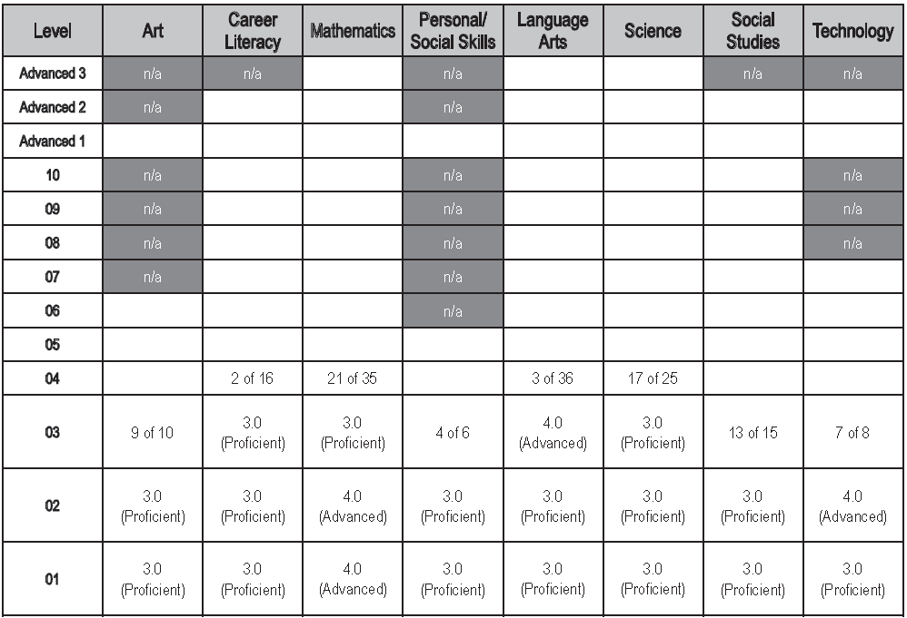
Critical Aspect Competency-Based Education
Adjusting reporting systems accordingly

Slide 43
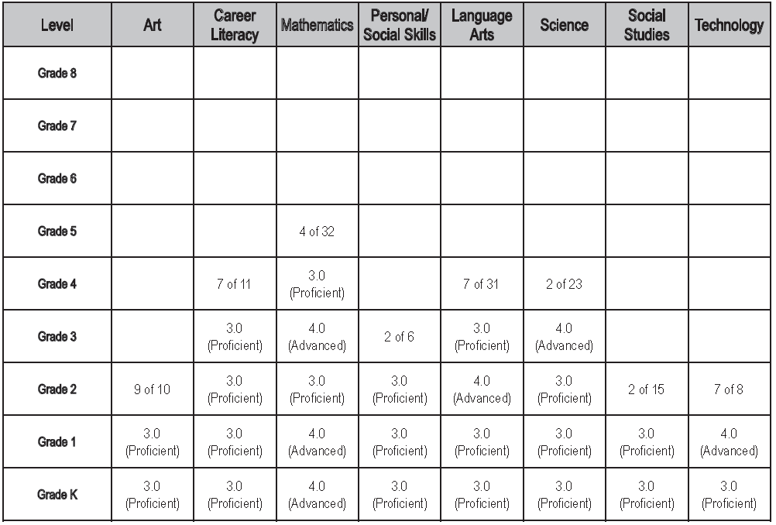
Reporting System: Grade-Level Approach

Slide 44
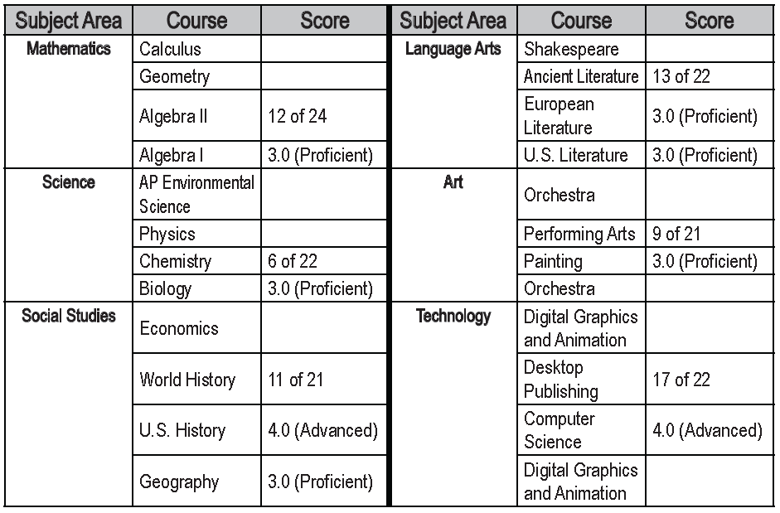
Reporting System: High School Approach

Slide 45
REPORTED AND REAL Status in a Competency-Based System
Level | Math | Science | Lang Arts | SS
10
9
8
7
6
5 |  | 20/21
4
3 | 4/18 |  | 7/22
2 |  |  |  | 3/16
1

