Slide 1
Safety Training
Week 3

Slide 2
Covid-19
Ways the virus can spread
Between people who are in close contact with one another (within 6 ft)
Respiratory droplets (coughs, sneezes, or talking)
Through people who do not show symptoms
There currently is no vaccine to prevent Covid 19

Slide 3
Social Distancing
What is it?
Putting space (6 feet or more) between you and another person
Why is it important?
It helps slow the spread of Covid 19
It keeps you and everyone you love SAFE.

Slide 4
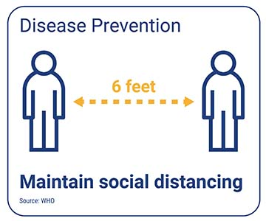
Social Distancing
To help prevent the spread:
Stay at least 6 feet away
Wear a mask
WASH HANDS

Slide 5
Proper Mask Wearing
Wash hands BEFORE touching your mask

Slide 6
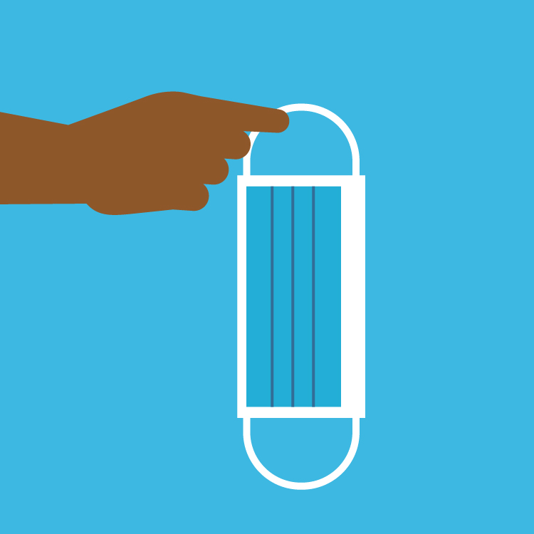
Proper Mask Wearing
Touch only the bands or ties when putting on and taking off your mask

Slide 7
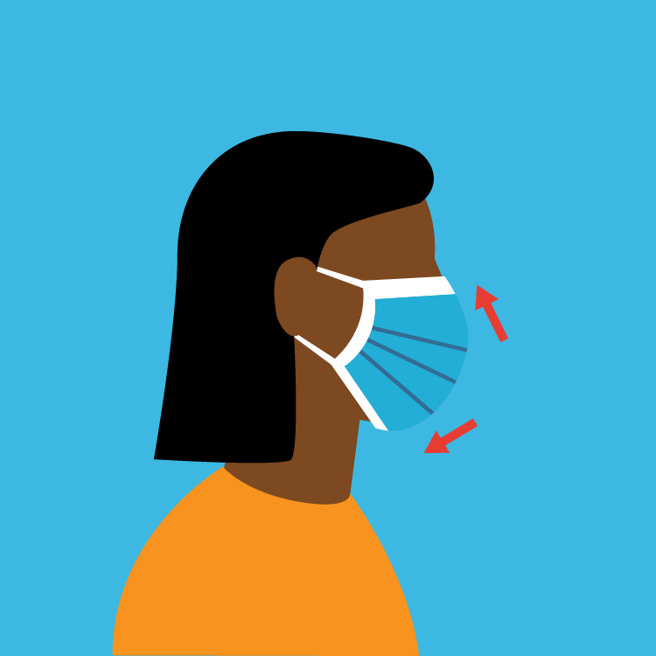
Proper Mask Wearing
Make sure the mask fits to cover your nose, mouth, and chin.

Slide 8
Proper Mask Wearing
Make sure you can breathe and talk comfortably through your mask

Slide 9
Proper Mask Wearing
Wash reusable masks and throw away disposable masks when visibly soiled or damaged

Slide 10
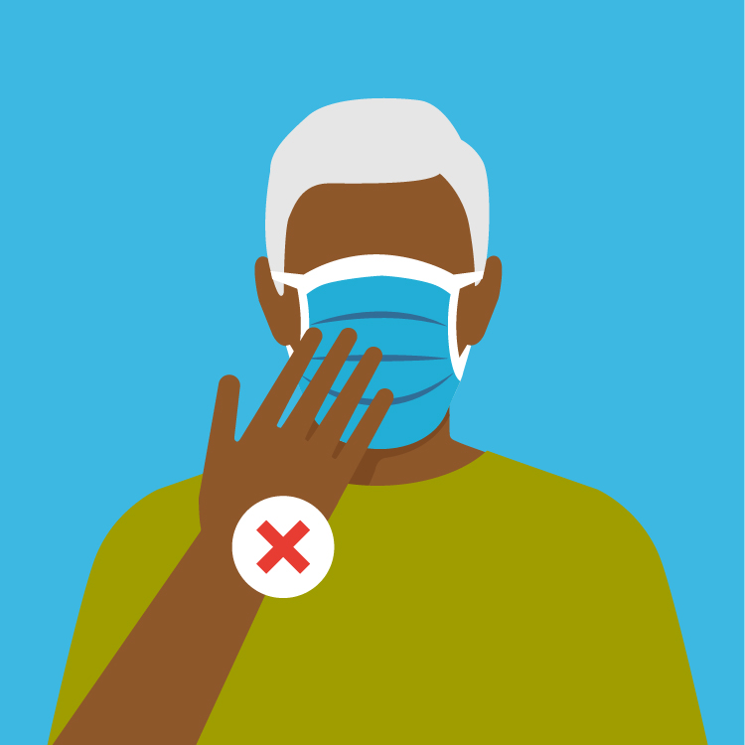
Avoid These Mistakes!!!
Do not touch your mask while it is being worn

Slide 11
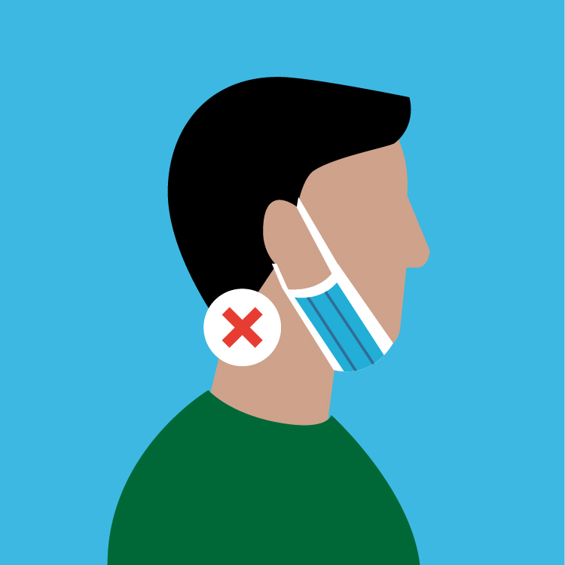
Avoid These Mistakes!!!
Do not wear the mask under your chin with your mouth and nose exposed

Slide 12
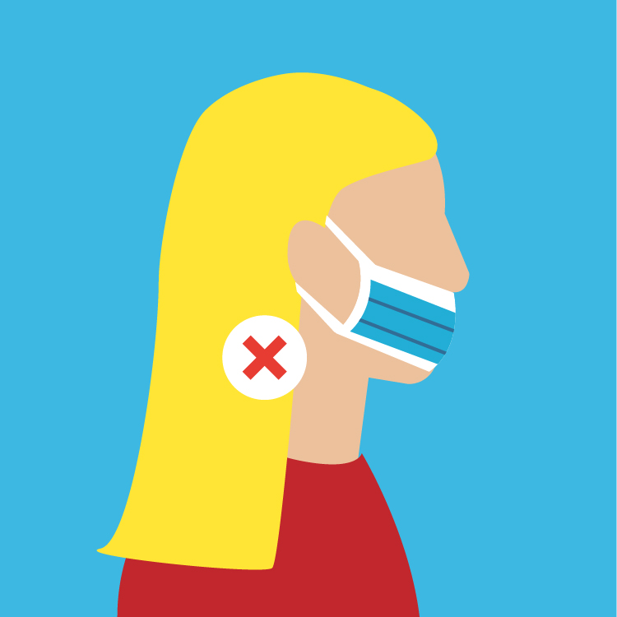
Avoid These Mistakes!!!
Do not leave your nose or mouth uncovered

Slide 13
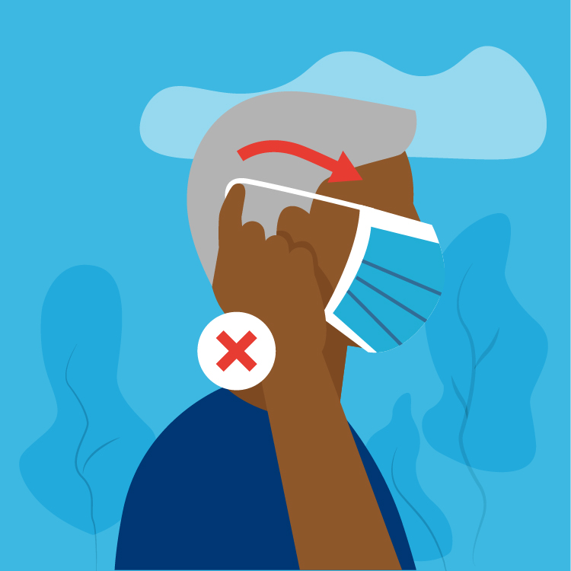
Avoid These Mistakes!!!
Do not remove the mask while around others in public

Slide 14
Avoid These Mistakes!!!
Do not share your mask with family members or friends

Slide 15
REMEMBER!
Hand washing is the BEST prevention against illnesses
Social distancing and proper mask wearing can slow the spread of Covid-19

Slide 16
Hip Hop Hand Washing
20 seconds or more
https://healthmatters.nyp.org/hip-hop-video-promotes-hand-washing-for-20-seconds-or-more/

