Slide 1
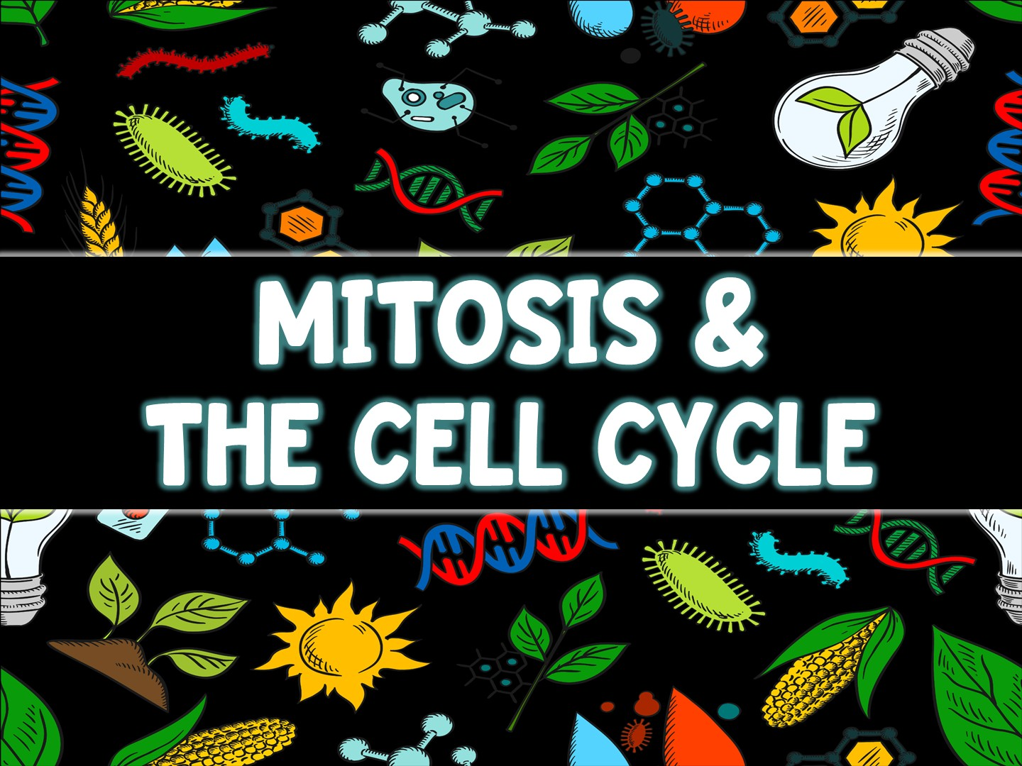

Slide 2
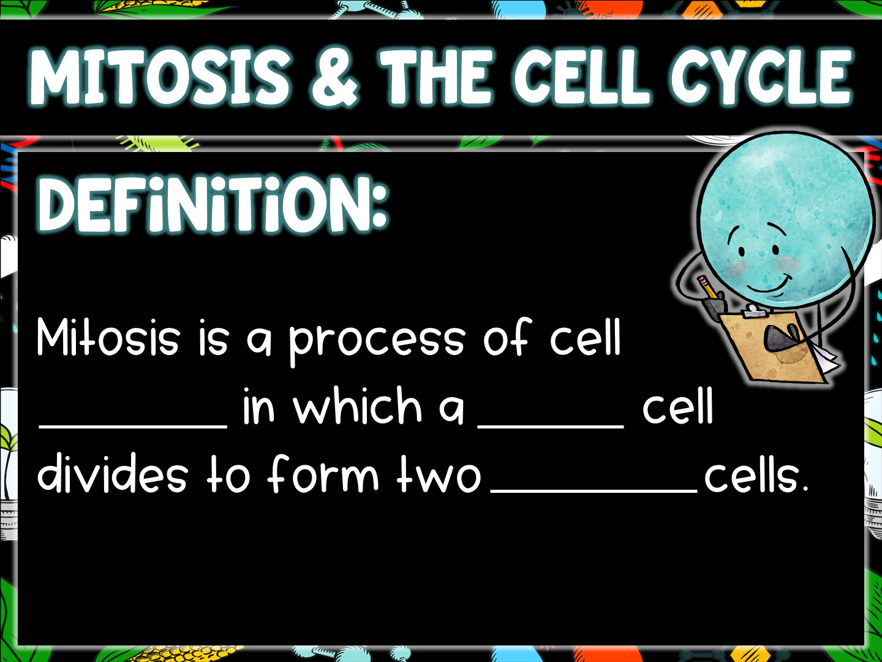
division
single
identical

Slide 3
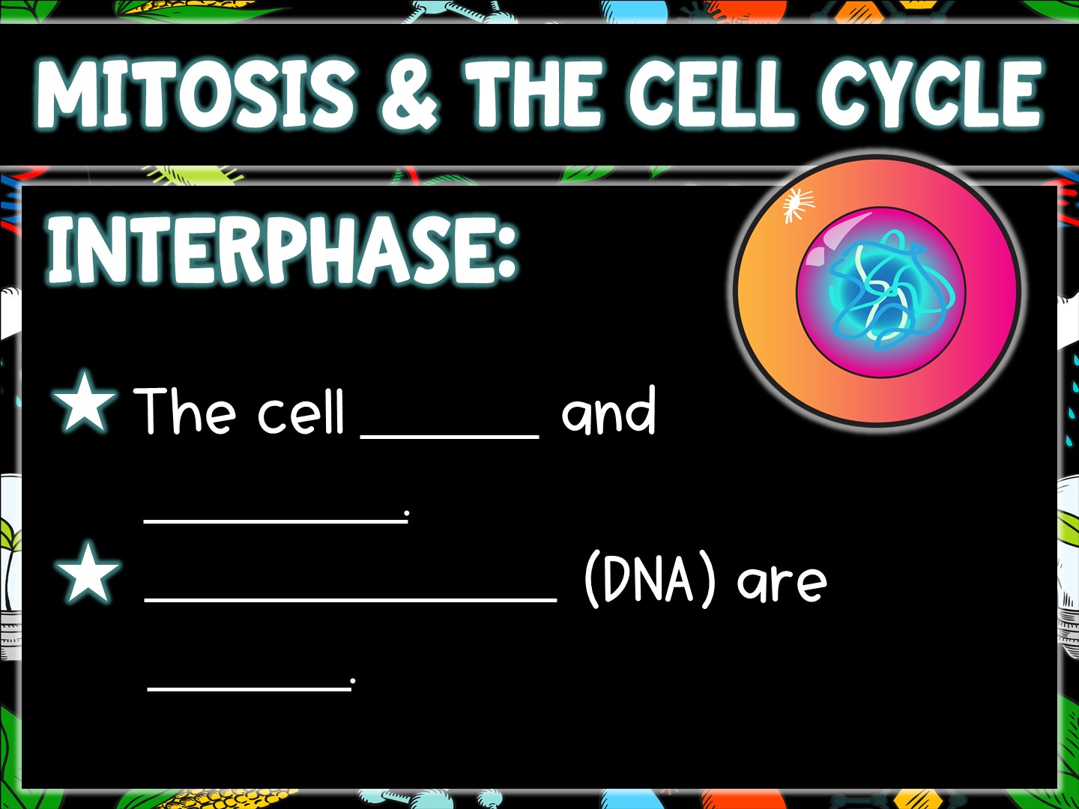
grows
develops
Chromosomes
copied

Slide 4
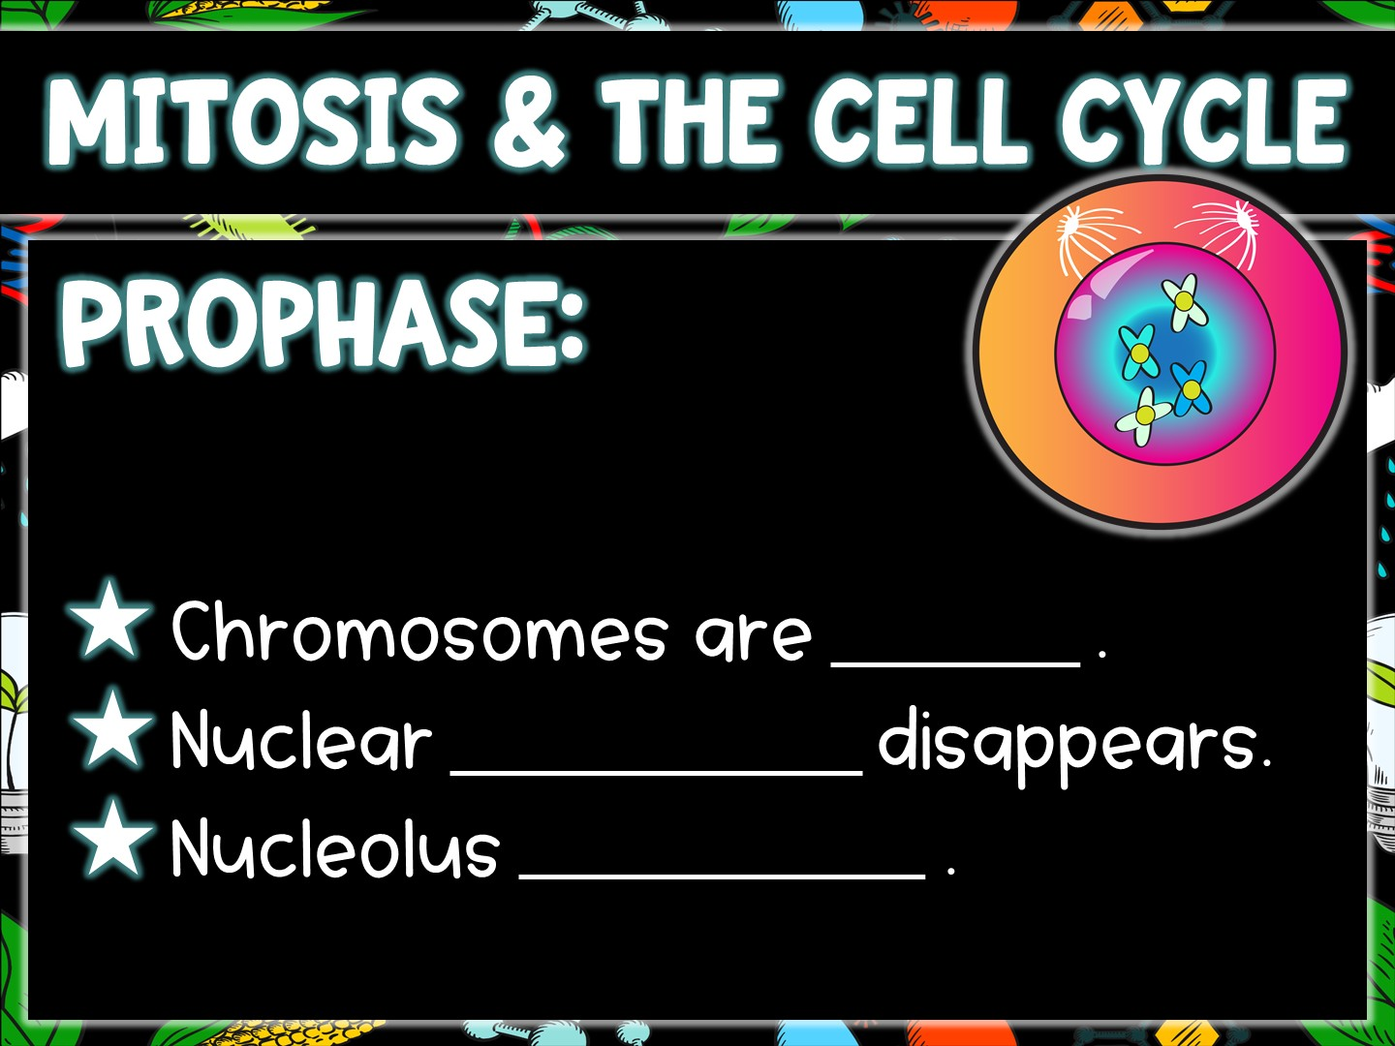
visible
membrane
disappears

Slide 5
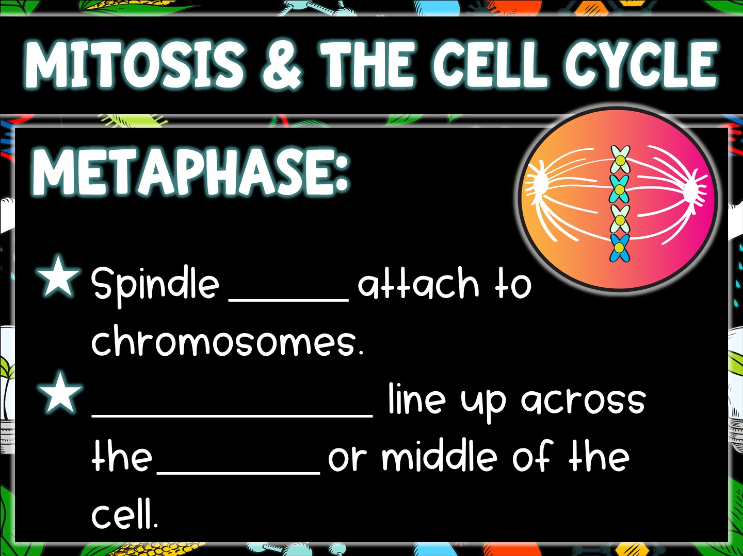
fibers
Chromosomes
equator

Slide 6
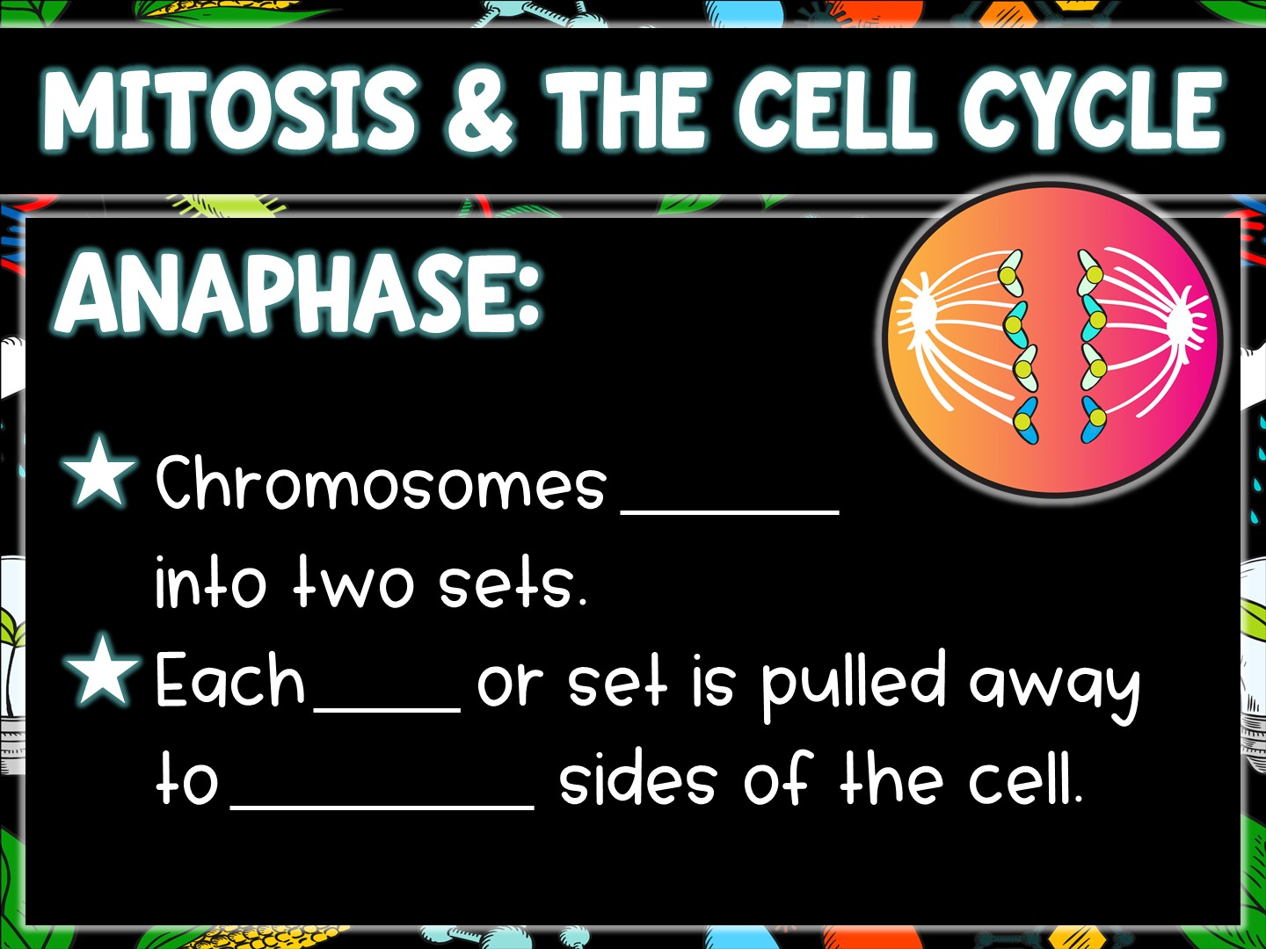
divide
half
opposite

Slide 7
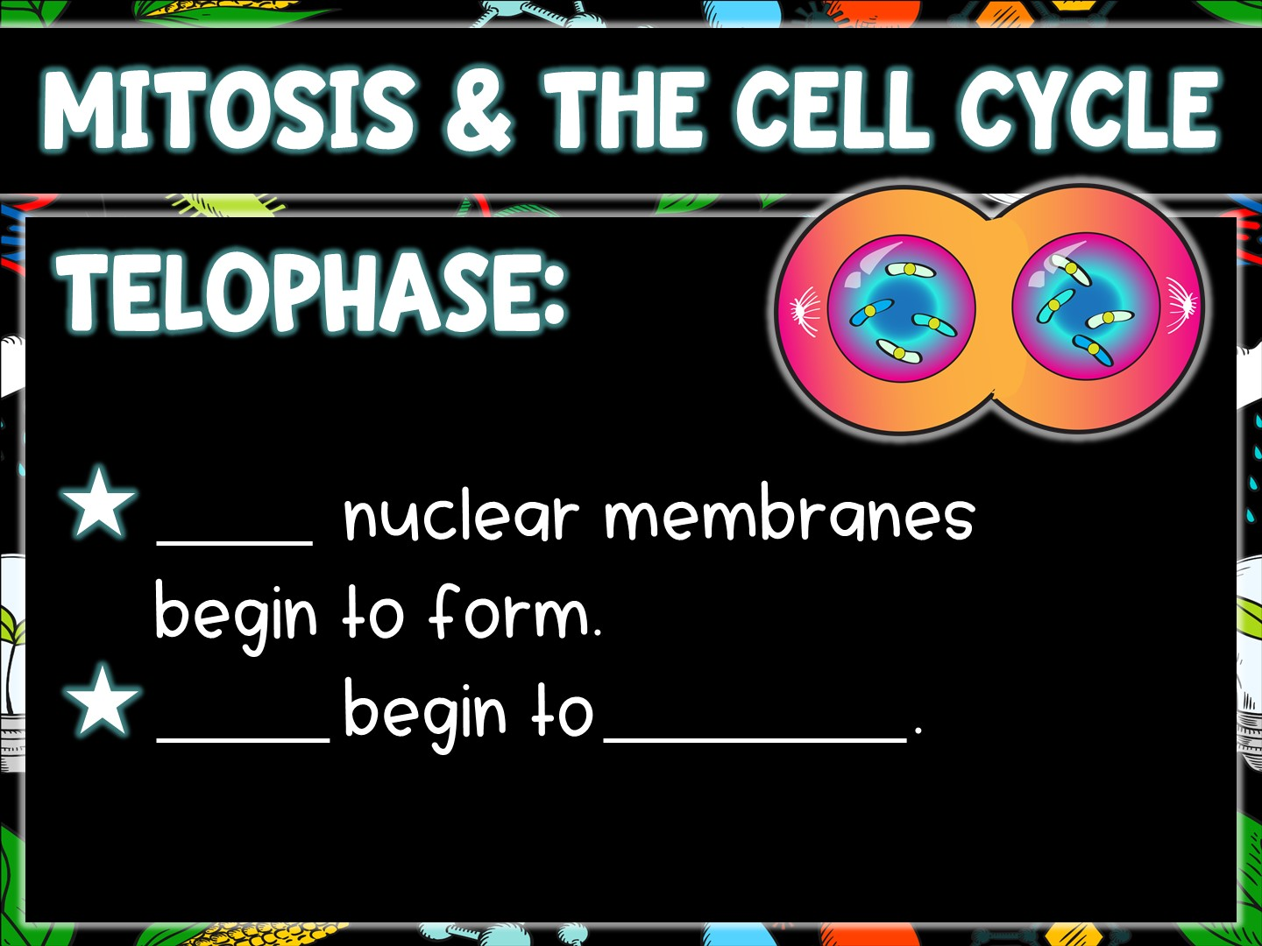
Two
Cells
separate

Slide 8
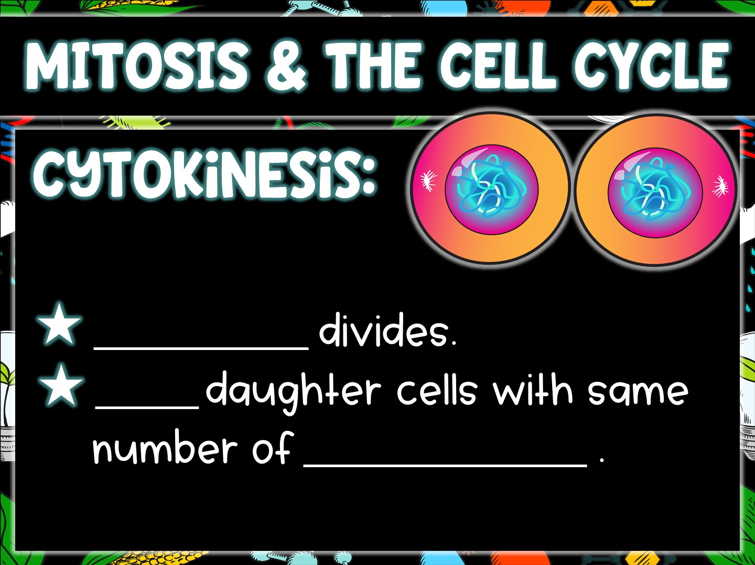
Cytoplasm
Two
chromosomes

