Slide 1
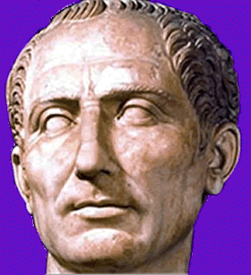
JULIUS CAESAR
POWER
To
Rise

Slide 2
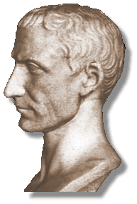
His Name
Gaius Julius Caesar
Julius was the family name.
Gaius was his given name, one of only eight names which could be given to boys.
The name of Gaius’ branch of the Julius family was “Caesar,” which originally meant “hairy.”

Slide 3
The Early Years
Born in 100 B.C. to Aurelia (mom) and Gaius Julius Caesar (dad) and grew up in the Republic during days of the Marius/Sulla struggle
He is the only son, but apparently had 2 sisters named Julia Major and Julia Minor (really?)
Dad died when he was 15 or 16.

Slide 4
This is likely what Caesar’s home looked like back in the day when he was growing up.

Slide 5
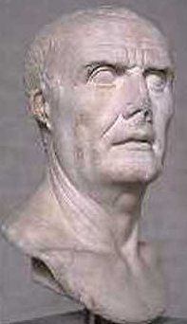
His uncle was the most powerful leader in Rome at the time
Gaius Marius
(his mom’s sister Julia married him)
(the general from the Reformer sheet)
This connection put Julius Caesar in danger with Marius’ rival, Sulla
(more on that later…)
UNCLE MARIUS

Slide 6
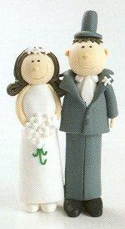
Got married when he was 18 to Cornelia, the daughter of the consul Cinna
Often marriages were political arrangements.
Soon he had a daughter named….
You guessed it…
JULIA!…..
can you see the pattern here?

Slide 7
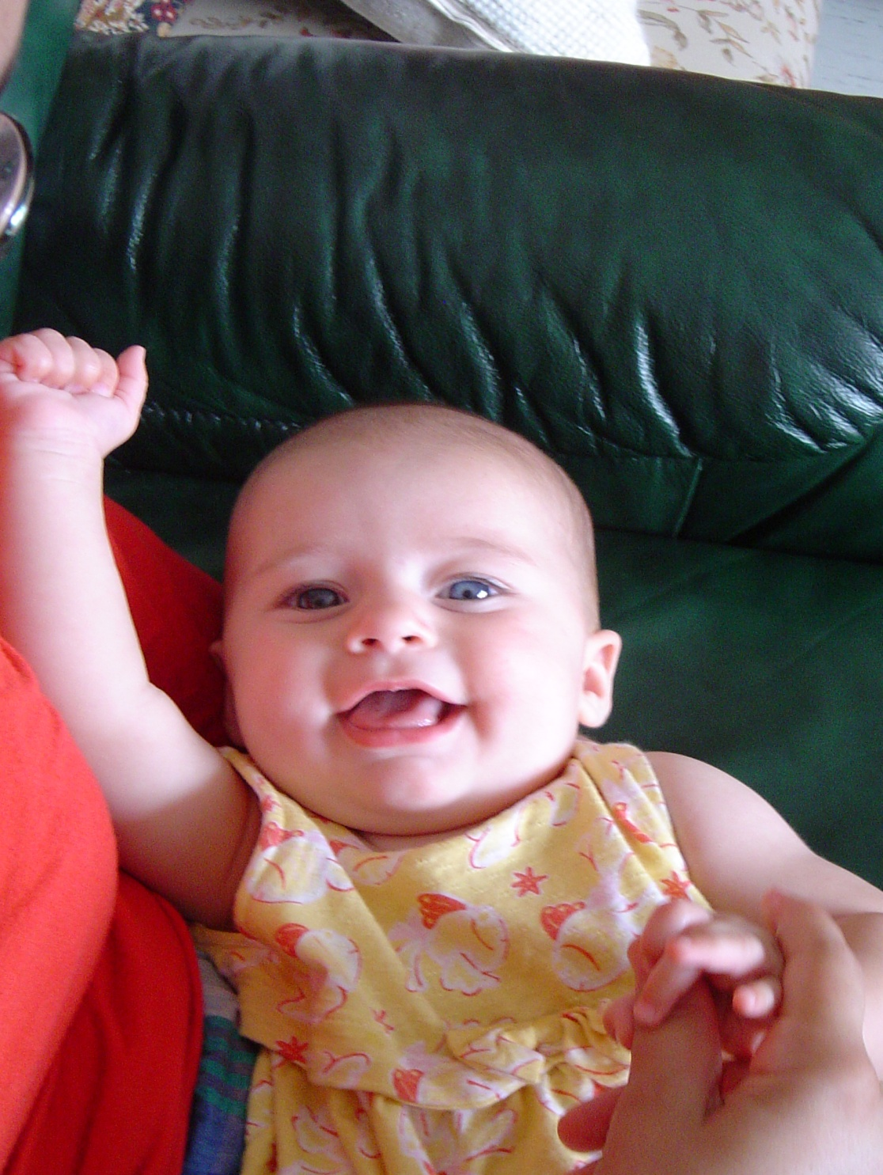
Hi,
I’m Julia, I come from a long line of Julias
My aunt Julia, my other aunt Julia, my great Aunt Julia, heck, my dad and grandpa are almost Julias (Julius)
I think I’ll name my daughter…Julia.
See Ya,
Love Julia

Slide 8
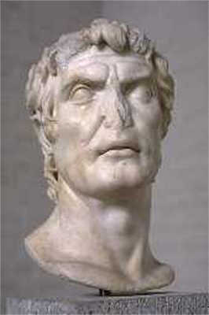
DANGER!!!
During the Marius/Sulla struggle, Julius Caesar was proscribed by Sulla
(put on a list to be arrested) but he and his family were able to bribe them into a pardon. Around 81 B.C. (Age 19)
Remember, he is
Marius’ nephew…
SULLA

Slide 9
Mediterranean
Julius Caesar was kidnapped by Sicilian
pirates for ransom in 75 B.C (Age 25)
He maintained a friendly relationship,
playing games and joking,
but all the while telling them he intended to
track them down and kill them once he
was released…
He did. ‘Nuff said

Slide 10
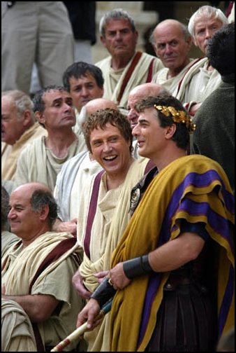
Julius Caesar played the game of Roman
Politics for years
He charmed the crowds in the Forum with speeches.
Threw lavish parties for influential politicians
Borrowed money from “Crassus the Rich”

Slide 11
Some of his achievements
Obtained a seat in the Senate around 68 B.C. (Age 32)
Elected Pontifex Maximus (Chief Priest) in 63 B.C. (Age 37)
Soon became appointed governor of a province in Spain in 61 B.C. (Age 39) This could make him rich!!!

Slide 12
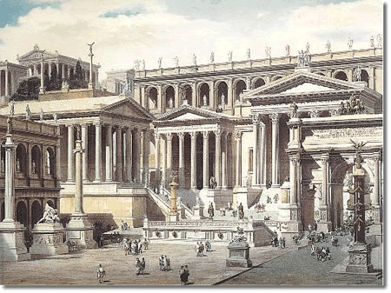
This is where Julius Caesar hung out – The Forum

Slide 13
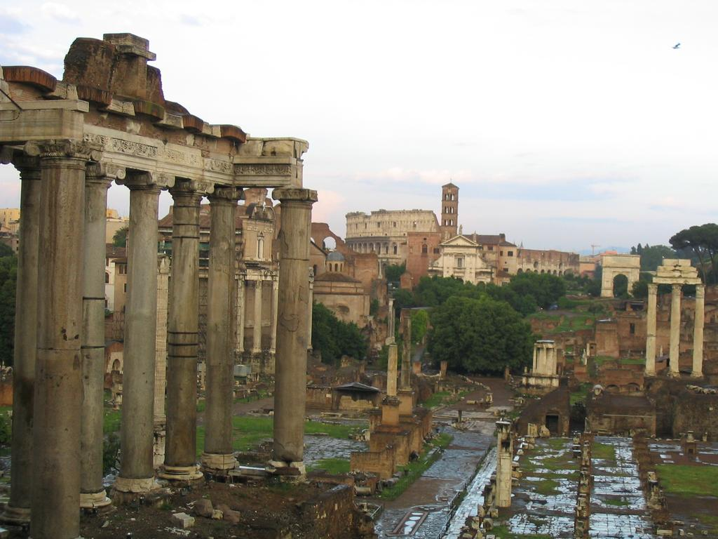
Here’s what it looks like now…

Slide 14
More achievements
59 B.C. Caesar elected consul
with another named Bibulus
Caesar strong-armed many
things including a 5 year (later
extended to 9) proconsul of
Gaul.

Slide 15
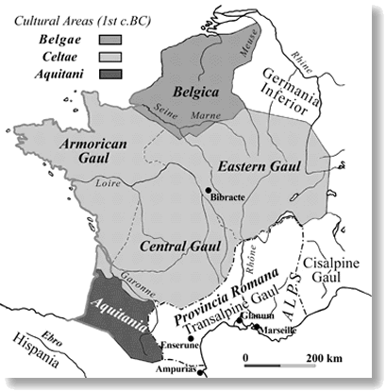
He could be
prosecuted
for his actions
once he was
out of office,
but he
went to Gaul
Conquered much of what we now know as Central Europe

Slide 16
The First Triumvirate
A government ruled by three people equally
In 60 B.C. Julius Caesar joined with two other powerful men – Crassus (a rich man) and Pompey (military hero) and ruled Rome for 10 years. (Age 40-50)
They dominated politics and often bullied or bribed the Senate to attain their goals.

Slide 17
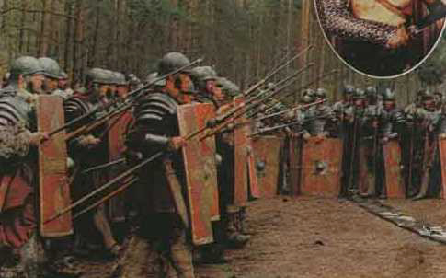
CAESAR BECOMES VERY POPULAR
With his soldiers…
because he endured
the same
hardships as
his men and
won many
battles in Gaul

Slide 18
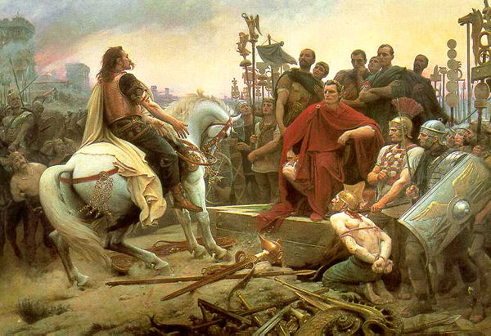
With the poor citizens….
because he was trying to make changes and he was a war hero – he would write back to Rome about all his successes

Slide 19
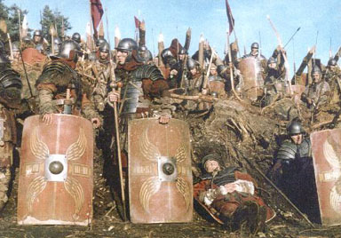
with the Senators…?
NOT!

Slide 20
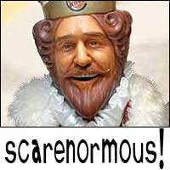
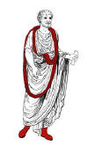
The Senators were watching him
and concerned about his growing
power…was he trying to be a
KING?
Watch out!

Slide 21
Remember the three rulers,
The Triumvirate?
Caesar, Pompey, Crassus
They started to disband, Actually, Crassus died and Pompey became Caesar’s rival

Slide 22
Soon…
The Senate, with Pompey’s approval ordered Julius Caesar to disband his army and return to Rome
Julius Caesar refused and actually marched his army back to Italy (From Gaul)
This was seen as a defiance to the Senate’s order and as a direct challenge to Pompey’s power

Slide 23
In 49 B.C. (age 51) Caesar “Crossed the
Rubicon” Which was a river at the
border of Gaul and Italy.
This became a term meaning “No turning
back..”
It was illegal to bring an armed force
into Italy…His act meant Civil War.

Slide 24
Caesar eventually fought and defeated Pompey ( in Greece in 48 B.C.)
Caesar returned to Rome in 46 B.C. and had full support of the army and the masses
In 44 B.C. Senate appointed him dictator for 10 years. He has absolute power.

Slide 25
Weakening of Government Structure that supported THE VOW
Sulla was 1st to abolish the 6 month dictator limit in 82 B.C. He became dictator until “whenever”
Caesar strong armed his co-consul Bibulus and controlled the consulship in 59 B.C.

Slide 26
Pompey was the first to be elected “consul without a colleague” due to civil unrest in Rome in 52 B.C.
Caesar appointed dictator for 10 years in 44 B.C. – but remember, he got killed.

Slide 27
Changes that Caesar made as absolute ruler
Granted citizenship to people in provinces outside Italy
Expanded Senate to 900, making it more
representative of the Empire
Land owners must use free men rather than slaves for at least 1/3 of the workforce

Slide 28
Set up public works program for jobs
Found colonies in Spain, France and
Switzerland to provide land for poor
Roman citizens
Set up new Julian Calendar
But he didn’t rule for long……….

Slide 29
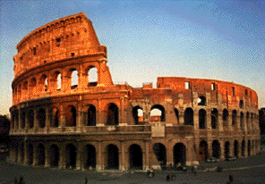
Julius Caesar’s Death:
Killed by Senators, chiefly Brutus, who was his friend, and Cassius
They were trying to “save the Republic” (it was already nearly dead)
March 15, 44 B.C. Age 56

Slide 30
What happens next….?
The Second Triumvirate
formed to avenge Caesar’s death in 43 B.C. The following ruled for 10 years
Octavian – grand nephew of Caesar
Marc Antony – not the singer but a general
Lepidus – a powerful politician
Later they also disband and become rivals creating the third Civil War.
This includes the story of Antony and Cleopatra

Slide 31
The outcome was that Octavian became The Sole Ruler (Emperor) of the now Roman Empire in 27 B.C.

Slide 32
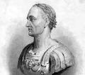
Other Characters that played an important part in Caesar’s life
Spartacus~leader of slave rebellion against Rome
Bibulus~Caear’s co-consul and political enemy

Slide 33
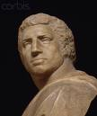
Marcus Brutus~member of plot to assassinate Caesar
Cato~senator who bitterly opposed Caesar for 20 years

Slide 34
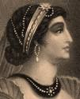
Marc Antony~tribune who supported Caesar duing the civil war with Pompey
Cleopatra~queen of Egypt; may have had a child with Caesar

Slide 35
The End
Or is it the beginning?

