Slide 1
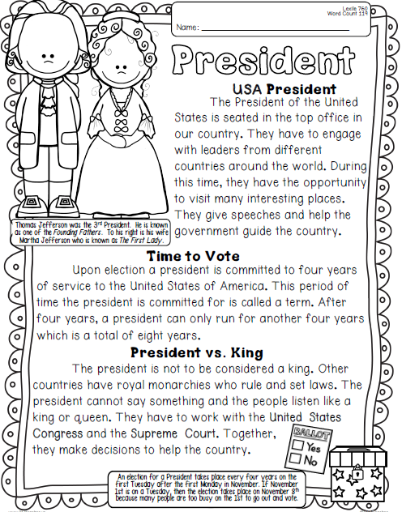
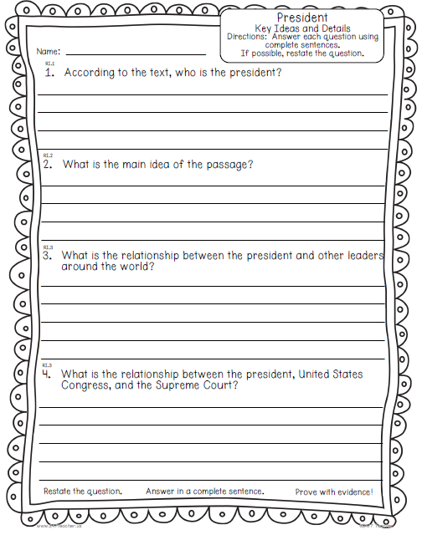
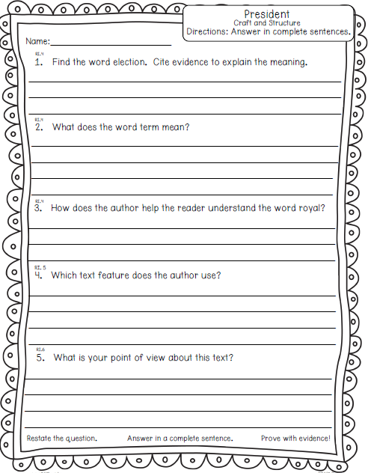
Wednesday, October 23, 2019
Wednesday: Classworks
M - Amiyah - 1
M – Erin - 2
M – Jaiden – 3
M – Caydance - 4
M – Jaylie – 5
M – Macon – 6
M – Paisleigh - 7
M – Jearon - 8
M – Landon – 9
M – Kaylee - TC
7:55 – 8:30

Slide 2
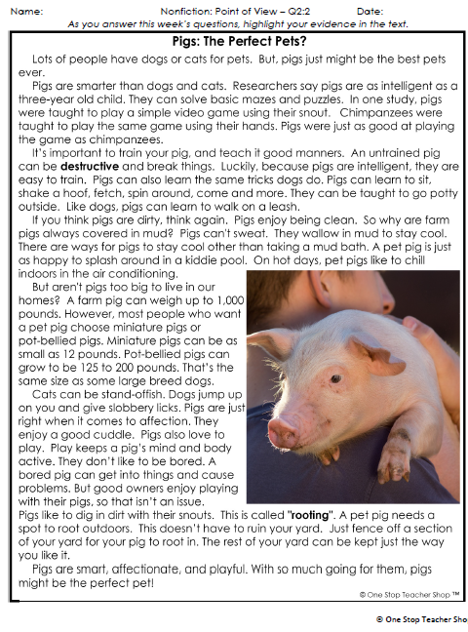
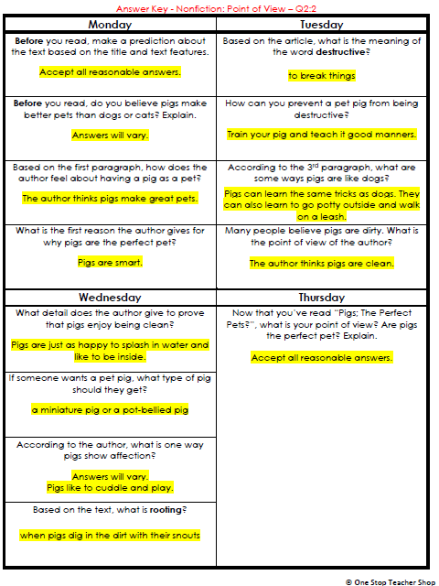
Reading Homework

Slide 3
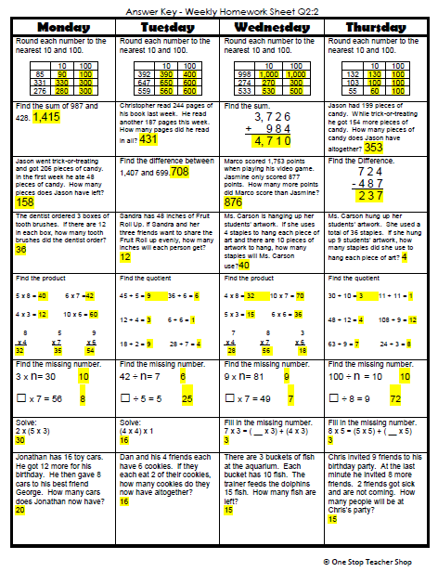
Math Homework

Slide 4

CHOMP TIME
F.A.S.T. Groups
Focused Academic Support Time

Slide 5
F.A.S.T. Designations
Computers – Classworks: M - Jaiden- 1 M - Erin - 2 M - Jearon - 3 R - Aiden - 4 M – Carleen– 5 M – Alexis - 6 M - McKenzie- 7 M - Brena - 8 M - Noah – 9 M – Emma - TC | Mrs. Roby: Check In Aiden Alexis Cayli Khamani | Mrs. Thompson: SIPPS Cohen Amiyah Caydance Jaylie Kaylee Paisleigh | Paired Partners Book Club: Khamani - Katelynn Cayli - Adalyn
Landon – Phonics 1st with Mrs. Page
Macon – SIPPS with Mrs. Bess
8:40 – 9:10

Slide 6

Reading Time
Objective: RL.3.3 Describe characters in a story and explain how their actions contribute to the sequence of events.
Objective: RL.3.5 Refer to parts of stories and poems when writing or speaking about a text, using terms such as chapter, scene, and stanza; describe how each successive part builds on earlier sections.
Objective: RL.3.7 Use information gained from illustrations, other visual elements, and the words in a text to demonstrate understanding of the text.
9:10 – 9:45

Slide 7
Drawing for New Partners!
Be a responsible partner
  Must think on your own and share your thinking in pairs
  What will you do to be a good partner?

Slide 8

Gather at the Carpet.
Are we still the best?

Slide 9
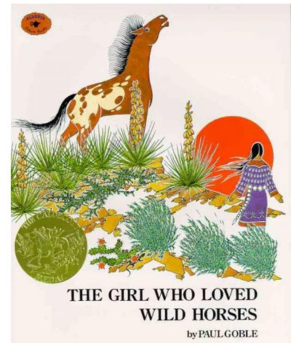
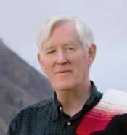
Author and Illustrator: Paul Goble
The Girl Who Loved Wild Horses
What do you wonder about this story?
Let’s make a chart!

Slide 10
Stop at p11
What questions do you have, or what do you wonder, at this point in the story?
Turn to your partner

Slide 11

Stop at p18
What questions do you have, or what do you wonder, at this point in the story?
Turn to your partner

Slide 12
Stop at p23
What questions do you have, or what do you wonder, at this point in the story?
Turn to your partner

Slide 13
Stop at p28
What questions do you have, or what do you wonder, at this point in the story?
Turn to your partner

Slide 14
Finish Story

Slide 15


Classroom Discussion
What is this story about?
What happens in the story that is strange or magical?
Was it hard or easy to think of questions as you listened to the story? What made it hard or easy?

Slide 16

Restroom Break
9:45 – 9:55

Slide 17

Computers – Classworks:
  M - Jearon - 1
  M – Cayli -2
  M – Alexis - 3
  M – McKenzie - 4
  M - Carleen - 5
  M - Katelynn - 6
  M – Jaiden – 7
  M - Brena - 8
  M – Erin – 9
  M – Caydance - TC
  Mrs. Roby
  LLI:
  Kaylah
  Kaylee
  Emma
  Adalyn
Independent Daily Reading & Teacher Conferences
  Mrs. Thompson:
  LLI
  Landon
  Paisleigh
  Jaiden
  Macon
Everyone else – Independent Novel
9:55 – 10:25

Slide 18



Vocabulary & Grammar Time
10:25 – 10:40

Slide 19

obstinate – stubborn
P5
Obstinate is a synonym for stubborn.
Who remembers the definition of a synonym?
If you are obstinate, you are unwilling to change your mind about something.
Even though Alexander’s parents explain why the family must move, Alexander is obstinate. He does not want to move, and he is not willing to change his mind.

Slide 20
obstinate
When have you been obstinate or seen someone being obstinate? – Turn to your Partner
  I was obstinate when…
  OR
  I saw…being obstinate when…

Slide 21
What’s the new word we are learning that means “stubborn”?
obstinate

Slide 22
Career Opportunities…
Doctor -.
Nurse -
Medical Researcher -
All of these professionals must be obstinate and never give up trying to heal those who are ill.

Slide 23

immature – childish or silly
P9
“Nick says I’m a fool and should get a brain transplant. Anthony says I’m being immature.”
Look at the illustration on page 9 and notice that Anthony thinks Alexander is being immature, or childish, when he pouts and says he will not move.

Slide 24
What’s the new word we are learning that means “childish or silly”?
immature

Slide 25

mature – ??
P29.
Alexander’s mother, father, and even his brother Nick try to comfort him about all the change that lies ahead.
“Nick says if I’m lonesome in my new room by myself, he might let me sleep with him for a little while. Anthony says that Nick is being mature.”
Mature and immature are antonyms. Remember that antonyms are words with opposite meanings.

Slide 26
mature - ??
Classroom Discussion
If mature and immature are antonyms, what do you think mature might mean?
I think mature might mean?

Slide 27

mature – grown up or adult
How is Nick being grown up, or mature?
  Nick is being mature when he…
  P30 By the end of the story Alexander is being mature, or sensible and reasonable like an adult. Think about how Alexander is being mature.

Slide 28
mature – grown up or adult
How is Alexander being mature? What is he doing that is reasonable and sensible?
  Alexander is being mature when he…

Slide 29
Is Olive being mature or immature?
Olive is working quietly at her desk at school. Her friend Orlando makes a funny face at her. Olive ignores Orlando and continues to do her work.
Is Olive being mature or immature? Why? Turn to your partner.

Slide 30
Is Olive being mature or immature?
Olive wants to go to Orlando’s house to play baseball. Olive’s mother tells her she can’t go because her cousin is coming to visit. When her cousin arrives, Olive pouts and won’t talk to her.
Is Olive being mature or immature? Why? Turn to your partner.

Slide 31
Is Olive being mature or immature?
Olive is riding her skateboard. She sees a group of children down the street. She wants to show them how well she skateboards, so she speeds up and whirls in and out among them. She knocks one little boy to the ground.
Is Olive being mature or immature? Why? Turn to your partner.

Slide 32
Is Olive being mature or immature?
Olive and Orlando are hungry. Olive has a muffin in her lunchbox. She breaks the muffin in half so that both she and Orlando get a piece.
Is Olive being mature or immature? Why? Turn to your partner.

Slide 33
What’s the new phrase we are learning that means “grown up or adult”?
mature

Slide 34
Out of Classroom!
Recess 10:40 – 11:05

Slide 35
Writing Time
11:05 – 11:35

Slide 36
Team captains pass out Writing Journals to your group

Slide 37
Gather at the Carpet with your Writing Journal and pencil.
Are we still the best?

Slide 38

Curiosity
Last time we heard Are You a Dragonfly? and started thinking about animals we were curious about.
Why might curiosity be an important quality for a writer to have?
Writers do not have to know a lot about a topic when they begin writing about it, but they do need to be curious about it.

Slide 39
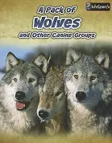

Review:
What are some things you learned about wolves yesterday?
Yesterday we talked about curiosity and why it is an important quality for a writer to have.
What else are you curious to know about wolves? Turn to your partner
Author: Anna Claybourne

Slide 40
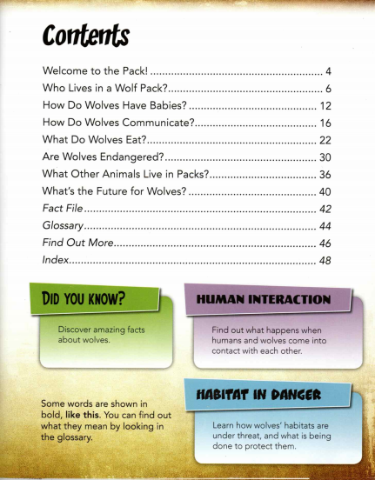
“Table of” Contents Page
Let’s review.
This page also lists special features at the end of the book.
Fact File, Glossary, Find Out More, and the Index.

Slide 41
Read Aloud:
Today I will read more from this book. Listen as I read the chapter on What do Wolves Eat?
What is something you learned today from this book?
What is a question the author didn’t answer that you are still curious about?
What are some different ways that the author of this book provides information about wolves and other canine groups?
Author: Anna Claybourne

Slide 42


Writing Time
Writing Journal
Remember:
Write silently
Double-space, or skip every other line
Continue writing until time is up
Write more questions about the animal you chose.
Write questions about other animals.
Write about anything you choose.
11:25 – 11:35

Slide 43
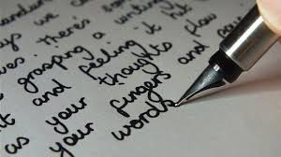
Sharing and Reflecting
Tomorrow you will look at some nonfiction resources on animals. You will be selecting an animal to research in detail later. Do not get attached to any one animal yet. ☺

Slide 44
Math Fluency & Focus Lesson!
11:35 – 11:55

Slide 45
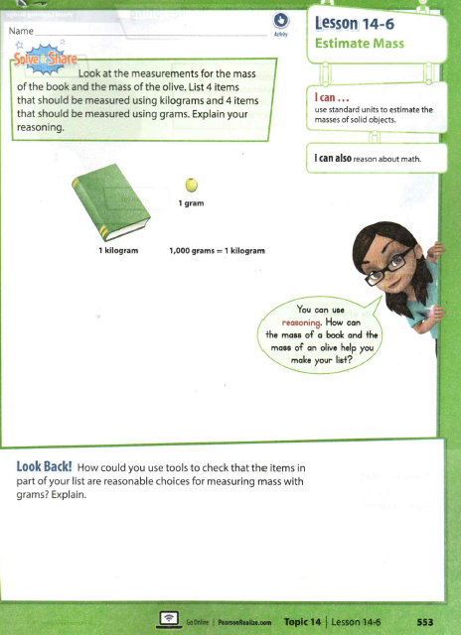
Let’s watch a video to introduce this topic!

Slide 46
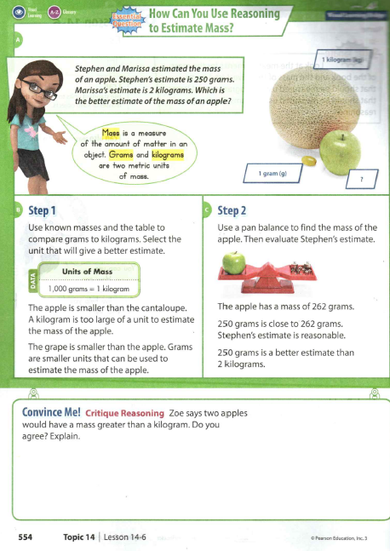
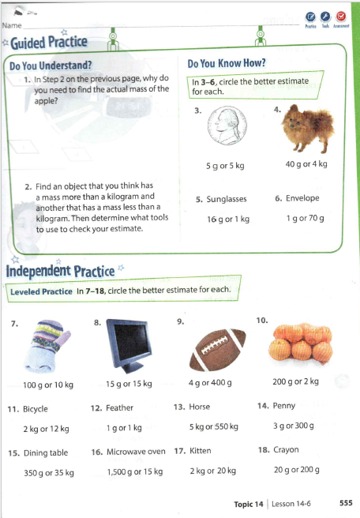

Slide 47
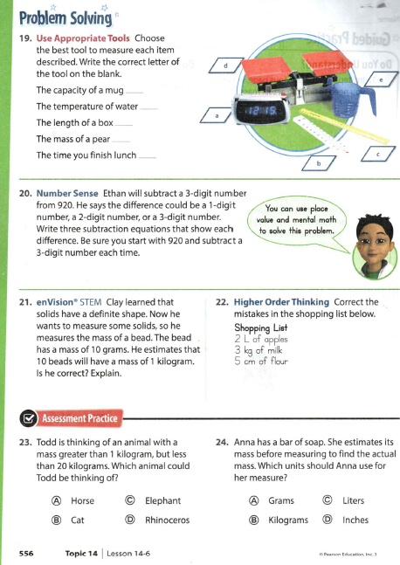

Slide 48
Small Group Rotations 1 & 2
  Rotation #1 - 11:55 – 12:15
Group 1 – Computers (TC, A, B, C, D): Classworks R
Group 2 – Mrs. Roby: Math Practice
Group 3 – Computers (E, F, G, H, I): Imagine Math
Group 4 – Mrs. Thompson: Reading Practice
Group 5 – Independent Practice
  Rotation #2 - 12:15 – 12:35
Group 5 – Computers (TC, A, B, C, D): Classworks R
Group 1 – Mrs. Roby: Math Practice
Group 2 – Computers (E, F, G, H, I): Imagine Math
Group 3 – Mrs. Thompson: Reading Practice
Group 4 – Independent Practice

Slide 49

Out of Classroom!
Lunch 12:35 – 1:05

Slide 50
Restroom Break
1:05 – 1:10

Slide 51

Out of Classroom!
Activity 1:10 – 1:55

Slide 52
Small Group Rotations 3 & 4
  Rotation #3 - 1:55 – 2:15
Group 4 – Computers (TC, A, B, C, D): Classworks R
Group 5 – Mrs. Roby: Math Practice
Group 1 – Computers (E, F, G, H, I): Imagine Math
Group 2 – Mrs. Thompson: Reading Practice
Group 3 – Independent Practice:
  Rotation #4 - 2:15 – 2:35
Group 3 – Computers (TC, A, B, C, D): Classworks R
Group 4 – Mrs. Roby: Math Practice
Group 5 – Computers (E, F, G, H, I): Imagine Math
Group 1 – Mrs. Thompson: Reading Practice
Group 2 – Independent Practice:

Slide 53
Small Group Rotation 5
  Rotation #5 - 2:35 – 2:55
Group 2 – Computers (TC, A, B, C, D): Classworks R
Group 3 – Mrs. Roby: Math Practice
Group 4 – Computers (E, F, G, H, I): Imagine Math
Group 5 – Mrs. Thompson: Reading Practice
Group 1 – Independent Practice:

Slide 54
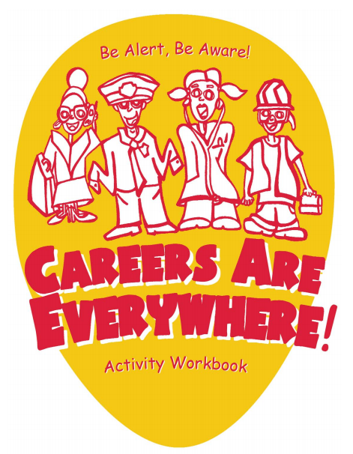

Slide 55
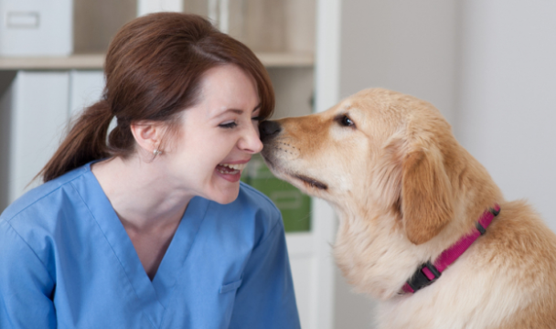
Career Opportunities…
Zoo Veterinarian - tend to animals at the zoo.
Zoologist - work with animals in the wild and controlled environments such as zoos. They provide data that shapes wildlife conservation and preservation policy, work with animals extensively and spend time crunching numbers.
Animal Nutritionist - determine the dietary needs of animals in captivity, study animal behavior and economics to make recommendations to corporations or governmental agencies about diet. They spend more time in the lab than the barn.

Slide 56
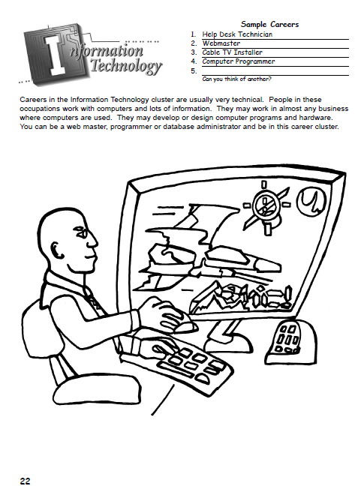

Slide 57
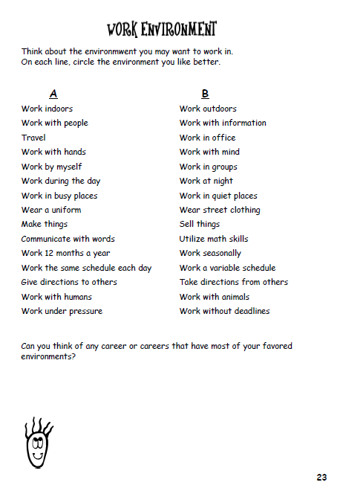

Slide 58
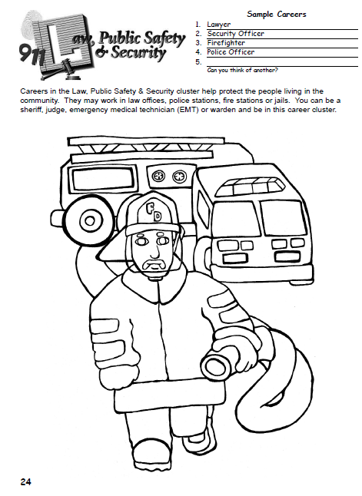

Slide 59
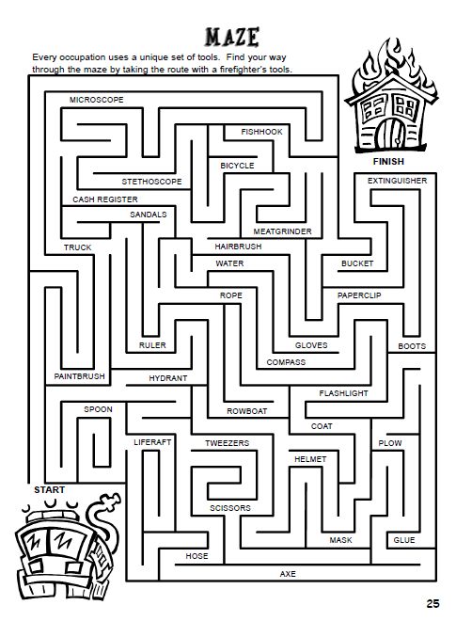

Slide 60
Restroom Break
3:10 – 3:15

Slide 61




3:10 – 3:15 Wrap Up!
Pair-Up back to back and share one thing you learned in class today with your partner
Pack-Up
Office will announce:
Car Riders – Leave around 3:20
Bus Riders – (listen to intercom for dismissal)
2:30 – 3:20
How much time has elapsed?

