Slide 1
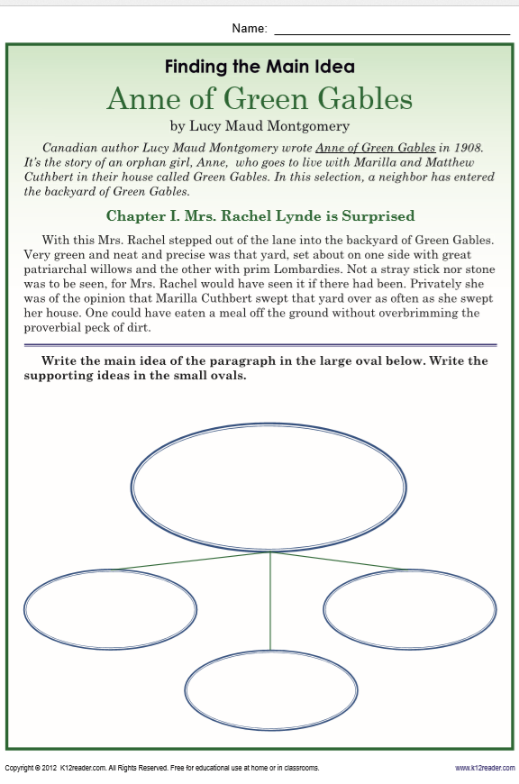
Wednesday, Februrary 19, 2020
GREEN BUTTONS FIRST
Erin, Jearon, Jaylie, Cohen, Macon - Math
Superkids | Classworks – Math | Mrs. Thompson - LLI
3 – Amiyah | 1 - Jearon 2 – Kaylee 5 - Caydance 6 - Brena 7 – Erin 9 – Jaylie 4 - Cohen | Landon Macon Paisleigh Jaiden
7:55 – 8:30

Slide 2
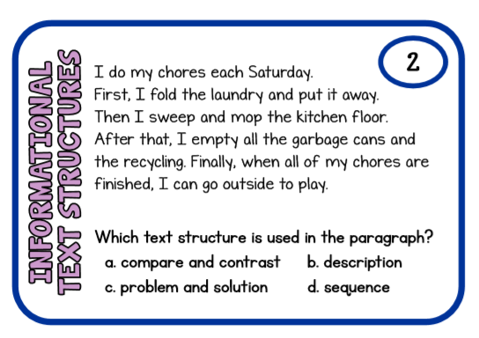

Slide 3
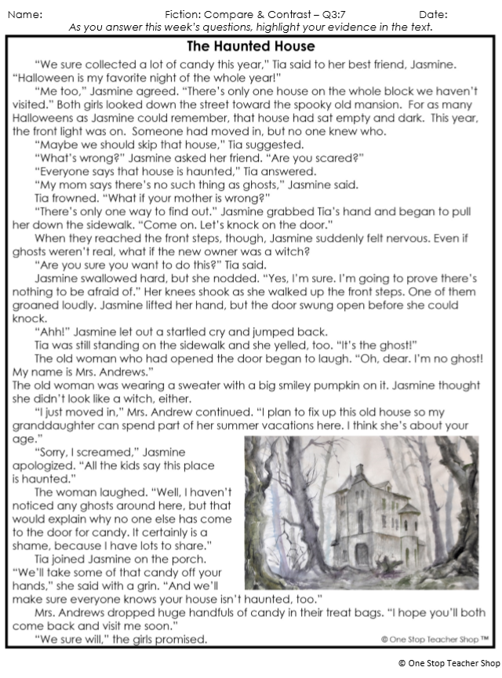
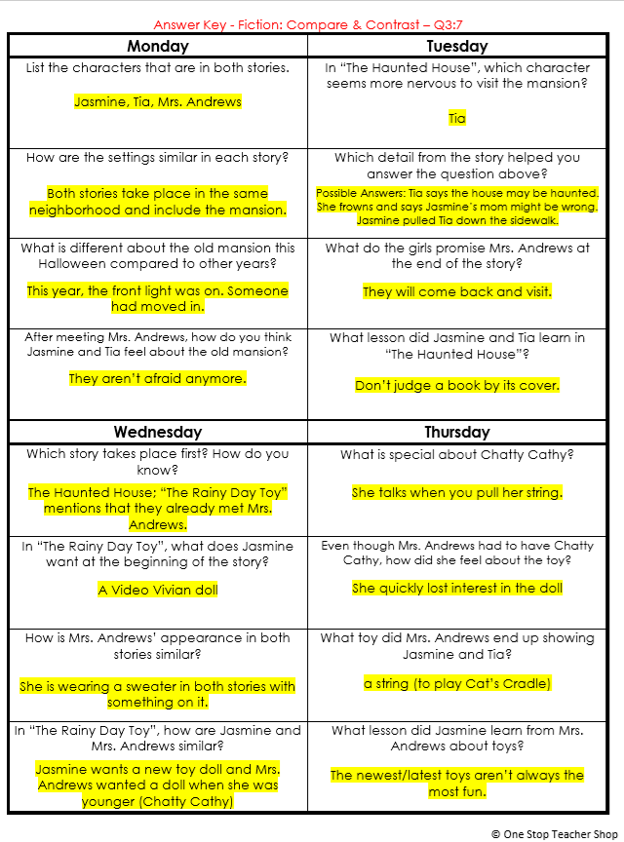
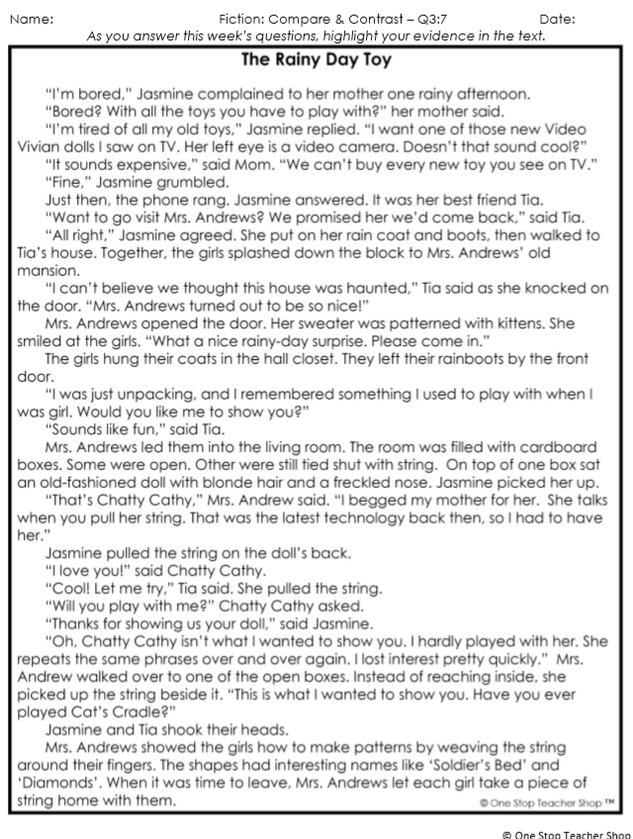
Reading Homework

Slide 4
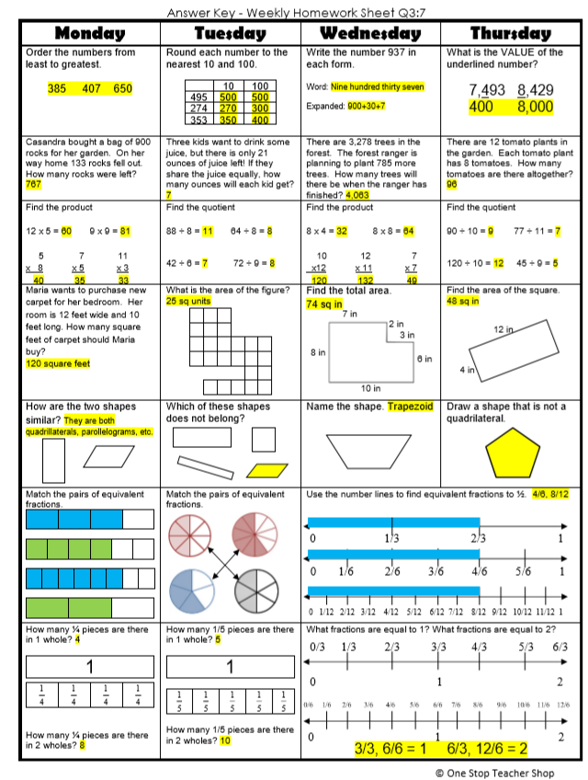
Math Homework

Slide 5

CHOMP TIME
F.A.S.T. Groups
Focused Academic Support Time

Slide 6
F.A.S.T. Designations
Superkids: 9 - Paisleigh | Classworks: 1 – Aiden – Reading 2 - Emma – Math 3 - Lexi - Math 4 - Kaylah- Math 5 - Addisen - Reading 6 – Jaiden – Math 7 – Brena – math 8 – Carleen – math | Mrs. T: SIPPS Amiyah Jaylie Caydance Kaylee Cohen Paisleigh Lazerrick
Landon – Phonics 1st with Mrs. Page
Macon – SIPPS with Mrs. Bess
8:40 – 9:10

Slide 7

Reading Time
9:10 – 9:30

Slide 8
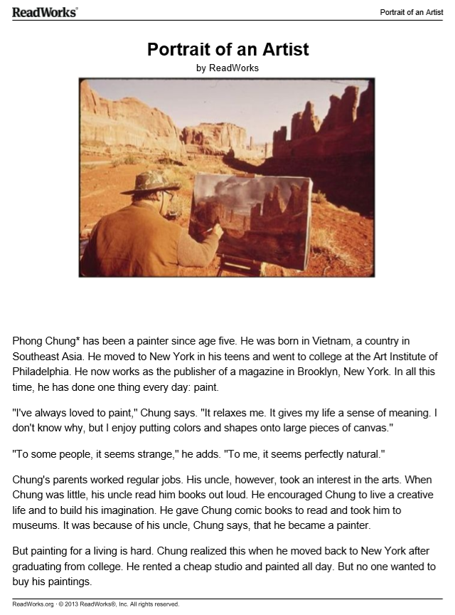
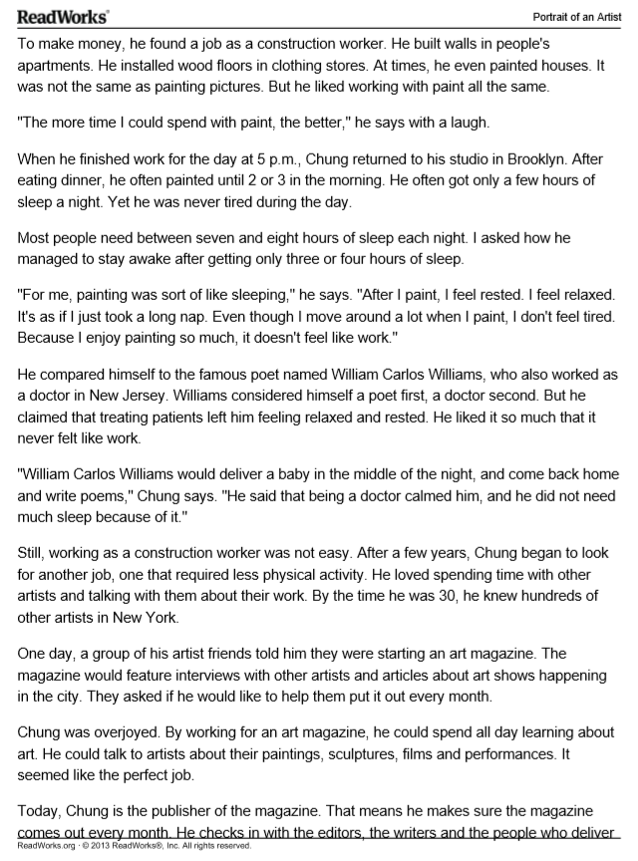

Slide 9
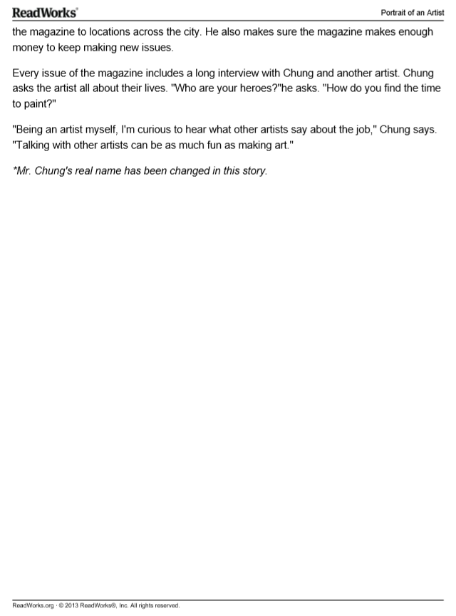

Slide 10
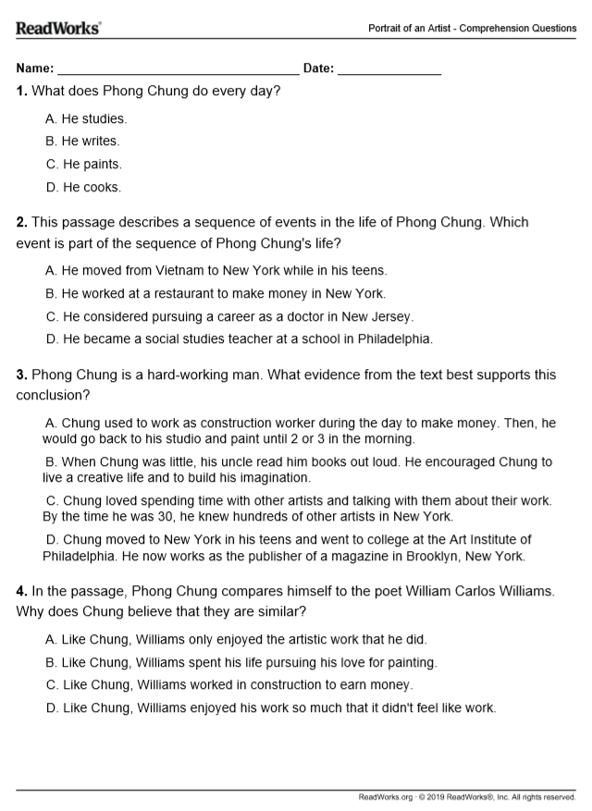
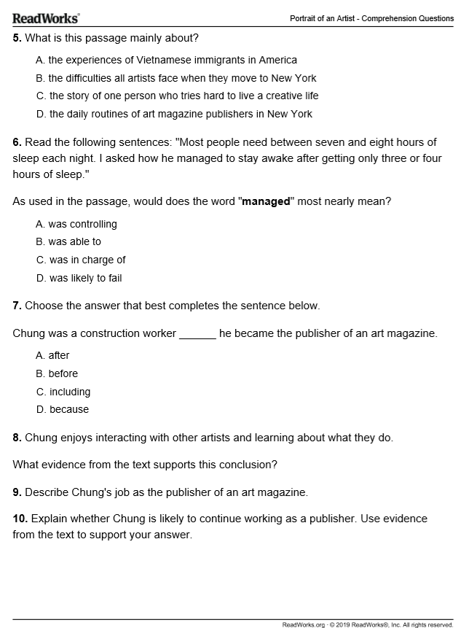

Slide 11


American Heart Association Rally

Slide 12
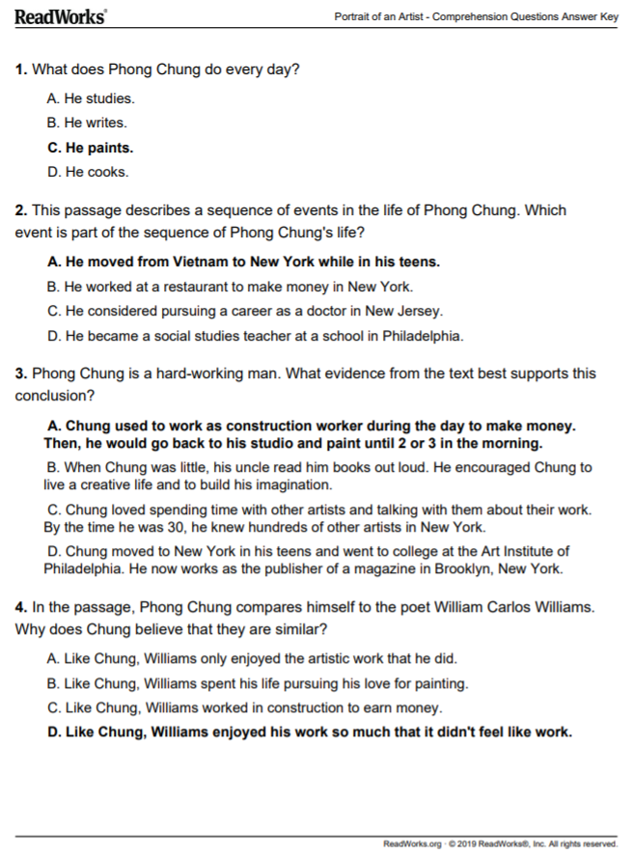
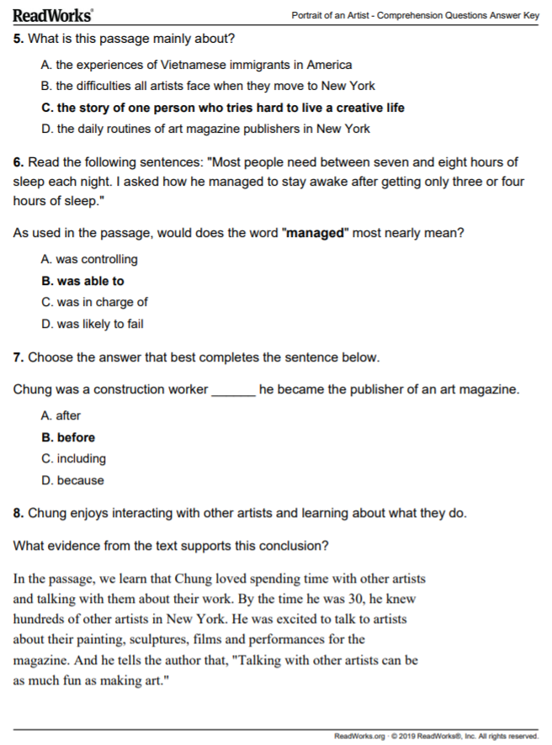
Answer Key

Slide 13
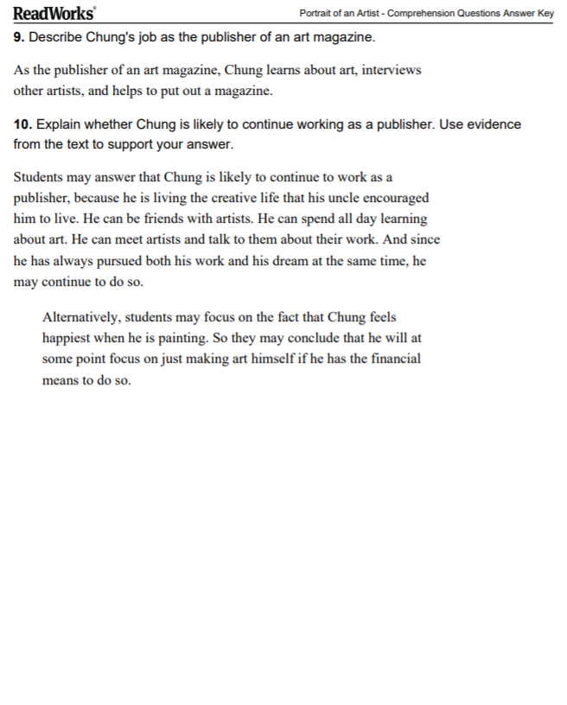

Slide 14



Morning Work Review & Snack Time
10:25 – 10:40

Slide 15
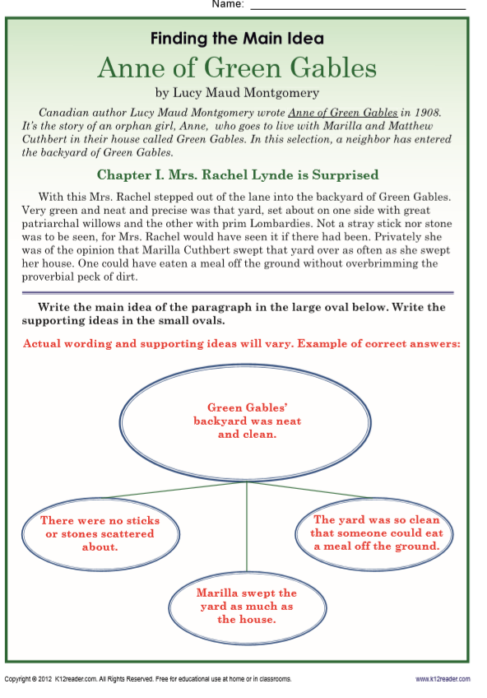

Slide 16
Out of Classroom!
Recess 10:40 – 11:05

Slide 17
Math Fluency & Focus Lesson!
11:05 – 12:35
Math 3.NF.1 I can understand that a fraction 1/b as the quantity formed by one part when a whole is partitioned into b equal parts. I can understand that a fraction a/b as the quantity formed by a parts of size 1/b.
Math 3.NF.2 I can represent a fraction 1/b on a number line diagram by defining the interval from 0 to 1 as the whole and partitioning it into b equal parts.
.

Slide 18
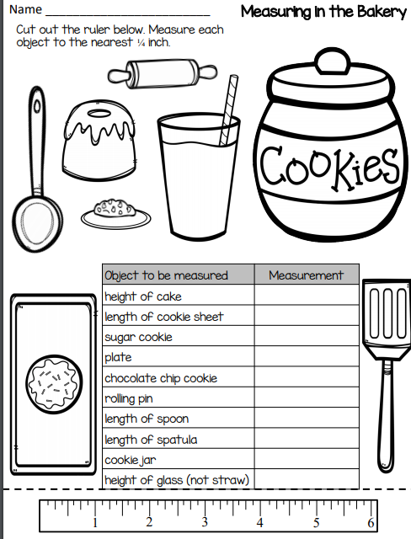
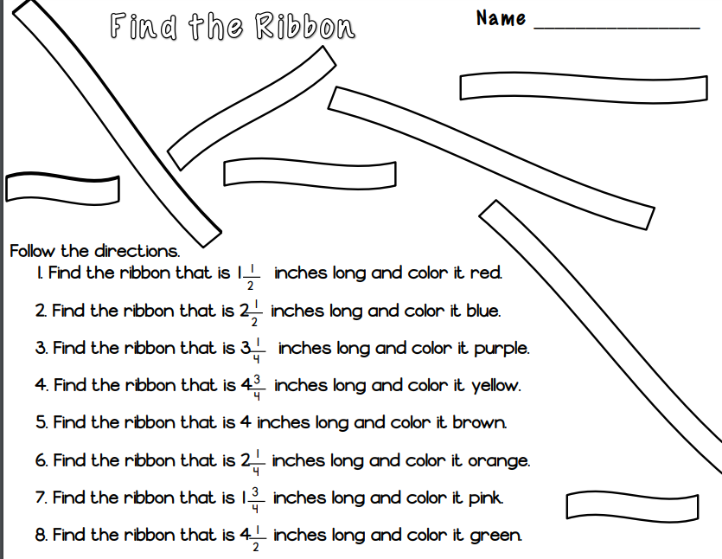
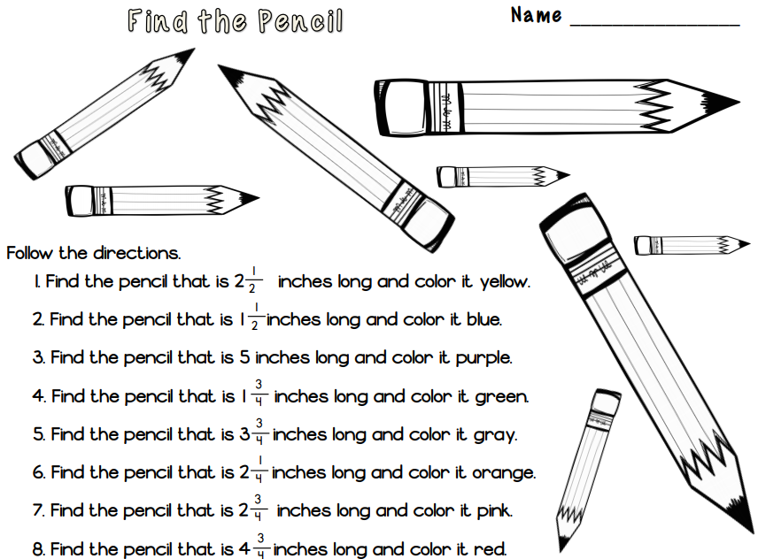
Finish during Independent Rotation

Slide 19
Station Time!
11:05 – 12:25
Math 3.NF.1 I can understand that a fraction 1/b as the quantity formed by one part when a whole is partitioned into b equal parts. I can understand that a fraction a/b as the quantity formed by a parts of size 1/b.
Math 3.NF.2 I can represent a fraction 1/b on a number line diagram by defining the interval from 0 to 1 as the whole and partitioning it into b equal parts.
.

Slide 20
Rotation 1
11:15 – 11:30
Group 1 – Computers 1-5: Classworks Reading
Group 2 – Mrs. Roby –
Group 3 – Computers 6-TC: Classworks Math
Group 4 – Mrs. Thompson –
Group 5 – Rotating Subjects
  (Monday: Math, Tuesday: Science,
  Wednesday: Reading, Thursday: Writing,
  Friday: Social Studies)

Slide 21
Rotation 2
11:30 – 11:45
Group 5 – Computers 1-5: Classworks Reading
Group 1 – Mrs. Roby –
Group 2 – Computers 6-TC: Classworks Math
Group 3 – Mrs. Thompson –
Group 4 – Rotating Subjects
  (Monday: Math, Tuesday: Science,
  Wednesday: Reading, Thursday: Writing,
  Friday: Social Studies)

Slide 22
Rotation 3
11:45 – 12:00
Group 4 – Computers 1-5: Classworks Reading
Group 5 – Mrs. Roby –
Group 1 – Computers 6-TC: Classworks Math
Group 2 – Mrs. Thompson –
Group 3 – Rotating Subjects
  (Monday: Math, Tuesday: Science,
  Wednesday: Reading, Thursday: Writing,
  Friday: Social Studies)

Slide 23
Rotation 4
12:00 – 12:15
Group 3 – Computers 1-5: Classworks Reading
Group 4 – Mrs. Roby –
Group 5 – Computers 6-TC: Classworks Math
Group 1 – Mrs. Thompson –
Group 2 – Rotating Subjects
  (Monday: Math, Tuesday: Science,
  Wednesday: Reading, Thursday: Writing,
  Friday: Social Studies)

Slide 24
Rotation 5
12:15 – 12:30
Group 2 – Computers 1-5: Classworks Reading
Group 3 – Mrs. Roby –
Group 4 – Computers 6-TC: Classworks Math
Group 5 – Mrs. Thompson –
Group 1 – Rotating Subjects
  (Monday: Math, Tuesday: Science,
  Wednesday: Reading, Thursday: Writing,
  Friday: Social Studies)

Slide 25

Out of Classroom!
Lunch 12:35 – 1:05

Slide 26

Restroom Break
1:05 – 1:10

Slide 27

Out of Classroom!
Activity 1:10 – 1:55

Slide 28
Math Time!
1:55 – 2:30

Slide 29
Review

Slide 30
Reading Time

Slide 31
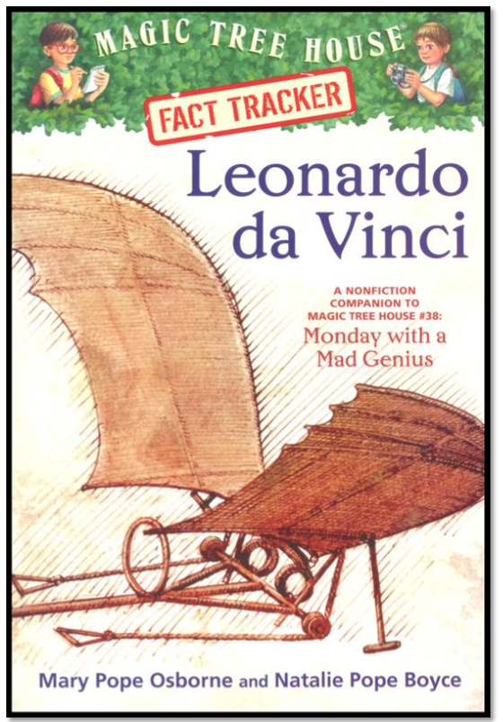
Book Study
Read Aloud Chapter 5
Paired Partners Workbook
2:30 – 3:00

Slide 32
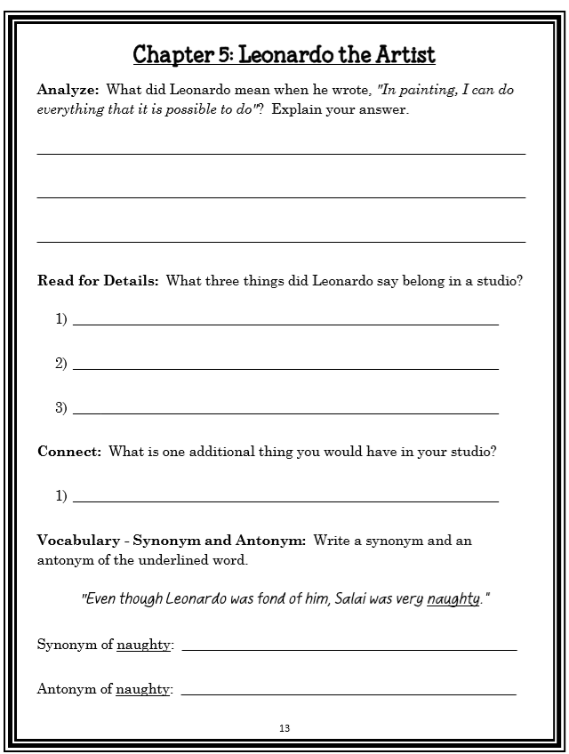
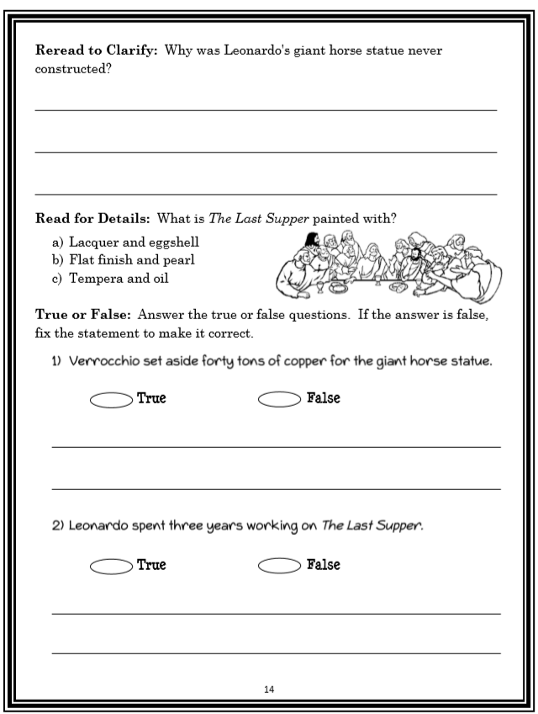

Slide 33


Slide 34
Restroom Break
3:10 – 3:15

Slide 35




3:20 – 3:25 Wrap Up!
Pair-Up back to back and share one thing you learned in class today with your partner
Pack-Up
Office will announce:
Car Riders – Leave around 3:25
Bus Riders – (listen to intercom for dismissal)
2:30 – 3:20
How much time has elapsed?

