Slide 1
Milestones Night 2020-2021
Mr. Blue
Mrs. Hill
Mrs. Hogan
Mrs. Young

Slide 2
5th Grade Curriculum
MATH
SCIENCE
READING/WRITING

Slide 3
Math
Multiplication/division
Decimals (add, subtract, multiply and divide)
Powers of 10
Fractions (add, subtract, multiply and divide)
Order of Operations
Measurement

Slide 4
Reading/Writing
Paired Passages
Text Evidence
Conventions (spelling & punctuation)
Ideas
Constructed Responses
Theme
Narrative/Informational/Opinion

Slide 5
PHYSICAL/CHEMICAL CHANGES
CELLS
CLASSIFICATION
ELECTRICITY
CONSTRUCTIVE & DESTRUCTIVE PROCESSES
LANDFORMS

Slide 6
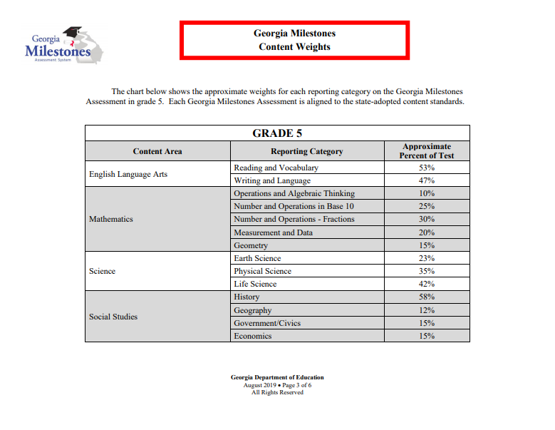

Slide 7
Schedule
Week 1: April 22-23
ELA (2 days)
Week 2: April 26-27
Math (1 day), Science(1 day)
Make-up Testing: May 19-20

Slide 8
Housekeeping
Attendance
Adequate Rest
Following Test Directions

