Slide 1
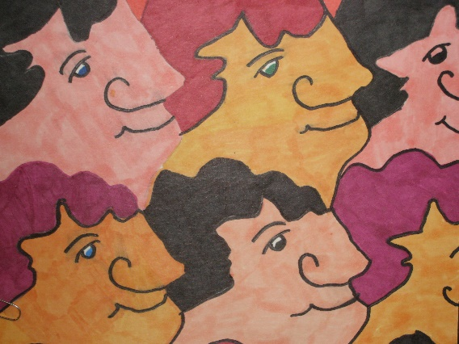
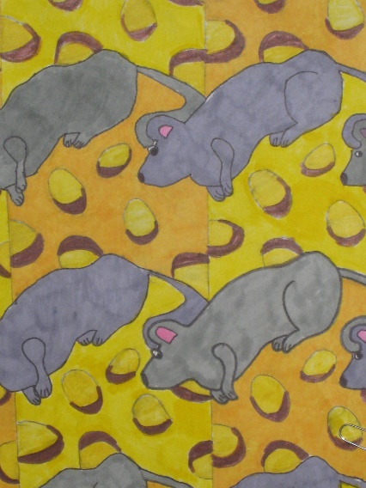
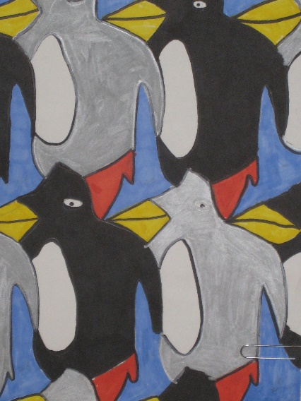
Imagination Tessellation

Slide 2
Vocabulary Words
Symmetrical – a well-defined balance – what is on one side is also on the other side
Plane – any flat, 2-dimensional surface
Congruent- identical figures that are the same shape and size
Tessellation – an arrangement of congruent shapes on a flat surface. This ancient form of decoration dates to the 4th century B.C. These geometric patterns are made of one or more shapes that fit together to make a repeating pattern—a tessellation.

Slide 3
History of Tessellations
Tessellations were used decoratively in Mesopotamia more than 6000 years ago.
The original designs were made from pebbles set in plaster, like a mosaic.
As tessellations became more advanced, clay mosaic tiles were used to decorate walls, floors, and ceilings in castles and mosques.
American Colonies in the 1600s created quilts, in tessellated patterns.
Later, the Dutch artist M.C. Escher popularized these designs in the 1920s. MORE ABOUT HIM LATER

Slide 4
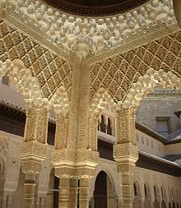
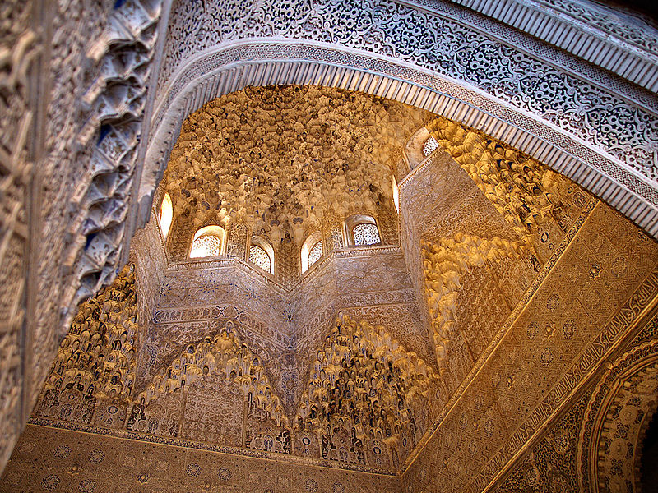
The Alhambra
700-year-old castle
Granada, Spain
Many examples of tessellations in the structure

Slide 5
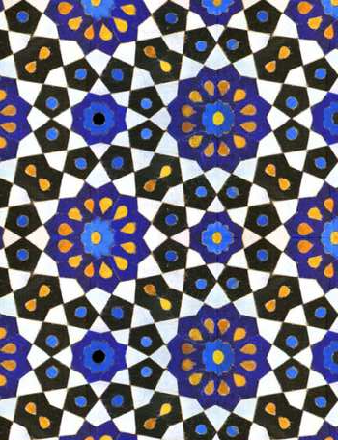
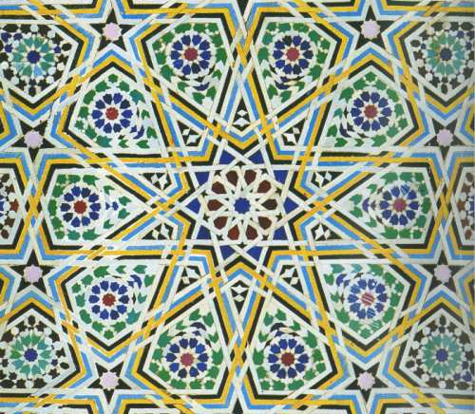
Islamic Tessellations

Slide 6
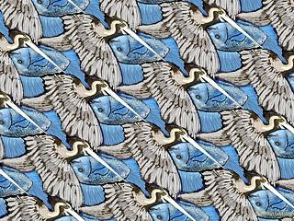
PELICANS FISH-BOAT

Slide 7
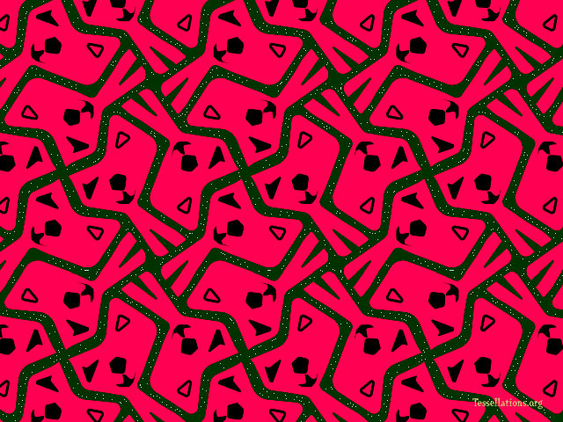
PINK WINKING CATS COWS

Slide 8
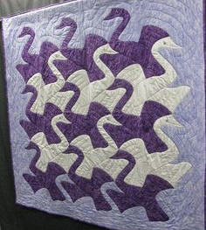
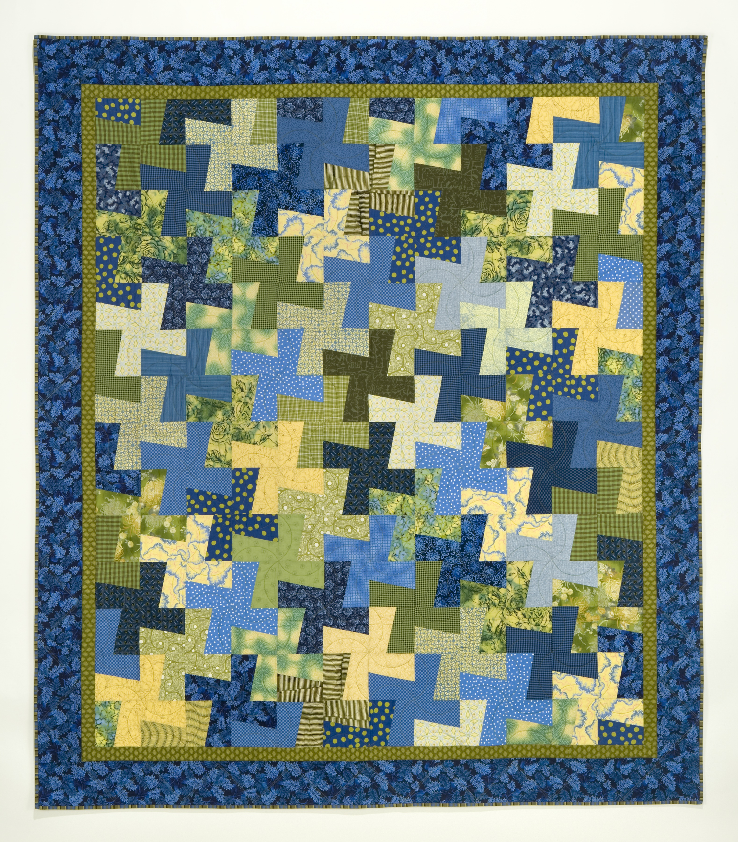
QUILTS

Slide 9
Maurits Cornelis (M C) Escher (1898-1972)
Dutch artist, M.C. Escher, was a man studied and greatly appreciated by respected mathematicians, scientists and crystallographers yet he had no formal training in science or mathematics.
He was a humble man who considered himself neither an artist nor a mathematician. He wanted to be an architect like his father, but it was not to be. He was inspired by tessellations he saw at Alhambra and wanted to create them using human and animal shapes.
He is most famous for his so-called impossible structures, such as Ascending and Descending, Relativity, his Transformation Prints, such as Metamorphosis I, Metamorphosis II and Metamorphosis III, Sky & Water I or Reptiles. During his lifetime, M.C. Escher made 448 lithographs, woodcuts and wood engravings and over 2000 drawings and sketches. https://www.mcescher.com/gallery/most-popular/
It is Escher’s work with tessellations that we will try to imitate today. Escher showed that not only triangles, squares and hexagons could be used for tessellations, but also irregular polygons could tessellate a plane.

Slide 10
Let’s make a Tessellation!
We will create a tessellation starting with a 3”x 3” square, which is a regular geometric shape that can easily be tessellated.
We will turn the square into a non-geometric shape and trace it over and over again on a piece of paper until all of the space is covered, with no gaps showing
We will then decide what animal or person to make from the shape we have created
REMEMBER … a design pattern is a tessellation if:
It is made of one or more congruent shapes that can be extended in every direction to cover a surface AND
The pattern pieces fit together without any gaps or overlapping.
Notes:
Lesson In this lesson, we will create a tessellation using a square, which is a regular geometric shape. We will turn the square into a non-geometric shape and trace it over and over again on a piece of paper until all of the space is covered, with no gaps showing. Using our imaginations, we will then decide what animal or person we want to make out of the shapes we have created and decorate them with our markers.
Go through the entire process on the board, with the students gathered around you at a table, or using the PowerPoint presentation. You can actually go through the process yourself so the students can see each step or talk them through each step so they have a visual image of what they will be doing. Show the students some examples of Escher’s work as well as the examples included on the first page of this presentation. Once you have done this project, you can also use actual pieces that your previous students have created.

Slide 11
Let's Make a Tessellation! Paper Cut Method #I
1. First, take your 3 X 3 inch square and write P, A , R, T in the corners like this.
2. Next, draw a smooth, random line on the paper from left to right. (Do not draw a zigzag line or a line with sharp angles.)
Notes:
Teacher Notes
Make sure that each student completes each step correctly before moving on. Some students may need a little help along the way.
Also, you may have to take a minute to remind students about clockwise and counter-clockwise, which is being taught less and less in these digital times.
P
R
A
T

Slide 12
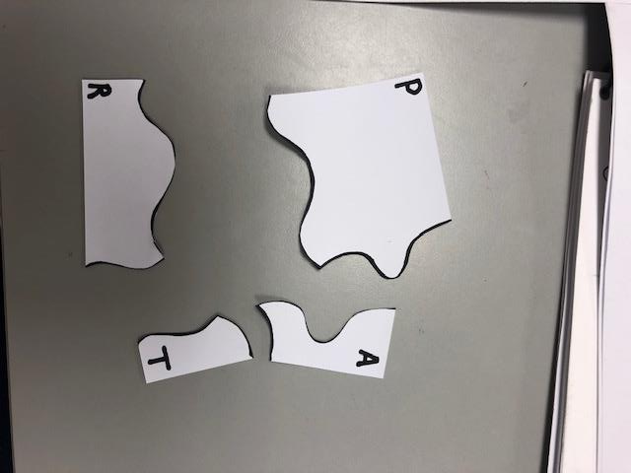
3. Next, draw a smooth, random line on the paper from top to bottom. (Do not draw a zigzag line or a line with sharp angles.)
4. Cut across all of the lines until all of the pieces are apart. (Go slowly.)

Slide 13
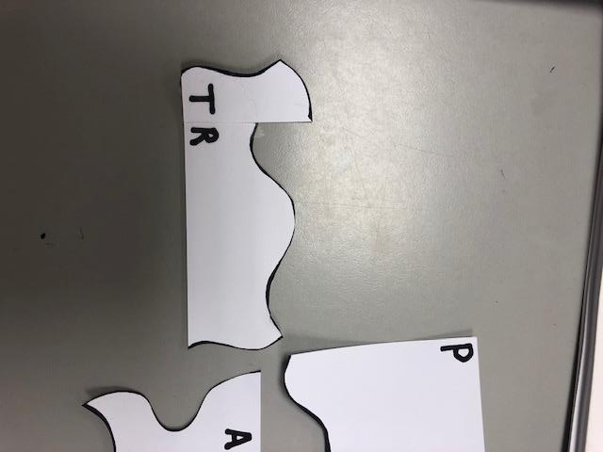
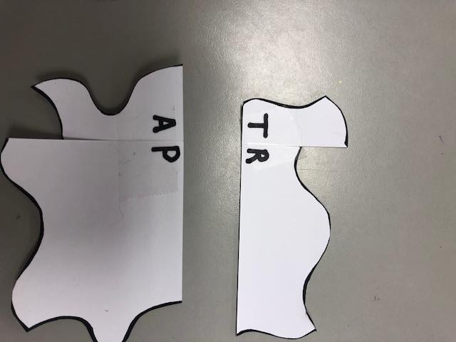
5. Carefully match the corners of the T and R pieces together. When they are lined up tape them together. Make sure not to overlap the pieces.
6. Carefully match the corners of the A and P pieces together. When they are lined up tape them together. Make sure not to overlap the pieces.

Slide 14
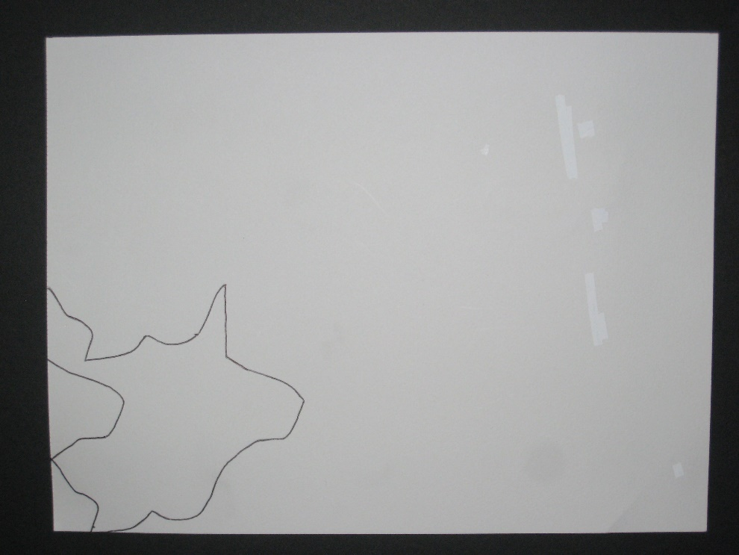
7. Line all four corners up and tape them together to spell TRAP. You have taken the parts and trapped them together to form an irregular polygon.
8. Place the completed pattern in the lower left-hand corner of the 8½ x 11 white construction paper and trace the shape, making sure to hold it down tightly so the next tracing will fit properly in its place.

Slide 15
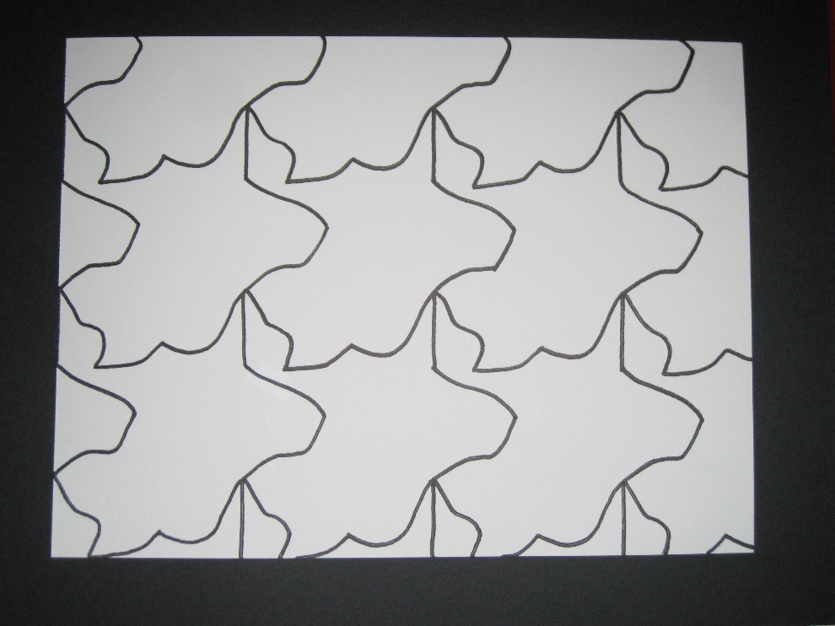
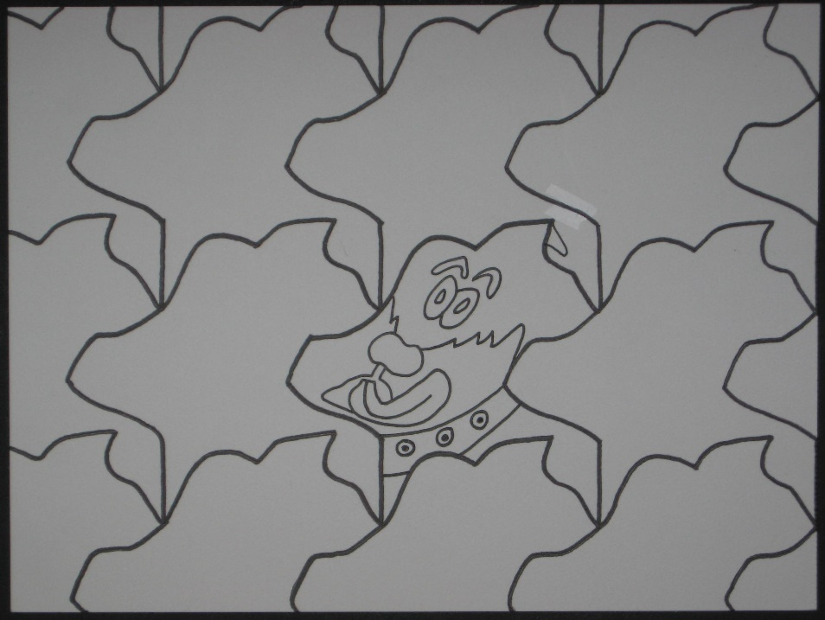
7. Continue tracing the pattern across and up the paper, interlocking each tracing like a puzzle until it is traced over the entire paper. Do not retrace lines that are already there, and there should be no overlapping or gaps!
8. After the entire paper is filled up, look at the shapes and decide what they look like to you. Use your imagination! Do you see an animal or a person? Rotate the paper if you want. After you decide, draw your picture into one of the shapes.

Slide 16
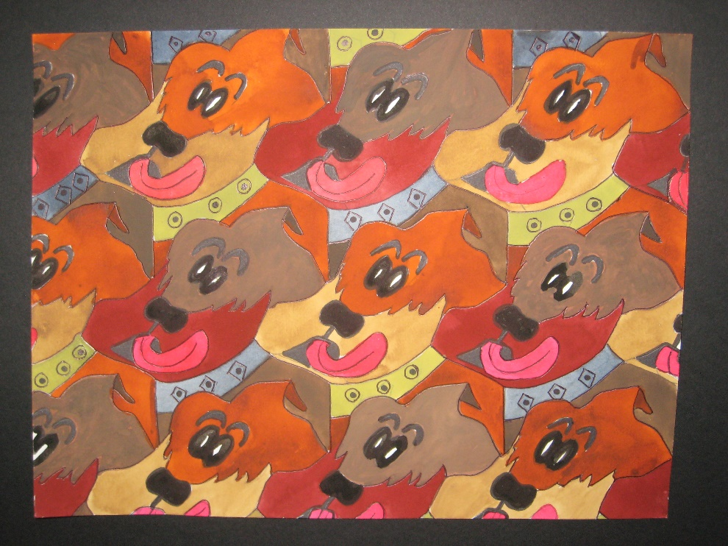
10. Using crayons or markers, color in each shape on the paper. Even though each shape is the same, be creative in how you color each one. You can use two alternating colors.
You are the artist!

Slide 17
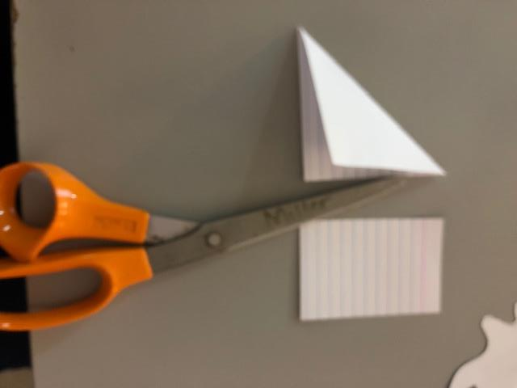
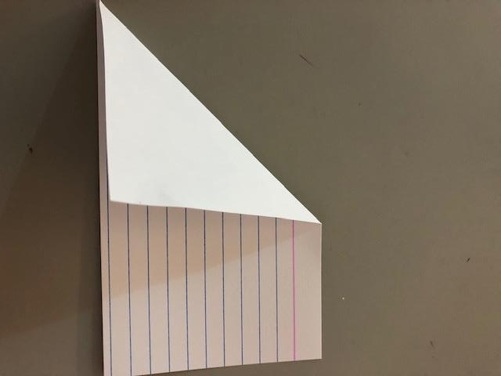
Let's Make a Tessellation! Paper Cut Method #2
1. First, to create a square, fold the index card over and cut off the excess.
1a.
Notes:
Teacher Notes
Make sure that each student completes each step correctly before moving on. Some students may need a little help along the way.
Also, you may have to take a minute to remind students about clockwise and counter-clockwise, which is being taught less and less in these digital times.
P
R
A
T

Slide 18
2. Open the index card.
3. Next, draw a smooth, random line from the top right corner to the bottom corner. Make sure to start in the corner. (Do not draw a zigzag line or a line with sharp angles.)

Slide 19
4. Slide the cut off piece across to the left side, match the corners, and tape it down.
5. Draw a smooth, random line from the bottom right corner to the bottom left corner. Make sure to start in the corner. (Do not draw a zigzag line or a line with sharp angles.)

Slide 20
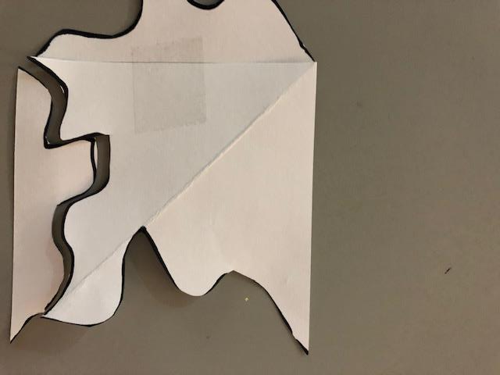
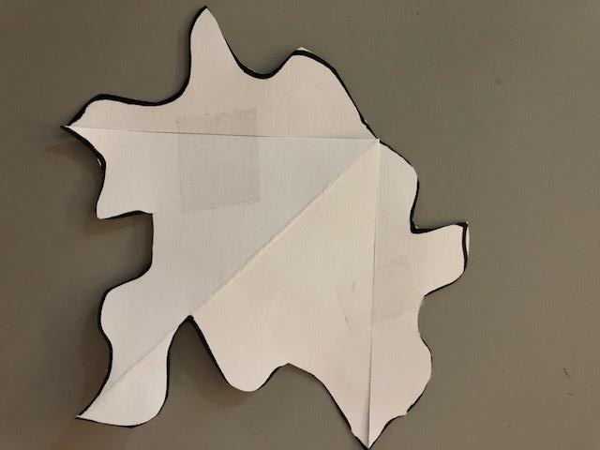
6. Slide the cut off piece up to the top, match the corners, and tape it down.
6a.

Slide 21
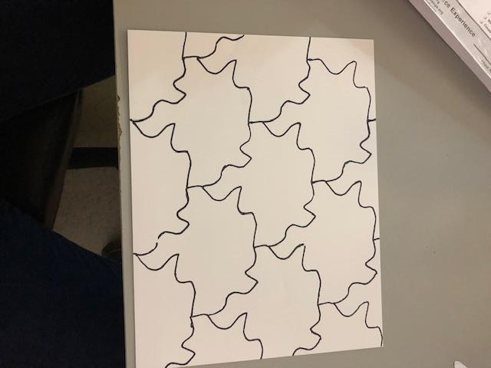
7. Place the completed pattern in the center of the white paper and trace the shape, making sure to hold it down tightly so the next tracing will fit properly in its place.
8. Continue tracing the pattern across and up the paper, interlocking each tracing like a puzzle until it is traced over the entire paper. Do not retrace lines that are already there, and there should be no overlapping or gaps!

Slide 22
10. Using crayons or markers, color in each shape on the paper. Even though each shape is the same, be creative in how you color each one. You can use two alternating colors.
You are the artist!

