Slide 1
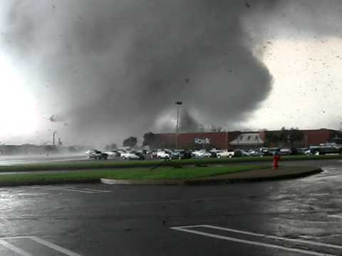
Tornado Safety
What will you do if a tornado is coming in your direction?

Slide 3
Terminology
tornado A tornado is a column-like vortex of rapidly-rotating air in contact with the ground. Winds in the most extreme tornadoes can be over 300 mph (500 km/h). Most tornadoes are short-lived.

Slide 4
This is a tornado

Slide 5
Terminology
funnel cloud A funnel cloud is a rotating column of wind that does not touch the ground. A funnel could turn into a tornado (a tornado touches the ground).
anemometer An anemometer is a weather instrument that measures wind speed. Anemometers are destroyed in severe tornadoes.

Slide 6
This is a Funnel Cloud

Slide 7
Terminology
barometer A barometer is a device that measures air (barometric) pressure. It measures the weight per square inch of the column of air that extends from the instrument to the top of the atmosphere.
updraft An updraft is a current of air that is flowing upwards.

Slide 9
Terminology
tornado watch A tornado watch means that a tornado may form in the area, because conditions are favorable for their formation.
tornado warning A tornado warning means that a tornado is expected in the warning area soon. A tornado warning means that lives are in danger in that area, and that people should take cover!

Slide 10
Terminology
air pressure Air pressure is the weight of the column of air that extends from the ground (or water's surface) to the top of the atmosphere. Air pressure is also called barometric pressure; it is measured by a barometer. The air pressure is very low in a tornado.

Slide 11
Terminology
supercell A supercell is a dangerous type of thunderstorm that has a rotating updraft (called a mesocyclone). This type of storm can last for hours and may produce large hail, strong winds, lightning, flash floods, and tornadoes.

Slide 12
Supercell on Radar

Slide 13
Terminology
gustnado A gustnado is a weak eddy or whirlwind. Although it can do minor damage, a gustnado is not a tornado.

Slide 14
EF-Scale
The EF-scale (enhanced F-scale) classifies tornado wind speeds into five categories The Enhanced F Scale, the EF scale (replacing the older F scale) is now used to rate tornadoes. The original scale was named for Dr. Theodore Fujita, who developed the original F-scale in 1971. Wind speeds are at least 3-second gusts.

Slide 15
EF-Scale
EF-0 -- Winds 65-85
EF-1 -- Winds 86-110 mph
EF-2 -- Winds 111-135 mph
EF-3 -- Winds 136-165 mph
EF-4 -- Winds 166-200 mph
EF-5 -- Winds over 200 mph.

Slide 16
EF-0

Slide 17
EF-1

Slide 18
EF-2

Slide 19
EF-3

Slide 20
EF-4

Slide 21
EF-5

Slide 22
April 27, 2011

Slide 23
Loved ones lost
Outbreak death tollState/ProvinceFatalities
Alabama238Arkansas5Georgia14Mississippi31Tennessee32Virginia4
Totals324Only tornado-related deaths are included (24 deaths were not caused by tornadoes)

Slide 24
Number of tornadoes spawned
Total Confirmed - 358
EF0 Confirmed - 128* EF1 Confirmed - 143 EF2 Confirmed - 44 EF3 Confirmed - 20 EF4 Confirmed - 11 EF5 Confirmed - 4

Slide 25
Philadelphia, MS

Slide 26
Phil Campbell, AL

Slide 28
How to prepare
During any storm, listen to local news or a NOAA Weather Radio to stay informed about tornado watches and warnings.
Know your community's warning system. Communities have different ways of warning residents about tornados, with many having sirens intended for outdoor warning purposes.
Pick a safe room in your home where household members and pets may gather during a tornado. This should be a basement, storm cellar or an interior room on the lowest floor with no windows.

Slide 29
How to prepare cont.
Practice periodic tornado drills so that everyone knows what to do if a tornado is approaching.
Consider having your safe room reinforced. Plans for reinforcing an interior room to provide better protection can be found on the FEMA web site.
Prepare for high winds by removing diseased and damaged limbs from trees.
Move or secure lawn furniture, trash cans, hanging plants or anything else that can be picked up by the wind and become a projectile.

Slide 30
How to prepare cont.
Watch for tornado danger signs:
̶ Dark, often greenish clouds – a phenomenon caused by hail
̶ Wall cloud – an isolated lowering of the base of a thunderstorm
̶ Cloud of debris
̶ Large hail
̶ Funnel cloud – a visible rotating extension of the cloud base
̶ Roaring noise

Slide 31
Sources
www.google.com/image
http://www.enchantedlearning.com/subjects/weather/tornado/glossary.shtml
http://www.redcross.org/prepare/disaster/tornado
http://en.wikipedia.org/wiki/April_25%E2%80%9328,_2011_tornado_outbreak

