Slide 1
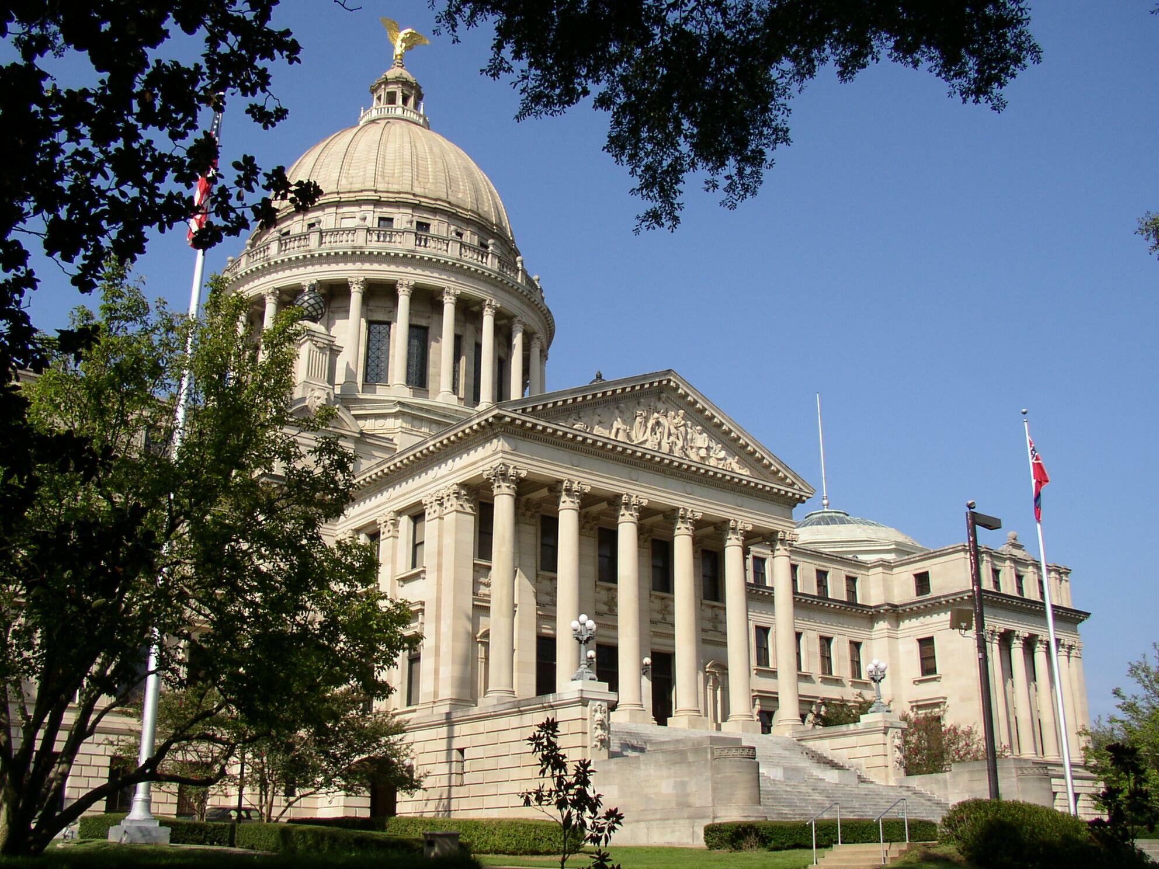
A Place Called Mississippi
Chapter 6: Civil War and Reconstruction, 1860- 1876
STUDY PRESENTATION
© 2013 Clairmont Press

Slide 2
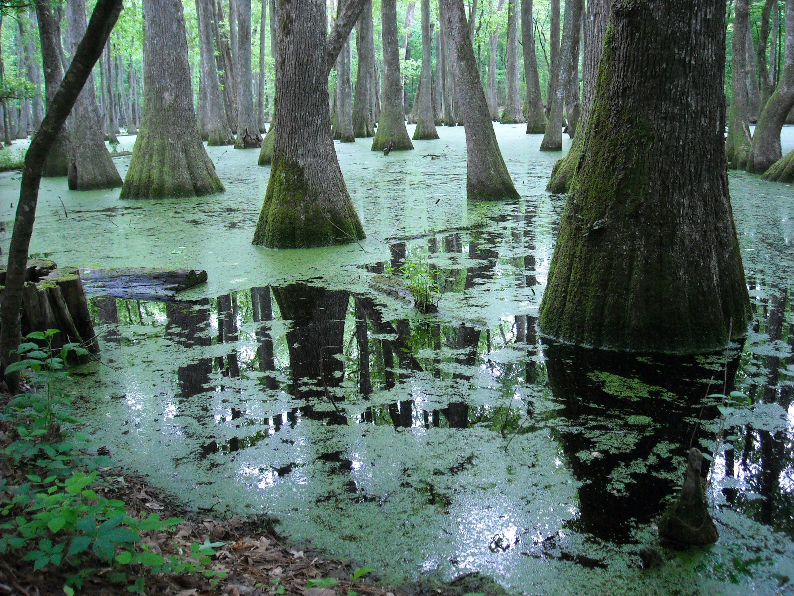
Section 1: General Grant at Oxford
Section 2: The Vicksburg Campaign
Section 3: Reconstruction and Reunion, 1865- 1876

Slide 3
Section 1: General Grant at Oxford
Essential Question: How did strategies change as battles were fought during the Civil War?

Slide 4
Section 1: General Grant at Oxford
What terms do I need to know?
  bivouac
  casualties
  battery
  forage

Slide 5
Section 1: General Grant at Oxford
The objective of the Vicksburg campaign was to capture the city and gain control of the Mississippi River.
During this time, soldiers under Ulysses S. Grant were marching toward Vicksburg. They eventually established a post at Holly Springs.
Grant couldn’t move toward Vicksburg anymore, so he decided to move down the river and take Vicksburg by naval assault.
Vicksburg National Military Park

Slide 6
General Grant at Oxford:
Battle of Shiloh, April 6-7, 1862
Confederate soldiers were ordered to protect the railroad intersection known as the “Crossroads of the South.”
In April of 1862, Grant met the Confederate army at Shiloh.
The Battle of Shiloh was one of the bloodiest battles of the Civil War.
On April 7th, the battle changed and General Grant’s army, who had been reinforced overnight, won the battle.
On each side, there were over 11,000 casualties.

Slide 7
The Importance of Vicksburg
Grant resumed the march toward Vicksburg. He was determined to reopen trade on the Mississippi River.
Vicksburg’s location on a high bluff allowed complete control over who was able to travel along the river.
The Confederates used their shore batteries to control the river.
Vicksburg’s capture was very important to the Union military.

Slide 8
Farragut Fails to Capture Vicksburg
David Farragut captured New Orleans in 1862.
He sailed his fleet up the Mississippi River.
He began an attack on Vicksburg that lasted almost 2 months.
Eventually he passed Vicksburg where he was joined by federal gunboats. The two combined their forces and attacked the city.
Farragut eventually realized that he wouldn’t be able to take control of the city.
He tried to dig a canal around the city, but even that attempt failed.
Soon, Farragut was forced to forget his attacks and move back down the river.

Slide 9
Pemberton Placed in Command of Vicksburg
October 14th, 1862: Confederate General John C. Pemberton was ordered to hold Vicksburg at all costs.
He was given a hopeless assignment and to make things worse, he would soon meet the Union army.

Slide 10
General Grant Occupies Oxford
In 1862, Grant established an army supply depot at Holly Springs.
Soon Grant would make his long march to Vicksburg.
That December, Grant’s army moved south and occupied Oxford.

Slide 11
General Grant Occupies Oxford: Mrs. Grant Almost Captured at Holly Springs
In December of 1862, Mrs. Grant and her son went to Holly Springs to spend Christmas with General Grant.
On December 20th, a Confederate cavalry unit came to kidnap Mrs. Grant.
There was just enough warning to get her and her son out of Holly Springs before Confederate troops came in.

Slide 12
General Grant Occupies Oxford:
What Grant Learned at Oxford
When he lost his supply base at Holly Springs, Grant sent his men out in a 15 mile radius to find food.
He was amazed at the amount they brought back.
He learned he could live off the land. This discovery shaped the future military campaigns of the Union.

Slide 13
Section 2: The Vicksburg Campaign
Essential Question: How did the Vicksburg Campaign affect the Civil War?

Slide 14
Section 2: The Vicksburg Campaign
What terms do I need to know?
  Grierson’s Raid
  siege
  Emancipation Proclamation

Slide 15
Section 2: The Vicksburg Campaign
January 29th, 1863 - Grant established his headquarters north of Vicksburg.
Grant ordered General Sherman to dig a canal between the two main channels of the river.
Sherman’s attempt, like Farragut’s, failed.
Grant was forced to abandon the idea.

Slide 16
Yazoo Pass Expedition
Grant ordered his men to blow up the levee at Yazoo Pass.
Grant reasoned that an explosion of so much water would fill an old channel that connected the Mississippi to Moon Lake, meaning he could transport his troops to get to the high ground above Vicksburg.
Although the dynamite broke the levee on February 3, 1863, the Confederacy’s General Pemberton was able to block the invading Union troops.

Slide 17
Grant’s Bold and Daring Maneuver
General Grant decided to march his troops down the Louisiana side of the Mississippi and to cross it south of Vicksburg.
The land south of the city was less swampy.
Grant believed he could use his troops to make attack on land.
He would then need to have Admiral David Porter to run his ships past the Vicksburg batteries and meet Grant south of the city.
When Grant told Sherman about his plan, he opposed it because it was so risky.
The plan was also dangerous because it could cut the army off from its supply lines.
Even with all the risks, Grant believed the prize of Vicksburg was even greater.
He knew that if he could capture Vicksburg, trade and travel along the Mississippi would be open for Union troops.

Slide 18
Grierson’s Raid, April 17 - May 2, 1863
Grant’s maneuver was initiated on March 29, 1863.
Grant created diversions to try to keep the attention off of his huge army as it migrated south.
The most important of these distractions was a cavalry raid led by Colonel Grierson.
The purpose was to cause part of the Confederate army to follow Grierson.
They were also supposed to destroy railroad lines that connected to Vicksburg.

Slide 19
Porter Runs the Guns of Vicksburg
On April 16th, 1863, Rear Admiral Porter and the 8 gunboats under his command passed the shore batteries at Vicksburg and met Grant.
By the end of April, Grant had moved his entire army of 24,000 men to the appointed meeting place.
In early May, General Sherman’s army joined Grant and the attack on Vicksburg began.

Slide 20
Grant Closes in on Vicksburg
Confederate President Jefferson Davis ordered 10,000 troops to reinforce Pemberton’s army.
When Grant learned about this, he captured the city of Jackson to prevent the two forces from linking up.
He burned several buildings and destroyed the railroads around Jackson. Then he began marching toward Vicksburg.

Slide 21
Battle of Champion Hill, May 16, 1863
The Confederate general was ordered to put his troops between Vicksburg and Jackson so they could try to stop them.
As the troops were moving, they encountered the Union army.
Eventually, the battle of Champion Hill was won by the Union, who chased the Confederate soldiers.
General Pemberton made the mistake of withdrawing all of the citizens and military men into the walls of Vicksburg.

Slide 22
What Sherman Learned at Vicksburg
While Grant and Sherman observed the Union soldiers surrounding Vicksburg, Sherman realized that this was the first positive assurance he’d had that the Union would win the war.
Sherman learned that the men could live off the land, and he did so.

Slide 23
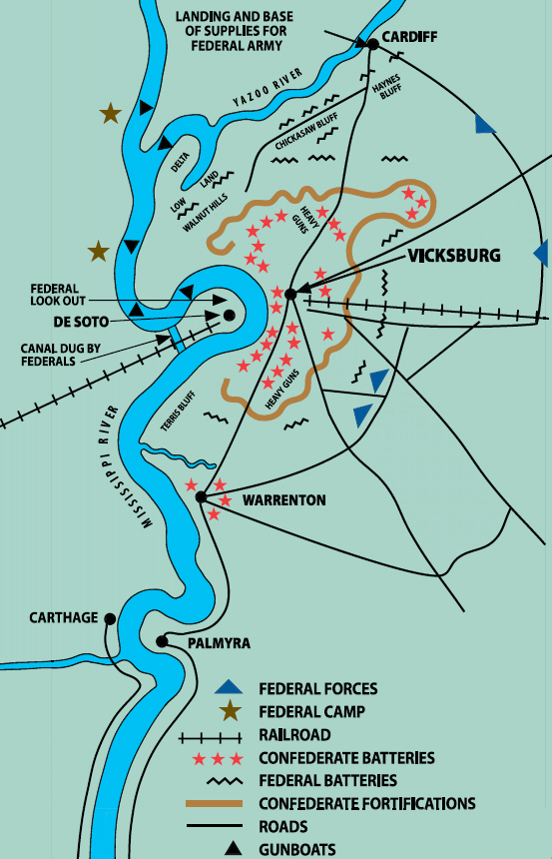
The Siege of Vicksburg,
May 19- July 4, 1863
Grant put his forces all around Vicksburg and prevented any goods or supplies from entering the city.
Grant and his army waited 47 days for the city to use up all their supplies.
On July 4th, 1863, Grant and Pemberton agreed on the terms of surrender.

Slide 24
Sherman’s March Through Mississippi, February 3 - March 4, 1864
Union officers realized that the Confederate army was still a threat.
Sherman was ordered to destroy the railroads to cut off the supply lines.
By March 4, Sherman and his troops had made their way to Vicksburg.
Along the way they burned supplies they could not carry and took food from the land.
Their goal was to not only destroy the railroads, but to destroy any supplies the Confederates could possibly use.
Sherman completed his mission and returned to Chattanooga. From there, he went on to make his famous march through Georgia.

Slide 25
The Day of Jubilee
On January 1st, 1863, President Lincoln instated the Emancipation Proclamation.
This freed the slaves in all of the southern states.
Although it was years before most slaves heard about this new freedom, this day was known as the Day of Jubilee.
It was a very cheerful time for many slaves and abolitionists.

Slide 26
Mississippi Black Troops
In the latter half of 1862, many slaves were out of work because agriculture was interrupted by the war.
They began to follow the federal troops who gave them food and clothing.
Over 17,000 former slaves joined the Union military during that time.
At the Battle of Milliken’s Bend, the troops showed their bravery and courage.

Slide 27
Mississippi Black Troops:
The 3rd United States Colored Calvary
This was one of many units formed by the 186,000 blacks who joined the Union army and navy.
This unit fought Confederate forces in May of 1864.
About 136,000 of these men were former slaves.

Slide 28
Mississippi Black Troops:
Wilson Brown, Congressional Medal of Honor Winner
When David Farragut was in Mississippi in 1862, Wilson Brown boarded his ship and joined the navy.
He was sent to New Jersey to train, and eventually he ended up under the command of Farragut.
He received the Congressional Medal of Honor on August 4, 1864 for the courage he displayed by putting his personal safety at risk during the Battle of Mobile Bay.

Slide 29
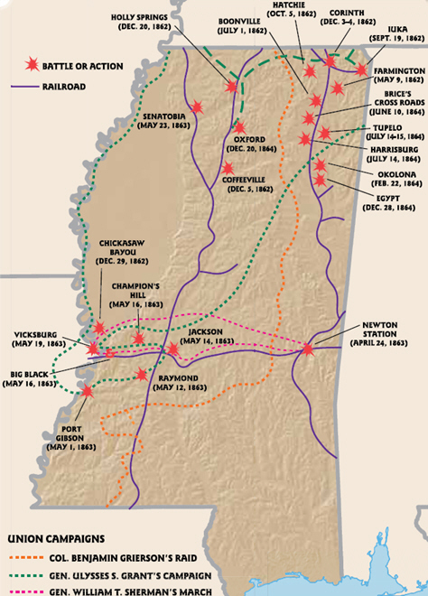
The War Ends
When the Confederates surrendered Vicksburg, their morale went down significantly.
At the same time, one of the South’s most prominent generals, Robert E. Lee, lost a major battle.
These two losses were devastating to the Southern morale.
The war ended in 1865 with the Union as the victor.

Slide 30
Section 3: Reconstruction and Reunion, 1865- 1876
Essential Question: How was Reconstruction accomplished in Mississippi?

Slide 31
Section 3: Reconstruction and Reunion, 1865- 1876
What terms do I need to know?
  Reconstruction
  disfranchise
  amnesty
  freedmen
  black codes
  impeachment
  scalawag
  carpetbagger
  Mississippi Constitution of 1868
  Ku Klux Klan
  Mississippi Plan
  shoestring district
  redeemers

Slide 32
Section 3: Reconstruction and Reunion, 1865- 1876
There were two phases of reconstruction in Mississippi:
  Presidential: policies implemented by President Lincoln and Vice President Andrew Johnson.
  Congressional: Congress took over when the southern states wouldn’t obey the president
Whites discouraged racial equality and implemented policies to segregate whites and blacks in the South.

Slide 33
Presidential Reconstruction,
1865- 1867
Reconstruction began in 1863.
Lincoln planned to issue amnesty to any Confederate soldier who would pledge allegiance to the United States.
According to the plan, if 10% of the voters took the oath and created a state government, the state would be able to vote again.
Lincoln was assassinated before he was able to complete his plan.
Former vice president Andrew Johnson took over his plan. He made a few minor changes, and began on May 29, 1865.

Slide 34
Governor William L. Sharkey
President Johnson wanted to make Reconstruction as easy and quick as possible.
William L. Sharkey was appointed provisional governor for Mississippi.
Sharkey was in favor of the Union during the Civil War.
Sharkey was supposed to hold a constitutional convention to get rid of the Secession Ordinance and give rights of citizenship to former slaves (freedmen).
At the convention, the secession was nullified, but the issue of former slaves’ rights were left to the new legislature.

Slide 35
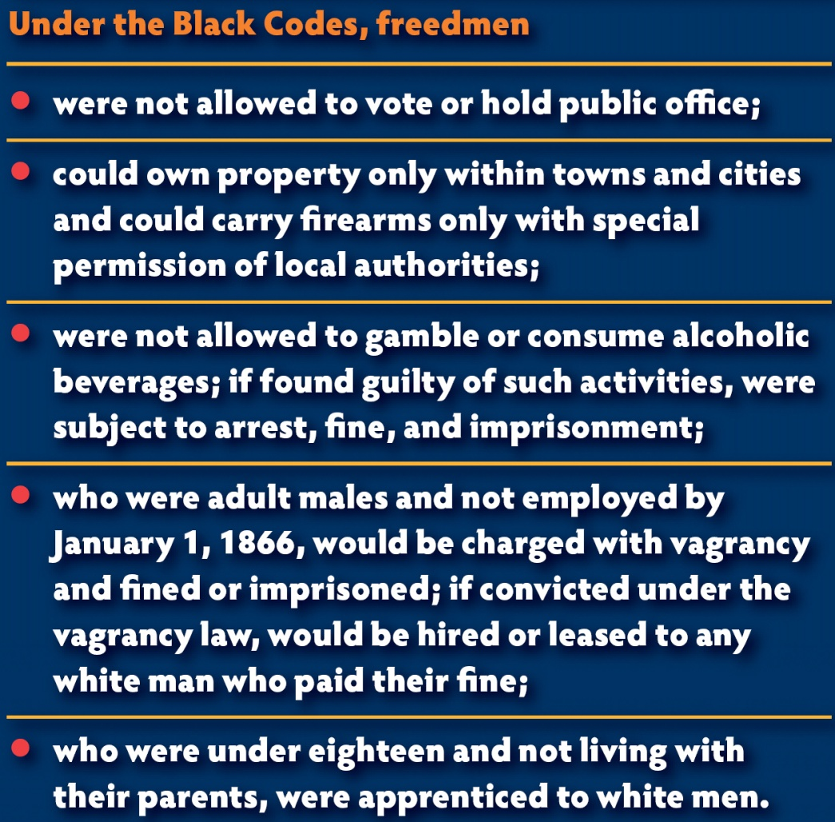
The Black Codes
Now that all of the slaves were free, Mississippi, along with the rest of the nation, had to establish what freedmen were.
Eventually, the Mississippi Legislature came up with the Black Codes, a set of laws that regulated the lives of freedmen.
Slave marriages were legalized and children from those marriages were legalized, but there were still very few rights.
Mississippi refused to ratify the 13th Amendment, which abolished slavery.
The federal government realized that Mississippi was not going to cooperate.

Slide 36
Impeachment of President Andrew Johnson
Other states also refused to ratify the 13th Amendment, so Congress passed the Reconstruction Acts.
These transferred the ability to reconstruct the south to Congress.
When President Johnson tried to block the Acts, Congress impeached him.
He was not removed from office.

Slide 37
Congressional Reconstruction,
1867- 1875
The South was divided into five military districts.
Each district was under the command of a military governor.
Mississippi was in the Fourth District.
The military governor could remove any public official that he believed was disloyal to the United States.
There were three types of “loyal” men during this time:
  Scalawags
  Carpetbaggers
  Blacks

Slide 38
Congressional Reconstruction,
1867- 1875: Scalawags
Scalawags were white Republicans who wanted citizenship for former slaves.
In the South, a “scalawag” was synonymous with hate, anger, and frustration to those who opposed racial equality.

Slide 39
Congressional Reconstruction,
1867- 1875: Carpetbaggers
Carpetbaggers were northerners who moved to the South during or after the war.
These people were viewed as taking advantage of the people in the south and their poor economic condition.

Slide 40
Congressional Reconstruction,
1867- 1875: Blacks
Only a few black officials were illiterate in Mississippi, so most elected black officials were able to do their jobs.
Most were hard-working, honest men.
Some white men made their jobs difficult by refusing to cooperate with black officials.

Slide 41
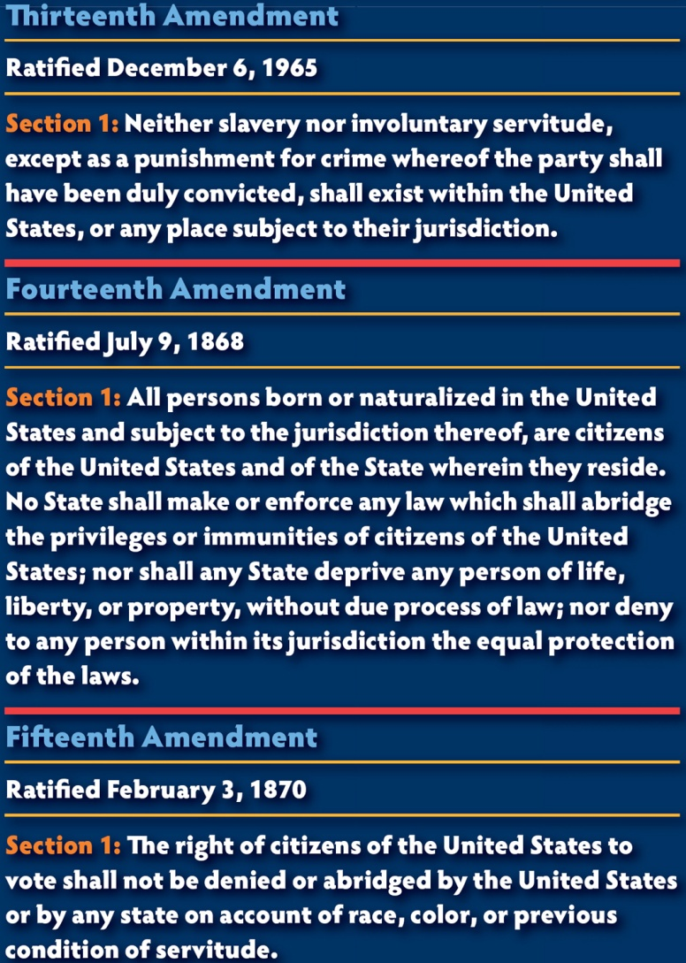
Readmission of Mississippi,
February 23, 1870
The new constitution of Mississippi was required to give blacks equal rights and protection by the law.
The Mississippi legislature ratified the 13th and 14th Amendments when 36 black men were elected to the legislature.
After Mississippi performed the tasks necessary to return to the Union, Congress allowed Mississippi to rejoin the Union.
Mississippi returned to the Union on February 23, 1870.

Slide 42
Ambrose Henderson Letter
Few whites could accept the radical changes that were sweeping the nation.
The Ambrose Henderson letter reveals the complex relationship between the former slave and his former owner. He describes him as his friend and is recommending him for a job as Circuit Judge.

Slide 43
Mississippi Public School System
Probably one of the most important achievements of Reconstruction was the establishment of a public school system.
Blacks responded well to the idea of public schooling; however, only a few local whites would teach in black schools.
Since very few blacks were qualified to teach, most teachers in black schools were Northerners.

Slide 44
Ku Klux Klan
The idea of black schools enraged some white Mississippians.
Terrorist groups formed to discourage blacks and northern teachers from going to school.
The most famous of these terrorist groups was the Ku Klux Klan.
When their first tactics did not work, the Klan resorted to violence.
Black schools and churches were burned.
Parents of children who attended the black school were sometimes beaten or killed along with the teachers who taught there.
Strict laws were passed causing the imprisonment of several Klan leaders.
Activity died down until the election of 1875.

Slide 45
Administration of Adelbert Ames, 1874- 1876
Adelbert Ames, a former Union general, was elected governor in 1873.
He was a moderate who wanted to reduce taxes and decrease racial tension.
A large number of black officials were elected that year also.
Very soon, white Mississippians considered the Republican Party the black man’s party and the Democratic Party the white man’s party.

Slide 46
The Vicksburg Riot
In 1874, racial skirmishes were frequent, but by summer time, it was almost uncontrollable.
Highly exaggerated reports of a riot spread across the state.
Governor Ames was heavily criticized for his handling of the Vicksburg Riot. Many white voters lost faith in him.

Slide 47
The “Revolution of 1875”
The “Revolution of 1875” was actually the election of 1875. It was so chaotic and riotous that it was called a revolution.
Governor Ames sent out troops from the state militia to keep the peace, but that failed because most of the troops were black.
To avoid an all out war, Ames agreed to break up the militia. In response, the Democratic Party said that they would try to keep their party members from further violence.
It did not discourage whites from trying to intimidate the black voters.

Slide 48
The Mississippi Plan
This plan was devised by the Democratic Party. It was created to guarantee a victory for them in the fall election.
The plan worked and as a result, the Democratic party took over the House of Representatives and the Senate.

Slide 49
Impeachment of Republican Officials
The Democratic Party controlled two thirds of the vote in the Senate.
This gave them the ability to impeach any Republican senator they felt was corrupt.
After impeaching a few black officials, they brought up charges on Governor Ames.
The charges were very political as he hadn’t done anything illegal.
Ames resigned in 1876 and John M. Stone became governor.

Slide 50
The Shoestring District
After the election of 1875, the Democratic Party controlled nearly everything.
To minimize the impact of black voters, a district was created which was mostly black, but left the rest of the state with majority white districts.
It was spread over a long expanse along the western edge of the Mississippi border.

Slide 51
Redemption of Mississippi
The Democrats who planned the election of 1875 were called the Redeemers.
Many accusations made about the Republican party by the Democrats cannot be supported by facts.
No one was ready for the freedom of 4 million slaves.
There were political battles between southerners and northerners and between whites and blacks.
The “Bourbon Era” of the Democrats followed that chaotic time after the Civil War.

Slide 52
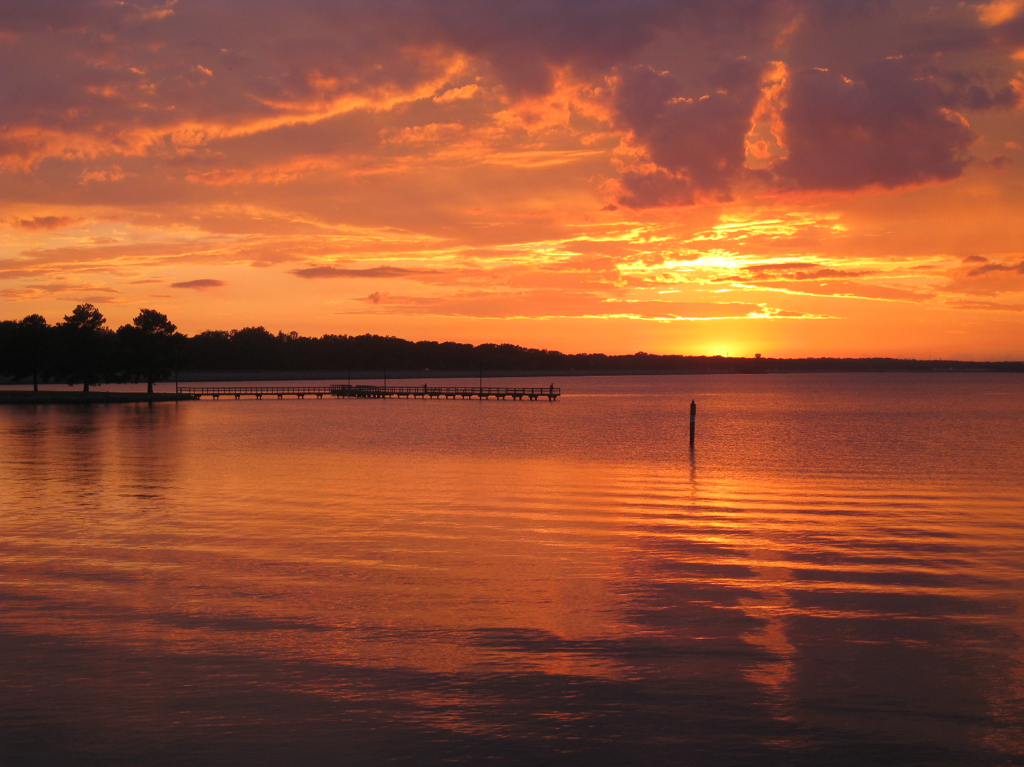
Image Credits
Slide 1: allstarecho on Wikimedia Commons; Slide 2: Public Domain Wikimedia Commons; Image Credits slide: Thomas R. Machnitzki on Wikimedia Commons; all others copyright Clairmont Press or public domain.
Return to Main Menu

