Slide 1
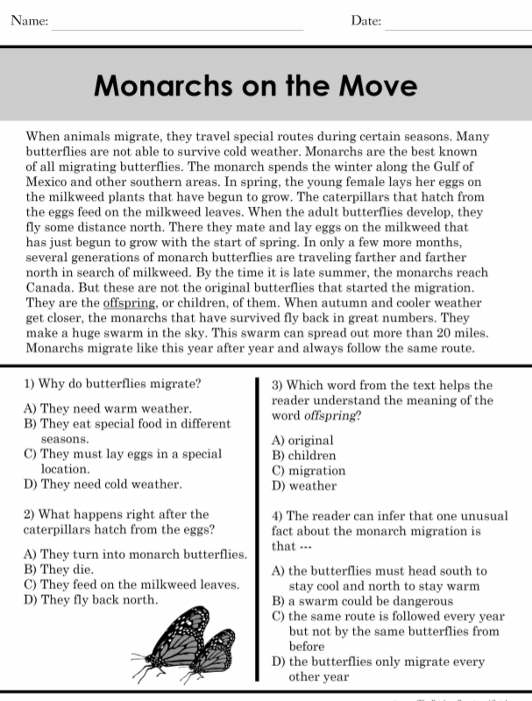
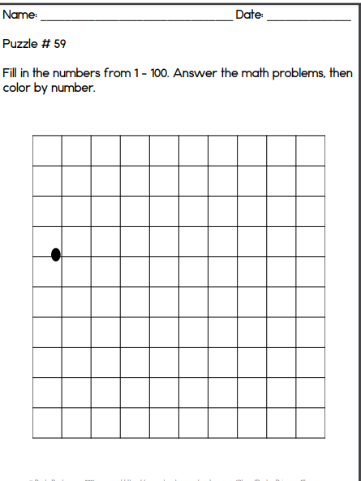
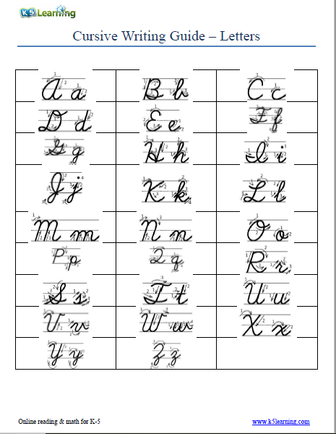
Wednesday, September 4, 2019
Complete reading passage first, then begin math handout.
Practice writing “q” in cursive if finished.
7:55 – 8:30

Slide 2
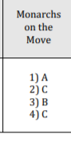

Slide 3
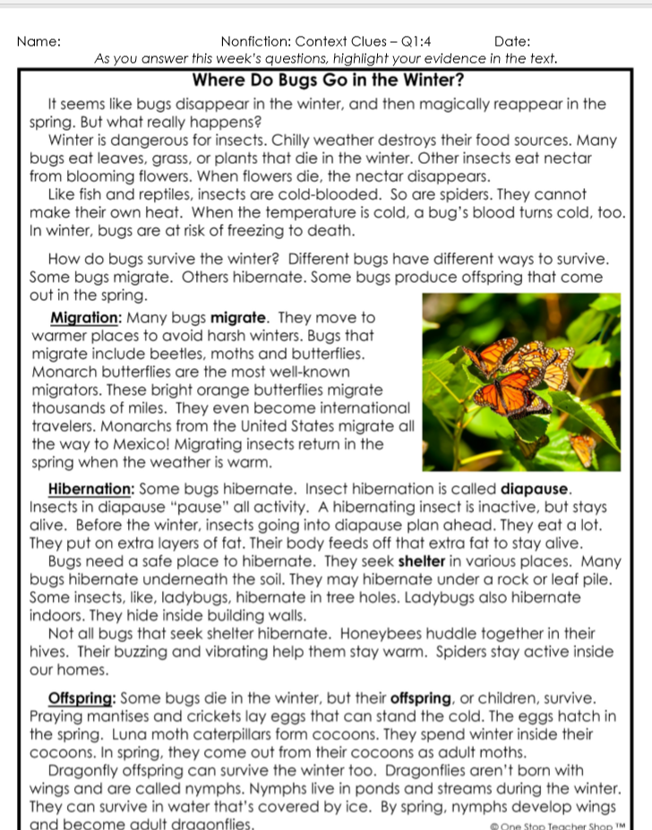
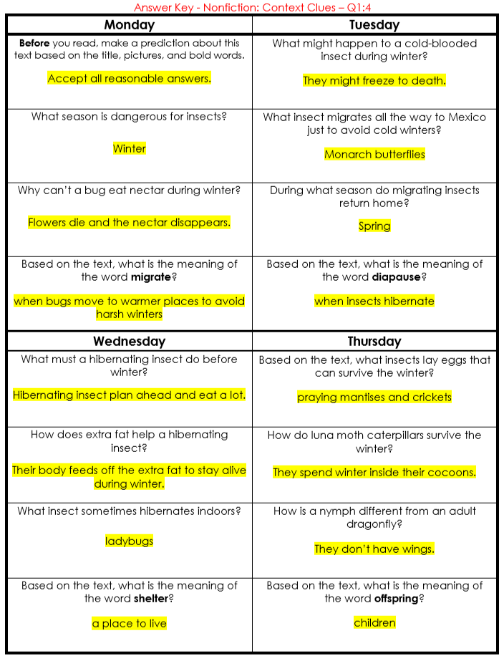
Reading Homework

Slide 4
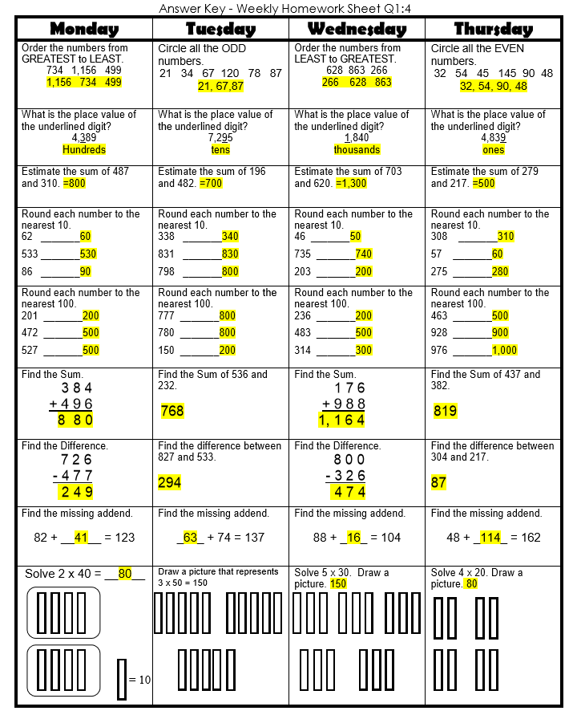
Math Homework

Slide 5

CHOMP TIME
F.A.S.T. Groups
Focused Academic Support Time

Slide 6
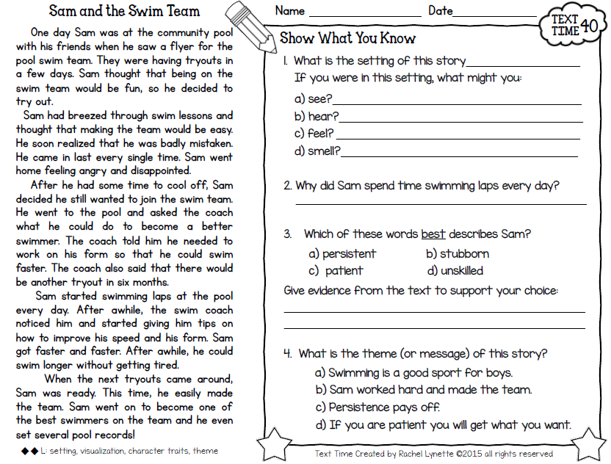
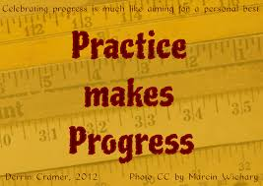
F.A.S.T. Designations
Computers – EPIC: Amiyah - 1 Khamani - 2 Cayli - 3 Brena - 4 Jearon – 5 Cohen - 6 Jaylie - 7 Erin - 8 Noah - 9 Elin - TC | Mrs. Roby: LLI Kaylah Macon Carleen Adalyn | Mrs. Thompson: LLI Landon Paisleigh Jaiden | Paired Partners Complete passage: Katelynn & Caydance Jordyn & Emma Kaylee & Aiden McKenzie & Lexi
8:40 – 9:10

Slide 8

Restroom Break
9:10 – 9:20

Slide 9

Reading Time
Objective: RL.3.3 Describe characters in a story and explain how their actions contribute to the sequence of events.
Objective: RL.3.5 Refer to parts of stories and poems when writing or speaking about a text, using terms such as chapter, scene, and stanza; describe how each successive part builds on earlier sections.
Objective: RL.3.7 Use information gained from illustrations, other visual elements, and the words in a text to demonstrate understanding of the text.
9:20 – 9:55

Slide 10

Gather at the Carpet with your MM Student Response book…
Are we still the best?

Slide 11

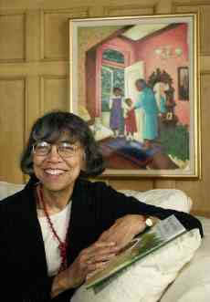
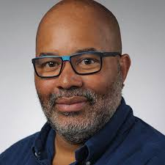
What do you remember about Aunt Flossie’s Hats (and Crab Cakes Later) - Turn to your Partner.
Author: Elizabeth Fitzgerald Howard
Illustrator: James Ransome

Slide 12

Today I will reread one of the hat stories and I want you to visualize what is happening in the story.
After you talk to your partner about what you visualized, you will draw and write about their mental images.
Read page 20-27
What did you see in your mind as you listened to this part of the story? - Turn to Your Partner

Slide 13

Making Meaning Response Book
Turn to page 4 of your Student Response book
You will draw a picture of something you visualized clearly as you listened to her story
Write two sentences that describe what your picture shows

Slide 14

Close your eyes and think about your mental image.
Open your eyes and look at your drawing.
Does your drawing reflect what you saw in your mind?
Reread page 20-27
I will reread the story one more time. I want you to listen for any details you might want to add to your drawings. – we will share your drawings tomorrow.

Slide 15

Computers – Classworks and *Epic:
  *Amiyah - 1
  Landon - 2
  *Jearon - 3
  *Adalyn - 4
  *Khamani - 5
  *Lexi - 6
  Jaiden - 7
  *Brena - 8
  *Carleen - 9
  Paisleigh - TC
Independent Daily Reading & Teacher Conferences
  Mrs. Roby:
  LLI
  Emma
  Caydance
  Kaylee
  Jordyn
All others Independent Novel for Book Challenge! ☺
9:55 - 10:25

Slide 16



Vocabulary & Grammar Time
Snack Time
10:25 – 10:40

Slide 17
flutter – wave or flap rapidly
When people get a piece of dirt in their eye, they flutter their eyelashes, or move them rapidly up and down, to get rid of the dirt.
Let’s act that out.
What did you see your classmate do when he/she fluttered his/her eyelash?
When my classmate fluttered his/her eyelash, he/she…

Slide 18


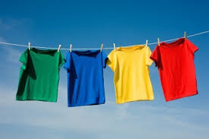
Things that flutter
Butterflies and insects flutter their wings.
Things such as flags, curtains, and clothes on a clothesline can also flutter, or flap rapidly.
When might the clothes on a clothesline flutter? - Turn to your Partner

Slide 19
What’s the new word we are learning that means “wave or flap rapidly”?
flutter

Slide 20
clutch – grab or hold onto something tightly
When have you clutched something or seen someone clutching something?
I clutched…
What did it look like when you clutched it?

Slide 21
What’s the new word we are learning that means “grab or hold onto something tightly”?
clutch

Slide 22
dodge
Let’s use Context Clues to figure out what is the meaning of the word.

Slide 23
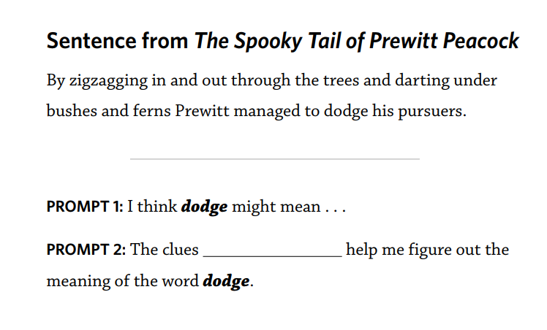
Using Context Clues

Slide 24
dodge – move quickly to avoid something
When have you dodged something or seen someone dodge something? Turn to your Partner
I dodged…or I saw…dodge…

Slide 25
What’s the new word we are learning that means “move quickly to avoid someone or something”?
dodge

Slide 26

All For Books Coin Drive Update
Classroom Goal…
$100

Slide 27
Out of Classroom!
Recess 10:40 – 11:05

Slide 28

SCIENCE TIME
Science L.3.4.1 – obtain data from informational text to explain how changes in habitats can be beneficial or harmful to the organisms that live there.
Science L.3.4.2 – ask questions to predict how natural or man-made changes in a habitat cause plants and animals to respond in different ways, including hibernating, migrating, responding to light, death, or extinction.
11:05-11:35

Slide 29

Turtle Hurdles

Slide 30


Slide 31
Explain – Turtle Hurdles!
(focus – changes in habitat)
Add to I Wonder/I Learned Chart
Classroom Anchor chart that
lists 3 facts about sea turtles
Lists 3 ways sea turtles are harmed by humans
1 reason endangered sea turtles should be helped
1 question you still have about sea turtles
Science L.3.4.1 – obtain data from informational text to explain how changes in habitats can be beneficial or harmful to the organisms that live there.
Science L.3.4.2 – ask questions to predict how natural or man-made changes in a habitat cause plants and animals to respond in different ways, including hibernating, migrating, responding to light, death, or extinction.

Slide 32
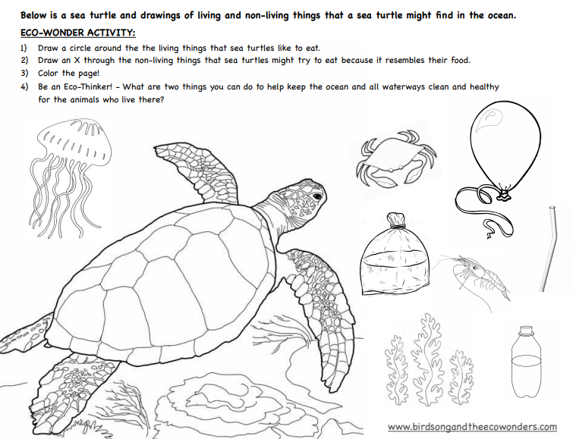

Slide 33
Math Fluency & Focus Lesson!
11:35 – 11:55

Slide 34
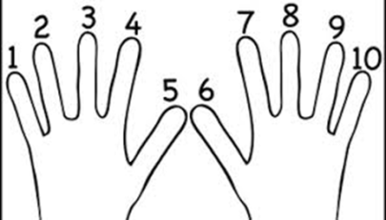
Group Counting!
Count to 18 forward and backward (watch my fingers so you know if I’m going up or down; a closed hand means stop)
  Whisper, whisper then speak number (whisper -1, whisper-2, speak-3)
  Think every number we just whispered, then speak the next one (think-1, think-2, speak-3)
  What did we just count by? Turn and talk to your Partner
  Now let’s count by threes

Slide 35

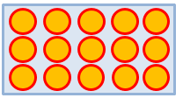
Add to multiply!
How many groups are circled?
How many are in each group?
Write it as an addition sentence?
Write a multiplication sentence for 3 fives equals 15.

Slide 36
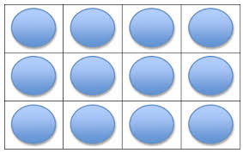

Add to multiply!
How many groups are circled?
How many are in each group?
Write this as an addition sentence?
Write a multiplication sentence for 3 fours equals 12.

Slide 37
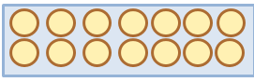
Add to multiply!
How many groups are circled?
How many are in each group?
Write this as an addition sentence?
Write a multiplication sentence for 7 twos equals 14.

Slide 38
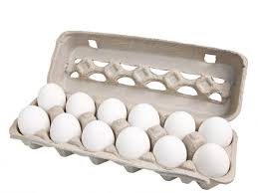
Application Problem
Robbie sees that a carton of eggs shows an array with 2 rows of 6 eggs. What is the total number of eggs in the carton? Use the RDW process to show your solution.
RDW = Read, Draw, Write
Read the problem
Draw and label items
Write an equation.
Write a word sentence (statement).

Slide 39
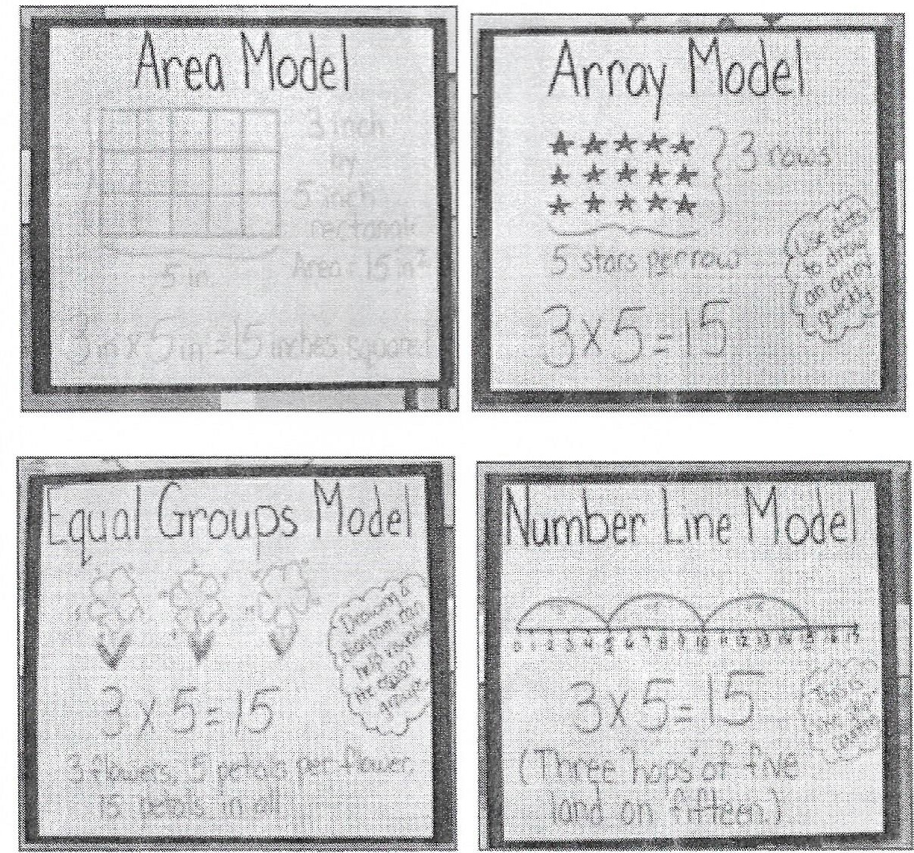
Strategies Review

Slide 40
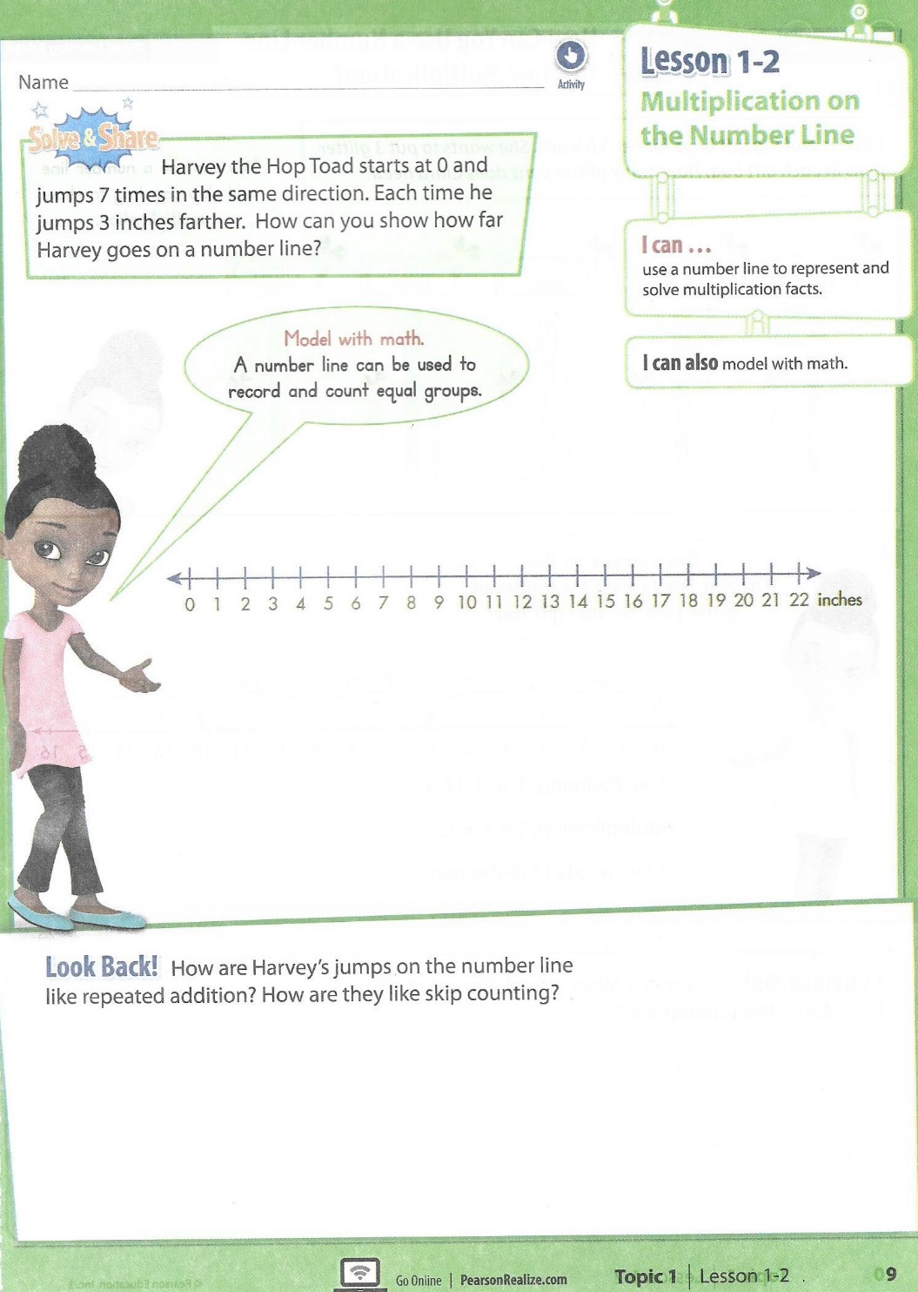
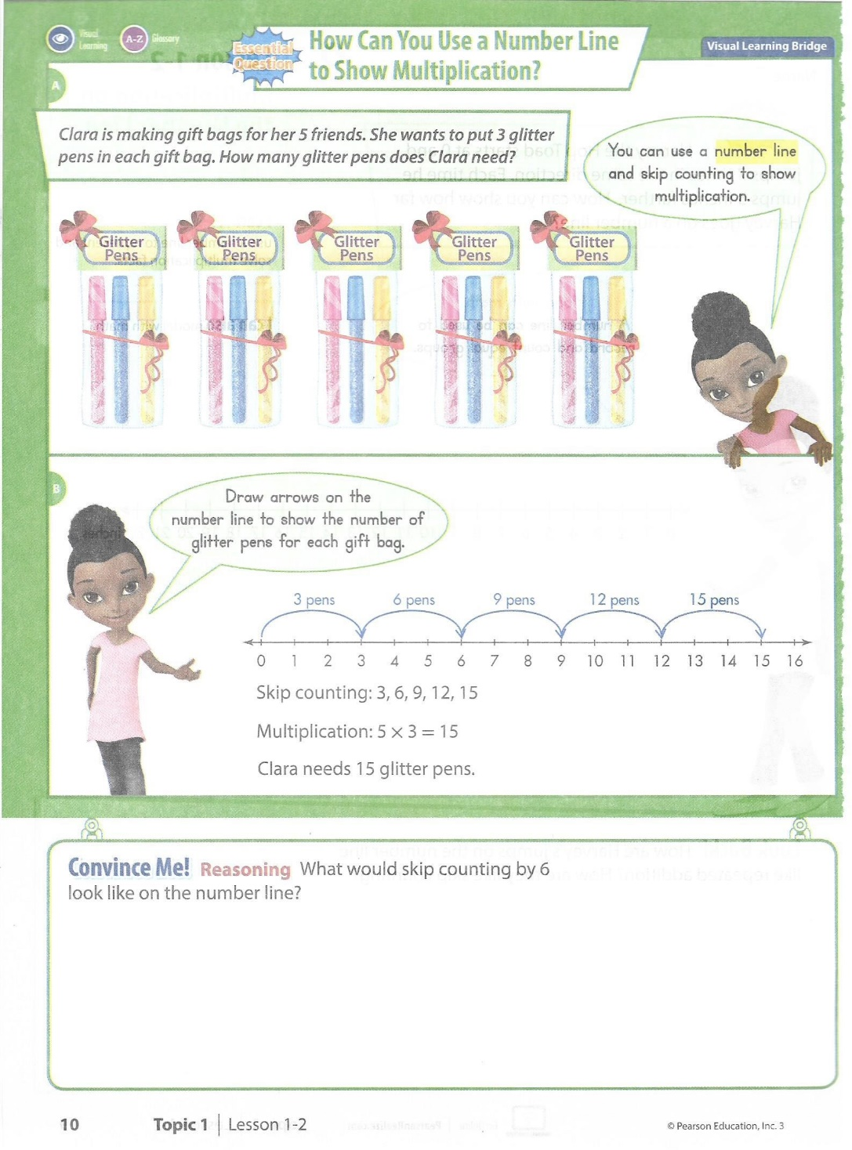

Slide 41
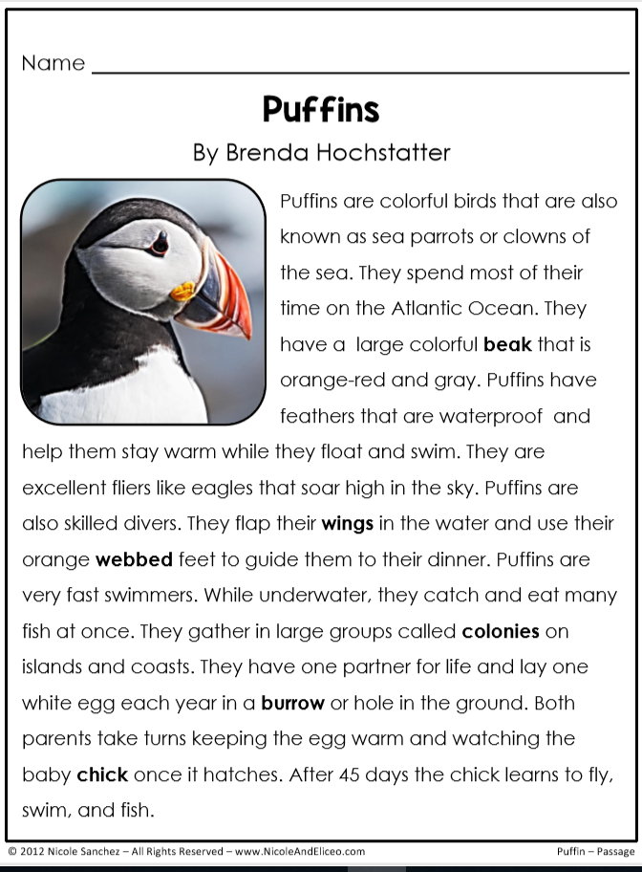
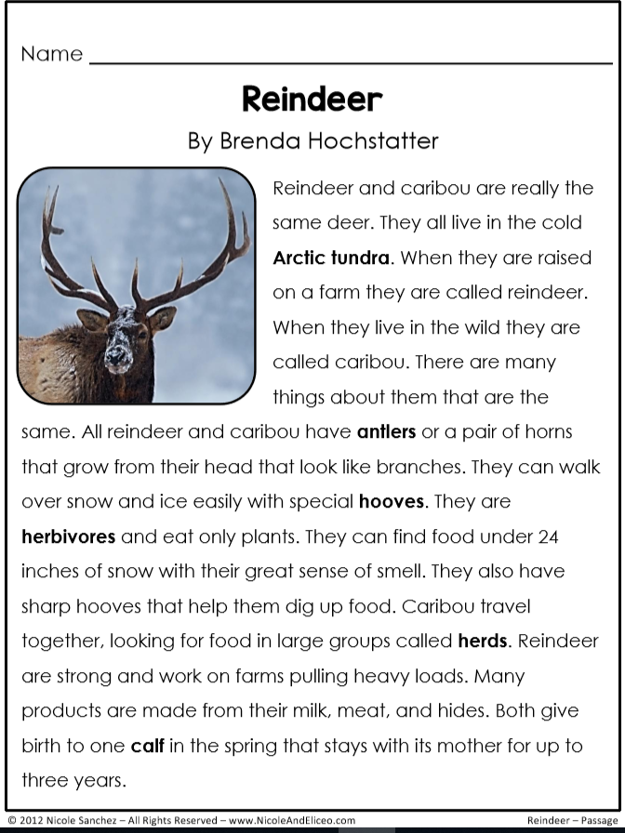
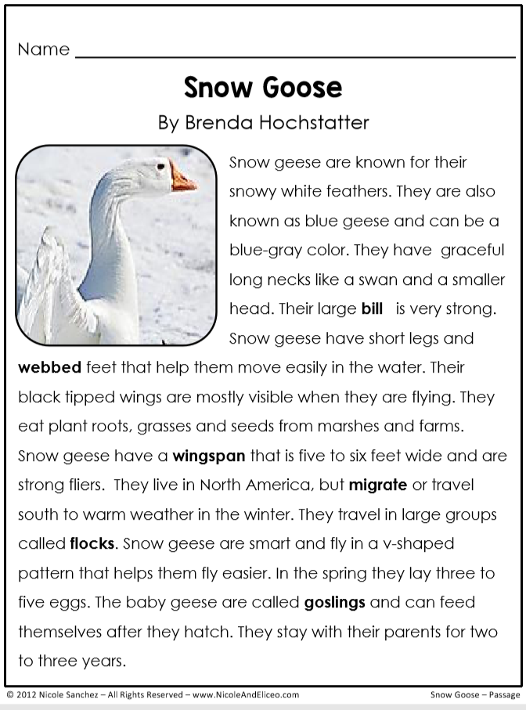
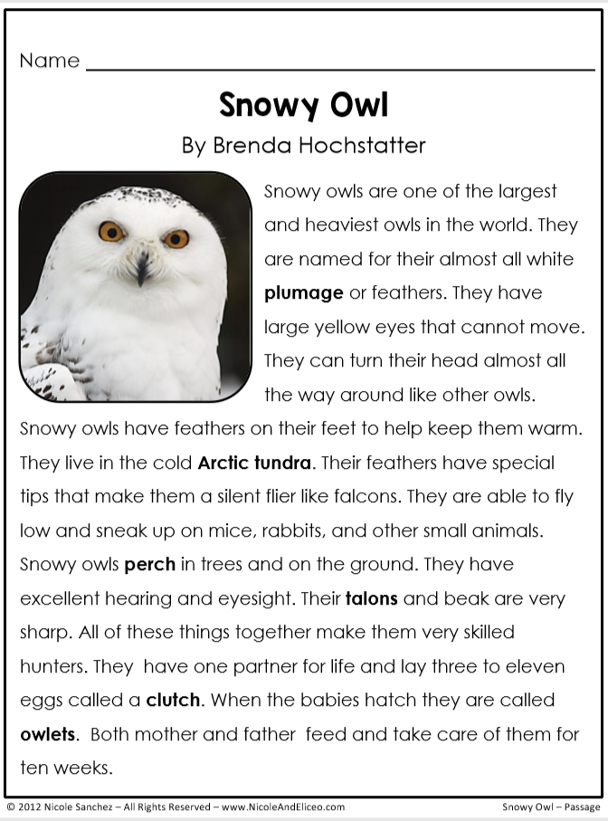
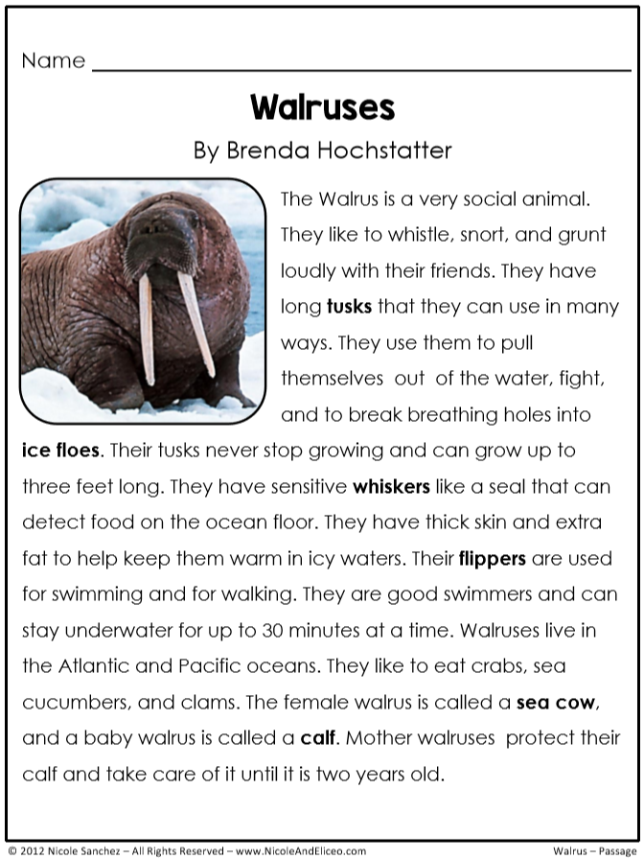
Independent Practice Choices:
Create a report:
  Read about a few new arctic animals.
  Draw representations of animals in equal groups. Give a reason in a complete sentence as to why those animals formed those groups.
  Use a multiplication equation to show the total number of animals in all of your groups.
Workbook page – page 11 and 12 odd numbers
Fluency Practice –
  Kicking It practice page with dry erase marker
  Kaboom – practice game

Slide 42
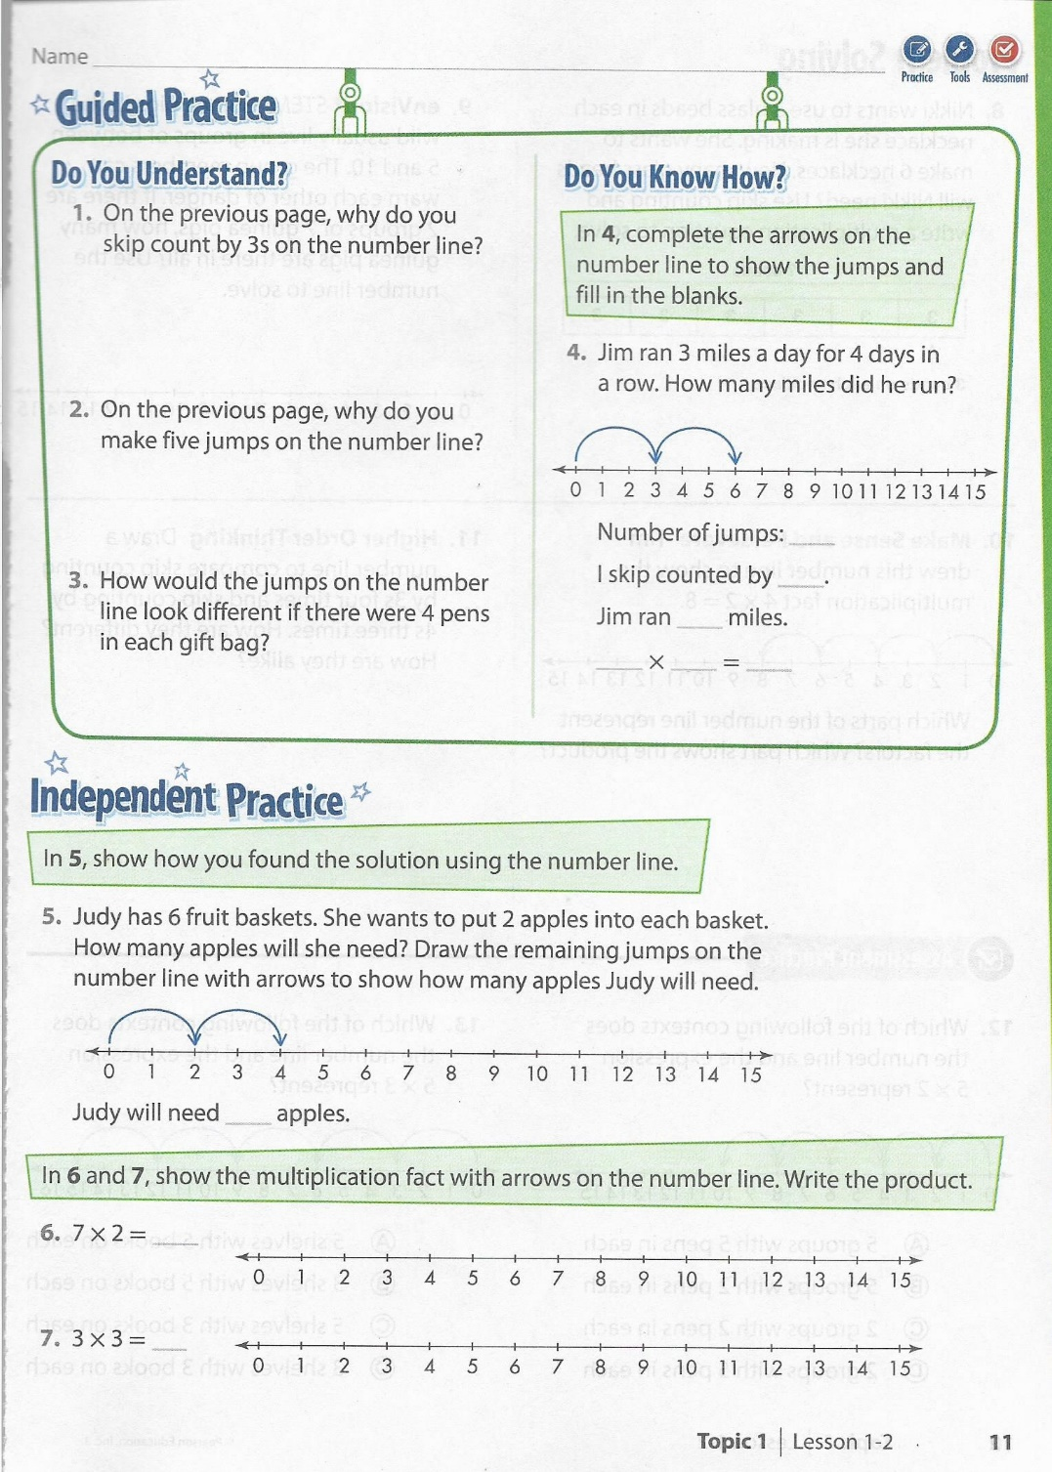
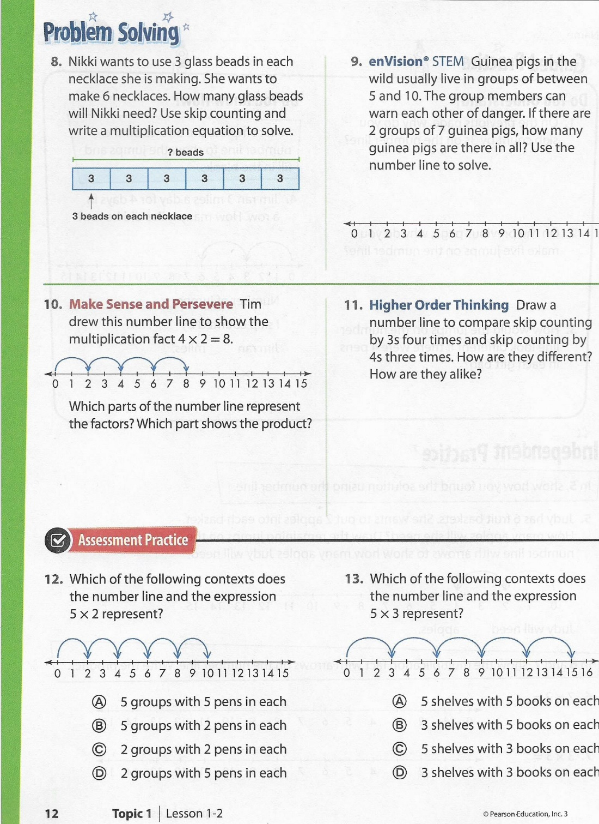

Slide 43
Small Group Rotations 1 & 2
  Rotation #1 - 11:55 – 12:15
Group 1 – Computers (TC, A, B, C, D): Epic
Group 2 – Mrs. Roby: p 11 & 12 even numbers
Group 3 – Computers (E, F, G, H, I): Imagine Math
Group 4 – Mrs. Thompson: Complete a Number Line
Group 5 – Independent Practice: 3 choices
  Rotation #2 - 12:15 – 12:35
Group 5 – Computers (TC, A, B, C, D): Epic
Group 1 – Mrs. Roby: p 11 & 12 even numbers
Group 2 – Computers (E, F, G, H, I): Imagine Math
Group 3 – Mrs. Thompson: Complete a Number Line
Group 4 – Independent Practice: 3 choices

Slide 44

Out of Classroom!
Lunch 12:35 – 1:05

Slide 45
Restroom Break
1:05 – 1:10

Slide 46

Out of Classroom!
Activity 1:10 – 1:55

Slide 47
Small Group Rotations 3 & 4
  Rotation #3 - 1:55 – 2:15
Group 4 – Computers (TC, A, B, C, D): Epic
Group 5 – Mrs. Roby: p 11 & 12 even numbers
Group 1 – Computers (E, F, G, H, I): Imagine Math
Group 2 – Mrs. Thompson: Complete a Number Line
Group 3 – Independent Practice: 3 choices
  Rotation #4 - 2:15 – 2:35
Group 3 – Computers (TC, A, B, C, D): Epic
Group 4 – Mrs. Roby: p 11 & 12 even numbers
Group 5 – Computers (E, F, G, H, I): Imagine Math
Group 1 – Mrs. Thompson: Complete a Number Line
Group 2 – Independent Practice: 3 choices

Slide 48
Small Group Rotation 5
  Rotation #5 - 2:35 – 2:55
Group 2 – Computers (TC, A, B, C, D): Epic
Group 3 – Mrs. Roby: p 11 & 12 even numbers
Group 4 – Computers (E, F, G, H, I): Imagine Math
Group 5 – Mrs. Thompson: Complete a Number Line
Group 1 – Independent Practice: 3 choices

Slide 49
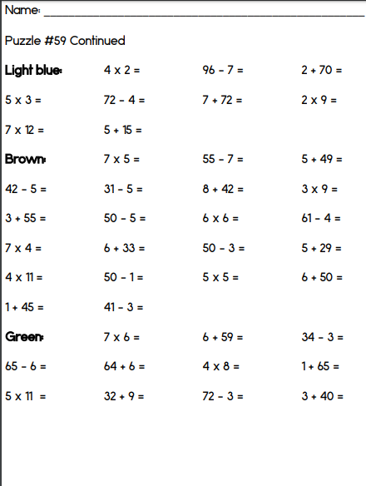
Finish Morning Work

Slide 50
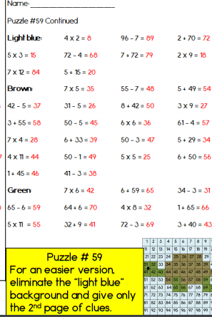
Morning Work Check

Slide 51
Restroom Break
3:10 – 3:15

Slide 52




3:10 – 3:15 Wrap Up!
Pair-Up back to back and share one thing you learned in class today with your partner
Pack-Up
Office will announce:
Car Riders – Leave around 3:20
Bus Riders – (listen to intercom for dismissal)
2:30 – 3:20
How much time has elapsed?

