Slide 1
Unit 2
Lesson 2
Grammar on the Go! PowerEd Express
Make the sentence
corrections in red.
Write the vocabulary words
in your personal dictionary.
PowerEd Plans 2014

Slide 2
Grammar on the Go! PowerEd Express
Unit 2-2
Sentence
I had a eerie feeling it was time to go to class so i followed a boisterous group of students into my first class math with mrs scary l smith
Sentence Identification – Compound, Complex, Simple, Compound/Complex
Type of Sentence(s) – Declarative, Imperative, Interrogative, Exclamatory
PowerEd Plans 2014

Slide 3
Unit 2-2
Corrections
Grammar on the Go! PowerEd Express
I had an eerie feeling it was time to go to class, so I followed a boisterous group of students into my first class - math with Mrs. Scary L. Smith.
Compound Declarative
Article
Run-on Sentence
Capitalization
Non-restrictive Clause
End Punctuation
PowerEd Plans 2014

Slide 4
Unit 2-2
Articles
Grammar on the Go! PowerEd Express
Articles: “A” versus “An”
“A” goes before words that begin with consonants:
a cat a dog a purple onion a buffalo
“An” goes before words that begin with vowels:
an apricot an egg an orbit an uprising
I had an eerie feeling it was time to go to class, so I followed a boisterous group of students into my first class - math with Mrs. Scary L. Smith.
PowerEd Plans 2014

Slide 5
Unit 2-2
Capitalization
Grammar on the Go! PowerEd Express
Capitalization
Writing a word with its first letter as a capital letter (upper-case letter) and the remaining letters in lower case.
Capitalize the word “I” when referring to oneself in the first person.
Capitalize proper names.
Capitalize a person's title when it precedes the name.
I had an eerie feeling it was time to go to class, so I followed a boisterous group of students into my first class - math with Mrs. Scary L. Smith.
PowerEd Plans 2013

Slide 6
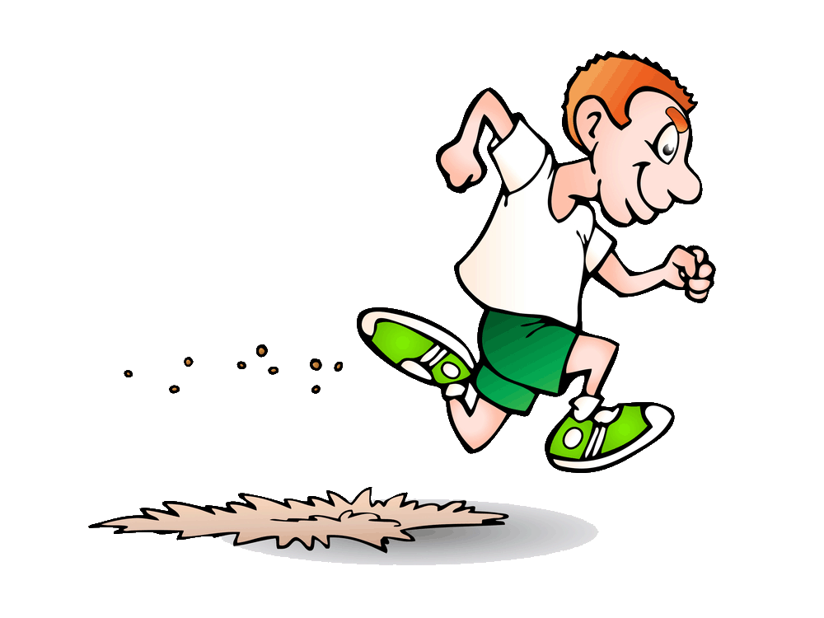
Unit 2-2
Run-on Sentence
Grammar on the Go! PowerEd Express
Run-on Sentence
A run-on sentence is a sentence in which two or more independent clauses with more than one complete idea are joined without appropriate punctuation or a conjunction.
I had an eerie feeling it was time to go to class, so I followed a boisterous group of students into my first class - math with Mrs. Scary L. Smith.
PowerEd Plans 2014

Slide 7
Unit 2-2
Non-restrictive clause
Grammar on the Go! PowerEd Express
Non-restrictive Clause
A relative clause that describes or supplements but is not essential in establishing the identity of the antecedent and is usually set off by commas or dashes in English. Also called descriptive clause.
I had an eerie feeling it was time to go to class, so I followed a boisterous group of students into my first class - math with Mrs. Scary L. Smith.
PowerEd Plans 2014

Slide 8
Unit 2-2
End Punctuation
Grammar on the Go! PowerEd Express
End Punctuation
. A period is a full stop. It marks the end of a sentence. It marks the end of an idea or a thought. It marks the end of an action.
? A question mark is, naturally, a mark which shows the sentence is a question. A question mark is required at the end of an interrogative sentence.
! Exclamation marks are used in exclamatory sentences, and sometimes in imperative sentences.
I had an eerie feeling it was time to go to class, so I followed a boisterous group of students into my first class - math with Mrs. Scary L. Smith.
PowerEd Plans 2014

Slide 9
Unit 2-2
Compound Sentence
Grammar on the Go! PowerEd Express
Compound Sentence
A compound sentence contains two independent clauses joined by a coordinator or a semi-colon. The coordinators are as follows: for, and, nor, but, or, yet, so. Coordinators are preceded by a comma.
I had an eerie feeling it was time to go to class, so I followed a boisterous group of students into my first class - math with Mrs. Scary L. Smith.
PowerEd Plans 2014

Slide 10
Unit 2-2
Declarative
Grammar on the Go! PowerEd Express
Declarative Sentence
A sentence in the form of a statement. In a declarative sentence, the subject normally precedes the verb. A declarative sentence ends with a period.
I had an eerie feeling it was time to go to class, so I followed a boisterous group of students into my first class - math with Mrs. Scary L. Smith.
PowerEd Plans 2014

Slide 11
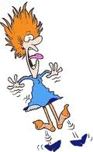
Unit 2-2
Vocabulary
Grammar on the Go! PowerEd Express
eerie
Adjective
strange and frightening
PowerEd Plans 2014

Slide 12
Unit 2-2
Vocabulary
Grammar on the Go! PowerEd Express
boisterous
Adjective
noisy, energetic, and
cheerful; rowdy
PowerEd Plans 2014

